Slide 1

5 Steps Before Making an Air Compressor Purchase Decision
Loran Circle, Circle Training & Consulting
Keynote Speaker
Sponsored by
The recording and slides of this webinar will be made available to attendees via email later today.
PDH Certificates will be e-mailed to attendees within 2 days.

Slide 2
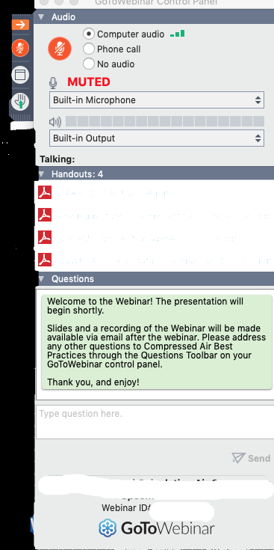
Q&A Format
Panelists will answer your questions during the Q&A session at the end of the Webinar.
Please post your questions in the Questions Window in your GoToWebinar interface.
Direct all questions to Compressed Air Best Practices® Magazine
Sponsored by

Slide 3

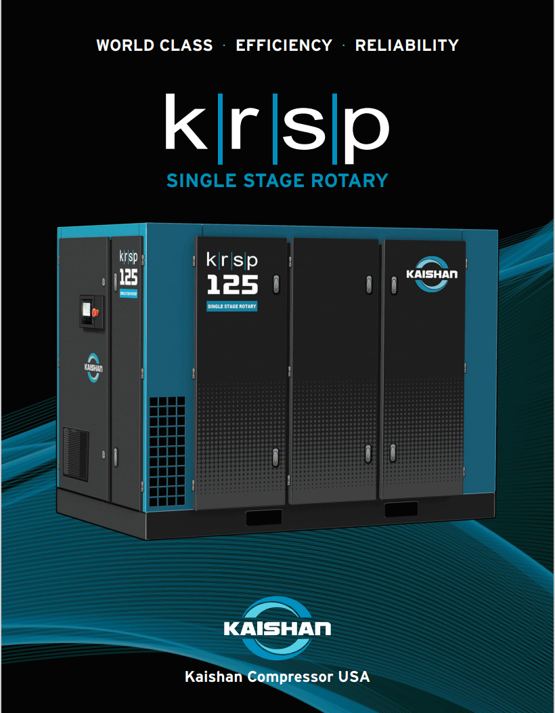
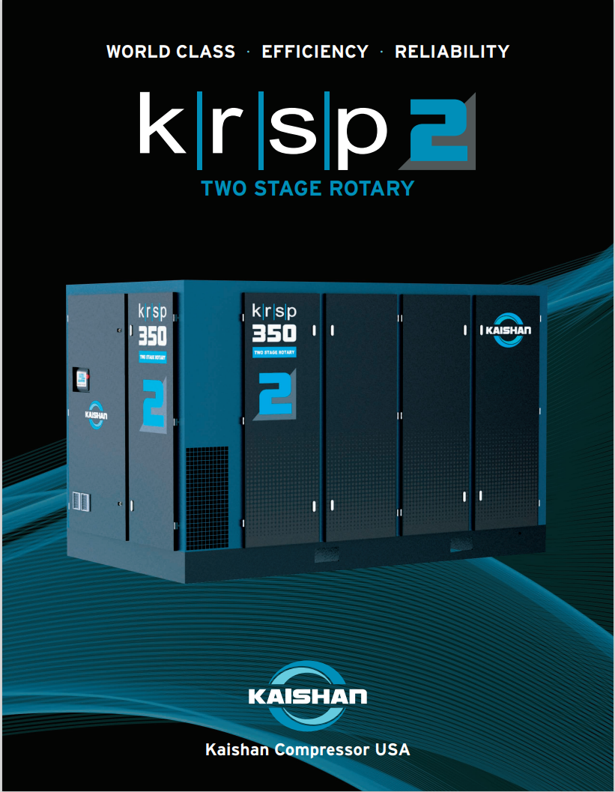
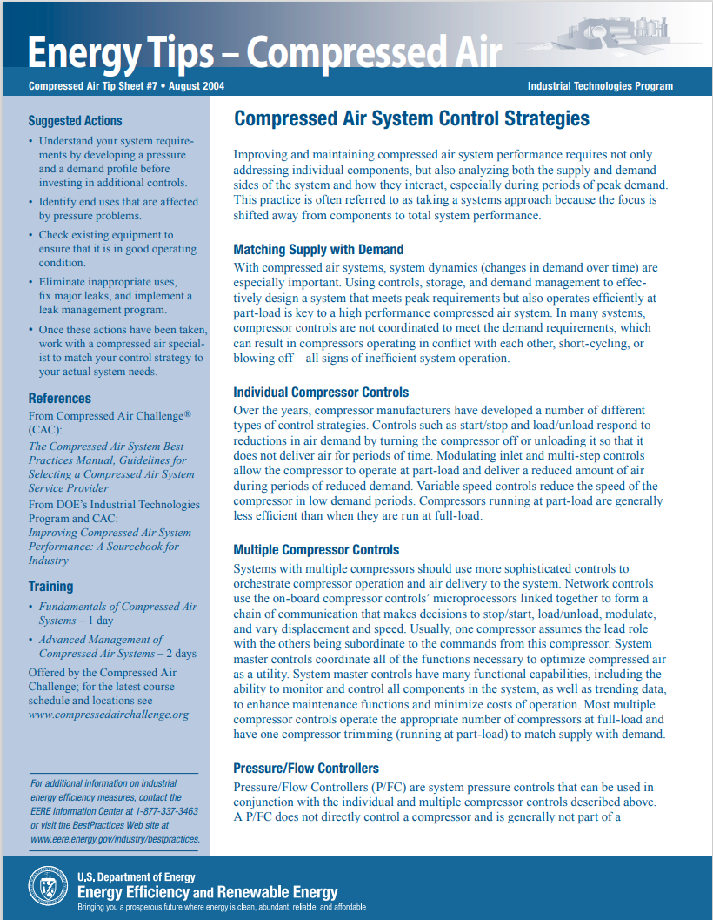
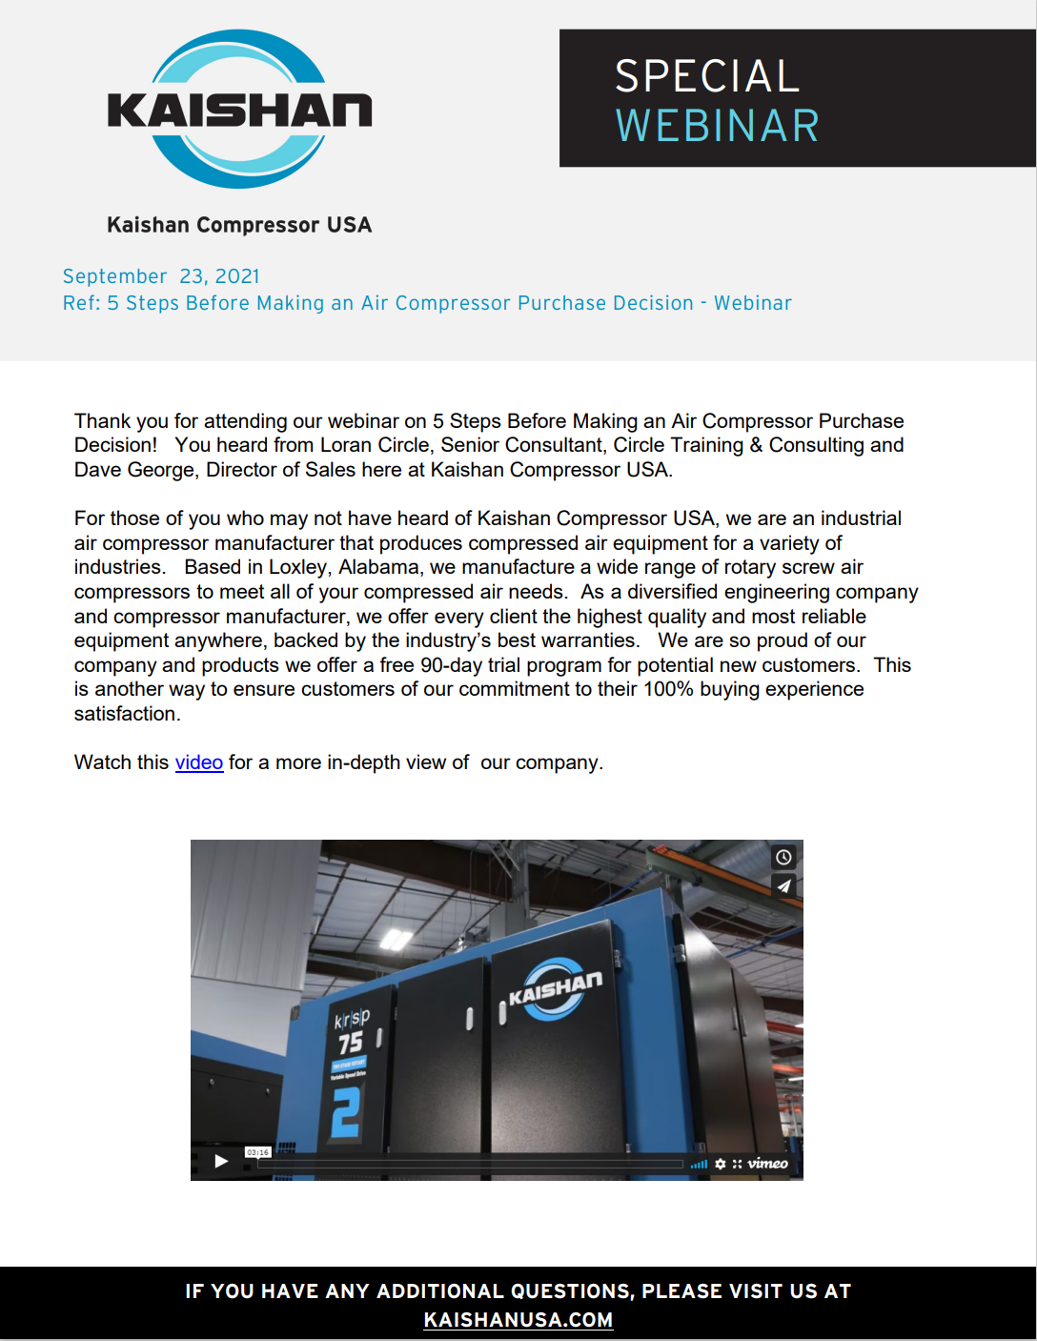
Handouts

Slide 4
Disclaimer
All rights are reserved. The contents of this publication may not be reproduced in whole or in part without consent of Smith Onandia Communications LLC. Smith Onandia Communications LLC does not assume and hereby disclaims any liability to any person for any loss or damage caused by errors or omissions in the material contained herein, regardless of whether such errors result from negligence, accident, or any other cause whatsoever.
All materials presented are educational. Each system is unique and must be evaluated on its own merits.

Slide 5
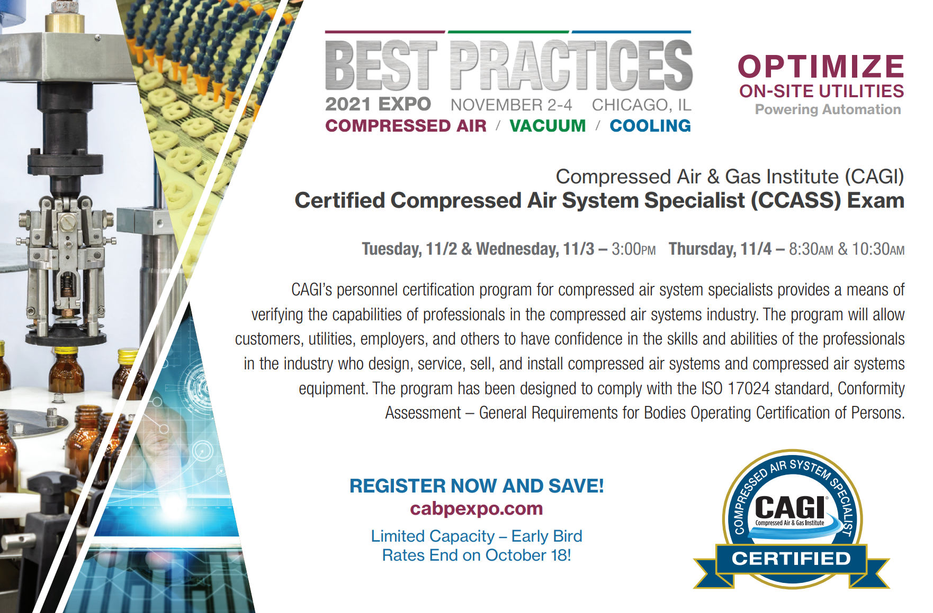
At the end of the webinar, we are having a fun contest for a chance for two people to win a free full conference pass valued at $675!

Slide 6
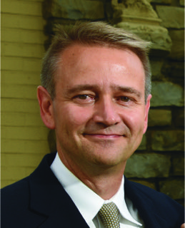
5 Steps Before Making an Air Compressor Purchase Decision
Introduction by Rod Smith, Publisher
Compressed Air Best Practices® Magazine
Sponsored by

Slide 7
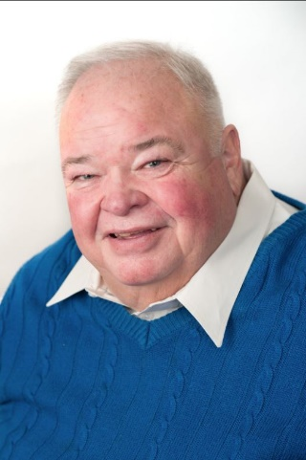
About the Speaker
Compressed Air Systems Sales Training
Design and Consulting of Compressed Air Systems
Certified DOE AirMaster+
Loran Circle
Circle Training & Consulting
Sponsored by

Slide 8
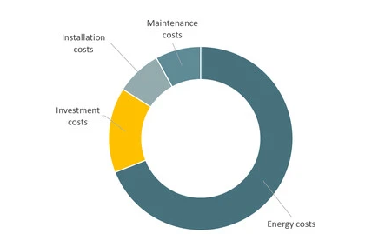
Why Is This Important?
Air Compressor Lifecycle Cost
Review the chart to the right. This is an example of the total costs of a compressed air system over the life span of the compressor.
What is the lowest lifecycle cost?
What is the highest lifecycle cost?
Price is what you pay up front once, Costs are what you pay over the lifetime of the equipment.

Slide 9
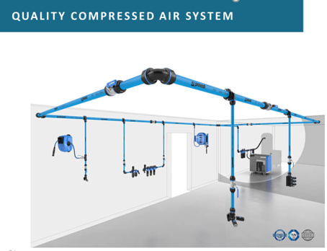
The 5 Steps Before Making an Air Compressor Purchase Decision
System Analysis (walkthrough)
Demand Profile Analysis, Site Conditions, and Application (system audit)
Selection Research (annual costs, energy efficiency, support)
Decision (NOT BASED ON PRICE! IT’S ON LIFECYCLE COST)
Implementation (installation, system modifications, controls)
By following these steps, you can assure an energy efficient, reliable, and smooth-running system.

Slide 10
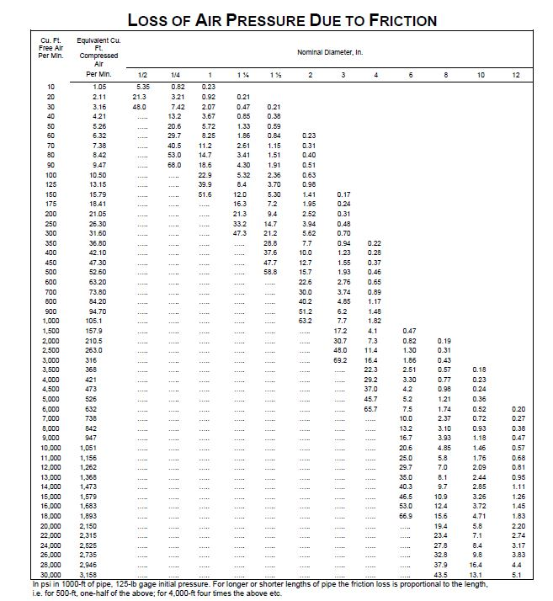
Step 1 - Walk Through System Analysis
Start with the problem, not the solution.
Start with a walk-through audit. What is the leak load? Is the distribution piping system able to handle increased flow if any?
Determine if there is any obvious issue that is creating the problem, Sometimes fixing the root cause saves money and no compressor is needed.
Is the problem caused by the distribution system or overdemand?
Quick tell: If the pressure at the end of the line is low (10+ psig or more) you have a flow restriction happening. If the compressor pressure is low, say 90 psig and the end of the line is low, 85 psig, that is an overdemand. The facility is taking out more air than the compressors are replacing.
After the walkthrough, do a plant air audit to determine demand and pressure your facility needs. (demand profile)
Analyze the audit.

Slide 11
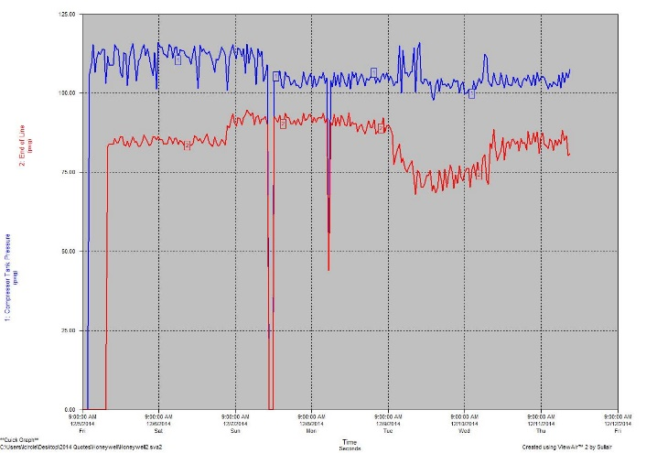
Step 2 – Demand Profile Analysis
In ALL compressor decisions there are 3 pieces of information that are needed to determine which compressor is right for your system
Demand Profile (flow and pressure)
  Identify leak loads
  Identify demand events
Site conditions (outside, inside, altitude, etc.)
Application (what is the air being used for)
Pro Tip Of The Day: Do not call and a request for quote for XXX HP air compressor.
Rather then request a quote, ask prospective vendors to do an analysis on your system. Tell them what is happening not what you need! Listen to the ones who ask the most pertinent questions!

Slide 12
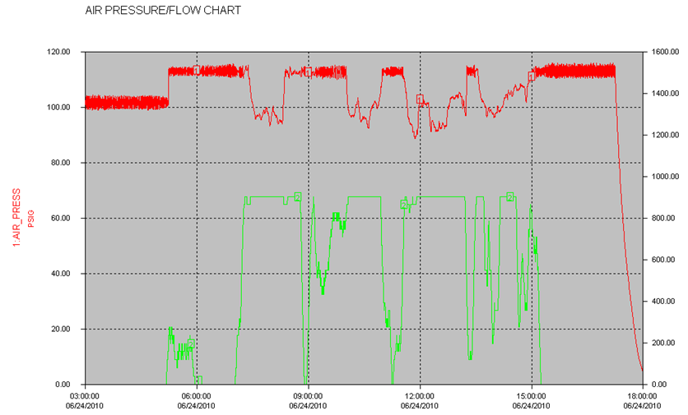
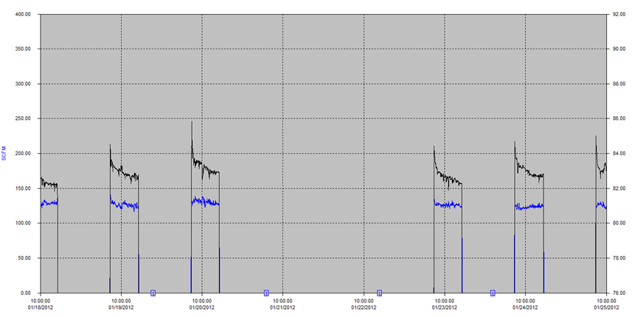
Step 2 - Demand Profile Analysis
SYSTEM AUDIT
A system audit is very important, It takes air, which you cannot see and it moves it onto a chart that can be analyzed.
It can be read 24 hours per day for weeks.

Slide 13


Step 2 - Site Conditions
Where is the compressor going to be installed?
Inside or outside?
If outside where is the setting summer sun?
What are the temperature ranges?
What is the altitude of the installation?
Clean area or dirty area?
Is the prevailing direction of the wind bringing in contaminants?
Cooling water temperature and quality?
You can put an air compressor almost anywhere that you want it, you just have to make provisions for it

Slide 14
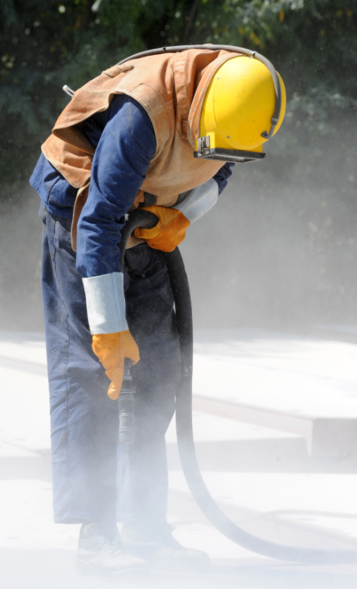
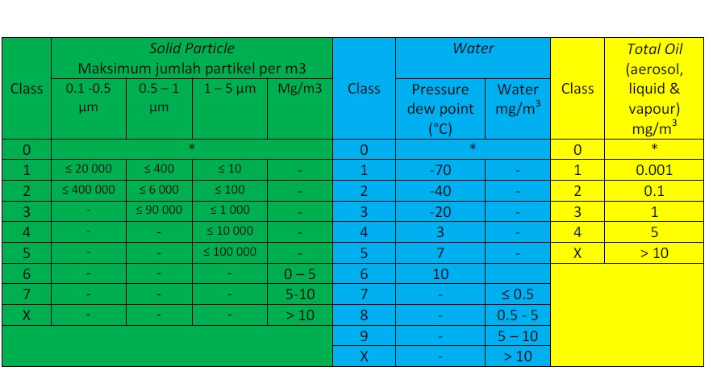
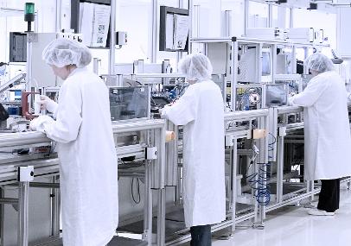
Step 2 - Application
Different types of applications require different types of compressors and purification standards. See ISO8573.1 below.

Slide 15
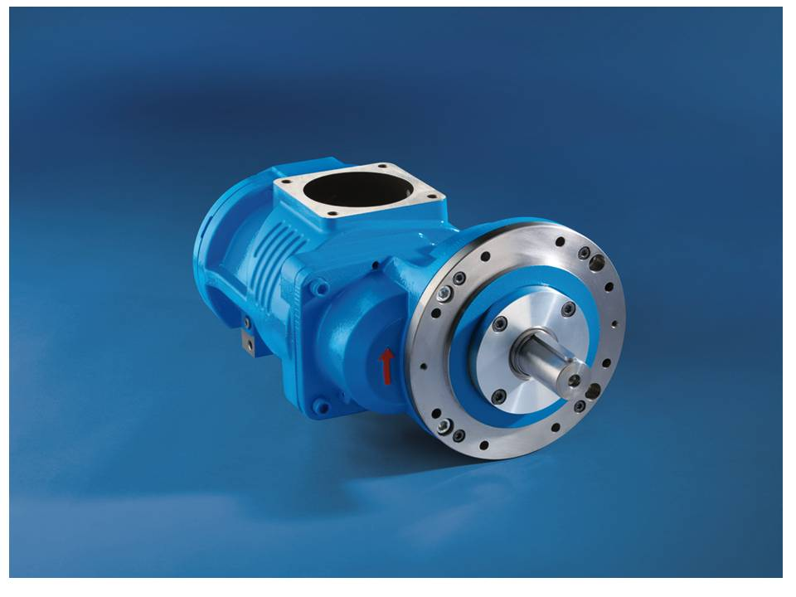

Step 3 – Selection Research
Hopefully by now there is a solution and a plan.
Start by looking at the energy costs and efficiency of each vendor.
Air Best Practices webinar May 13, 2021. Understanding and Calculating Air Compressor Specific Power
About 70% of an air compressor expense is energy usage.
DO NOT GO BY PRICE ALONE! You pay price once and you pay electrical expense every minute.
Electrical expense (energy efficiency) IS the number one priority.
Then look at the service availability for your area. You can have the best machine and poor service or the worst machine and great service.
How confident are you in the company supplying you to perform?

Slide 16

Step 4 - Decision
Now that all the research is in, it is time to make your decision.
Have you considered electrical loads?
Location of machine? Control scheme with other compressors?
Have you met with sub contractors and coordinated installation?
Now it is time to pull the trigger, you have done your analysis, determination research, decision and are ready to go.
Pro Tip: Get tech data sheet and drawings for the machine you choose and supply to contractors.
Execute the plan.

Slide 17
Step 5 - Implementation
Make sure everyone involved understands their part of the plan.
Follow the equipment and contractors at time intervals and keep all posted of any machine lead time changes or other situations that may occur.
Coordinate the arrival of the equipment and verify with others that it has arrived so they may schedule their crews.
What are the times the facility can be shutdown for “tie in”? Usually piping can be done while the plant is running, then shut down for a short period to hook up the new air compressor.

Slide 18
Good Luck With Your Compressor Project
Thanks for attending and thanks to our sponsor
Kaishan Compressor
And Compressed Air Best Practices
Loran Circle
Compressed Air System Design, Audit Analysis and Consulting
832-906-0469
Poland, Ohio 44514
loranc@comcast.net

Slide 19
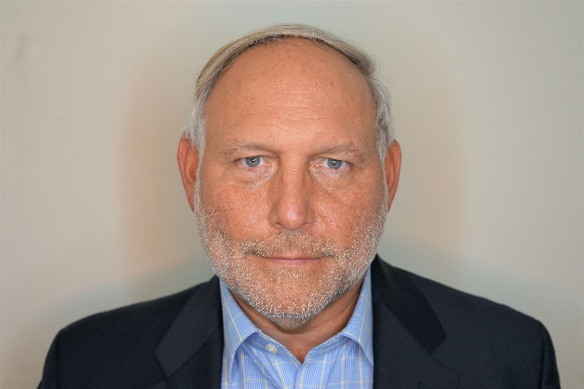
About the Speaker
Director of Sales, Kaishan
Certified DOE AirMaster+
36 years of experience in the air compressor industry
Dave George
Kaishan
Sponsored by

Slide 20
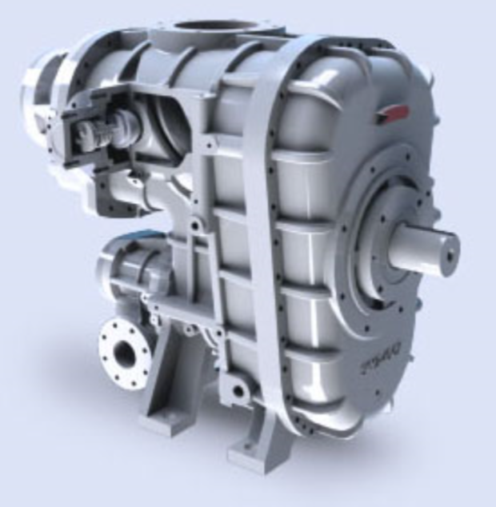


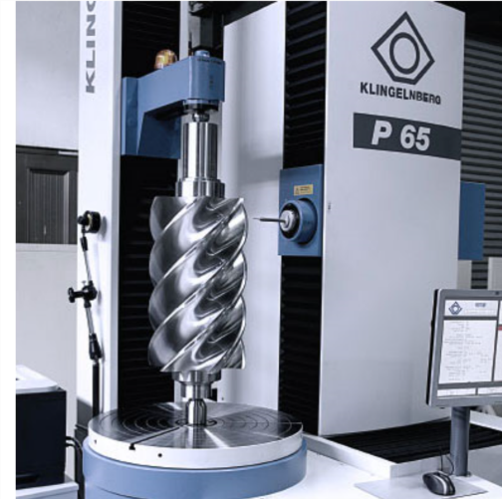
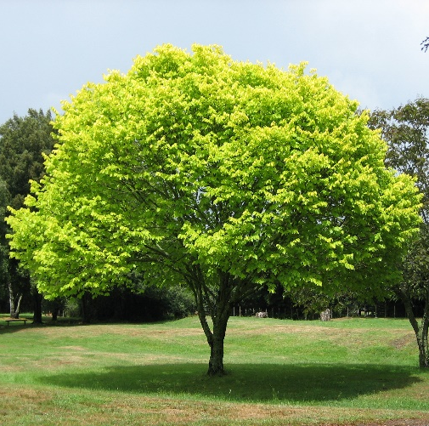
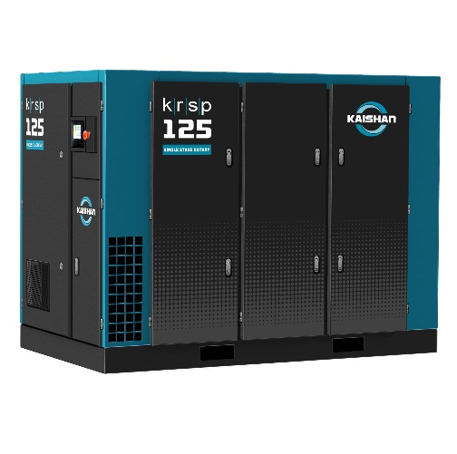
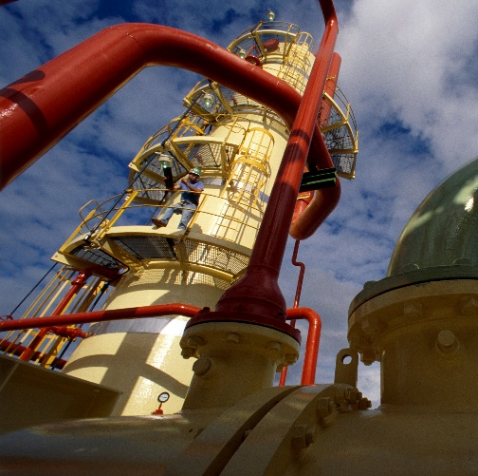
Compressed Air Best Practices
Webinar
Dave George – Dir. Sales
DOE Airmaster+
Engineering
The
Future

Slide 21
Kaishan Compressor:
3rd largest compressor manufacturer in the world
USA HQ and manufacturing plant in Loxley, AL USA
Members of the Compressed Air and Gas Institute (CAGI)
Participants in the CAGI Performance Verification Program
Performance Verification on published flow and power
CAGI has standardized Data Sheets for use in evaluating real world performance

Slide 22
The Situation:
You need a new compressor but not sure of what you need.
Existing 200HP is old and has reliability issues.
Existing machine is running at 125 psig.
You do the right thing, and someone does an air audit.
Recommendation is for a 250 HP compressor.
Find the most efficient 250 HP and buy it? – NOT THAT SIMPLE!

Slide 23

https://www.cagi.org/pdfs/cagirotarydirectory.pdf

Slide 24
https://www.cagi.org/pdfs/cagirotarydirectory.pdf

Slide 25

Single stage, modulation control

Slide 26

Add a 5,000 gallon tank and use L/UL control?
Tank: $30K

Slide 27
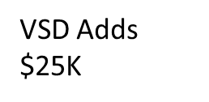
What about a VSD control?

Slide 28

https://www.cagi.org/pdfs/cagirotarydirectory.pdf

Slide 29
What about a Two Stage more efficient compressor?
Two Stage additional cost $35K

Slide 30




Slide 31
What about a VSD control?
VSD adds $30K

Slide 32
Can You lower your plant pressure to 100 psig?
Now maybe you can use a smaller HP (200) two stage compressor

Slide 33

Conclusions:
Every system is different
Every installation is different
Don’t just look at the basics – details matter!
Work with an air expert who knows what they are doing.
I’ll be glad to help you with your analysis – contact me.
Dave George – Kaishan USA
239-213-8797
dgeorge@kaishanusa.com
www.kaishanusa.com

Slide 34
5 Steps Before Making an Air Compressor Purchase Decision
Q&A
Please submit any questions through the Question Window on your GoToWebinar interface, directing them to Compressed Air Best Practices Magazine. Our panelists will do their best to address your questions and will follow up with you on anything that goes unanswered during this session.
Thank you for attending!
Sponsored by

Slide 35
Best Practices EXPO Contest
Play for a chance to win a FREE Full Conference Pass to the Best Practices 2021 EXPO & Conference!! This is a $675 value! This contest is open to factory personnel, compressed air distributors, utility incentive programs and engineering firms. Exhibiting and sponsor companies are not qualified. TWO winners* will be randomly selected from those who submitted at least 1 correct answer and notified tomorrow via email.
The next slide will show a statement related to today’s topic that needs to be filled in. You will be provided the first letter of the words as a clue. Please submit your answers in your questions box.
Example
When I think of a beach vacation, I think of _______.
T_ _ _ _
T_ _ _ B_ _
S_ _ S_ _ _ _ _
*By entering you are giving permission to announce your name if you are a winner

Slide 36
Best Practices EXPO Contest
Play for a chance to win a FREE Full Conference Pass to the Best Practices 2021 EXPO & Conference!! This is a $675 value! This contest is open to factory personnel, compressed air distributors, utility incentive programs and engineering firms. Exhibiting and sponsor companies are not qualified. TWO winners* will be randomly selected from those who submitted at least 1 correct answer and notified tomorrow via email.
The next slide will show a statement related to today’s topic that needs to be filled in. You will be provided the first letter of the words as a clue. Please submit your answers in your questions box.
Example
When I think of a beach vacation, I think of _______.
TOWEL
TIKI BAR
SEA SHELLS
*By entering you are giving permission to announce your name if you are a winner

Slide 37
Best Practices EXPO Contest
Play for a chance to win a FREE Full Conference Pass to the Best Practices 2021 EXPO & Conference!! This is a $675 value! This contest is open to factory personnel, compressed air distributors, utility incentive programs and engineering firms. Exhibiting and sponsor companies are not qualified. TWO winners* will be randomly selected from those who submitted at least 1 correct answer and notified tomorrow via email.
Based on the clues below, please submit your answer in the questions box.
When I think of “Air Compressor Lifecycle Costs,” I think of _______.
I _ _ _ _ _ _ _ _ _
I _ _ _ _ _ _ _ _ _ _ _
M _ _ _ _ _ _ _ _ _ _
E _ _ _ _ _
*By entering you are giving permission to announce your name if you are a winner

Slide 38
Best Practices EXPO Contest
Play for a chance to win a FREE Full Conference Pass to the Best Practices 2021 EXPO & Conference!! This is a $675 value! This contest is open to factory personnel, compressed air distributors, utility incentive programs and engineering firms. Exhibiting and sponsor companies are not qualified. TWO winners* will be randomly selected from those who submitted at least 1 correct answer and notified tomorrow via email.
Based on the clues below, please submit your answers in the questions box.
When I think of “Air Compressor Lifecycle Costs,” I think of _______.
INVESTMENT
INSTALLATION
MAINTENANCE
ENERGY
*By entering you are giving permission to announce your name if you are a winner

Slide 39
Thank you for attending!
The recording and slides of this webinar will be made available to attendees via email later today.
PDH Certificates will be e-mailed to Attendees within 2 days.

Slide 40


September 2021 Webinar
Vacuum Specification Fundamentals: Flow vs. Pressure
Sponsored by
Andy Smiltneek
Growth Solutions Consultants
Keynote Speaker
Thursday, September 30, 2021 – 2:00 PM EST
Register for free at
www.airbestpractices.com/magazine/webinars

