Slide 1

Air Compressor Lubrication & Maintenance
Loran Circle, Circle Training & Consulting
Keynote Speaker
The recording and slides of this webinar will be made available to attendees via email later today.
PDH Certificates will be e-mailed to attendees within two days.
Sponsored by

Slide 2
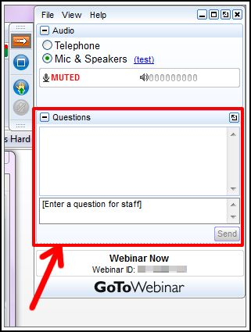
Q&A Format
Panelists will answer your questions during the Q&A session at the end of the Webinar.
Please post your questions in the Questions Window in your GoToWebinar interface.
Direct all questions to Compressed Air Best Practices® Magazine
Sponsored by

Slide 3
Handouts

Slide 4
Disclaimer
All rights are reserved. The contents of this publication may not be reproduced in whole or in part without consent of Smith Onandia Communications LLC. Smith Onandia Communications LLC does not assume and hereby disclaims any liability to any person for any loss or damage caused by errors or omissions in the material contained herein, regardless of whether such errors result from negligence, accident, or any other cause whatsoever.
All materials presented are educational. Each system is unique and must be evaluated on its own merits.

Slide 5
Air Compressor Lubrication & Maintenance
Introduction
Compressed Air Best Practices® Magazine
Sponsored by

Slide 6

About the Speaker
Senior Consultant, Circle Training & Consulting
Over 45 years of experience in the compressed air industry
Certified AirMaster Plus by Department of Energy
Loran Circle
Circle Training & Consulting
Sponsored by

Slide 7
Air Compressor Preventative Maintenance

Slide 8
Warning!
Before starting any preventive maintenance of any type on any type of compressor make sure that the machine is off, locked out and tagged according to proper procedures and the air system and machine has been depressurized.
Refer to any safety notes in the machines operation manual before performing a PM.

Slide 9
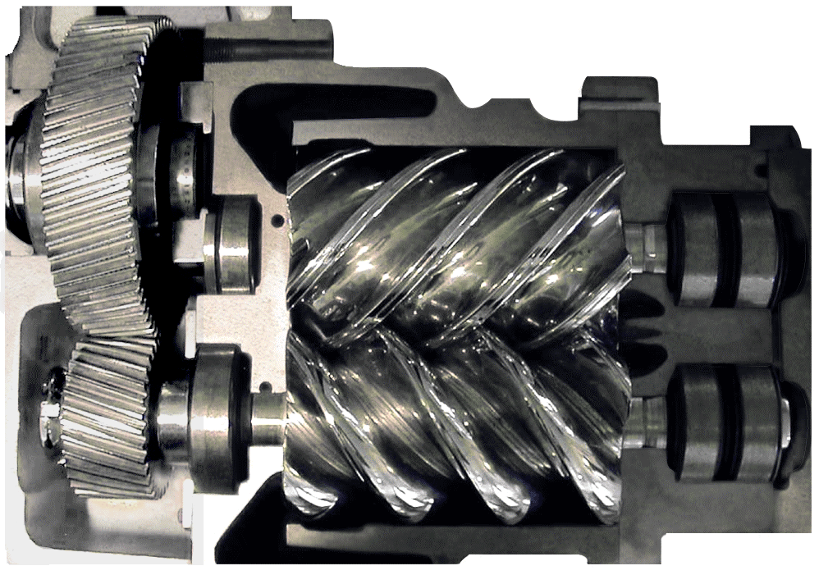
Preventive Maintenance Should Be Top Priority
The compressor is the life blood of the plant.
The Lubricant is the lifeblood of the compressor
It is the fourth utility.
Plant downtime costs can far exceed PM costs.
Recognizing and diagnosing machine issues.
Establish a baseline for the machines operation.
Track trends to identify PM issues.
Use a log on the machine to determine intervals.
Use oil analysis to PRE-determine internal operational issues.

Slide 10
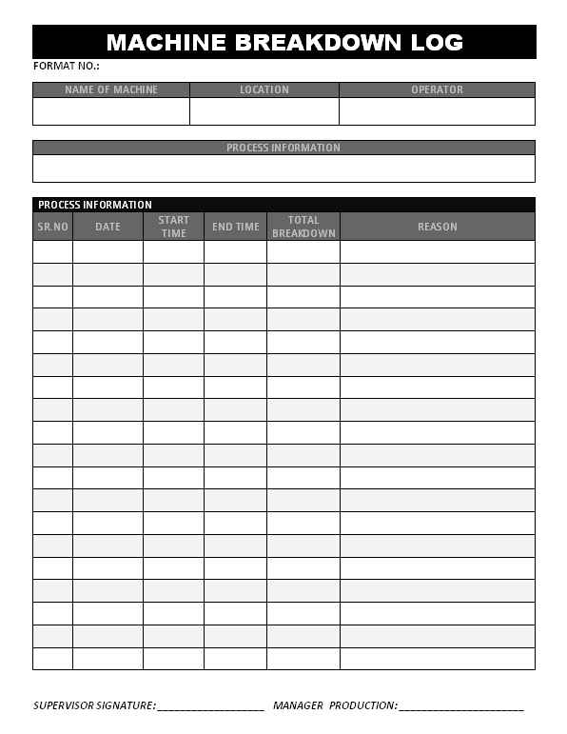
Creating A Maintenance Tracking Plan
Refer to the Manufacturers Maintenance manual for establishing a maintenance plan.
Check with Manufacturer or Distributor about preventive maintenance programs they offer.
Ask Manufacturer and Distributor about any technical classes they may offer regarding the equipment.
Do a machine check out daily. The following log will assist in foreseeing any trends or issues arising.
Keep a breakdown log to justify maintenance expenses
Most importantly implement and follow a lubricant testing program

Slide 11
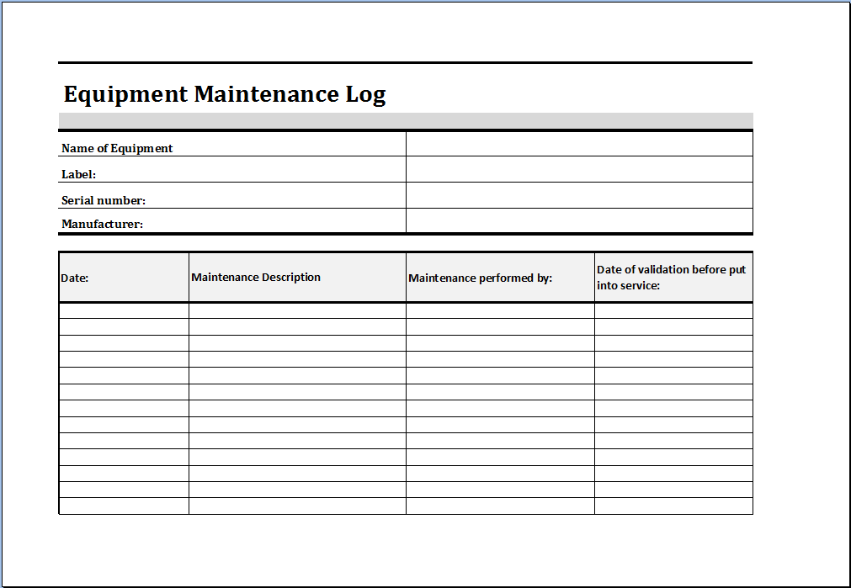
Typical Log

Slide 12
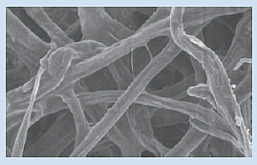
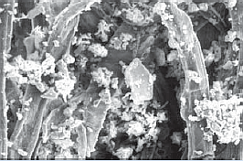
FLUID FILTRATION PRESSURE DROP
Scanning Electron Microscope
Scanning Electron Microscope
As dirt gets caught in the media it eventually
builds up and fills the openings
As the pore openings shrink the pressure drop
( restriction ) ΔP increases
Excessive dirt in the media can cause dirt
migration or even filter failure should the
restriction be too high
Major Factors Contributing to Pressure Drop
  Type of Filter Media
  Dirt/Contamination
  Fluid Flow
  Fluid Viscosity

Slide 13

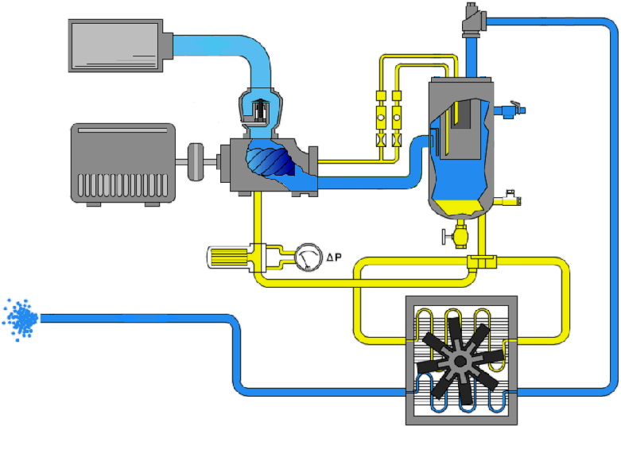
7.54 Gal./24Hrs. @ 50ºF
37 Gal./24Hrs. @100ºF
62.83 Gal./24Hrs. @120ºF
Ambient Air Moisture Content
Inlet Ambient Air
75ºF/75%RH
17.3 Gal/24Hrs.
Inlet Filter
100 CFM
Compressor
Motor
Fluid Filter
Thermal Valve
After Filter
Pre Filter
Dryer
5.80 Gal. Removed
/24Hrs @ 75ºF
Moisture
Separator
Oil Cooler
Water Content
.67 Gal./24Hrs
@ 75ºF
Water Content
6.47 Gal./24Hrs
@ 75ºF
Aftercooler
(65% Condensate Removed)
Removes 10.78 Gal/24Hrs.
@ 75ºF

Slide 14
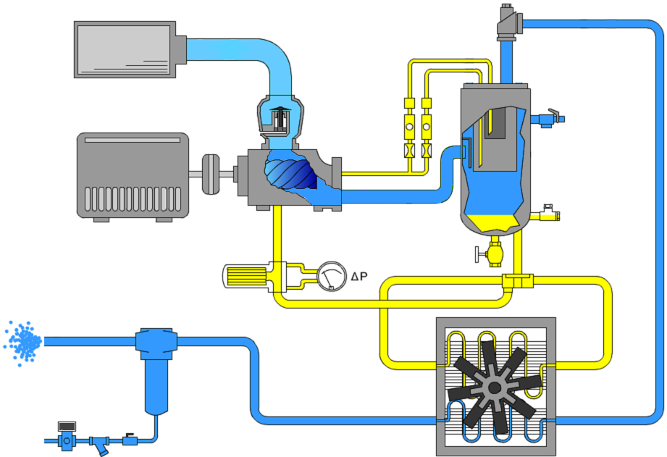

Discharge System
Minimum Press./Check Valve
Blowdown Valve
Capacity Control
Inlet Filter
Air End
Separator
Fluid Filter
Moisture Separator
Aftercooled Air

Slide 15

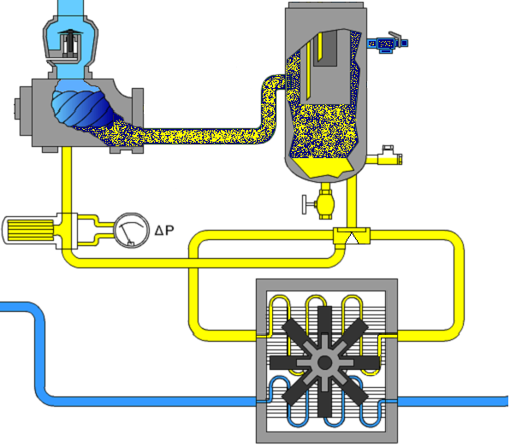
Temp. Trouble Shooting
Discharge Air
190º
210º
Thermal Valve
Fluid Filter
Legend
Atmosphere
High Pressure Air
Oil
Oil/Air Mixture
180º
Aftercooled Air

Slide 16
Fluid Carryover - Ounces per 24 Hrs.
18
16
6PPM
14
5PPM
12
4PPM
10
8
3PPM
6
2PPM
4
1PPM
OZ
2
CFM 0 200 400 600 800 1000 1200 1400 1600

Slide 17
ADDITIONAL BENEFITS TO CONSIDER:
  Varnish Cleanup/Non-Varnishing
  Reduced Downtime for Maintenance
  Lower Carryover and Make Up Rate
  Lower Operating Temperature
  Lower DeltaP Across Separator
  Typical 8000 Hour Life
Est. Annual Savings $4,900.00

Slide 18
Causes of High Lubricant Consumption
Leakage
Return Line Position
Plugged Orifice or Strainer
Defective Separator Element
Foaming Lubricant
Compressor Overfilled
Machine Running Unloaded
Machine Running Low Pressure
Ruptured Water-Cooled Oil Cooler

Slide 19
Temp. Trouble Shooting
Discharge Air
150º
210º
Thermal Valve
Fluid Filter
150º
Aftercooled Air

Slide 20
Fluid Analysis Provides
    Condition of the fluid
    Presence of cross contamination
    Abnormal wear condition
    Condition of inlet filtration system
    Presence of corrosion

Slide 21
Visual Checks
Visually check machine for any air or oil leaks.
Check wiring connections to make sure they are solid.
Clean area of any debris that could be sucked into the inlet or the coolers of the compressor.
During startup watch that pressure is increasing and that temperature is rising at proper rate.
Wait, watch and listen. Make sure no alarms or unusual sounds are coming from machine.
Is there flow through the oil return lines?
Are controls operating properly?

Slide 22
Air Filter
Do a visual inspection of the inlet air filter.
DO NOT blow dirt out of the filter with high pressure air.
Clogged Air Filter…uses more or less energy?

Slide 23
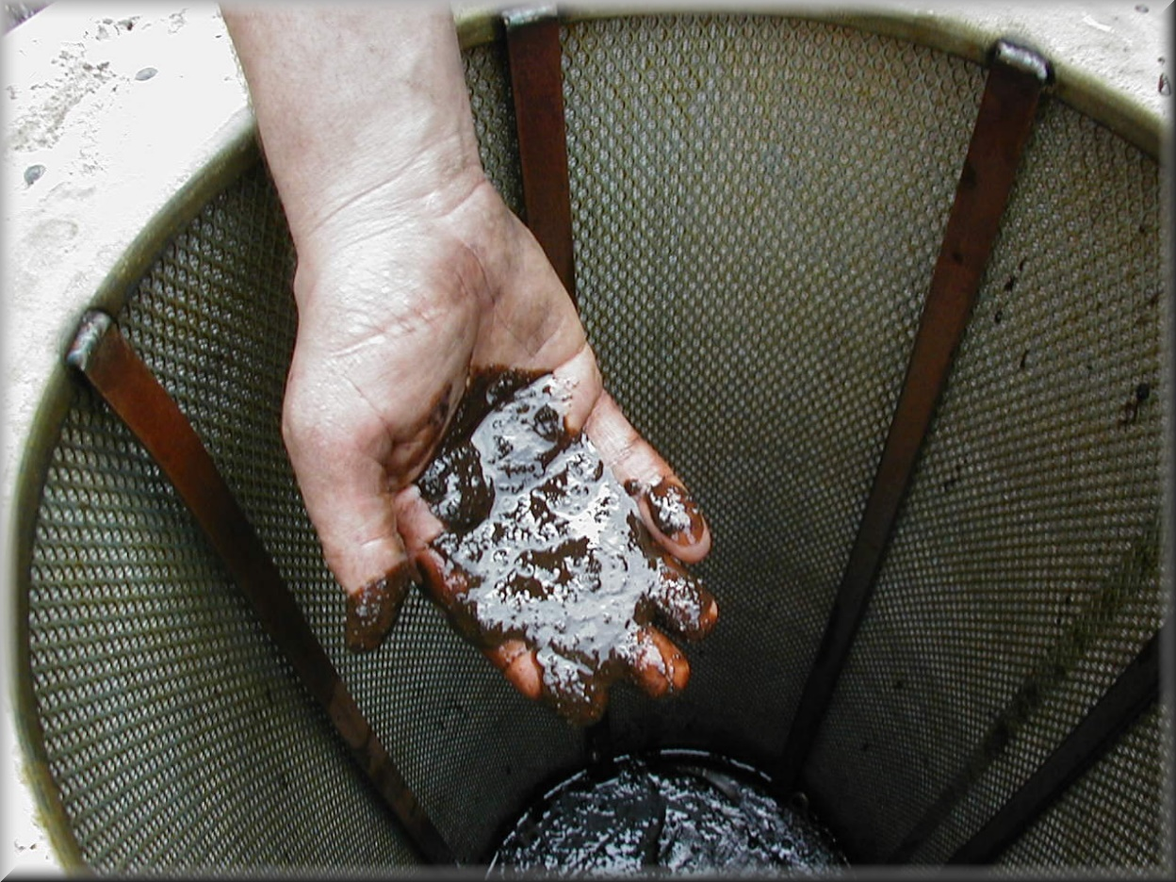
Varnish

Slide 24
Oil Filter
Check differential pressure across filter.
Change oil filter per manufacturers recommendation.
Plugged oil filter can cause high machine temperature.
Can also cause premature bearing wear.

Slide 25
Separator
Check differential pressure on separator.
A separator with high differential pressure adds to electrical expense.
For every 1 PSI drop across costs ½% of the BHP of the machine.
Looking at a 10 PSI drop across separator it will use an additional 5% of the power. A 100 HP running 24/7 @ $.08/kwh would waste over $2500 annually.

Slide 26
Diagnosing High Temperature
Discharge Air
195º
210º
Fluid Filter
Thermal Valve
195º
Legend
Atmosphere
High Pressure Air
Oil
Oil/Air Mixture
Aftercooled Air

Slide 27
Causes of High Amp Draw
HIGH PRESSURE!!!
LOW VOLTAGE
LOOSE CONNECTIONS
DEFECTIVE CONTACTS
DEFECTIVE BEARINGS
HIGH VISCOSITY FLUID
HIGH VOLTAGE
Notes:
HIGH PRESSURE requires more horsepower thus requiring higher amp draw.
LOW VOLTAGE can result in higher amp draw.
LOOSE CONNECTIONS causes increased current draw through the connection resulting in higher amp draw.
DEFECTIVE CONTACTS require additional current through the contacts resulting in higher amp draw.
DEFECTIVE BEARINGS could require more horsepower. resulting in higher amp draw.
HIGH VISCOSITY FLUID requires more horsepower to move the thicker fluid through airend requiring higher amp draw.
HIGH VOLTAGE can result in higher amp draw.

Slide 28
VFD’s Drive Maintenance
Drive Maintenance is the most important tip in Optimizing VFD’s and is the most neglected.
Uptime of VFD compressor is vital to manufacturing plants
One to 7 days of downtime on a drive can eliminate a year of more of energy savings Plant downtime and loss of a VFD compressor in a plant can wipe out days months or years of energy savings
Keep dust and dirt out of machine

Slide 29
VFD Maintenance (contd.)
Most VFD’s fall into the NEMA 1 category (vents for cooling airflow) or NEMA 12 category (sealed, dust-tight enclosure).
Inspect VFD hardware for any dust that can cause a lack of airflow, resulting in diminished performance or life. USE CLEAN DRY compressed air to blow out drive heat sinks.
Keep it dry
Visually inspect control board for any sign of moisture or heat
Make sure VFD is kept within manufacturers suggested temperature ranges
Do a regular visual Inspection for loose fans, bearing noise etc.

Slide 30
VFD Maintenance (contd.)
Keep it clean
Keep it dry
Keep connection tight.
Refer to VFD manual for torque values on electrical connections.
Do not overtighten.

Slide 31
Maintenance Manuals
The maintenance manual from the manufacturer is invaluable and should be read and understood when the machine first arrives.
Keep copy of manual in plastic pouch or folder with machine log.
If all else fails read the manufacturers maintenance manual.
If there is still an issue go back to above statement

Slide 32


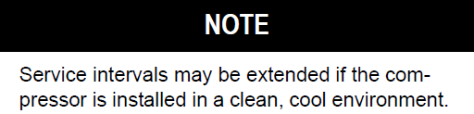
Pay Attention to Warnings
Safety is Priority One!

Slide 33
Thanks for your attention.
Questions?
Loran Circle
Compressed Air Systems Consulting and Training
Poland, OH
832-906-0469

Slide 34

About the Speaker
Market Manager for Air Compressor Lubricants, Summit
Chemical Engineer with 10 years experience in the lubricant and compressor industry
Experienced in formulating compressor oils, troubleshooting lubrication issues in gas and air compressors
Enjoys traveling, reading & spending time with her family outside of her role at Summit
Jasween Jagjit-Webb
Summit
Sponsored by

Slide 35
Optimizing Lubricant Life in an Air Compressor by Jasween Webb
Market Manager - Air Compressor Lubricants

Slide 36
Function of Air Compressor Lubricant
• LUBRICATION - Lubricates all moving parts
• SEALING - Works as a sealant to prevent air leakage
• COOLING - Removes heat from the compression
• PROTECTION – Inhibits corrosion of metals

Slide 37
Air Compressor Lubricant Requirements
Oxidation resistance
Prevention of acidity , sludge, deposit
Good foam control
Good demulsibility to shed water that enters the lubrication system
Bearing wear protection
Is the lubricant formulated specifically for an air compressor application?

Slide 38
Selecting The Right Lubricant
GOAL → To select a lubricant that is able to protect the unit, withstand the conditions & minimize unscheduled downtime.

Slide 39
Selecting The Right Lubricant
What type of air compressor is it? Rotary/Reciprocating/Vane/Centrifugal?
  Even though they all compress air, they use very different mechanisms and have different viscosity and protection requirements.
What are the operating conditions (temperature/pressure)? What is the ambient environment like?
  Synthetic lubricants are able to withstand harsher conditions
  Life of a lubricant is affected by operating conditions such as discharge temperature, humidity, cleanliness, contaminants through air intake.
What is the upper temperature limit of the lubricant?
  Does the discharge temperature change the life of the lubricant?

Slide 40
Benefits of A High Quality Synthetic Air Compressor Lubricant vs Petroleum
Deposit/Varnish Free Unit
Reduced oil usage/carryover
Safety
Increased Oil Drain Interval
Reduced wear

Slide 41
Consistent Oil Analysis
Determine the condition of the lubricant in a compressor
Monitor changes in lubricant properties:
  Viscosity change, additive depletion, increase in Acid Number.
Identify contaminants:
  Water, sediment, mixed fluids, glycol
Monitor abrasive or corrosive wear:
  Increasing concentrations of wear metals like iron (Fe), copper (Cu), aluminum (Al), lead (Pb), zinc (Zn), tin (Sn) and Acid.
  Optimize oil drain and service intervals
  Spot trouble before a major unscheduled breakdown occurs

Slide 42
Questions?
Jasween Webb
Market Manager - Air Compressor Lubricants
Kluber Lubrication (Summit)
Cell: 903.279.2496
jasweenj@klsummit.com

Slide 43
Air Compressor Lubrication & Maintenance
Q&A
Please submit any questions through the Question Window on your GoToWebinar interface, directing them to Compressed Air Best Practices Magazine. Our panelists will do their best to address your questions and will follow up with you on anything that goes unanswered during this session.
Thank you for attending!
Sponsored by

Slide 44
Thank you for attending!
The recording and slides of this webinar will be made available to attendees via email later today.
PDH Certificates will be e-mailed to Attendees within two days.
Sponsored by

Slide 45

January 2020 Webinar
Compressed Air Leak Management Best Practices
Ron Marshall
Marshall Compressed Air Consulting
Keynote Speaker
Thursday, January 23, 2020 – 2:00 PM EST
Register for free at
www.airbestpractices.com/magazine/webinars

