Slide 1
Calculating Storage Volume for Compressed Air Systems
Tom Taranto, Data Power Services
Keynote Speaker
The recording and slides of this webinar will be made available to attendees via email later today.
PDH Certificates will be e-mailed to attendees within two days.
Sponsored by

Slide 2
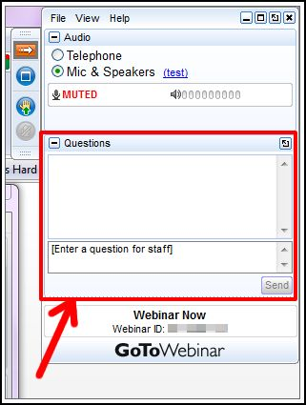
Q&A Format
Panelists will answer your questions during the Q&A session at the end of the Webinar.
Please post your questions in the Questions Window in your GoToWebinar interface.
Direct all questions to Compressed Air Best Practices® Magazine
Sponsored by

Slide 3
Handouts

Slide 4
Disclaimer
All rights are reserved. The contents of this publication may not be reproduced in whole or in part without consent of Smith Onandia Communications LLC. Smith Onandia Communications LLC does not assume and hereby disclaims any liability to any person for any loss or damage caused by errors or omissions in the material contained herein, regardless of whether such errors result from negligence, accident, or any other cause whatsoever.
All materials presented are educational. Each system is unique and must be evaluated on its own merits.

Slide 6
Calculating Storage Volume for Compressed Air Systems
Introduction
Rod Smith, Publisher
Compressed Air Best Practices® Magazine
Sponsored by

Slide 7
About the Speaker
Owner, Data Power Services
Conducts compressed air system assessments, equipment testing and compressed air system training throughout the world with over 40 years of industry experience
U.S. DOE Energy Expert, Compressed Air Challenge technical committee member, Compressed Air Challenge qualified instructor and instructor for Qualified AIRMaster+ Specialist Training
Tom Taranto
Data Power Services
Sponsored by

Slide 8
Calculating Storage Volume for Compressed Air Systems
August 22, 2019 Tom Taranto, Owner Data Power Services

Slide 9
Today’s Agenda
Rules of thumb for compressed air storage volume.
How compressed air storage is used.
Calculating storage volume.
Evaluating System wide pressure drawdown

Slide 10
Rules of Thumb For Sizing Storage
Use system piping as storage – receivers not required.
Inlet modulation control does not need an air receiver
The system still benefits from stored pneumatic energy
1 gallon per cfm
Large double acting reciprocating compressors with 10 psid load / unload control band
3 – 5 gallons per cfm
Improves part load efficiency of load / unload lubricant injected air compressors.

Slide 11
Rule of Thumb: 3 – 5 gallons per cfm

Slide 12
Application of Storage
Supply Side – Primary Storage
Improve compressor control response
Additional pneumatic energy source
Unanticipated compressor shutdown / permissive start-up
Demand Side – Secondary Storage
High volume intermittent demand
Dedicated storage, improve speed / thrust
Increased system volume, stabilize pressure

Slide 13
Supply Side – Primary Storage
Calculate the required primary storage volume?
226 cfm Air flow from storage for 1½ minutes
100 psig Compressor load pressure
90 psig Minimum pressure

Slide 14
Primary Storage 1½ min 226 cfm 100 ↓ 90 psig
$V_{REC}= \frac{T ×Q × P_{atm}}{∆P}$ $491{ft}^{3}= \frac{1.5 ×226 ×14.5}{90 −100}$
$491{ft}^{3}x 7.48 \frac{gallons}{{ft}^{3}}=3,673 gal.$
V_{REC} = Receiver volume (cu. ft.)
1.5 min. T = Time duration of required air flow rate (minutes)
226 cfm Q = Required air flow rate (cu. ft. / minute)
14.5 psia P_{atm} = Atmospheric pressure (psia)
– 10 psia ΔP = Pressure change in the air receiver ( P_{final} – P_{initial} = 90 – 100 = -10)
660
gal.
3,000 gal.

Slide 15
Demand Side – Dedicated Storage

Slide 16
Demand Side – System Volume Storage

Slide 17
Demand Side – High Volume Intermittent Demand

Slide 18
Demand Side – Dedicated Storage

Slide 19
Solving for Receiver Size or Air Flow Rate
Calculate Receiver Volume
Calculate Air Flow Rate
$$V_{REC}= \frac{T ×Q × P_{atm}}{∆P}$$
$$491{ft}^{3}= \frac{1.5 ×226 ×14.5}{100 − 90}$$
$$Q=\frac{V_{REC}× ∆P}{P_{atm} × T}$$
$$225.7=\frac{491{ft}^{3}×10}{1.5 ×14.5}$$

Slide 20
System Wide Air Storage Calculations

Slide 21
System Pressure Drawdown

Slide 22
Total System Storage Volume

Slide 23
Effective System Storage Volume

Slide 24
Calculate Effective System Volume
$V_{SYS}= \frac{T ×Q × P_{atm}}{∆P}$
$Q=\frac{V_{SYS}× ∆P}{P_{atm} × T}$
Q = ?? Air flow
T = 17.9 minutes
V_{SYS} = ?? System
P_{atm} = 14.5 psia
ΔP = 11 psia

Slide 25
System Storage – L / NL Control Interaction
460 acfm

Slide 26
System Storage – L / NL Control Interaction

Slide 28
System Volume avg. of 5 cycles = 1,214.5 ft³
 | Cycle 1 | Cycle 2 | Cycle 3 | Cycle 4 | Cycle 5
Load cfm | 3171 | 3193 | 3182 | 3172 | 3172
Unload cfm | 2987 | 2993 | 2981 | 2980 | 2980
Measured flow Δ | 184 | 200 | 201 | 192 | 192
Cut-in Pressure | 98.9 | 98.8 | 98.8 | 98.8 | 99
Cut-out Pressure | 102.5 | 102.6 | 102.5 | 102.5 | 102.5
Load Time | 1:44:36 | 1:47:54 | 1:52:12 | 1:55:42 | 1:59:30
Unload Time | 1:46:24 | 1:50:30 | 1:54:18 | 1:58:00 | 2:00:54
Reload | 1:47:54 | 1:52:12 | 1:55:42 | 1:59:30 | 2:02:42
Load Duration | 0:01:48 | 0:02:36 | 0:02:06 | 0:02:18 | 0:01:24
Load Seconds | 108.00 | 156.00 | 126.00 | 138.00 | 84.00
Unload Duration | 0:01:30 | 0:01:42 | 0:01:24 | 0:01:30 | 0:01:48
Unload Seconds | 90.00 | 102.00 | 84.00 | 90.00 | 108.00
cubic feet | 1,111.7 | 1,297.4 | 1,496.8 | 1522.6 | 1825.8
Average of 5 Load / Unload Cycles
Flow | Cut-in | Cut-out | Load | Unload
194 | 98.8 | 102.5 | 122 | 95

Slide 29
Calculate System Volume w/ Measured Flow Change
Calculate System Volume
Measured Flow Change
$$V_{SYS}= \frac{T_{NL} ×Q × P_{atm}}{∆P}$$
$$V_{SYS}= \frac{1.58 ×194 ×14.5}{98.8 −102.5}$$
$V_{SYS}=1,201.2 {ft}^{3}$
$$V_{SYS}=1,201.2{ft}^{3} ×7.48$$
$$V_{SYS}=8,985 gal.$$
Average of 5 Load / Unload Cycles
Flow | Cut-in | Cut-out | Load | Unload
194 | 98.8 | 102.5 | 122 | 95

Slide 30
Calculate System Volume Load Cycle % & Compressor Rated Flow
Load / Unload Percentage
Calculate System Volume
Load | 1 m 48 s | 2 m 36 s | 2 m 6 s | 2 m 18 s | 1 m 24 s
Unload | 1 m 30 s | 1 m 42 s | 1 m 24 s | 1 m 30 s | 1 m 48 s
$$V_{SYS}= \frac{T_{NL} ×Q × P_{atm}}{∆P}$$
$$V_{SYS}= \frac{1.58 ×259 ×14.5}{98.8 −102.5}$$
$V_{SYS}=1,603.7 {ft}^{3}$
$$V_{SYS}=1,603.7 {ft}^{3} ×7.48$$
$$V_{SYS}=11,996 gal.$$
$$Load \%=\frac{T_{L}}{T_{L}+T_{NL}}×100$$
$$\frac{612}{612+474}×100$$
$$460 acfm×56.3\%=259 acfm$$

Slide 31
AIRMaster+ Storage Calculator Load / Unload Cycles => Rated Flow => Vsys
AIRMaster+ Storage Calculator
Calculate System Volume
$$V_{SYS}= \frac{T_{NL} ×Q × P_{atm}}{∆P}$$
$$V_{SYS}= \frac{1.58 ×259 ×14.5}{98.8 −102.5}$$
$V_{SYS}=1,603.7 {ft}^{3}$
Average of 5 Load / Unload Cycles
Flow | Cut-in | Cut-out | Load | Unload
460 | 98.8 | 102.5 | 122 | 95

Slide 32
Measured Flow Change – vs – Compressor Rating

Slide 33
Knowing System Volume => Calculate Flow
Calculate System Volume
Calculate Flow Deficit
$$V_{SYS}= \frac{T ×Q × P_{atm}}{∆P}$$
$$V_{SYS}= \frac{1.58 ×259 ×14.5}{3.7}$$
$${Demand Side V}_{SYS}=1,245 {ft}^{3}$$
$${Supply Side V}_{SYS} = 394 {ft}^{3}$$
$${ Total V}_{SYS} =1,605 {ft}^{3}$$
$$Q=\frac{V_{SYS} × ∆P}{T × P_{atm}}$$
$$Q=\frac{1,605 cu. ft. ×11 psi}{17.9 min. ×14.5 psi}$$
$Q=68.0 cu.{ft.}/{minute}$

Slide 34
Chat Your
Questions
Tom Taranto
tom@datapowerservices.com
Thank
You !

Slide 35
About the Speaker
Product Manager, BEKO Technologies
Product Manager for BEKOMAT, METPOINT, QWIK-PURE, and CLEARPOINT product families.
Felipe Gonzalez
BEKO Technologies

Slide 36
Understanding and Evaluating a Drain for Your Storage Needs
Felipe Gonzalez
Product Manager - Condensate Management
Notes:
Wet receiver tanks play an important part in the compressed air chain so understanding the benefits of having a reliable drain at this link is highly beneficial. We will also discuss tools to help monitor compressed air and size the correct equipment for storage and beyond using measurement and data logging systems.
-understanding how much condensate is in a compressed air system and therefore how to size the drain
-alarm monitoring: how folks can become aware through alarm systems of required repairs, maintenance etc.

Slide 37
BEKOMAT® | General Info – The Compressed Air Chain
COMPRESSION
A Chain is Only As Strong As Its Weakest Link
COOLING
SEPARATION
DRAINING
STORING
DRAINING
DRYING
DRAINING
FILTERING
DRAINING

Slide 38
BEKOMAT® | General Info – The Compressed Air Chain
Where does all this condensate come from?

Slide 39
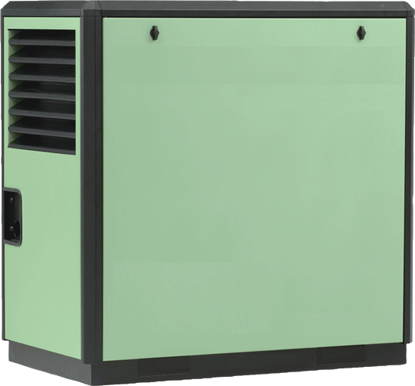
BEKOMAT® | General Info – The Compressed Air Chain
Moisture
Bacteria
Viruses
Hydrocarbons
Particles
Other contaminants
Oil
Moisture
Bacteria
Viruses
Hydrocarbons
Particles
Other contaminants
Notes:
Everything a compressor takes in on the suction side will pass trough and goes into your system. Depending on the compressor type the compressor will also add oil what is used for lubrication. A very large impact on the contamination in the compressed air comes from the location the compressor is placed in because the compressor takes in the ambient air. What means if the compressor takes his air in from right next to a heavily used road or in a harbor the hydro carbon amount for example will go up significantly.

Slide 40
BEKOMAT® | General Info – The Compressed Air Chain
What makes up the condensate in the Summer?
What makes up the condensate in the Winter?
Water approx. 33%
Oil approx. 65%
Contamination
approx. 1%
Contains dirt due to corrosion particles from the tubing or air contamination
Accumulates contamination from the aspirated ambient air
Oil-contaminated due to lubricated compressors
.. is possibly aggressive (pH value)
Notes:
Composition of condensate of a screw compressor in the winter vs summer

Slide 42
BEKOMAT® | How Much Water is in Your Static Compressed Air in a lab?
Air Before Compression
Air After Compression
Pressure
Atmospheric = 14.7 psig Or 1Bar
Pressure
Atmospheric = 100psig Or 7 Bar
Volume
8 m3
Volume
1 m³
Temperature
68.0 °F Or 20 °C
Temperature
68.0 °F Or 20 °C (After Cooling Down)
Relative Humidity
50%
Relative Humidity
400%*
Total Water Present as Vapor
17 g
Total Water Present as Vapor
68 g
Total Water Present as Liquid
51 g
Notes:
magically the temperature of this air drops right after compression.
So for every 8 cubic meters of ambient air that we compressor, we generate 1 cubic meter of compressed air at 7 bar (relative pressure, 8 bar absolute pressure), with a water vapor content of 17 g/m³ .
And we generate 51 g of liquid water. That’s 0.051 liters.

Slide 43
BEKOMAT® | How Much Water is in Your Compressed Air system?
Inlet Air
(Before Compression)
Air After Compression
Pressure [bar, absolute] | 1 bar 14.6 Psig | 8 bar 116 psig
Volume | 1 m³ | 1/8 m³ ( 0.125 m³) (We reduced the volume 8 times)
Temperature | 20 °C 68.0 °F | 20 °C 68.0 °F (We are assuming the temperature dropped)
Per m³ Cubic Meter of Air
Water present | 8.5 g/m³ | 68 g / m³ (8.5 g x compressing 8 times)
Water as vapor | 8.5 g/m³ | 17 g / m³
Water as liquid | 0 g/m³ | 51 g / m³
Per day
Air volume | 10,080 m³ | 1,260 m³ (10,080 / 8 bar )
Water present | 85,680 g | 85,680 g (Amount of water present is the same)
Water as vapor | 85,680 g | 21,420 g (amount of water vapor our compressed air can hold is 1,260 x 17grams per cubit meter = 21,420)
Water as liquid | 0 g | 64,260 g = 64 liter or 17 Gallons
7m3 * 60min * 24hrs
7m3 * 60min * 24hrs
BUT…..
Notes:
We change from our static example of compressing 1 cubic meter once, to compressing many cubic meters every minute.
we can just imagine that we have a huge compressed air receiver and we store all the compressed air for the day inside that compressed air receiver.
In this case we are using an Ingersoll Rand rotary screw air compressor which takes in 7 m³/min.
That’s 7cubic meters * 60 minutes *24 hours = 10,080 m³ per day (of ambient air) which then becomes 1260 m3 of Compressed air! At 8 bar or 116psig
We saw in the static example that the compressed air can hold 17 grams of water per cubic meter of compressed air.
In total, we created 1,260 m³ of compressed air in a day.
The amount of water vapor our compressed air can hold is 1,260 * 17grams = 21,420 grams of vapor in total.
The problem is: we have a total water content of 85,680 grams.
Just like in our static example, the difference condenses into liquid water.
85,680 – 21,420 = 64,260 grams of water per day. That’s 64.2 liters!
Total water content (liquid and vapor) = 85,680 grams Water vapor = 21,420 grams (the maximum, 100% relative humidity) Liquid water = 64,260 grams
That is 64.2 (17 gallons) of liquid water per day in our compressed air system at these conditions

Slide 44
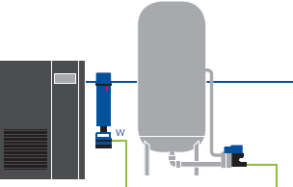
BEKOMAT® | How Much Water is in Your Compressed Air system?
Wet air in your pipes due to condensation as the temperature drops
T = 68.0 °F
Max = 17g/m3
Actual = 8.5g/m3
Vapor = 8.5g/m3
Liquid = 0 g/m3
RH = 50 %
T = 104°F
Max = 51g/m3
Actual = 68g/m3
Vapor = 51g/m3
Liquid = 17 g/m3
RH = 100 %
T = 68.0 °F
Max = 17g/m3
Actual = 51g/m3
Vapor = 17g/m3
Liquid = 34 g/m3
RH = 100 %
Saturated air which will condense further when cooled down
Compressed air created = 1,260 m³ Total water content generated = 85,680 grams of water or 22 Gallons Condensation in after cooler = 21,420 grams, or 21 liters - 5.6 Gallons Condensation in piping system after cooling down = 42,940 g, or 43 liters - 11.5 Gallons
Per Day!
Notes:
At the end of our compressed air piping system, the air has cooled back down to 20°C.
We already saw that our compressed air of 20 °C (1,260 m³ total for the day) can hold 1,260 * 17 = 21,420 grams of water vapor.
The difference between the 40 °C compressed air and the 20 °C will condense to liquid water in our compressed air system. So in a more realistic scenario this means ….
And that is why we need condensate drains and why it is important to know how much condensate a standard application generates!

Slide 46
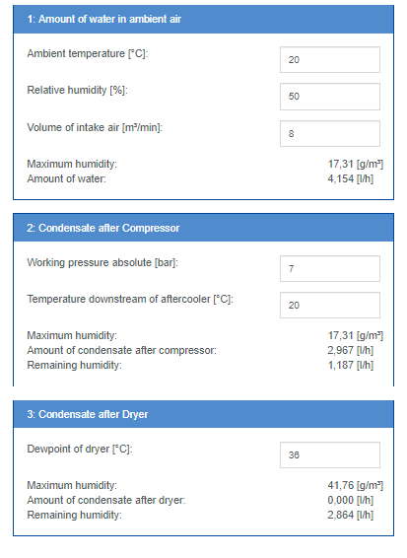
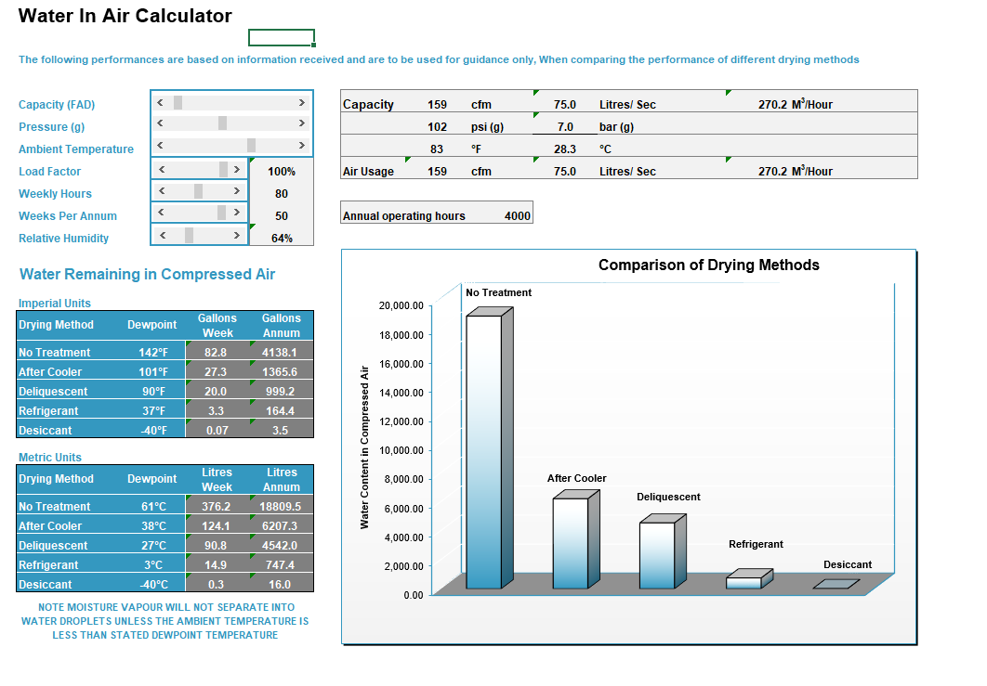
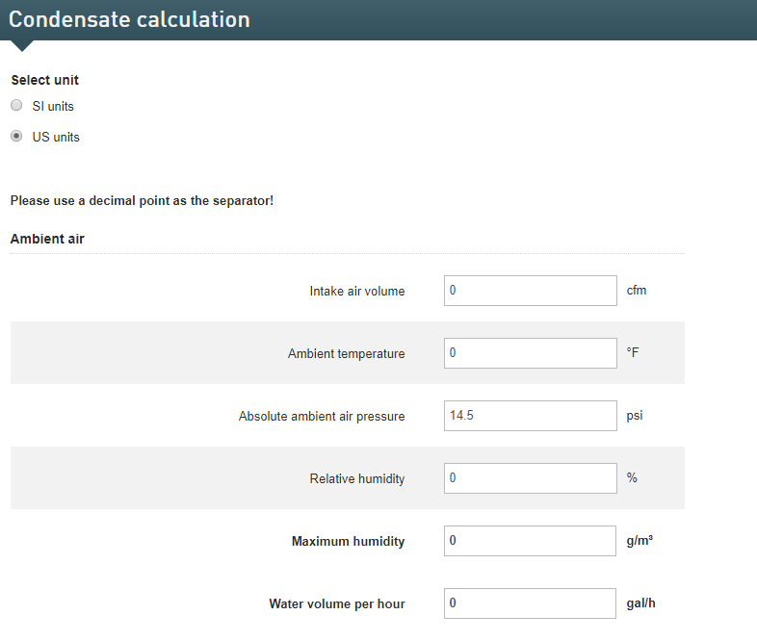
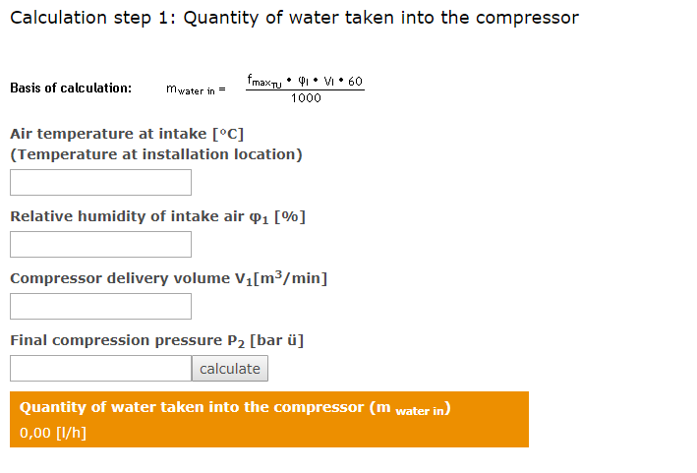
BEKOMAT® | Online Free Tools - Calculate amount of Condensate

Slide 47
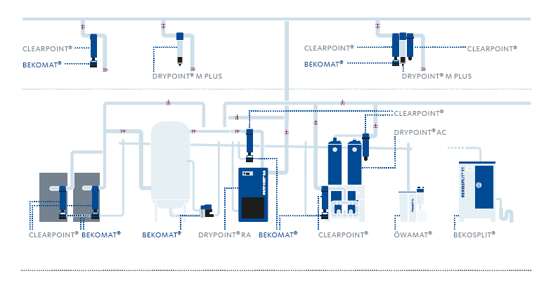
BEKOMAT® | General Info – The Compressed Air Chain
Imagine if this is your Weakest Link

Slide 48
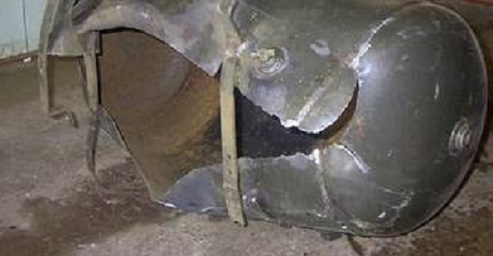
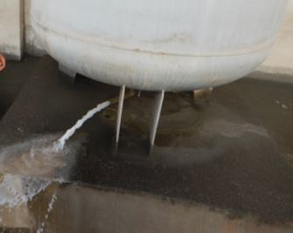
BEKOMAT® | General Info – The Compressed Air Chain
Too Much Condensate + Improper Drainage =
Notes:
Condensate management starts with properly sized drains. If we make the mistake to not take care of the drains in our system we will pay a large price in the long run. An exploding receiver tank can cause large property damage and in the worst case VERY unsafe working conditions. By just installing and maintaining our drains we can save thousands in the long run.

Slide 49
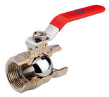
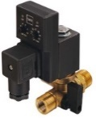
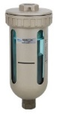
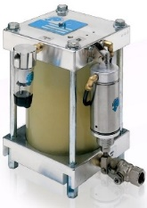
BEKOMAT® | General Info – Condensate Drain Types
Low Cost
Manual
No Alarm
Medium Cost
Timer Controlled
No Alarm
Low Cost
Level Control
No Alarm
Low Cost
Level Controlled
No Alarm
Higher Cost
Level Control
No Alarm
The Reliable Solution

Slide 50
BEKOMAT® | Why BEKO Technologies?
Why is Power Important?
Indicates when service is due
Indicates all alarm types
Ability to unclog and unjam
Dry contact for further feedback

Slide 51
METPOINT® | General Info – Everyday Instrumentation

Slide 52
METPOINT® | Application
Would you ever drive a car without any gauges?

Slide 53
METPOINT® | Application
When is the last time you actually checked your tire pressure?
Constant monitoring or periodic check . . . Which do you prefer?

Slide 54
METPOINT® | Application
“When do you find out you drain failure?”
“When there is water in the pipes…”
…and at that point it’s too late.”
Notes:
Using a Dew Point Sensor can give you more insight into the current state of your system

Slide 55
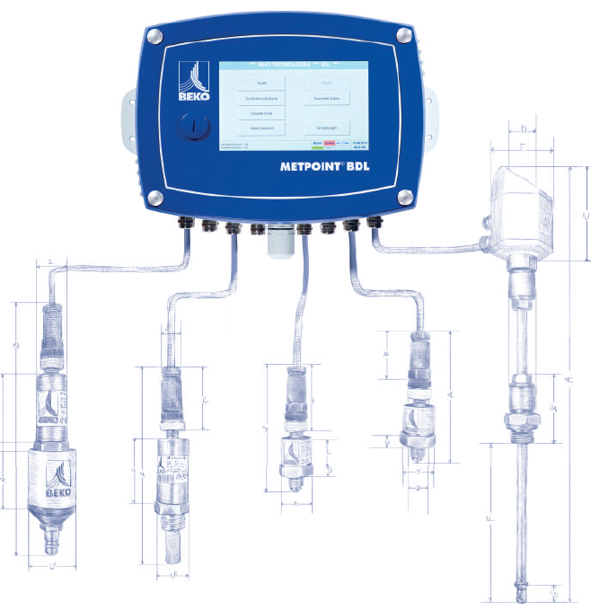
METPOINT® | Application

Slide 56
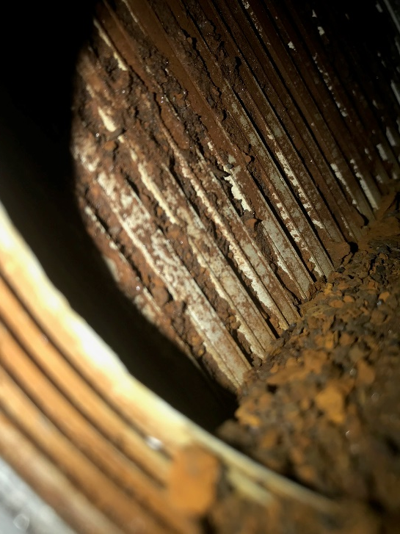
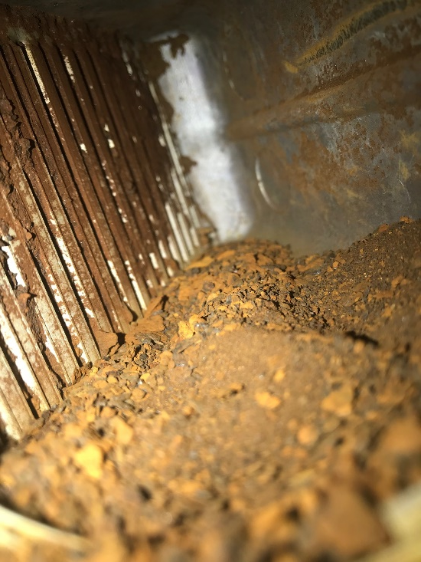
Safety and Quality in Compressed Air
Moisture In Your Air …
Notes:
Inlet side of an Evaporator with no prefiltration and black pipe installed in the system. Proper condensate management equipment like the BEKOMAT or CLEARPOINT water separator and filters will help you prevent rusty pipes and receiver tanks. Choosing the right material for the piping system before the dryer is vital to you system. Going with Aluminum, copper or galvanized in front of the dryer is always a good choice. It is also important to not mix materials like copper and steel because it will come to corrosion. This is called Galvanic corrosion and is an electrochemical process in which one metal corrodes preferentially when it is in electrical contact with another, in the presence of an electrolyte (Water).

Slide 57
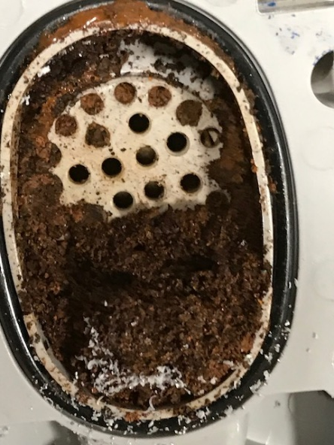
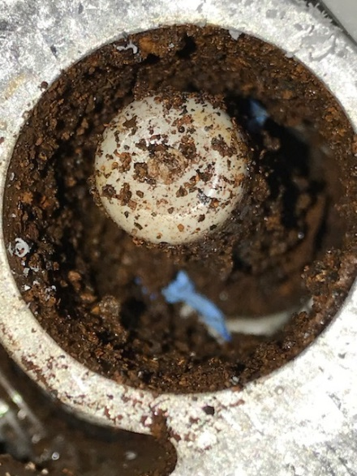
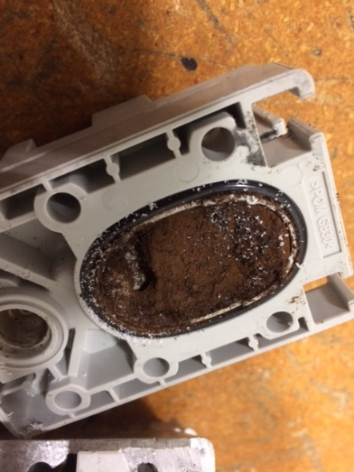
Safety and Quality in Compressed Air
Moisture in your air
Notes:
BEKOMAT at a Wet receiver Tank. Rust from the inside of the tank can accumulate which at this stage it not necessarily a bad thing! You want the BEKOMAT to catch all this junk so it does not go further into your compressed air line.

Slide 58
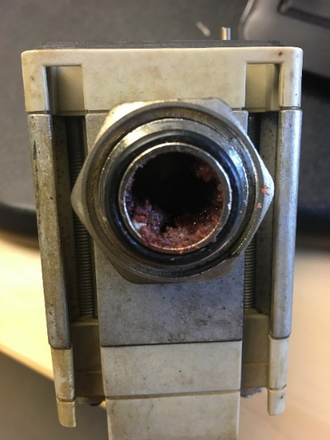
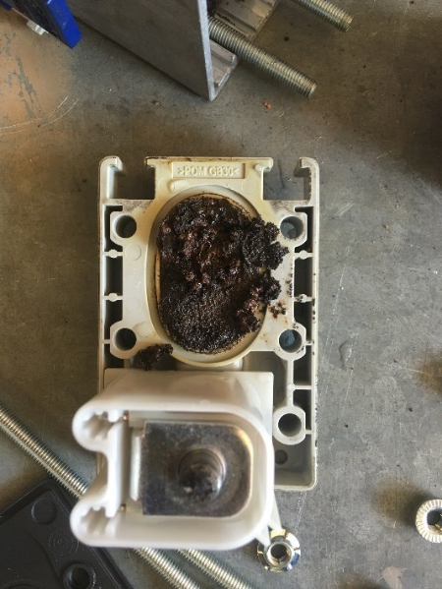
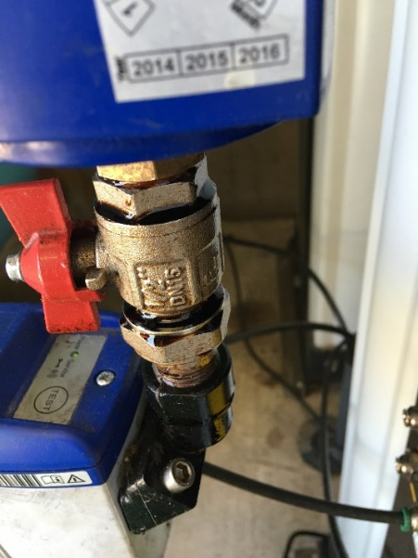
Safety and Quality in Compressed Air
Moisture in your air

Slide 59
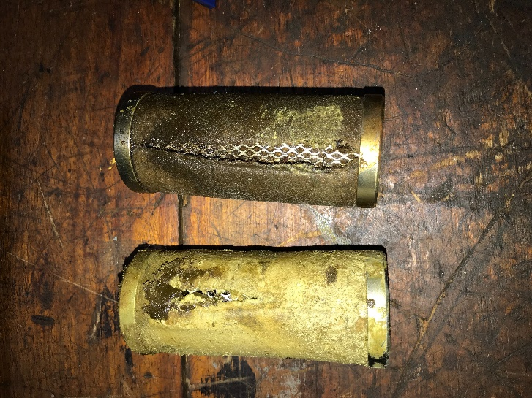
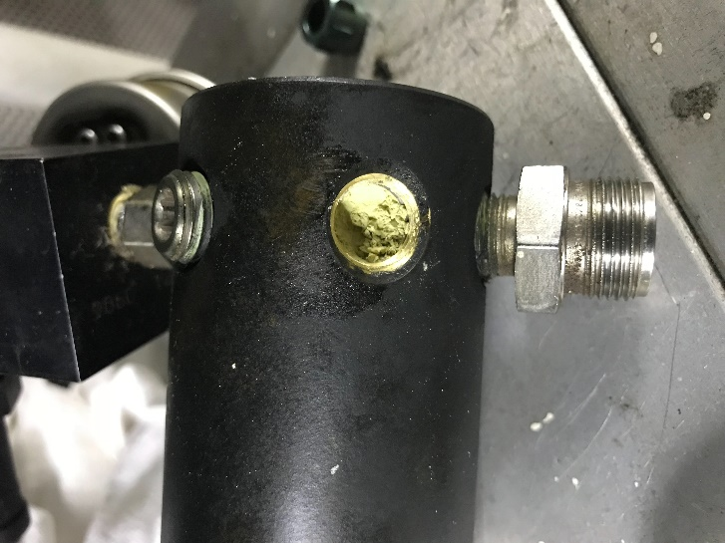
Safety and Quality in Compressed Air
Moisture in your air
Notes:
Here we see an pre and after filter of a desiccant dryer, after years without maintenance. This is a very good example of a lack of maintenance. The lack of maintenance destroyed also the pressure reduction valve who is in charge of the control air on this dryer.

Slide 60
Questions?
Thank you for your time and attention!
Felipe Gonzalez
Role in organization: Product Manager
Email: felipe.Gonzalez@bekousa.com

Slide 61
Calculating Storage Volume for Compressed Air Systems
Q&A
Please submit any questions through the Question Window on your GoToWebinar interface, directing them to Compressed Air Best Practices Magazine. Our panelists will do their best to address your questions and will follow up with you on anything that goes unanswered during this session.
Thank you for attending!
Sponsored by

Slide 62
Best Practices EXPO Contest
Play for a chance to win a FREE Full Conference Pass to the 2019 Best Practices EXPO & Conference!! This is a $675 value! This contest is open to factory personnel, compressed air distributors, utility incentive programs and engineering firms. Exhibiting and sponsor companies are not qualified. A winner will be randomly selected from those who submitted at least 1 correct answer and notified tomorrow via email and phone.
The next slide will show a statement related to today’s topic that needs to be filled in. You will be provided the first letter of the words as a clue. Please submit your answers in your questions box.
Example
When I think of a beach vacation, I think of _______.
T____
T___ B___
S___ S_____

Slide 63
Best Practices EXPO Contest
Play for a chance to win a FREE Full Conference Pass to the 2019 Best Practices EXPO & Conference!! This is a $675 value! This contest is open to factory personnel, compressed air distributors, utility incentive programs and engineering firms. Exhibiting and sponsor companies are not qualified. A winner will be randomly selected from those who submitted at least 1 correct answer and notified tomorrow via email and phone.
The next slide will show a statement related to today’s topic that needs to be filled in. You will be provided the first letter of the words as a clue. Please submit your answers in your questions box.
Example
When I think of a beach vacation, I think of _______.
TOWEL
TIKI BAR
SEA SHELLS

Slide 64
Best Practices EXPO Contest
Play for a chance to win a FREE Full Conference Pass to the 2019 Best Practices EXPO & Conference!! This is a $675 value! This contest is open to factory personnel, compressed air distributors, utility incentive programs and engineering firms. Exhibiting and OEM companies are not qualified. A winner will be randomly selected from those who submitted at least 1 correct answer and notified tomorrow via email and phone.
Based on the clues below, please submit your answers in your questions box.
What variables are needed to calculate receiver volume? _______.
T--- D------- of required air flow rate
Required A-- F--- R---
A---------- P-------
P------- C----- in Air Receiver

Slide 65
Best Practices EXPO Contest
Play for a chance to win a FREE Full Conference Pass to the 2019 Best Practices EXPO & Conference!! This is a $675 value! This contest is open to factory personnel, compressed air distributors, utility incentive programs and engineering firms. Exhibiting and OEM companies are not qualified. A winner will be randomly selected from those who submitted at least 1 correct answer and notified tomorrow via email and phone.
Based on the clues below, please submit your answers in your questions box.
What variables are needed to calculate receiver volume? _______.
Time Duration of required air flow rate
Required Air Flow Rate
Atmospheric Pressure
Pressure Change in Air Receiver

Slide 66
Thank you to all who participated! The winner will be notified tomorrow via email and phone.
Best Practices EXPO & Conference
Special Offer for Webinar Attendees
Save $100 off a Full Conference
Use Code: WEBINAR
Register Now
www.cabpexpo.com
October 13-16, 2019
Nashville Music City Center

Slide 67
Thank you for attending!
The recording and slides of this webinar will be made available to attendees via email later today.
PDH Certificates will be e-mailed to Attendees within two days.
Sponsored by

Slide 68
December 2019 Webinar Air Compressor Lubrication & Maintenance
Sponsored by
Loran Circle
Circle Training & Consulting
Keynote Speaker
Thursday, December 12, 2019 – 2:00 PM EST
Register for free at
www.airbestpractices.com/magazine/webinars

