Slide 1
Compressed Air Condensate Drain Selection and Oil/Water Separation
Loran Circle, Circle Training & Consulting
Keynote Speaker
The recording and slides of this webinar will be made available to attendees via email later today.
PDH Certificates will be e-mailed to attendees within two days.
Sponsored by

Slide 2
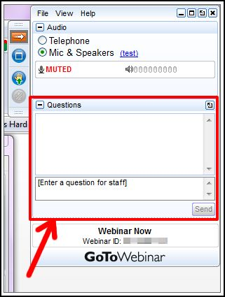
Q&A Format
Panelists will answer your questions during the Q&A session at the end of the Webinar.
Please post your questions in the Questions Window in your GoToWebinar interface.
Direct all questions to Compressed Air Best Practices® Magazine
Sponsored by

Slide 3
Handouts

Slide 4
Disclaimer
All rights are reserved. The contents of this publication may not be reproduced in whole or in part without consent of Smith Onandia Communications LLC. Smith Onandia Communications LLC does not assume and hereby disclaims any liability to any person for any loss or damage caused by errors or omissions in the material contained herein, regardless of whether such errors result from negligence, accident, or any other cause whatsoever.
All materials presented are educational. Each system is unique and must be evaluated on its own merits.

Slide 5
Compressed Air Condensate Drain Selection and Oil/Water Separation
Introduction by Rod Smith, Publisher
Compressed Air Best Practices® Magazine
Sponsored by

Slide 6
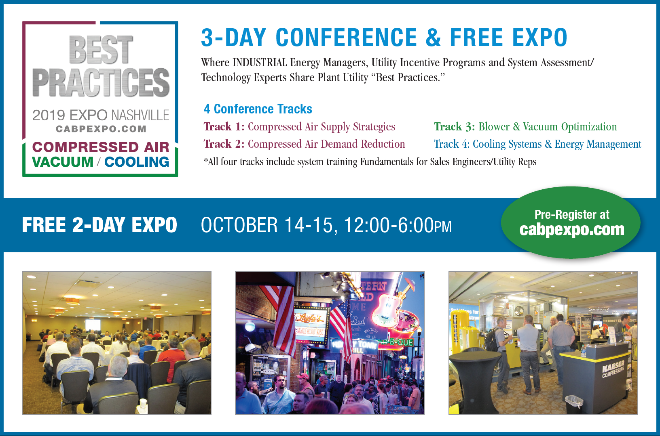
2019 Best Practices EXPO & Conference

Slide 7
2018 Best Practices EXPO & Conference

Slide 8
About the Speaker
Senior Consultant, Circle Training & Consulting
Over 45 years of experience in the compressed air industry
Certified AirMaster Plus by Department of Energy
Loran Circle
Circle Training & Consulting
Sponsored by

Slide 9
COMPRESSED AIR CONDENSATE MANAGEMENT
Loran Circle
Thursday November 15, 2018

Slide 10
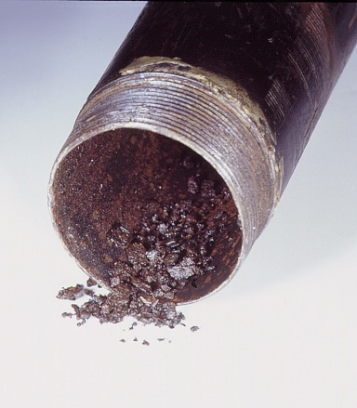
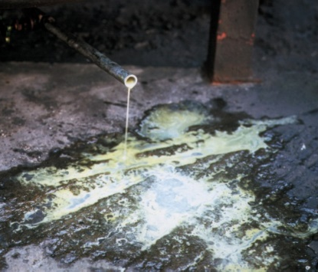
Condensate Disposal
There are basically three types of disposal
To a municipal sewage treatment plant which will be governed by your local water district.
To storm drain, tributaries, or wetlands which in most cases will require a state or federal permit. If you currently have effluent water discharge from your plant, the condensate disposal would generally come under that permit.
To ground, which is not allowed in most all cases. It eventually could be washed off to storm or into the wetlands causing groundwater contamination

Slide 11
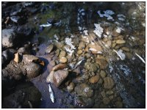
Discussion Points
How does condensate happen and why is there oil entrained in the condensate?
For this discussion we will mainly be referring to oil carryover in condensate used in oil flooded rotary screws, rotary vane and reciprocating air compressors
In Centrifugals and Oil Free Screw air compressors there is no oil used in the compression chambers, thus usually do not need oil/water separation systems.
Condensate contaminates the compressed air system causing corrosion, equipment failure and product spoilage - It must be removed using filtration and drying methods
Removal from the compressed air system creates new problems
Oily condensate discharged into the environment kills plants, fish & animals.

Slide 12
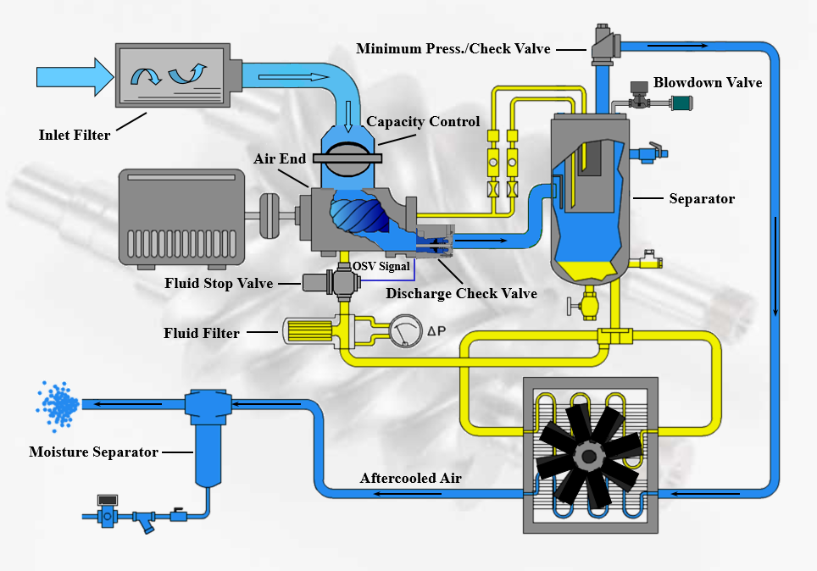
Condensate and Oil
Air is taken into the inlet of the air compressor containing moisture in vapor form (humidity)
When introduced into the compression chamber on rotary screws, the vapor mixes with the oil
On reciprocating compressor the oil makes contact with the air by seepage past the rings on the piston. The longer between ring changes, the higher the oil content
After compression takes place, the air/lubricant on rotary screws is separated by a separator. The oil is recirculated, and the air is sent to an aftercooler to drop the temperature causing condensation
The condensate is then trapped out of the system and discharged to an Oil/Water Separator before being sent for disposal.

Slide 13
Drains and Traps
Plugged traps and malfunctioning drains are the single largest cause of water in the compressed air system!

Slide 14
Typical Compressed Air System With Refrigerated Dryer
Used with permission from the Compressed Air Challenge

Slide 15
Calculation Chart for Determining Amount of Condensate in Air

Slide 16
Functions of a Lubricant
Control temperature in the air compressor
Form a seal to decrease slippage between the screws
Control friction between the screws or the piston and cylinders
Control wear of both type air compressors
Control corrosion
Remove contaminants
Lubricate bearings

Slide 17
Sample MSDS for Polyalphaolefins

Slide 18
Lubricant Types Affect Type of Oil/Water Separators Used
Let’s break down the different types of lubricants that effect the type of oil/water separator needed for your application. On the MSDS sheet the manufacturer will list the specific gravity of the lubricant.
This is important in choosing the right oil/water separator for your application.
It is important to know the Specific Gravity of your lubricant found on the MSDS sheet
Water is the base specific gravity and is 1.0
Diesters (Reciprocating air compressor oils) = .93
Petroleum Based .87
Polyalphaolefins .83-.90
Polyolester lubricants .97-1.0
Polypropylene Glycols sp. 0.9827
Silicone based lubricants 0.97
The lower the specific gravity, the easier it is to use flotation type Oil/Water Separators

Slide 19
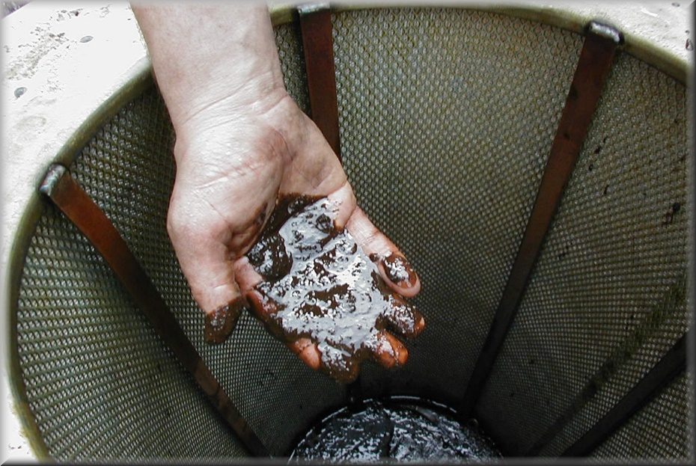
How Poor Maintenance Affects Lubricant Levels in Condensation
Quality of maintenance of the equipment. Without proper maintenance, the oil carryover into the condensate can increase many times over.
Make sure your oil/water separator is changed at proper intervals to avoid saturation. This will add to the levels of contaminants in your condensate.
Check the oil return line screen or filter. This picks up oil passed through the separator and returns it to the inlet of the air compressor. A plugged oil return line will add to the carryover levels. Also placement of oil return line inside of the separator is important. If the pick up line is too low or too high, it may not be effective in removing excess oil.
Aftermarket parts can effect the carryover of oil. Manufacturers design their oil separation system around their parts. Using other parts not specifically designed for your air compressor, could cause oil carryover to increase.

Slide 20
How Air Compressor Controls Affects Lubricant Levels in Condensation
Load/No load controls could effect the oil carryover if a receiver tank is not sized properly causing the air compressor to short cycle rapidly.
If modulation controls are not set properly, the air compressor can short cycle increasing oil carryover
Variable speed drive air compressors can increase oil carryover in cases where the air compressor is operating on a minimum speed level
All of these factors need to be considered when sizing an oil/water separator

Slide 21
What You Need to Determine
Is your facility covered under a state program or national program?
Are you discharging condensate to Sewer, Stormwater or Tributary?
What is the type of lubricant you are using?
What are the levels of contaminant in the condensate?
What are your local water treatment regulations?
What options are available for condensate cleanup prior to discharge?

Slide 22
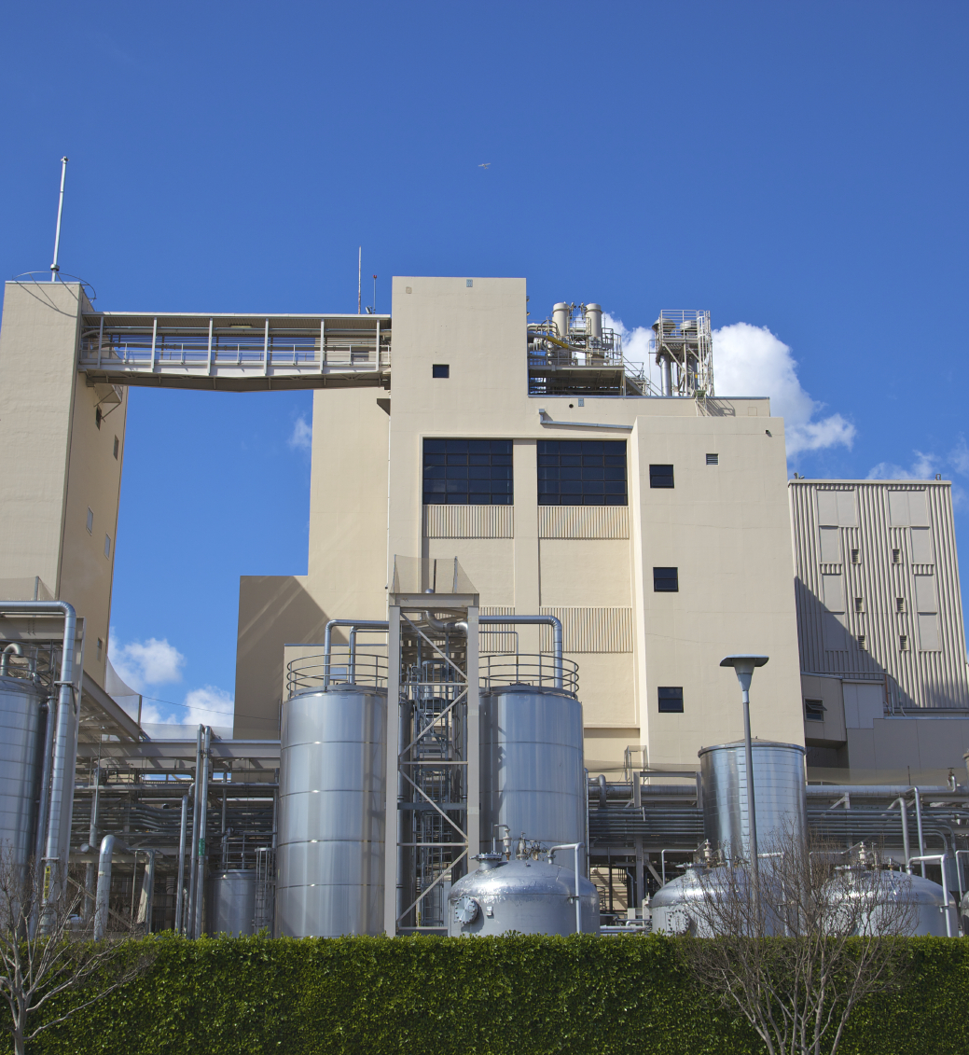
So What To Do?
First is to determine your site conditions
Is your plant on a municipal system?
Does your plant have its own water treatment system?
Which regulatory department does your plant’s location fall under?
Find out what levels of contamination are allowed for your location
Have your raw condensate tested by a laboratory or oil/water separator manufacturer’s test kit.
Many of your oil/water separator suppliers provide this service

Slide 23
Before Starting Your Search for the Right Oil/Water Separators
Get the manufacturers MSDS sheet for the lubricant
What is the type of lubricant?
Is my lubricant biodegradable?
(*Caution: Biodegradable lubricants can still be toxic and difficult to treat by waste water facilities. Check with local authorities when disposing of these fluids.)
What is the approximate oil carryover of the air compressor?
Where is the final destination of the condensate?
What are the local regulations regarding levels of contaminants within the condensate?
How much condensate is being disposed of?

Slide 24
Types of Oil/Water Separators
Skimmer types
Absorption types
Filtration types
Flotation types

Slide 25
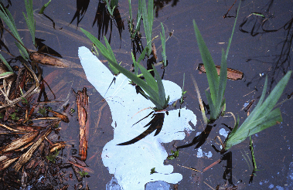
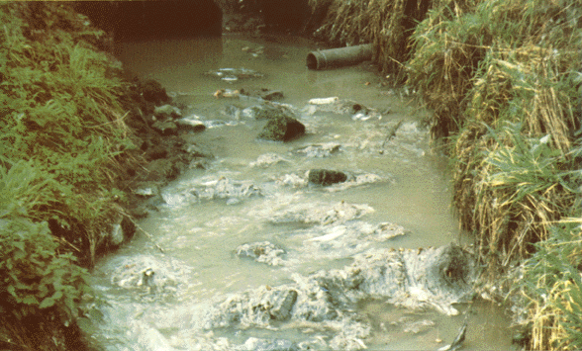
Things to Know About Condensate
Regulations affecting condensate levels are different depending on your plant location.
Some the regulations come under the states jurisdiction
Others come under the federal jurisdiction
Once you determine what jurisdiction your location is under, check what your local municipality requires to dispose of condensate into their sewage system
If you are not under a municipality, then you are probably subject to regulations of discharge into wetlands and tributaries and most states require a study and application for a permit

Slide 26
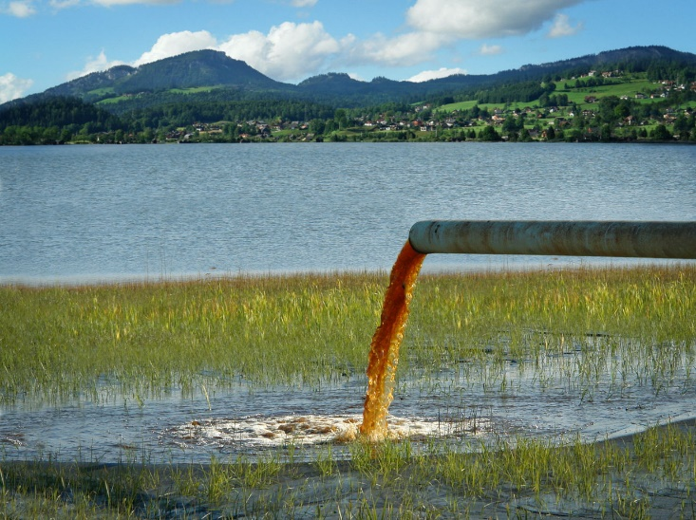
In Closing
Do not send condensate directly to ground at any time even with an oil/water separator
Find which agency your are governed by
Determine the amount of carryover in ppm and what is allowed in your location
Talk to your local supplier and get your water tested and the MSDS from them
Even though the local supplier could be knowledgeable, your plant is responsible for any contamination
Make sure you check and document your local requirements

Slide 27
Thanks for Attending
Mark Your Calendars
Don’t forget to register or get your booth reserved
for 2019 Best Practices EXPO & Conference
October 13-16, 2019
Nashville Music City Center
www.cabpexpo.com
Loran Circle
Certified AirMaster Plus
Sales, Air System Design, and Maintenance Training
for The Compressed Air Industry
Pearland, Texas
832-906-0469

Slide 28
About the Speaker
Regional Sales Manager, BEKO Technologies
Over 20 years of experience in the compressed air industry
Russ Jones
BEKO Technologies

Slide 29
| General Info – The Compressed Air Chain
COMPRESSION
COOLING
A Chain is Only As Strong As Its Weakest Link
SEPARATION
DRAINING
STORING
Reliability is KEY for the CHAIN
DRAINING
DRYING
DRAINING
FILTERING
DRAINING

Slide 30
| General Info – Drain Types
manual
drain
automatic
drain
level controlled
timer controlled
electronic
mechanical
electronic controlled drain with capacitive sensor
mechanical float drain
timer controlled
solenoid valve

Slide 31
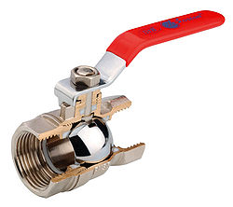
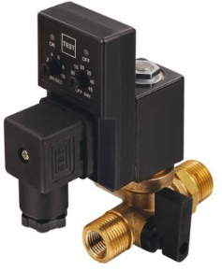
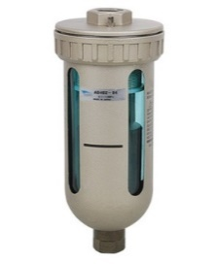
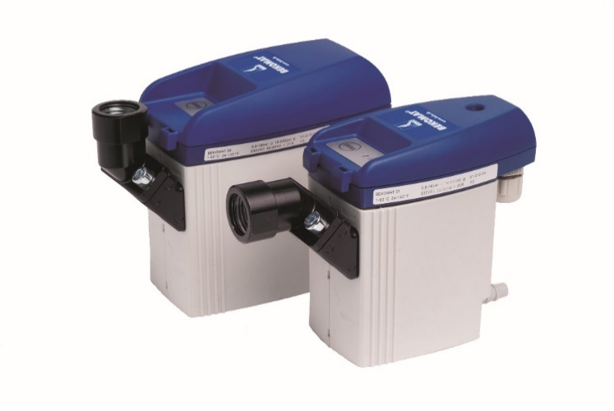
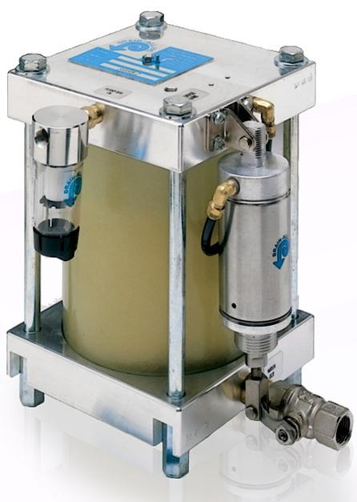
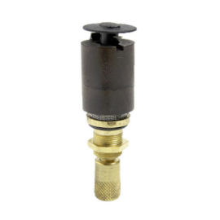
| General Info – Condensate Drain Types

Slide 32
Next up: Electronic Zero Loss Drain Function

Slide 33
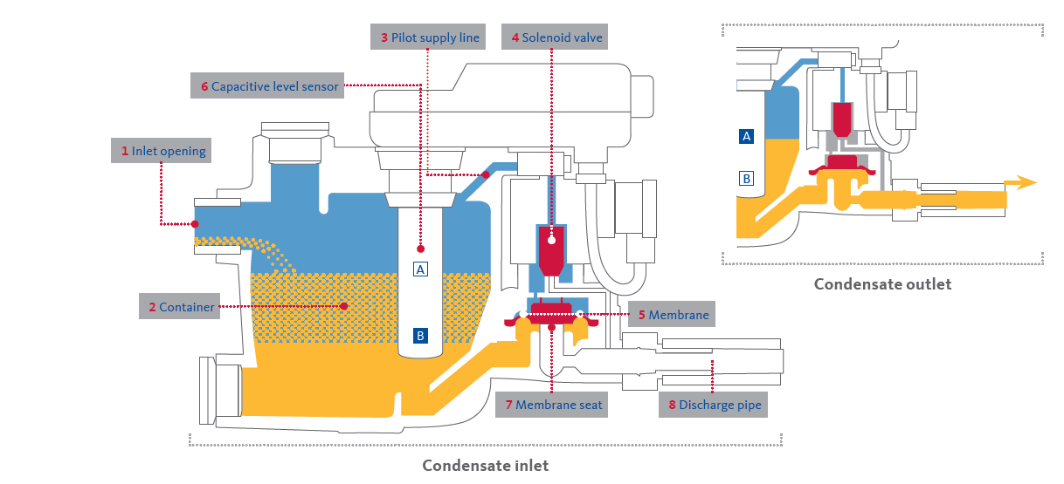
| Electronic Zero Loss Drain Function

Slide 34
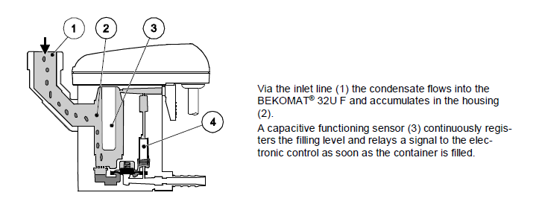
| Electronic Zero Loss Drain Function

Slide 35
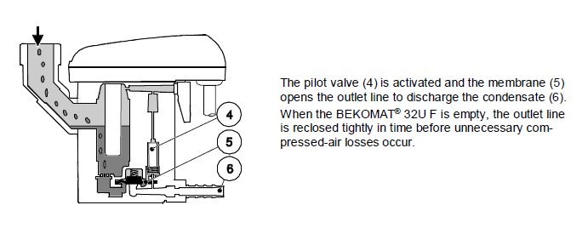
| Electronic Zero Loss Drain Function

Slide 36
Electronic Zero Loss Drains
Why is Power Important?
Indicates when service is due
Indicates all alarm types
Ability to unclog and unjam
Dry contact for further feedback

Slide 37
Electronic Zero Loss Drains | Advantages
No Air Loss
Saves Energy
Return Of Investment <12 months
Noise reduction
No Oil Vapor in the compressor room

Slide 38
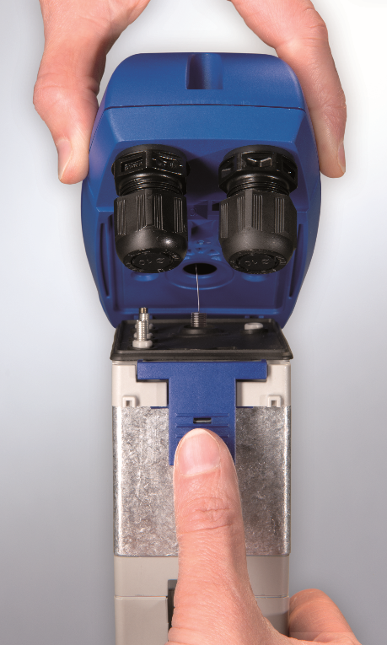
Electronic Zero Loss Drain Maintenance |
Quick Replacement Service Units
Good for 1,000,000 Cycles or 8,000 Hours
Replaces all moving parts and built in strainer
Strainer installed before drain?
No!

Slide 39
Next up: Electronic Zero Loss Drain Application

Slide 40
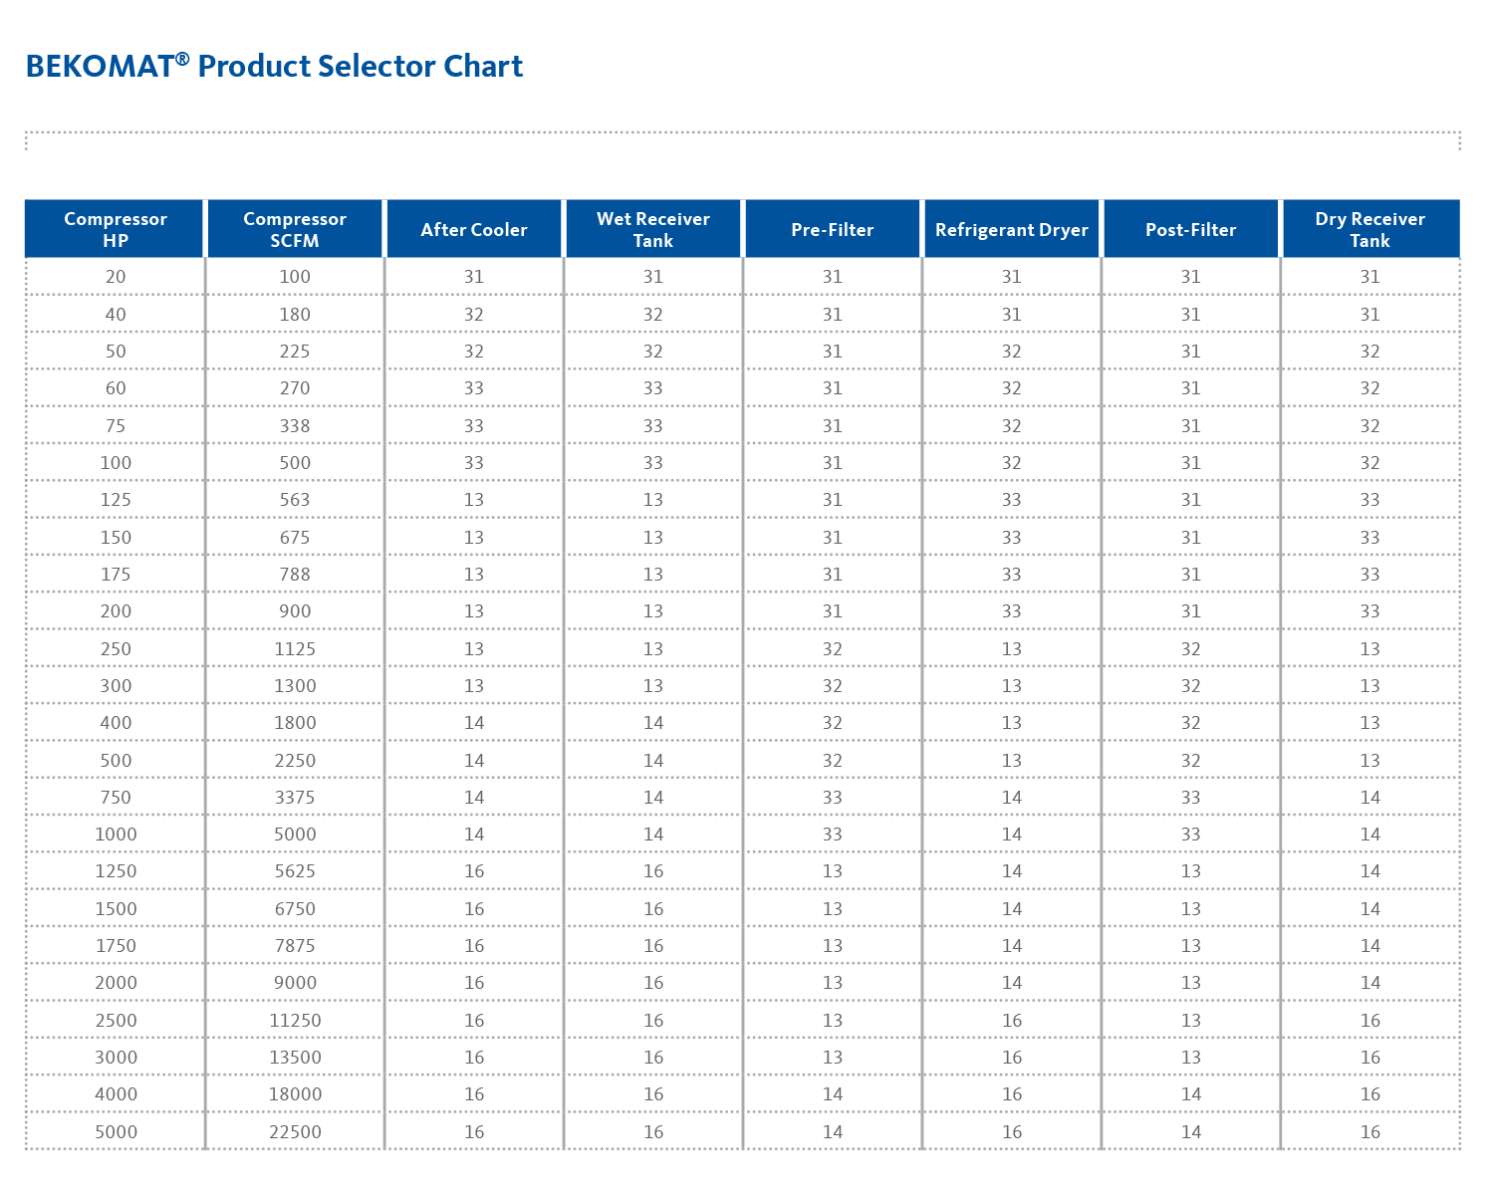
Electronic Zero Loss Drain | Application
Easy to Use Sizing Charts Available
Identify Air Flow to Drain Location
Determine Drain Location in System
Confirm Operating
Parameters of Drain

Slide 41
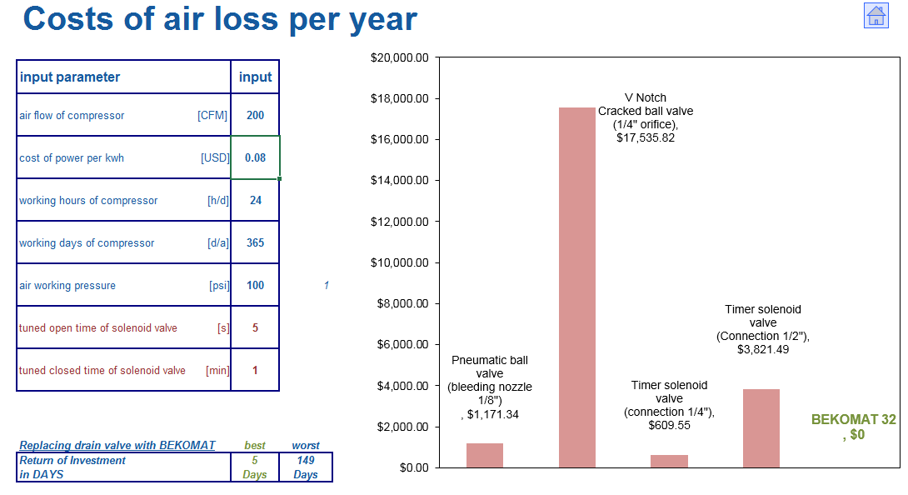
Electronic Zero Loss Drain | Application
ROI Calculator Available

Slide 42
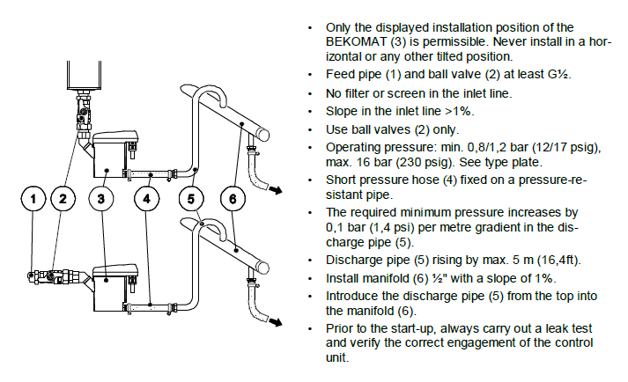
Electronic Zero Loss Drain | Installation

Slide 43
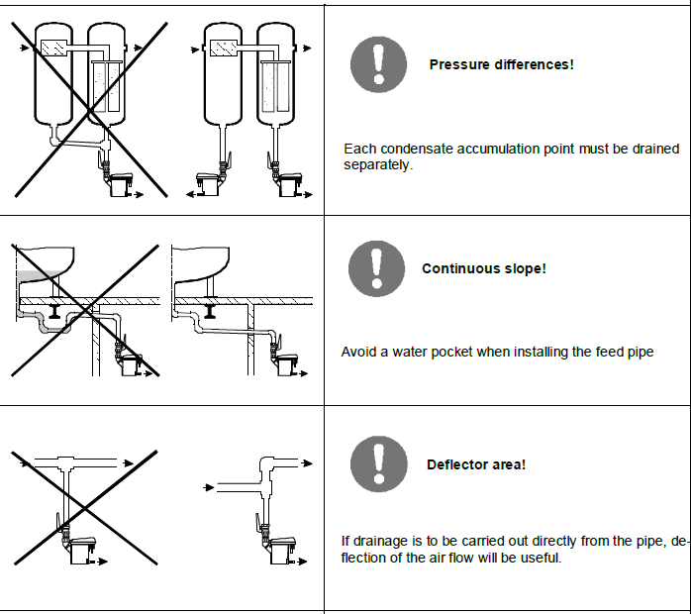
Electronic Zero Loss Drain | Installation

Slide 44
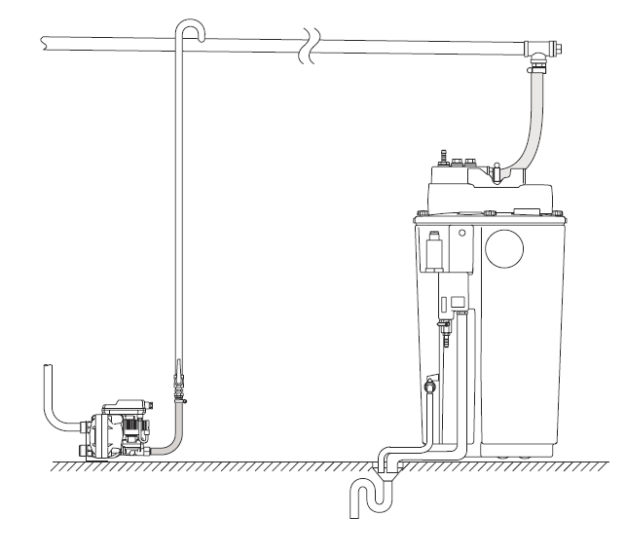
Oil Water Separators
So where does all that efficiently drained condensate go?
And is it just water?

Slide 45
Oil Water Separators| General Info
On average, how much oil does a 100 HP compressor pass each year?
Conservatively about 10 gallons per year!

Slide 46
Oil Water Separators | General Info
Fact: It takes 2.5 drops of oil to contaminate one gallon of water…
Fact: 1 gallon of oil would contaminate about 1 MILLION gallons of water…
A 100 HP Compressor is capable of contaminating 10 MILLION GALLONS OF WATER PER YEAR
Notes:
Contamination level considered 10ppm our higher.

Slide 47
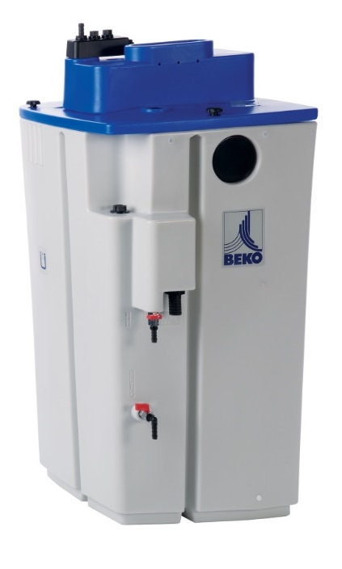
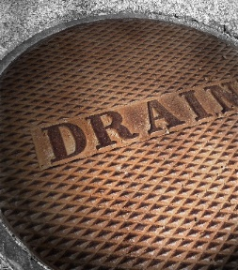
Oil Water Separator | General Info
Where should the condensate and oil go after it is discharged from a drain?
or
or

Slide 48
Oil Water Separator | Function
Depressurization Chamber
Pre-Filter
(Floating)
Main Cartridge
(Polishing)

Slide 49
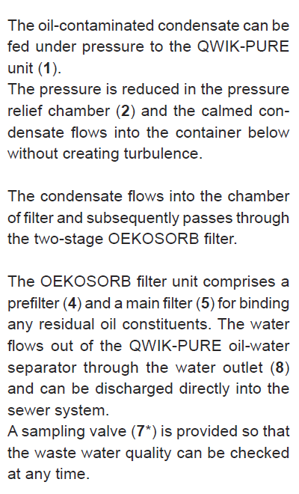
Oil Water Separator | Function

Slide 50
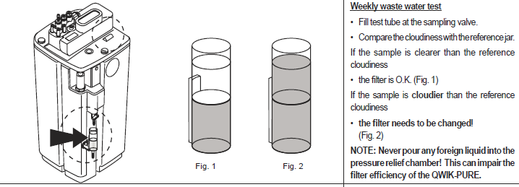
Oil Water Separator | Maintenance

Slide 51
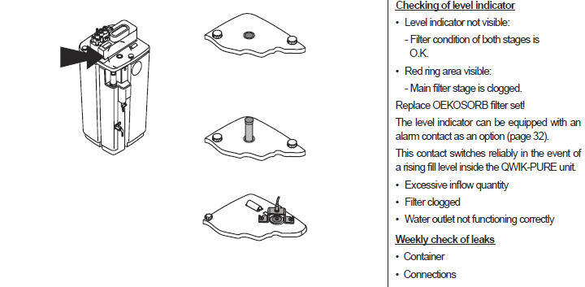
Oil Water Separator | Maintenance

Slide 52
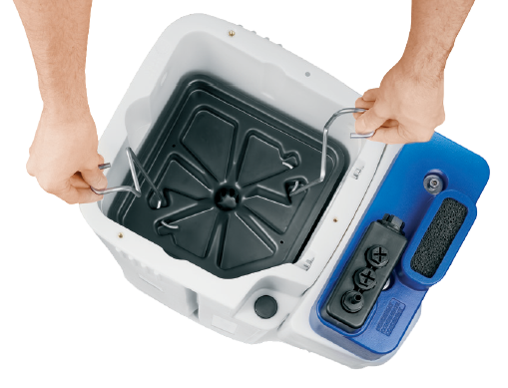
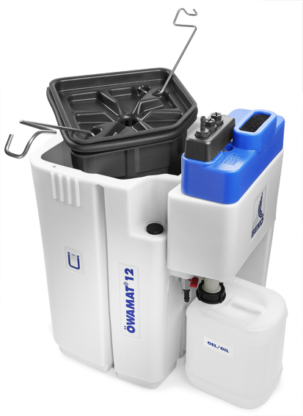
Oil Water Separator | Maintenance
Clean and Easy to Change Cartridges
Landfill Compliant

Slide 53
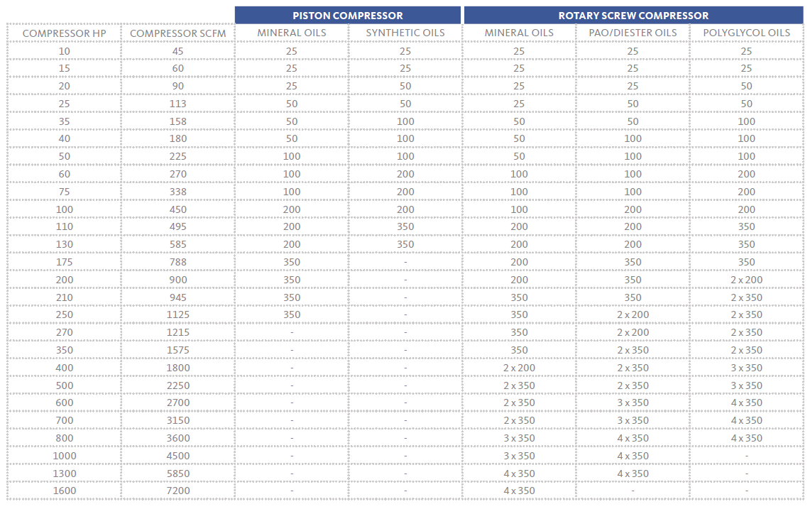
Oil Water Separator | Application and Sizing
Identify type of compressor
Identify type of oil
Match up to HP or SCFM
Apply climate zone correction factor

Slide 54
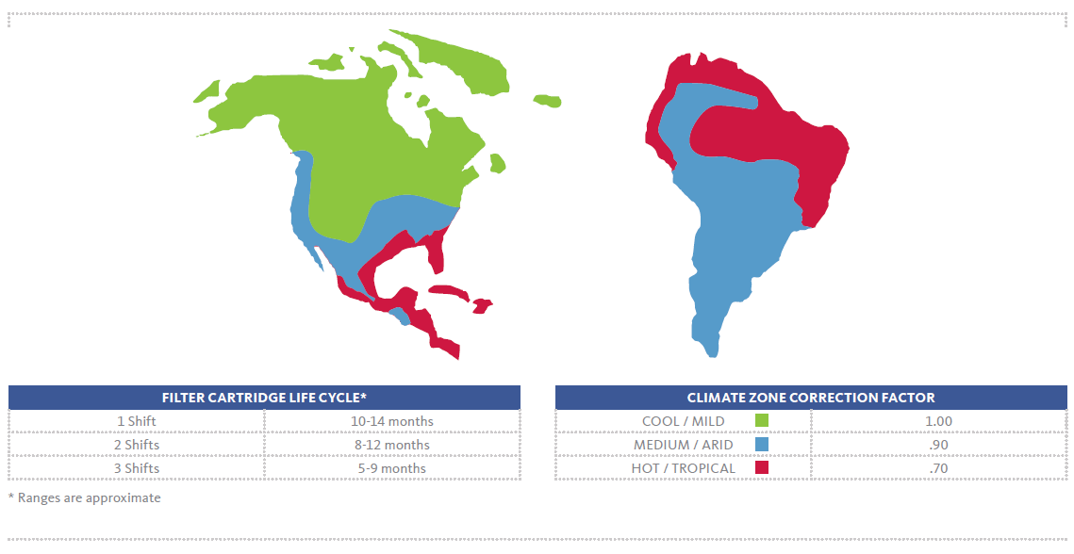
Oil Water Separator | Application and Sizing
Cartridge Life Expectancy and Climate Zone Correction Factors

Slide 55
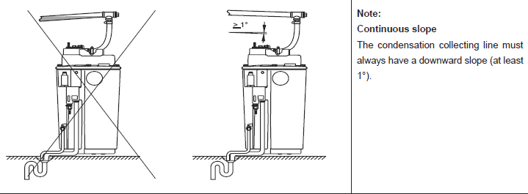
Oil Water Separator | Installation

Slide 56
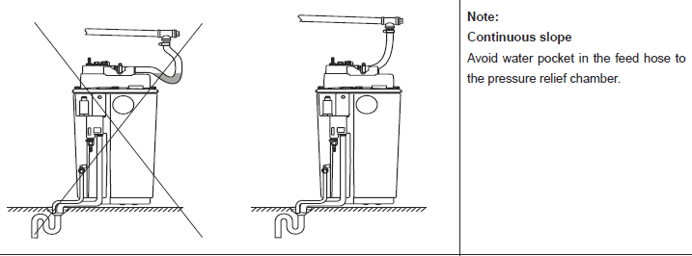
Oil Water Separator | Installation

Slide 57
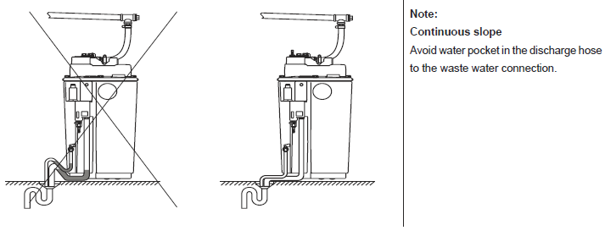
Oil Water Separator | Installation

Slide 58
THANK YOU!

Slide 59
Compressed Air Condensate Drain Selection and Oil/Water Separation
Q&A
Please submit any questions through the Question Window on your GoToWebinar interface, directing them to Compressed Air Best Practices Magazine. Our panelists will do their best to address your questions, and will follow up with you on anything that goes unanswered during this session.
Thank you for attending!
Sponsored by

Slide 60
Thank you for attending!
The recording and slides of this webinar will be made available to attendees via email later today.
PDH Certificates will be e-mailed to Attendees within two days.
Sponsored by

Slide 61
2019 Best Practices EXPO & Conference

Slide 62
2019 Webinar Series
Proper Installation & Sizing of VSD Air Compressors – January 24, 2019
Visualizing KPI’s: Specific Power, Flow, Pressure, Dewpoint – February 28, 2019
Air Quality Specs: ISO 8573.1 & the Safe Quality Foods Standard – April 4, 2019
Selecting & Sizing Heat of Compression Desiccant Dryers – May 16, 2019
Selecting & Sizing Oil-Free Air Compressors – June 6, 2019
Control Strategies for Multiple VSD Air Compressors – July 18, 2019
Piping and Storage for Compressed Air Systems – August 22, 2019
Air Compressor Lubrication & Maintenance – December 12, 2019
Register for free at
www.airbestpractices.com/magazine/webinars

