Slide 1


Compressed Air Leak Management Best Practices
Ron Marshall, Marshall Compressed Air Consulting
Keynote Speaker
The recording and slides of this webinar will be made available to attendees via email within one day.
PDH Certificates will be e-mailed to attendees within two days.
Sponsored by

Slide 2
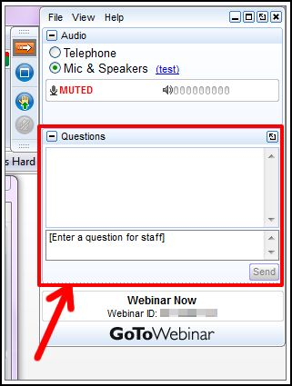
Q&A Format
Panelists will answer your questions during the Q&A session at the end of the Webinar.
Please post your questions in the Questions Window in your GoToWebinar interface.
Direct all questions to Compressed Air Best Practices® Magazine
Sponsored by

Slide 3
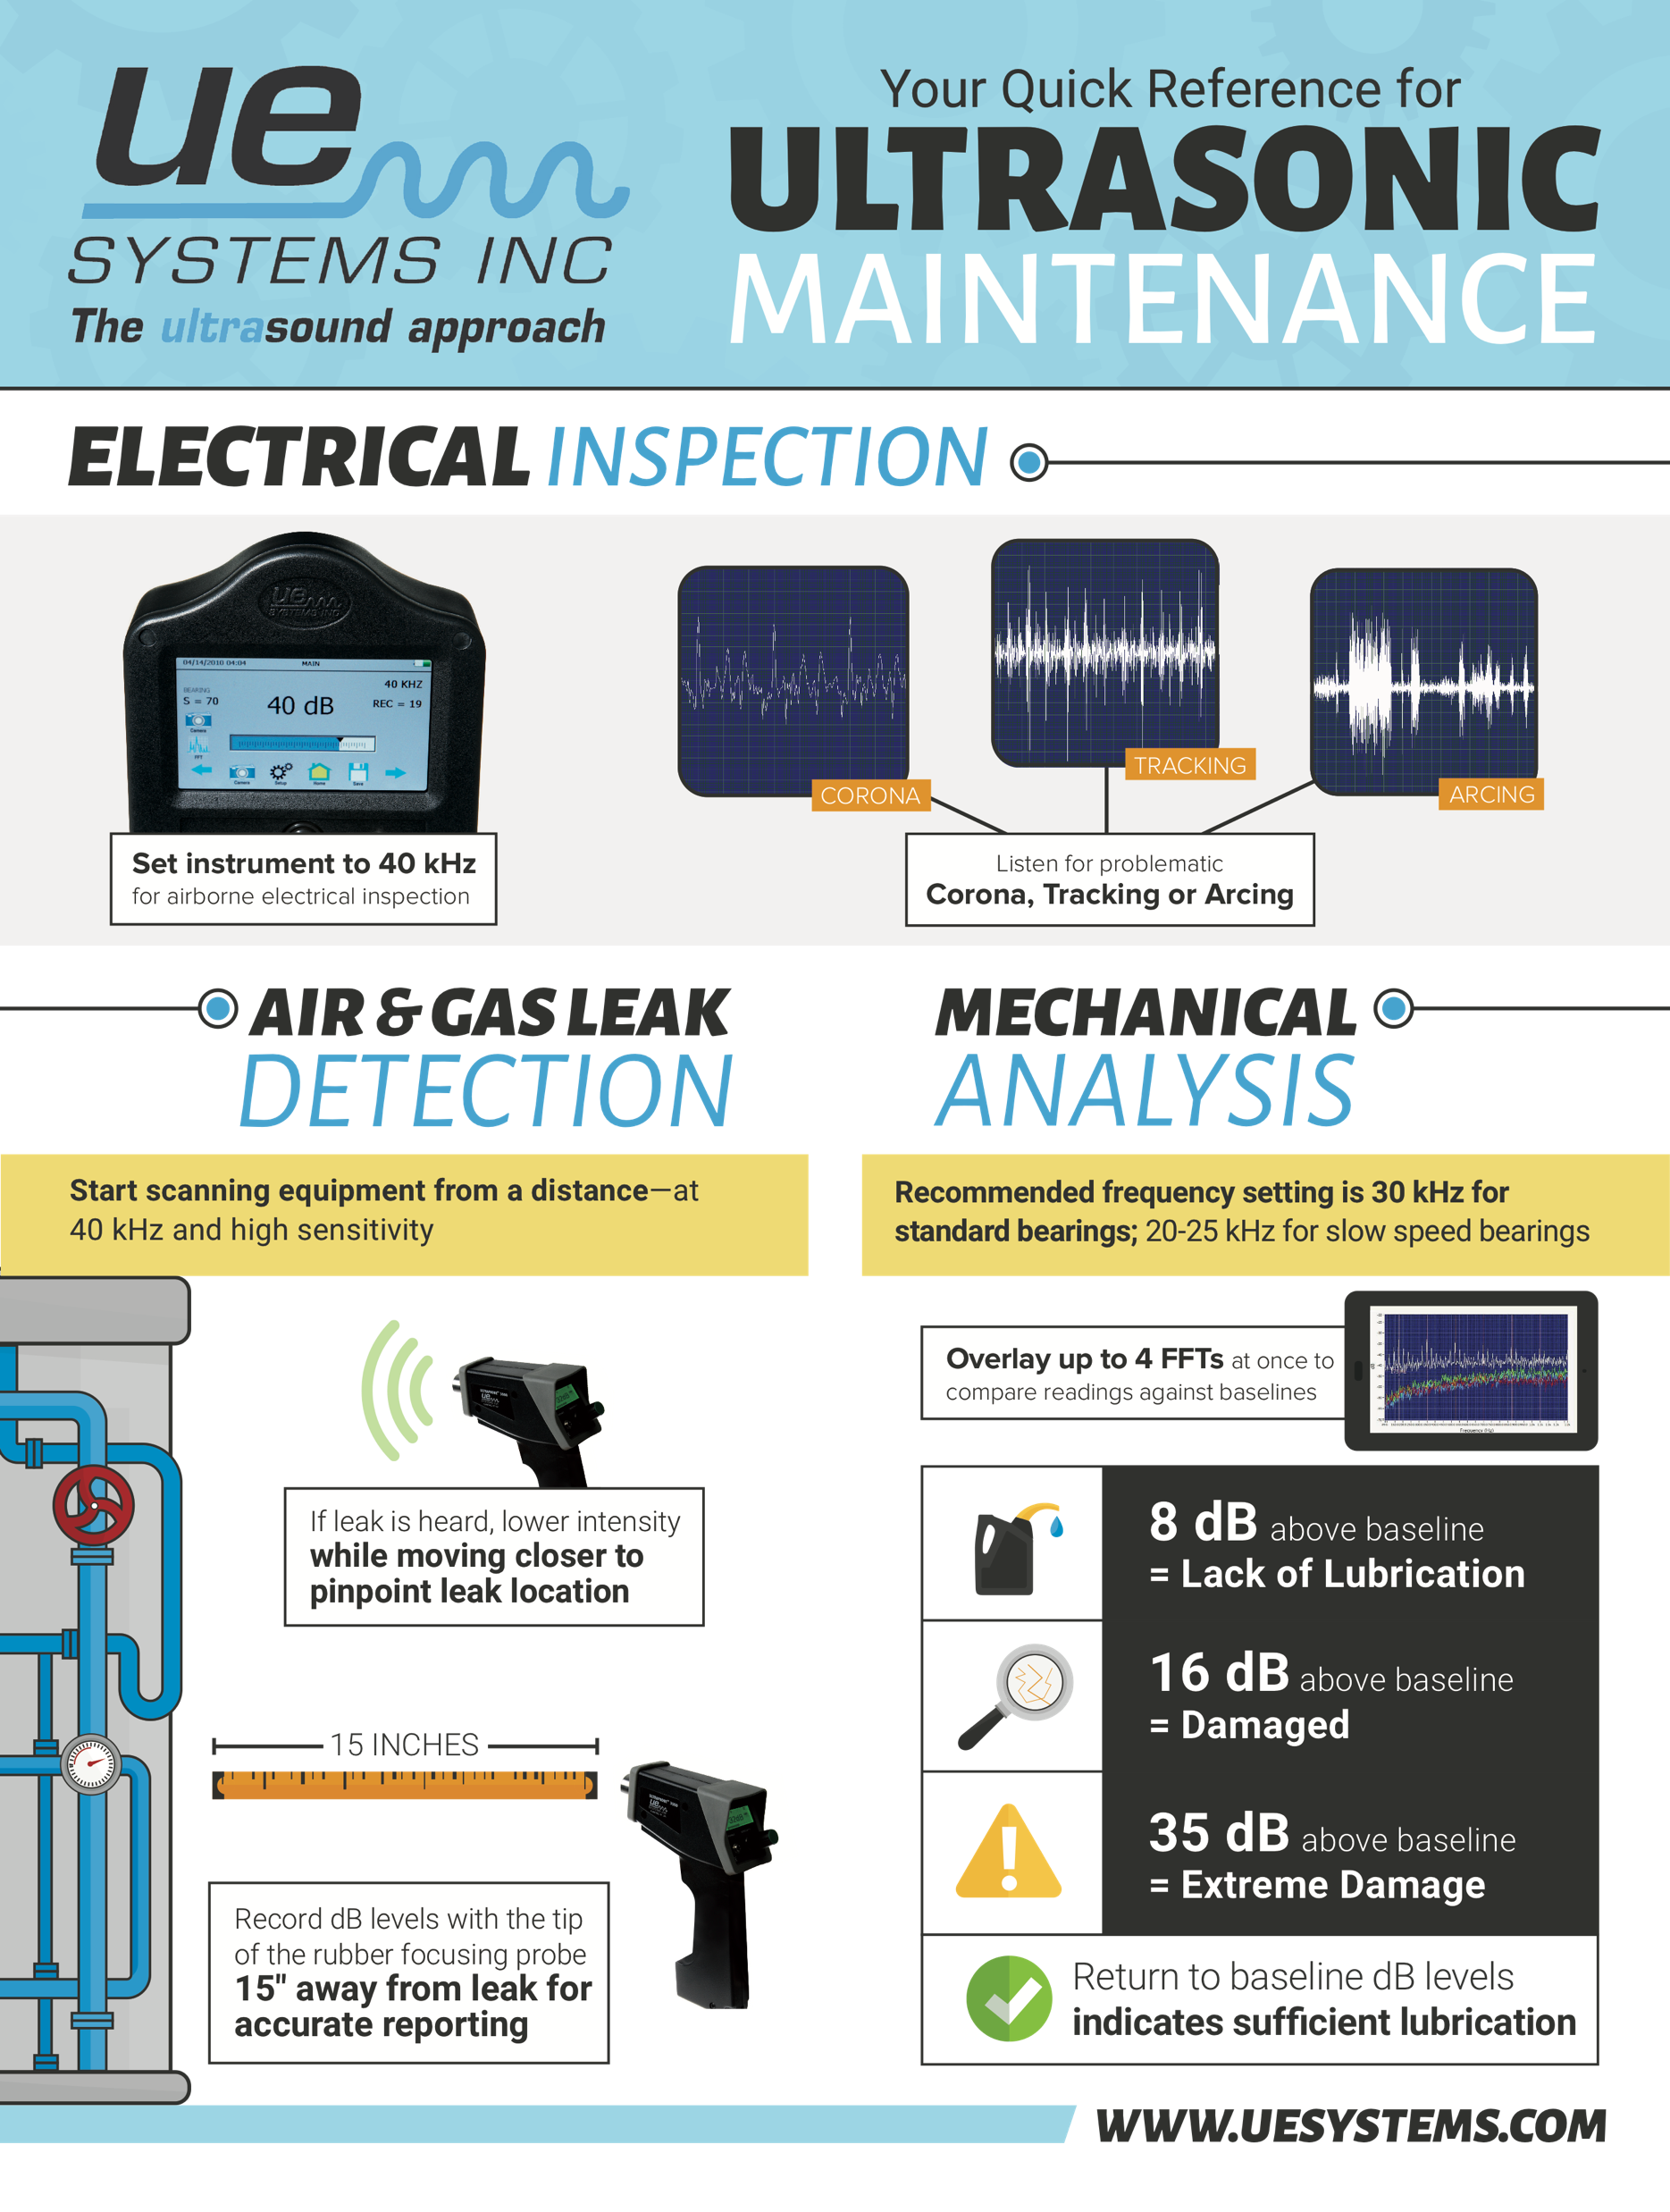
Handouts

Slide 4
Disclaimer
All rights are reserved. The contents of this publication may not be reproduced in whole or in part without consent of Smith Onandia Communications LLC. Smith Onandia Communications LLC does not assume and hereby disclaims any liability to any person for any loss or damage caused by errors or omissions in the material contained herein, regardless of whether such errors result from negligence, accident, or any other cause whatsoever.
All materials presented are educational. Each system is unique and must be evaluated on its own merits.

Slide 5
Compressed Air Leak Management Best Practices
Introduction
Compressed Air Best Practices® Magazine
Sponsored by

Slide 6
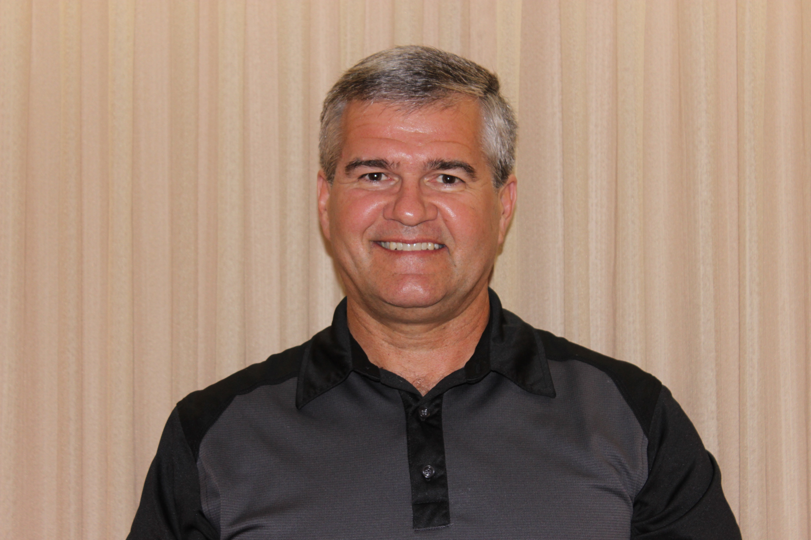



About the Speaker
Chief Auditor, Marshall Compressed Air Consulting
Consultant MCAC
38 Years with Power Utility
24 Years Technical CA Support
CAC Level 2 Instructor
International Trainer UNIDO
Ron Marshall
Marshall Compressed Air Consulting
Sponsored by

Slide 7
Compressed Air Leak Management Best Practices
Source: Compressed Air Challenge

Slide 8

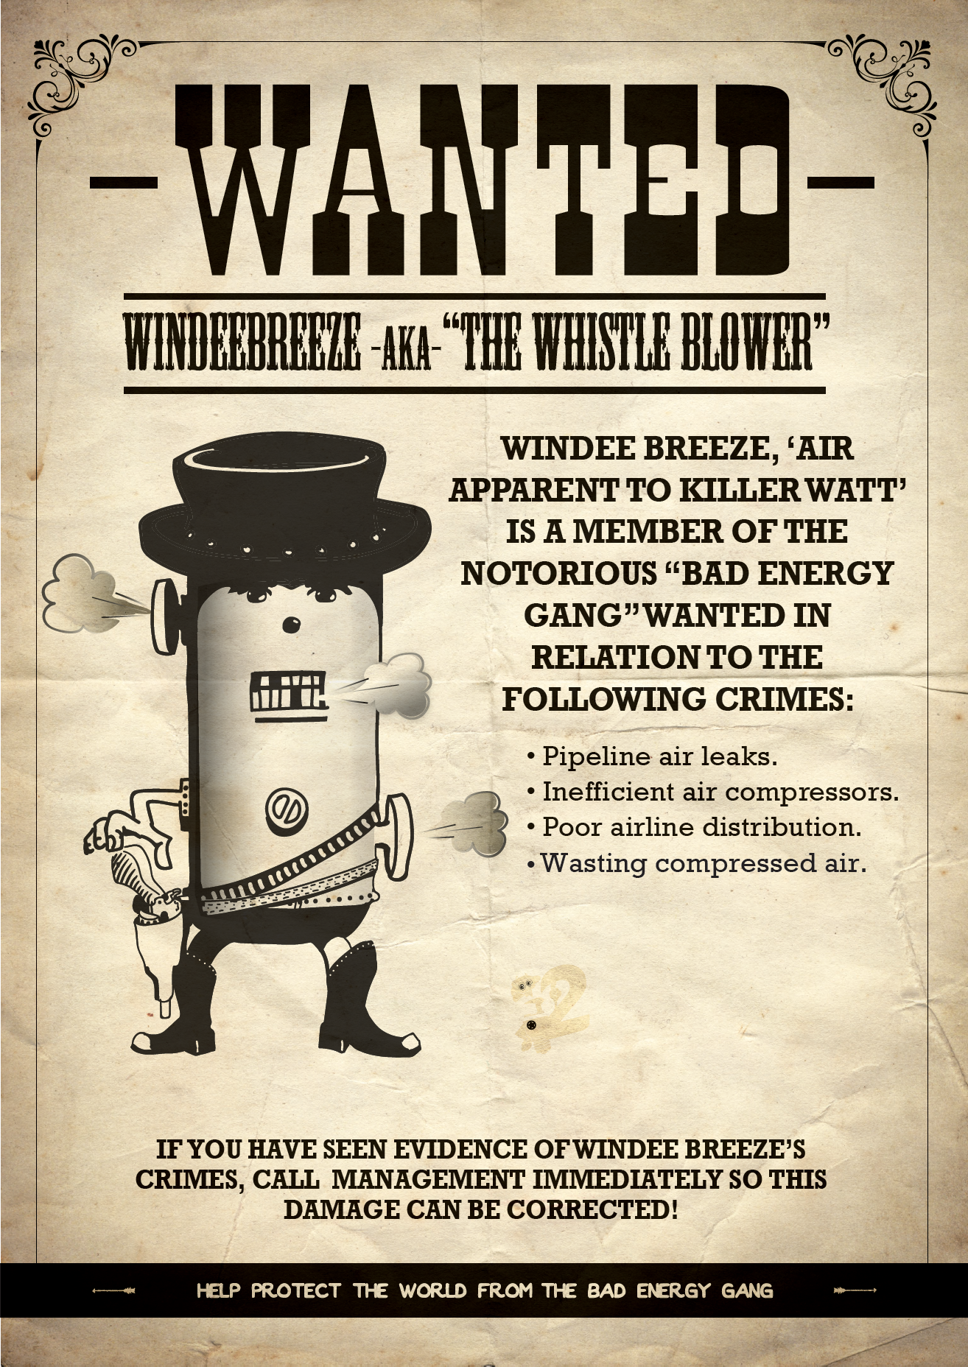
Wanted Energy Wasters

Slide 9
Coming Up
Typical Plant Situation
Cost of Leakage
Common Challenges Preventing Results
Leakage Assessments
  Step 1 - Get a Baseline
  Step 2 - Get the Required Tools for the Job
  Step 3 - Find, Document and Fix
  Step 4 - Verify Results
Examples of Best Practices
  Employee awareness
  Teaming with plant employees
  Management support
  Other actions
Getting Help

Slide 10
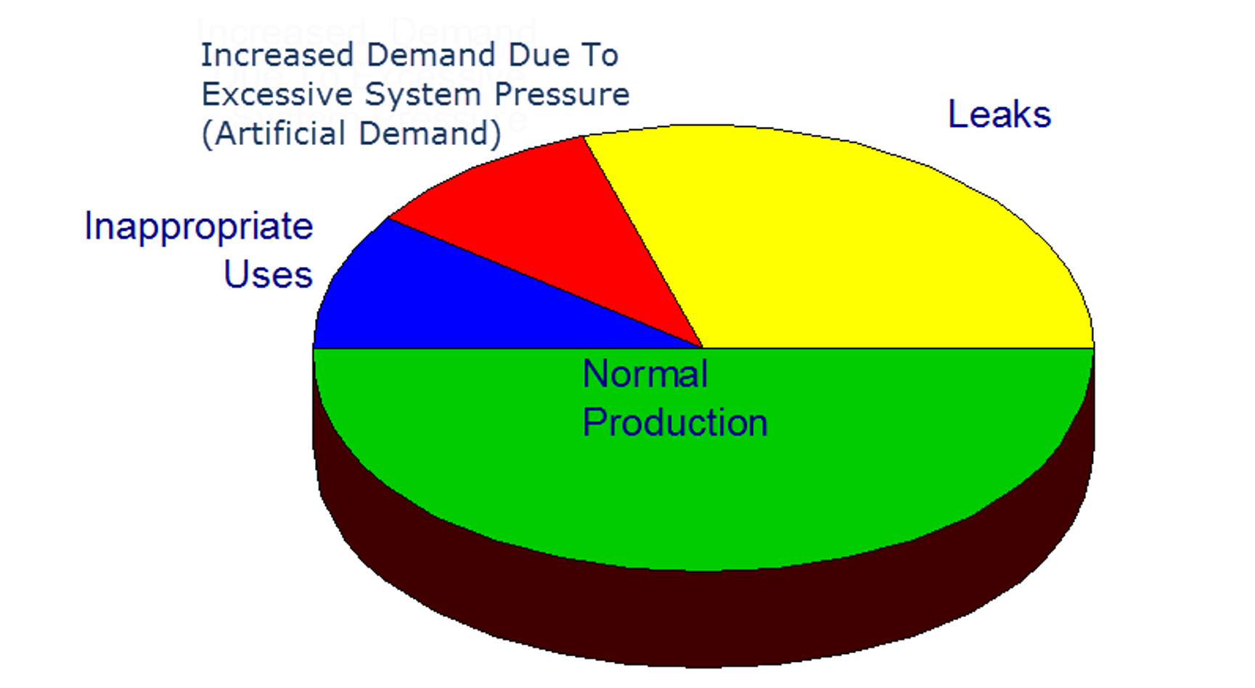
Typical Plant Situation
Leakage Big Portion of Demand
Basic Leakage Repair Program
Only Breakdown Maintenance
Funding Shortages
Lack of Employee Awareness
No Leakage Measurement System
High System Pressure
Poor Compressor Turndown
Average 20 to 30%
Source: Compressed Air Challenge

Slide 11
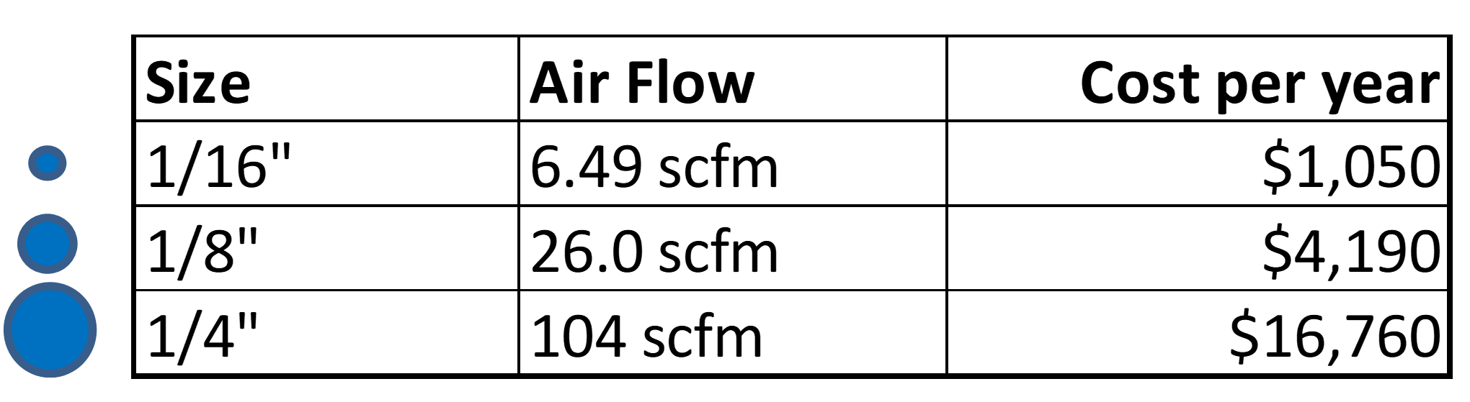
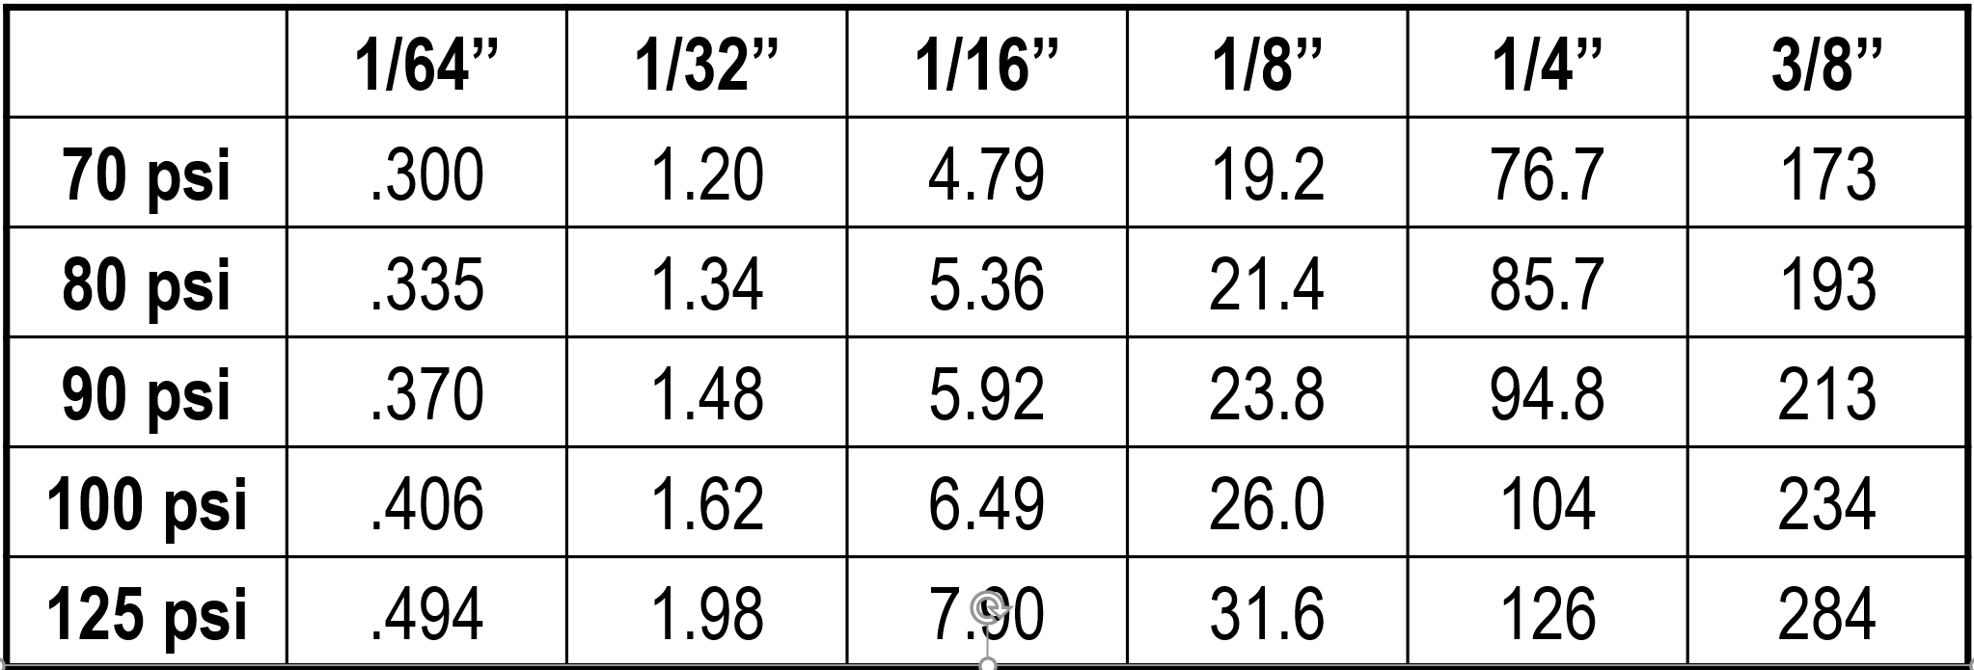
Cost of Leakage
Even small leaks can be costly
Less efficient compressors have higher costs (hint!)
Higher system pressures have higher costs (hint!)
For systems that shut down nights and weekends the leakage costs are lower (hint!)
Cost for Leaks 10 cents per kWh full time
Leak flow changes with pressure
Source: Compressed Air Challenge

Slide 12
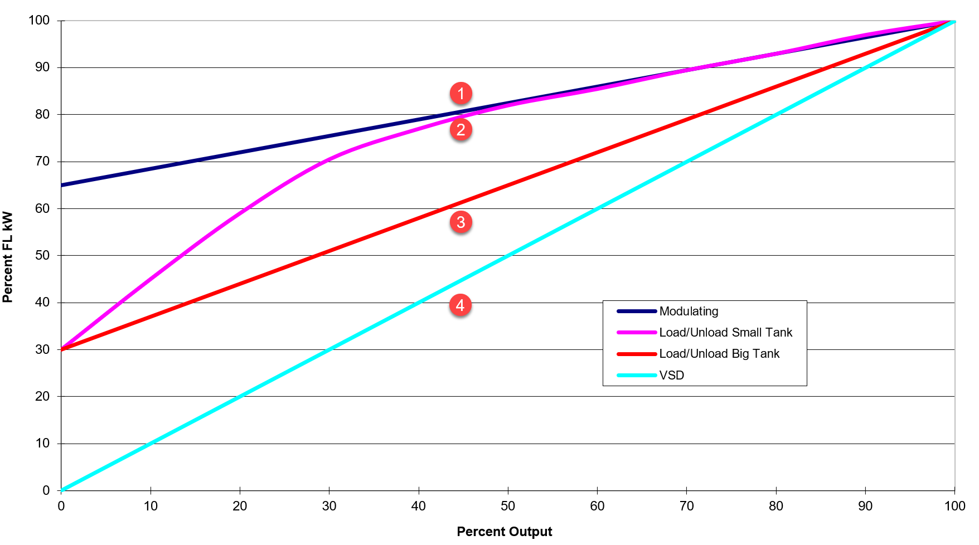
Leakage Repair Savings
Savings depends on system turn-down
Poor control = Poor savings
Good control = Good savings
Leakage will return, savings may not be sustained without good follow up
Savings Change with Control Mode

Slide 13
Common Challenges Preventing Results
From a recent leak assessment client:
  Q: Did you repair any of the leaks I found in your plant?
  A: “NO, not even one…”
  Q: What is the biggest barrier?
  A: “Scheduling work, overloaded people, and overspend budget money issues. The question came up “Does it cost more money to fix it than it is worth?”
From a leak assessment professional
  Q: What’s the biggest barrier to leakage repair?
  A: “Don’t get me started on f***ing repairs! We’ve had some spectacular success…because we took responsibility for the leakage survey. We’ve also had some spectacular failures.
    By far the biggest issue is that there is almost never any money allocated to the end user maintenance budgets for leakage surveys or repairs.
    And if assessments are done the repairs will always be much more costly than the leakage survey, but with no allocated budget there will be few or no repairs done.”

Slide 14
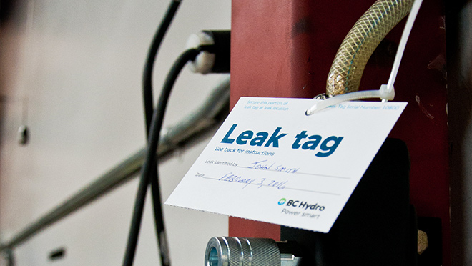
Common Challenges Preventing Results
Lack of employee and management awareness
Unknown costs
Unsure of the savings
No money to DIY
No appropriate tools
No staff to fix
Poor management commitment

Slide 15
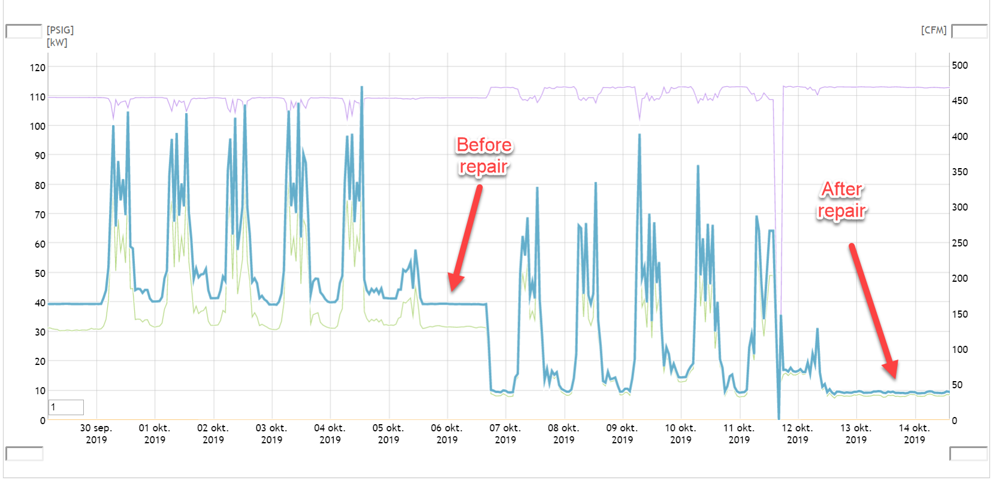
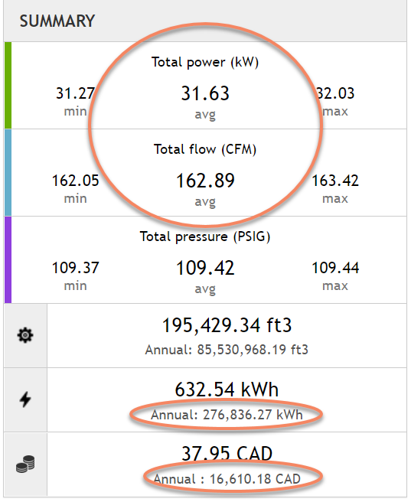
Leakage Assessments - Step 1 - Getting a Baseline
It is important to know the existing costs, very important to management
Leakage in shift-oriented plants can be detected by flow meter
Do compressor duty tests if no meter
Receiver draw down tests if in modulation mode
See how in Fact Sheet #7 at www.compressedairchallenge.org
Large plants more difficult if no shutdown hours
Source www.calms.eu

Slide 16
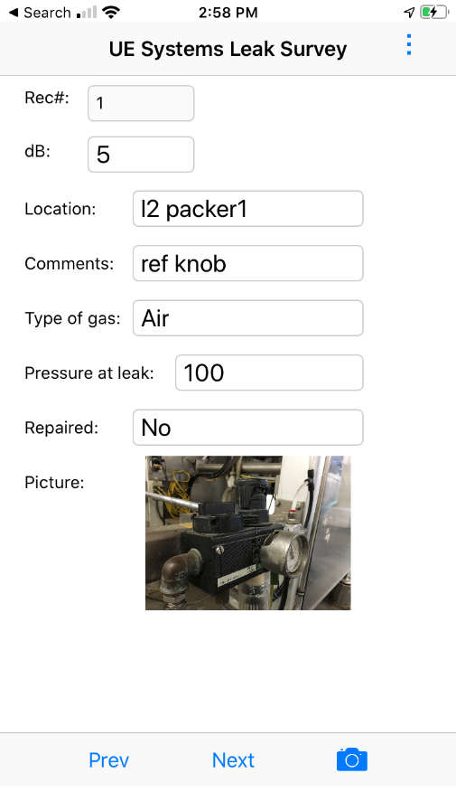
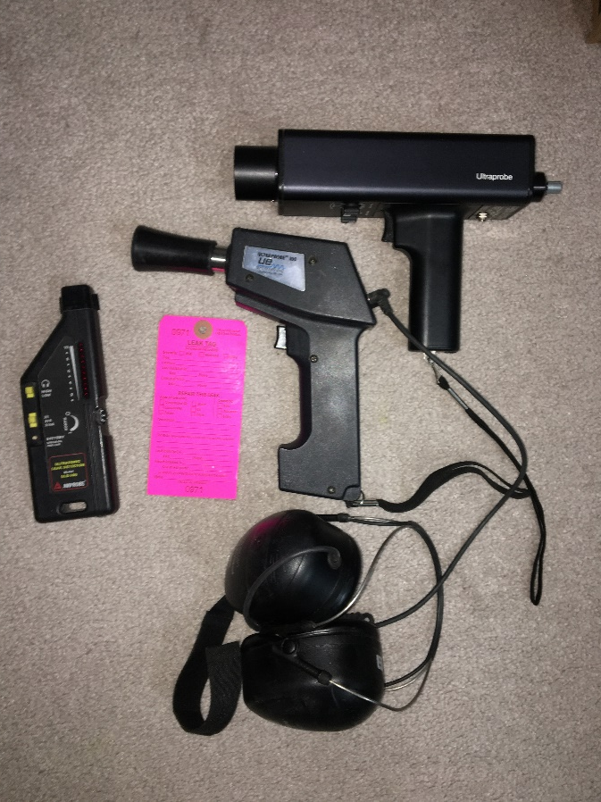
Leakage Assessments - Step 2 - Get the Required Tools for the Job
Large leaks can be heard by ear, but sensitivity varies with ambient noise
Best to use ultrasonic leak detection
Large variety of leak detectors available
If budget is limited some low-cost units are acceptable – Less than $1k
Generally for basic leakage detection the simpler the better
Some estimation and documentation system is recommended – free apps and spreadsheets available
Some high cost detectors have detector, camera, database all in one

Slide 17
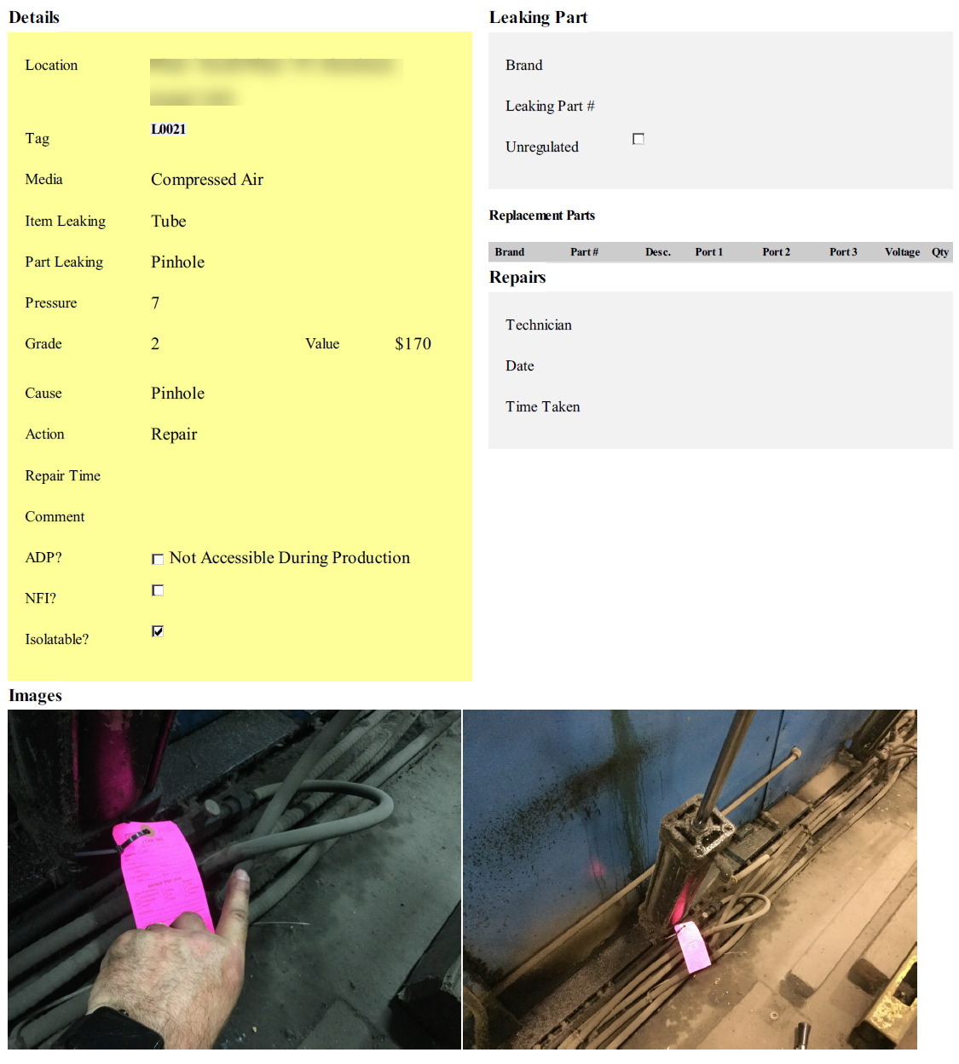
Leakage Assessments - Step 3 – Find, Document and Fix
Thoroughly detect and tag
Get training and become familiar with sound level detection procedures
Document location so leaks can be found for repair
Take two photographs of location
Repeat as necessary after major repairs – large leaks mask small ones
Use of database system that can track repair and progress recommended
Source: www.bvrg.com.au

Slide 18
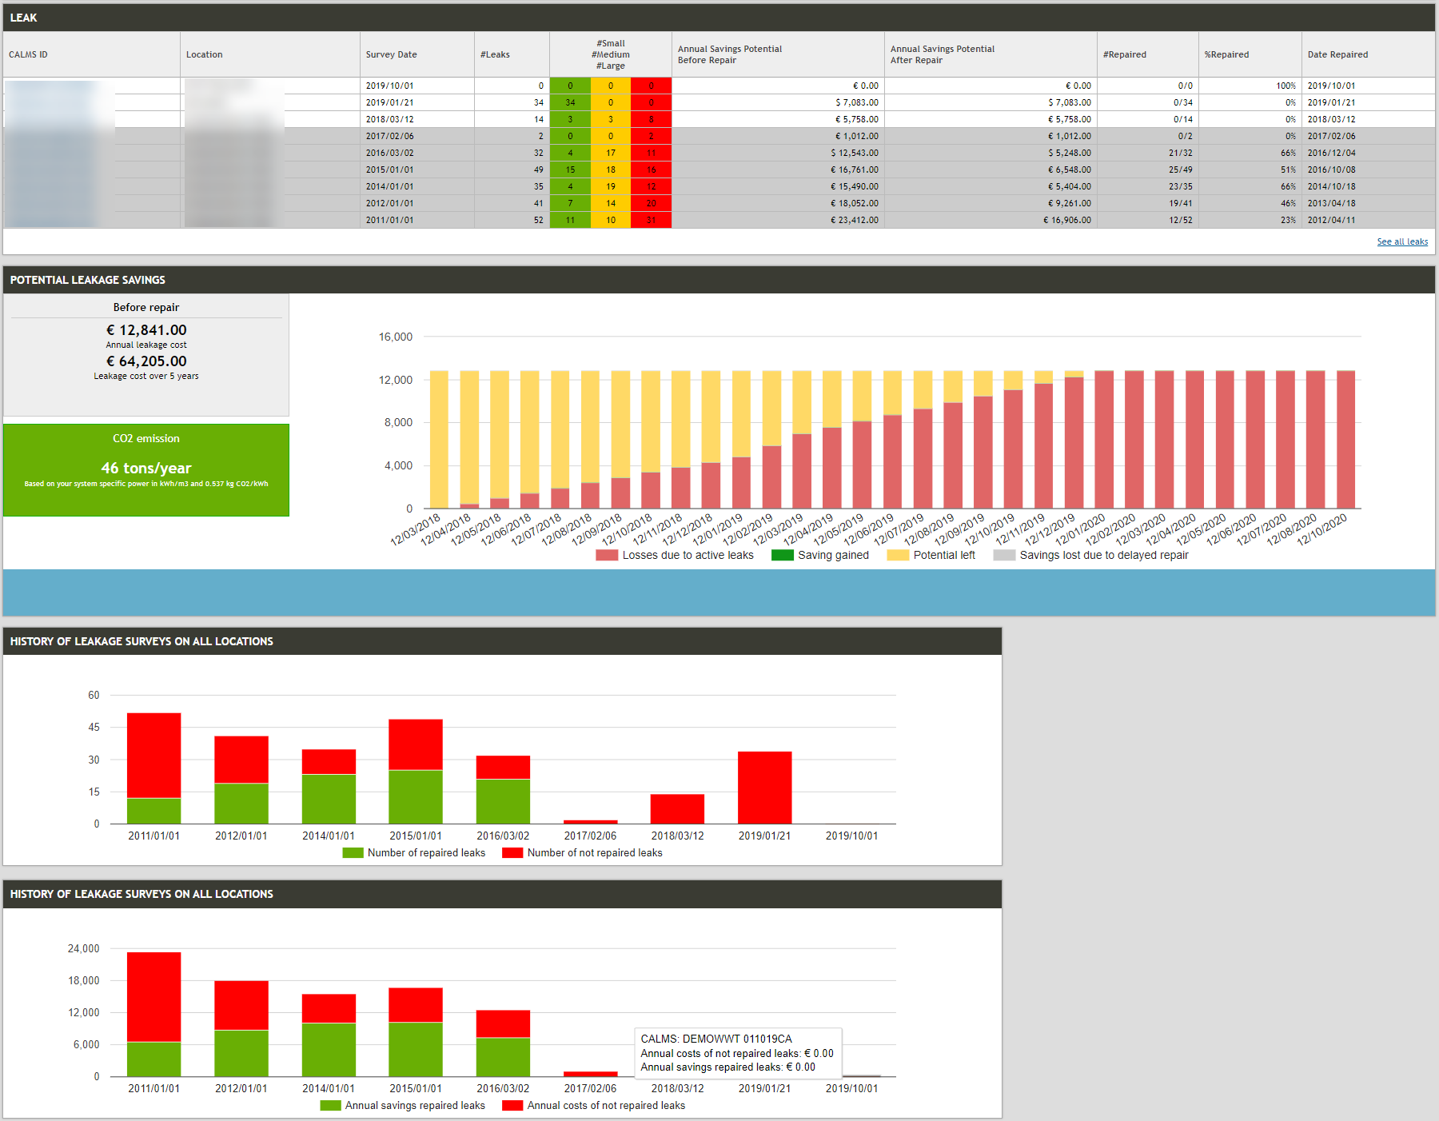
Leakage Assessments - Step 3 – Find, Document and Fix
Warning: it is very easy to overestimate leakage flow
Estimating by db readings is not an exact science
Test leaks with flow meter when possible
Compare total flow against main flow meter
If there is more estimated leakage flow than shows on the flow meter, reevaluate
Source www.calms.eu

Slide 19
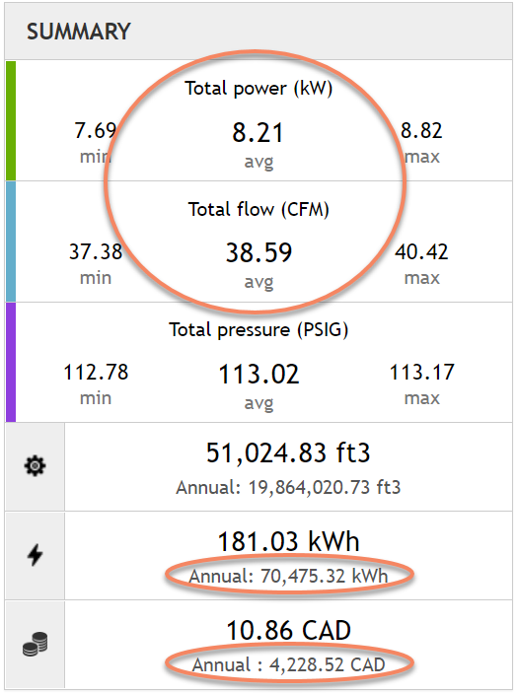
Leakage Assessments - Step 4 - Verifying Results
Very important to track success
Compare new level against baseline flow (and power if possible)
Report the results to management
Keep track of the new level and constantly monitor
Initiate leakage detection and repair if low level increases above a target value
Saved $12,400
Source www.calms.eu

Slide 20
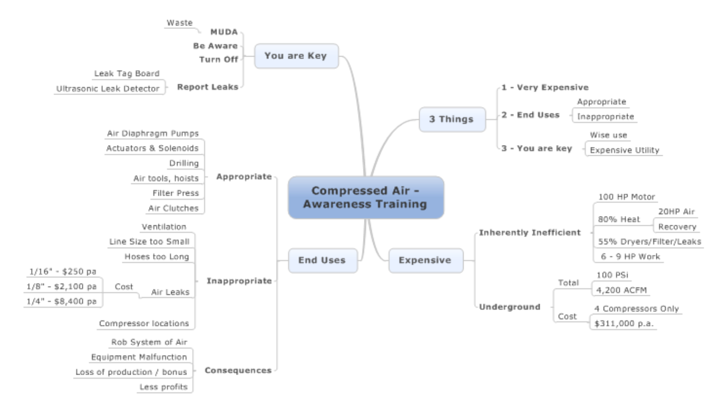
  Examples of Best Practices - Employee Awareness
Train employees on the cost of compressed air leakage and what to do about it
Example CABP New Gold article: “Compressed Air Training – It’s a Gold Mine”
Implement leak tag system
Make sure employees are recognized for success
Compressed Air Challenge has new awareness training:
“Compressed Air: It Isn’t Free”

Slide 21
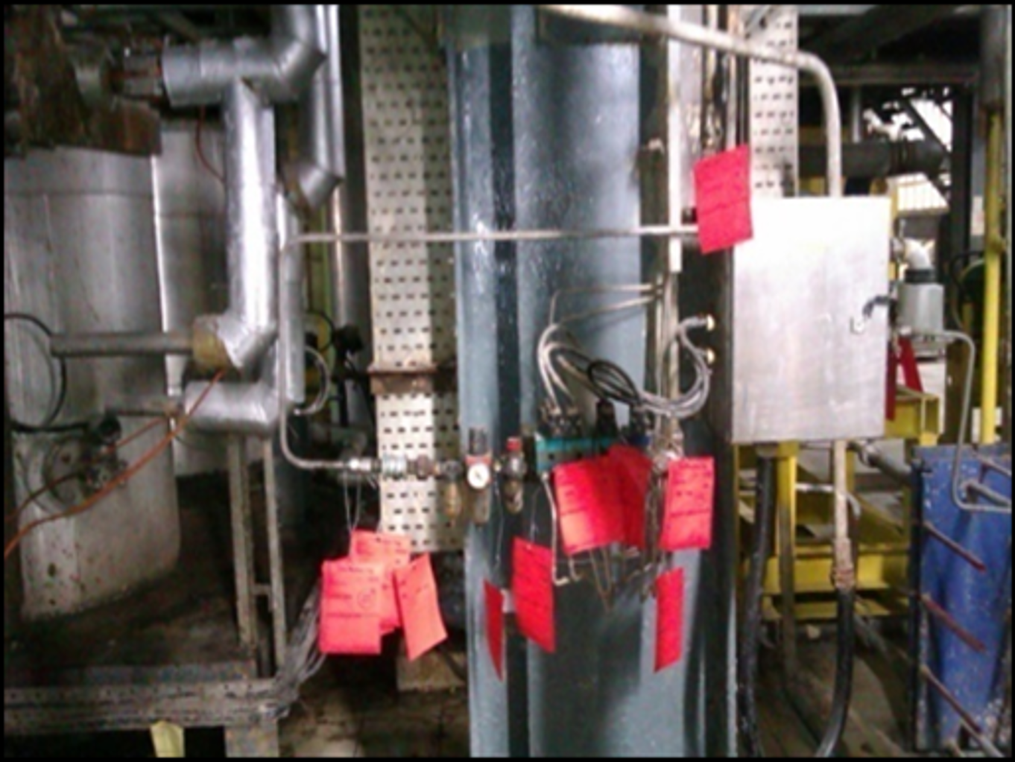
  Examples of Best Practices - Management Support
Very important key to success is having support of management.
Best Practices: Monarch Industries, Canada
  Monthly auto-generated workorder to audit the facility. (using ultrasonic)
  Identify leak locations are with red tags and assign responsibility to repair.
  Supply lines to all equipment distribution points are hard-plumbed with shutoff valves. (prevent main supply leaks)
  Machine operators are encouraged to report leaks.
  Eliminate quick couplers where possible (crimp fittings only)
  Eliminate all ratchet type hose clamps.
  Better quality air line/hose.
  Remove leaking air tools and blow guns from service for repair/replacement. (spares in stock)
  Regularly reinforce awareness and importance with maintenance staff
Manager Quote: “And most importantly, express extreme displeasure when leaks are not dealt with as soon as detected. Most are simple fixes and there is no excuse to ignore them.
I expect our total facility leakage at any given time to be no greater than 50cfm. I occasionally verify this when I am in the building during off hours.”

Slide 22
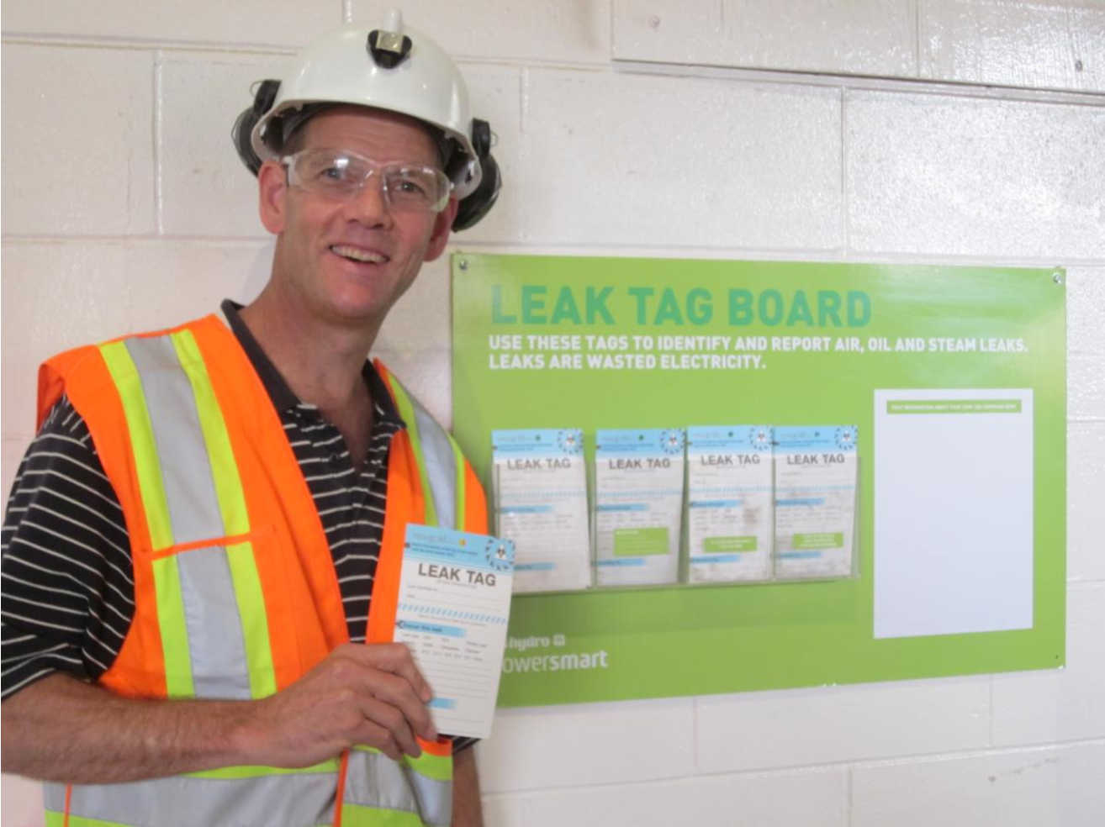
  Examples of Best Practices - Teaming with plant employees
One seasoned auditor:
“When I do my audits, I insist on always having at least one employee with me with tools. Many times when we find a leak, we can fix it right away. This saves everyone time and money. – Chris Beals”
The best assessments are often DIY and involve trained and motivated employees
Experience auditors can assist and have the benefit of lots of experience
Employees know the plant and can help find leakage and inappropriate uses
Management support is important, especially for repairs
Very good results can be gained using the treasure hunt approach
Andrew Cooper, Award winning Energy Manager at New Gold

Slide 23
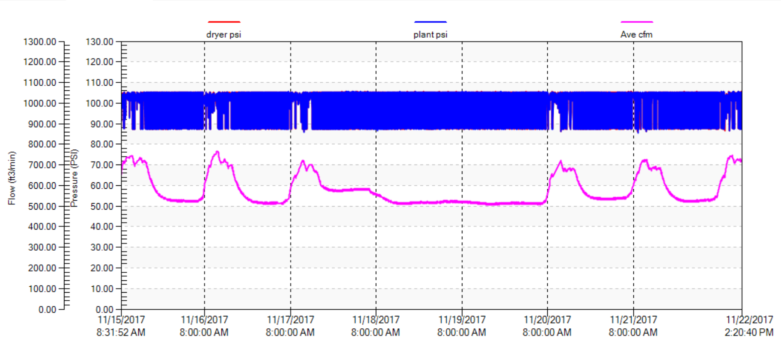
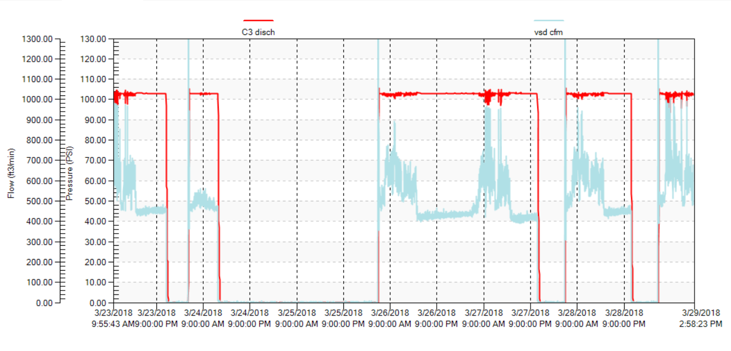
  Best Practices – Optimizing Leakage Efforts
Things that can be done to maximize leakage efforts:
Make sure your compressors have good power turndown.
Lower the pressure (double savings)
Turn your system off at night and on weekends.
Fix the biggest leaks first
Continuously monitor leakage levels
Make sure found leaks get repaired using maintenance work order system
Track the savings and report

Slide 24


Getting Help
Compressed Air Service Providers
Monitoring and Control System Vendors
Leak Detection Equipment Manufacturers
Independent Auditors
Power Utilities
  Incentive Programs
  Equipment Lending
  Energy Manager Programs
Energy Efficiency Programs
Compressed Air Challenge

Slide 25
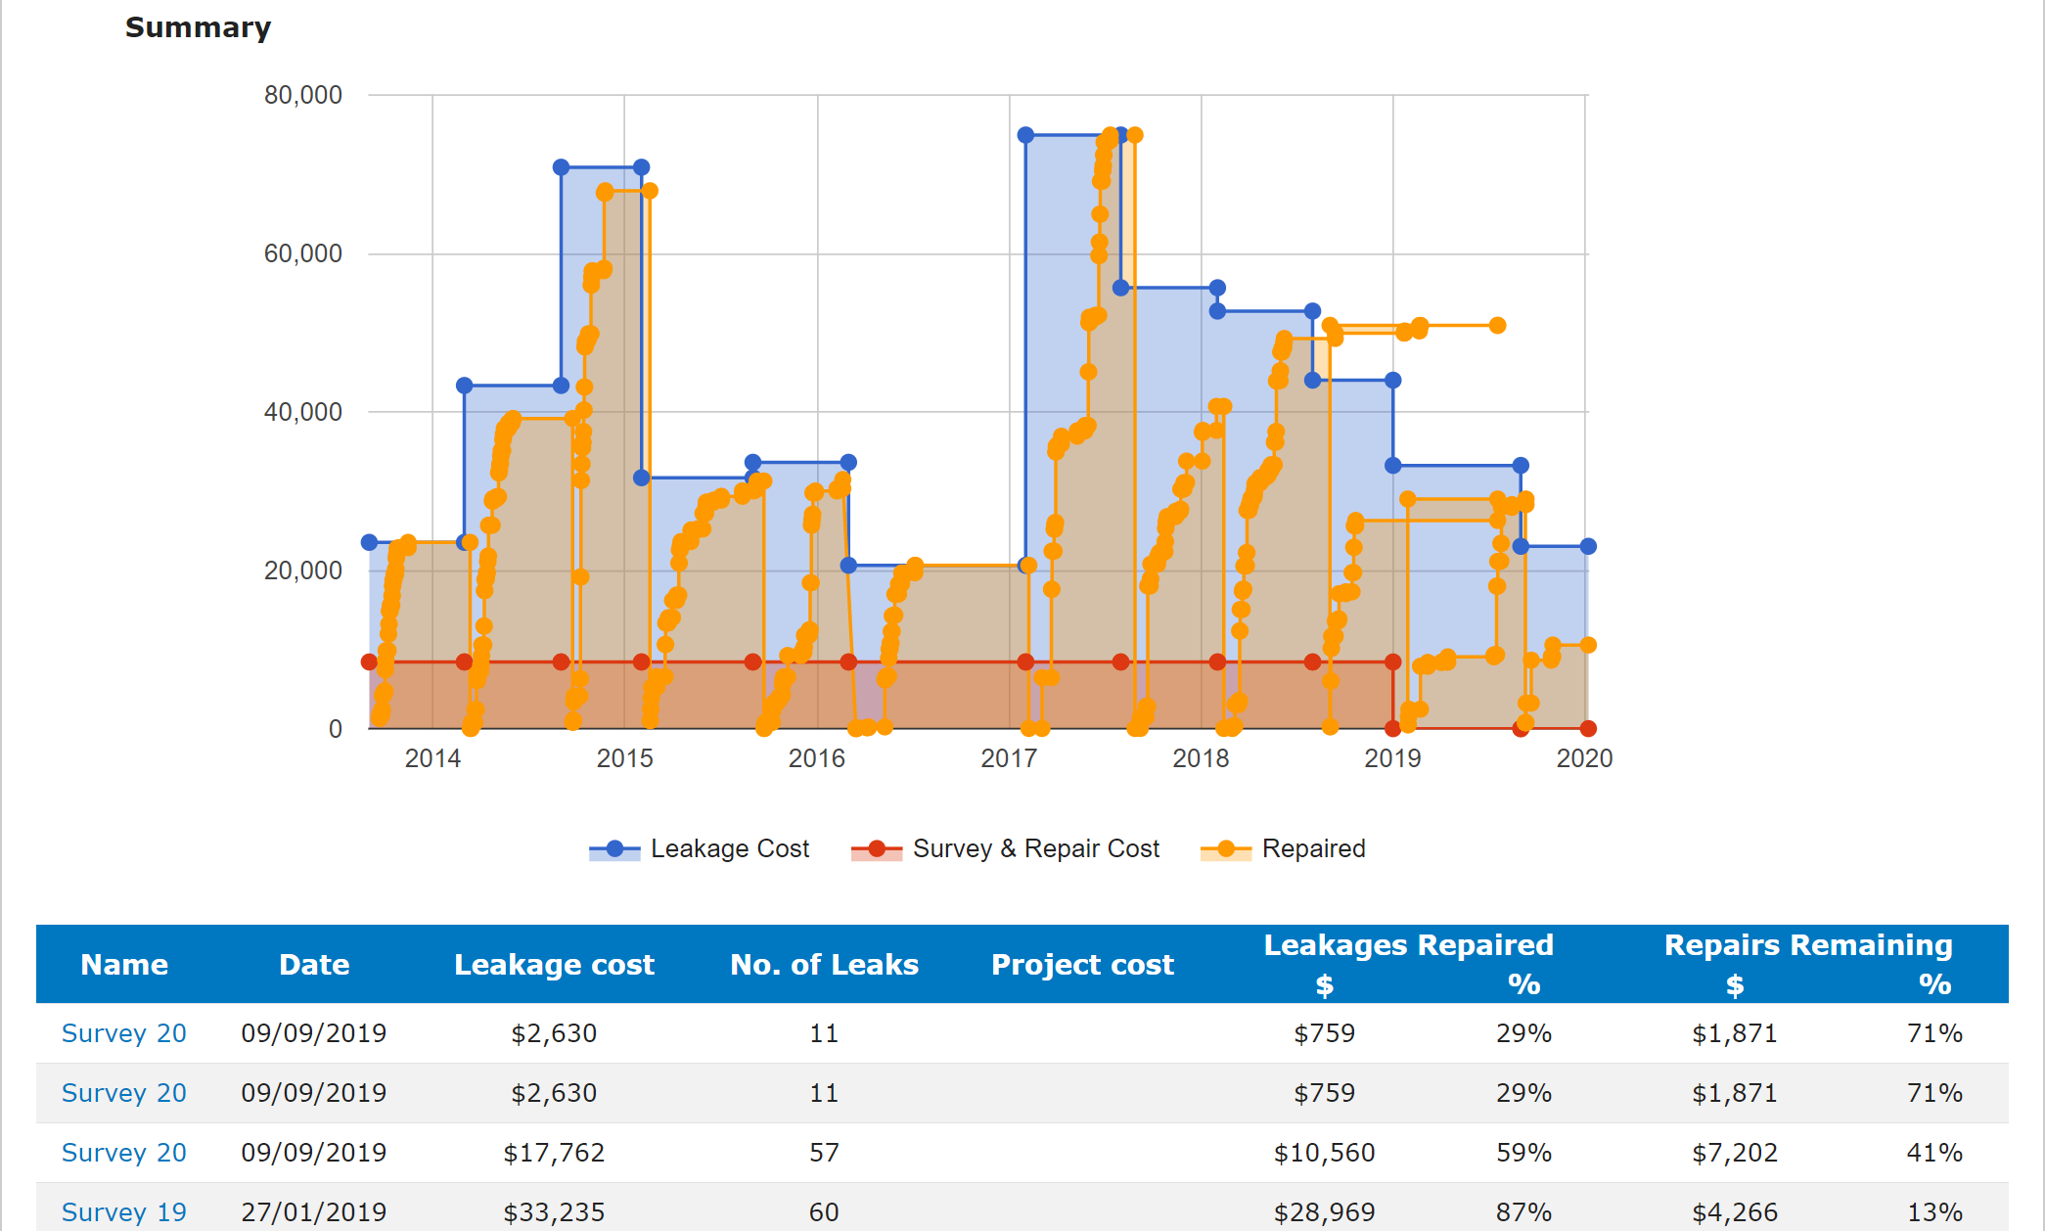
Summary
Leakage is a constant ongoing cost
Average leakage 20 to 30 percent
Lower pressure less leaks
Better compressor control more savings
When doing assessments
  Get a baseline for comparison
  Use high quality tools and software
  Find, document and fix
  Verify to measure your success
Best Practices
  Employee awareness important
  Good management support essential
  Team with plant staff for best results
  Turn it off to save more
  Monitor constantly to ensure sustainability
  Use a good repair system to make sure leaks are fixed
  Report your success to management
Get help and training
  https://www.compressedairchallenge.org/data/sites/1/media/library/tipsheets/tipsheet03.pdf
  https://www.compressedairchallenge.org/data/sites/1/media/library/factsheets/factsheet07.pdf
Source: www.bvrg.com.au

Slide 26
About the Speaker
Customer Service and Sales Manager, Trace Analytics
Experienced in customer service with a passion for problem solving
HACCP Certified
Trace Analytics is an A2LA accredited laboratory specializing in compressed air and gas testing
Erin Zimmerman
Trace Analytics
Sponsored by

Slide 27

The AirCheck Laboratory
Compressed Air Testing – Particles, Water, Oil, and Micro
Erin Zimmerman | Customer Service and Sales Manager | 512-263-0000 ext. 3 | sales@airchecklab.com

Slide 28




How Leaks Cause Contamination:
If a line has a leak, when it is depressurized, ambient air can be sucked into the line.
Typical Ambient Air:
  Particles: 0.1 - 0.5 microns: 910 million / cubic meter
  Particles: 0.5 - 1.0 microns: 67 million / cubic meter
  Particles: 1.0 – 5.0 microns: 13 million / cubic meter
  Total Volatile Hydrocarbons: 20-30 ppm
  Microorganisms: 100 million / cubic meter
  Water Vapor: 0-100% RH

Slide 29
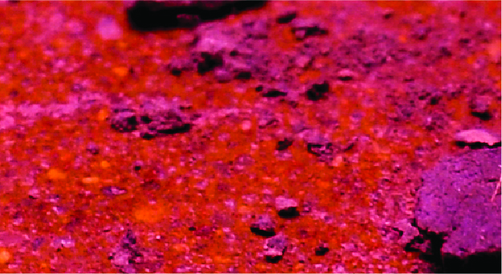
Particles
Improper maintenance
Inadequate or damaged filters
Insufficient purging after changes to existing piping
Leaks

Slide 30

Water
Length and condition of the distribution line
Piping
Drops
Dead ends
Condensate traps
Polymer tubing Leaks can allow water into the system.

Slide 31

Oil
According to ISO 8573, both oil aerosol and oil vapor must be monitored to meet purity classes 1 and 2 – commonly called “Total Oil”
Ambient Air
Compressor itself

Slide 32

Micro
Excess water and oil can create an optimal breeding ground for additional contamination.
Bacteria, yeast, and mold
ISO 8573-7 states that compressed air must be monitored for microbial growth.

Slide 33

DESIGNATING ISO 8573 PURITY CLASSES
ISO 8573-1:2010 [P:W:O]
direct contact: [2:2:1]
indirect contact: [2:4:2]
water unspecified: [2:–:1]

Slide 34
Monitoring Plans as per ISO 8573
1
Assessing your risks, system capabilities, and facility needs
2
Choosing an ISO 8573 purity class
3
Analyses and Packages for Your Specifications
4
Sampling Plans

Slide 35
CONDUCT A RISK ASSESSMENT

Slide 36





HOW MANY SAMPLES?
HOW OFTEN TO TEST?
ANNUALLY
SEMI-ANNUALLY
QUARTERLY
PERCENTAGE
MAINTENANCE
MINIMAL
SINGLE

Slide 37
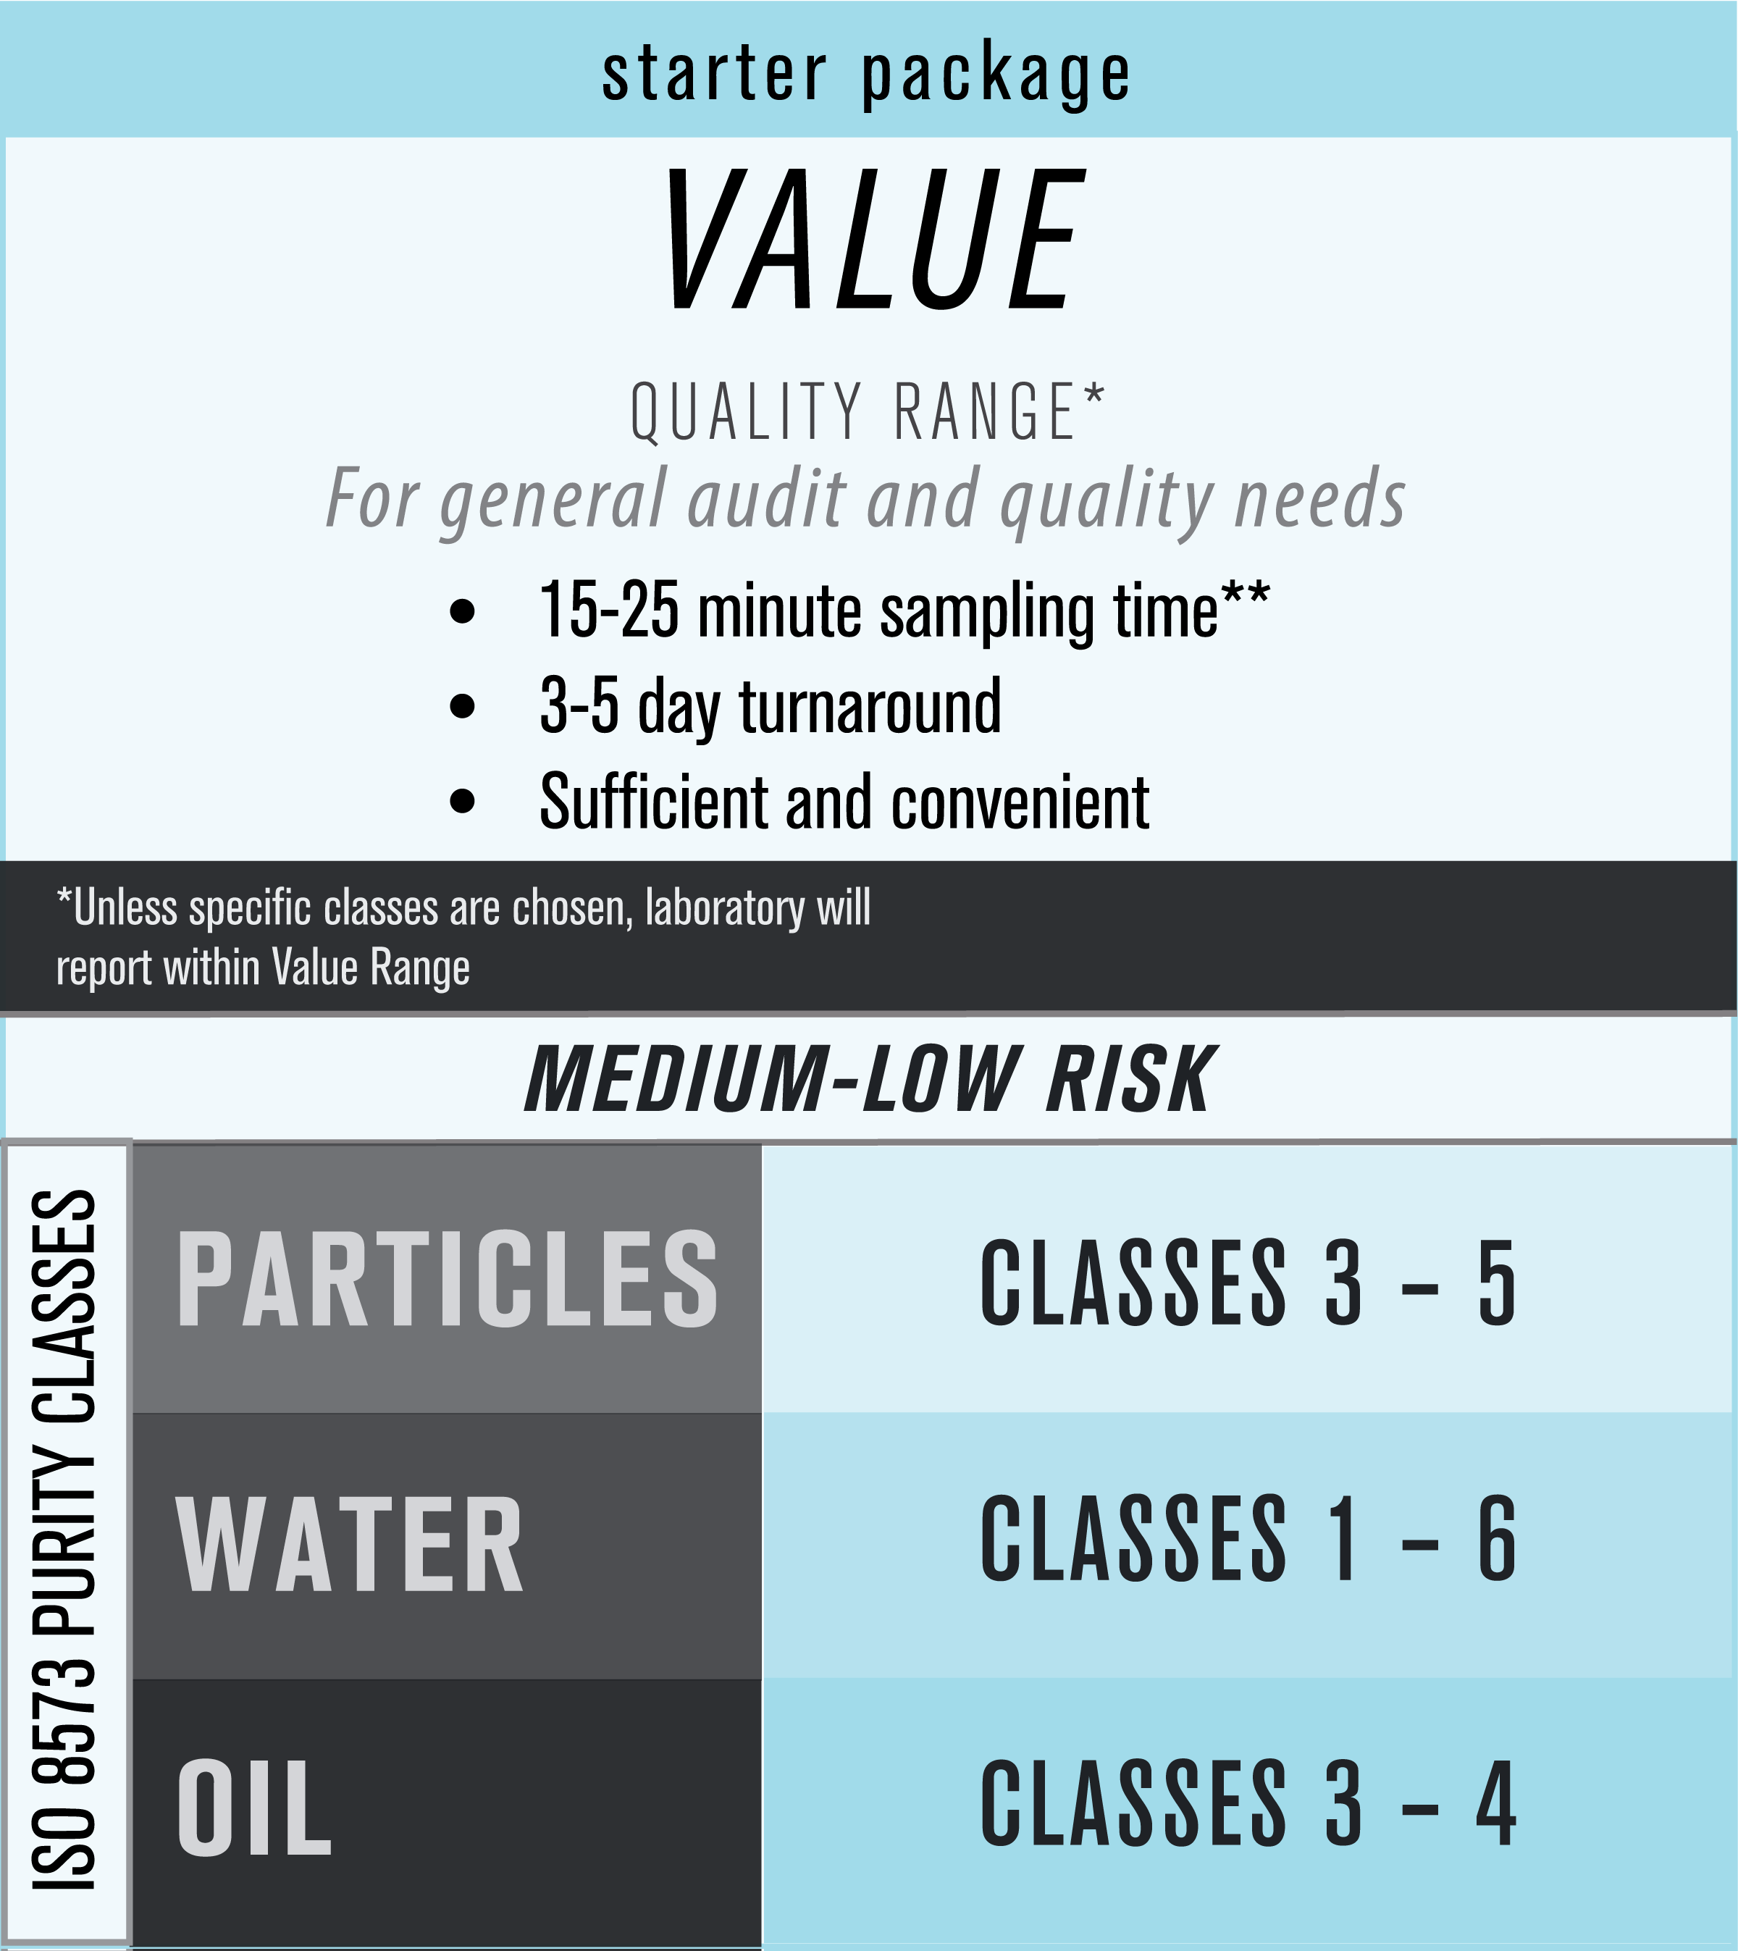
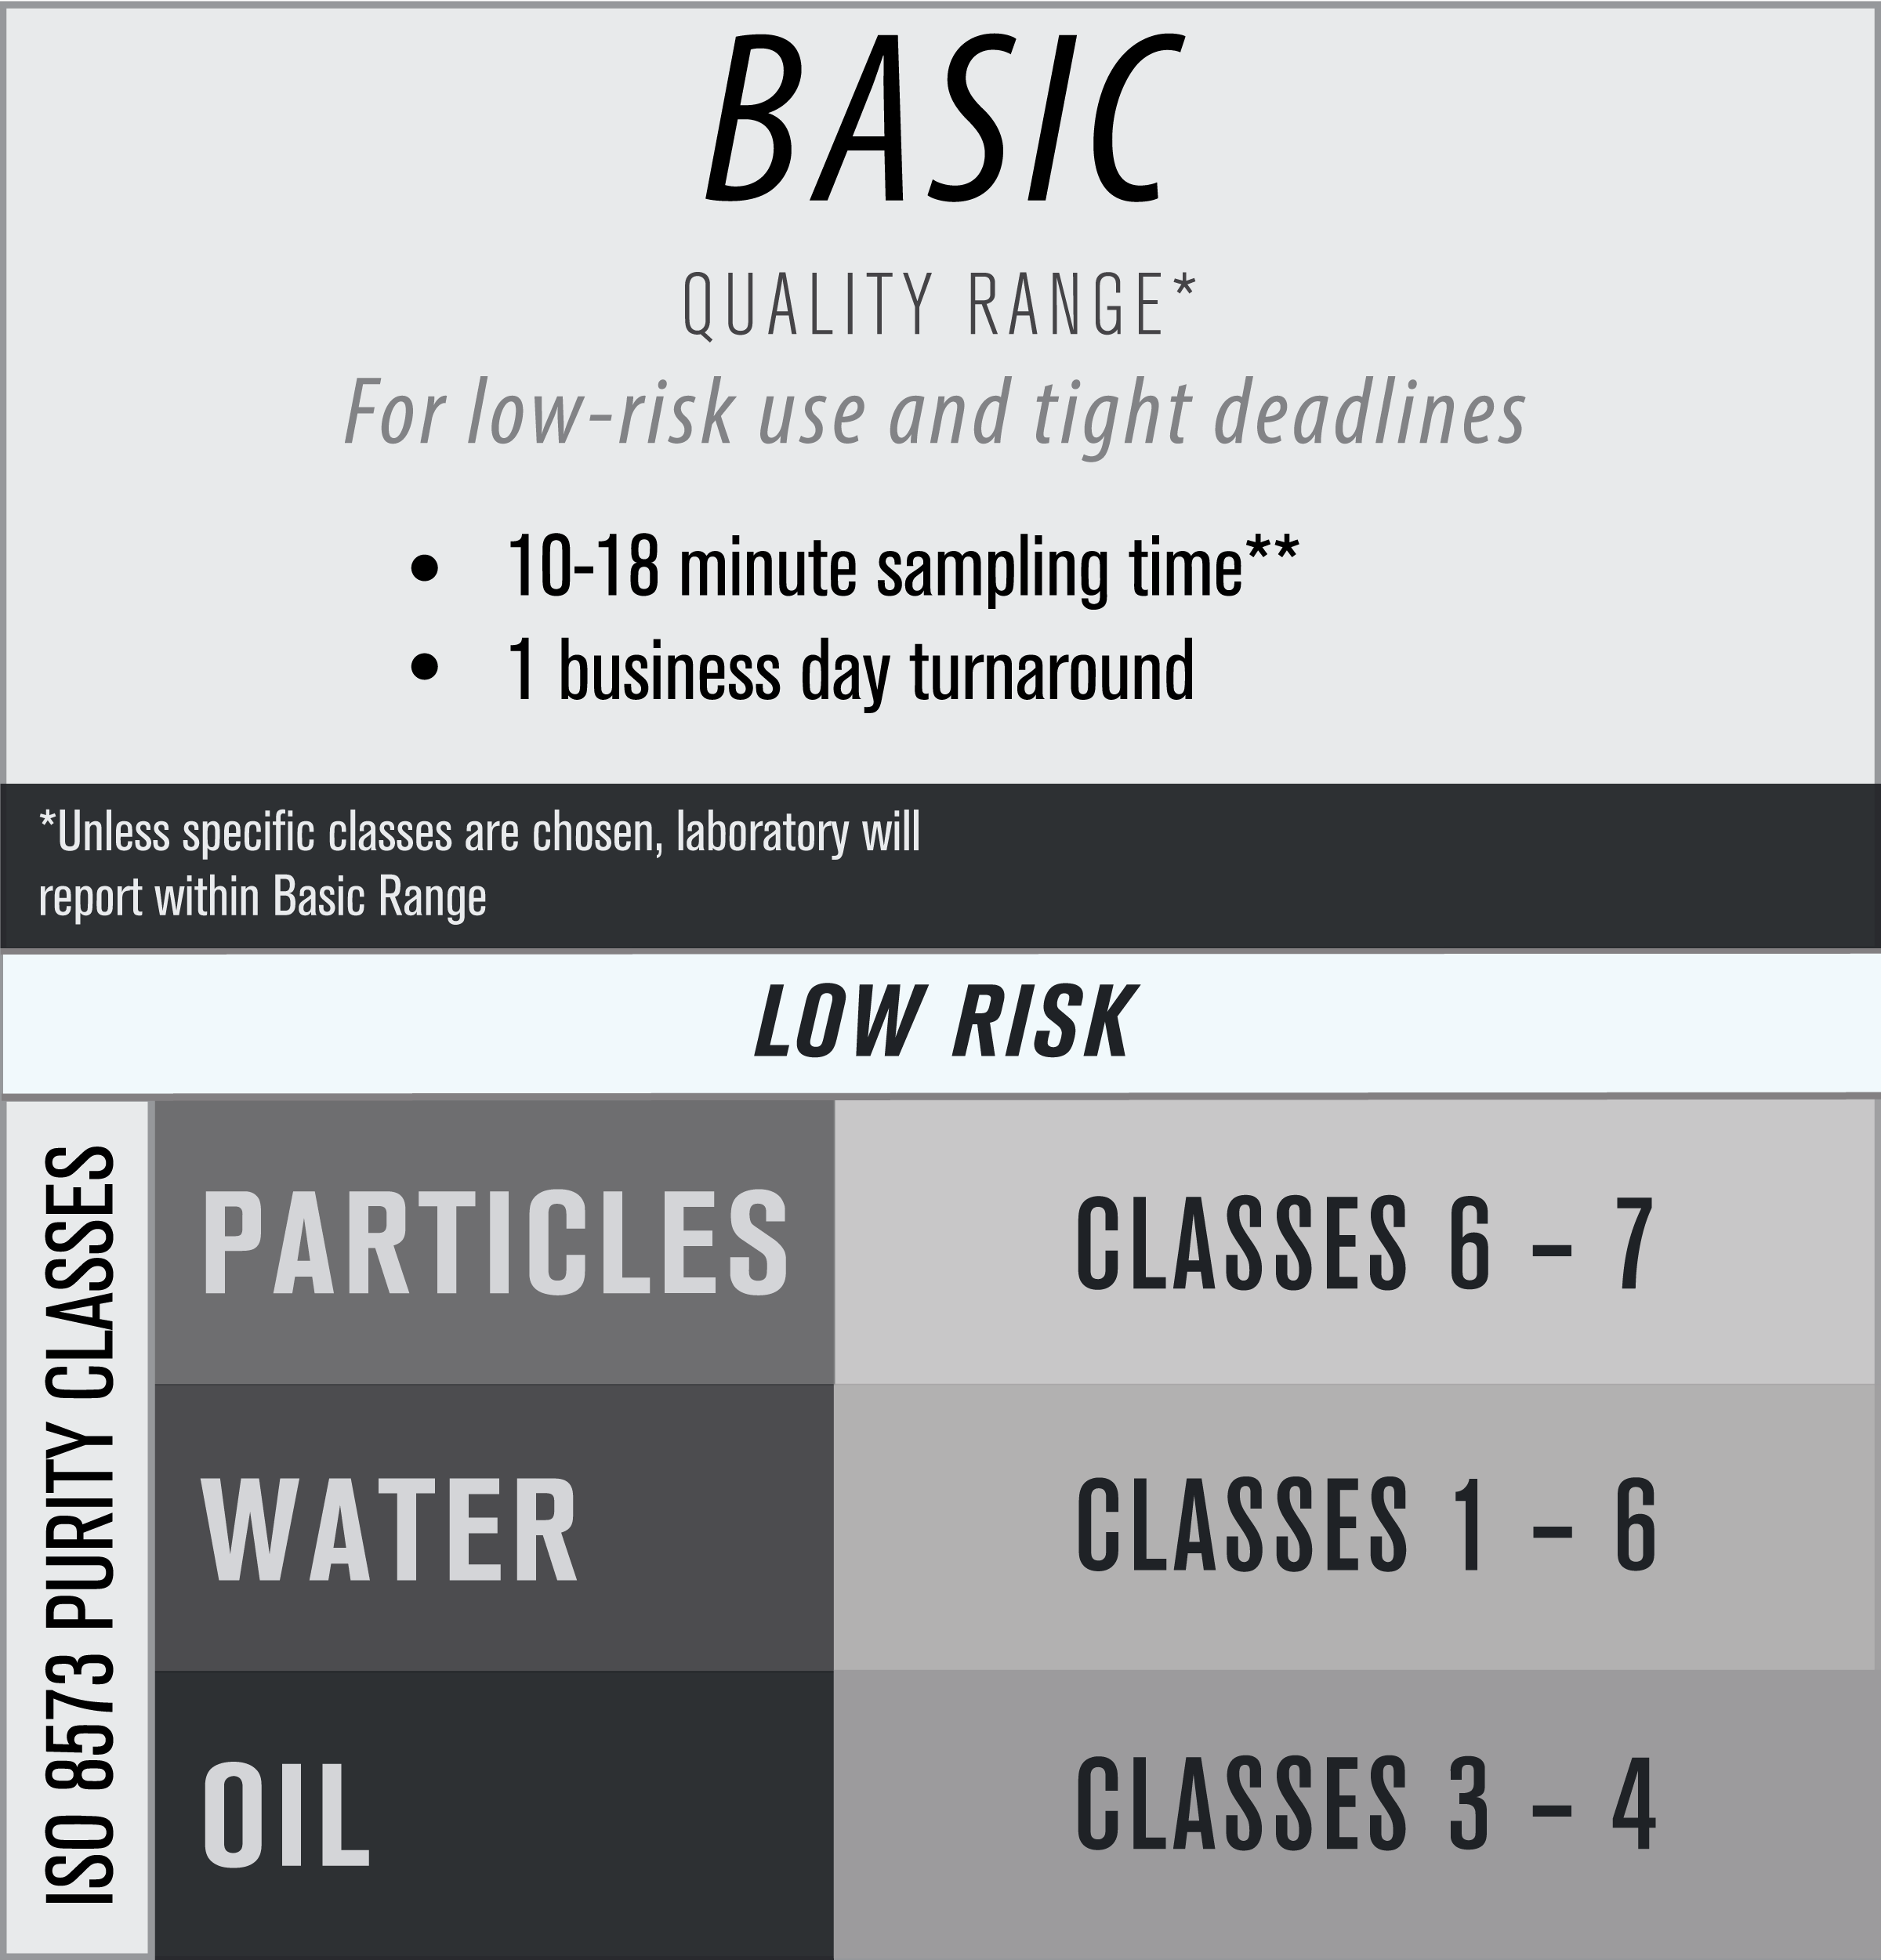
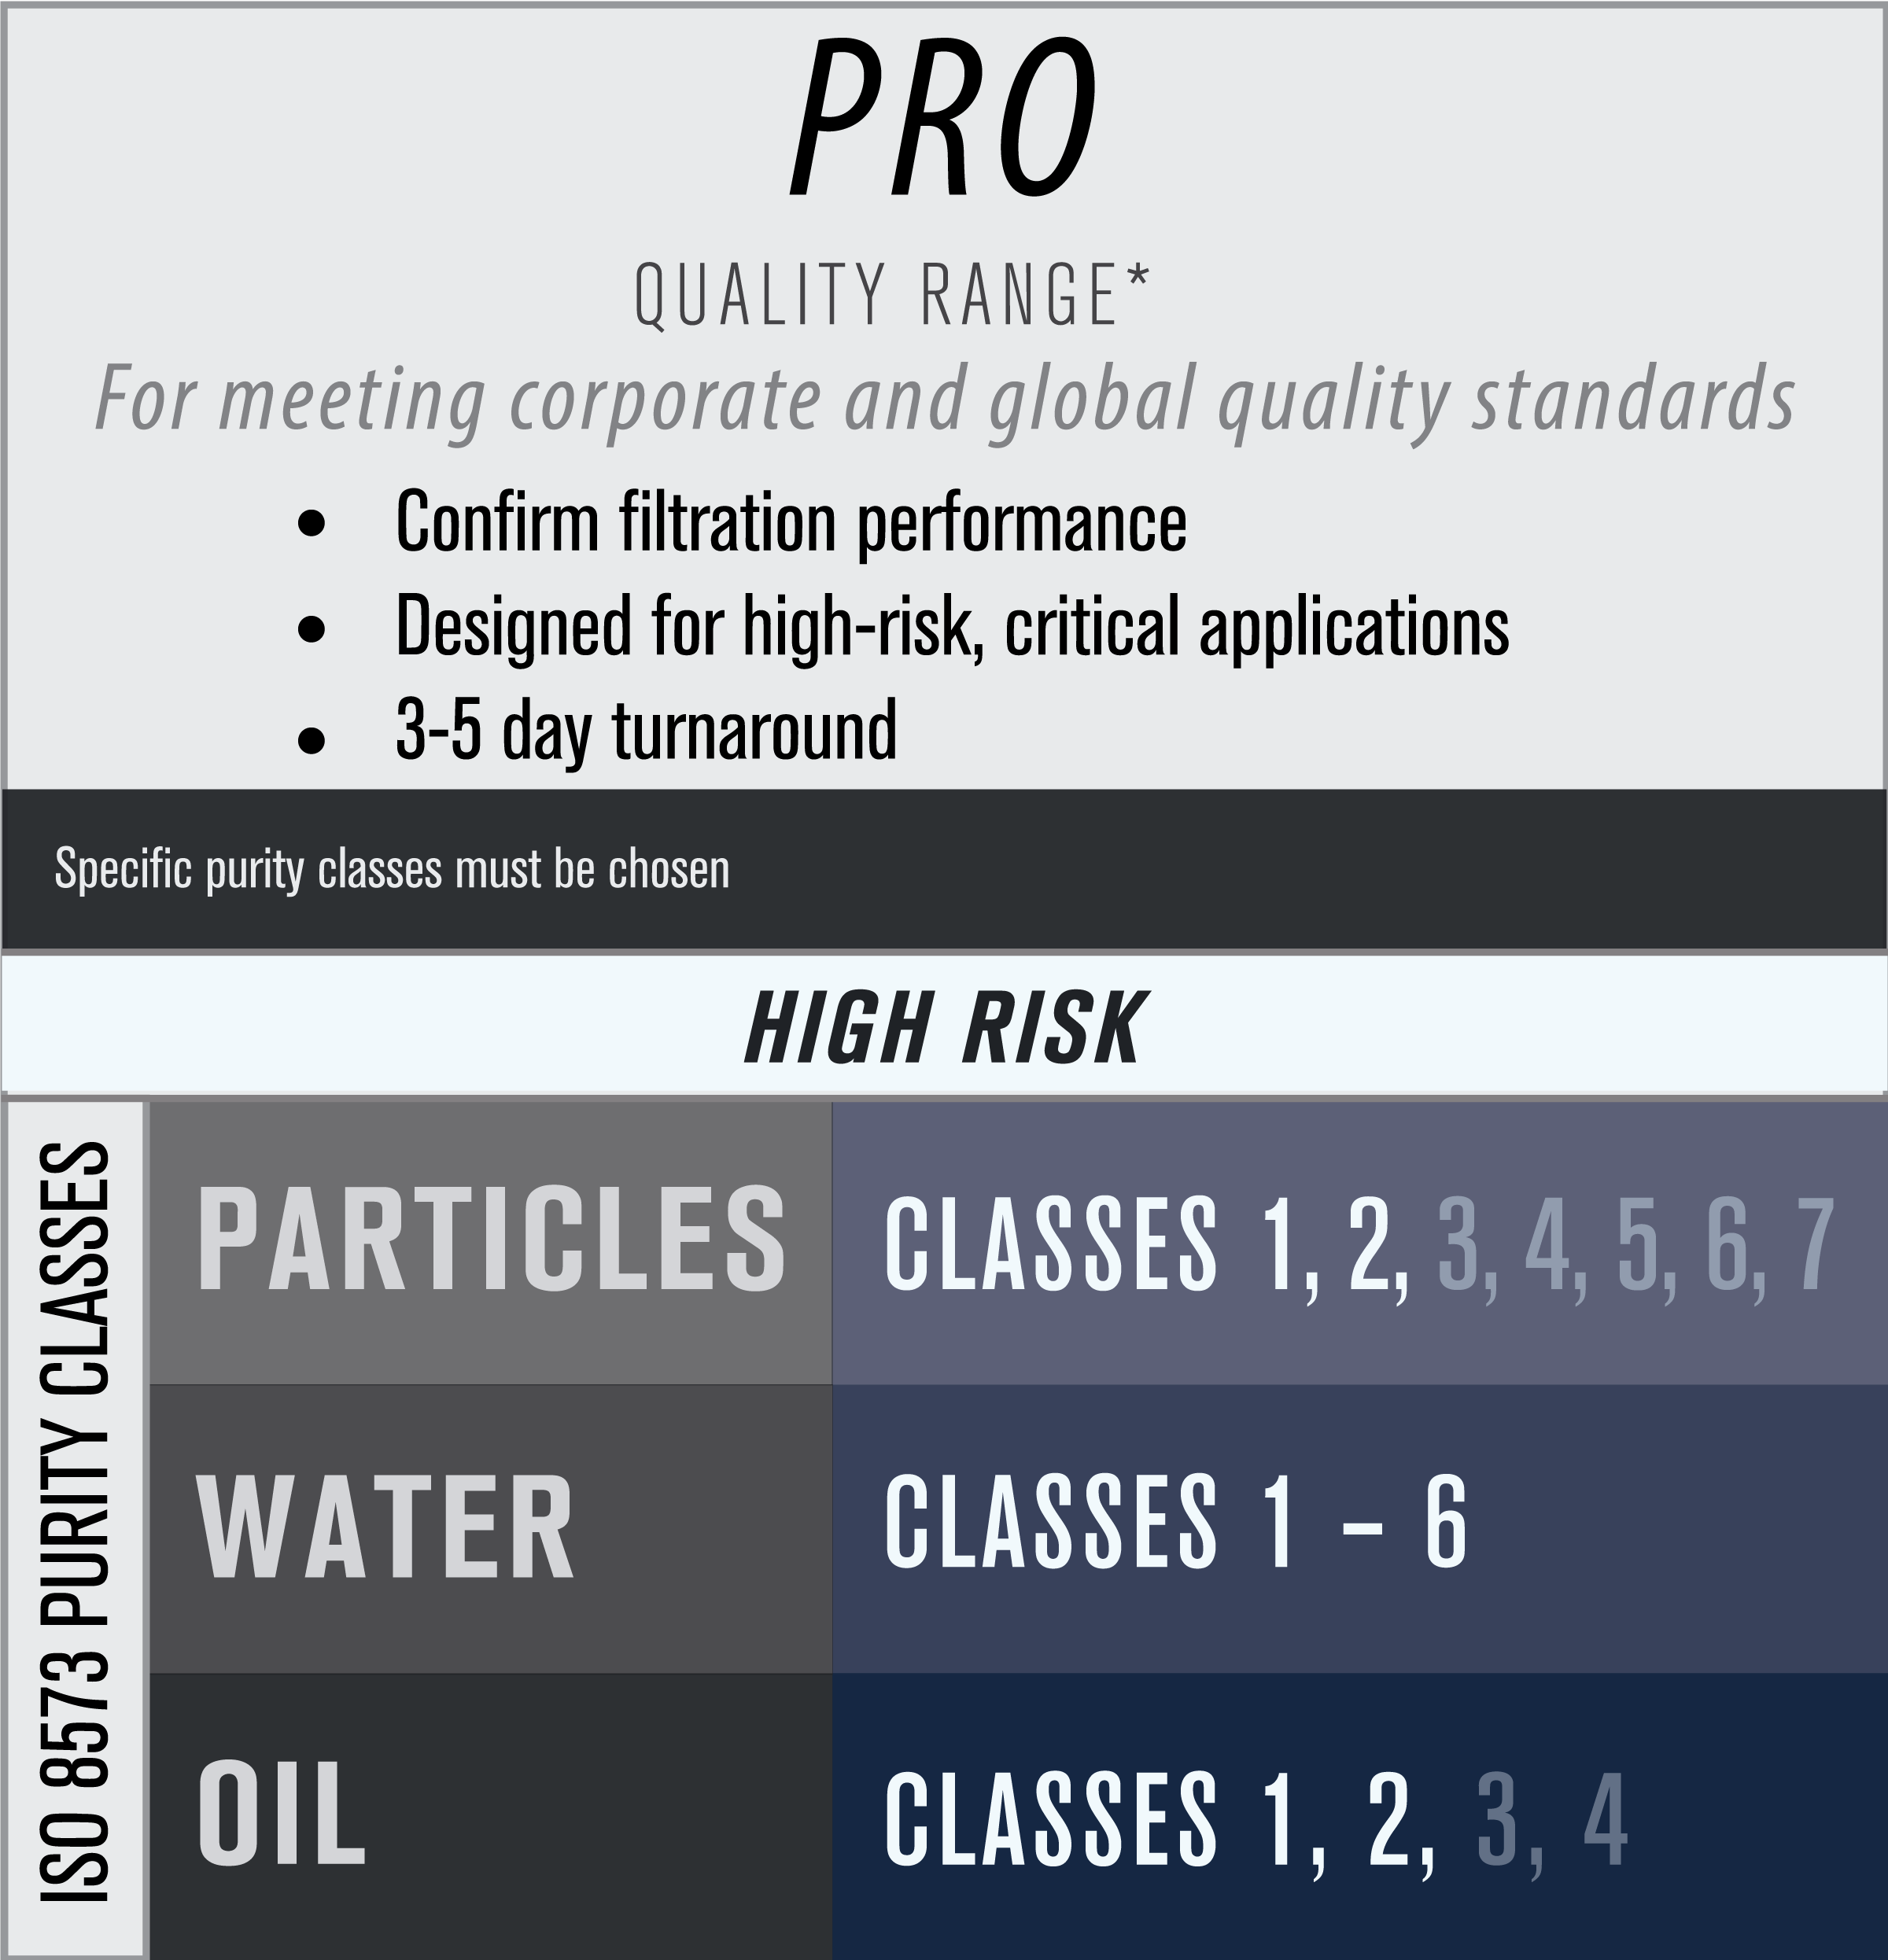
Trace Analytics Packages: [P:W:O]

Slide 38
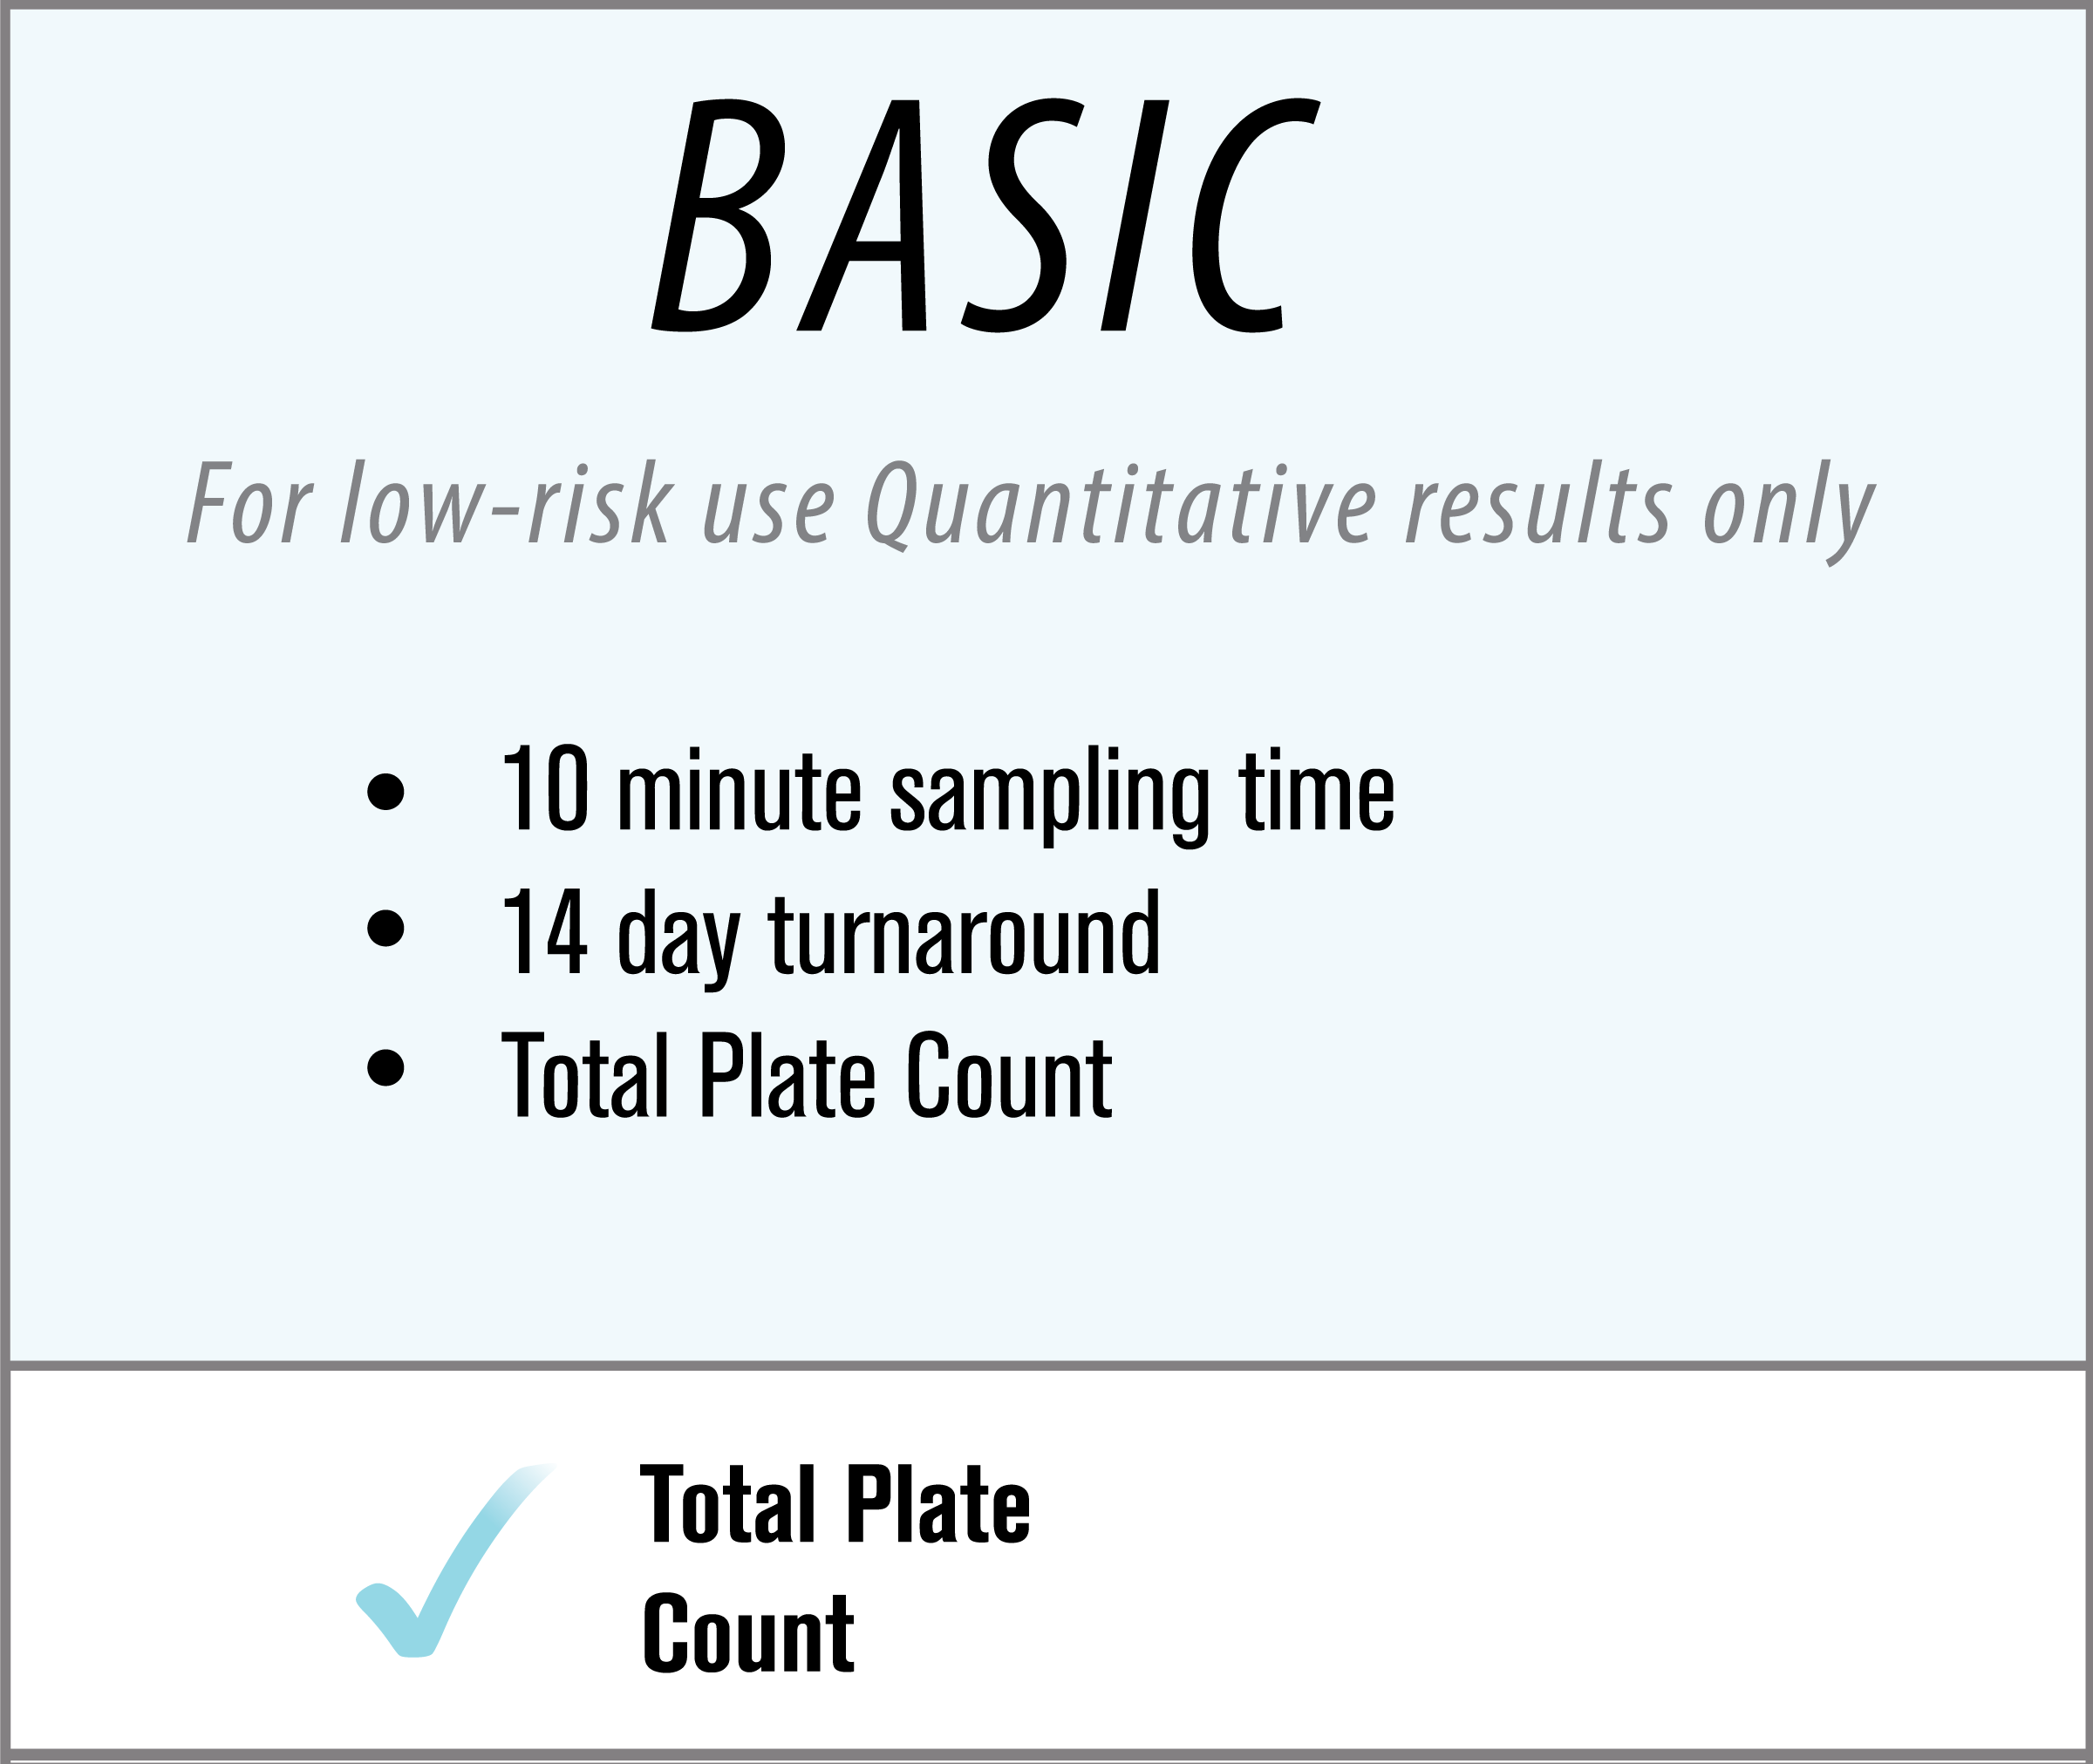
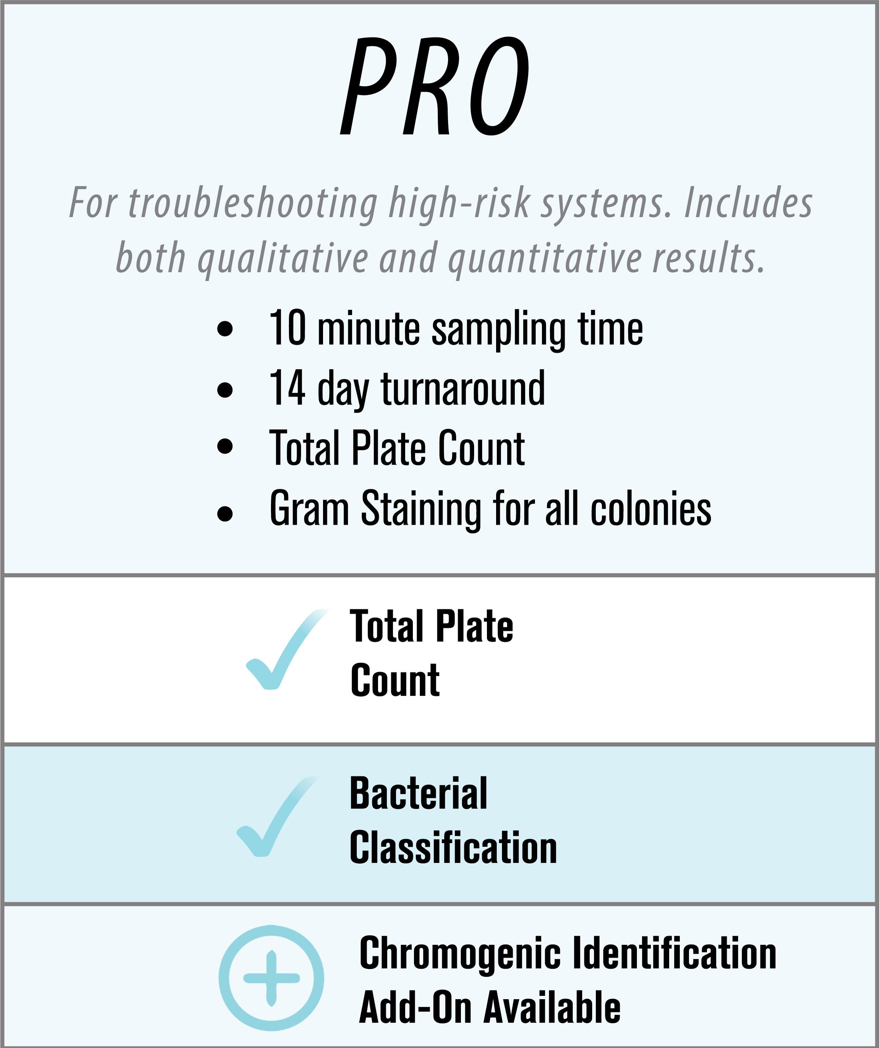
Trace Analytics Packages: MICRO

Slide 39


Third-Party, ISO 17025 Accredited Laboratory
AirCheck Academy and training documents available
HACCP certified staff and dedicated customer service
Full Service laboratory – Particles, Water, Total Oil, Micro, and Gases
CONTACT US FOR MORE
Erin Zimmerman | Customer Service and Sales Manager | 512-263-0000 ext. 3 | sales@airchecklab.com

Slide 40

About the Speaker
Manager of US Operations, UE Systems, Inc.
Nearly17 Years of experience in airborne & structure-borne instruments, software and applications
CMRP (Certified Maintenance & Reliability Professional) through the SMRP (Society for Maintenance & Reliability Professionals)
Graduate of Clemson University
Resides in Anderson, SC and enjoys spending time out on the lake with his wife and daughter
Adrian Messer
UE Systems, Inc.
Sponsored by

Slide 41


Compressed Air Leak Detection Using Ultrasound
YOUR SOURCE FOR
ULTRASONIC DETECTION EQUIPMENT AND PLANT RELIABILITY!
www.uesystems.com

Slide 42

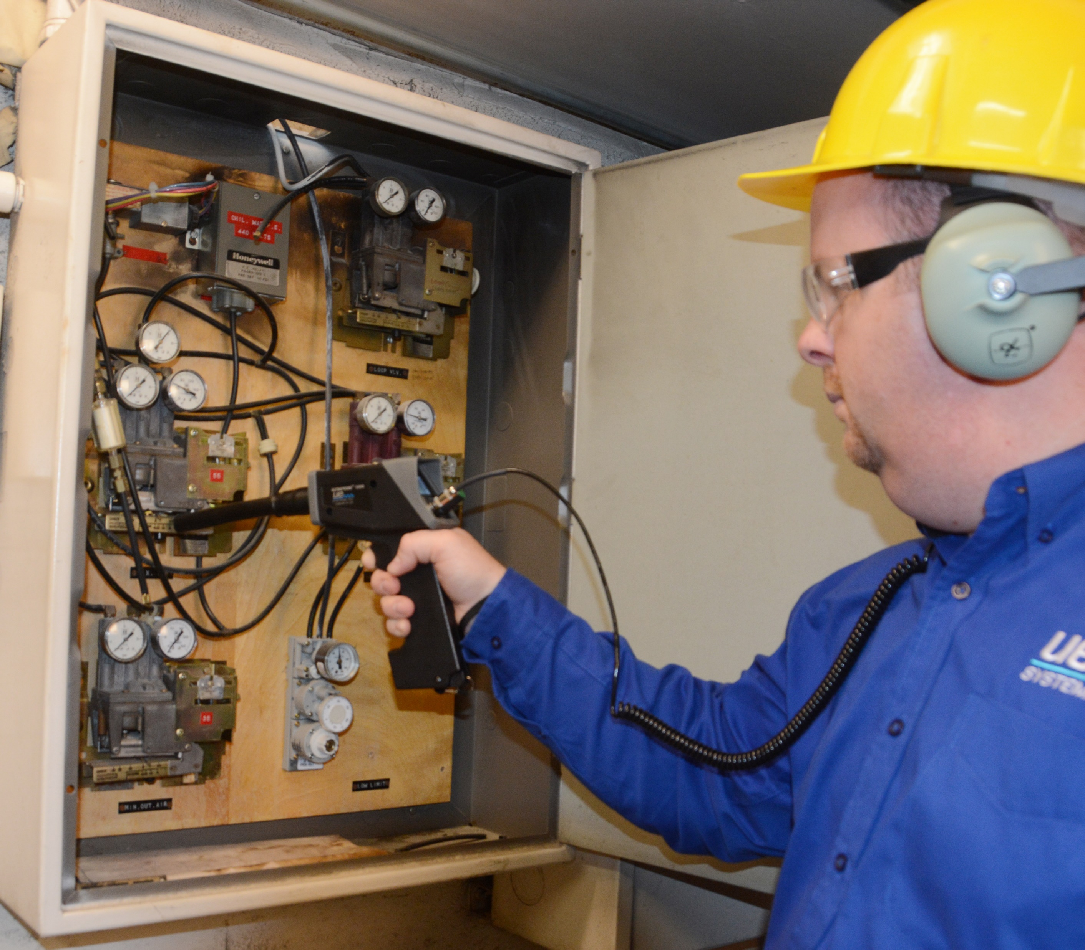
Compressed Air Leak Detection Using Ultrasound:
Creating Awareness
Compressed air is considered the most expensive utility to a plant/facility
Identify areas where compressed air is misused & look for other methods
Improve overall compressed air system maintenance
Utilize ultrasound’s ease of use for locating compressed air leaks

Slide 43
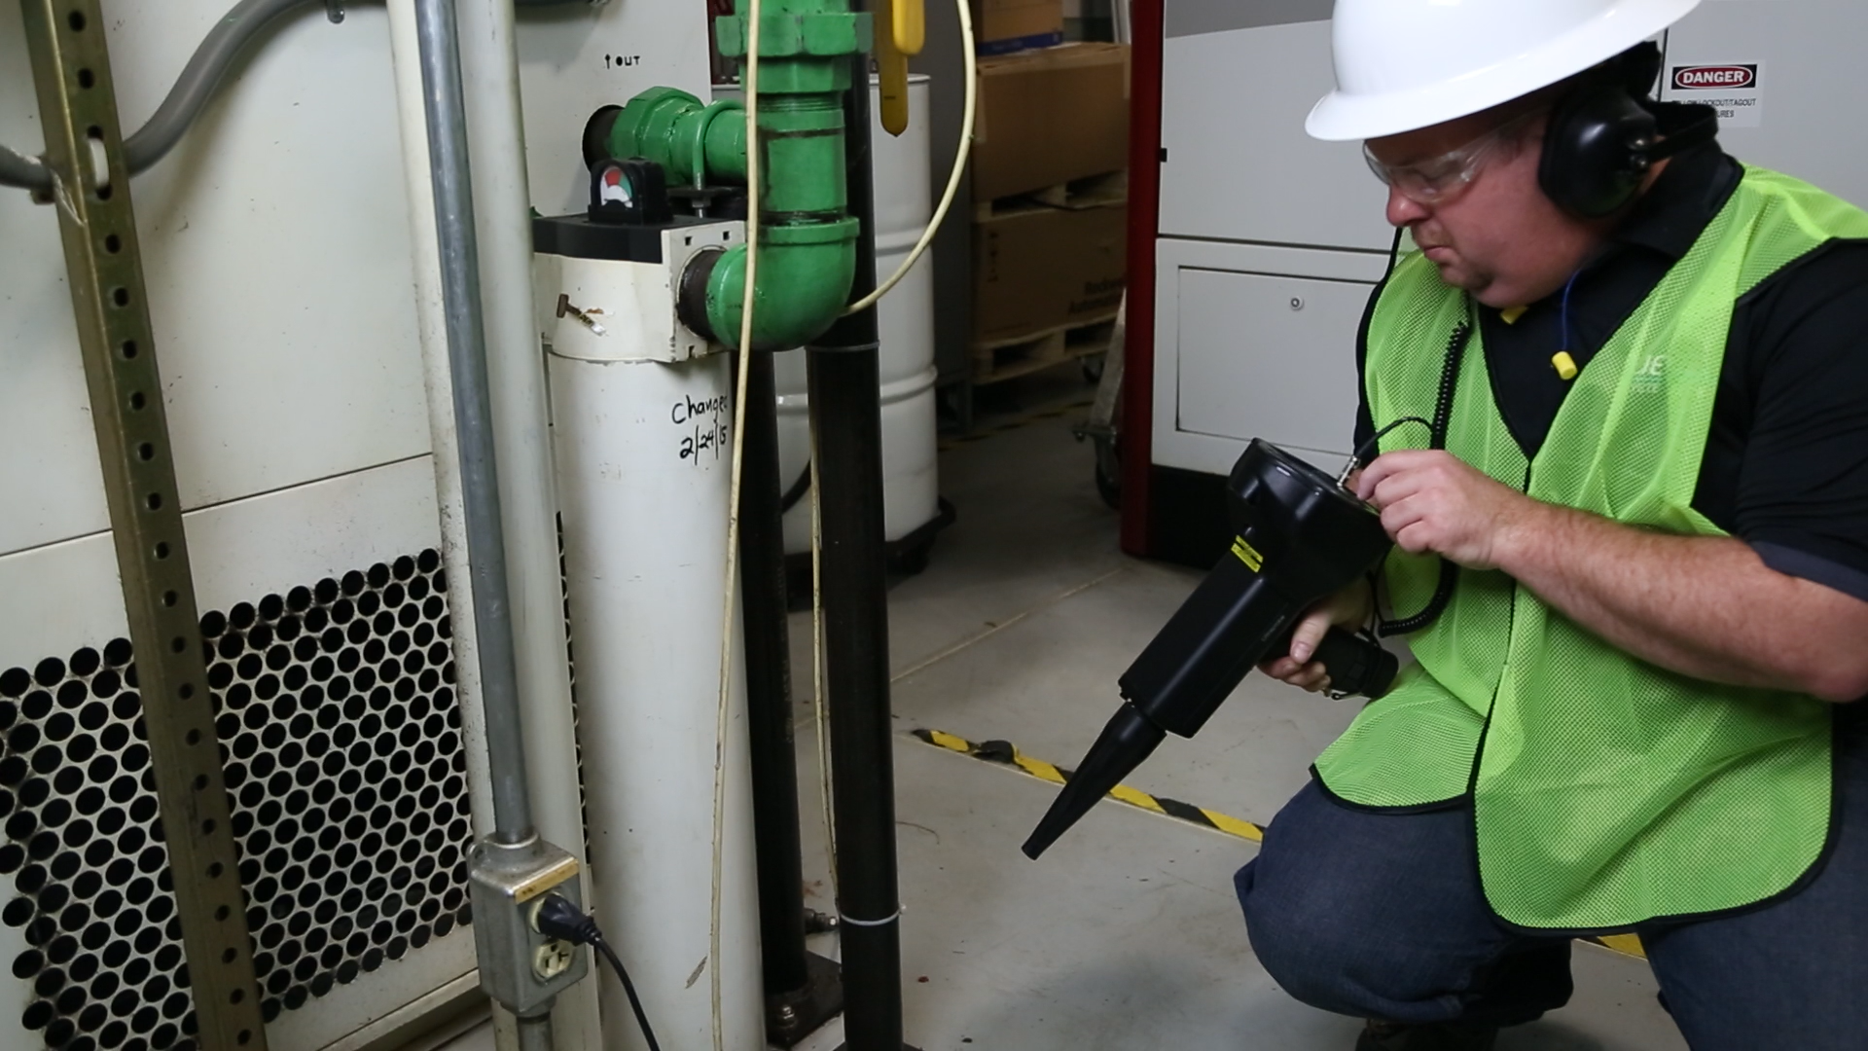
Compressed Air Leak Detection Using Ultrasound:
Creating A Plan
Review compressed air applications, blueprints, and piping
Prioritize equipment location
Schedule the survey during peak operating times
Select a trained & qualified person
Have your ultrasound instrument charged, tags, hangers, PPE

Slide 44
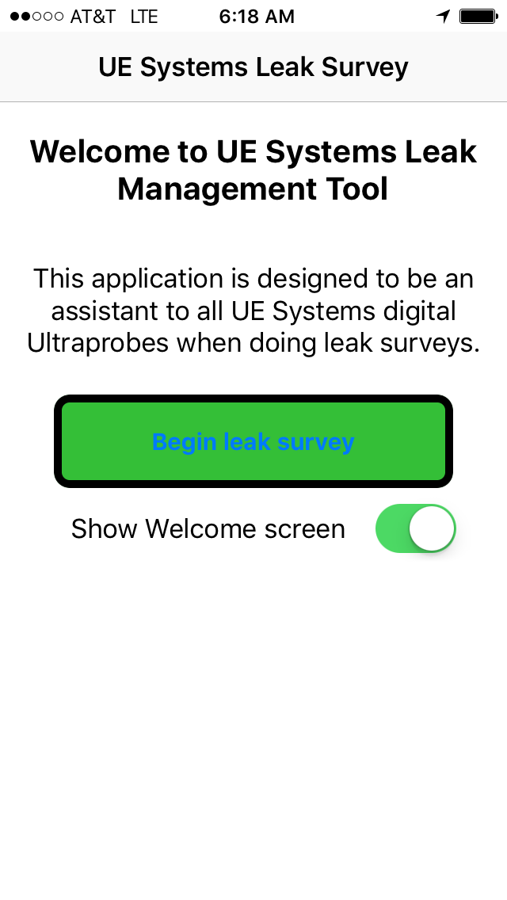
Compressed Air Leak Detection Using Ultrasound:
Reporting & Documentation
Quantify the dollar loss & CFM loss for the air leaks
Once the location of the leak has been identified, note the dB level approximately 15” away from the leak
Use UE Systems’ Leak Survey App
Take a photo
Generate the report

Slide 45
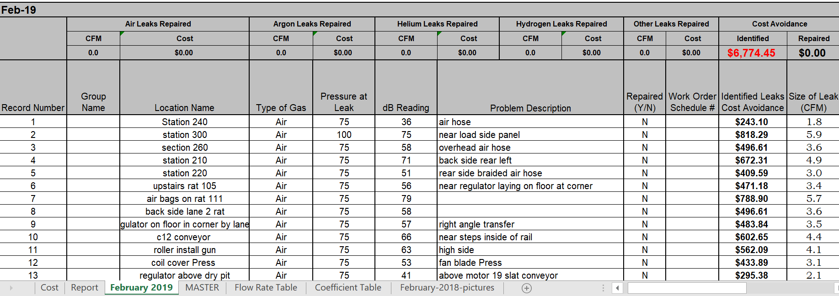
Reporting & Documentation

Slide 46

QUESTIONS?
CONTACT
Adrian Messer, CMRP - Manager of US Operations
adrianm@uesystems.com
YOUR SOURCE FOR
ULTRASONIC DETECTION EQUIPMENT AND PLANT RELIABILITY!
www.uesystems.com

Slide 47
Compressed Air Leak Management Best Practices
Q&A
Please submit any questions through the Question Window on your GoToWebinar interface, directing them to Compressed Air Best Practices Magazine. Our panelists will do their best to address your questions and will follow up with you on anything that goes unanswered during this session.
Thank you for attending!
Sponsored by

Slide 48
Thank you for attending!
The recording and slides of this webinar will be made available to attendees via email within one day.
PDH Certificates will be e-mailed to Attendees within two days.
Sponsored by

Slide 49

February 2020 Webinar
Verifying Blower System Energy with PTC 13
Sponsored by
Tom Jenkins, P.E.
JenTech Inc.
Keynote Speaker
Thursday, February 20, 2020 – 2:00 PM EST
Register for free at
www.airbestpractices.com/magazine/webinars

