Slide 1


Compressed Air System Design for Lowest kW/100scfm
Tom Taranto, Data Power Services
Keynote Speaker
Sponsored by
The recording and slides of this webinar will be made available to attendees via email later today.
PDH Certificates will be e-mailed to attendees within 2 days.

Slide 2
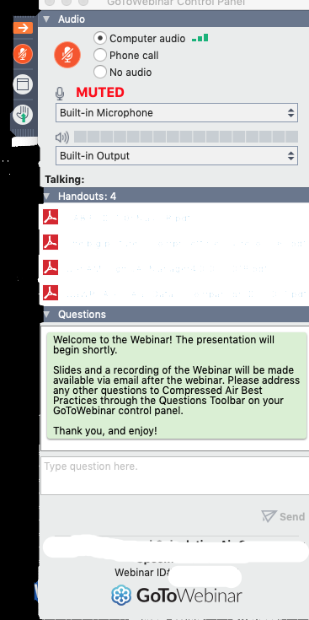
Q&A Format
Panelists will answer your questions during the Q&A session at the end of the Webinar.
Please post your questions in the Questions Window in your GoToWebinar interface.
Direct all questions to Compressed Air Best Practices® Magazine
Sponsored by

Slide 3

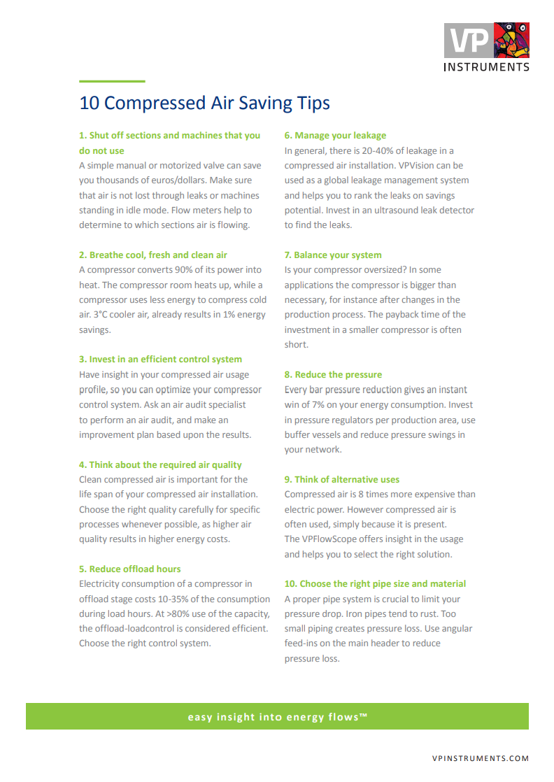
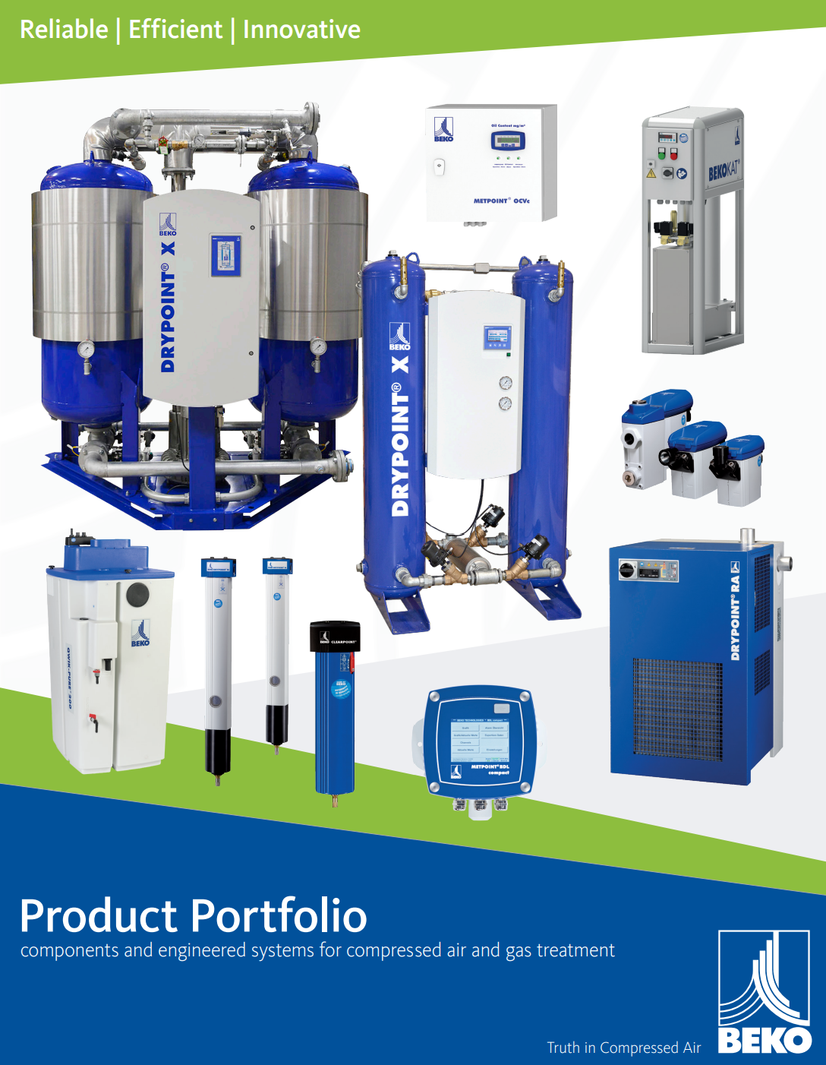
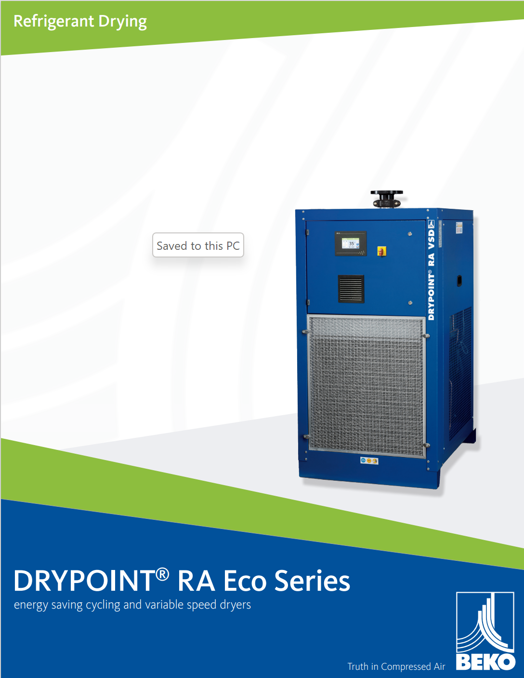

Handouts

Slide 4
Disclaimer
All rights are reserved. The contents of this publication may not be reproduced in whole or in part without consent of Smith Onandia Communications LLC. Smith Onandia Communications LLC does not assume and hereby disclaims any liability to any person for any loss or damage caused by errors or omissions in the material contained herein, regardless of whether such errors result from negligence, accident, or any other cause whatsoever.
All materials presented are educational. Each system is unique and must be evaluated on its own merits.

Slide 5
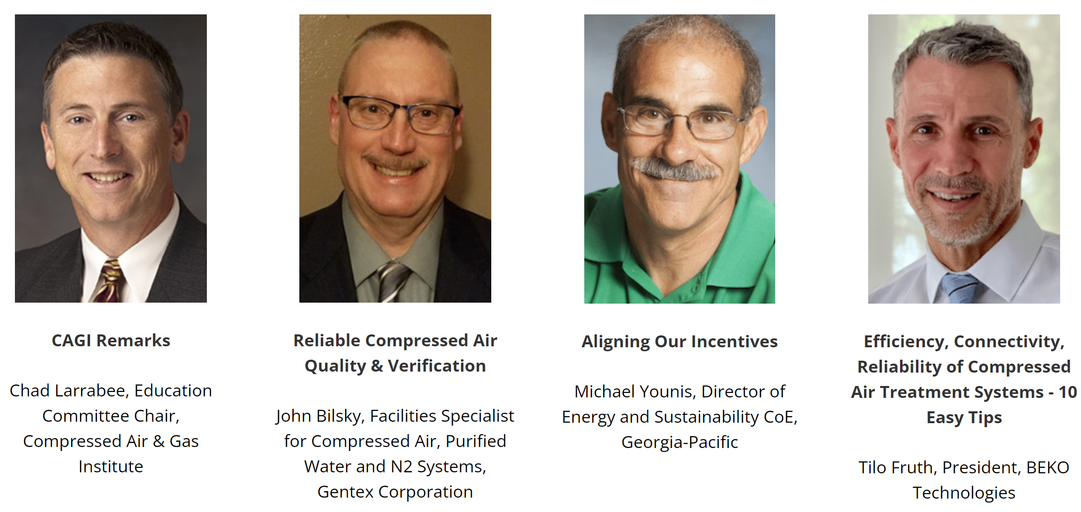

The Opening and Plenary Sessions welcomes all EXPO, Exhibitor and Conference Attendees! Tuesday, October 4, and Wednesday October 5, 2022, 10:15-12:00pm
At the end of the webinar, we are having a fun contest for a chance to win a free full conference pass valued at $675!

Slide 6

Compressed Air System Design for Lowest kW/100scfm
Introduction by
Compressed Air Best Practices® Magazine
Sponsored by

Slide 7

About the Speaker
Owner, Data Power Services
Over 45 years of experience in the compressed air industry
U.S. DOE Energy Expert, Compressed Air Challenge technical committee member, Compressed Air Challenge qualified instructor and instructor for Qualified AIRMaster+ Specialist Training
Tom Taranto
Data Power Services
Sponsored by

Slide 8
Compressed Air System Design for Lowest kW / 100 scfm
Measurement of Compressed Air Supply Efficiency
Specific Power (SP)
  kW / 100 scfm – kilowatts per 100 standard cubic feet per minute
Compressed Air Supply Efficiency index (C.A.S.E index)
  SCF / kWh – standard cubic feet per Kilowatt
        (Babu Joseph, Southern Cal Edison; IETC paper Houston April 2004)
SP – measured at a moment in time (power), & like a golf score lower is better
  kW / 100 scfm
C.A.S.E Index – measured over time (energy), & like miles per gallon higher is better
  SCF / kWh
Notes:
Air flow and power must be independent measurements.
Calculation of air flow based on measured power is only accurate if the compressor is in perfect working condition and is operating in a test laboratory environment, not interacting with a compressed air system.

Slide 9
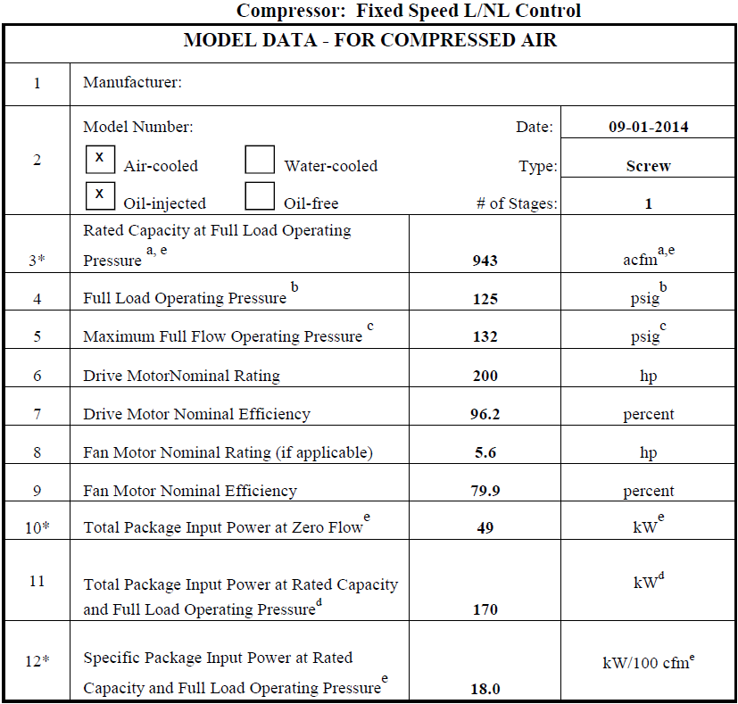
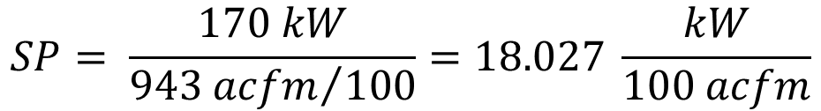
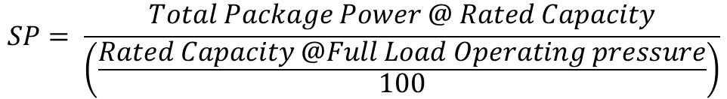

Air Compressor Rated Performance – Specific Power kW / 100 acfm
CAGI Rating kW / 100 acfm
  Line 3 Rated Capacity 943 acfm
  Line 11 Total Pkg Power 170 kW
  Line 12 Specific Power 18.0 kW / acfm
$$SP= \frac{Total Package Power @ Rated Capacity}{\left(\frac{Rated Capacity @Full Load Operating pressure}{100}\right)}$$
$$SP= \frac{170 kW}{{943 acfm}/{100}}=18.027 \frac{kW}{100 acfm}$$
Notes:
Full load specific power. What about part load operation?

Slide 10
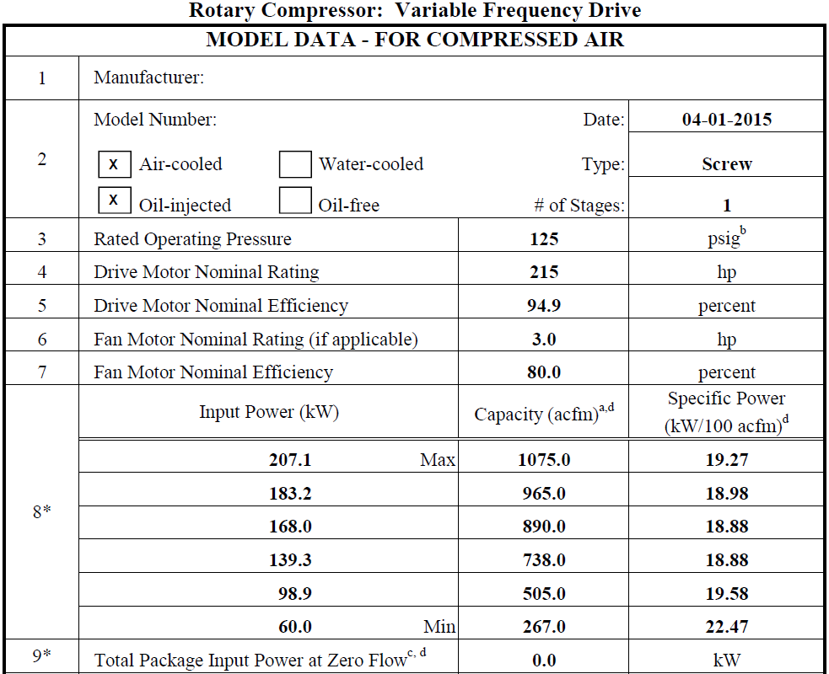
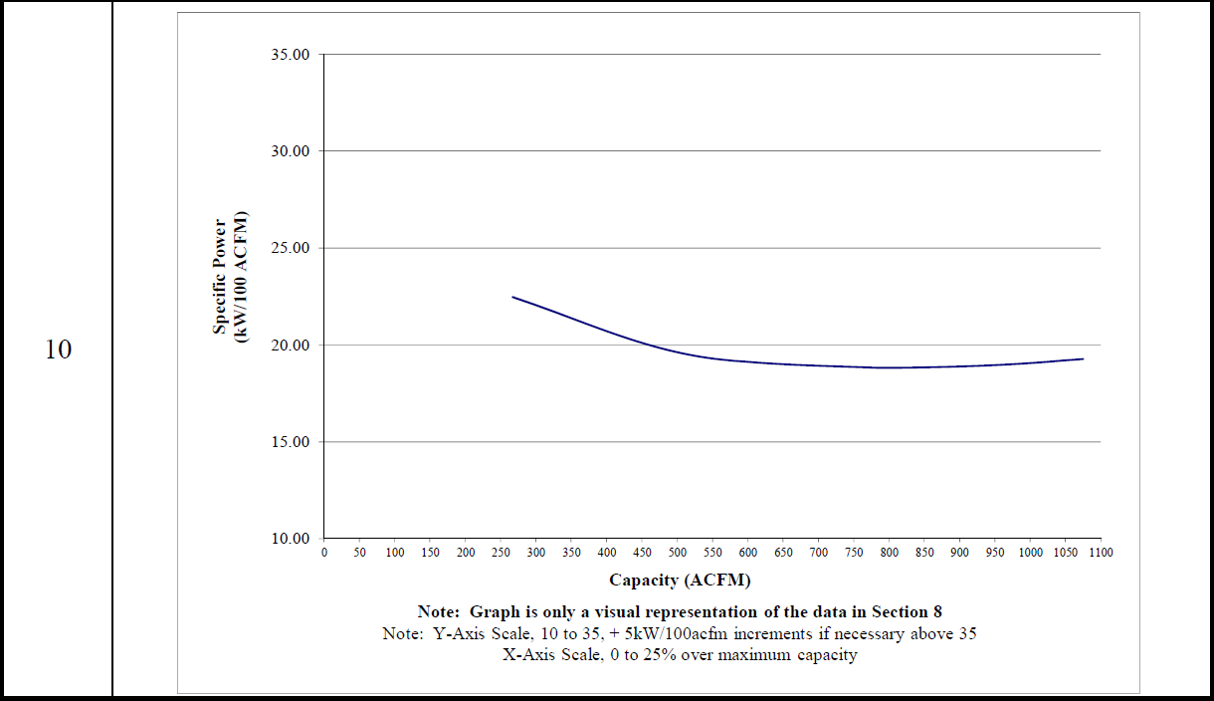
Variable Speed Drive VSD – Rated SP Curve CAGI Data
Notes:
VSD part load specific power.

Slide 11
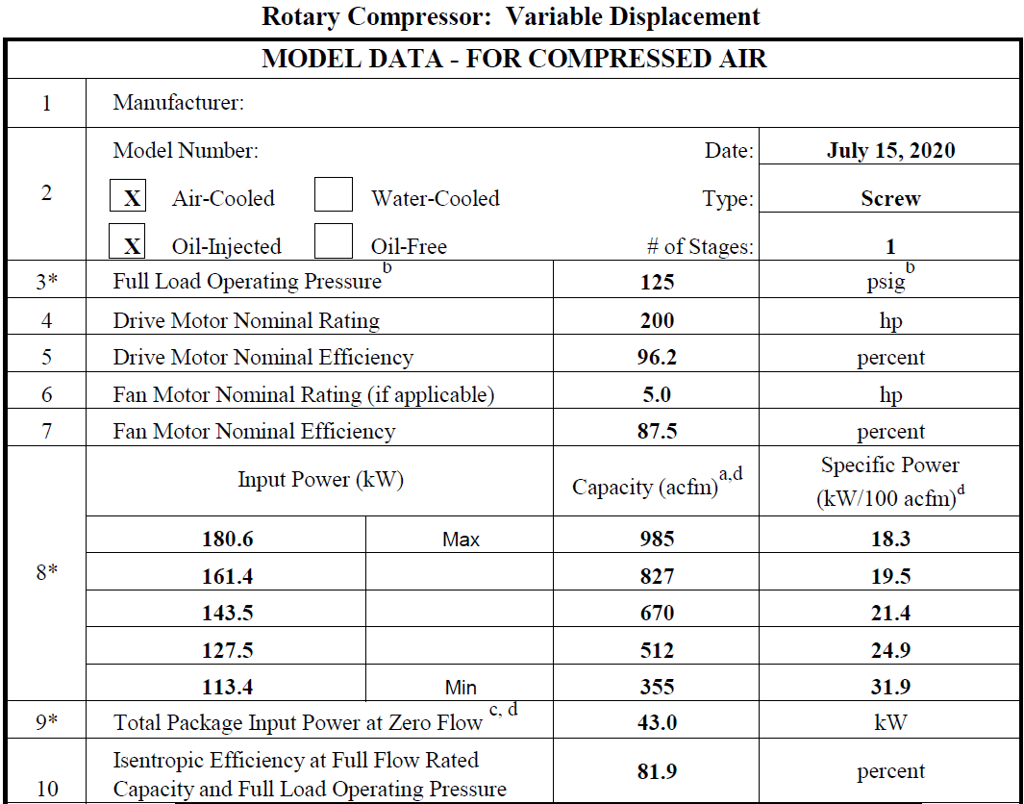
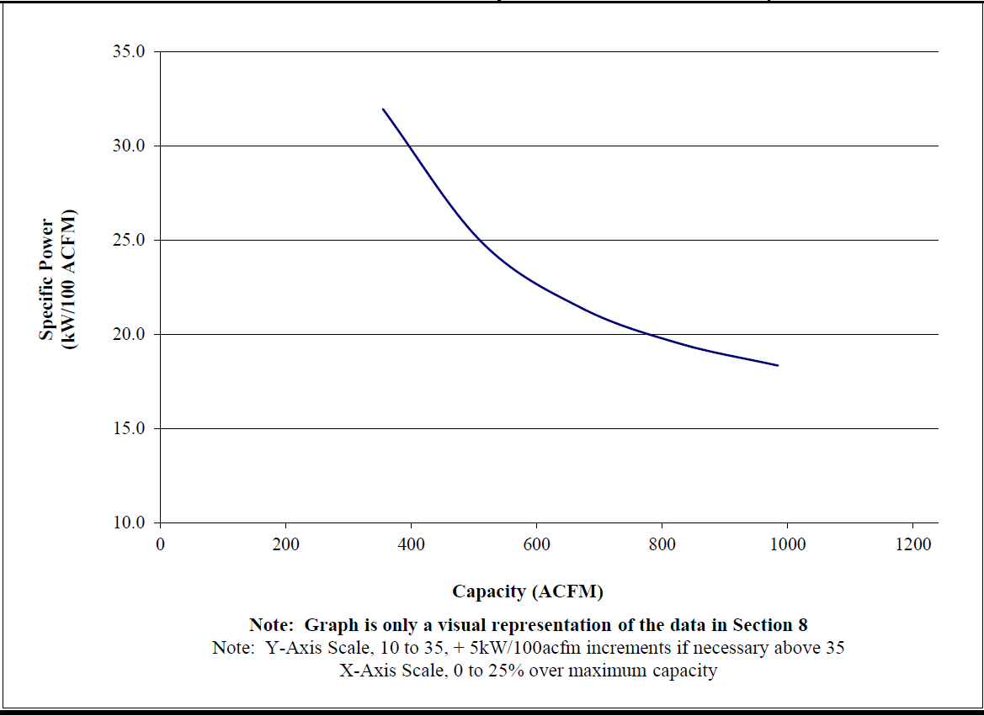
Variable Displacement – Rated SP Curve CAGI Data

Slide 12
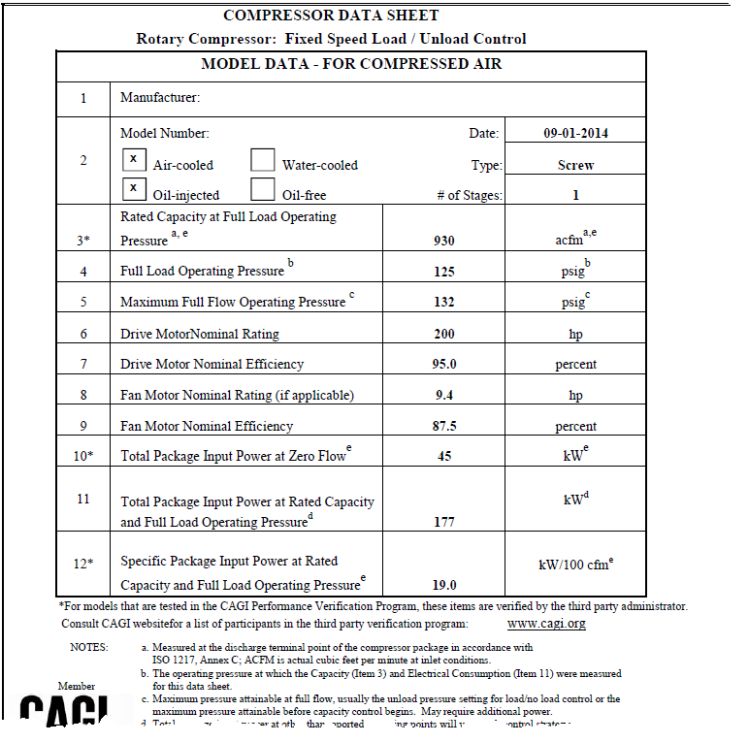
Load / Unload – Rated SP Curve CAGI Data

Slide 13
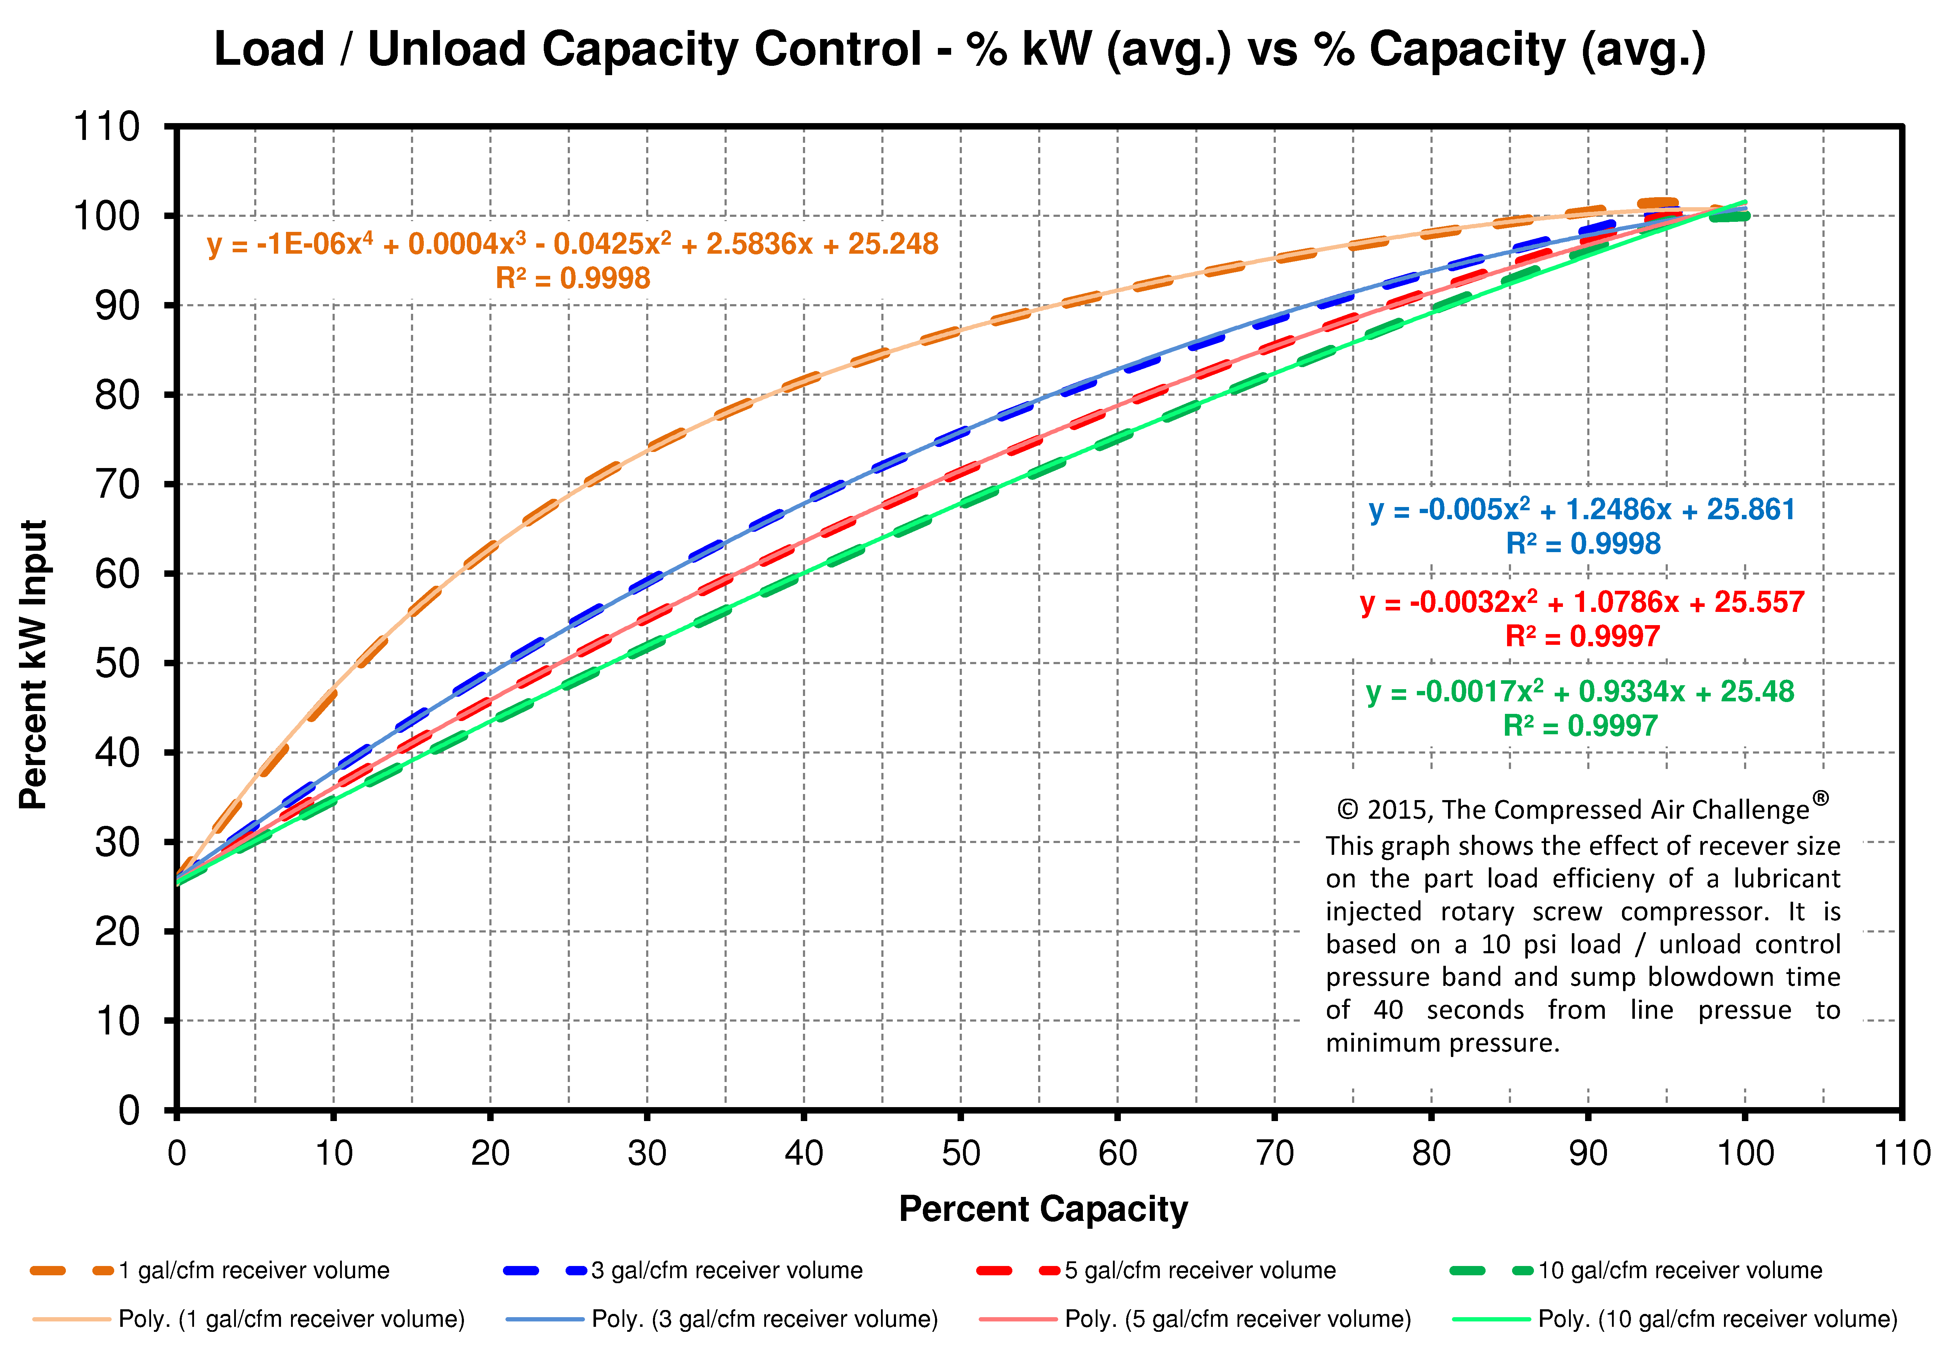
Compressor Package Power –vs– Airflow Delivered Capacity
Performance is a function of system Storage Volume
  System storage volume affects air compressor performance.
  Therefore, a system independent air compressor Specific Power performance curve is not possible.
  The same is true for inlet modulation control.

Slide 14
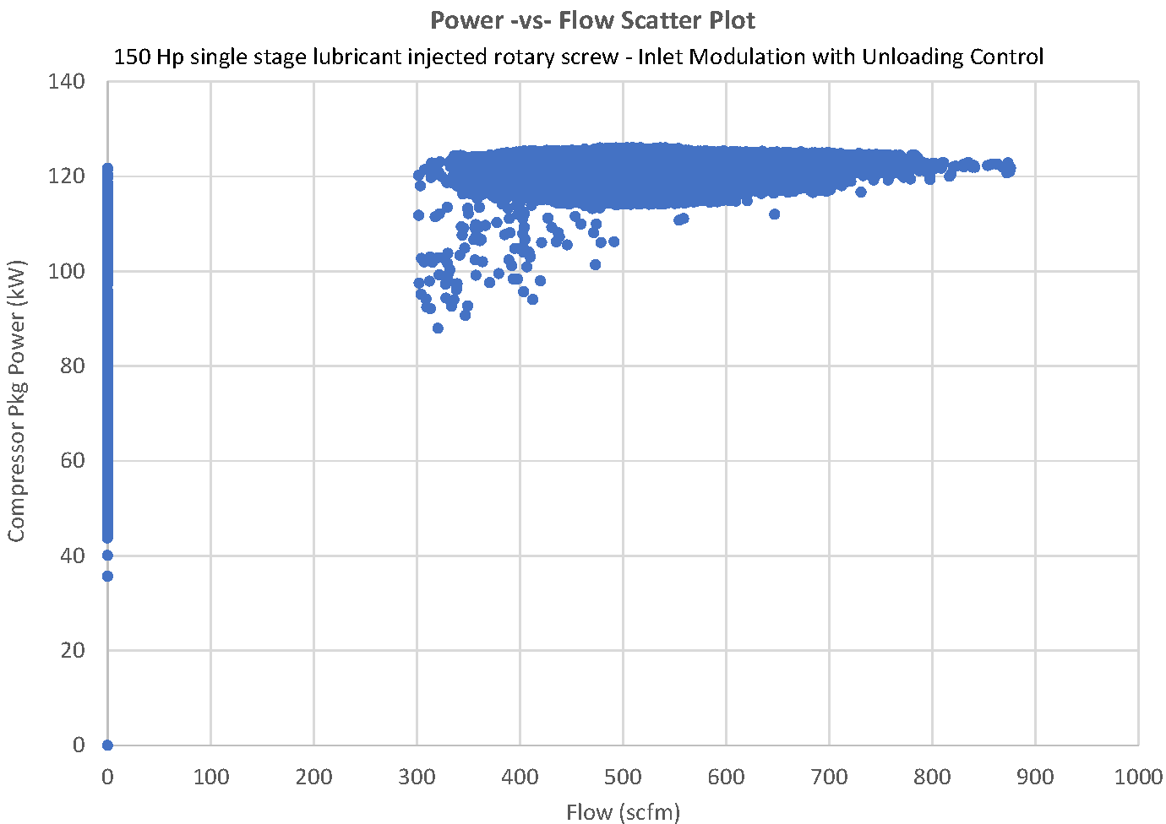
Power –vs – Flow Control Scatter Plot 150 Hp lubricant injected rotary
Inlet modulation control with unloading
Compressor flow = zero
  Unloaded operation
  Automatic Shutdown
Notes:
There are two conditions when compressor air flow is zero.
The compressor unloads and air flow is zero but kW is at the compressor’s unloaded power.
The compressor is stopped in which case both air flow and compressor power are zero.
A two dimensional power –vs- flow scatter plot does not identify the unloaded operation versus shutdown.

Slide 15
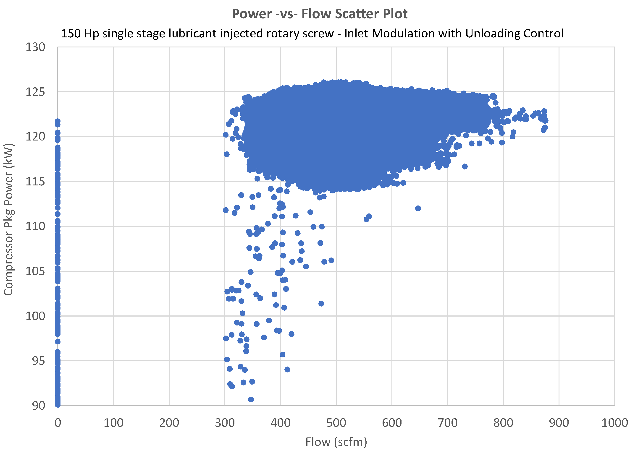
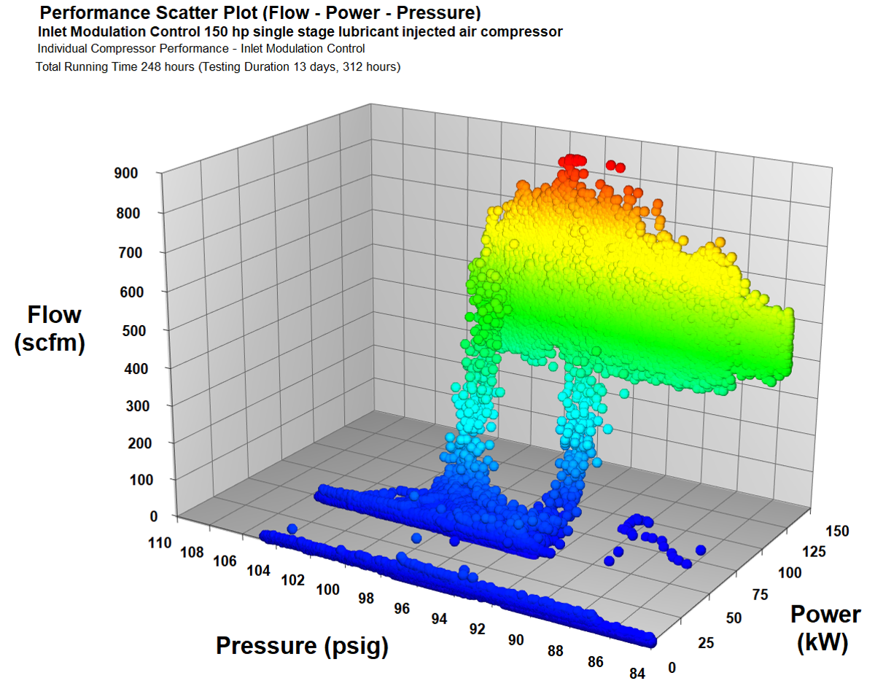
Power –vs – Flow Control Scatter Plot 150 Hp lubricant injected rotary
Inlet modulation control with unloading
Notes:
The 3D scatter plot of Power, Flow, and Pressure easily identifies the two conditions when air flow is zero.
It clearly shows zero flow at the unloaded power of about 45 kW.
There is also a group of data points at zero flow and zero power when the compressor is stopped.

Slide 16
Measurement parameters to quantify Specific Power
Compressor Specific Power
System Specific Power
Compressor power (kW)
Compressor air flow (scfm)
Compressor pressure (psig)
Consider using hourly average calculation.
System total compressor power
System total air flow
System supply pressure
Using total power and total air flow should account for unloaded power consumption of an individual compressor’s while delivering no air flow to the system.

Slide 17
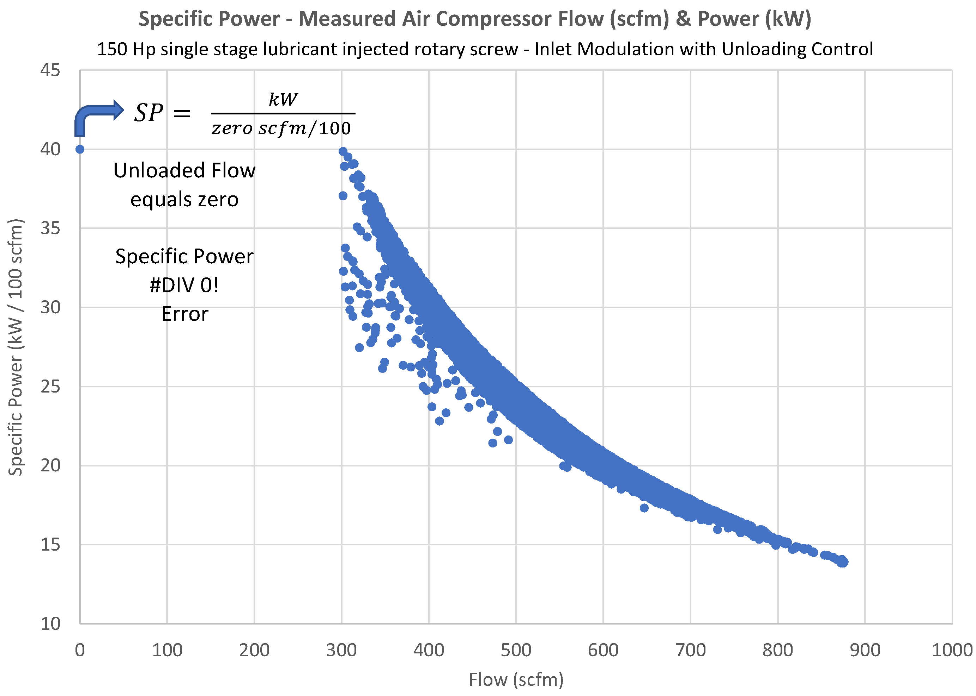

Compressor Specific Power – Scatter Plot 150 hp inlet modulation
Compressor flow = zero
  Unloaded operation
  Automatic Shutdown
$$SP= \frac{kW}{{zero scfm}/{100} }$$
$SP=$ #DIV 0!
error
Notes:
When calculating specific power and the compressor flow is zero there is a mathematical divide by zero error.
There are two conditions when compressor flow is zero.
The compressor unloads and air flow is zero but kW is at the compressor’s unloaded power.
The compressor is stopped in which case both air flow and compressor power are zero.
Note the thickness of the scatter plot. The specific power curve is not a single line as shown for compressor rated performance.
That is because at constant flow rate, specific power varies higher with increasing pressure and lower with decreasing pressure.

Slide 18
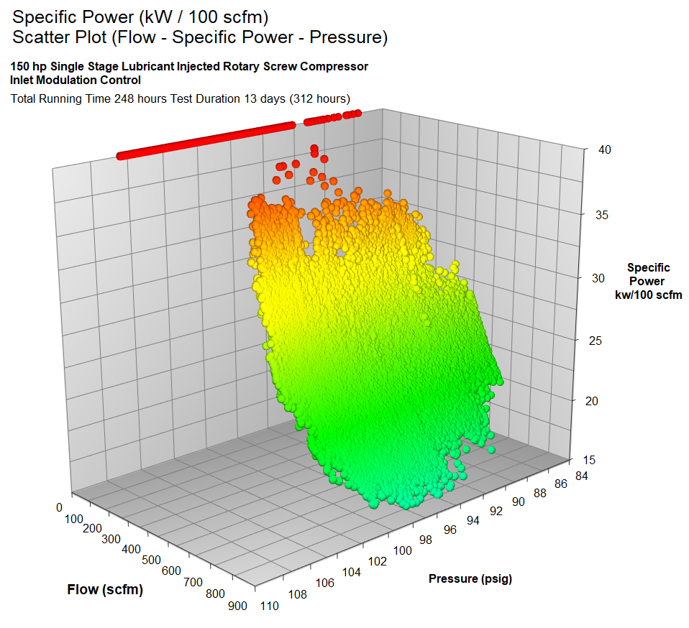
Compressor Specific Power – 3D Scatter Plot 150 hp inlet modulation
Specific Power is lower
  with higher air flow rate
  at lower discharge pressure
Eliminating waste (reducing air flow)
  leakage
  inappropriate use
  artificial demand
  will  specific power kWh / 100scfm
  will  energy kWh & $$$$$

Slide 19
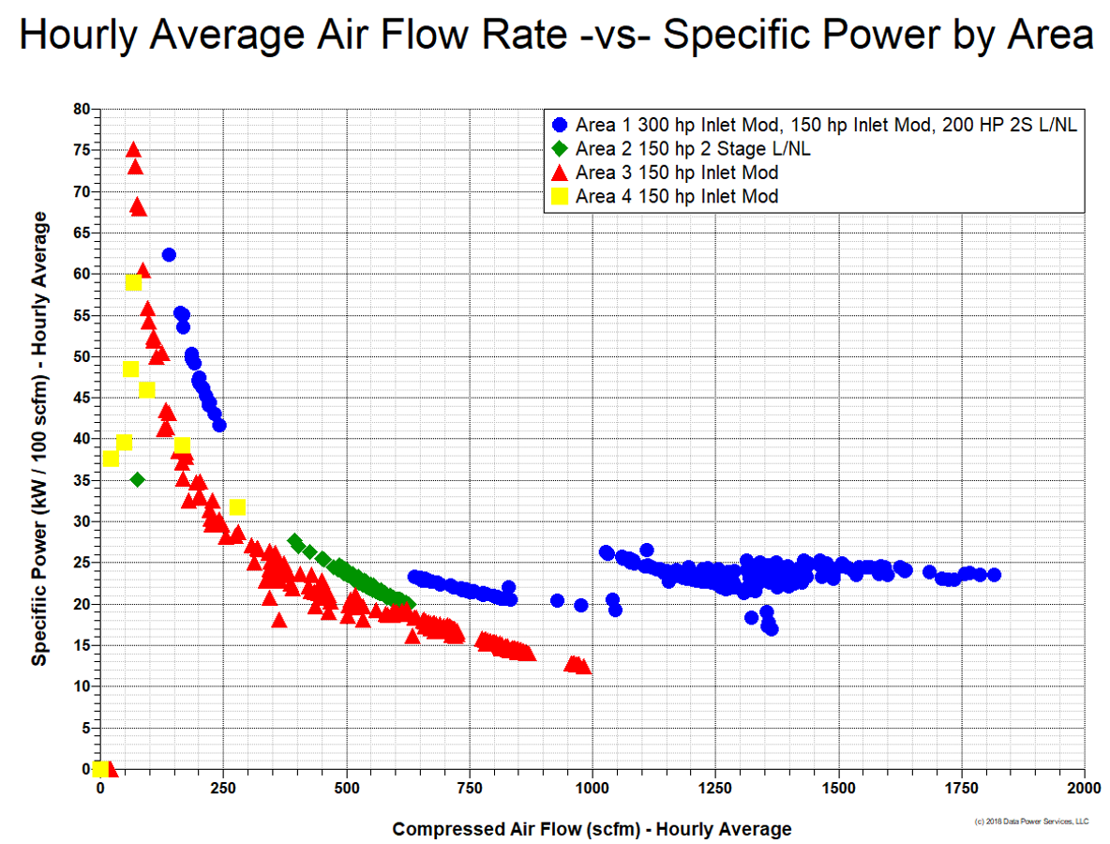
System Specific Power – Flow –vs- Specific Power by location
System Specific Power
  With multiple compressors operating it is less likely that flow will equal zero.
  For single compressors calculating hourly average flow and power makes it less likely that flow will be zero.
  But it happens one client disabled automatic shutdown and the compressor ran unloaded all of 3rd shift.
It is good practice to error trap #DIV 0! & if it comes up set specific power to zero.
Remember if the compressor is unloaded, power is still being consumed.

Slide 20
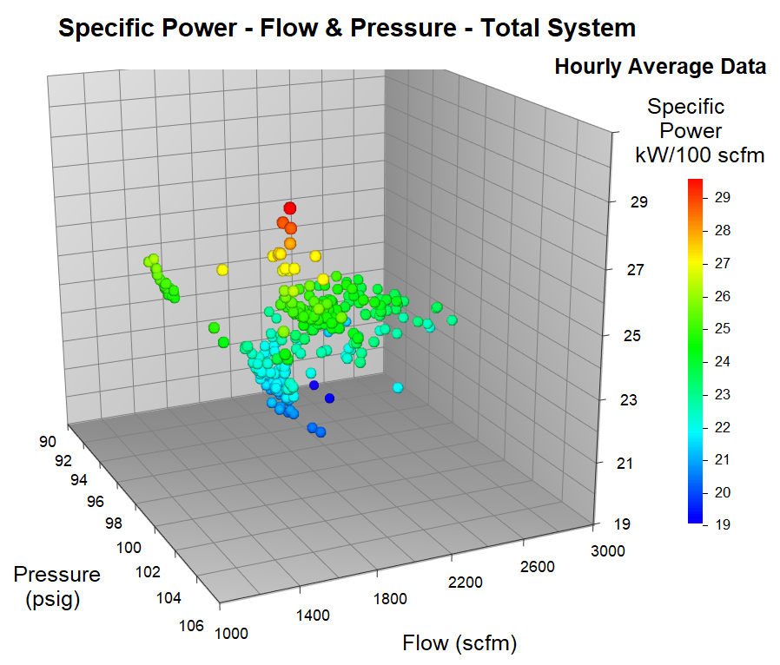
System Specific Power – Flow –vs- Specific Power by location
System Specific Power
  With multiple compressors operating it is less likely that flow will equal zero.
  For single compressors calculating hourly average flow and power makes it less likely that flow will be zero.
  But it happens one client disabled automatic shutdown and the compressor ran unloaded all of 3rd shift.
It is good practice to error trap #DIV 0! & if it comes up set specific power to zero.
Remember if the compressor is unloaded, power is still being consumed.

Slide 21
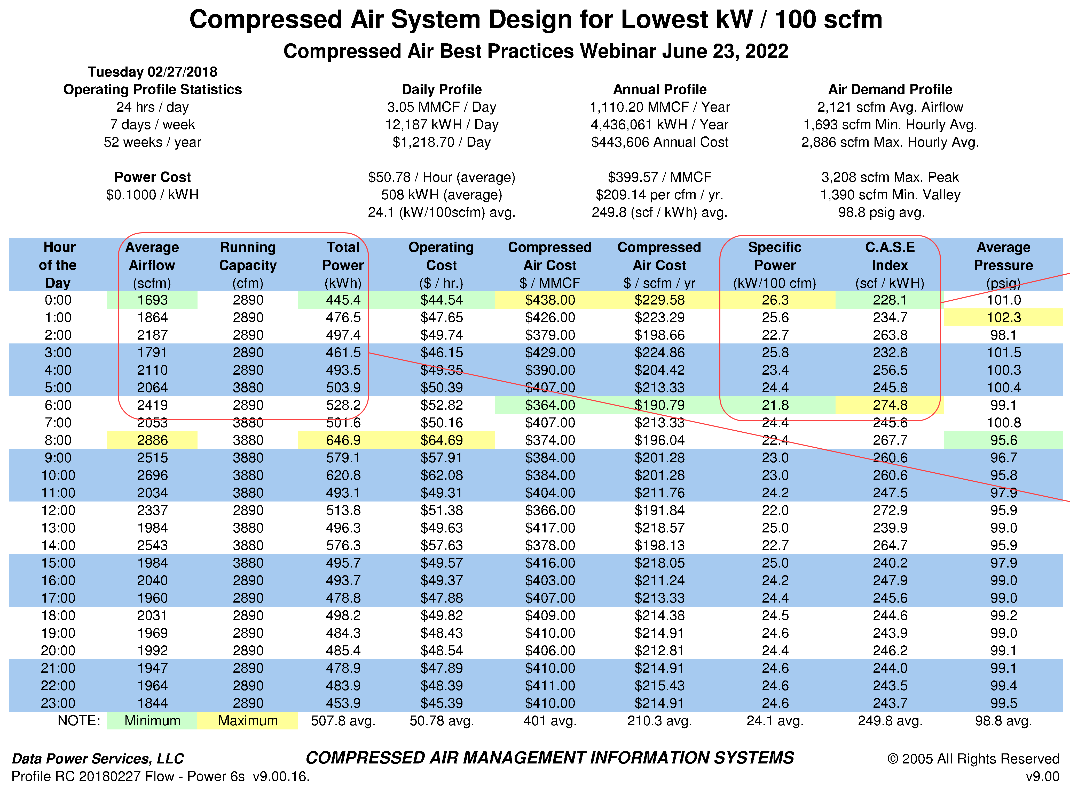
Hourly Average Measured Performance Profile
Hourly average performance reduces #DIV 0! Error potential.
CASE Index eliminates the #DIV 0! error.
  It also continues to account for power consumed during unloaded operation.
Specific Power can be calculated from CASE index value.

Slide 22
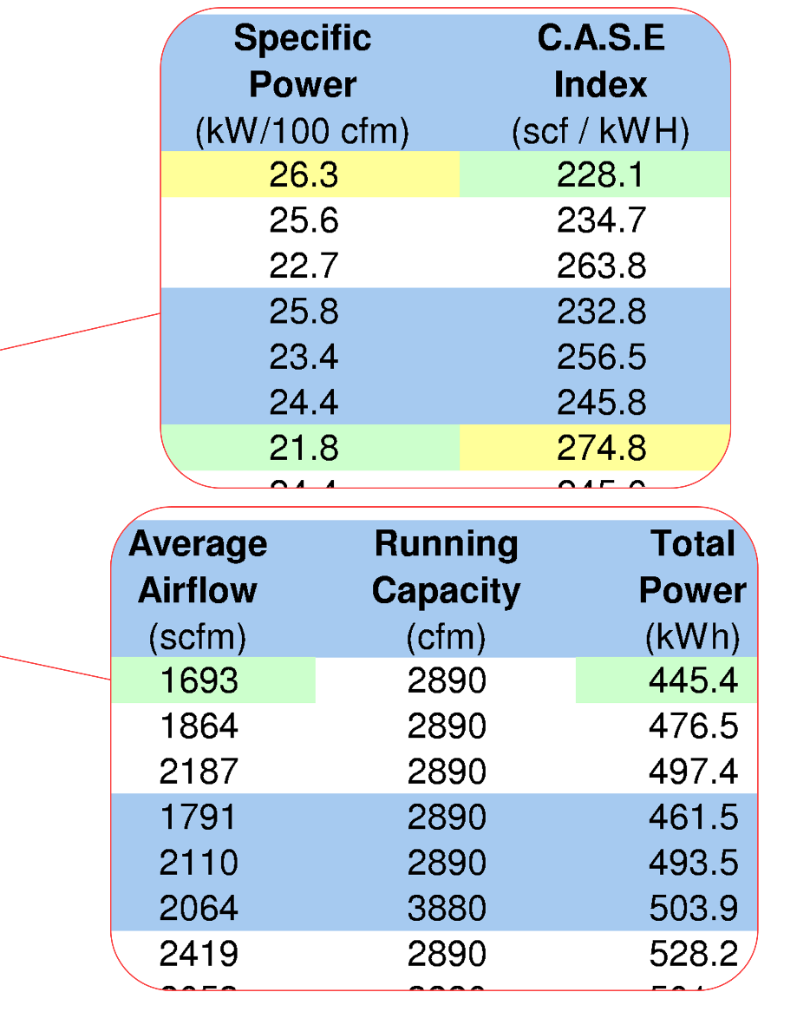
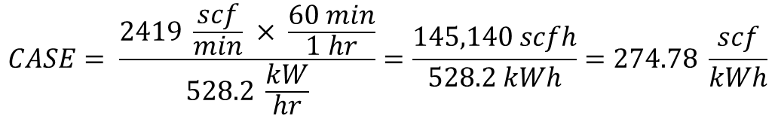
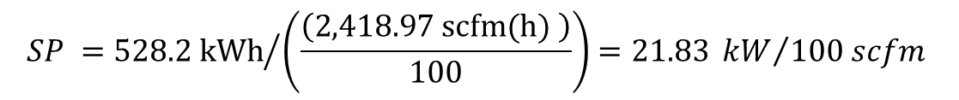
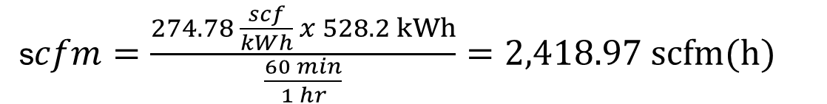


C.A.S.E. index
Specific Power (kW / 100 scfm)
$$CASE= \frac{2419 \frac{scf}{min} × \frac{60 min}{1 hr}}{528.2 \frac{kW}{hr}}=\frac{145,140 scfh}{528.2 kWh}=274.78 \frac{scf}{kWh}$$
s$cfm=\frac{274.78 \frac{scf}{kWh} x 528.2 kWh}{\frac{60 min}{1 hr}}=2,418.97 scfm(h)$
$$SP ={528.2 kWh}/{\left(\frac{\left(2,418.97 scfm(h) \right)}{100}\right)=21.83 {kW}/{100 scfm} }$$

Slide 23
Compressed Air System Design for Lowest Specific Power (SP = kW / 100 scfm)
Do’s
Don’ts
Eliminate compressed air waste
  leaks – inappropriate use – artificial demand
Right size compressor capacity
  size for existing productive air demand
Deliver lowest optimum pressure
  maintain storage pressure differential
Operate with appropriate storage
  supply peak air demand from storage
Optimize SP before demand management
  increase airflow to reduce specific power
Run large compressors @ light load
  up-size compressors “unknown future demand”
Run multiple compressors @ part load
  adjust controls so compressors “share load”
Use inlet modulation for trim capacity
  use poor part load SP for trim capacity

Slide 24
Compressed Air System Design for Lowest Specific Power (SP = kW / 100 scfm)
Do’s
Don’ts
Measure Flow – Power & Pressure
  be aware of unloaded operation (#DIV 0!)
Optimize controls & specific power
  only after applying demand management
Consider a System Master Control (SMC)
  use SMC for operating multiple compressors
Consider using pressure flow control
  pipe base load downstream of flow control
Measure Power & Calculate Flow for SP
  Use dependent variables to calculate SP
Supply excessive compressed air waste
  feed leaks, inappropriate use & artificial demand
Independently adjust compressor controls
  use individual controls to maintain alignment
Operate baseload capacity at storage pressure
  pipe baseload through primary storage

Slide 25
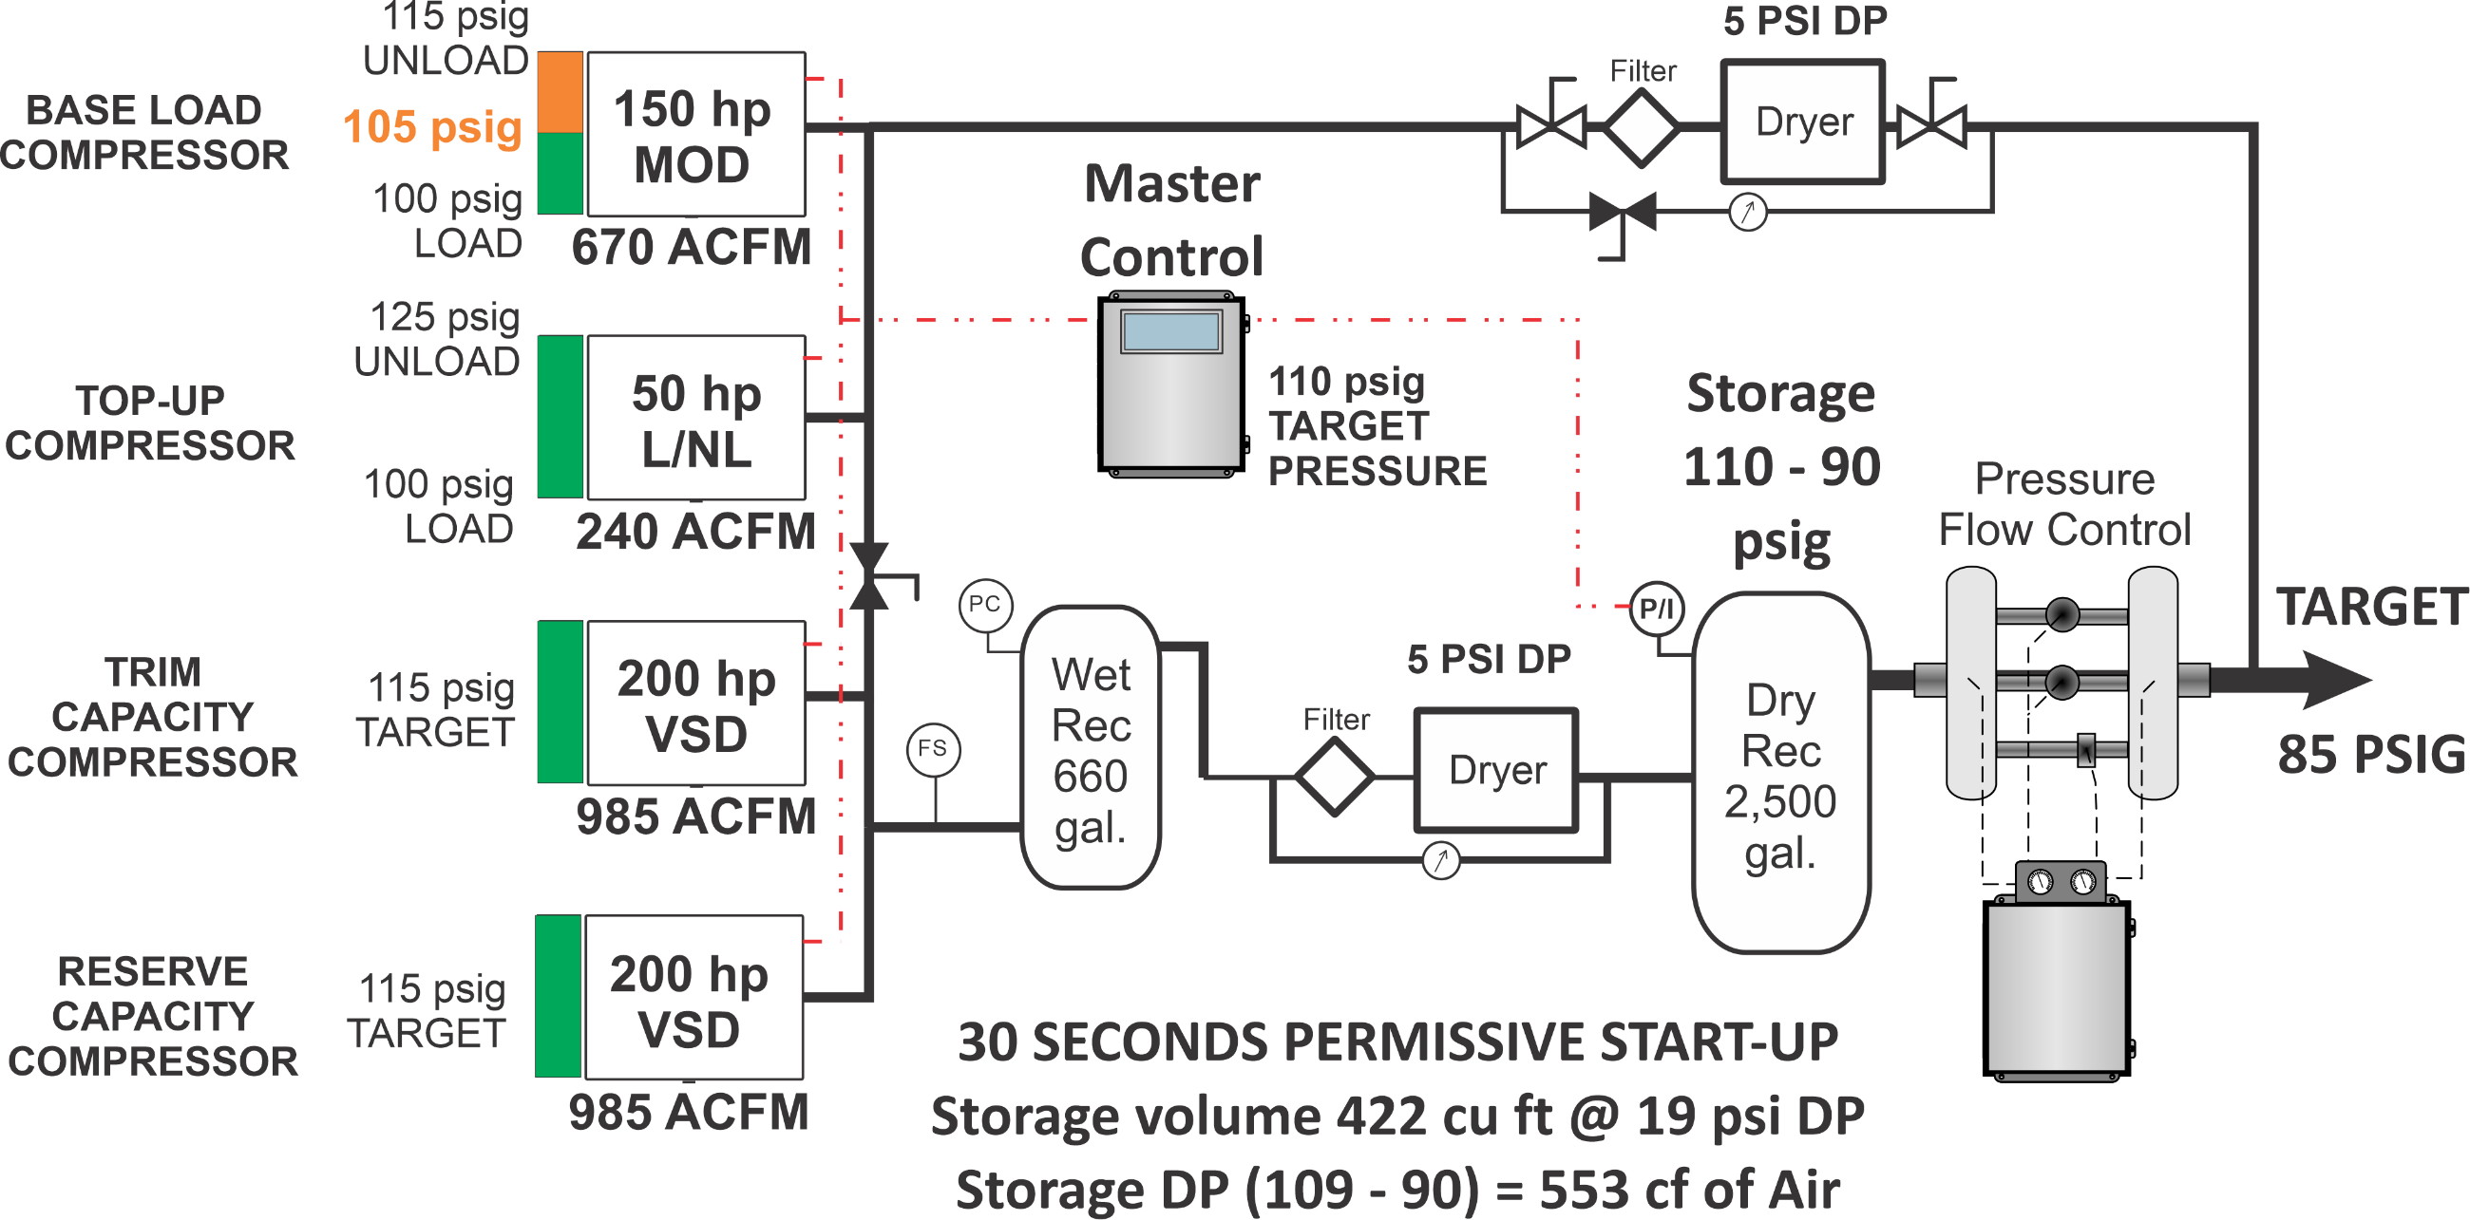
Compressed Air System Design for Lowest kW / 100 scfm

Slide 26


Questions
@ the end!
Tom Taranto
tom@datapowerservices.com
Thank
You !

Slide 27

About the Speaker
CEO, VPInstruments
> 20 years experience
VPInstruments offers industrial clients Energy Management Solutions for compressed air, technical gases as well as other utilities
Pascal van Putten
VPInstruments
Sponsored by

Slide 28
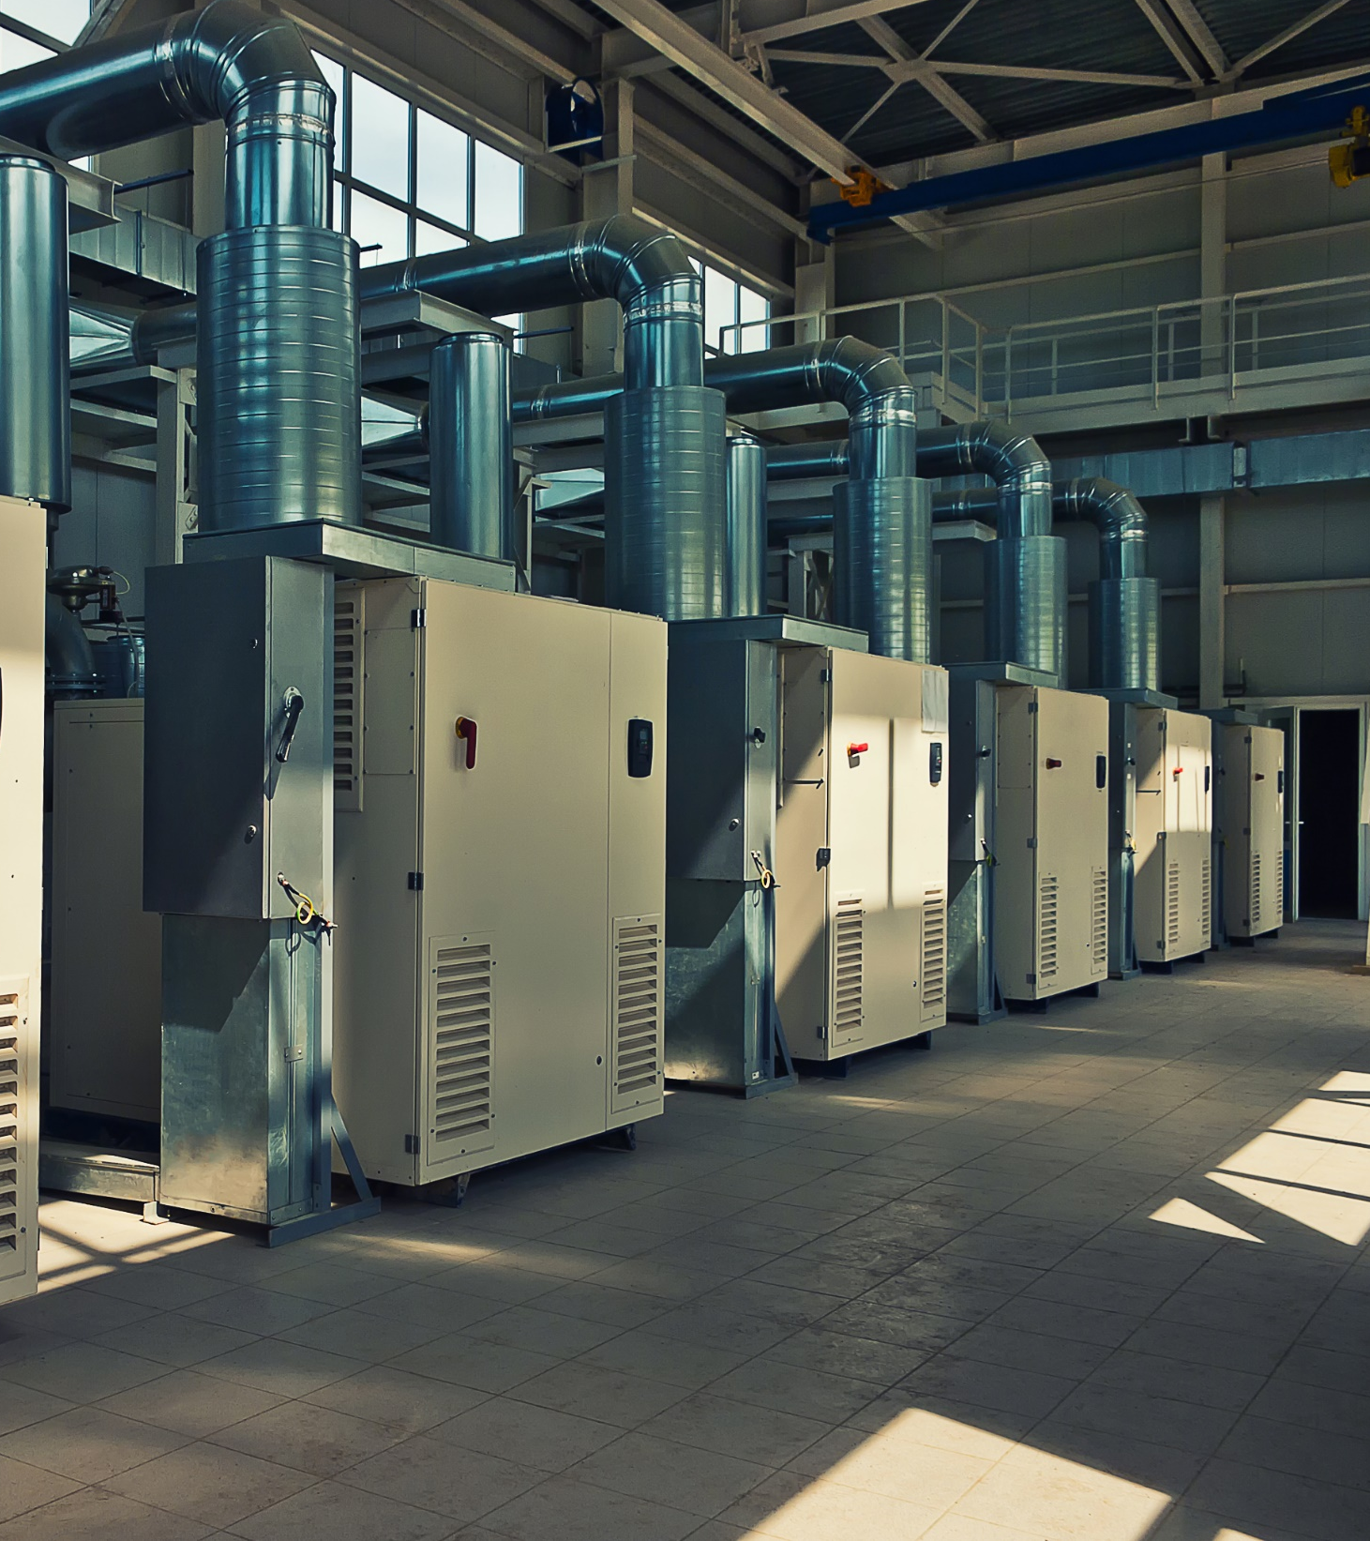
Specific Power: kW and Flow measurement
By Pascal van Putten, VPInstruments
Notes:
Thank you for the introduction

Slide 29

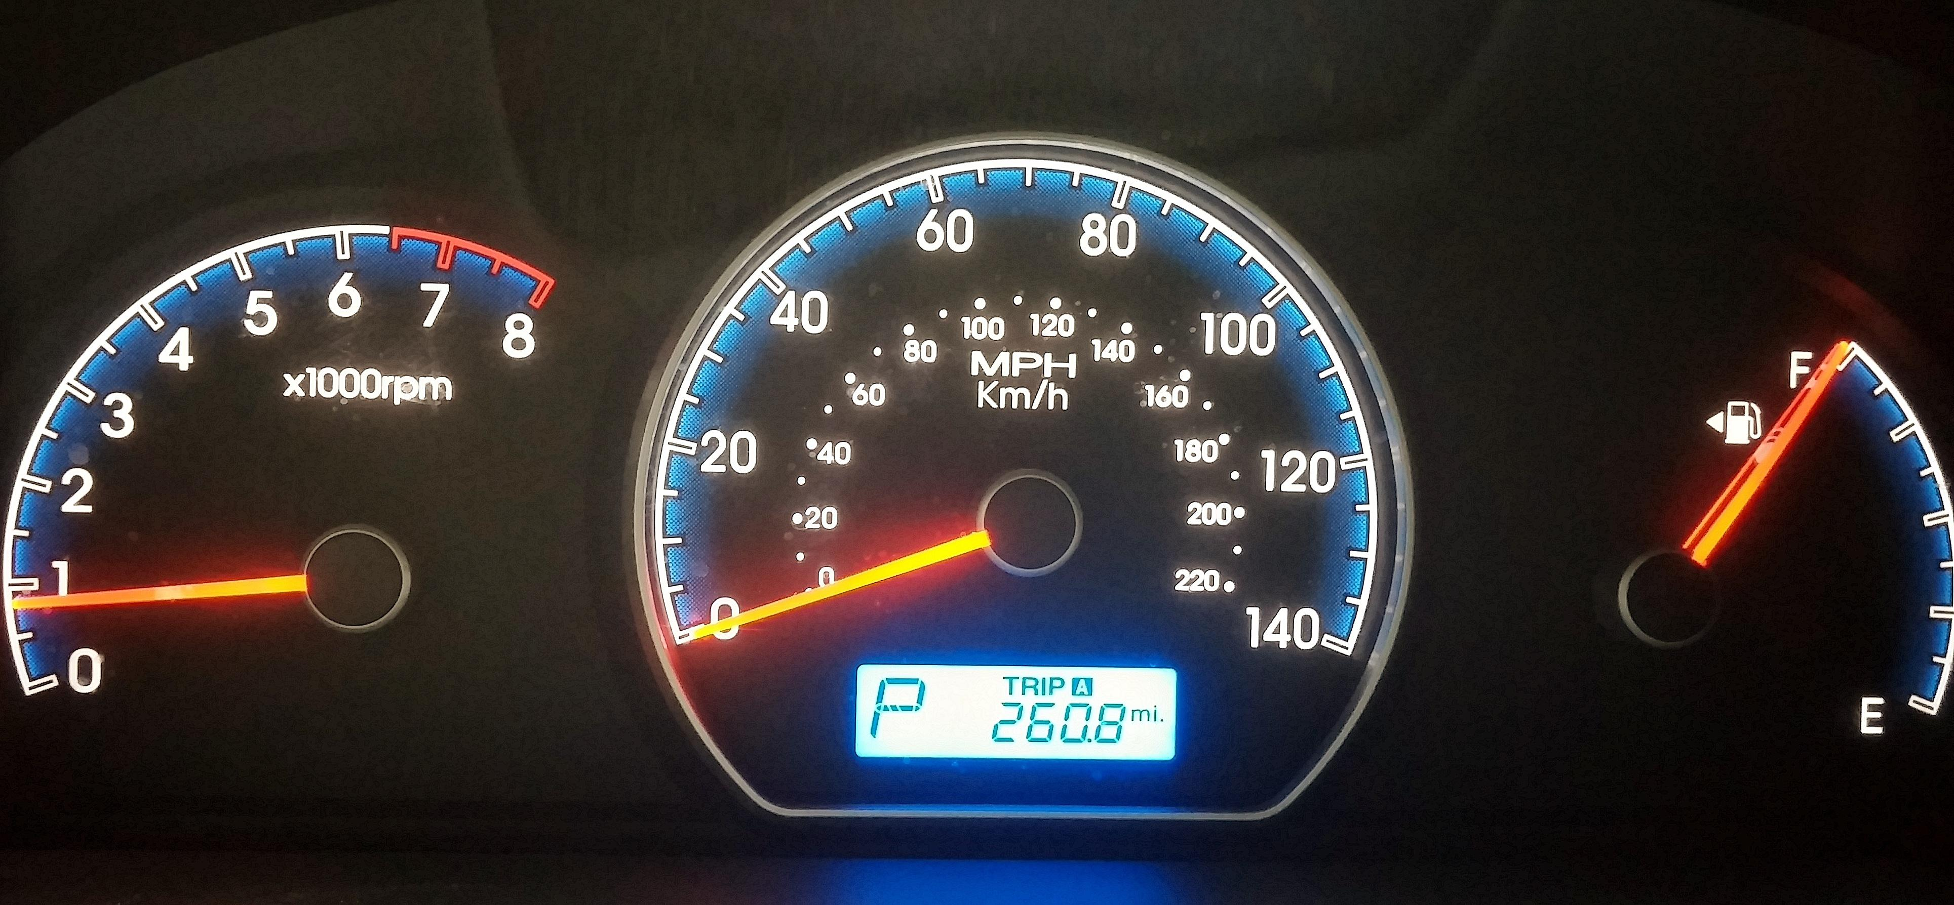
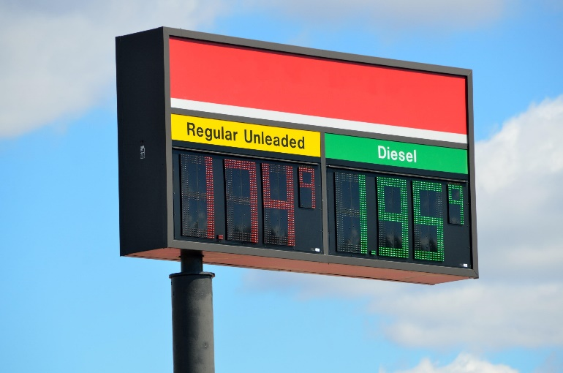

Slide 30
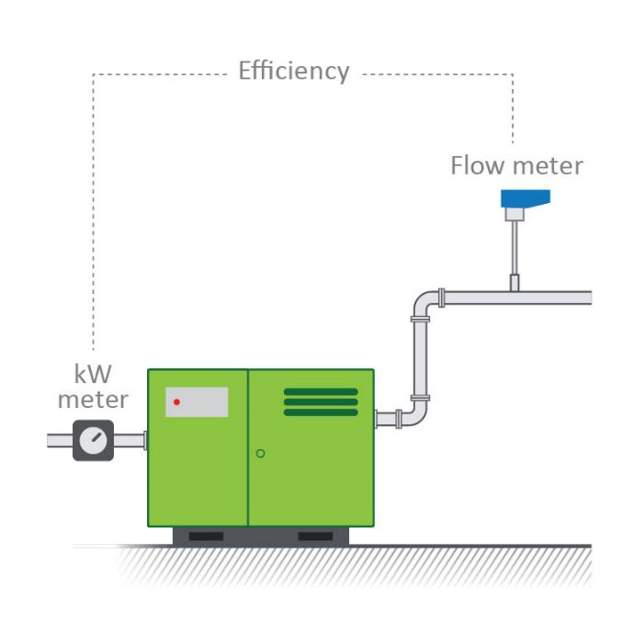
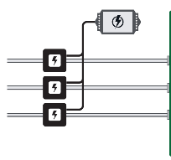
What is specific power / compressor efficiency
kW / 100 scfm or kW/m3/min
Mandatory in some states
  Title 24 (California)
  EED (Europe)
  Tax incentives
  Rebate programs
17
kW/100 scfm
Power meter
Notes:
One interesting power measurement applications is measuring the specific power of your compressors. Here you combine power measurement of the compressors with the flow output.
Specific power or compressor efficiency is measured by measuring power consumption and comparing this with flow output. So flow / power. A typical unit is kW/ 100 SCFM, outside of Europe often kW/m3/min is used.
Efficiency number is dependent on compressor type, industry, lay out of CAS.
Title 24: > 100HP need to measure compressor efficiency.

Slide 31
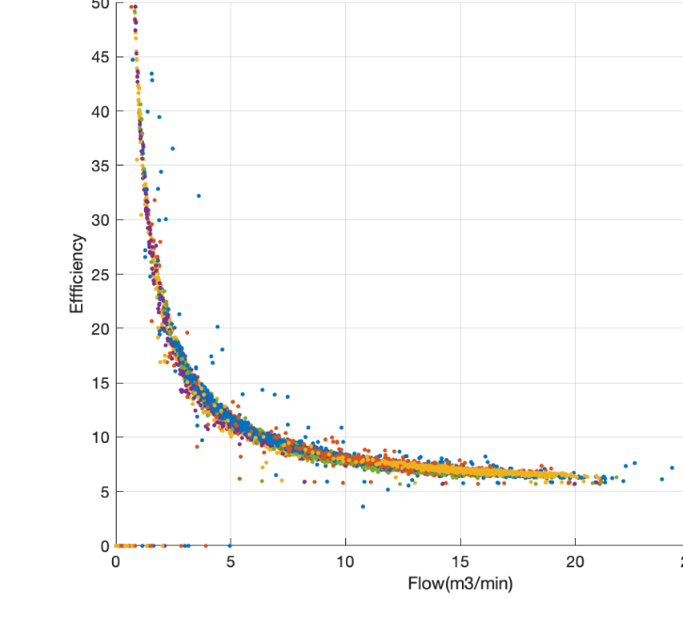
Why is specific power important?
Track impact of downstream improvements
Optimize supply side based on actual demand
Maintenance management of compressors
Flow based (smart) control
Master controller selection / optimization
Benchmarking compressors/ compressor rooms
Notes:
Never combin a master controls with energy management. By a separate monitoring system, the master controls can be validated.

Slide 32
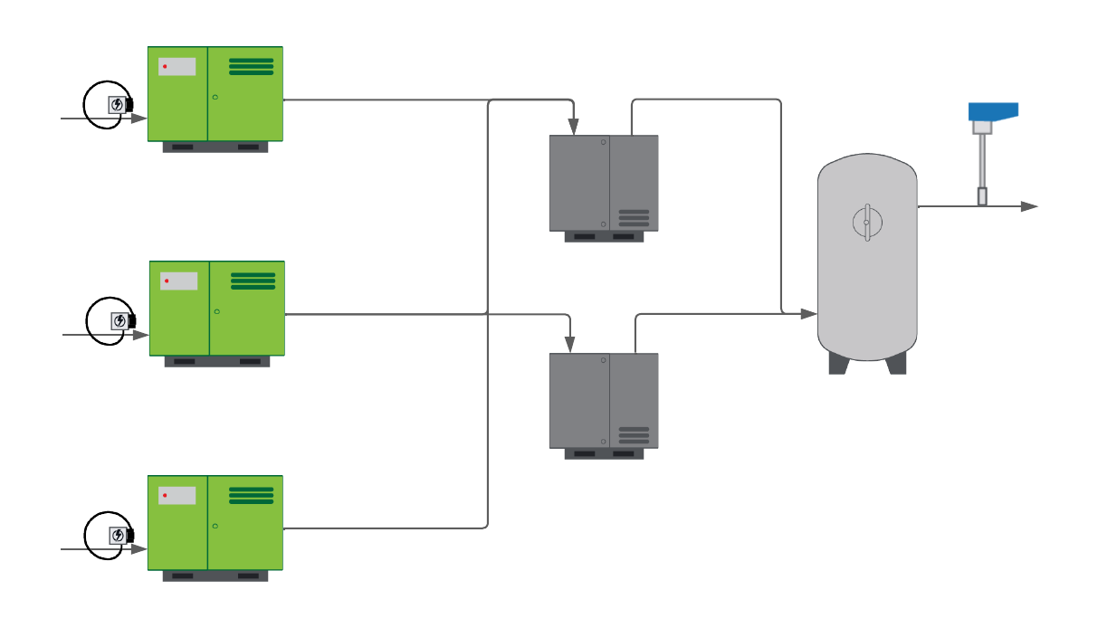
Basic setup: factory demand/ power input
Notes:
As a start: start by measuring power on all compressor and flow on the main line. Discover the impact of amongst others your compressor controls.
After receiver: Delay between flow and power, so you need to average power and flow over a long period of time.

Slide 33
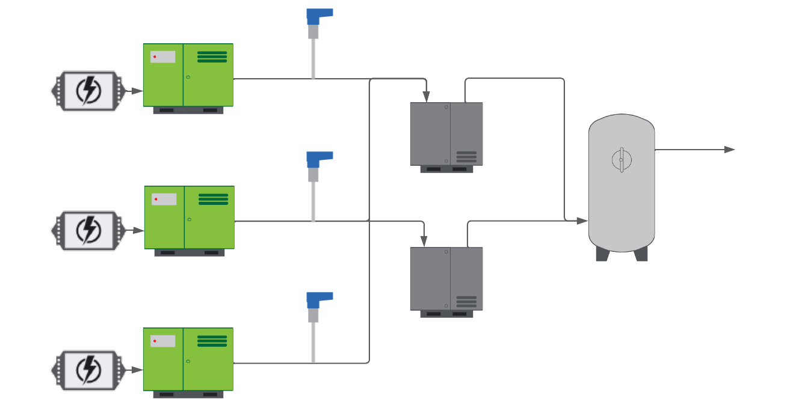
Advanced setup: individual compressors
Notes:
Depending on the compressor type, budget for measurement equipment, and goals: you can measure compressor efficiency per compressor. . Especially with centrifugal machines this is of interest, to see if their output is affected by inlet filter pollution or any internal issue. But also, to check failure of screw compressors, it can be very revealing to have a flow meter in the discharge pipe of each compressor.

Slide 34
Monitoring efficiency per compressor
Measuring specific power: average it over time, to get the right number.
Asset management:
  Clogged inlet filters
  Issues with cooling
  Wear of (oil free) air end
Compressor sizing: Undersized/oversized compressors due to changed demand profile
Control system optimization: Automatically select compressor combination which matches the actual demand: improved efficiency
Notes:
Focus on matching demand side capacity request brings more energy savings than getting 100% accurate compressors

Slide 35
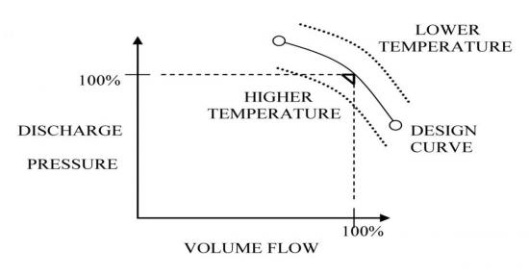
Specific power: Environmental factors
Environment has an impact on specific power:
Ambient pressure
Ambient temperature
Cooling water temperature
→ Monitor them all
Impact of inlet conditions
Airbestpractices.com
Notes:
Vooral centrifugal compressoren

Slide 36
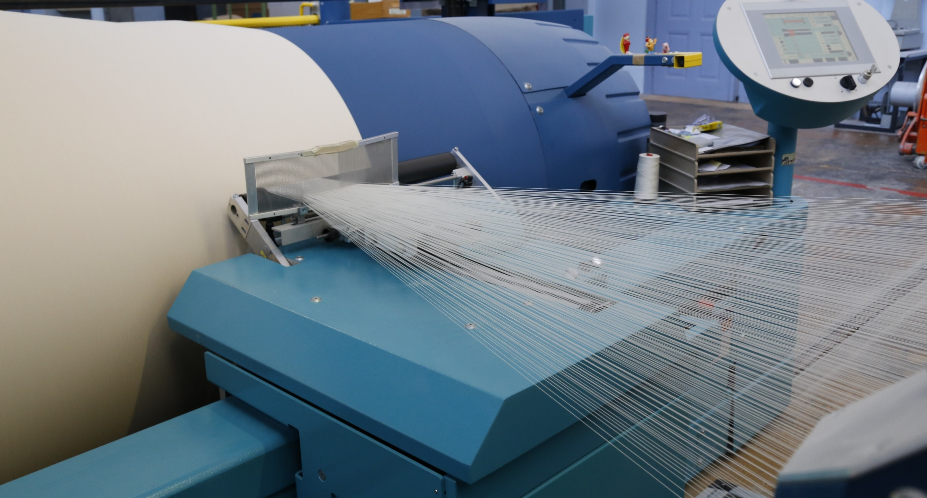
Textile Factory Turkey
VPVision showed which compressors have the worst efficiency and needed to be replaced
first
Compressor room details
1 MW Compressor stations
14 older turbo compressors
Equipment:
VPVision
Power meters
VPFlowScope flow meters
Results:
Prioritization of replacing compressors

Slide 37
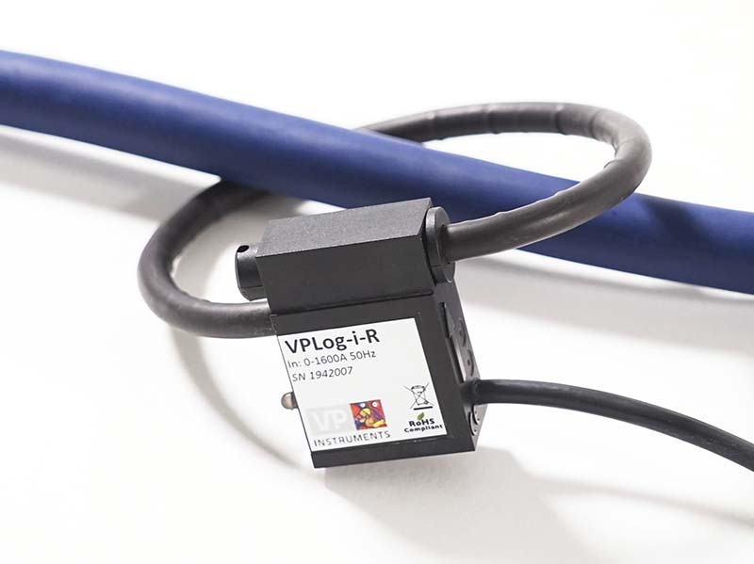
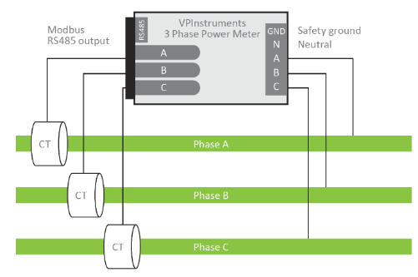
Sensors to measure input power/current
2 types of sensors:
Rogowski / current sensor (Amp sensor)
3 phase power meter with current transformers
Notes:
Feedback chuck:
You can rely on a quality power meter to give an accurate reading of power, but the reading is dependent on the following: factors:
The accuracy of the measured voltage, which is dependent on the tolerance and accuracy of any potential transformers which are used to provide voltage to the power meter.
The accuracy of the measured current, which is dependent on the tolerances of the current transformers used.
When power is estimated using a calculation it is often is done by measuring only one phase of the current and using an average value of the three-phase voltage. In this scenario, the assumptions make can have a big effect on the power calculation because:
It is necessary to assume that the three currents in the three-phase system are balanced. This is often a good assumption, especially when the load is a motor as is the case for a compressor.
The three voltage are is assumed to be balanced. This is often a reasonable assumption, but unbalanced voltages can lead to an inaccurate power calculation.
The biggest source of inaccuracy in the power calculation is the assumed power factor (Cos(phi).
Because the power factor varies as the compressor operating point (the amount of compressed air produced) changes and because you can only use one power factor value in the calculation, the calculated power is highly dependent on the power factor value that is used. A bad assumption about the power factor can lead to a 10% or more error in the power, which results in an equivalent error in the energy calculation and the cost in real money.
https://www.ecdonline.com.au/content/electrical-distribution/article/electricity-metering-accuracy-explained-372339275#axzz6TZ0UinFG

Slide 38
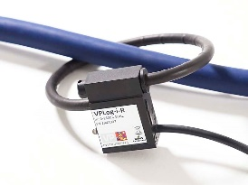
Current sensor vs. Power meter
Amp Clamp Power Measurement | Power Meter
Easy to install (Bus Bars) Large measurement range Installation on ”hot” lines On-time voltage measurement: accuracy may shift depending on stability | CT has fixed form factor: hard to install Current Transformers: properly sized Installation often requires powering down Continuous voltage measurement: More accurate power measurement
Applications | Applications
Compressor status (Off/On/Standby) Estimated power consumption Quick check during audits | Accurate energy usage Submetering Tax incentives (Title 24 California)

Slide 39
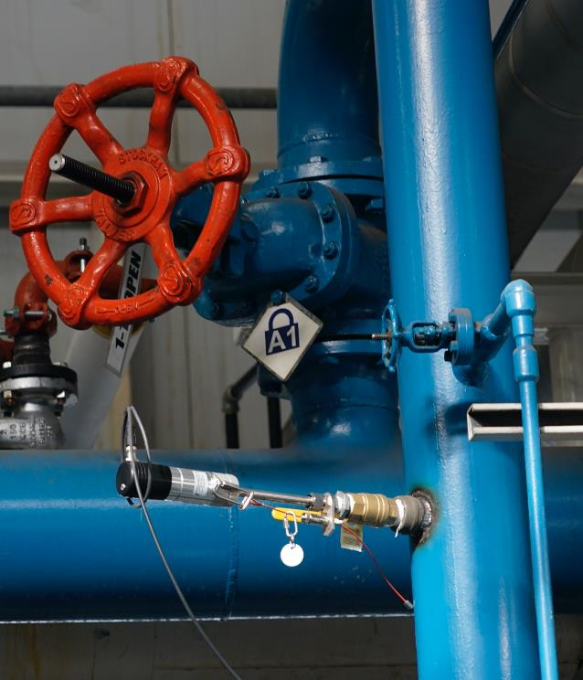
Flow sensors to measure compressor output
Match flow sensor technology with harsh outlet conditions (temperature, water, oil)
Measure 3-in-1: mass flow, pressure, temperature
Use calibrated flow sensors, with certificate rather than cheap flow switches which are “teached in” in the field. Especially when there is lots of $$$ at stake.
Manage expectations, especially when installation requirements of the sensor are not fully met. In that case the efficiency number can be a good KPI for maintenance management.
Compare apples with apples: check reference conditions
Notes:
Outlet conditions:
Condensate
Temperature swings
Reverse flow
Short pipe run
Vibrations
From FAD to normal: 8,7% difference!

Slide 40
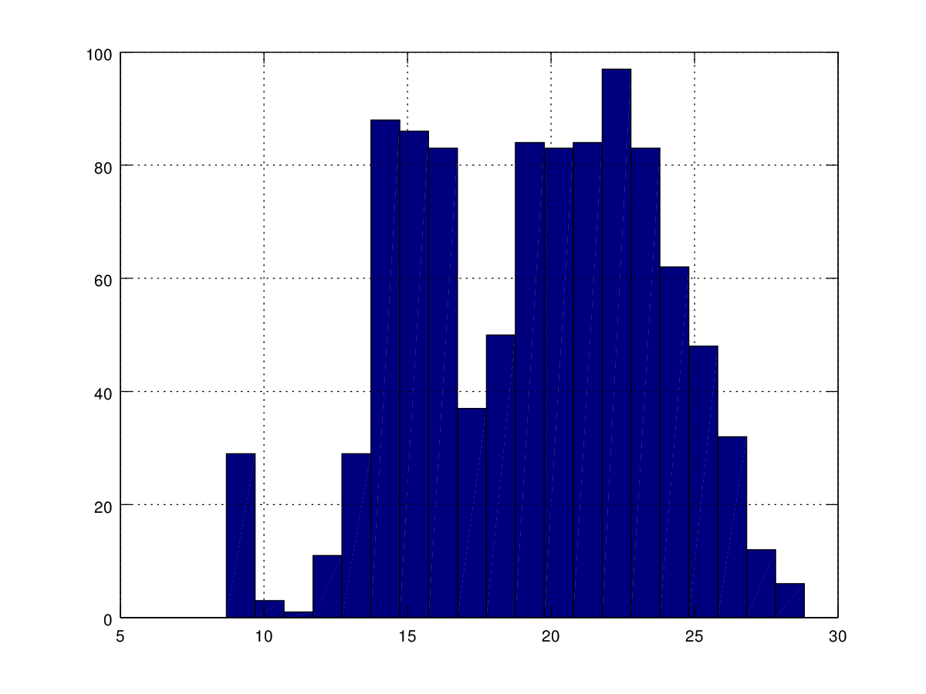
Flow measurement: multiple insights
3-in-1 (mass flow, pressure temperature):
Efficiency
Histogram (demand profile)
System leakages
Flow/ pressure relation
Flow/ temperature relation
Week 35
(August)
Notes:
Demand die over de tijd veranderd. Plus Programmatjes van compressor vendors wat optimale combinaties is obv van het flow/druk verbruik downstream.

Slide 41
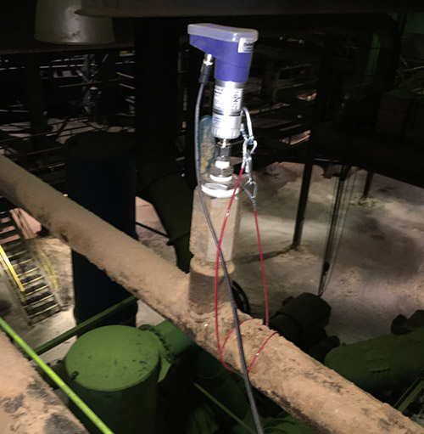
Make sure it is done right
Watch for errors!
Installation effects
Orifice parameter
Over/ under sizing of flow meters
Bi-directional vs. uni-directional
Wrong technology applied

Slide 42
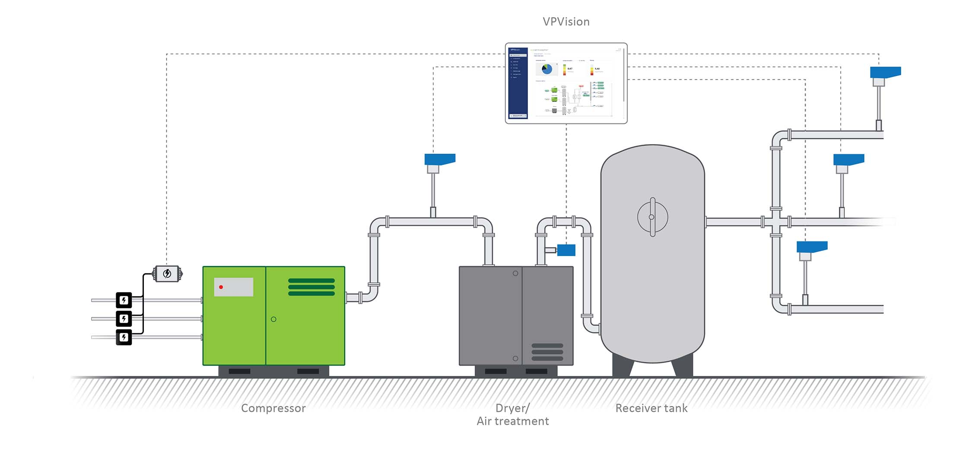
Combine it all: Monitoring System
Notes:
How to monitor compressor efficiency over time: a monitoring system where all data comes together can be useful. Standard KPI’s, tracking, overviews, graphs. Your trend monitoring is all combined in one system.

Slide 43
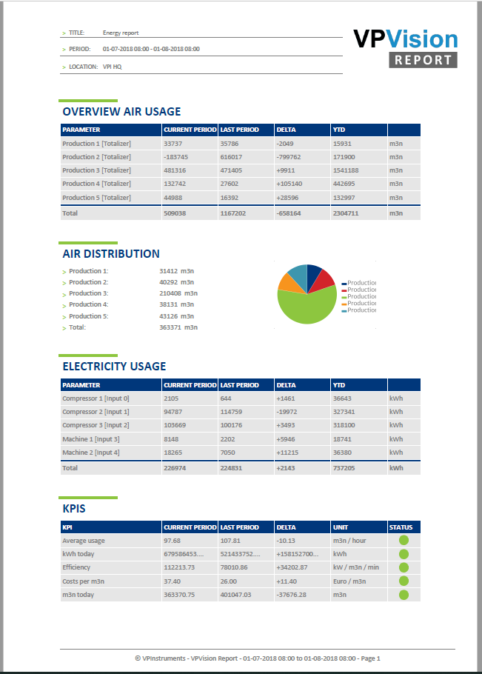
Energy Management Report
Trend monitoring over time
KPI visualization
Compare with earlier data
Notes:
Typically a monitoring system comes with automatisch reporting, making it even easier to track specific power over time.

Slide 44
Compressor efficiency – take aways
Accuracy vs. goal of the measurement: Just trending or legal compliance?
Be aware of uncertainties (single phase amp meter vs 3 phase, flow meter technology)
Take latency into account in real-time measurements: average over time
Choose reference conditions and stick to them

Slide 45
Pascal van Putten
pascal.van.putten@vpinstruments.com

Slide 46

About the Speaker
Product Manager, BEKO Technologies
16 years of experience in the compressed air industry
BS in Mechanical Engineering
Jason Brister
BEKO Technologies
Sponsored by

Slide 47
Efficiency Considerations for Compressed Air Treatment Systems
Compressed Air Best Practices Webinar
June 23, 2022

Slide 48
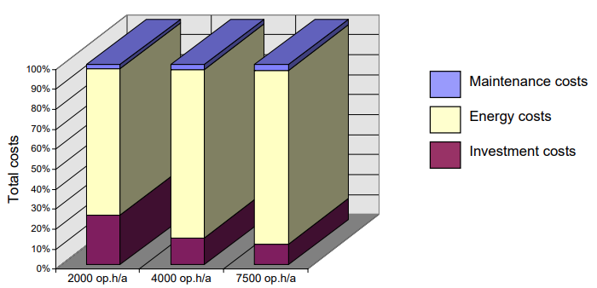
Design Considerations
Efficiency – why does it matter?
  Energy is the largest cost factor associated with compressed air production
  Large cost reductions possible with improved operating efficiency

Slide 49
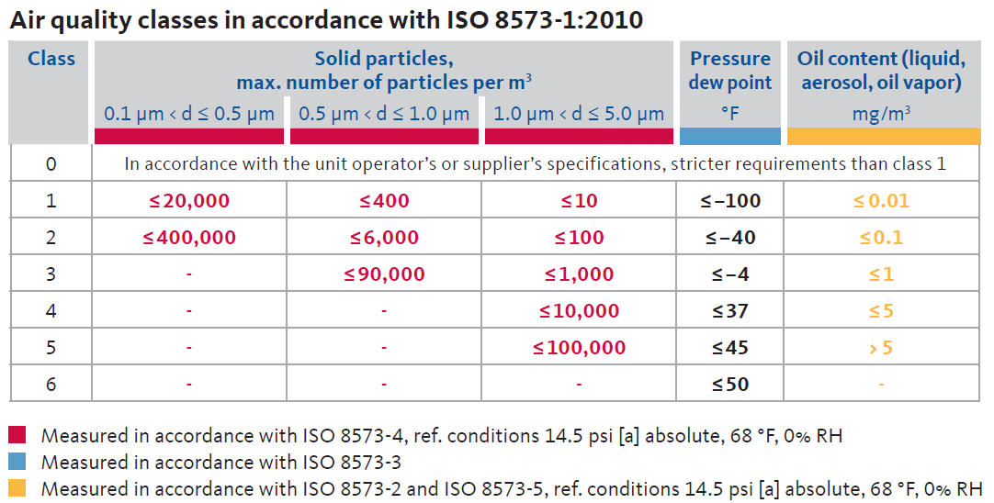
Air Treatment – What is Required?
General recommendations:
  Properly size all equipment
  Only treat the air to the required level (use ISO classes to specify)

Slide 50
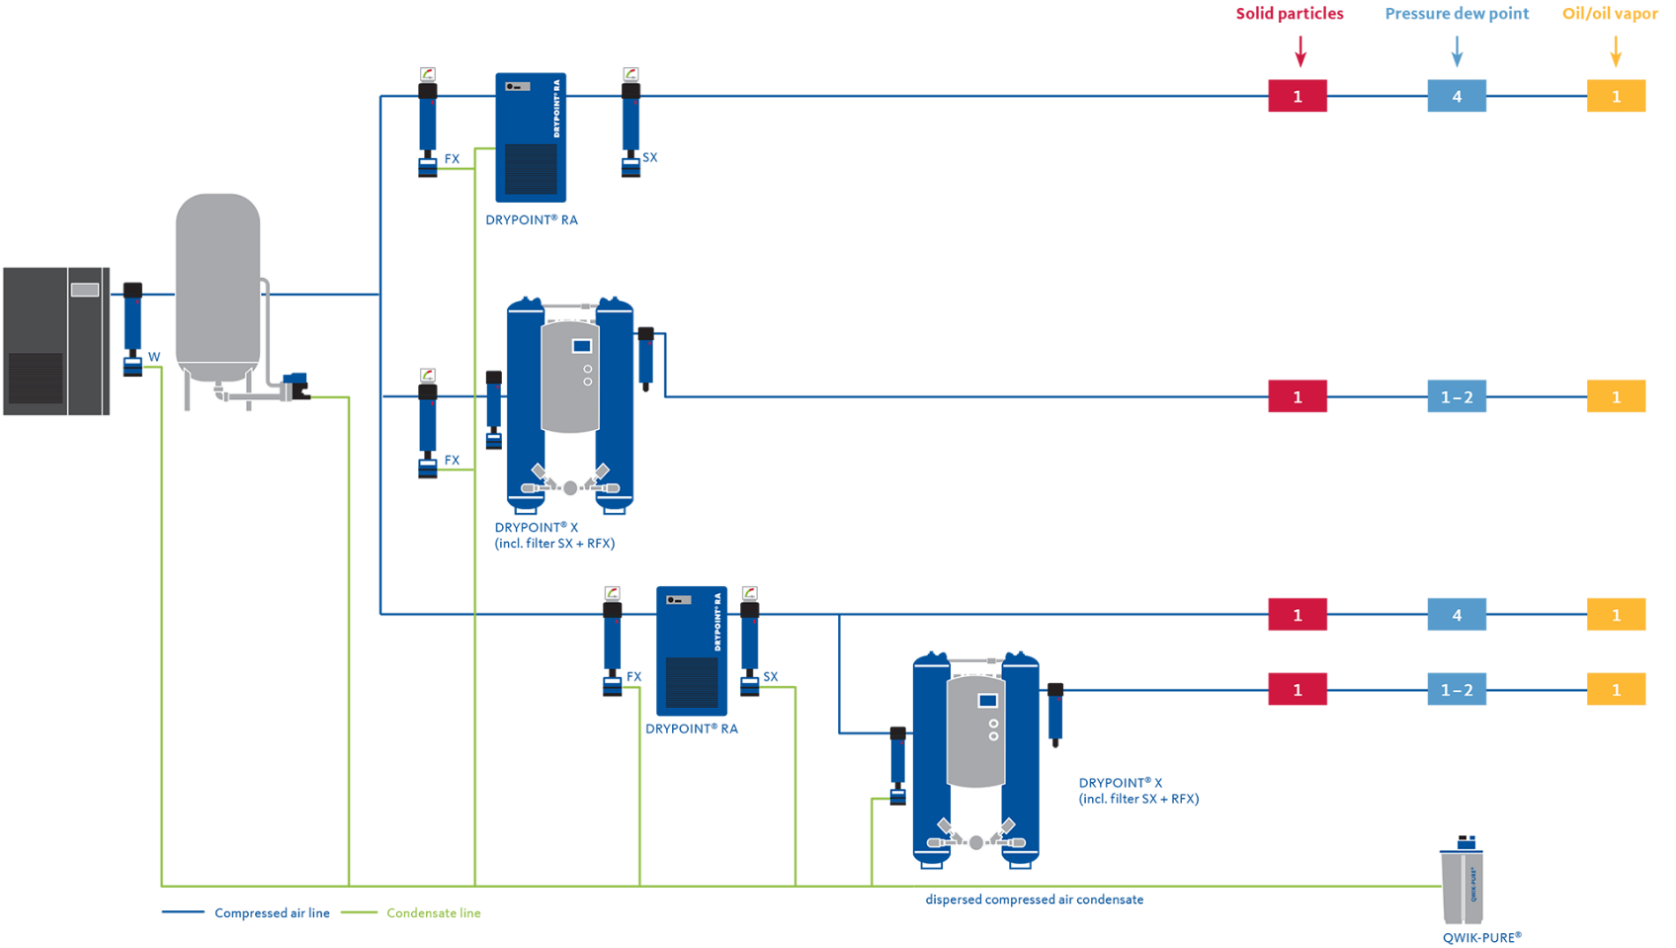
Air Treatment – What is Required?
Select appropriate dryer type(s) to achieve target pressure dew point for process(es)

Slide 51
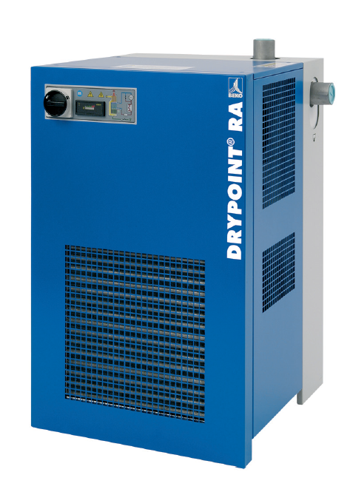
Refrigeration Dryers
Outlet Pressure Dew Point: ~37°F (ISO class 4)
Typical kW/100 cfm (excluding pressure drop): 0.04-0.08
Purge Air Consumption: None

Slide 52

Desiccant Dryers - Heatless
Outlet Pressure Dew Point: -40 to -100 °F (ISO class 1 to 2)
Heatless type (i.e. pressure swing) dryers have very low kW consumption, but consume a relatively large amount of purge air:
  Average purge rate ~15% of inlet flow at -40F
Equivalent kW/100 cfm for heatless desiccant dryer (from purge air, excluding pressure drop): ~3.3-4

Slide 53

Desiccant Dryers – Heated Blower
Outlet Pressure Dew Point: -40 F (ISO class 2)
Heated blower type consumes a relatively small amount of purge air for desiccant cooling
  Average purge/cooling rate 1-3% of inlet flow
Equivalent kW/100 cfm for heated blower dryer – combined energy input and purge/cooling air, excluding pressure drop):
~2.9-3.4

Slide 54

Refrigeration Dryers – Inherent Efficiency
BEKO RAx dryers feature optimized design for good operating efficiency:
Extremely efficient heat exchanger design for low pressure drop
Standard integral BEKOMAT electronic level-controlled condensate drains (no air loss)

Slide 55

Refrigeration Dryers – Eco Advantage
BEKO DRYPOINT RA Eco models include same efficiency advantages of RAx non-cycling dryers:
  Low pressure drop heat exchanger
  BEKOMAT zero-loss condensate drain
More advanced RA Eco models provide enhanced efficiency for partial-load operation:
  Cycling version – RA CT
  Variable speed version – RA VSD

Slide 56

Refrigeration Dryers – Eco Advantage
Variable speed dryers regulate speed of compressor and condenser fan based on load, yielding significant energy savings under reduced load conditions

Slide 57
Refrigeration Dryers – Eco Advantage
Example of variable speed energy savings over standard fixed speed/non-cycling model
Nominal dryer rating: 1500 scfm
Assuming 365 days/yr operation, comparison of annual energy consumption:
100%
 | 1st shift | 2nd shift | 3rd shift
Load: | 100% | 50% | 0%
Dryer Type | Annual Energy (kW-h)
Standard fixed speed dryer: | 37,376
VSD dryer: | 27,448
Potential energy savings of 9,928 kW-h per year (26.5% reduction) using VSD model

Slide 58

Desiccant Dryers – Eco Advantage
Consider more advanced heatless models with energy-saving features:
XCp features Humidity Demand Control – extended drying cycle time for reduced load conditions
Dew point monitoring and demand control
100%

Slide 59

Desiccant Dryers – Eco Advantage
Consider XFi heated blower model with advanced energy-saving features:
Patented ecoIntelligent control algorithm:
  Continuously monitors inlet and ambient conditions; autonomous smart adjustment to environment
  Dryer operation automatically adjusted for optimized performance and efficiency
  Purge (cooling) air reduced by over 2/3 vs. standard model
Standard dew point monitoring and demand control

Slide 60

Thank you and see you next time!

Slide 61
Best Practices EXPO Contest
Play for a chance to win a FREE Full Conference Pass to the Best Practices 2022 EXPO & Conference!! This is a $675 value! This contest is open to factory personnel, compressed air distributors, utility incentive programs and engineering firms. Exhibiting and sponsor companies are not qualified. Winners will be randomly selected from those who submitted a correct answer and notified tomorrow via email.
Please submit your answer in the questions box.
How can you achieve lowest specific power?
A
Run Large Compressors at Light Load
B
Run Multiple Compressors at Part Load
C
Right Size Compressor Capacity
*By entering you are giving permission to announce your name if you are a winner

Slide 62

Best Practices EXPO Contest
Play for a chance to win a FREE Full Conference Pass to the Best Practices 2022 EXPO & Conference!! This is a $675 value! This contest is open to factory personnel, compressed air distributors, utility incentive programs and engineering firms. Exhibiting and sponsor companies are not qualified. Winners will be randomly selected from those who submitted a correct answer and notified tomorrow via email.
Please submit your answer in the questions box.
How can you achieve lowest specific power?
A
Run Large Compressors at Light Load
B
Run Multiple Compressors at Part Load
C
Right Size Compressor Capacity
*By entering you are giving permission to announce your name if you are a winner

Slide 63
Compressed Air System Design for Lowest kW/100scfm
Q&A
Please submit any questions through the Question Window on your GoToWebinar interface, directing them to Compressed Air Best Practices Magazine. Our panelists will do their best to address your questions and will follow up with you on anything that goes unanswered during this session.
Thank you for attending!
Sponsored by

Slide 64
Thank you for attending!
The recording and slides of this webinar will be made available to attendees via email later today.
PDH Certificates will be e-mailed to Attendees within 2 days.

Slide 65



July 2022 Webinar
Applications for Adiabatic Cooling Technology
Bert Wesley, P.E.
Woodard & Curran
Keynote Speaker
Thursday, July 21, 2022 – 2:00 PM EST
Register for free at
www.airbestpractices.com/webinars

