Slide 1

Dryer/Filter Quality KPI’s: Dew Point/Pressure Before Summer Hits
Chris Beals, Air System Management, Inc.
Keynote Speaker
Sponsored by
The recording and slides of this webinar will be made available to attendees via email later today.
PDH Certificates will be e-mailed to attendees within 2 days.

Slide 2
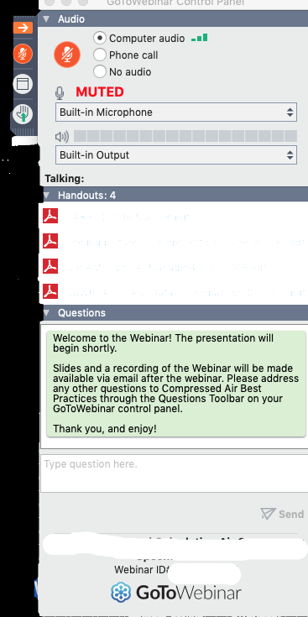
Q&A Format
Panelists will answer your questions during the Q&A session at the end of the Webinar.
Please post your questions in the Questions Window in your GoToWebinar interface.
Direct all questions to Compressed Air Best Practices® Magazine
Sponsored by

Slide 3
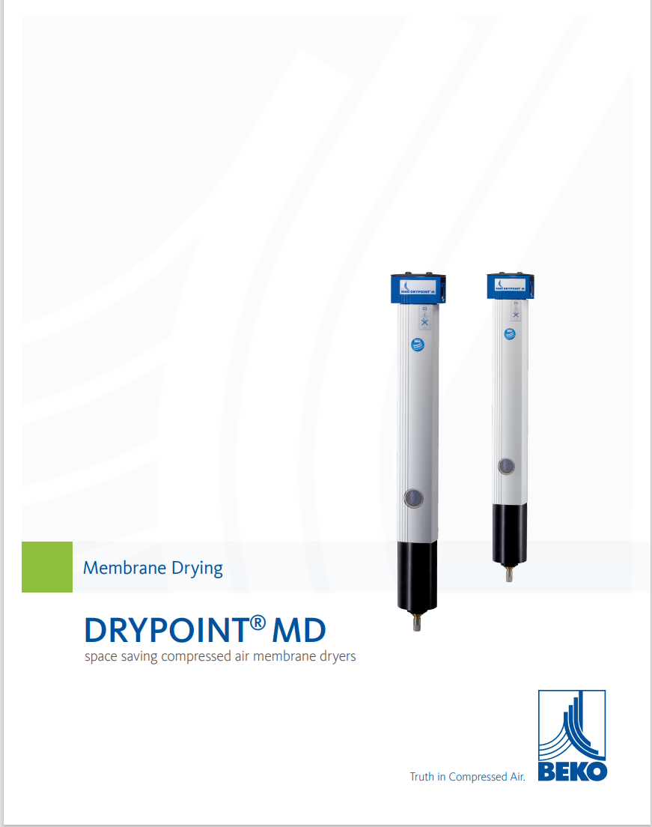
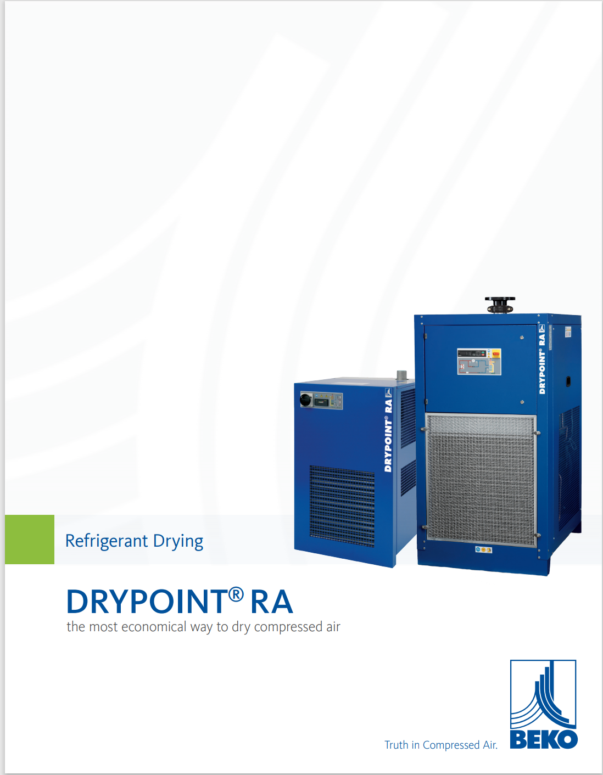
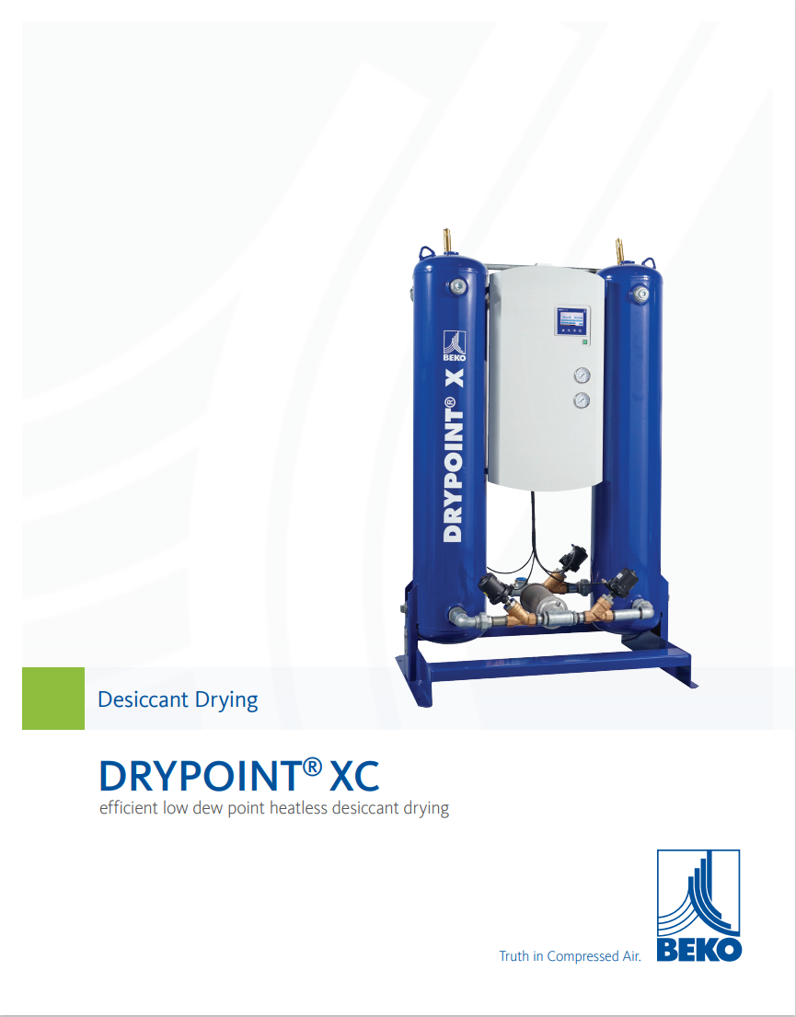
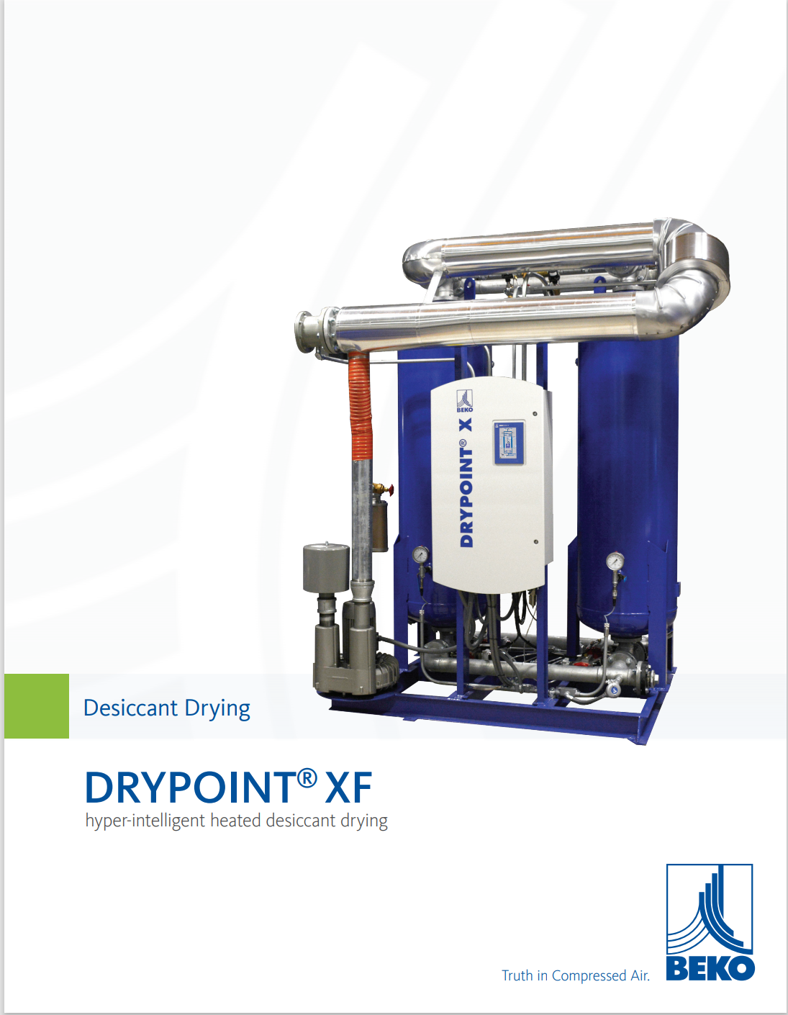
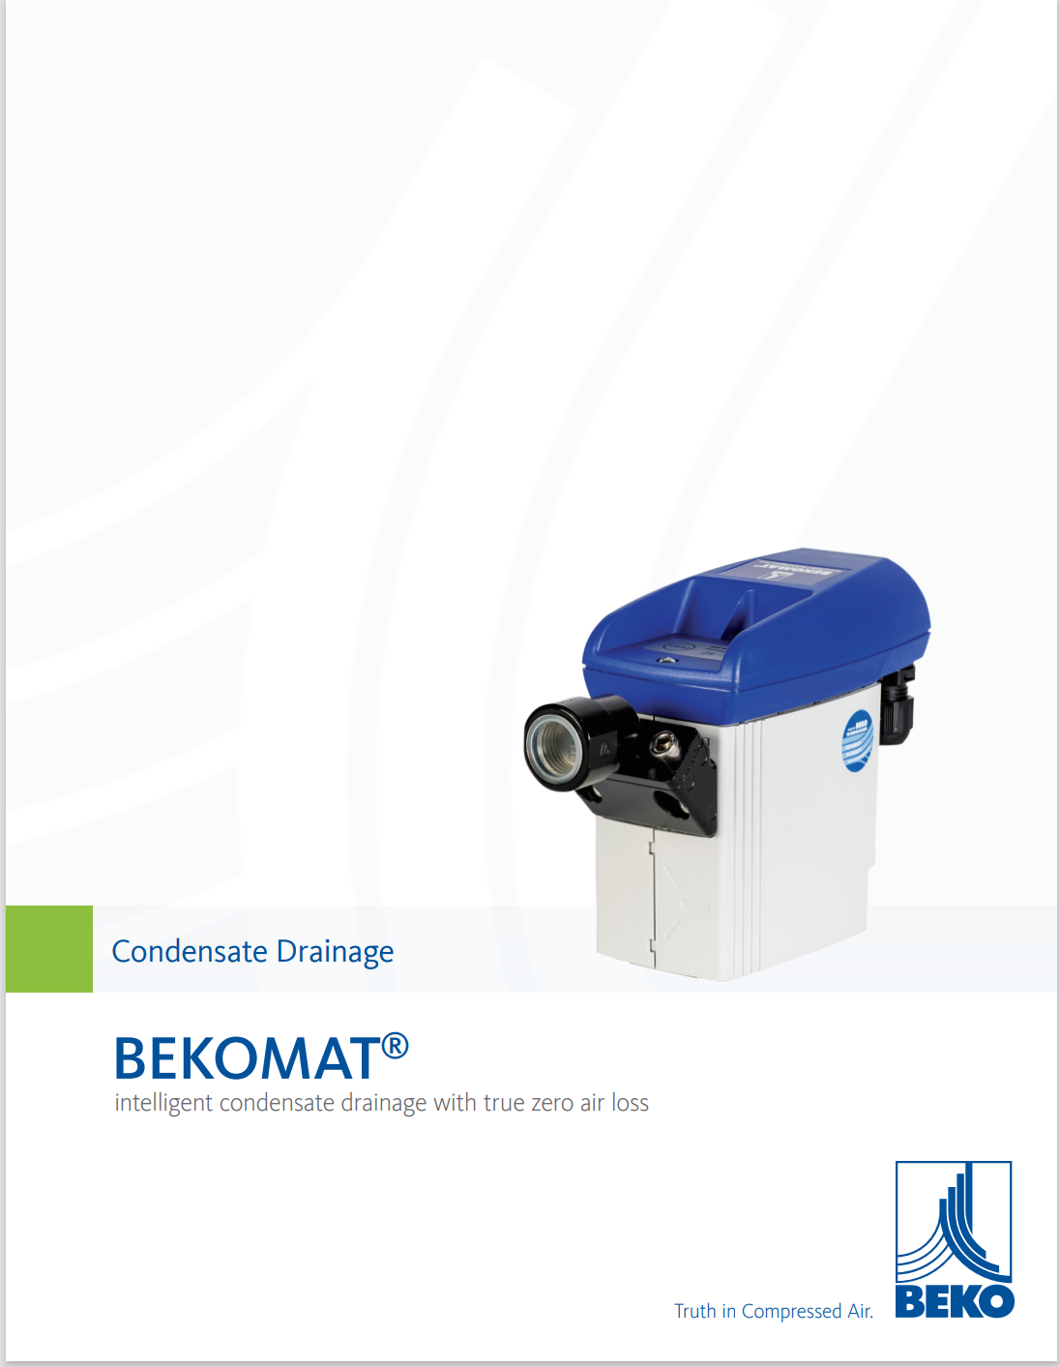
Handouts

Slide 4
Disclaimer
All rights are reserved. The contents of this publication may not be reproduced in whole or in part without consent of Smith Onandia Communications LLC. Smith Onandia Communications LLC does not assume and hereby disclaims any liability to any person for any loss or damage caused by errors or omissions in the material contained herein, regardless of whether such errors result from negligence, accident, or any other cause whatsoever.
All materials presented are educational. Each system is unique and must be evaluated on its own merits.

Slide 5


Slide 6
Dryer/Filter Quality KPI’s: Dew Point/Pressure Before Summer Hits
Introduction
Compressed Air Best Practices® Magazine
Sponsored by

Slide 7
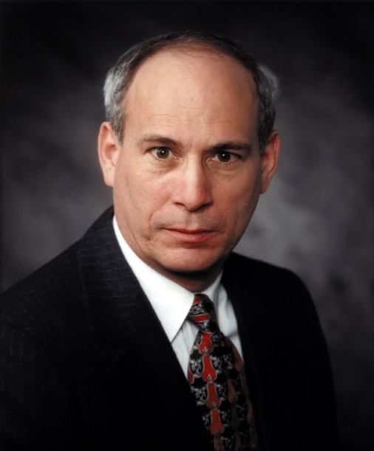
About the Speaker
23 Years of Auditing Experience
U.S. DOE designated Energy Expert for Compressed Air
Founding member of Compressed Air Challenge
Chris Beals
Air System Management, Inc.
Sponsored by

Slide 8
Compressed Air Dryer
Key Performance Indicators (KPI’s)
June 17, 2020
Chris E. Beals, President
Air System Management, Inc
303-881-8870 cbeals@earthlink.net

Slide 9
Dryer Types
Regenerative Heat Exchanger & Aftercooler
Deliquescent Dryers
Refrigerated Dryers
  Cycling
  Non-Cycling
Regenerative Desiccant Dryer Types
  Heatless
  Heated
    Externally Heated
    Internally Heated
    Split-Stream
    Blower Purge
  Heat of Compression

Slide 10
Webinar Focus
Refrigerated Dryers
Desiccant Dryers
  Heatless
  Externally Heated
  Blower Purge

Slide 11
Refrigerated Dryer Capacity Variation
The rated capacity of air-cooled refrigerated dryers is based upon standard conditions of:
  100⁰F inlet temperature; 100⁰F ambient temperature; 100-psig inlet pressure
The rated capacity of water-cooled refrigerated dryers is based upon standard conditions of:
  100⁰F inlet temperature; 90⁰F inlet water temperature; 100-psig inlet pressure
  The dryer’s capacity increases as the inlet pressure increases
  The dryer’s capacity decreases as the inlet air temperature increases
  The dryer’s capacity decreases as the ambient temperature increases or with a dirty cooler

Slide 12
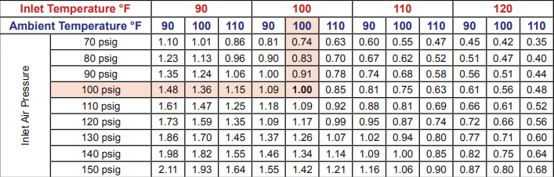
Capacity Correction factors for Refrigerated Dryers
To find the dryer’s rated capacity multiply its rated capacity at inlet conditions of 100⁰F, 100-psig & 100F ambient temperature times the multiplier for the actual conditions. The pressure drop across the dryer will vary as the actual flow varies from the dryer’s rated flow.

Slide 13
Heatless Dryer Capacity
The rated capacity of heatless desiccant dryers is based upon standard inlet conditions of 100⁰F & 100-psig
  The dryer’s capacity increases as the inlet pressure increases
  The dryer’s capacity decreases as the inlet air temperature increases

Slide 14
Capacity Correction Factors for Heatless Dryers

Slide 15
Dryer KPI’s
System Pressure Dew Point (PDP)
Inlet Temperature
Inlet Pressure
Ambient / Inlet Water Temperature (Refrigerated Dryers Only)
Other KPI’s
  System Pressure
  Pressure drop across components

Slide 16
The Most Important KPI’s
Monitoring the System Pressure Dew Point & System Pressure downstream of the equipment lets you know if the equipment performing well or not.
The other KPI’s help determine the reason for the poor System PDP or System Pressure

Slide 22
Options to Measure Differential across Components
Buy filters with differential gauges
  Many don’t give a pressure differential reading; they just indicate good or bad
  Many don’t provide an indication until pressure differential is between 5 & 7-psig
Install gauges upstream and downstream of each component
  The inaccuracy between gauges
  Gauges don’t get replaced
Install differential gauges that read an actual differential pressure

Slide 23

Filter Differential Gauges

Slide 24
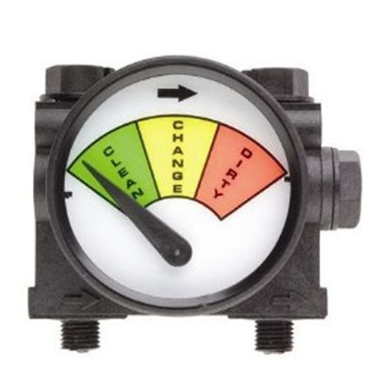
Filter Differential Gauges

Slide 25
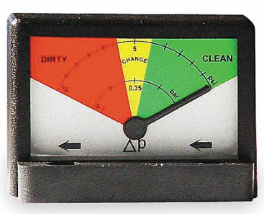
Filter Differential Gauges

Slide 26
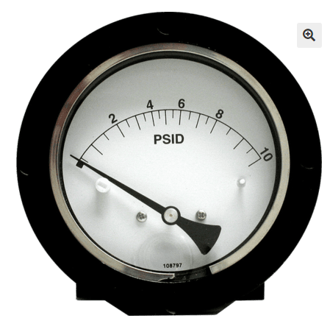
Filter or Equipment Differential Gauges

Slide 27
Options to Measure Differential across Components
Install differential gauges across each component
  The range of the differential gauges should be selected so they don’t read zero when the filters are clean, because a zero reading can also mean there is a hole in the filter element or it has collapsed
  Suggested Ranges
    Coalescing filter – 0 to 10-psid
    Dryer inlet to Dryer outlet – 0 to 10-psid
    Particulate Filter – 0 to 5-psid
    Mist Eliminator / NL Module – 0 to 5-psid

Slide 28
Monitoring
To be Successful the KPI’s must be Monitored
Monitor on regular basis
  Data can be used to schedule maintenance
Maintain equipment
  As dew point monitors age they typically give a lower PDP reading than the actual PDP. This can stop desiccant dryers, which switch towers based upon dew point, from switching towers or at least switching later than they should.

Slide 29
Compressed Air Treatment Equipment Maintenance
Tips for System Maintenance

Slide 30
Maintenance Topics
Filtration
Refrigerated Dryers
Desiccant Dryers
Condensate Drains
KPI Monitors and Measurement Instruments
IMPORTANT:
Please note that the information contained in this document is general maintenance/installation guidance. Always refer to your product manual on the specific model for detailed installation, operation and maintenance information for any piece of equipment.

Slide 31
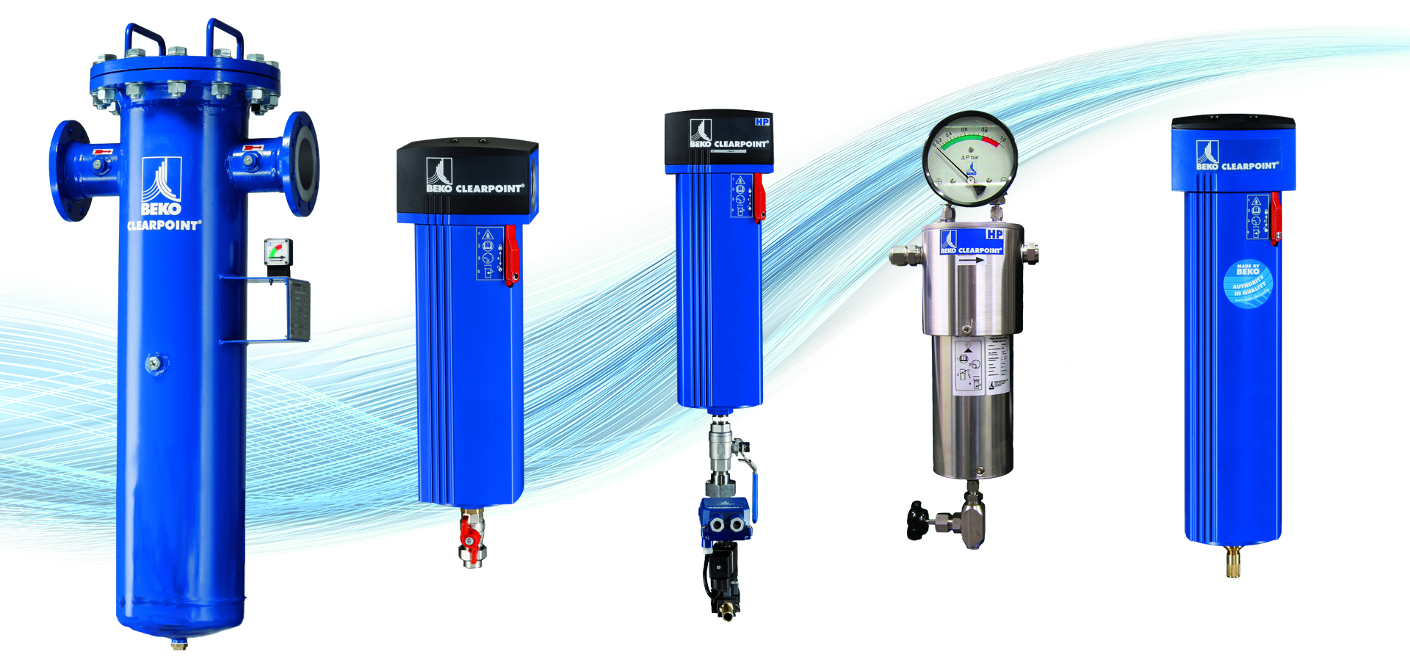
Compressed Air Treatment - Filtration
Flanged and Threaded Filters
High Pressure (PN) Filters
High Pressure (HP) Filters
Water Separator

Slide 32
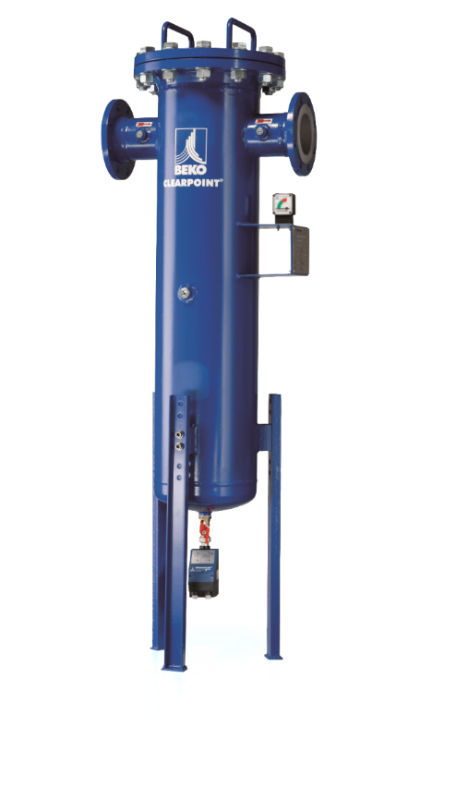
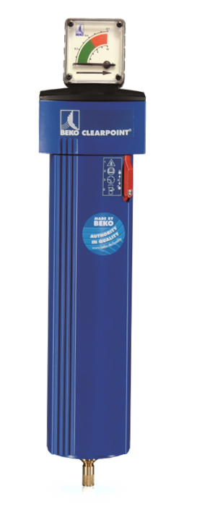
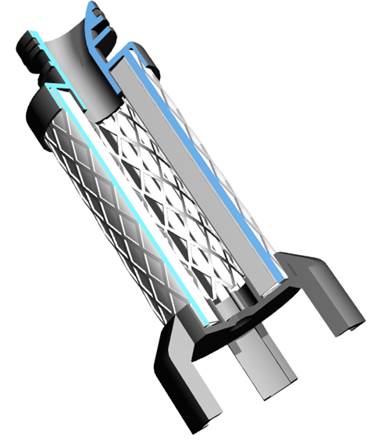
Compressed Air Treatment - Filtration
Equipment Types
  Function
  Application
Maintenance
  Filter Element
  Drain

Slide 33
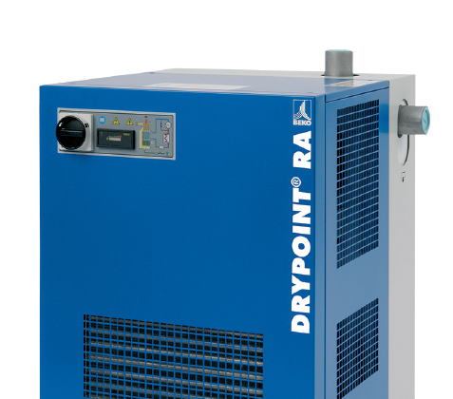
Refrigerated Dryers
Refrigerated Dryers – Commonly Used
38 F (3 C) Dew Point
How does it work?

Slide 34

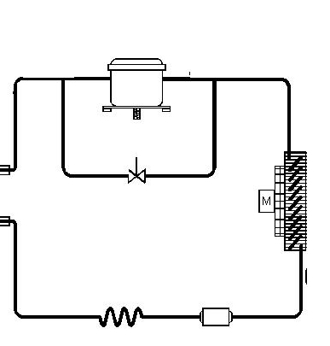

Refrigerated Dryers
LPLT
HPHT
gaseous
gaseous
compressor
Evaporator:
Cooling of
Compressed Air
Condenser:
Cooling of
Refrigerant
condenser
capillary tube
liquid
LPLT
liquid
HPLT

Slide 35
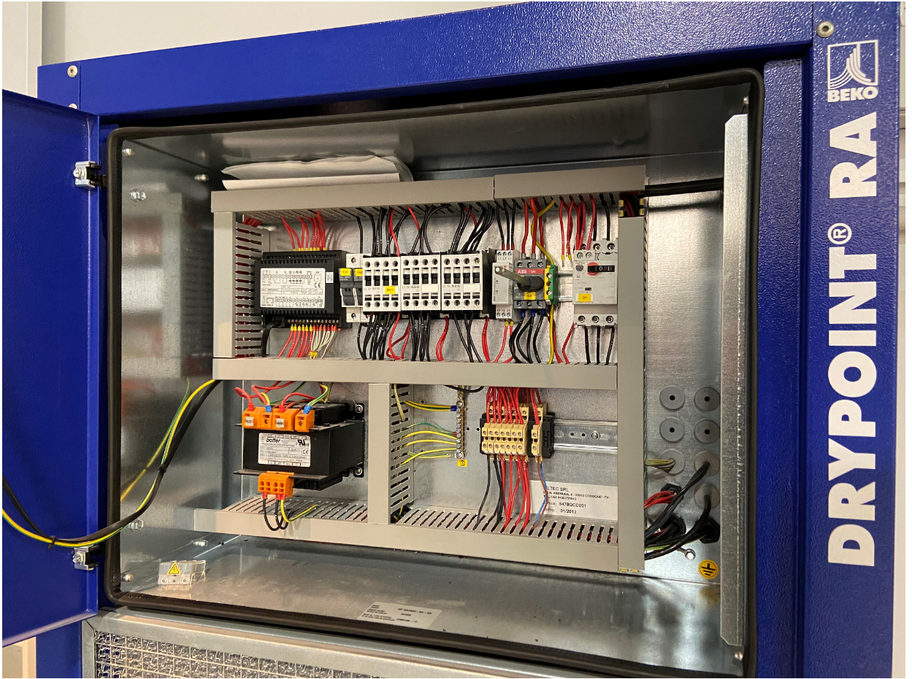
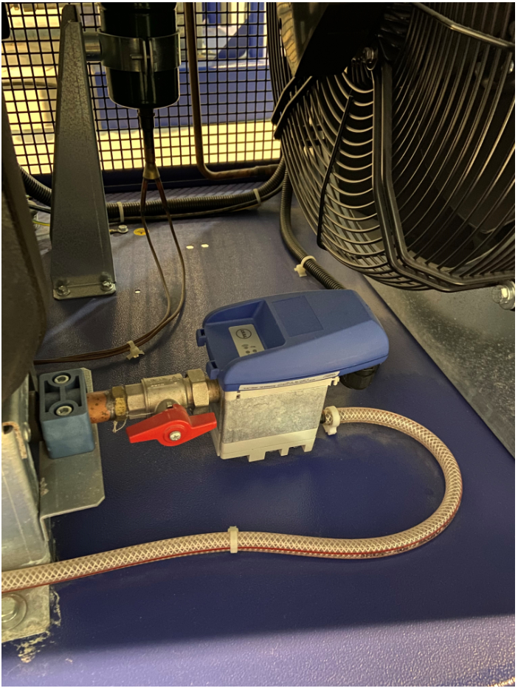
Refrigerated Dryers
Maintenance
  Condensers
  Drains
  Electrical
  Visual Inspection

Slide 36
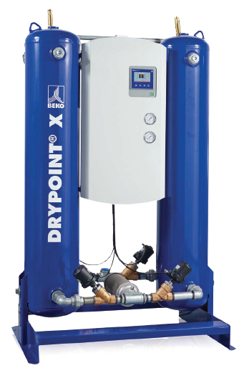
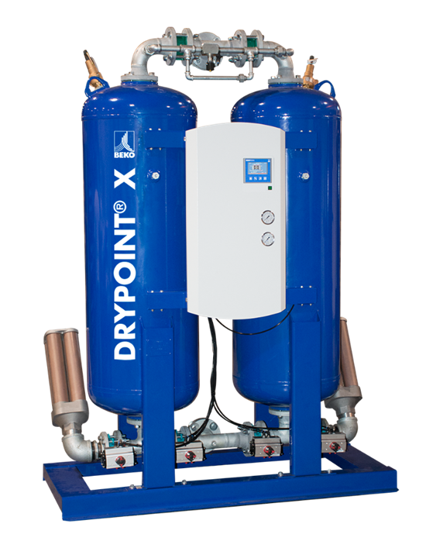
Desiccant Dryers
Dew Points from -4 F (-20 C) to -100 F (-73 C)

Slide 37
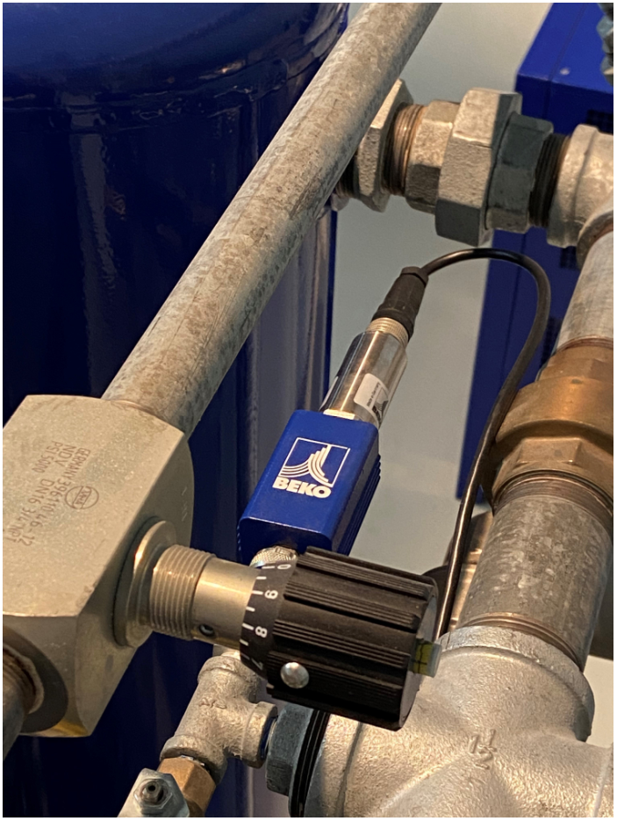
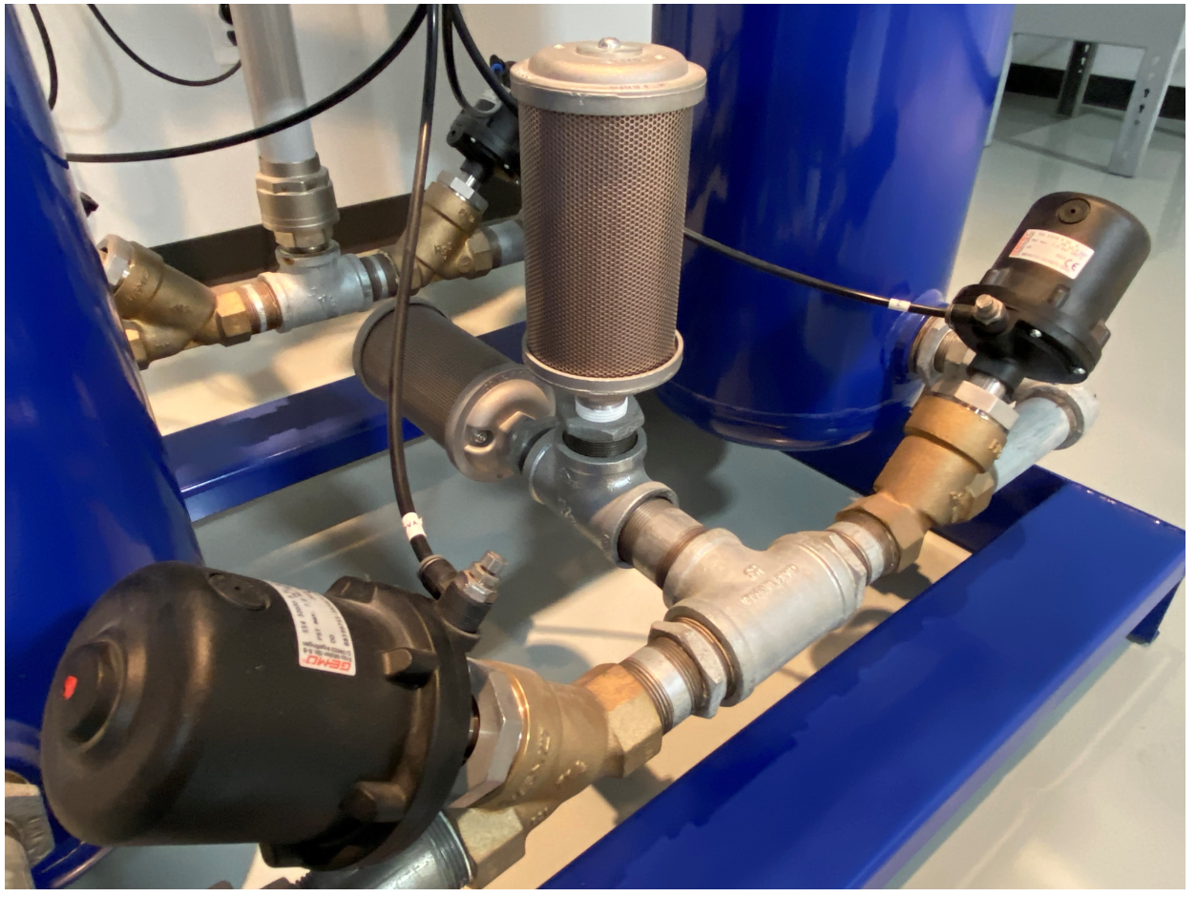
Desiccant Dryers
Dryer Operation/Components
Dryer Maintenance
  Annually
    Pre-/Post Filtration
    Silencers
    Dew Point Sensors
    Valve Service
    Safety Checks

Slide 38
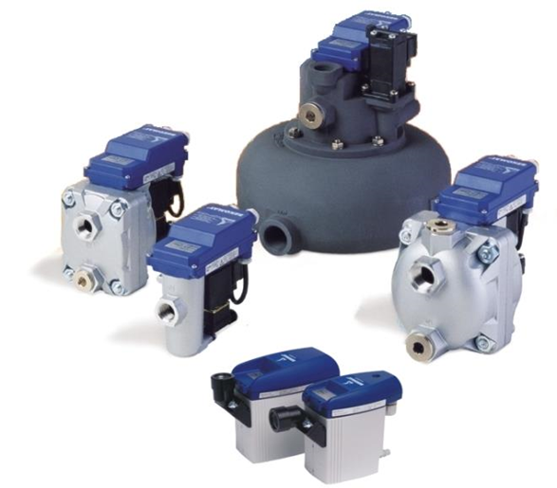
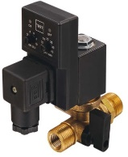
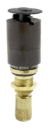
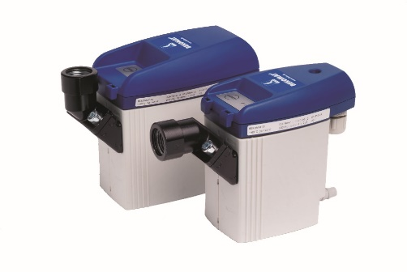
Drains
Drain Application/Types
Timer/Solenoid
Float
Zero Air Loss

Slide 39
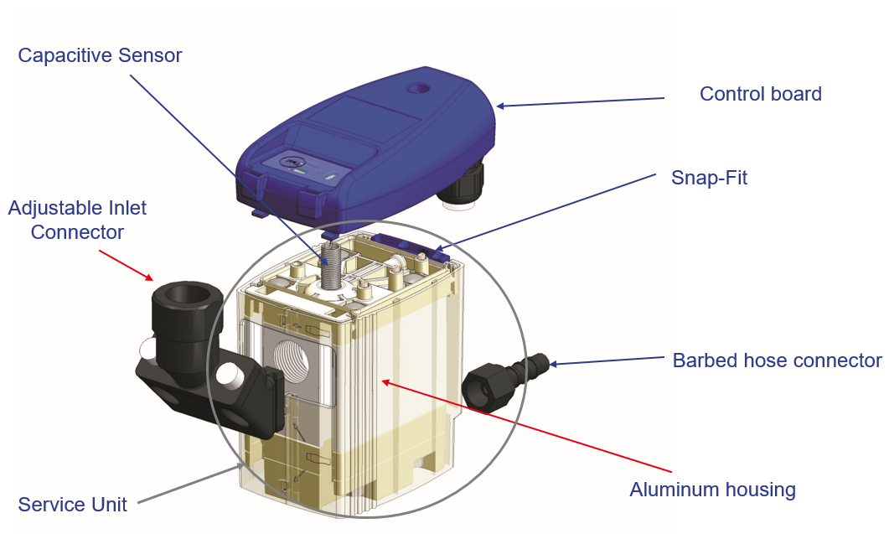
Zero Air Loss Drain

Slide 40
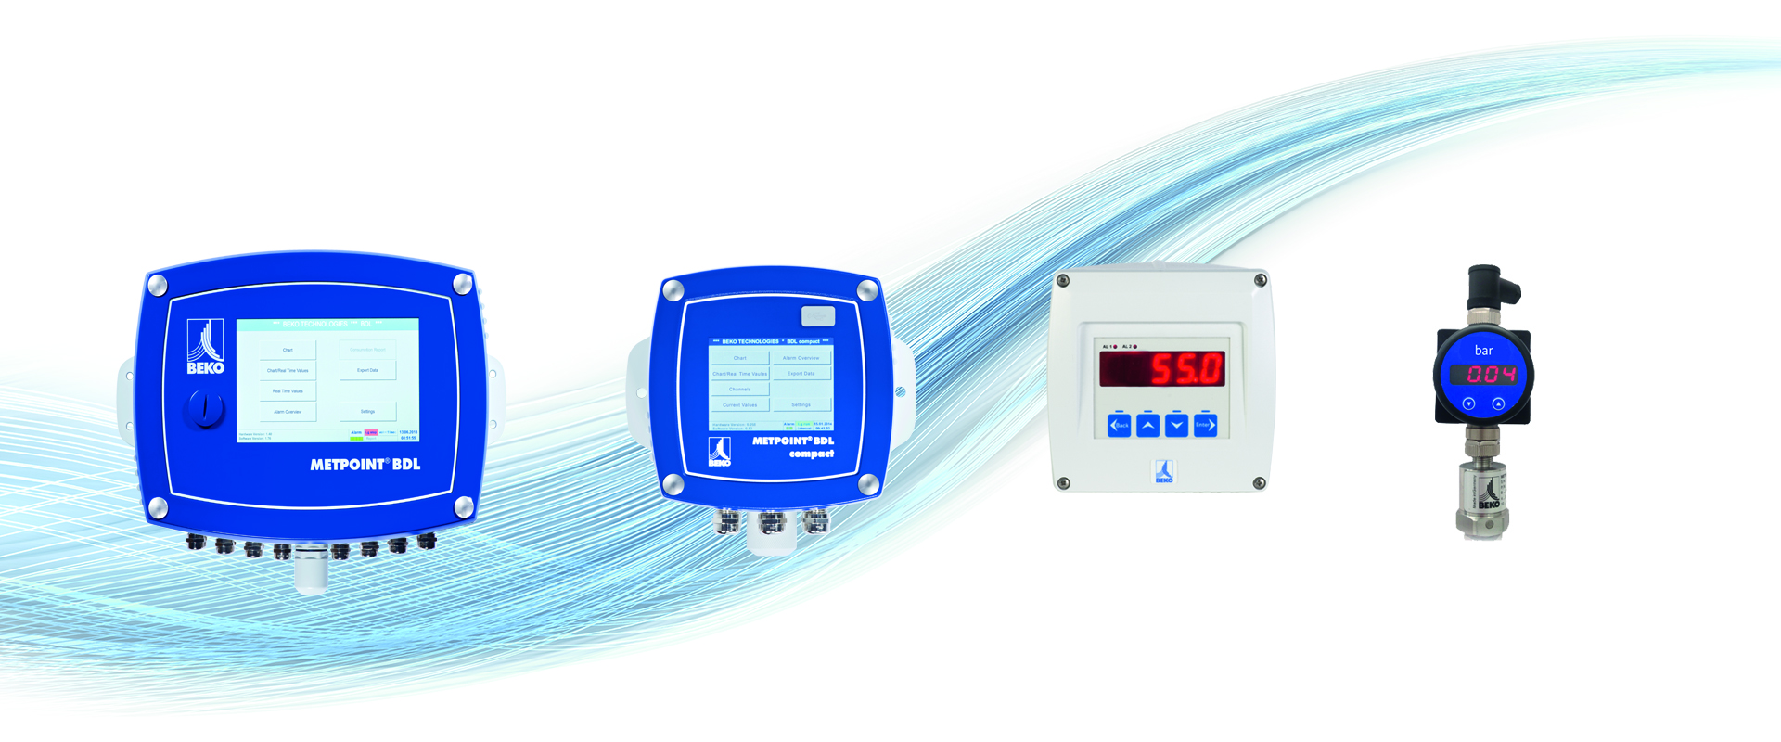
Compressed Air Treatment – KPI Monitors and Data Loggers
METPOINT BDL
METPOINT BDL compact
METPOINT DD0081
METPOINT UD02
Notes:
BDL systems measure connected input signals .. It evaluates the required information and displays and saves the data on the device. The process occurrence can be archived on a long-term basis and alarms can be forwarded to connected systems.
is versatile and flexible. For multiple industries!

Slide 41
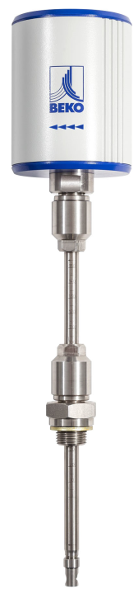
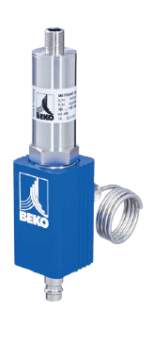
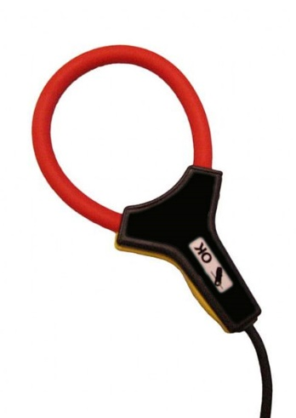
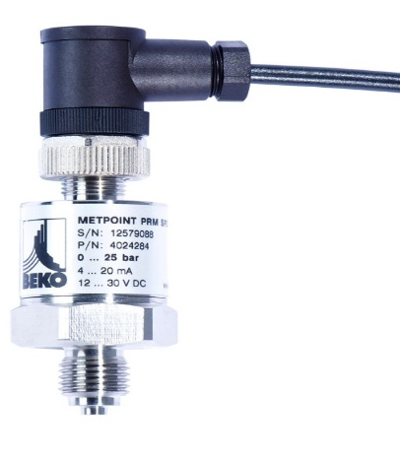
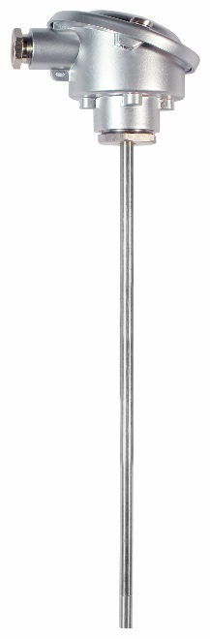
Compressed Air Treatment – Instrumentation Sensor Technology
FLM
Flow Meter
DPM
Dew Point Meter
SP
Pressure Meter
AS 109
Amp Meter
TS 109
Temperature Meter

Slide 42
To Conclude
Thank You!
BEKO TECHNOLOGIES, CORP.
900 Great SW Parkway SW
Atlanta, GA 30336
UNITED STATES
+1 (800) 235-6797
www.bekousa.com
Sales Contact Information:
https://www.beko-technologies.us/en-us/contact

Slide 43
Dryer/Filter Quality KPI’s: Dew Point/Pressure Before Summer Hits
Q&A
Please submit any questions through the Question Window on your GoToWebinar interface, directing them to Compressed Air Best Practices Magazine. Our panelists will do their best to address your questions and will follow up with you on anything that goes unanswered during this session.
Thank you for attending!
Sponsored by

Slide 44
Thank you for attending!
The recording and slides of this webinar will be made available to attendees via email later today.
PDH Certificates will be e-mailed to Attendees within 2 days.

Slide 45


July 2021 Webinar
Aeration Blower Control Strategies
Sponsored by
Tom Jenkins, P.E.
JenTech Inc
Keynote Speaker
Thursday, July 15, 2021 – 2:00 PM EST
Register for free at
www.airbestpractices.com/magazine/webinars

