Slide 1

Finding, Fixing and Monitoring Compressed Air Leaks
Ron Marshall, Marshall Compressed Air Consulting
Keynote Speaker
Sponsored by
The recording and slides of this webinar will be made available to attendees via email later today.
PDH Certificates will be e-mailed to attendees on within 2 days.

Slide 2
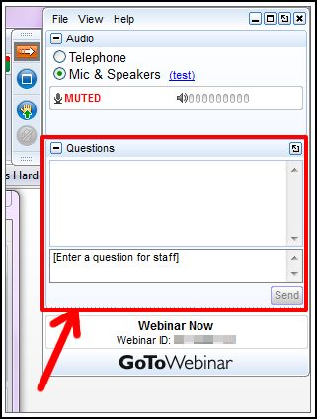
Q&A Format
Panelists will answer your questions during the Q&A session at the end of the Webinar.
Please post your questions in the Questions Window in your GoToWebinar interface.
Direct all questions to Compressed Air Best Practices® Magazine
Sponsored by

Slide 3
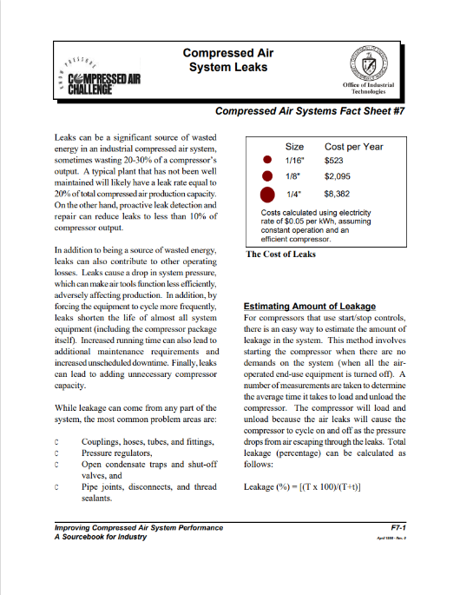
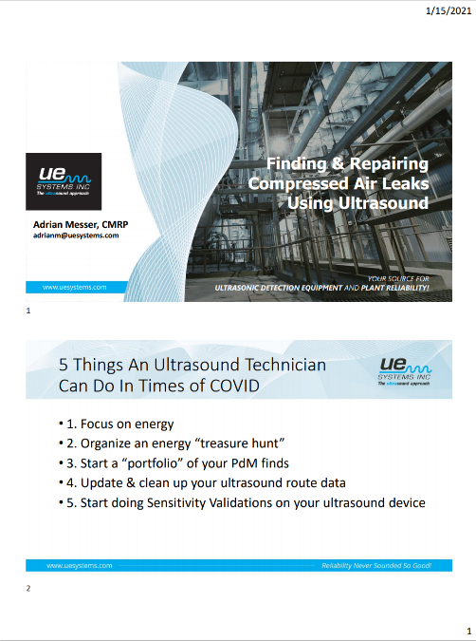
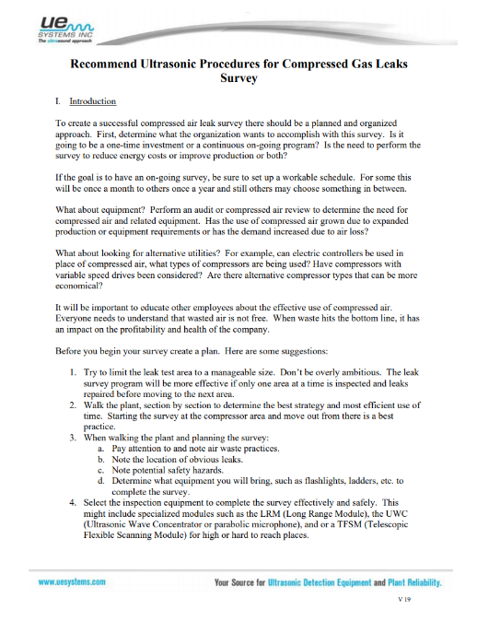

Handouts

Slide 4
Disclaimer
All rights are reserved. The contents of this publication may not be reproduced in whole or in part without consent of Smith Onandia Communications LLC. Smith Onandia Communications LLC does not assume and hereby disclaims any liability to any person for any loss or damage caused by errors or omissions in the material contained herein, regardless of whether such errors result from negligence, accident, or any other cause whatsoever.
All materials presented are educational. Each system is unique and must be evaluated on its own merits.

Slide 5
Finding, Fixing and Monitoring Compressed Air Leaks
Introduction
Compressed Air Best Practices® Magazine
Sponsored by

Slide 6
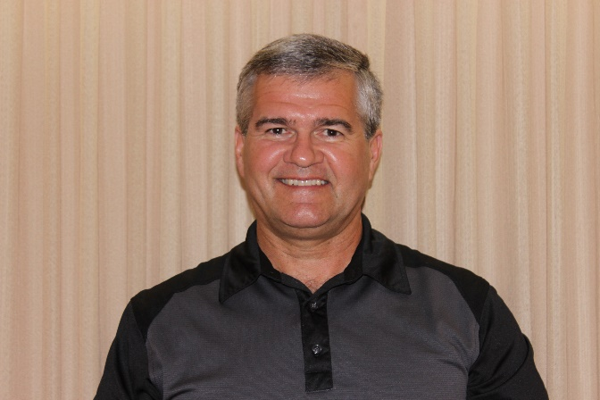



About the Speaker
Consultant MCAC
38 Years with Power Utility
24 Years Technical CA Support
CAC Level 2 Instructor
International Trainer UNIDO
Ron Marshall
Marshall Compressed Air Consulting
Sponsored by

Slide 7


Wanted Energy Wasters

Slide 8
Coming Up
Will you get full value from fixing leaks? – Check this first!
Starting out – Why Leaks?
Leakage Assessments
  Step 1 - Get a Baseline
  Step 2 - Get the Required Tools for the Job
  Step 3 - Find, Document and Fix
  Step 4 - Verify Results
Surprising results
  Foundry
  Tractor Plant
  Bus Plant
  Farm Implement Plant
  Board Plant
Getting Help to DIY

Slide 9
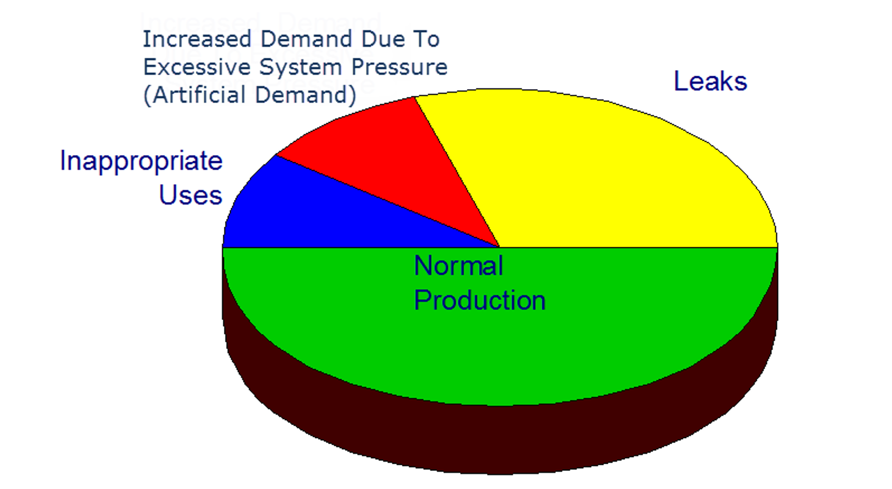
Typical Plant Situation – Leaks are a problem
Leakage Big Portion of Demand
Basic Leakage Repair Program
Only Breakdown Maintenance
Funding Shortages
Lack of Employee Awareness
No Leakage Measurement System
High System Pressure
Poor Compressor Turndown
Average 20 to 30%
Source: Compressed Air Challenge

Slide 10
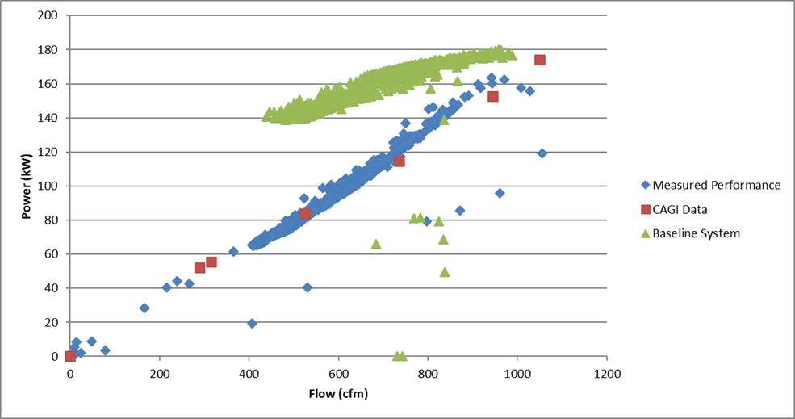
Check your system turn down?
How are your compressors controlled?
How much does kW turn down?
Blow-off control poorest
Modulation control unsatisfactory
Load/Unload adequate
VSD or multiple control best
Turn down will govern results
Supply side assessment defines system curve
Source: Compressed Air Challenge

Slide 11
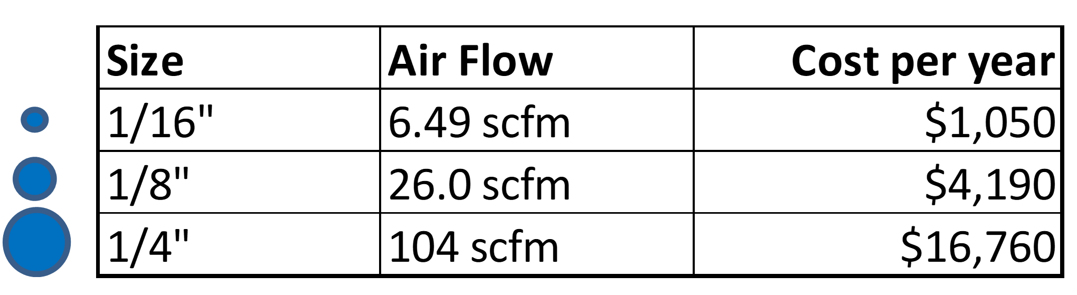
Cost of Leakage – Poor control could limit these savings
Variables that change the cost:
Electrical cost per kWh
Operating hours
Supply side efficiency
Compressor control mode
System pressure
Cost for Leaks 10 cents per kWh full time
Assumes fully loaded compressor at 17 kW/100 cfm and 100 psi

Slide 12
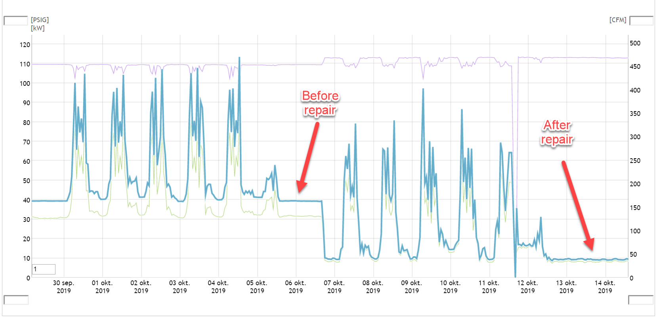
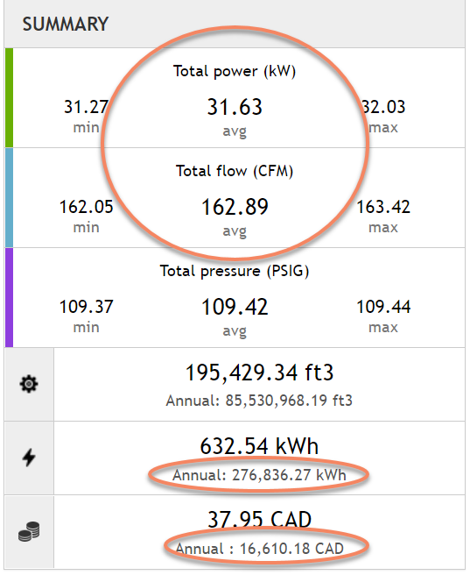
Leakage Assessments - Step 1 - Getting a Baseline
It is important to know the existing costs, very important to management
Leakage in shift-oriented plants can be detected by flow meter
Duty cycle tests if no meter
Receiver draw down tests if in modulation mode
See how in Fact Sheet #7 at www.compressedairchallenge.org
Large plants more difficult if no shutdown hours
Source www.calms.eu

Slide 13
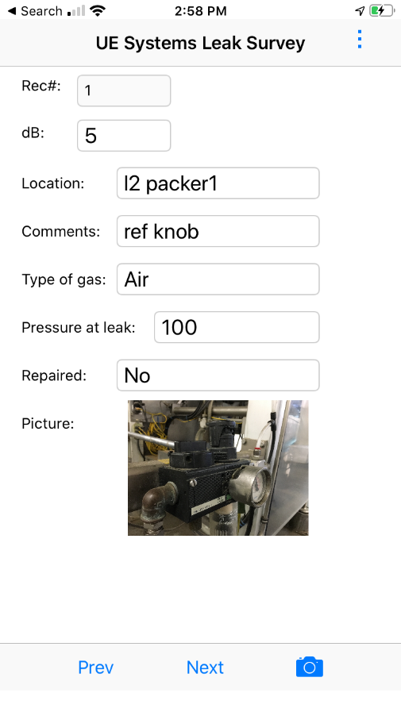
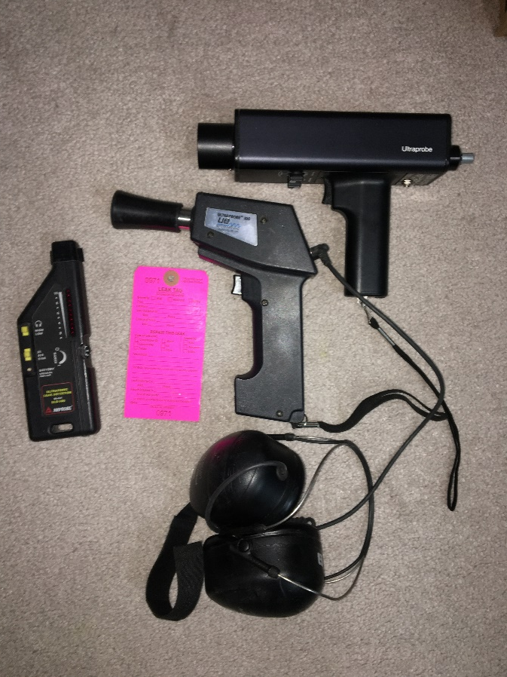
Leakage Assessments - Step 2 - Get the Required Tools for the Job
Large leaks can be heard by ear, but sensitivity varies with ambient noise
Best to use ultrasonic leak detection
Low-cost units available – under $1k
Basic detection - simpler is better
Documentation - free apps and spreadsheets available
Some high-cost detectors have detector, camera, database all in one

Slide 14
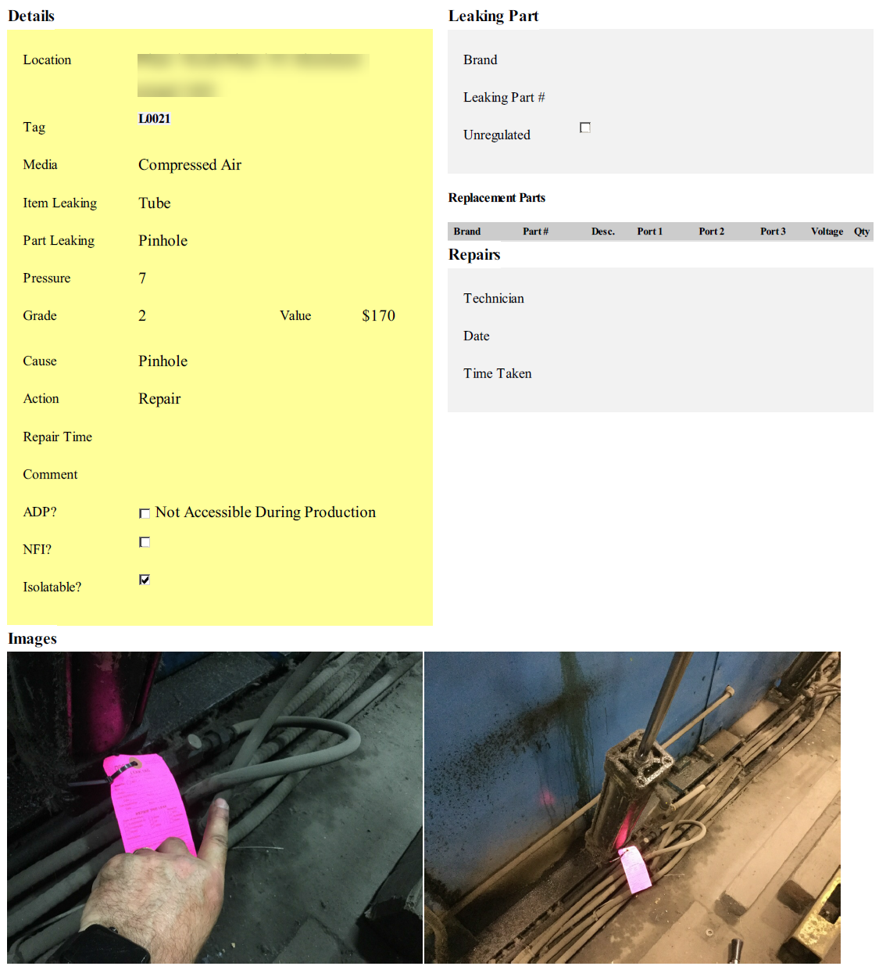
Leakage Assessments - Step 3 – Find, Document and Fix
Get training on detection procedures
Thoroughly detect and tag
Document to find again
Take two pictures of location
Best practice – fix immediately
Repeat– large leaks mask small ones
Track repair progress with database
Analyze database for common issues
Source: www.bvrg.com.au

Slide 15
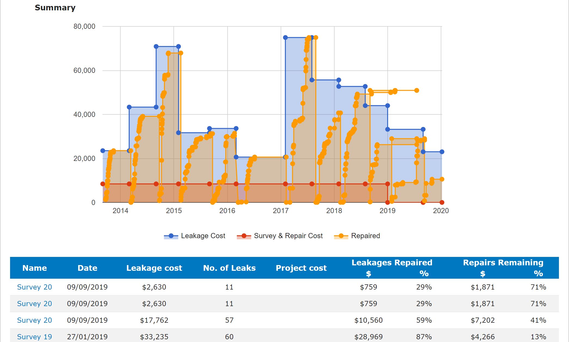
Leakage Assessments - Step 3 – Find, Document and Fix
Warning: overestimating common
db to flow is not an exact science
Use flow meter when possible
Compare total cfm to main flow meter
If significant difference - reevaluate

Slide 16
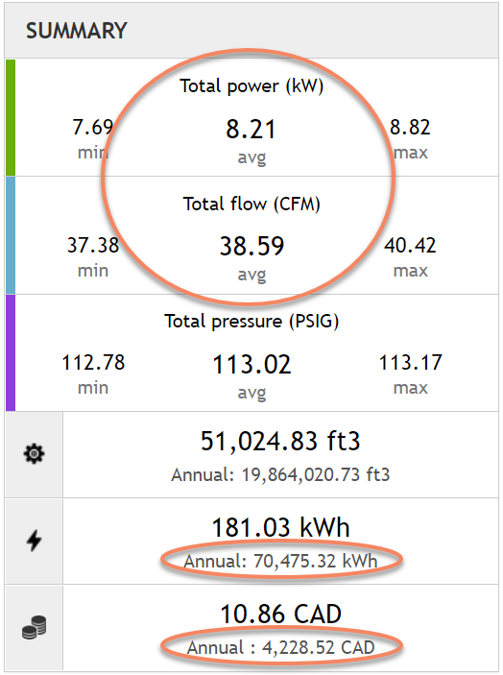
Leakage Assessments - Step 4 - Verifying Results
Very important to track success
Compare new level against baseline flow (and power if possible)
Report the results to management
Adjust baseline and monitor
Initiate leakage detection at a target
Saved $12,400
Source www.calms.eu

Slide 17
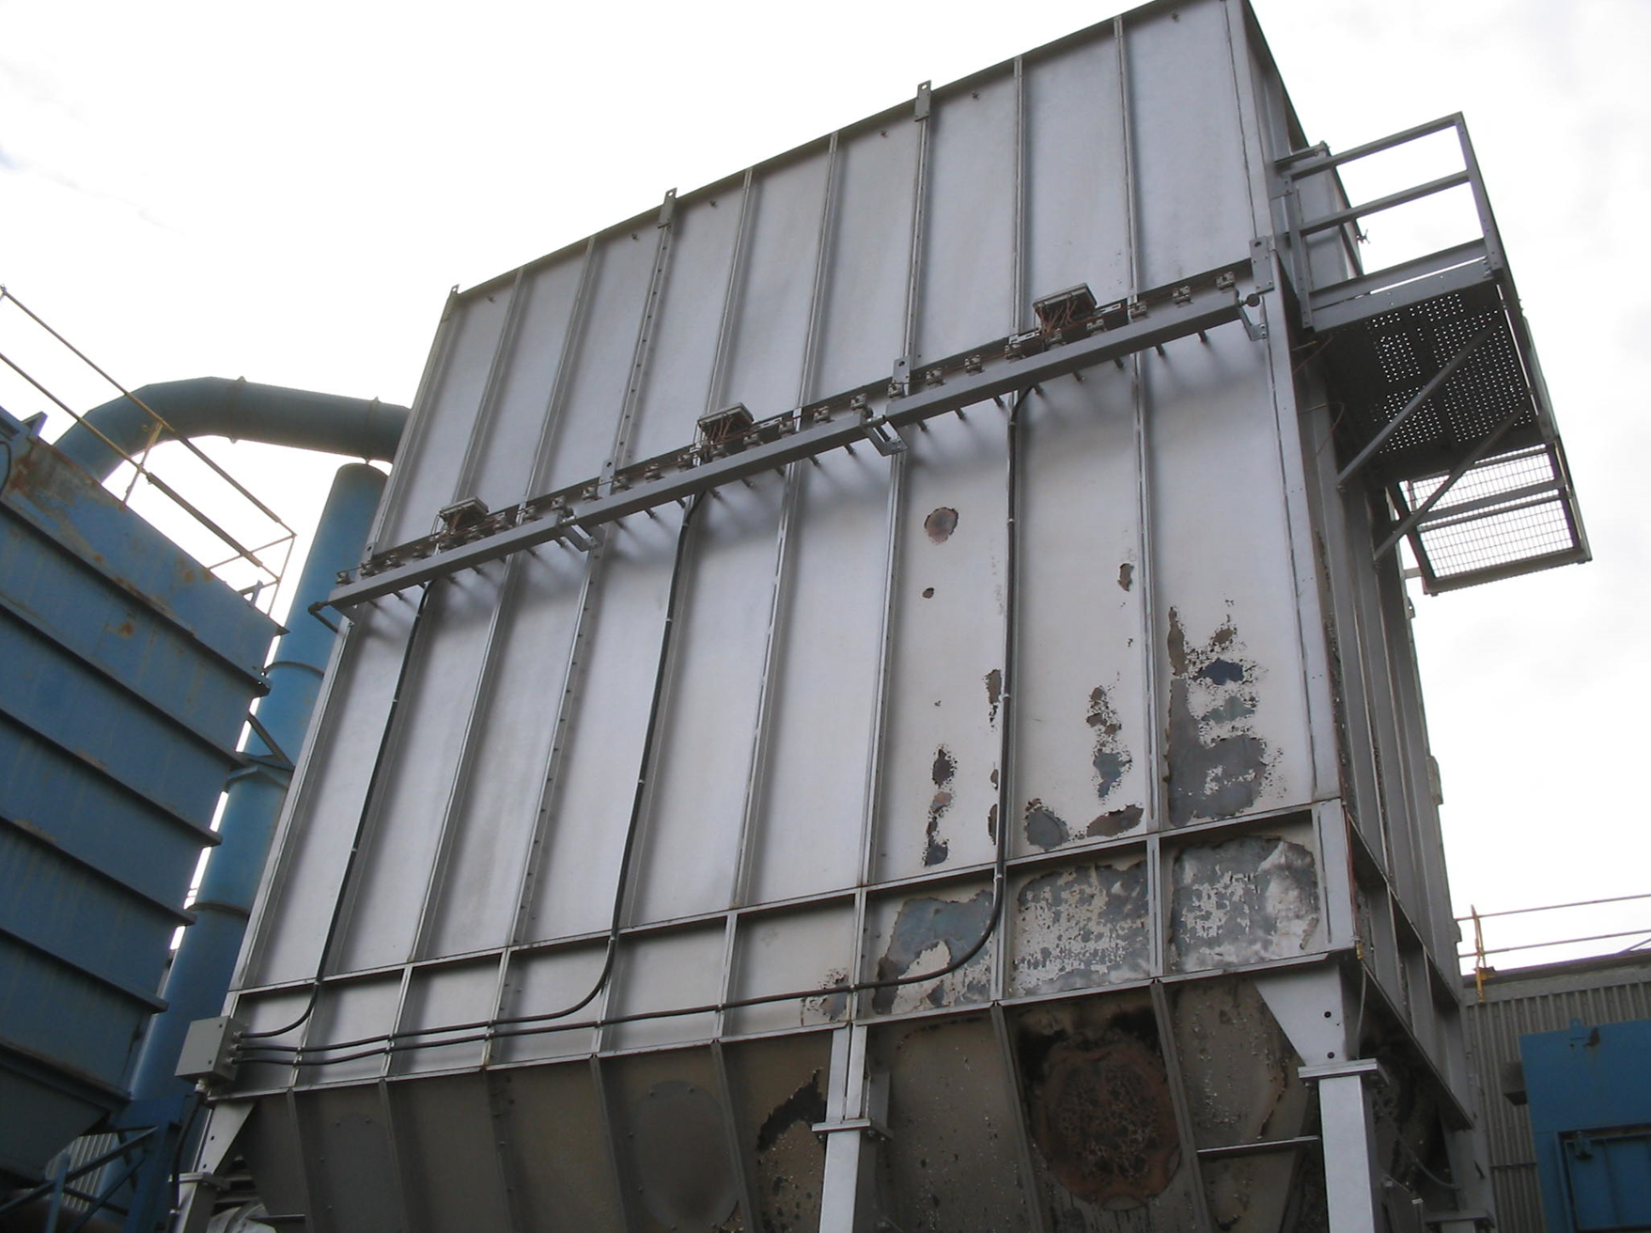
Surprising Results - Foundry
  Hired contractor to repair
  High level remained
  Additional detection done
  Found large leak very high up
  Leaking one whole compressor

Slide 18
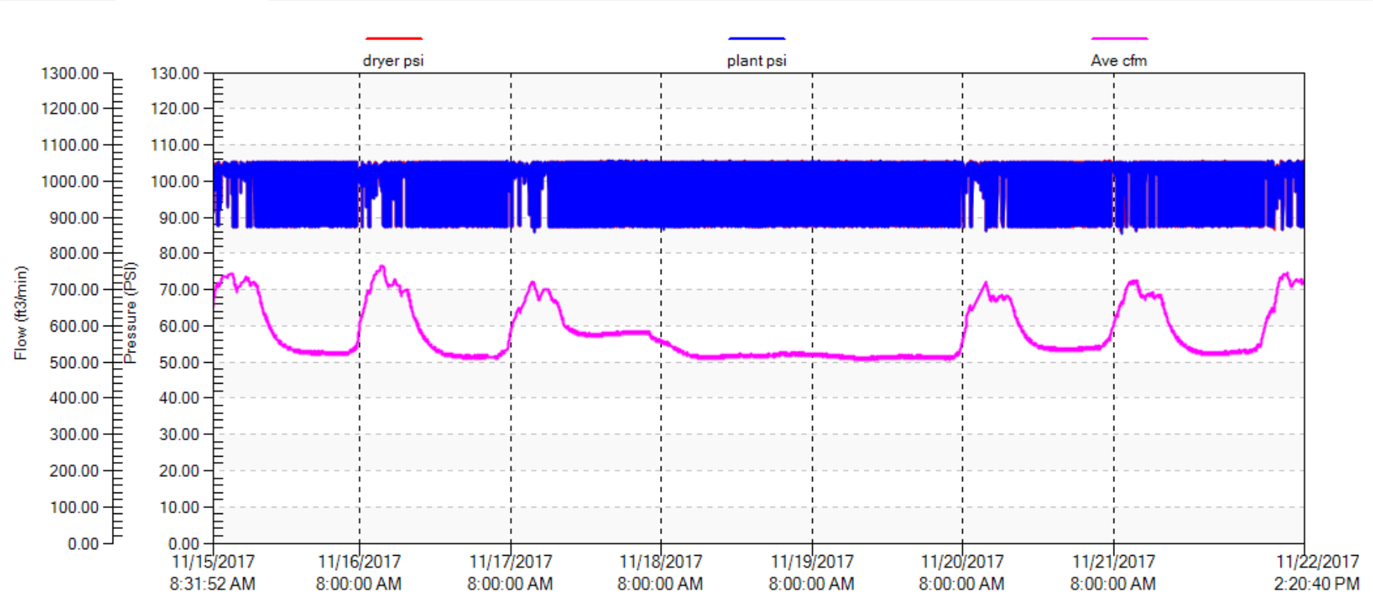
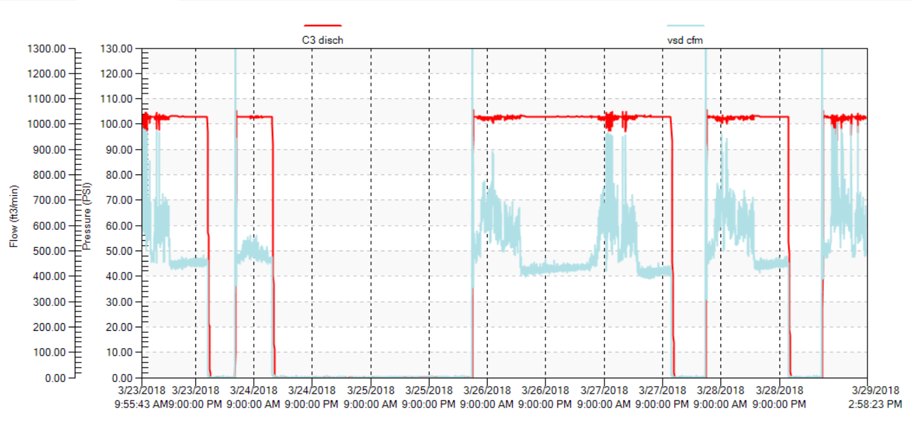
Surprising Results - Tractor Plant
  High non-productive flow
  Large plant but small production
  One main shift and one additional
  No weekend production
  > 500 cfm leakage
  > 80% leakage flow
  Assigned leakage champion
  Turned off at night

Slide 19
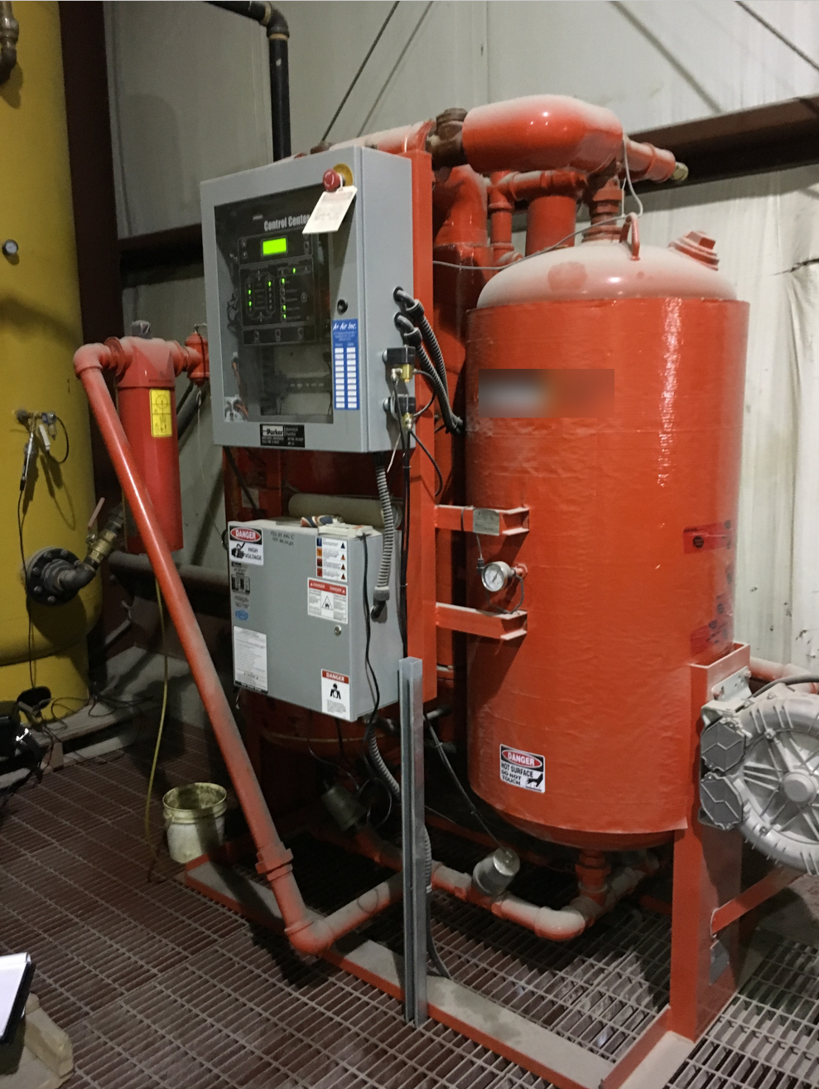
Surprising Results – Legume Processor
  Calculated cfm ≠ metered cfm
  Heated blower desiccant dryer
  Check revealed wiring error
  Very large flow during cooling
  Not detectable by ultrasonic
  Always special test dryers

Slide 20
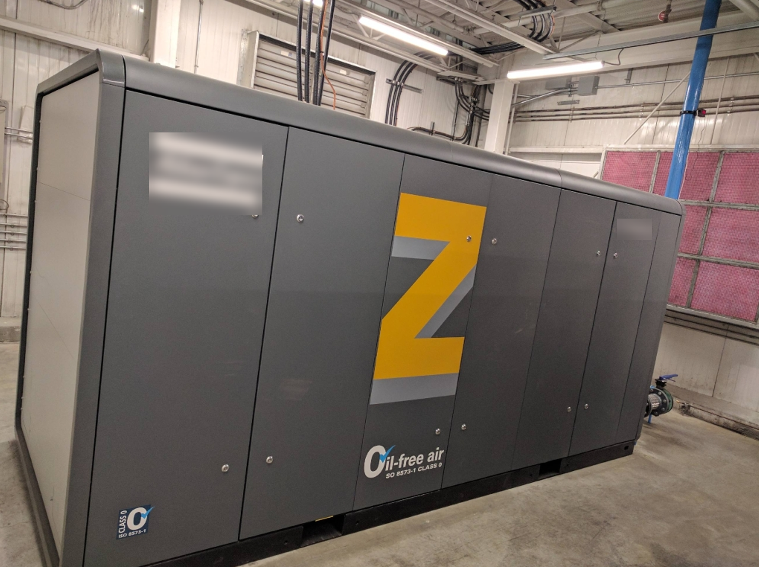
Surprising Results – Plastics Plant
  New install of VSD
  Meter ≠ flow display
  Tech initially skeptical
  Enclosure blocked leakage sound
  Found internal seal failure

Slide 21

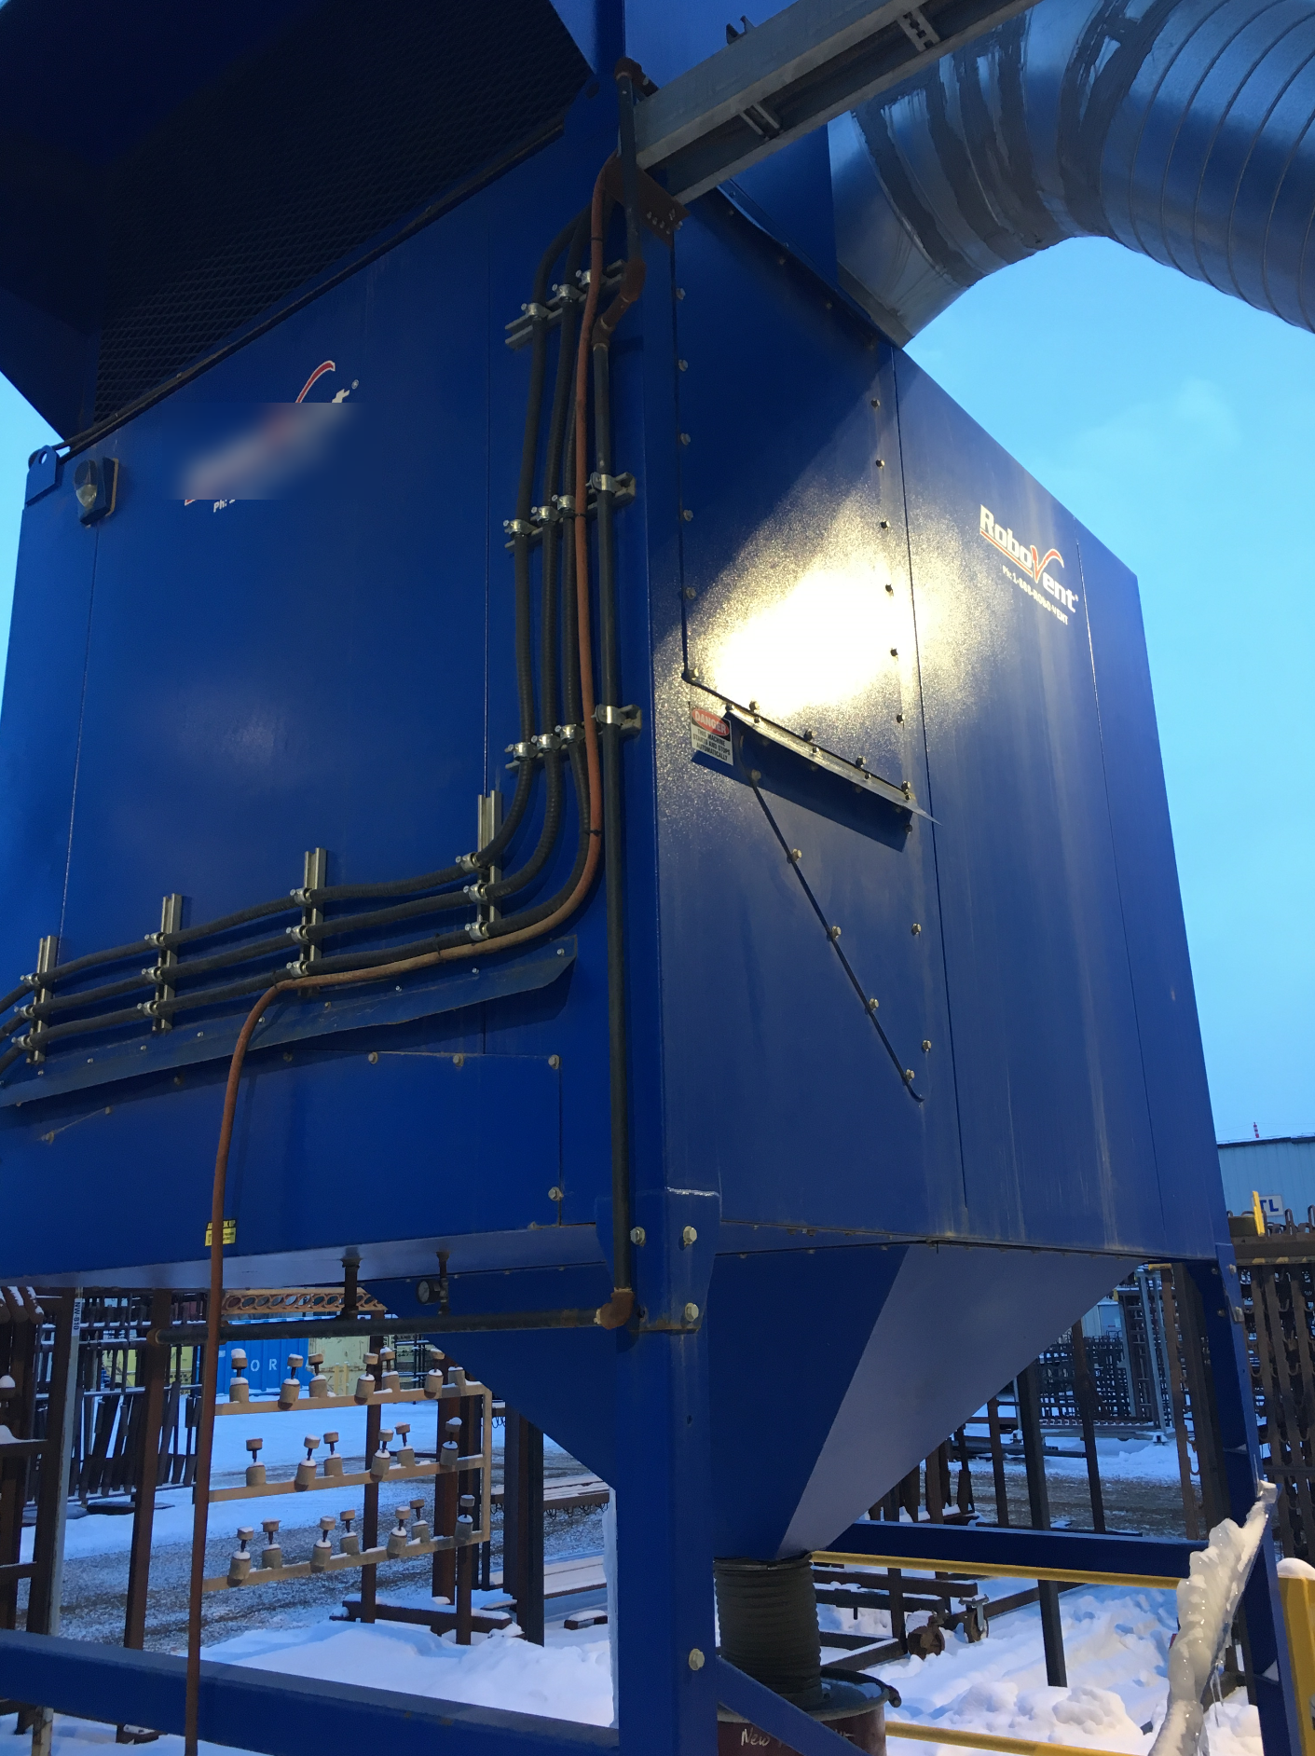
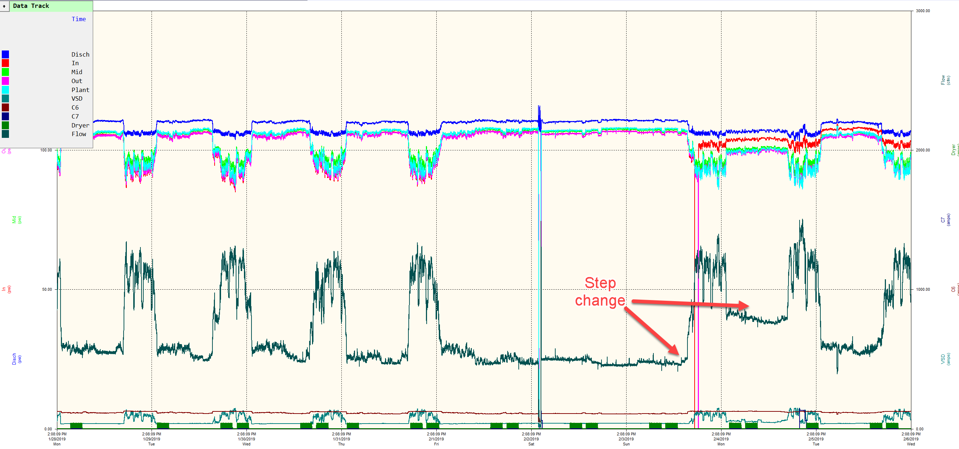
Surprising Results – Farm Implement Plant
  Very large plant area
  Numerous radial feeds
  Meter showed step increase
  Newly installed submetering
  One meter showed high flow
  Isolated to one dust collector

Slide 22
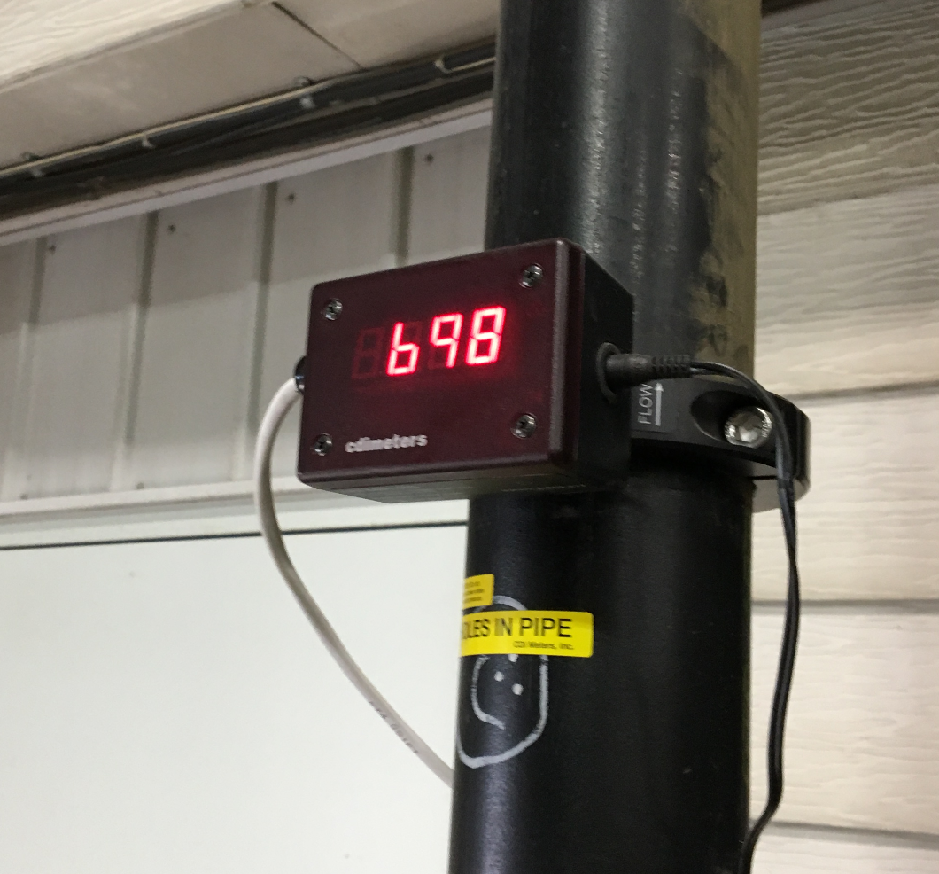
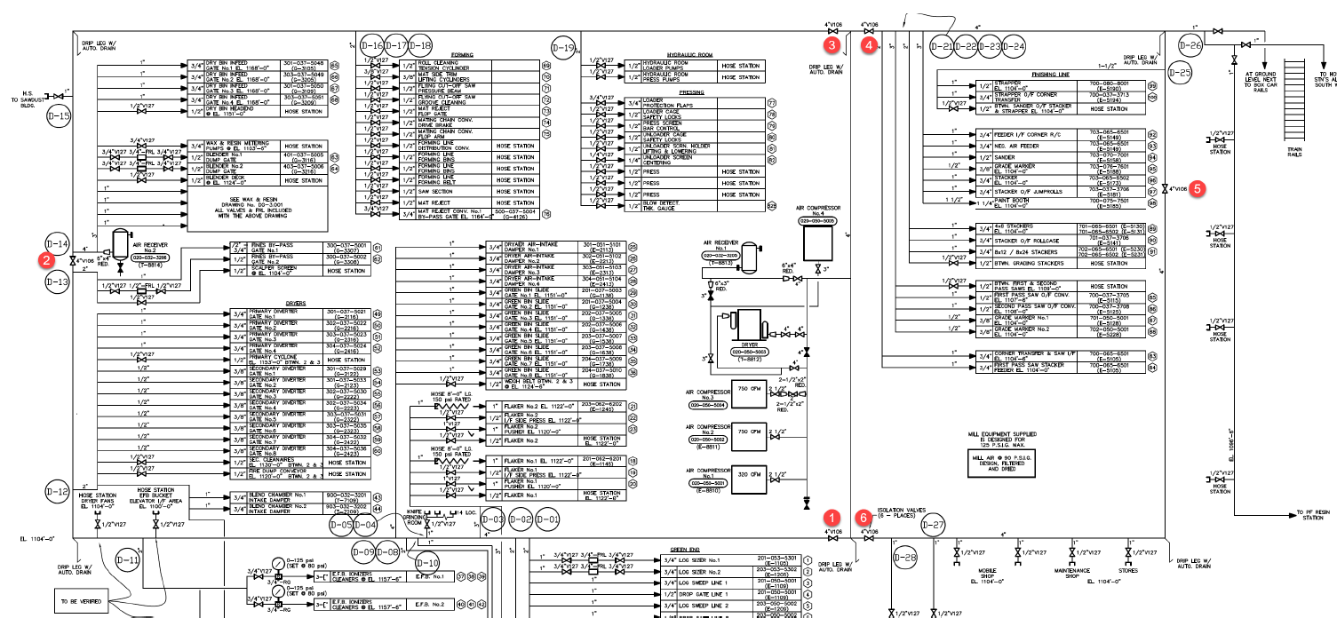
Surprising Results – Board Plant
  Shutdown only 2 time/ year
  Shutdown load 73% of average
  Ring system, isolation test done
  Most of leakage in one location
  Additional loads found

Slide 23
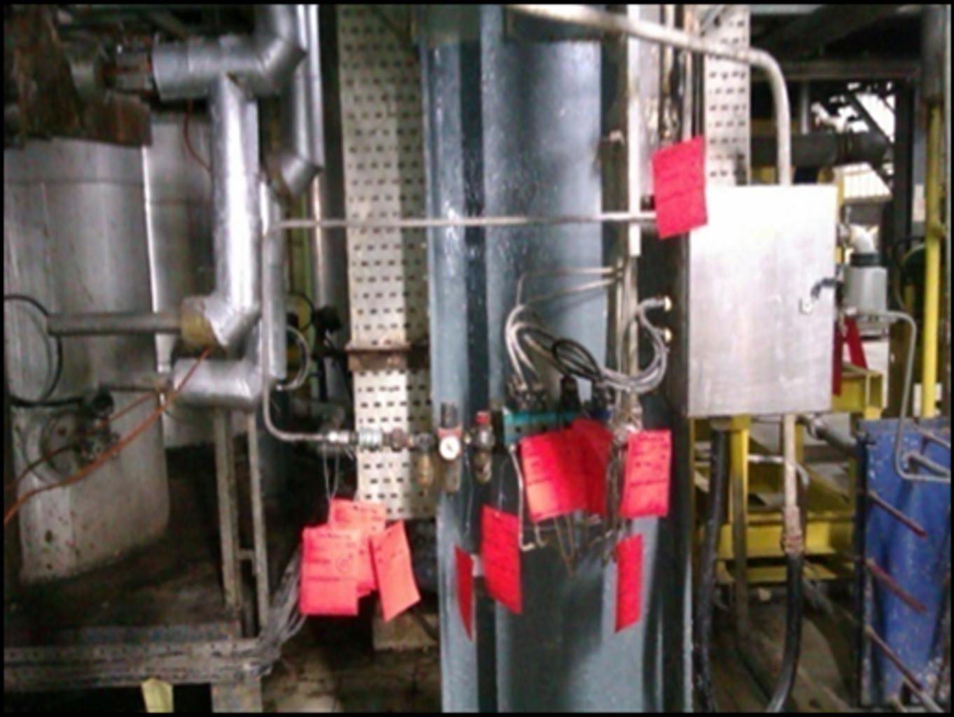
  Examples of Best Practices - Management Support
Very important key to success is having support of management.
Best Practices: Monarch Industries, Canada
  Monthly auto-generated workorder to audit the facility. (using ultrasonic)
  Identify leak locations are with red tags, and assign responsibility to repair.
  Supply lines to all equipment distribution points are hard-plumbed with shutoff valves. (prevent main supply leaks)
  Machine operators are encouraged to report leaks.
  Eliminate quick couplers where possible (crimp fittings only)
  Eliminate all ratchet type hose clamps.
  Better quality air line/hose.
  Remove leaking air tools and blow guns from service for repair/replacement. (spares in stock)
  Regularly reinforce awareness and importance with maintenance staff
Manager Quote: “And most importantly, express extreme displeasure when leaks are not dealt with as soon as detected. Most are simple fixes and there is no excuse to ignore them.
I expect our total facility leakage at any given time to be no greater than 50cfm. I occasionally verify this when I am in the building during off hours.”

Slide 24
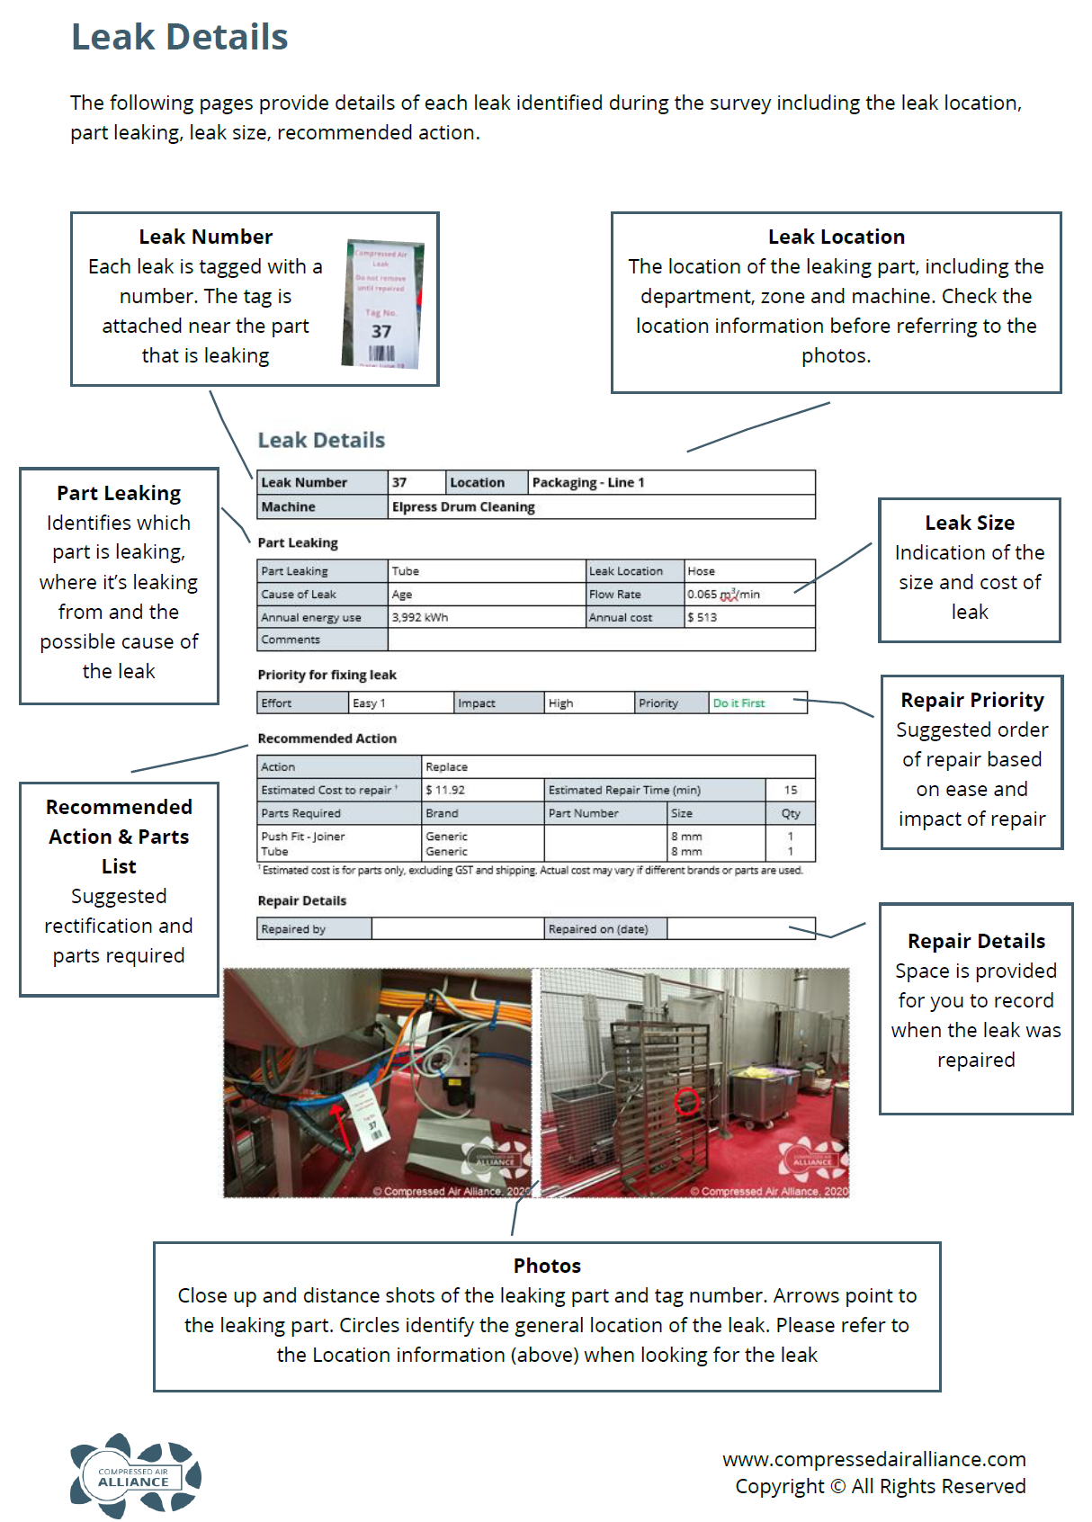
  Examples of Best Practices – Contractor Repairs
“Begin with the end in mind, leakage is not about finding leaks it’s about fixing them, if you don’t have a plan from the beginning to fix them then don’t bother doing the survey as the report is just going to overwhelm you.” – Warwick Rampley – Compressed Air Alliance
40 to 60 leaks per day, about $200 per leak to fix
About 55,000 square feet per day
Floor space of 220,000 ft², = 4 days to audit, averaging 50 leaks/day
Bag and sort parts per leak, ready for shutdown
Push fittings and poor sealing account for 60% of all leaks we identify, so ONLY use full metal push fittings and ensure everything gets extra thread sealant
Notes:
Begin with the end in mind, leakage is not about finding leaks it’s about fixing them, if you don’t have a plan from the beginning to fix them then don’t bother doing the survey as the report is just going to overwhelm you.
Some typical numbers we work from to give customers an indicator of what they are in for (budget numbers).
We get through approximately 5000m2 of floor space per day during a survey (if you have a roof space, your floor area is effectively double)
We find between 40-60 leaks per day
A leak costs (in Australia) an average $200 to fix
A quality survey identifies all the parts and the time required to fix each leak, if the parts are not identified the survey was pointless because someone now needs to visit each leak to work out how to fix it
Some leaks will require further investigation because you can’t get access to the exact point (we will investigate these on the repair day and repair if we have parts)
Broadly speaking I won’t take on a survey unless there is a repair plan of some format, either the customer is doing them or we are, or some combination, but if they think they can ad-hoc the repairs I’ll usually suggest they don’t bother and just rough calculate the leakage value for them (I.e. 20% of system usage)
So if you have a total floor space of 20,000m2, it will take 4 days to audit, averaging 50 leaks/day, we will find 200 leaks @ $200 each to fix, so budget price to fix is going to be $40,000. The caveat is some solenoids/actuators/cylinders can cost $2-3,000 each, so it’s just a budget price!
Typically we conduct repairs on a day we can switch the compressors off, this saves a lot of time isolating areas just to replace a push fitting. The best day for us is a high voltage ‘off’ day, when they service the local transformers (done annually here)
We need 4-6 weeks planning time to order, receive and sort parts, so we typically plan the audit for 10 weeks prior to the ‘repair’ day
On the repair day we have all the parts sorted and bagged per leak
We have planned enough labour to complete all leak repairs in an 8-12hr period
Finally – Push fittings and poor sealing account for 60% of all leaks we identify, so ONLY use full metal push fittings and ensure everything gets extra thread sealant

Slide 25
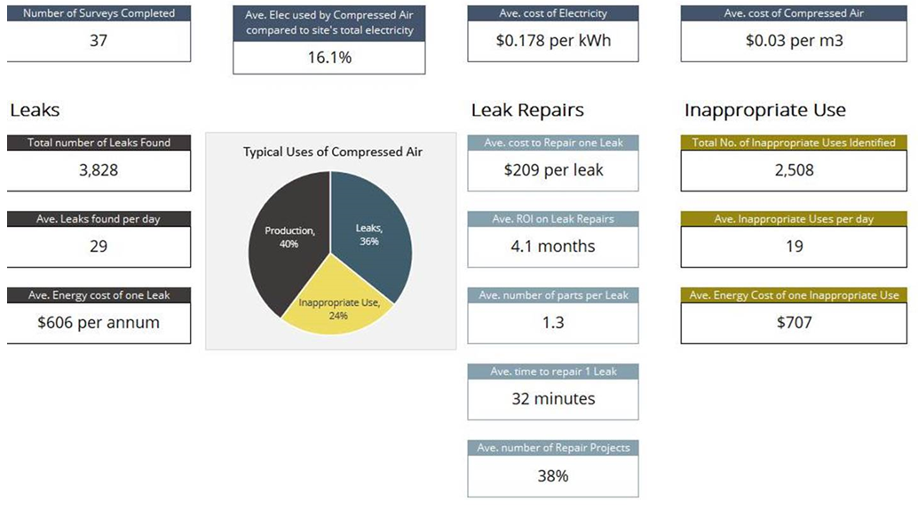
  Examples of Best Practices – Key Statistics
Part Leaking | Total | %
Push Fitting | 1348 | 35%
Fitting | 468 | 12%
Filter / Regulator / Lubricator | 362 | 9%
Actuator / Cylinder | 281 | 7%
Solenoid | 247 | 6%
Valve | 231 | 6%
Unable to access / RFI | 229 | 6%
Tube | 208 | 5%
Gauge | 83 | 2%
Hose | 75 | 2%
Air Gun | 71 | 2%
Filter | 59 | 2%
Flange | 34 | 1%
Regulator | 34 | 1%
Condensate Drain | 31 | 1%
Pipe | 28 | 1%
Lubricator | 27 | 1%
Diaphragm | 6 | 0%
NA | 6 | 0%
Total number of parts leaking | 3828 | 100%
Notes:
Begin with the end in mind, leakage is not about finding leaks it’s about fixing them, if you don’t have a plan from the beginning to fix them then don’t bother doing the survey as the report is just going to overwhelm you.
Some typical numbers we work from to give customers an indicator of what they are in for (budget numbers).
We get through approximately 5000m2 of floor space per day during a survey (if you have a roof space, your floor area is effectively double)
We find between 40-60 leaks per day
A leak costs (in Australia) an average $200 to fix
A quality survey identifies all the parts and the time required to fix each leak, if the parts are not identified the survey was pointless because someone now needs to visit each leak to work out how to fix it
Some leaks will require further investigation because you can’t get access to the exact point (we will investigate these on the repair day and repair if we have parts)
Broadly speaking I won’t take on a survey unless there is a repair plan of some format, either the customer is doing them or we are, or some combination, but if they think they can ad-hoc the repairs I’ll usually suggest they don’t bother and just rough calculate the leakage value for them (I.e. 20% of system usage)
So if you have a total floor space of 20,000m2, it will take 4 days to audit, averaging 50 leaks/day, we will find 200 leaks @ $200 each to fix, so budget price to fix is going to be $40,000. The caveat is some solenoids/actuators/cylinders can cost $2-3,000 each, so it’s just a budget price!
Typically we conduct repairs on a day we can switch the compressors off, this saves a lot of time isolating areas just to replace a push fitting. The best day for us is a high voltage ‘off’ day, when they service the local transformers (done annually here)
We need 4-6 weeks planning time to order, receive and sort parts, so we typically plan the audit for 10 weeks prior to the ‘repair’ day
On the repair day we have all the parts sorted and bagged per leak
We have planned enough labour to complete all leak repairs in an 8-12hr period
Finally – Push fittings and poor sealing account for 60% of all leaks we identify, so ONLY use full metal push fittings and ensure everything gets extra thread sealant

Slide 26




Getting Help
There’s an app for that!
Compressed Air Service Providers
Monitoring and Control System Vendors
Rental Companies
Leak Detection Equipment Manufacturers
Independent Auditors
Power Utilities
  Incentive Programs
  Equipment Lending
  Energy Manager Programs
Energy Efficiency Programs
Compressed Air Challenge

Slide 27

Important Points
Make sure you have good compressor control
Get good instruments and train your people
Find and document leaks
Fix immediately if possible
Validate your findings
Verify your results, analyze, and fix problem areas
Look thoroughly for hidden leaks inside equipment
Do special testing
Regularly schedule, get management support
Get outside help if overwhelmed

Slide 28

About the Speaker
Manager of US Operations, UE Systems, Inc.
Nearly 17 Years of experience in airborne & structure-borne instruments, software and applications
CMRP (Certified Maintenance & Reliability Professional) through the SMRP (Society for Maintenance & Reliability Professionals)
Graduate of Clemson University
Resides in Anderson, SC and enjoys spending time out on the lake with his wife and daughter
Sponsored by
Adrian Messer
UE Systems, Inc.

Slide 29


Finding & Repairing Compressed Air Leaks Using Ultrasound
Adrian Messer, CMRP
adrianm@uesystems.com
YOUR SOURCE FOR
ULTRASONIC DETECTION EQUIPMENT AND PLANT RELIABILITY!
www.uesystems.com

Slide 30

5 Things An Ultrasound Technician
Can Do In Times of COVID
1. Focus on energy
2. Organize an energy “treasure hunt”
3. Start a “portfolio” of your PdM finds
4. Update & clean up your ultrasound route data
5. Start doing Sensitivity Validations on your ultrasound device

Slide 31
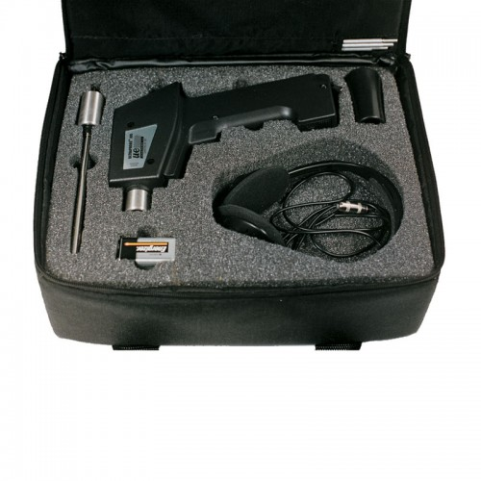
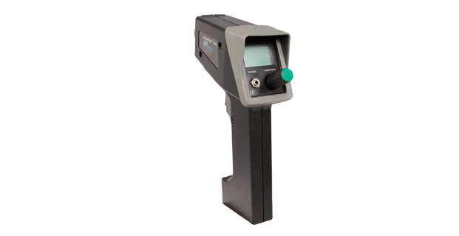
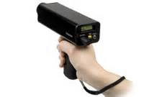
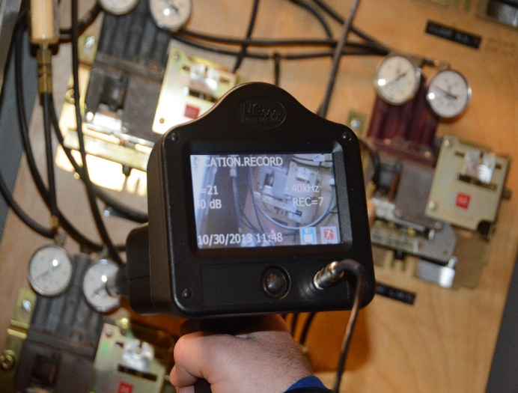
What Equipment is Available?
Ultraprobe 100
Ultraprobe 3000
Ultraprobe 9000
Ultraprobe 15000
Ultraprobe + UE Systems’ Leak Survey App = Easy & Affordable Leak Detection Arsenal

Slide 32
Planning the Survey
Review compressed air applications and blueprints of piping
Prioritize equipment location
Consult with production
Schedule the survey during peak operating times and when demand is the greatest
Select the personnel
  Trained, qualified, and have proper PPE
Select the equipment
  Ultrasonic instrument, tags, hangers, etc.

Slide 33
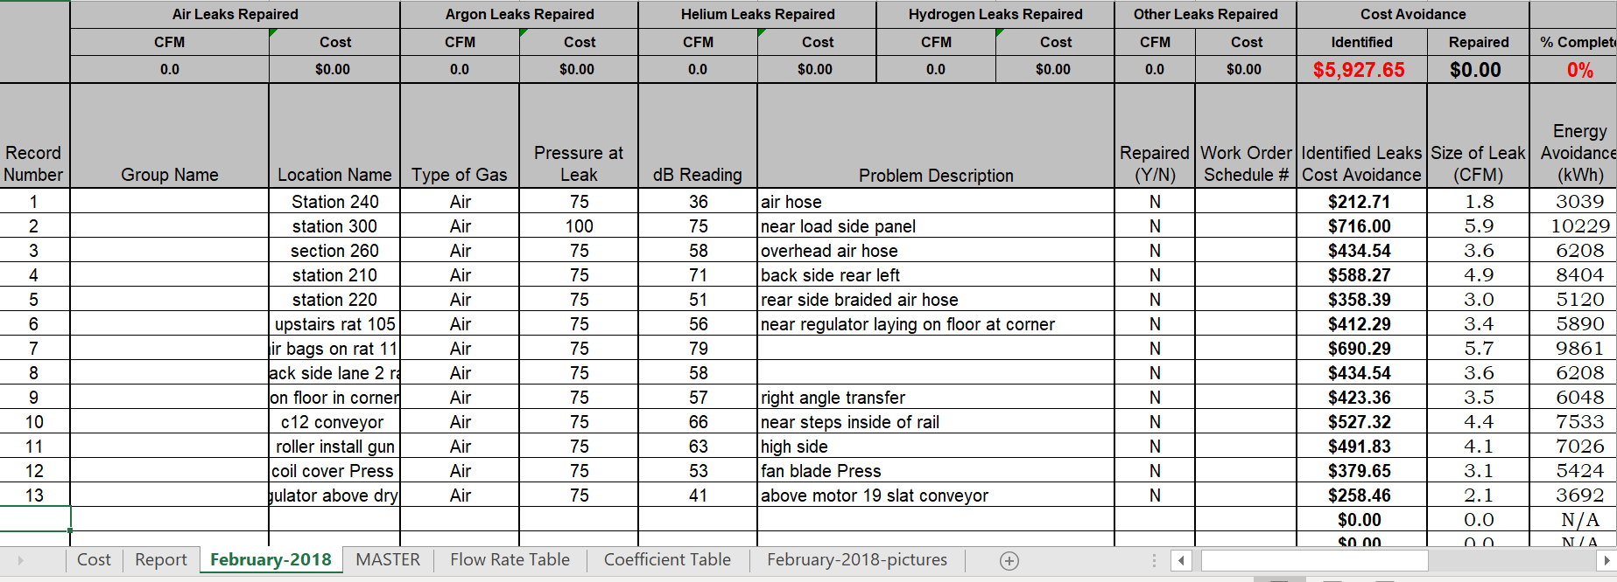
Document the Findings

Slide 34
Conclusions
Start small
Pick an area that has the greatest opportunity
Take before and after readings on compressor monitoring systems once the leaks have been repaired
Document your findings & share them throughout the organization
Partner with a reputable compressor company and consultant for other recommendations (storage, design, piping, etc.)

Slide 35

QUESTIONS?
CONTACT
Adrian Messer, CMRP - Director of US Operations
adrianm@uesystems.com
YOUR SOURCE FOR
ULTRASONIC DETECTION EQUIPMENT AND PLANT RELIABILITY!
www.uesystems.com

Slide 36
Finding, Fixing and Monitoring Compressed Air Leaks
Q&A
Please submit any questions through the Question Window on your GoToWebinar interface, directing them to Compressed Air Best Practices Magazine. Our panelists will do their best to address your questions and will follow up with you on anything that goes unanswered during this session.
Thank you for attending!
Sponsored by

Slide 37
Thank you for attending!
The recording and slides of this webinar will be made available to attendees via email later today.
PDH Certificates will be e-mailed to Attendees within 2 days.

Slide 38

February 2021 Webinar
Sorting Through the Menu of Aeration Blower Technologies
Julie Gass, P.E.
Black & Veatch
Keynote Speaker
Thursday, February 25, 2021 – 2:00 PM EST
Register for free at
www.blowervacuumbestpractices.com/magazine/webinars

