Slide 1
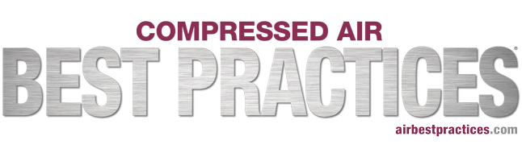
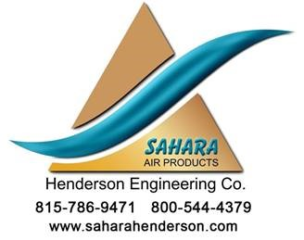
Heat of Compression Desiccant Dryers: Clearing up the Confusion
Sponsored by
Hank van Ormer, Air Power USA
Keynote Speaker
For your free subscription, please visit www.airbestpractices.com/magazine/subscription.

Slide 2
Heat of Compression Desiccant Dryers: Clearing up the Confusion
Hank van Ormer, Air Power USA
Keynote Speaker
The recording and slides of this webinar will be made available to attendees via email later today.
PDH Certificates will be e-mailed to Attendees within two days.
Sponsored by
For your free subscription, please visit www.airbestpractices.com/magazine/subscription.

Slide 3
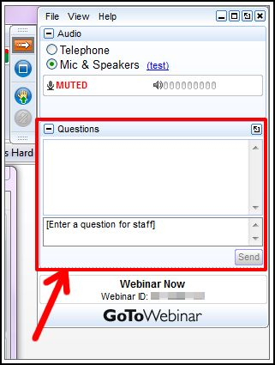
Q&A Format
Panelists will answer your questions during the Q&A session at the end of the Webinar.
Please post your questions in the Questions Window in your GoToWebinar interface.
Direct all questions to Compressed Air Best Practices Magazine
Sponsored by
For your free subscription, please visit www.airbestpractices.com/magazine/subscription.

Slide 4
Handouts

Slide 5
All rights are reserved. The contents of this publication may not be reproduced in whole or in part without consent of Smith Onandia Communications LLC. Smith Onandia Communications LLC does not assume and hereby disclaims any liability to any person for any loss or damage caused by errors or omissions in the material contained herein, regardless of whether such errors result from negligence, accident, or any other cause whatsoever.
All materials presented are educational. Each system is unique and must be evaluated on its own merits.

Slide 6
Heat of Compression Desiccant Dryers: Clearing up the Confusion
Introduction
Compressed Air Best Practices® Magazine
For your free subscription, please visit http://www.airbestpractices.com/magazine/subscription.

Slide 7
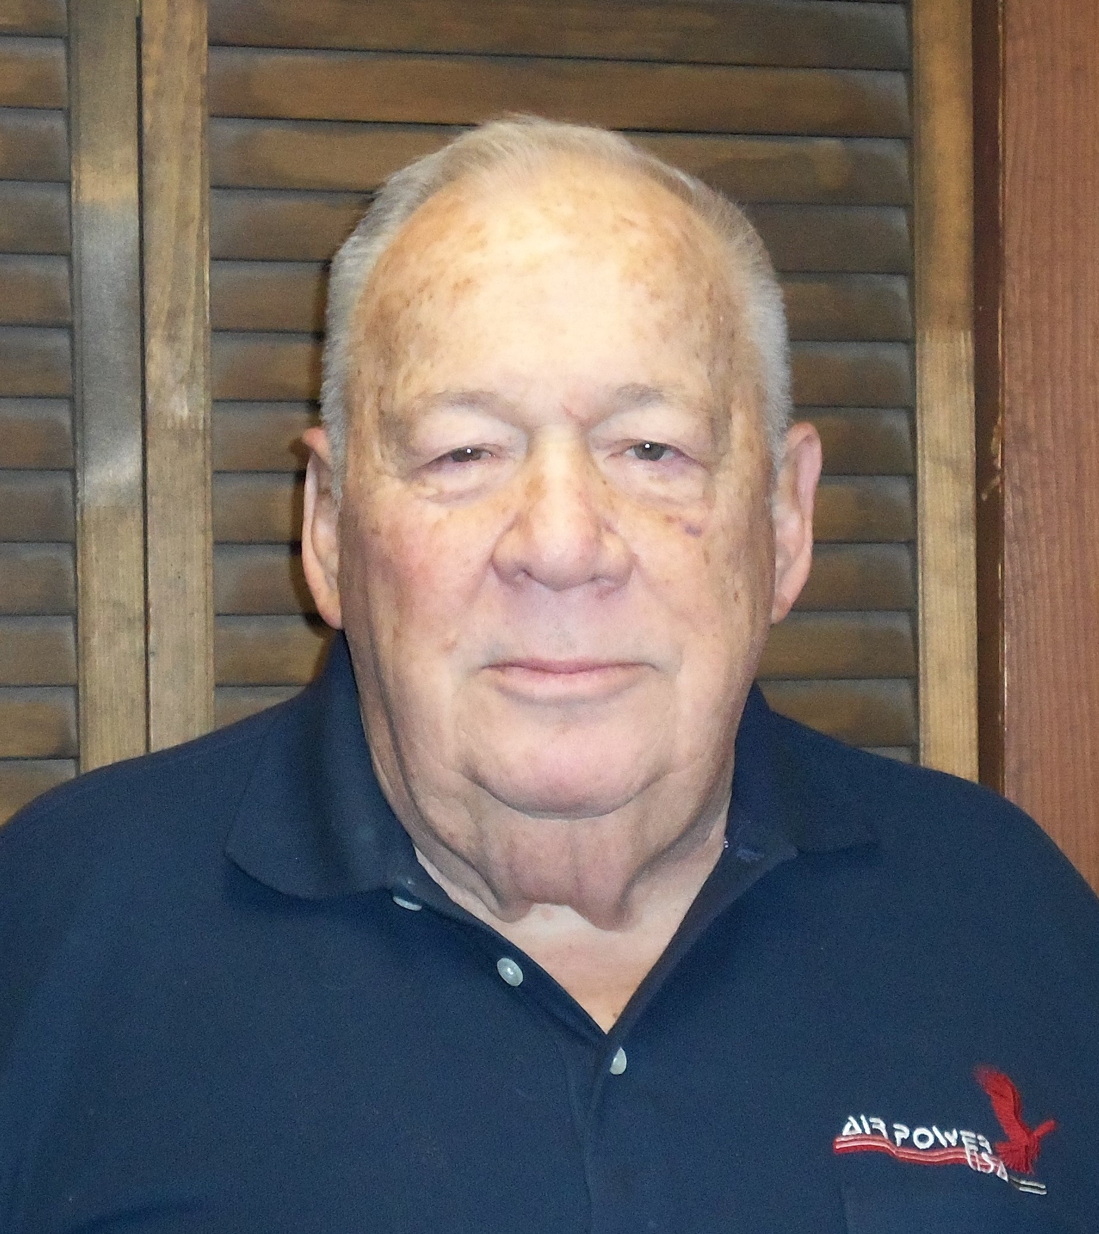
About the Speaker
Founded Air Power USA in 1986
Over 50 years of experience in the compressed air and gas industry
Sponsored by
Hank van Ormer
Air Power USA
For your free subscription, please visit www.airbestpractices.com/magazine/subscription.

Slide 8

Heat of Compression Desiccant Dryers -
Clearing up the Confusion
May 17, 2018
Air Power USA
Hank van Ormer – Technical Director
(740) 862-4112

Slide 9

Introduction
The heat of compression dryer is an established heated type desiccant dryer which was introduced in the 1960’s and has operated successfully all over the world for over 50 years.
The basic operating principles are similar to other heated type desiccant dryers which utilize heat in their regeneration process to reduce the amount of dry compressed air used and establish lower operating costs.
For various reasons, there are many misconceptions about this technology that often confuse the potential user with regard to its capabilities.
Like all quality equipment, in order to select and apply the RIGHT dryer for the conditions, the appropriate personnel must understand the basic operation.
Before looking at these misconceptions or myths – let’s review the
basic operating parameters that we have covered in previous
webinars.
Air Power USA Inc.
2

Slide 10
Where does the Heat of Compression (HOC) Come From?
Basic Compressed Air Inefficiency
8 hp of electric energy input = 1hp of compressed air work
Energy not used in work goes off as heat
This heat was generated when the air was compressed – when utilized, it is in effect “free.” If you don’t use, you lose it.
A Very Simple Technology
Utilize the heat of compression (HOC) from an oil-free air compressor “before” it goes to the aftercooler to supply some or ALL of the regeneration heat in the desiccant dyer
Air Power USA Inc.
3

Slide 11
Are there Limitations?
Must Have Hot Oil-free Compressed Air
  Early in the development years the use of oil-free air was often avoided. The majority of air compressor installations were lubricated.
  Many did not understand the process and were not interested because it did not affect them.
  Over the last several decades the trend has been more and more oil-free air compressor installations. This trend continues today – each one opening the door to utilizing HOC dryer technology and delivering SIGNIFICANT ENERGY SAVINGS.
There is no other dryer technology with lower operating energy costs and inherent low maintenance costs than HOC, when conditions are correct. For most commercial plant air systems the HOC is a viable choice when oil-free compressed air is available.
Additional details on application and selection will be covered in the following presentation by Chuck Henderson.
Air Power USA Inc.
4

Slide 12
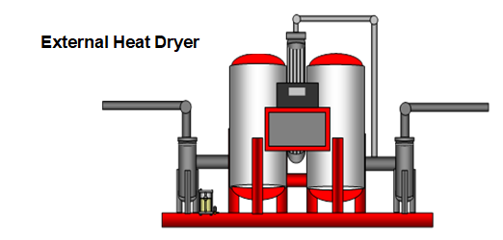
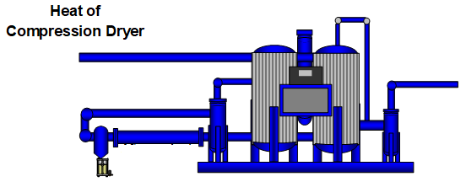
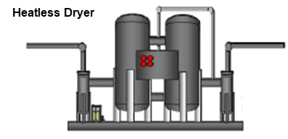
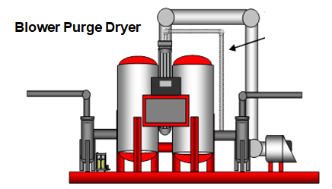
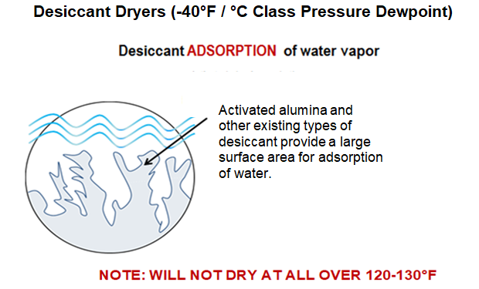
Common Heated Full Flow Type Desiccant Dryers – Drying Process
All desiccant dryers utilize the process of adsorption – water vapor moves from the saturated compressed air to the surface of the desiccant bead – in their drying cycle.
They will NOT remove liquid water!
Note: Will not dry at all above 130°F
Air Power USA Inc.
5

Slide 13
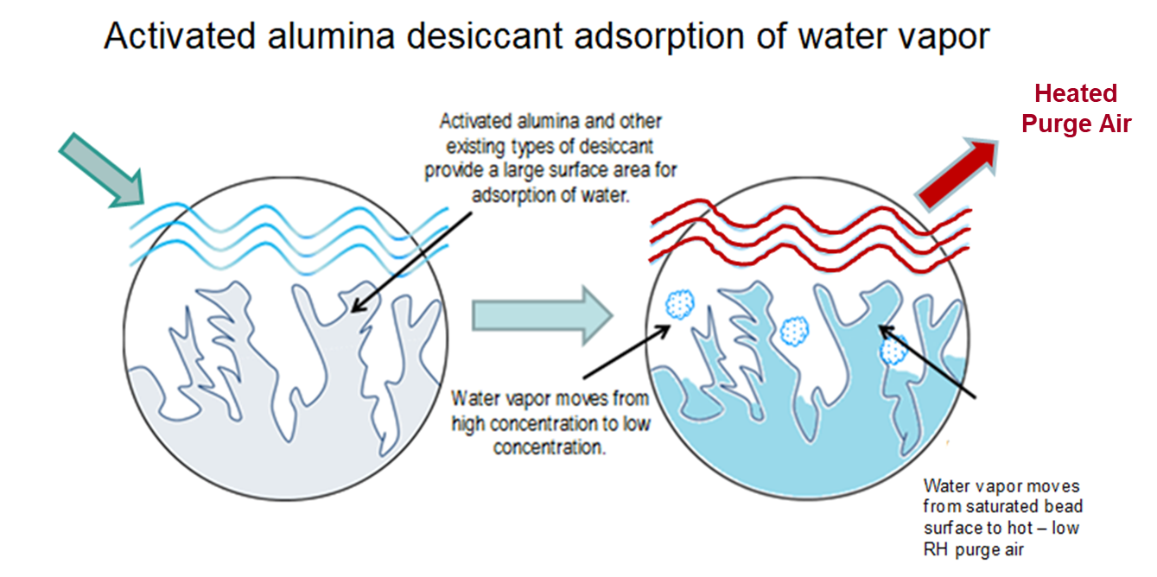
Desiccant Regeneration Process
Low Relative Humidity
All desiccant dryers regenerate the wet bed by creating low RH purge air to remove the water vapor on the surface of the beads.
A common way of doing this is to add heat to increase the RH differential. This is called “heated type” – one heated type of dryer is HEAT OF COMPRESSION OR HOC.
Air Power USA Inc.
6

Slide 14
Heat of Compression-
Desiccant Dryer Technology
No lost purge water vapor removal by HOC
Air Power USA Inc.
7

Slide 15

Getting Started –
Clearing up the Confusion
With these thoughts in mind, lets try to clear up the confusion and misconceptions in relation to HOC technology.
The rising interest in energy savings and the growth of oil-free installations create a need to clarify these misconceptions that will lead to more energy saving opportunities.
Air Power USA Inc.
8

Slide 16

Misconceptions that Create Confusion
#1 “There must be a 350°F discharge temperature from the oil-free air compressors to work”
  There are many applications over the last 50 years operating effectively at or near 200°F discharge temperature.
  Regeneration air needs a significant difference in relative humidity to pick up the moisture off the bed.
For example:
Inlet air 14.5 psia / 90°F / 60% relative humidity = 8.976 gr/CuFt. at 100 psig (7.9 cr.) = 70.91 gr/CuFt.
Discharge air multi-stage compressor (condensate and moisture drained by intercoolers) = 35 gr / ft³
  at 200°F the air will hold at 385 gr/ft. (35 ÷ 385 ) …………………………… 9% RH
  at 350°F the air will hold 1,083 gr/CuFt t or ……………………………….. 3.2% RH
When a continuous and stable low pressure dewpoint is required, the dryer should be equipped with such options as auxiliary heat source, dry air cooling etc. When well controlled, it will only run when needed.
Air Power USA Inc.
9

Slide 17
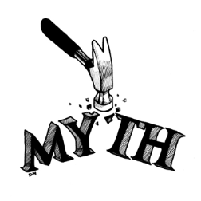
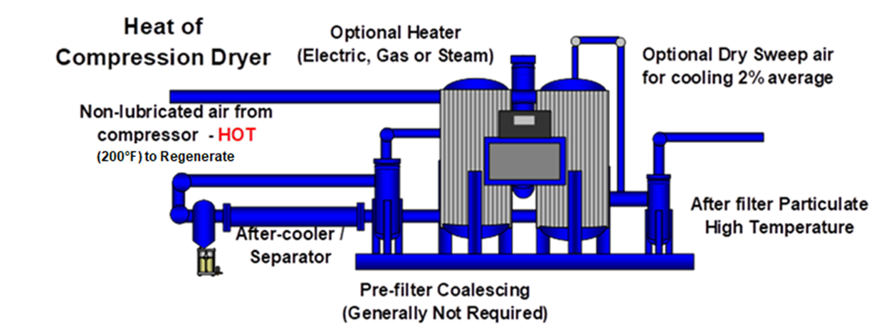
Misconceptions that Create Confusion
#2 “The air compressor must run 100% of the time”
  The HOC dryers will operate successfully under varying loads.
  The air compressor must be loaded high enough to deliver 200°F air to the dryer – if not, the options described in misconception #1 will correct the problem.
Air Power USA Inc.
10

Slide 18

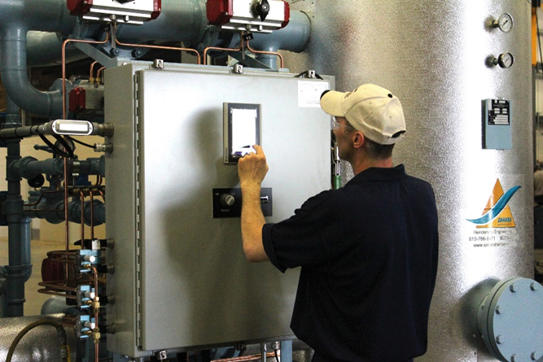
Misconceptions that Create Confusion
#3 “If the air compressor is down, the dryer is down”
  Many HOC dryers are integrally tied to the air compressor.
  If the air compressor is down for maintenance or repair and you need air from another source such as rental, there are HOC dryers than can easily run as a heatless dryer with an optional feature – and go back to HOC when the primary air compressor is ready.
Air Power USA Inc.
11

Slide 19
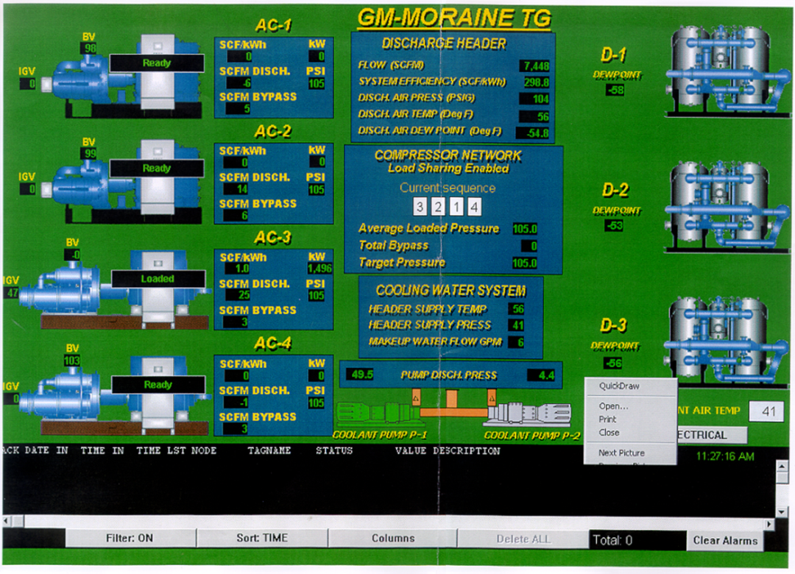
Misconceptions that Create Confusion
#4 “You have to run one air compressor to one dryer”
  This is not accurate when the system is well designed. Multiple oil-free air compressors can feed multiple HOC dryers.
Example:
This screen shot is of an actual operating system in a large automotive assembly plant.
The following diagram illustrates very clearly that this misconception is just that…a MISCONCEPTION!
Air Power USA Inc.
12

Slide 20
Misconceptions that Create Confusion
Inlet air to dryer – 234°F / -57°F PDP
Air Power USA Inc.
13

Slide 21
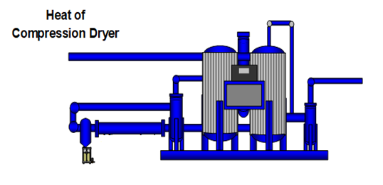
Misconceptions that Create Confusion
#5 “HOC’s have high pressure drop”
  The HOC dryer includes the aftercooler and separator – which with other type of dryers is on the air compressor discharge and this pressure loss will be about the same.
  Because the loss inside the air compressor unit doesn’t show, the perception is the HOC has more pressure loss.
  The pressure loss in a full flow with no trim is about the same as other high quality twin tower desiccant dryers and with the heater and dry gas cooling, possibly slightly higher.
Air Power USA Inc.
14

Slide 22
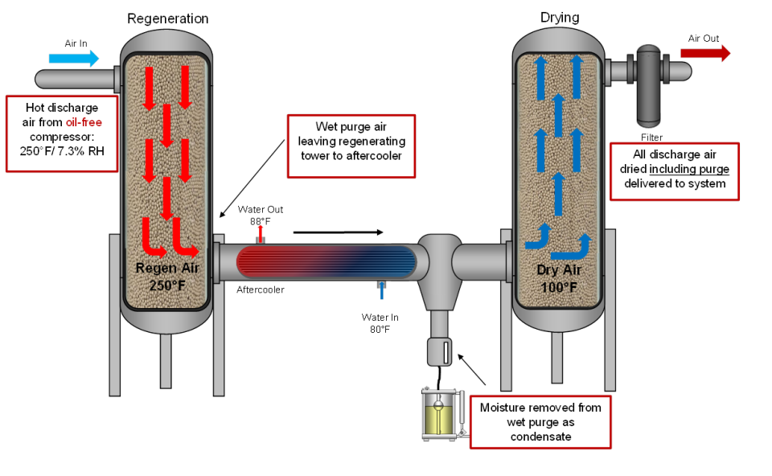
Misconceptions that Create Confusion
#6 “HOC dryers lose a lot of air”
  Nothing could be further from the truth
  The full flow model with no trim heater loses no compressed air. Other types of twin tower dryers lose approximately 5-15% of dry air with “purge sweeps” up to several hours
  Some full featured HOC dryers have a stripping and cooling cycle to optimize performance. Stripping is only 90 minutes with a typical air loss of 2%, only during this time and when needed.
Air Power USA Inc.
15

Slide 23
Misconceptions that Create Confusion
#7 “If the air compressor discharge temperature is low, you have to heat all of the inlet air”
  If the air compressor discharge temperature is low and the application requires a lower PDP - in some models a heater can be added to the stripping line. This heater would be comparable to other heated dryers but only operates for 90 minutes of the cycle and still delivering energy efficient dry air.
  This available option is relatively inexpensive and delivers full performance under virtually any operating conditions.
Air Power USA Inc.
16

Slide 24
Misconceptions that Create Confusion
#8 “HOC dryers cannot deliver low pressure dewpoint (PDP)”
  This misconception has been promoted by some otherwise knowledgeable people stating: “HOC dryers with multi-stage air compressors cannot provide better than a -20°F PDP below 180 psig.”
  Much of the support for this inaccurate conclusion comes “from a study” prepared using molecular sieve desiccant in the drying bed.
  The calculations use the appropriate isotheres for the molecular sieve desiccant and a 125°F desiccant bed operating temperature.
The math is correct….the premise and conclusion incorrect – and irrelevant!
Air Power USA Inc.
17

Slide 25
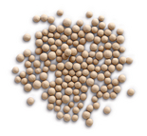
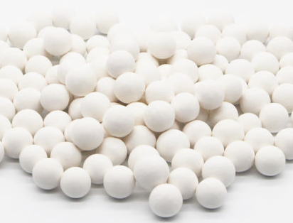
Molecular Sieve Product
What is molecular sieve?
  Molecular sieve is a synthesized product designed for specific uses and used often in the gas separator field.
  Industrially it may be used as a final drying agent at the tower exit, taking advantage of its ability to dry effectively in areas of low RH.
  The recommended regeneration temperature is usually from 300°F to 500°F or more – NOT 125°F.
The conclusion reached by this data is not relevant. Molecular sieve is not the bed desiccant used in HOC dryers. Most HOC desiccant dryers use a basic desiccant selection called activated alumina.
Air Power USA Inc.
18

Slide 26
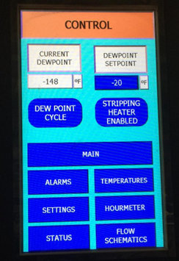
Misconceptions that Create Confusion
HOC dryers can be optimized to deliver lower than -40°F / C on a continual basis throughout the year.
Air Power USA Inc.
19

Slide 27
Final Thoughts
Desiccant dryers usually compared at -40°F – Why? What pressure dewpoint do you actually need?
Example - Often HOC dryers are selected instead of refrigerated type for several reasons:
  HOC dryers operating in acceptable environment and conditions without trim heater and dry gas cooling can hold an average PDP from +10 to +20°F - about twice the moisture removal of a well performing refrigerated dryer.
  No issue with Freon
  Low life cycle operating costs
As in the case of all dryer selection - do not “over dry”.
If you need -5°F, or some other level – run at that level for optimum performance.
Air Power USA Inc.
20

Slide 28
Final Thoughts
Energy savings (based on 8,760 hours/year and $.05 kWh)
  4,000 scfm non-cycling refrigerated dryer cost = $9,679 yr.
  4,000 scfm full flow no trim HOC dryer cost = $43.68 yr.
Air Power USA Inc.
21

Slide 29

Thank you for the opportunity
to present!
Air Power USA
Hank van Ormer – Technical Director
(740) 862-4112
Air Power USA Inc.
22

Slide 30
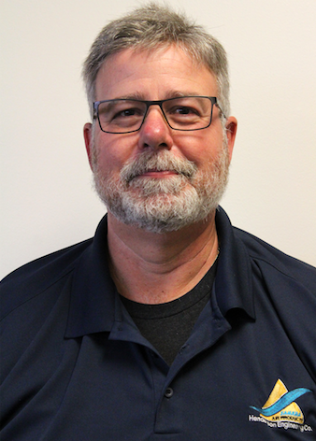
About the Speaker
Vice President of Henderson Engineering Company
Chuck Henderson
Henderson Engineering Company
For your free subscription, please visit www.airbestpractices.com/magazine/subscription.

Slide 31
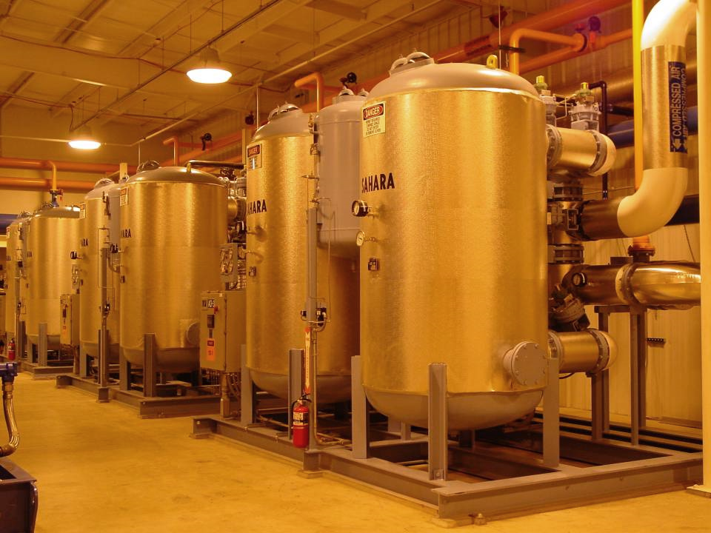
Energy Efficient Heat of Compression Dryers
Installation Guidelines
Chuck Henderson
Henderson Engineering Company
chuckhenderson@saharahenderson.com

Slide 32
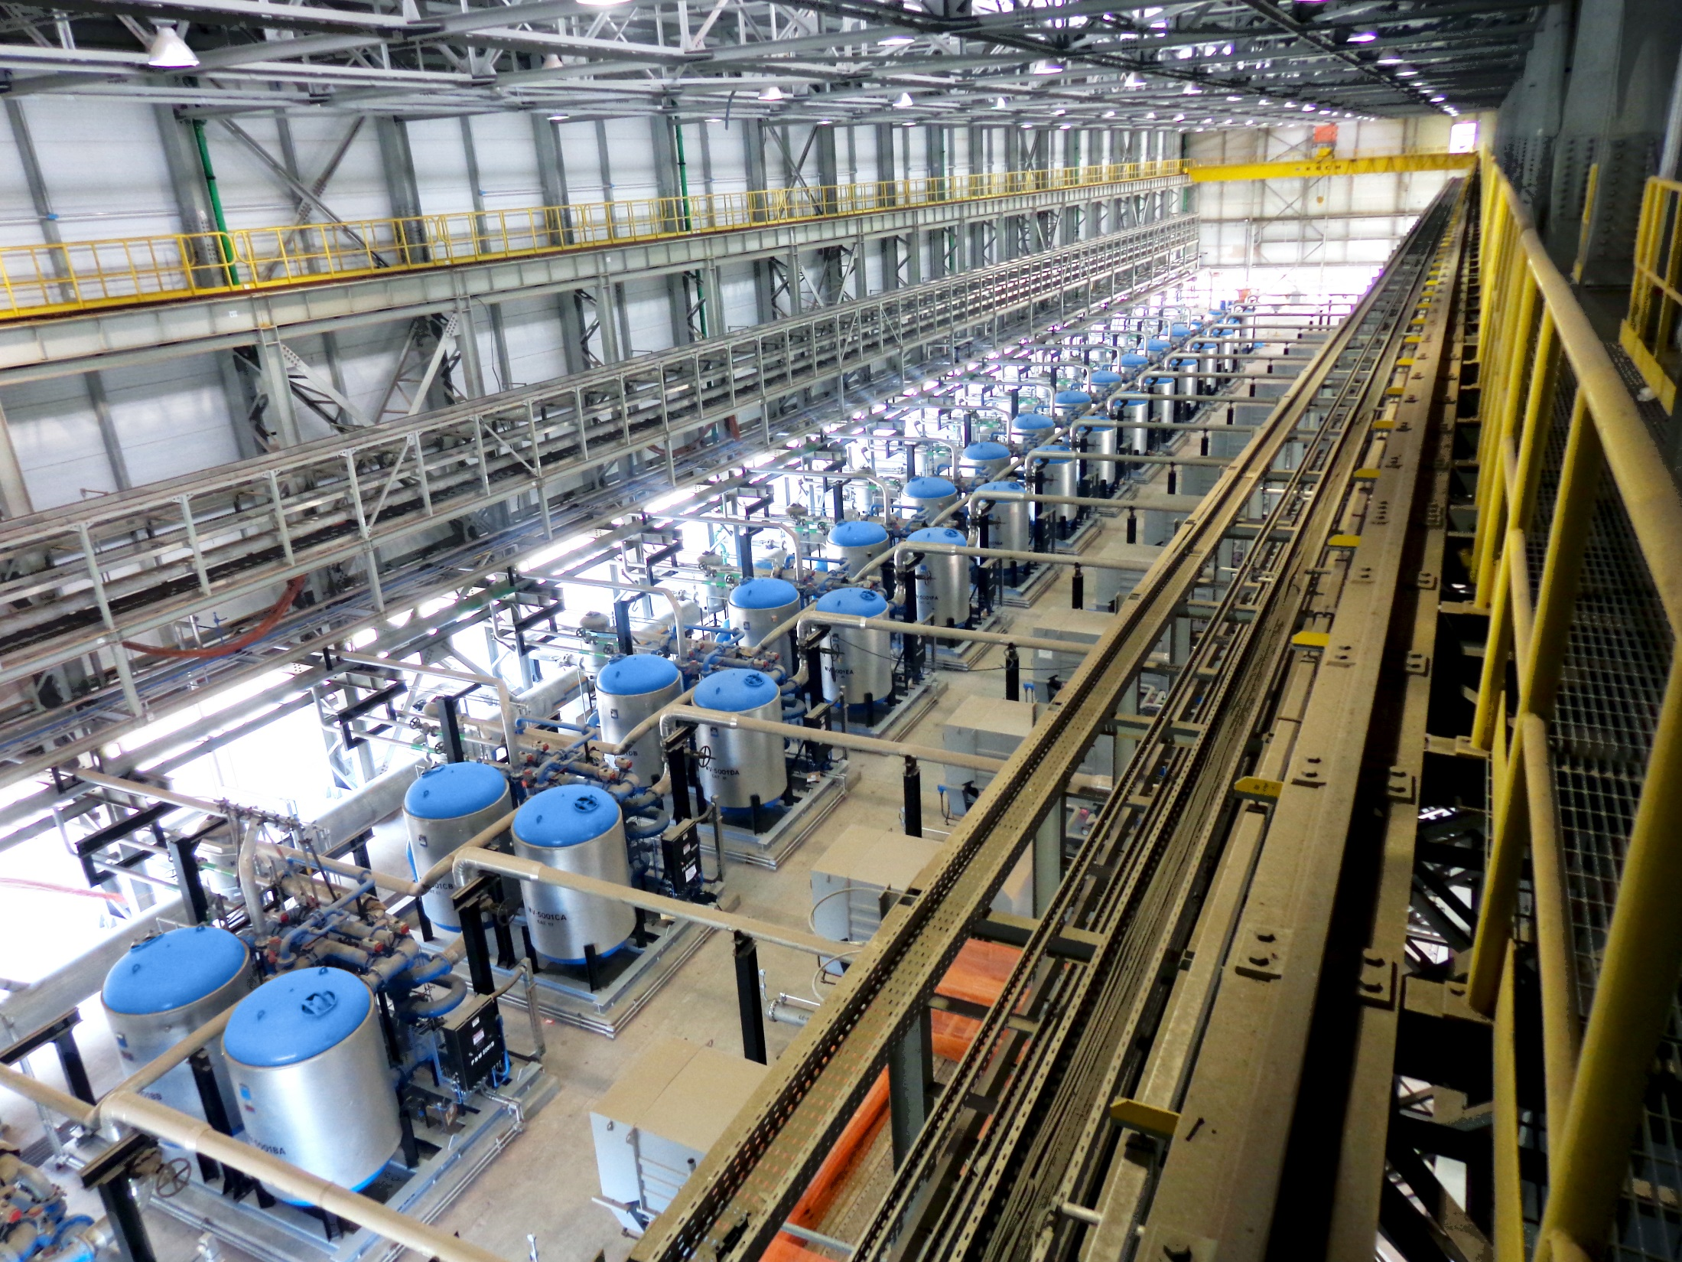

Slide 33
Misunderstanding
Misapplications
When HOC was first developed in the 60’s, most dryer companies didn’t offer this design and discounted its benefits.
Some dryer companies installed HOC with poor choices of components, leading to dissatisfied customers.

Slide 34
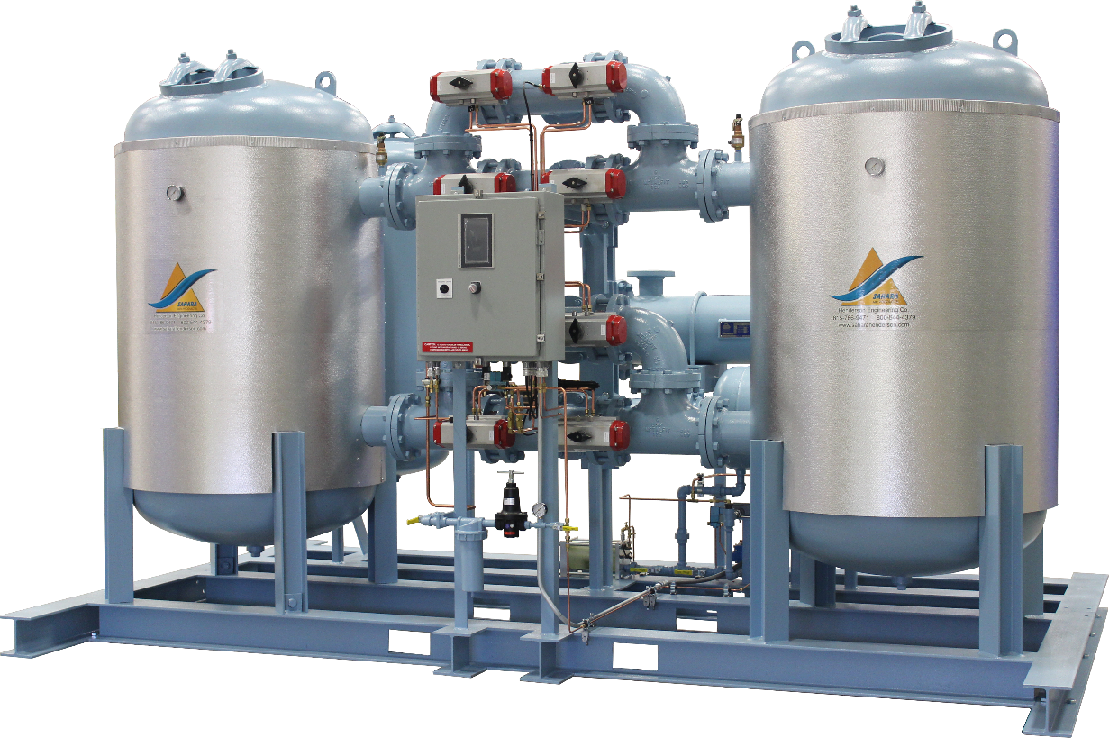
Heat of Compression
Must be oil-free
Must be located near the compressor

Slide 35
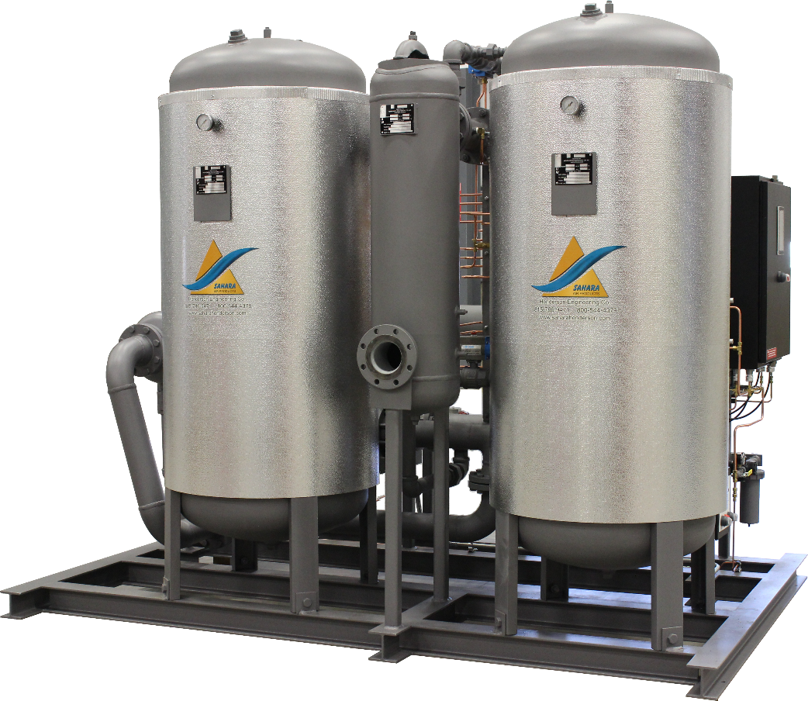
Heat-of-Compression Considerations
Two factors with any mechanical equipment:
1) Basic Design
2) Choice of Components

Slide 36
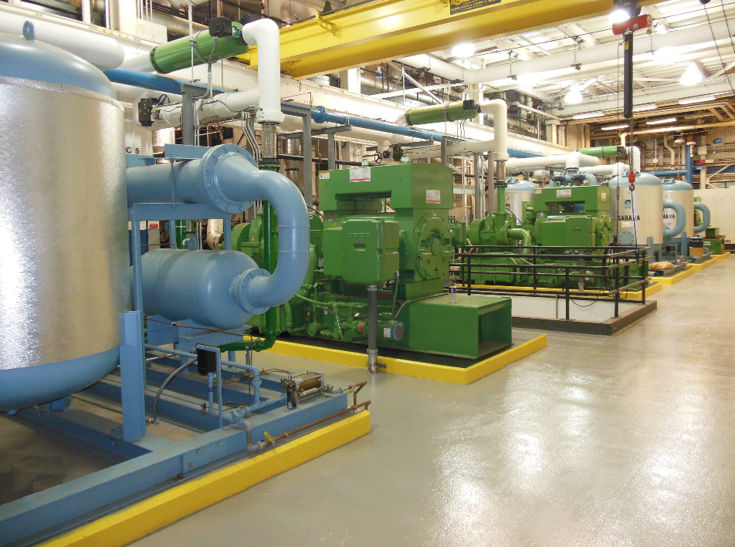
Basic Design
Regeneration must be full flow.
Cooling with wet air preloads desiccant and increases dew point.
Inlet heaters add to pressure drop and consume significant energy.
Using 2 aftercoolers doubles GPM.

Slide 37
Choice of Components
Valves must be high performance bubble tight; leakage across the valve means high dew points.
Multi-port valves leak and should never be used in HOC applications.
Drain traps must work; single traps fail.
Where does the water go?
Separators must be efficient at 0-100% flow. Cyclone and centrifugal separators are flow dependent; coalescing separators are not.

Slide 38
HOC Dryer Sizing Factors
SEVERAL FACTORS DETERMINE THE
POWER, SIZE, AND TYPE OF AN HOC DRYER
Minimum discharge temperature of oil-free air
Maximum inlet flow rate
Maximum cooling water temperature
Minimum inlet pressure
Desired continuous pressure dew point at site conditions

Slide 39
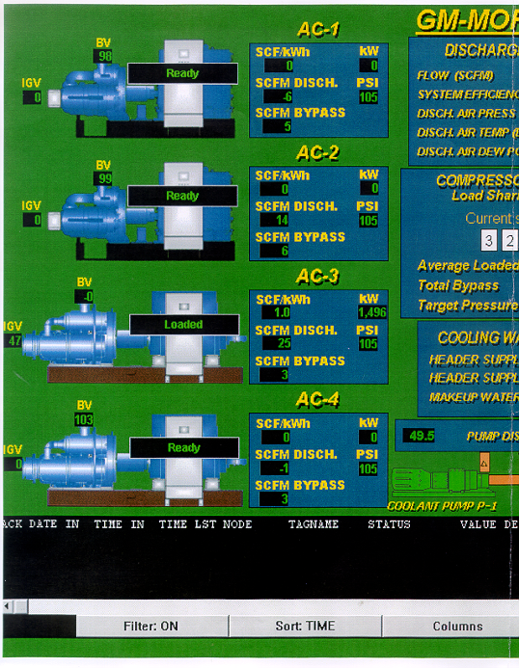
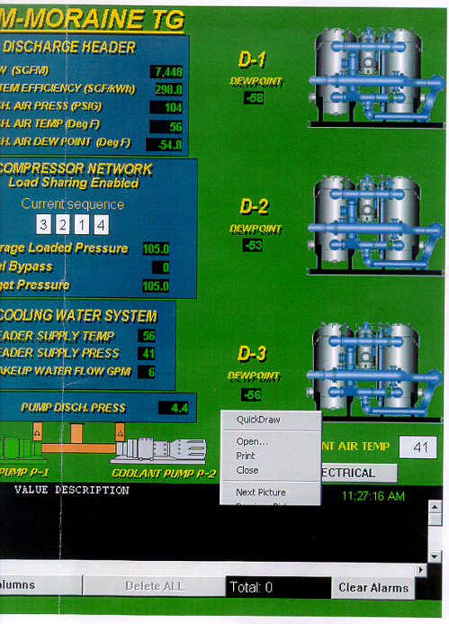
Notes:
39

Slide 40
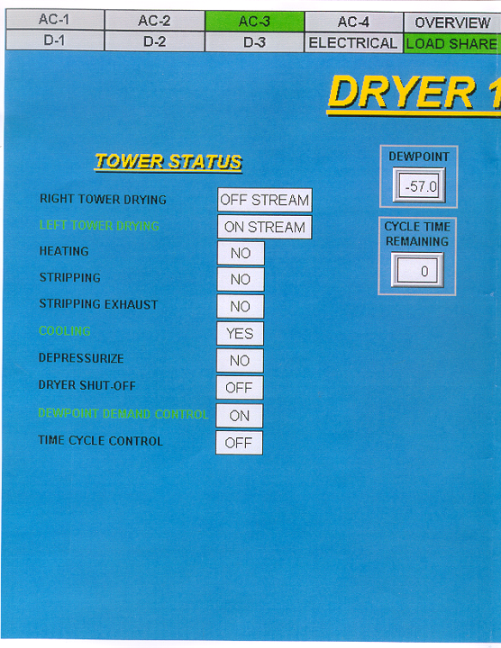
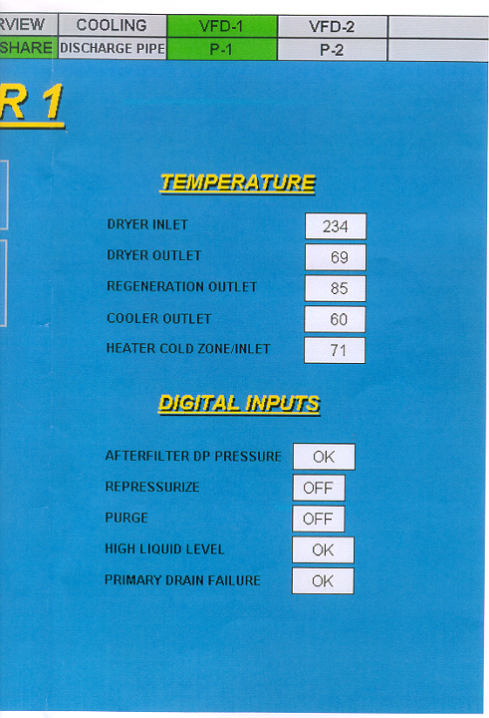
Notes:
40

Slide 41
Dew Point Demand Often Control Dew Point & Temperature Spike at Tower Switch

Slide 43
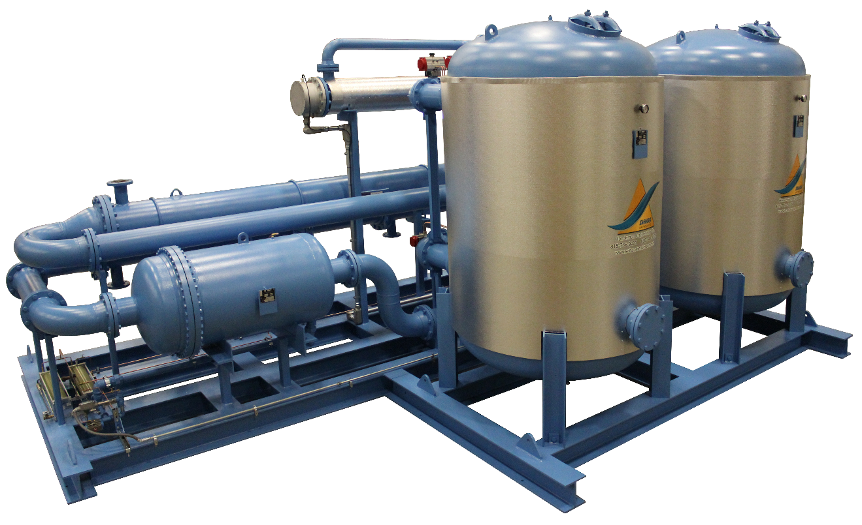
Why Heat of Compression is Popular
1) Virtually no operating cost
2) More reliable than other dryers
3) Guaranteed performance

Slide 44
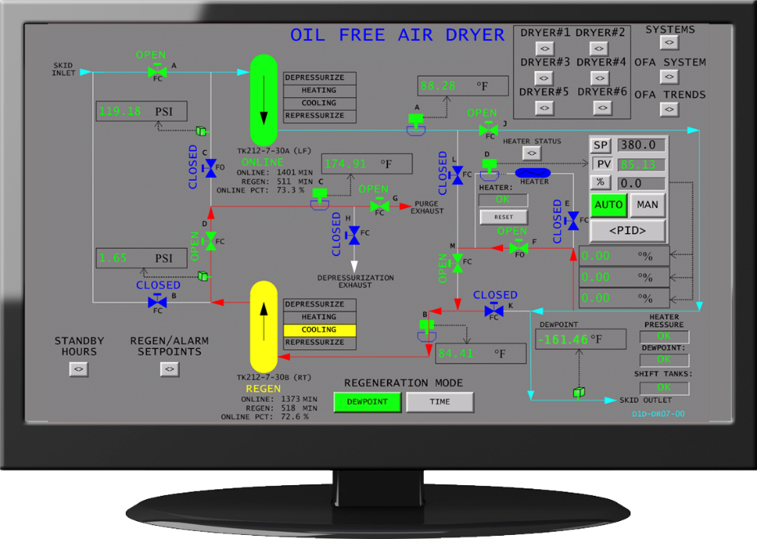
Dew Point Integrity to Ensure -40°F/C

Slide 45
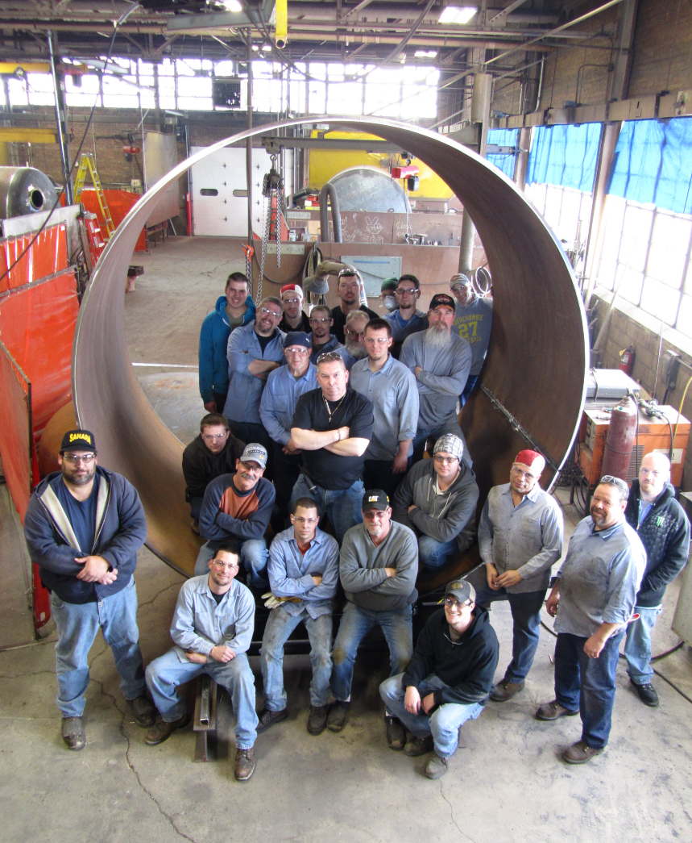
Thank you!

Slide 46
Heat of Compression Desiccant Dryers: Clearing up the Confusion
Q&A
Please submit any questions through the Question Window on your GoToWebinar interface, directing them to Compressed Air Best Practices Magazine. Our panelists will do their best to address your questions, and will follow up with you on anything that goes unanswered during this session. Thank you for attending!
Sponsored by
For your free subscription, please visit www.airbestpractices.com/magazine/subscription.

Slide 47
Thank you for attending!
The recording and slides of this webinar will be made available to attendees via email later today.
PDH Certificates will be e-mailed to Attendees within two days.
Sponsored by
For your free subscription, please visit www.airbestpractices.com/magazine/subscription.

Slide 48




June 2018 Webinar
5 Tips on Optimizing VSD Vacuum Pumps
Sponsored by
Tim Dugan, P.E.
Compression Engineering Corporation
Keynote Speaker
Thursday, June 28, 2018 – 2:00 PM EST
Register for free at
www.blowervacuumbestpractices.com/magazine/webinars

