Slide 1


Innovative Instrument Air Compliant System Design & Measurement
Mark Ames, John Henry Foster
Keynote Speaker
Sponsored by
For your free subscription, please visit www.airbestpractices.com/magazine/subscription.

Slide 2
Innovative Instrument Air Compliant System Design & Measurement
Mark Ames, John Henry Foster
Keynote Speaker
The recording and slides of this webinar will be made available to attendees via email later today.
PDH Certificates will be e-mailed to Attendees within two days.
Sponsored by
For your free subscription, please visit www.airbestpractices.com/magazine/subscription.

Slide 3
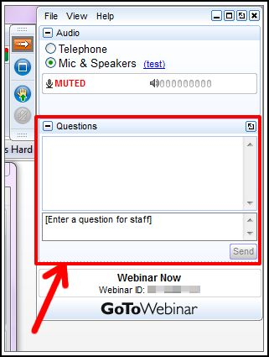
Q&A Format
Panelists will answer your questions during the Q&A session at the end of the Webinar.
Please post your questions in the Questions Window in your GoToWebinar interface.
Direct all questions to Compressed Air Best Practices Magazine
Sponsored by
For your free subscription, please visit www.airbestpractices.com/magazine/subscription.

Slide 4
Handouts

Slide 5
All rights are reserved. The contents of this publication may not be reproduced in whole or in part without consent of Smith Onandia Communications LLC. Smith Onandia Communications LLC does not assume and hereby disclaims any liability to any person for any loss or damage caused by errors or omissions in the material contained herein, regardless of whether such errors result from negligence, accident, or any other cause whatsoever.
All materials presented are educational. Each system is unique and must be evaluated on its own merits.

Slide 6

ATTEND THE INAUGURAL 3-DAY CONFERENCE & EXPO!
September 17-19, 2018, Chicago O’Hare Crowne Plaza Conference Center
FREE EXPO
Booths represented from manufacturers of air compressors, air treatment, flow meters, vacuum, blowers and chillers
HIGH-ROI CONFERENCE
TRACK 1: COMPRESSED AIR SUPPLY STRATEGIES
TRACK 2: COMPRESSED AIR DEMAND REDUCTION
TRACK 3: BLOWER AND VACUUM OPTIMIZATION
TRACK 4: COOLING SYSTEMS AND ENERGY MANAGEMENT
Register Today!
www.cabpexpo.com

Slide 7
Innovative Instrument Air Compliant System Design & Measurement
Introduction by Rod Smith, Publisher
Compressed Air Best Practices® Magazine
Sponsored by
For your free subscription, please visit http://www.airbestpractices.com/magazine/subscription.

Slide 8
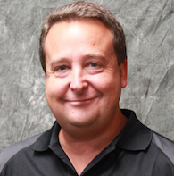
About the Speaker
Senior Auditor for John Henry Foster
Over 30 years of experience in the compressed air industry
Conducted over 500 compressed air system audits in a variety of industries
Sponsored by
Mark Ames
John Henry Foster
For your free subscription, please visit www.airbestpractices.com/magazine/subscription.

Slide 9
Varying
Compressed Air Pressure Dew-Point
September 2018
Mark Ames/Compressed air system auditor
John Henry Foster – St. Louis

Slide 10
Why design air treatment for -40°F pressure dew-point if you don’t need it all of the time? The costs go up for over drying compressed air.

Slide 11
What is your air quality requirement?
Do you have an air quality standard?
If so, how/why was it defined? ISO, ISA, or other?
If not, is the requirement simply “clean dry air” for all operating conditions acceptable?
Does your dew-point threshold adjust with changes in ambient temperature?

Slide 12
STANDARD ISA-7.0.01-1996 – “Quality Standard for Instrument Air”
Pressure dew-point at least 10°C (18°F) below the minimum temperature
Pressure dew point shall not exceed 4°C (39°F) at line pressure.
Monitoring (with alarm) is recommended.

Slide 13
STANDARD ISO 8573.1 – “Contaminants and purity classes”
ISO 8573.1 Quality Classes
Quality Classes | Solids (Particle Size in Micron) | Water Pressure Dew point (°F, °C, PPM) | Oil Solids and Vapor (mg/m³)
1 | 0.1 | -94, -70, .3 | 0.01
2 | 1 | -40, -40, 16 | 0.1
3 | 5 | -4, -20, 128 | 1
4 | 15 | 38, 3, 940 | 5
5 | 40 | 45, 7, 1240 | 25
6 |  | 50, 10, 1500

Slide 14
Case for varying pressure dew-point
Ambient temperatures above 50°F
Flexibility with the air quality (moisture content) required by production.
  “must be free of liquid water for all operating conditions”
System designed for (without the necessity of) air treatment to provide a -40°F (or lower) pressure dew-point
Dryer(s) installed without energy saving controls (dew-point dependent tower switching)
Lack of dryer redundancy
Under utilized master compressor system controller

Slide 15
High and low ambient temperatures in Kansas City
Average high
Average low
58% of the time, avg low ambient temp is >39°F

Slide 16
Average ambient temperature in Kansas City
Average temp
Average minus 18°F
50% of the time, avg ambient temperature (minus 18°F) is >39°F

Slide 17
Typical system design
Storage and flow control
Compressors
Air treatment

Slide 19
Opportunity for improvement?
Flow restriction through filtration and desiccant bed forces compressors to operate at a higher pressure
Purge requirements for tower regeneration can represent one of the largest constituents of demand
Should a dryer, filter, or drain fail, production could be interrupted due to moisture contamination.

Slide 20
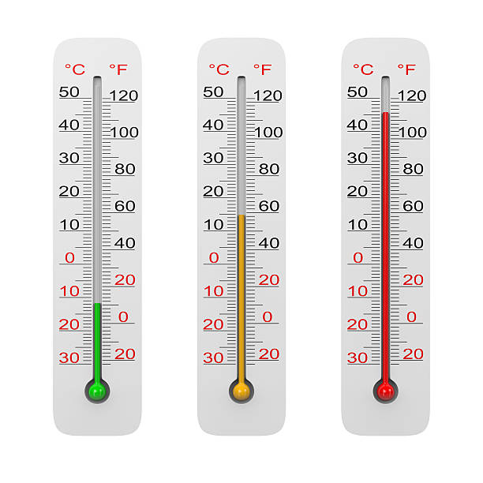
Variable dew-point system design
Automation to monitor ambient temperature, p.d.p., and for compressor and valve control
Ambient temp monitor
Desiccant dryer with d.d.s.
Path to -40°F pdp
Binary valve closed
Binary valve open
Binary valve open
Binary valve
Flow control valve
Cycling refrigerant dryer
Mist eliminator
Modulating valve
Dew-point monitor
Blending path of least resistance
Modulating valve open
Path to >+32°F pdp and path of least resistance
Modulating valve closed
Modulating valve partially open

Slide 21
Expectations from intelligent controller
At a minimum, the master system controller should:
Monitor ambient temperature
Monitor pressure dew-point from downstream of the flow control valve
Monitor filter differential pressure
Monitor condensate drain trap conditions
Monitor dryer health
Control dryer tower switching
Provide control to the binary valve, modulating valve, and system flow control valve
Compare ambient temperature to the measured pressure dew-point and control both the binary and modulating valves to allow for a varying pressure dew-point
Determine corrective actions in the event of a component failure
Should automation fail or lose communication with the components, air should be forced through the desiccant dryer to revert to -40°F

Slide 23
Benefits
Air quality will be appropriate for all operating conditions
Energy required to treat compressed air can be reduced by ≈ 40% depending upon ambient conditions.
Dryer redundancy
Continuous air quality monitoring with the master controller

Slide 24

About the Speaker
Product Manager for Kahn Instruments
Robert Bailey
Kahn Instruments
For your free subscription, please visit www.airbestpractices.com/magazine/subscription.

Slide 25
Using Capactive Dewpoint Sensors in Compressed Air Systems
Presented by: Robert T. Bailey, Product Manager
Kahn Instruments, Inc.
Wethersfield, CT
September 6, 2018

Slide 26
Simplified Compressed Air System
B

Slide 27
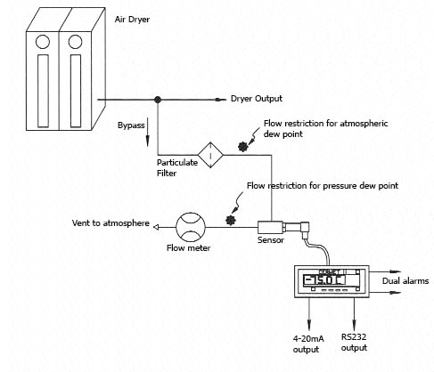
Compressed Air Dryer
Dewpoint Measurement Location
B
Dewpoint Hygrometer
(Sensor, cable, display)
Sample Block
(Optional)

Slide 28
Capacitive Sensor Technology
Ceramic or Aluminum Oxide Sensor
  Sensing element produces a capacitance value that’s related to the amount of water vapor it measures
  Wide measurement range: -148 to +68°Fdp
  -100 to +20°Cdp
  One instrument covers entire range
  Excellent measurement accuracy: ±1 to ±2°Cdp
  Special units measure to: -184°Fdp/-120°Cdp
Use on -40°Fdp or -100°Fdp air dryers

Slide 29
Capacitive Dewpoint Sensor
Ceramic or Aluminum Oxide
Dewpoint sensor responds to a small change in water vapor pressure
  + Advantages
    Economical
    Fast response
    Broad calibrated range (-148ºFdp to +68ºFdp)
    Suitable for industrial applications
  - Challenges
    Long term drift
    Temperature coefficient
Notes:
29

Slide 30
Capacitive Dewpoint Sensor
Ceramic or Aluminum Oxide
Dewpoint sensor responds to a small change in water vapor pressure
  + Advantages
    Economical
    Fast response
    Broad calibrated range (-148ºFdp to +68ºFdp)
    Suitable for industrial applications
  - Challenges
    Long term drift – addressed by periodic recalibration
    Temperature coefficient – addressed by incorporating a temperature sensor and compensation algorithm in the dewpoint sensor
Notes:
30

Slide 31
Kahn Ceramic Sensor Advantages
Better accuracy
Faster response
More durable
  Withstands saturation and liquid water
  Withstands pressure shocks
Greater contamination resistance
Wider dewpoint measurement range
Better manufacturing techniques
Latest technology

Slide 32
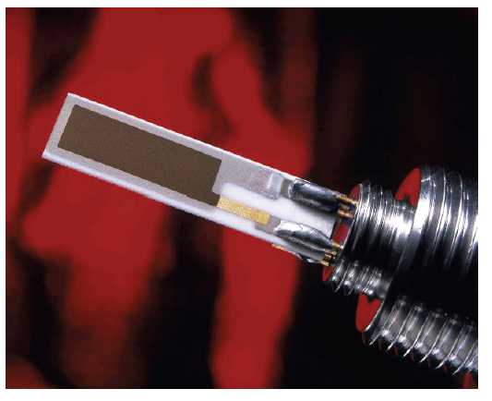
Capacitive
Kahn Ceramic Dewpoint Sensor
Porous Conductive
Layer
Hygroscopic
Active Layer
Conductive Layer
Ceramic Substrate

Slide 33
Capacitive Dewpoint Sensors
Product configurations
  A dewpoint transmitter
    Lowest cost, easiest to implement
  A dewpoint hygrometer with a display
    Gives you a local readout of measurements
  A portable hygrometer
    Allows monitoring of the air dryer, as well as the compressed air system throughout the plant

Slide 34
What instrument do you require?
For continuous measurements
Installed on air dryer or downstream
  Dewpoint transmitter
    4-20 mA output and no display
    Output signal wired to DCS or dryer control
    Easidew Dewpoint Transmitter
  Hygrometer with local readout
    Dewpoint sensor, digital display, sensor cable, power cord
    Cermet II Hygrometer

Slide 35
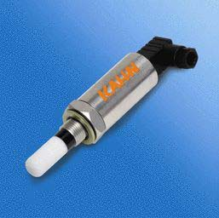
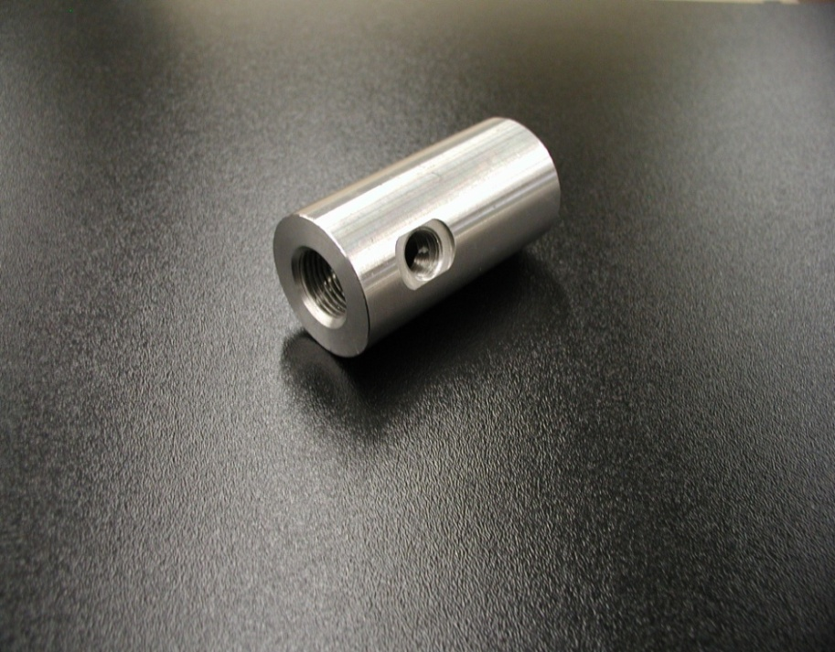
Installed on the Air Dryer or Downstream
Easidew Dewpoint Transmitter
4-20 mA analog output
  -148 to +68°Fdp range
  -100 to +20°Cdp range
2-Wire loop powered
12 to 28 VDC operating voltage
NEMA 4 stainless steel housing
6500 PSIG operating pressure
Simple and economical
NIST traceable calibration
Easidew Transmitter
Sample Block

Slide 36
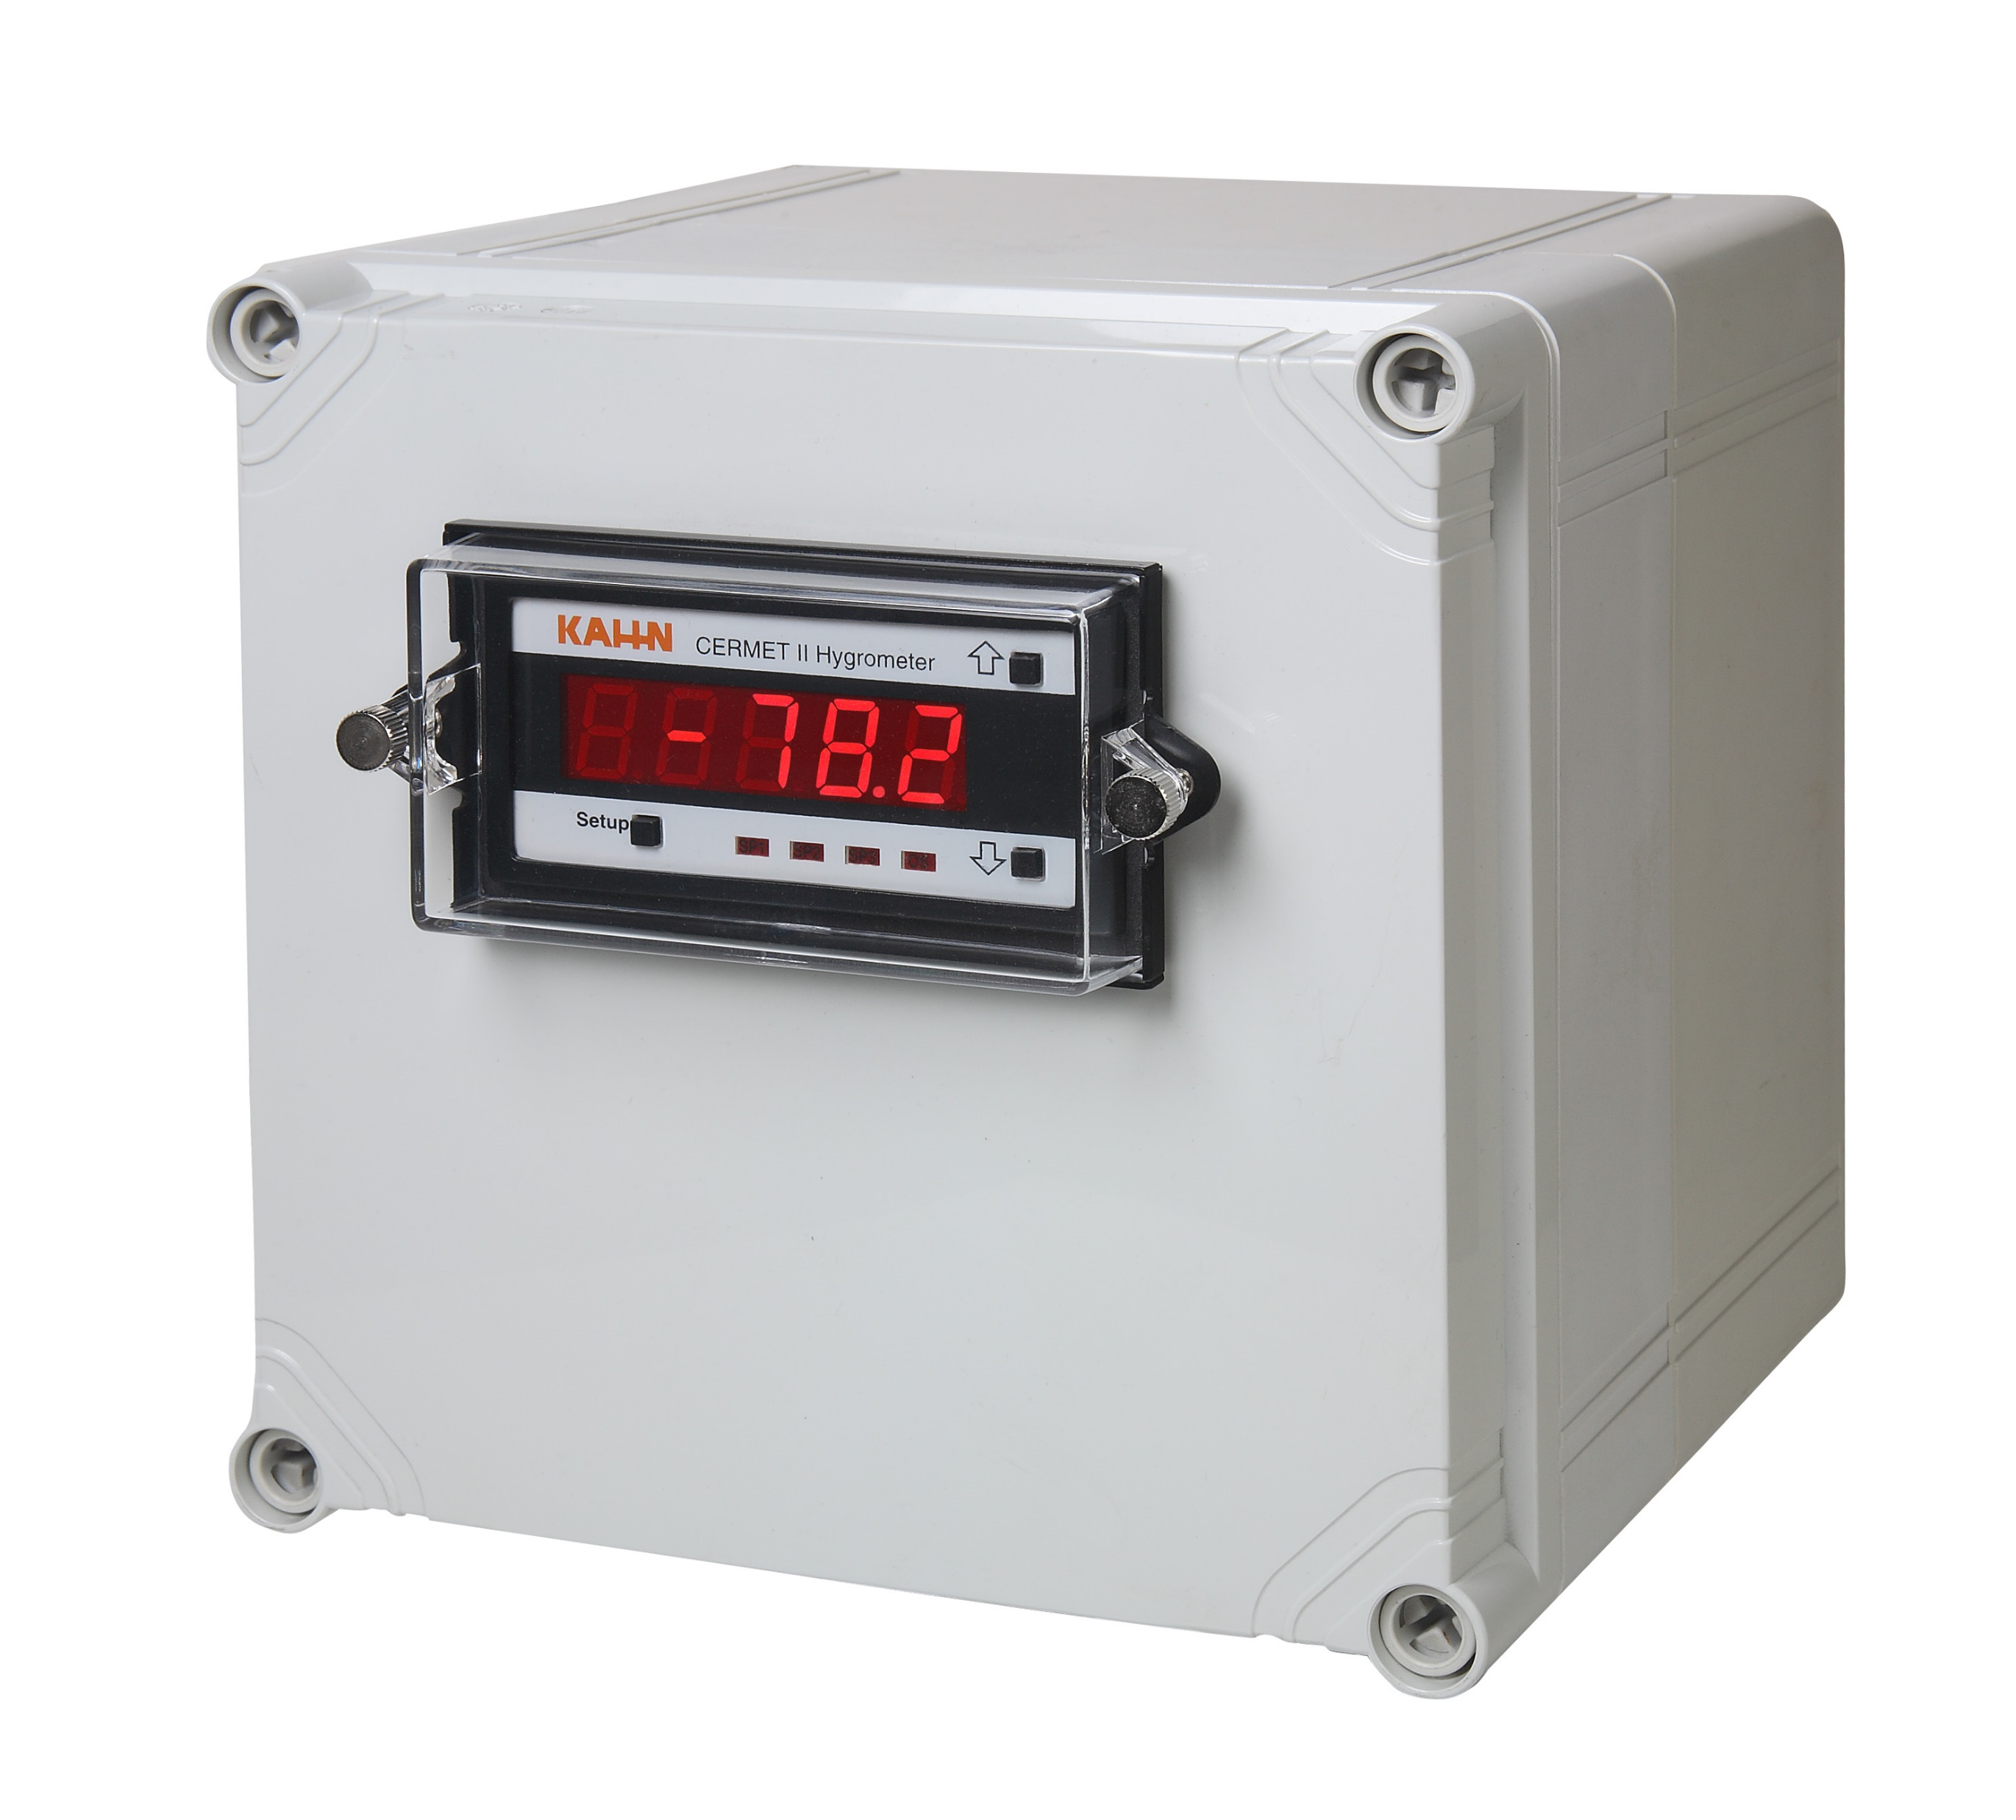
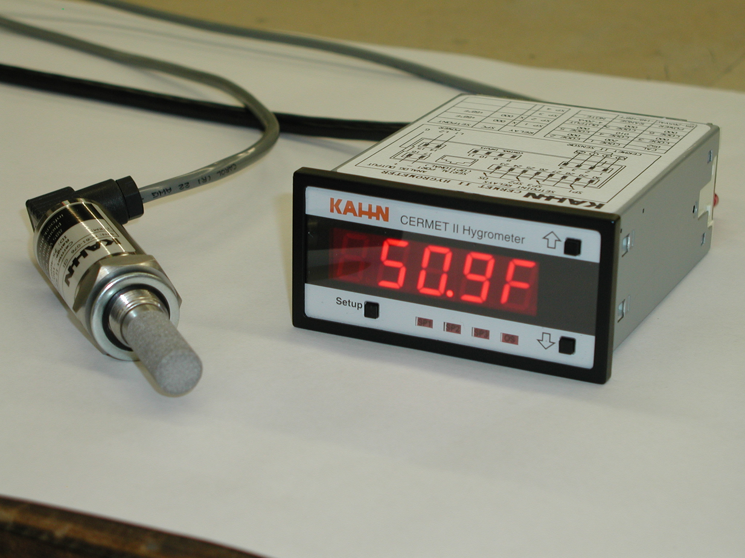
Installed on the Air Dryer or Downstream
If a local display is required
Cermet II Hygrometer
  Dewpoint sensor
  Digital display
  6-ft long sensor cable
  Power cord for 120 VAC
  -148 to +68°Fdp range
  -100 to +20°Cdp range
  4-20 mA analog output
  Programmable alarm relays
  Optional NEMA 4 enclosure for display
Cermet II Hygrometer
Sample Block
Cermet II Display in NEMA 4 enclosure

Slide 37
What instrument do you require?
For spot-check measurements:
  A hand-held, battery-operated, portable hygrometer:
    Easidew Plus Portable Hygrometer
    HygroPort Portable Hygrometer
  Verify air dryer performance
  Check the accuracy of the dewpoint sensor installed on the dryer or elsewhere
  Monitor the compressed air system throughout the plant

Slide 38
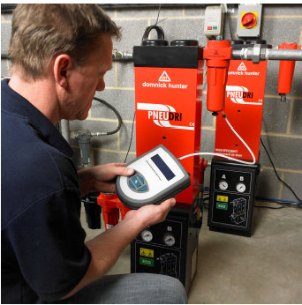
Hand-held, Portable Instruments
At or Downstream of the Air Dryer
Measure dryer dewpoint, check accuracy of on-board sensor, monitor dewpoint downstream
Internal or external dewpoint sensor
-148 to +68°Fdp (-100 to +20°Cdp)
Extremely fast measurements
°Fdp, °Cdp, PPMv, PPMw
Data log up to 320,000 points
BlueTooth wireless data upload
Backlit display
NimH battery -- 48 hour usage
Pressures to 5000 PSIG
Durable NEMA 4 industrial design
Easy to handle and operate
NIST traceable calibration
HygroPort Portable Hygrometer
Use on -40 or -100°Fdp air dryers

Slide 39
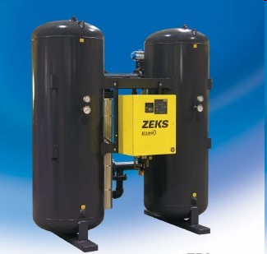
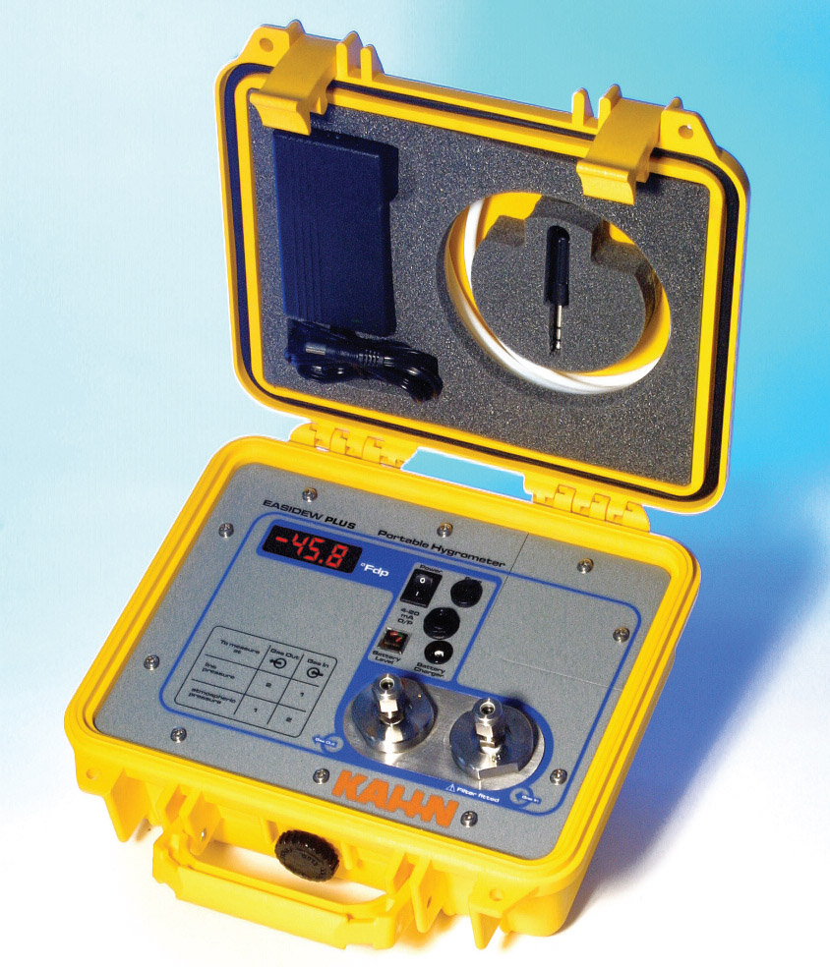
Hand-held, Portable Instruments
At or Downstream of the Air Dryer
Measure dryer dewpoint, check accuracy of on-board sensor, monitor dewpoint downstream
Economical, simple to operate
Dewpoint range -58°F to +68°F
Accuracy of ±3.6°F
Pressures to 4350 PSIG
Fast response
°F or °C display
NEMA 6 case
NIST calibration
Easidew Plus Portable Hygrometer
Ideal for -40°Fdp air dryers

Slide 40
Summary
Capacitive dewpoint sensor:
  The most common technology used to measure dewpoint in compressed air systems
  Economical to purchase, compact footprint, simple to install, easy to operate
  Available as a blind transmitter to provide a 4-20 mA analog signal, or display model, or portable
  Provides accurate measurements while responding rapidly to changes in dewpoint
  Can be installed on the air dryer or located downstream to measure dewpoint in the main air header, piping, or at points of use throughout the facility

Slide 41
Contact Information
Thank You!
Robert T. Bailey, Product Manager
Kahn Instruments, Inc.
885 Wells Road
Wethersfield, CT 06109
Phone: (860) 529-8643
Fax: (860) 529-1895
Email: hygros@kahn.com
Web site: www.kahn.com

Slide 42
Innovative Instrument Air Compliant System Design & Measurement
Q&A
Please submit any questions through the Question Window on your GoToWebinar interface, directing them to Compressed Air Best Practices Magazine. Our panelists will do their best to address your questions, and will follow up with you on anything that goes unanswered during this session. Thank you for attending!
Sponsored by
For your free subscription, please visit www.airbestpractices.com/magazine/subscription.

Slide 43
Thank you for attending!
The recording and slides of this webinar will be made available to attendees via email later today.
PDH Certificates will be e-mailed to Attendees within two days.
Sponsored by
For your free subscription, please visit www.airbestpractices.com/magazine/subscription.

Slide 44
ATTEND THE INAUGURAL 3-DAY CONFERENCE & EXPO!
September 17-19, 2018, Chicago O’Hare Crowne Plaza Conference Center
FREE EXPO
Booths represented from manufacturers of air compressors, air treatment, flow meters, vacuum, blowers and chillers
HIGH-ROI CONFERENCE
TRACK 1: COMPRESSED AIR SUPPLY STRATEGIES
TRACK 2: COMPRESSED AIR DEMAND REDUCTION
TRACK 3: BLOWER AND VACUUM OPTIMIZATION
TRACK 4: COOLING SYSTEMS AND ENERGY MANAGEMENT
Register Today!
www.cabpexpo.com

Slide 45
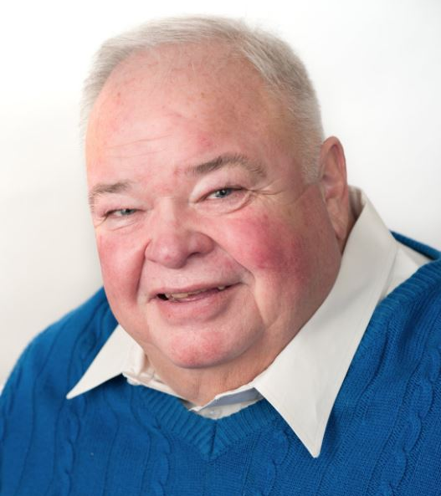

November 2018 Webinar
EPA Compliance: Condensate Drain Maintenance & Oil/Water Separation
Sponsored by
Loran Circle
Compressed Air System Training & Consulting
Keynote Speaker
Thursday, November 15, 2018 – 2:00 PM EST
Register for free at
www.airbestpractices.com/magazine/webinars

