Slide 1

Measuring Dew Point for Process Safety, Quality and Efficiency
Ron Marshall, Marshall Compressed Air Consulting
Keynote Speaker
Sponsored by
The recording and slides of this webinar will be made available to attendees via email later today.
PDH Certificates will be e-mailed to attendees on within 2 days.

Slide 2
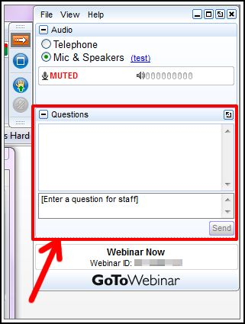
Q&A Format
Panelists will answer your questions during the Q&A session at the end of the Webinar.
Please post your questions in the Questions Window in your GoToWebinar interface.
Direct all questions to Compressed Air Best Practices® Magazine
Sponsored by

Slide 3
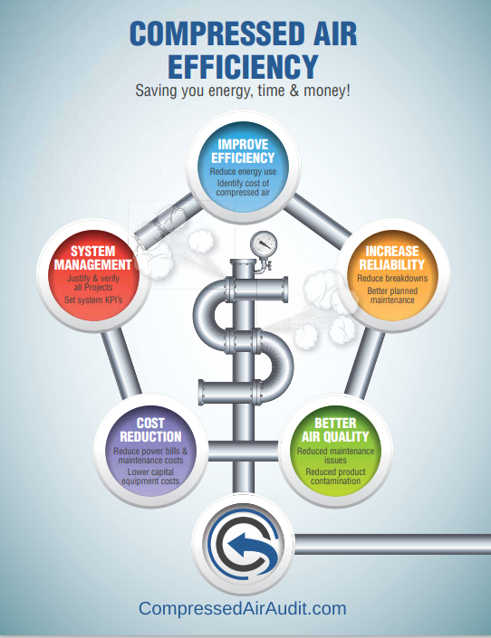
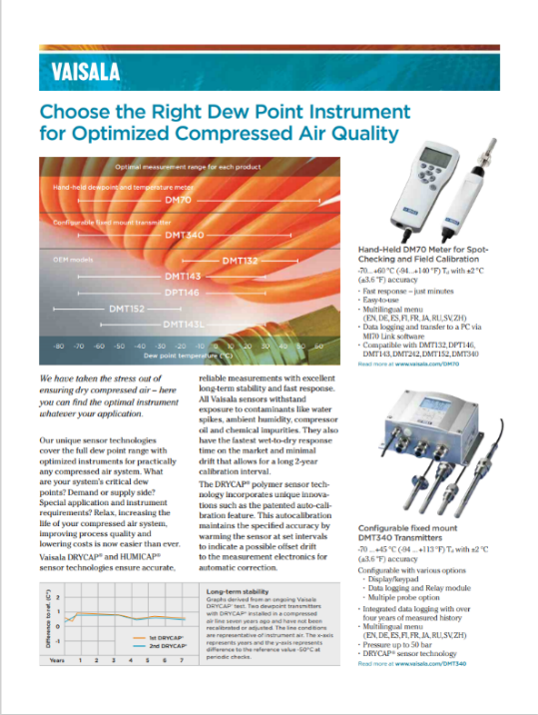
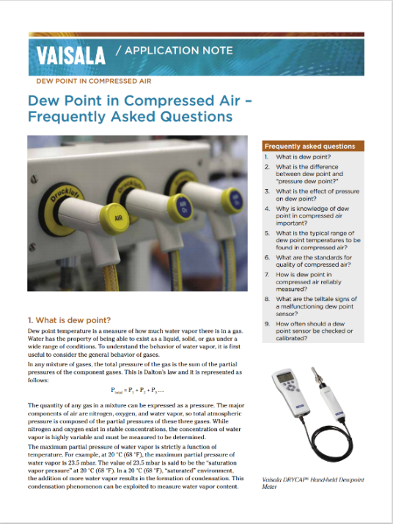
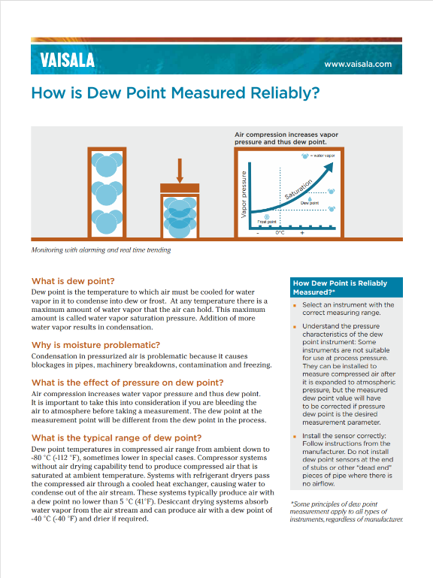
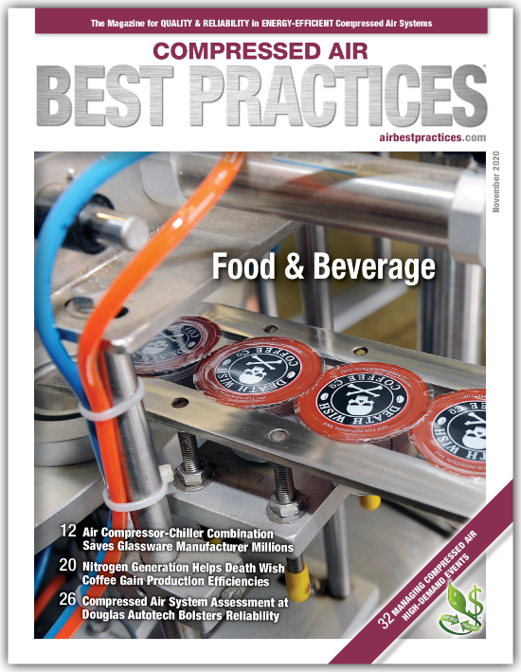
Handouts

Slide 4
Disclaimer
All rights are reserved. The contents of this publication may not be reproduced in whole or in part without consent of Smith Onandia Communications LLC. Smith Onandia Communications LLC does not assume and hereby disclaims any liability to any person for any loss or damage caused by errors or omissions in the material contained herein, regardless of whether such errors result from negligence, accident, or any other cause whatsoever.
All materials presented are educational. Each system is unique and must be evaluated on its own merits.

Slide 5
Measuring Dew Point for Process Safety, Quality and Efficiency
Introduction
Compressed Air Best Practices® Magazine
Sponsored by

Slide 6
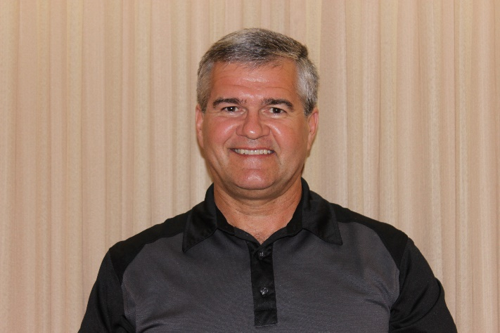

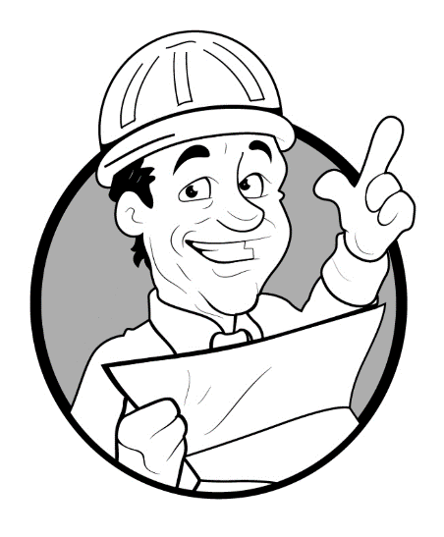

About the Speaker
Consultant MCAC
38 years with Power Utility
24 years Technical CA Support
CAC Level 2 Instructor
International Trainer UNIDO
600+ projects completed
Ron Marshall
Marshall Compressed Air Consulting
Sponsored by

Slide 7

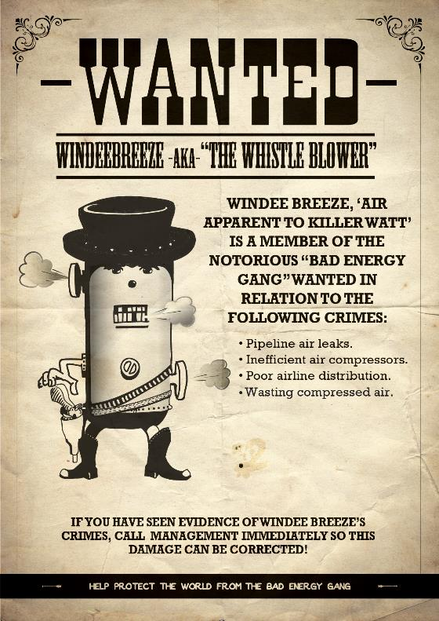
Wanted Energy Wasters

Slide 8

Coming Up
What is dew point?
Needs in CA – Air Quality
What happens if quality not maintained
Why measurement is important
Dryer controls – EE concerns
Problem examples regarding dew point

Slide 9
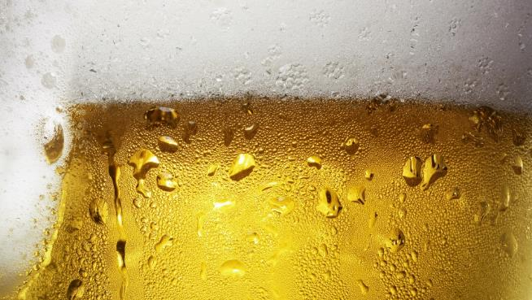
Why is dew point important in compressed air?
The dew point is the temperature to which air must be cooled to become saturated with water vapor
When cooled further, the airborne water vapor will condense to form liquid water
When air cools to its dew point through contact with a surface that is colder than the air, water will condense on the surface

Slide 10
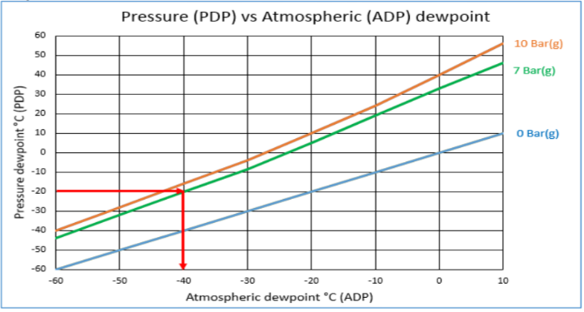
What is pressure dew point?
The term “pressure dew point” is encountered when measuring the dew point temperature of gases at pressures higher than atmospheric pressure
It refers to the dew point temperature of a gas under pressure. This is important because changing the pressure of a gas changes the dew point temperature of the gas - Vaisala

Slide 11
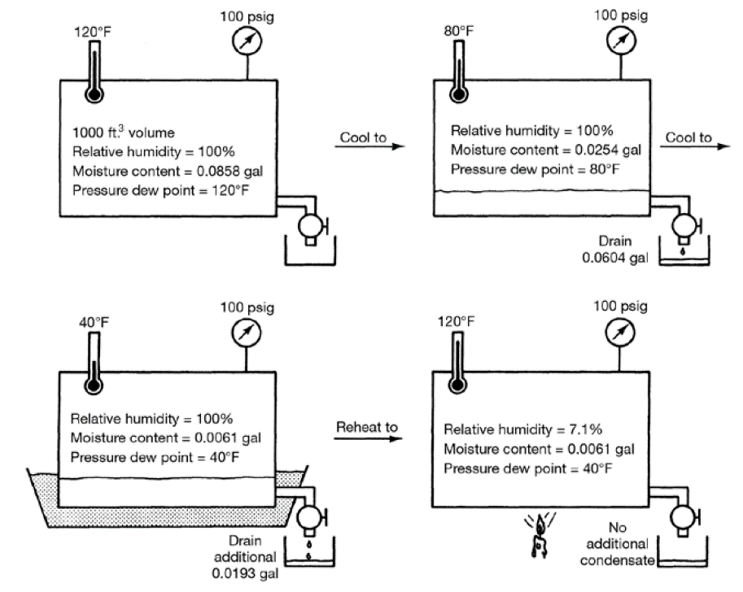
Dew point compression and drying
Source: CAGI Handbook

Slide 12
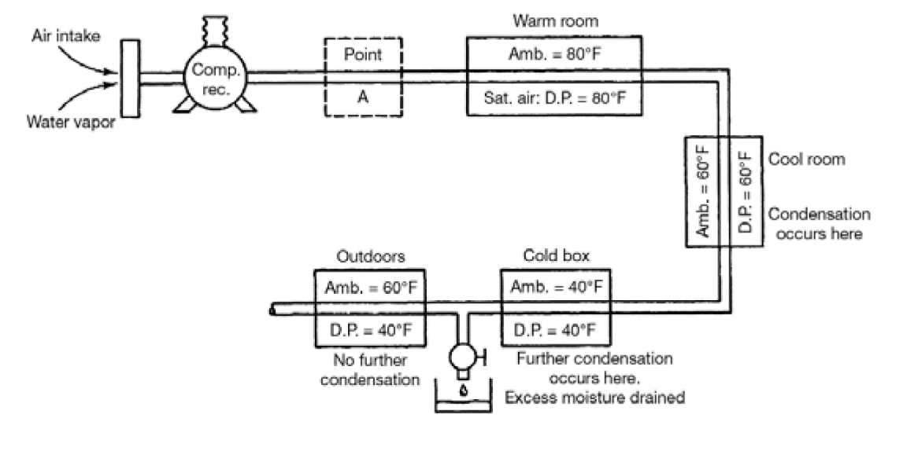
Dew point compression and drying
Source: CAGI Handbook

Slide 13
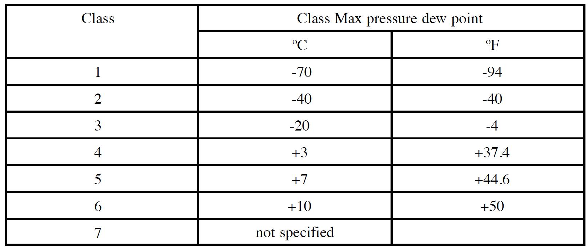
Dew point classes ISO 8573-1
Source: CAGI Handbook

Slide 14
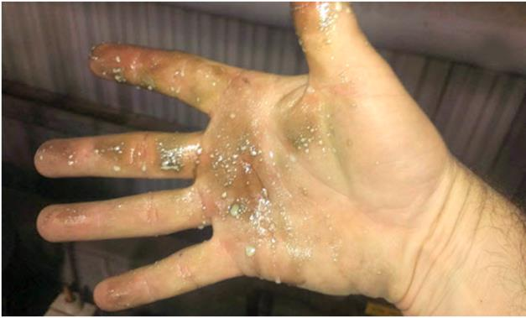
Negative effects of moisture in compressed air
Washing away required oils
Rust and scale formation within pipelines and vessels
Increased wear and maintenance of pneumatic devices
Sluggish and inconsistent operation of air valves and cylinders
Malfunction and high maintenance of control instruments and air logic devices
Product spoilage
Rusting of parts after sandblasting
Freezing in exposed pipelines during cold weather
Further condensation and possible freezing of moisture in mufflers whenever air devices are rapidly exhausted
Source CAGI Handbook
Source: CABP Magazine

Slide 15
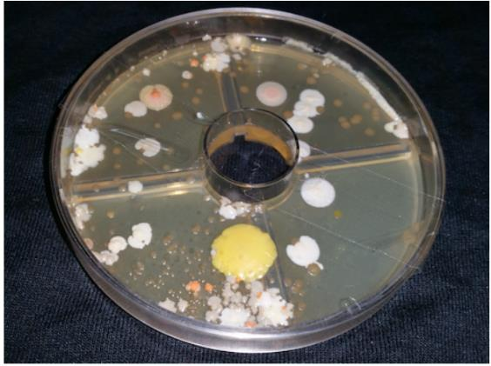
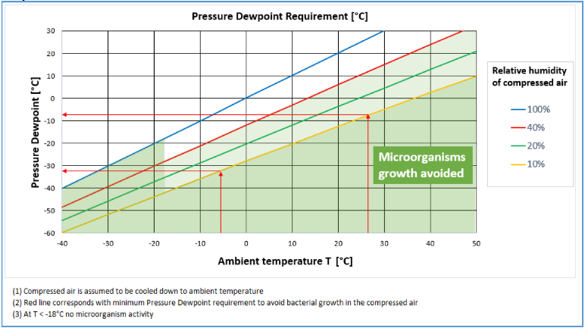
Growth of microorganisms
“To support microorganism growth, it is necessary to establish conditions that will permit organism reproduction. All microorganisms require the following to remain viable and grow on culture media:
Nutrients
Proper pH
Appropriate temperature
Gasses
Moisture
Source: Atlas Copco compressed air and microorganisms white paper
Source: CABP Magazine

Slide 16
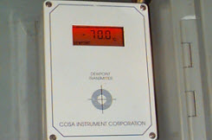
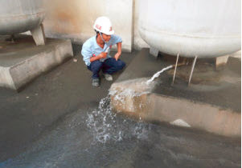
Things are not always the way they appear

Slide 17
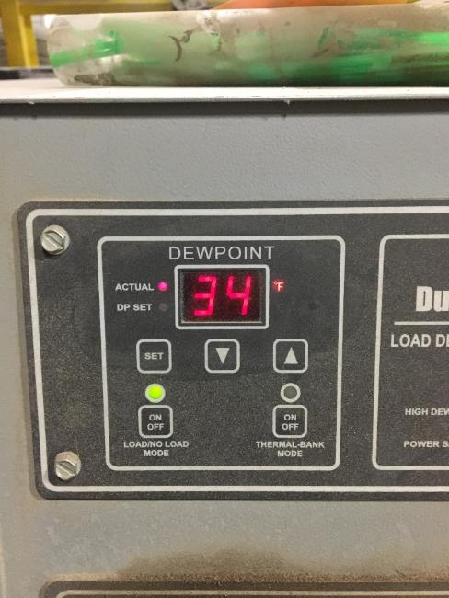
Question: What is the actual dew point of this plant?

Slide 18
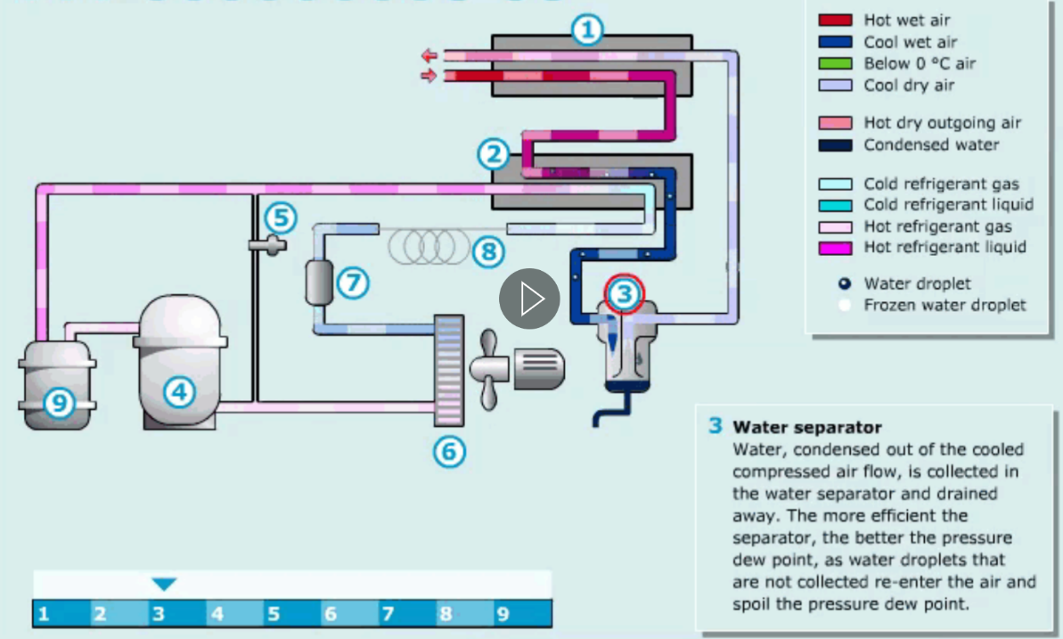
Panel displays temperature not dew point
Source: Atlas Copco

Slide 19
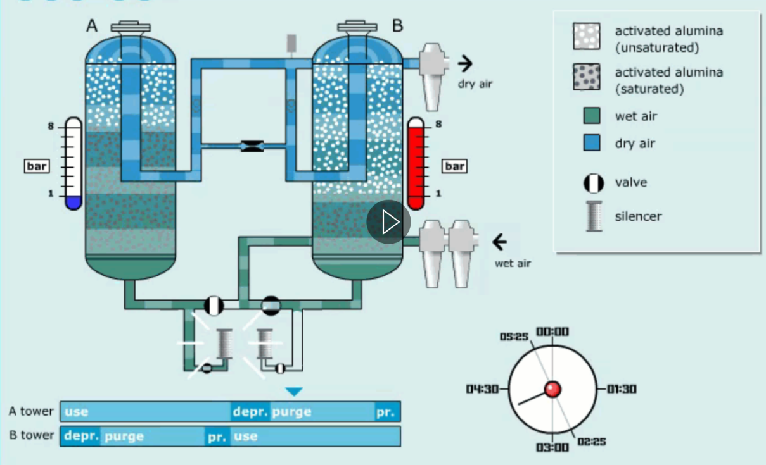
Desiccant air dryers consume costly compressed air
Source: Atlas Copco

Slide 20
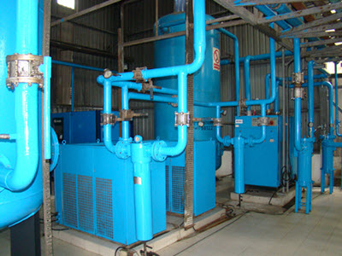
Dew point issues
Instruments on refrigerated dryers do not measure actual dew point, output could be different
Dew point controls on desiccant dryers:
  Incorrect readings may cause air quality issues
  Incorrect readings may cause air dryer inefficiency
  Example 1,000 cfm air dryer in fixed cycle 15% = 150 cfm
  At light load of 50% purge = 30% of actual
  Properly working dew point control could save up to 75 cfm
  At $0.10 per kWh saves $13k per year

Slide 21
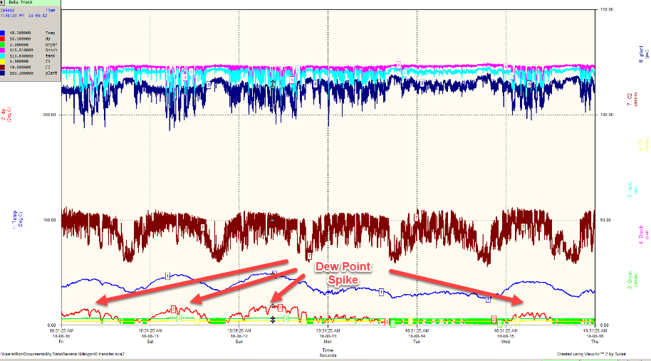
Example dew point problems – Refrigerated Dryer
Food plant with refrigerated areas
Audit showed dew point spikes during day production hours
No alarms on dryer
Constant problems with moisture in air, testing revealed contamination
Overheating due to poor ventilation and minimal size of dryer
Solution fix room temperature
Install dew point probe and alarm

Slide 22
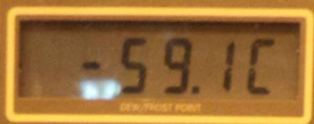
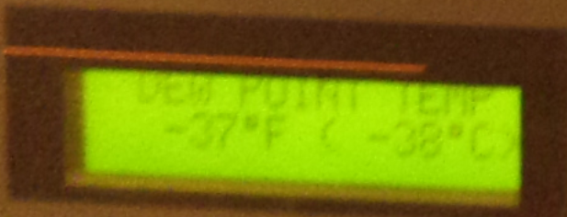
Example dew point problems – Heated Dryer
Dryer was constantly cycling, would never reach -40 switching point
Reading checked against portable dew point probe and found in error
Malfunction in dryer cooling was damaging probe
Replaced probe and operation returned to normal

Slide 23
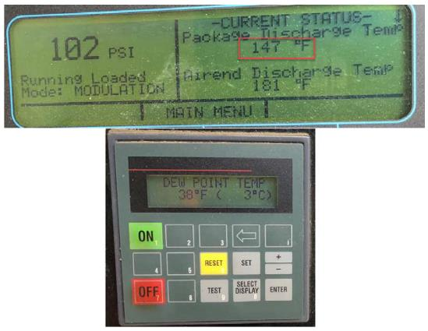
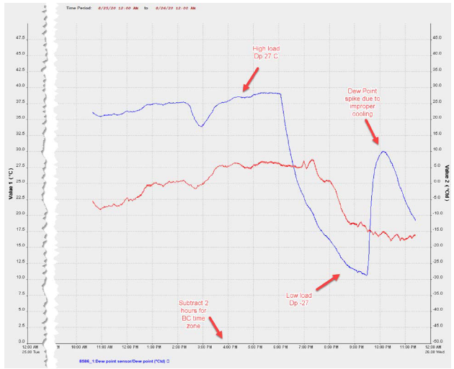
Example dew point problems – Heated Blower Dryer
Poor dew point in plant
Dryer constantly running
Compressor coolers plugged
Dryer over temperature
Excessive moisture in air
Dew point probe flooded and out of calibration
Cooling repair and probe recalibration

Slide 24
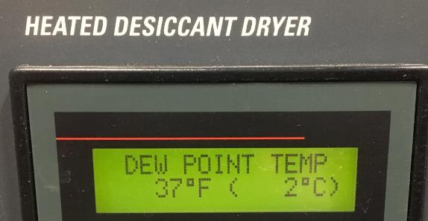
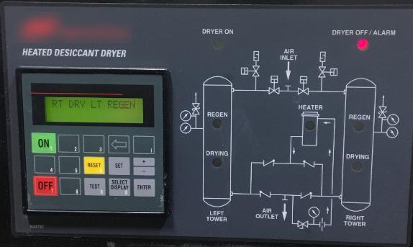
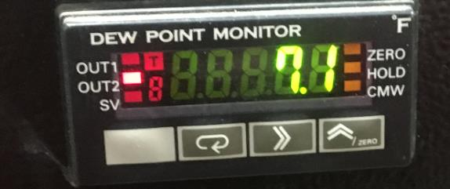
Example dew point problems – Dual dryers
Poor dew point in plant
Refrigerated areas in plant
Dryer 1 frozen on right side dry
Dryer 2 over temperature
Excessive moisture in air
Excessive purge flow during light loads
Dryer repair and probe calibration

Slide 25
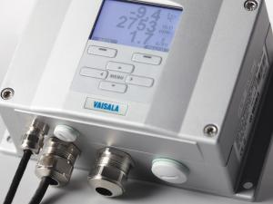
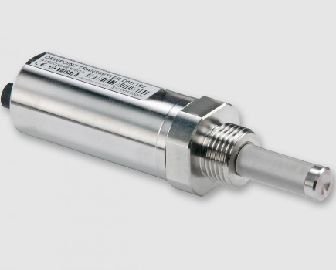
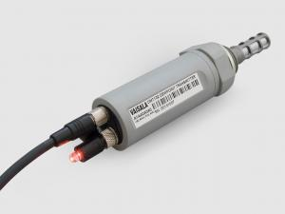
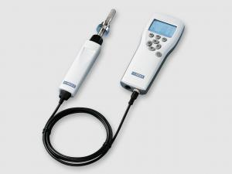
Summary
Dew point not always what is seems
Refrigerated dryers need probes
Secondary probes on desiccant
Proper calibration schedule
Hook up alarms
Make sure personnel are trained to recognize bad readings
Handheld or data logger connected probe useful for CA auditing
Source: Vaisala

Slide 26

About the Speaker
Business Development Engineer, VAISALA
Over 16 years of experience
Justin.Walsh@Vaisala.com
Sponsored by
Justin Walsh
VAISALA

Slide 27
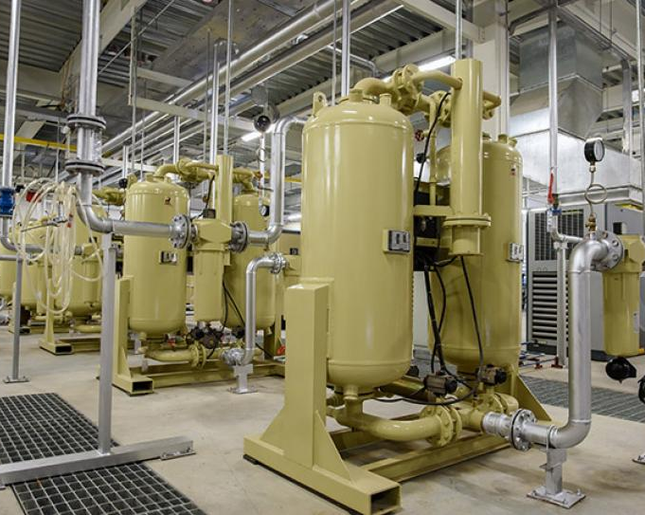
Topics
Energy Efficiency with Dew Point Control
Dew Point Sensor Technologies and their Performance
Selecting the Right Instrument for your Operation
Maintenance & Calibration Preserves Efficiency

Slide 28

Vaisala
80+ years of experience providing measurement products and services
Trusted supplier of instrumentation to protect processes and explore the unknown
Measurement solutions for indoor and industrial environments ensure, product quality, cost/energy efficiency and personal safety and wellbeing
January 1997
Vaisala launched the first ever polymer sensor for dew point measurements. DRYCAP® technology is now used in a wide variety of industrial applications.

Slide 29
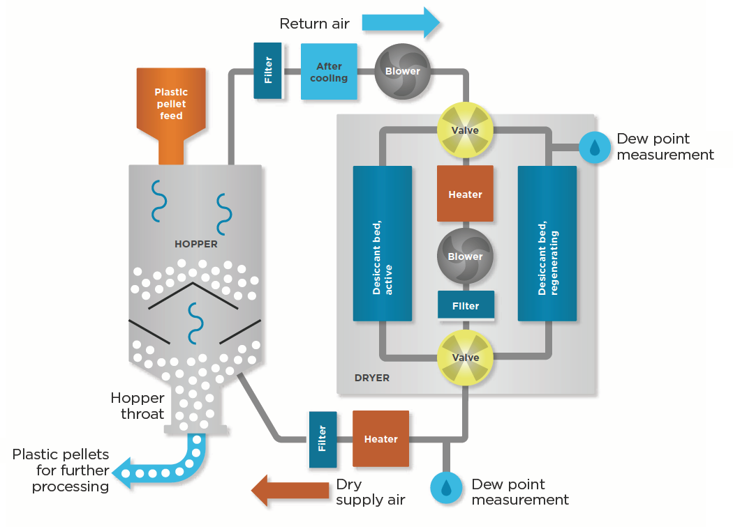
Compressed Dry Air Energy Demand
Importance of Accuracy
Energy Demand
Food Safety
Hospitals
Product Quality
Protect Capital Equipment
7-8 times More electricity to produce power
Leaks account for big losses
Thermal Challenges
  Creation
  Storage
  Use

Slide 30
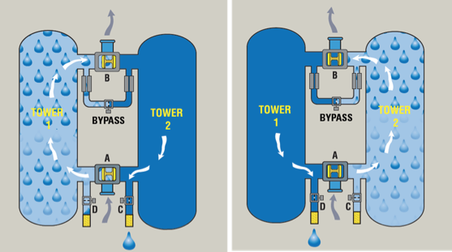
Increased Efficiency with Dew Point Demand Switching
Savings Example
Dew Point Demand Switching for a Heatless Desiccant Dryer (HDD)
Cycle Timed Switching:
-40 (Td), 1200 cfm, 250hp
15% Purge Flow (180 cfm) / Every 5 min
350cfm = min, 900 cfm = avg, 1080 cfm = max
261+ kWh / year
Td Demand Switching:
-40 (Td), 1200 cfm, 250hp
15% Purge Flow (180 cfm) / 5 min then STOP
> 1200 cfm = desiccant bed lasts longer
32% reduction in operating costs (82k kWh/year)
Image Credit: SPX Flow Hankison

Slide 31
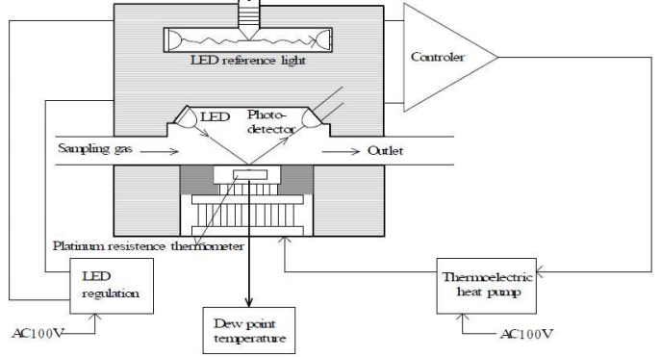
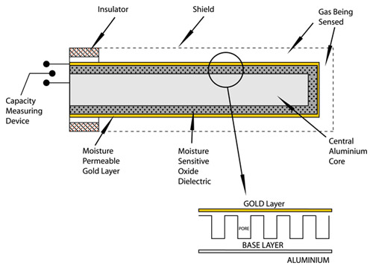
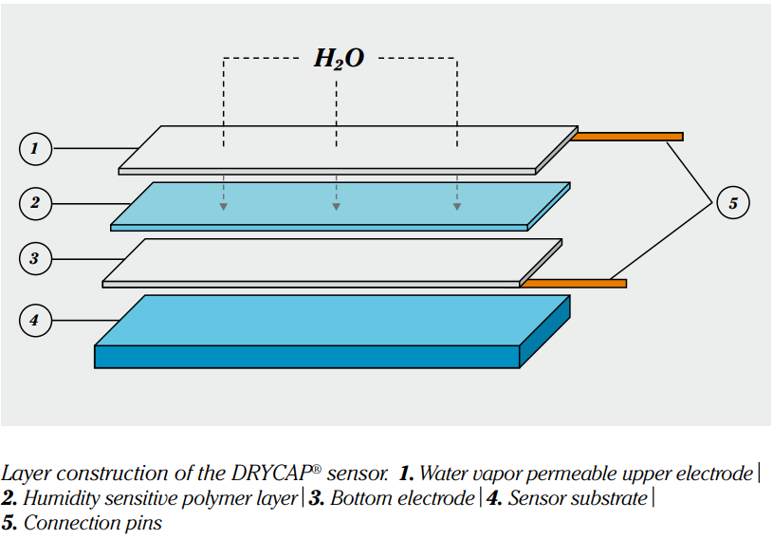
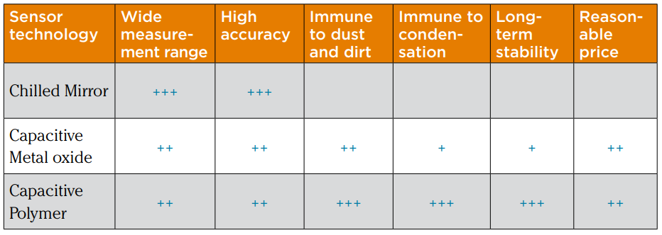
Dew Point Sensing Technologies
Chilled Mirror
Metal (Al) Oxide
Polymer Sensors

Slide 32
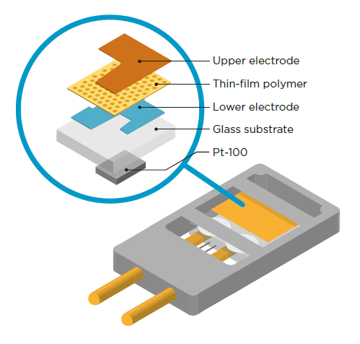
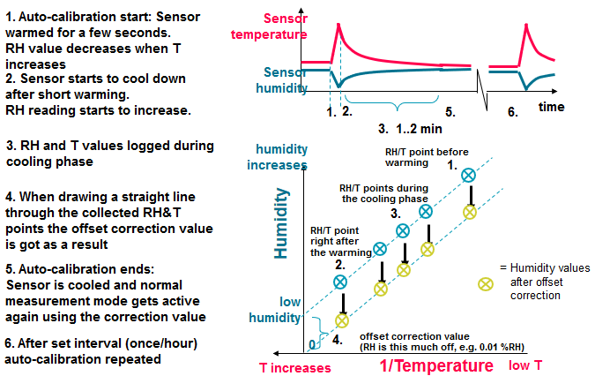
Polymer Sensors
Autocalibration for Low-Level Stability
Composite Sensor Structure

Slide 33
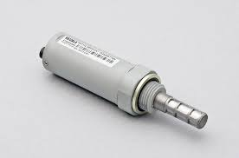
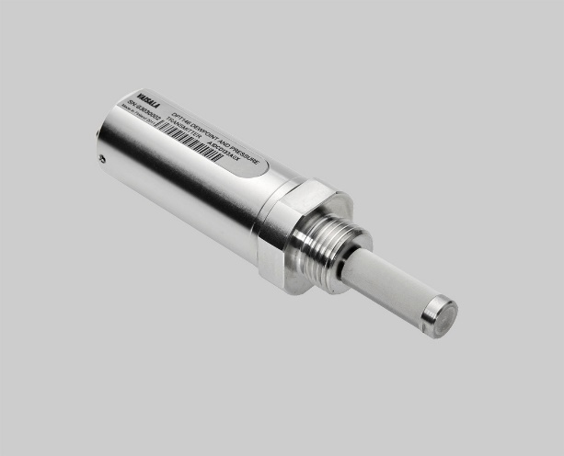
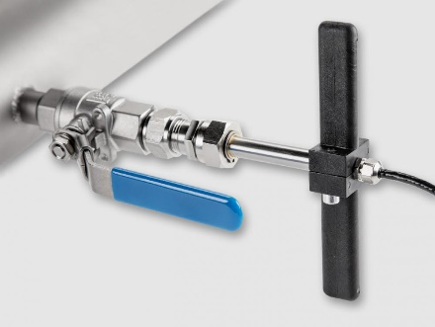
Polymer Sensor Versatility
Key Performance Issues
Custom Variations
Fast Response Time
Recovery from water spikes or condensation
Exposure to compressor oils
Special Conditions
Portable Sampling Systems
Wide Measurement Ranges

Slide 34
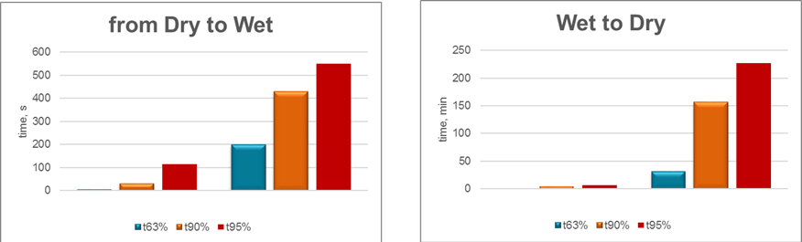
Sensor Response Times
Polymer sensor
Ceramic sensor
Polymer sensor
Ceramic sensor
Thin film Polymer sensor has a response time 20 times faster compared to Aluminum Oxide sensors (Frost point change from -76 °C to -40 °C)

Slide 35
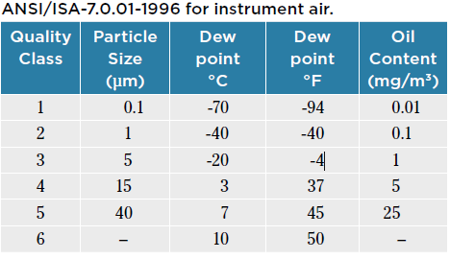

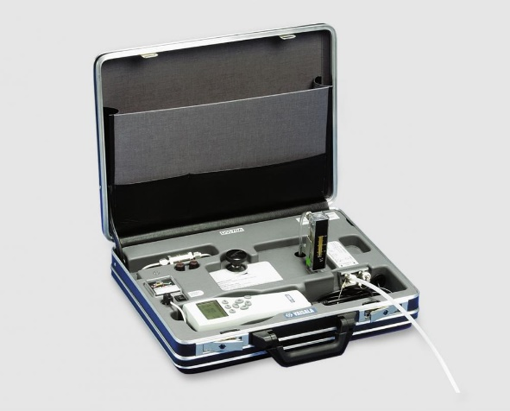
Selecting the Right Instrument - Conditions
What is the expected dewpoint level at the measurement location?
What is the pressure range?
What is the temperature range?
ISO 8573.1 Standard

Slide 36



Selecting the Right Instrument - Installation
Will the probe be installed directly in the line or will a sample line be used for external measurement?
Should the instrument be portable or fixed mount?

Slide 37




Selecting the Right Instrument - Communication
Signal output type– local display, analog, serial, IoT
Other features of interest – power supply, datalogging, alarm relays

Slide 38

Calibration & Maintenance
Spot Checking
Factory Calibration
Highest Possible Accuracy
Leak Detection
Calibration
Point Of Use Quality Control

Slide 39



Field Calibration Resources
Portable Instruments
Portable
Direct Connection
Interfacing
Software Solutions

Slide 40
…it’s more important than ever to base decisions on accurate and reliable data.
Thank You

Slide 41
Measuring Dew Point for Process Safety, Quality and Efficiency
Q&A
Please submit any questions through the Question Window on your GoToWebinar interface, directing them to Compressed Air Best Practices Magazine. Our panelists will do their best to address your questions and will follow up with you on anything that goes unanswered during this session.
Thank you for attending!
Sponsored by

Slide 42
Thank you for attending!
The recording and slides of this webinar will be made available to attendees via email later today.
PDH Certificates will be e-mailed to Attendees within 2 days.

Slide 43



November Webinar
Measuring KPI’s: kW, Flow, Pressure, Dew Point
Sponsored by
Tim Dugan
Keynote Speaker
Compression Engineering Corporation
Thursday, November 12, 2020 – 2:00 PM EST
Register for free at
www.airbestpractices.com/magazine/webinars

