Slide 1


Measuring KPI’s: kW, Flow, Pressure, Dew Point
Tim Dugan, Compression Engineering Corporation
Keynote Speaker
Sponsored by
The recording and slides of this webinar will be made available to attendees via email later today.
PDH Certificates will be e-mailed to attendees on within 2 days.

Slide 2
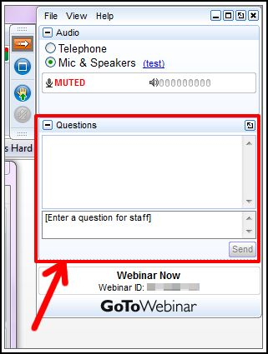
Q&A Format
Panelists will answer your questions during the Q&A session at the end of the Webinar.
Please post your questions in the Questions Window in your GoToWebinar interface.
Direct all questions to Compressed Air Best Practices® Magazine
Sponsored by

Slide 3
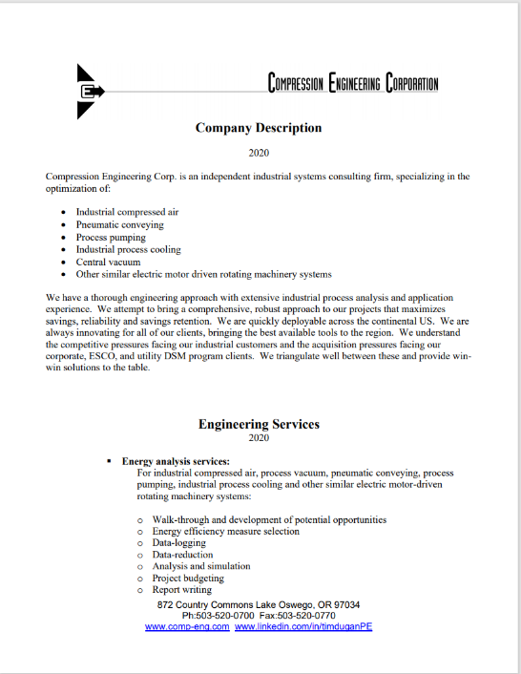

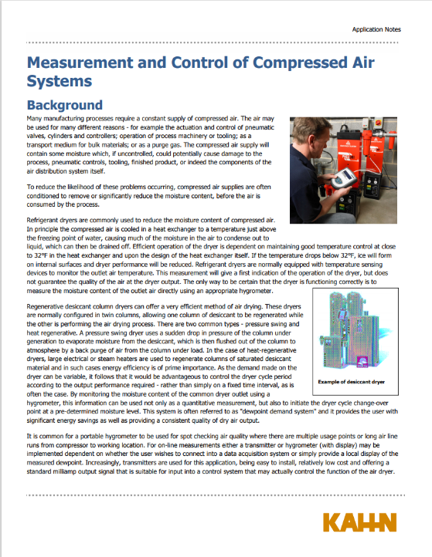
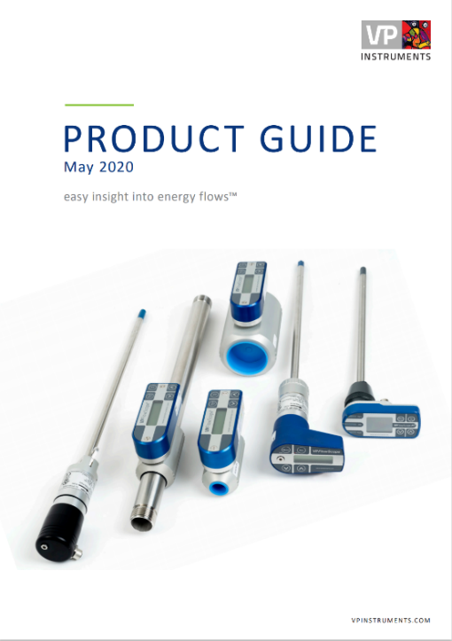
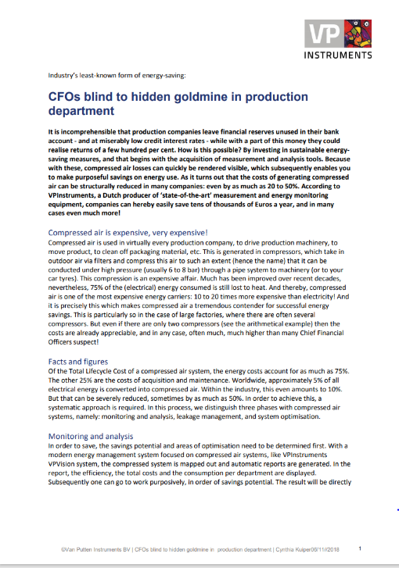
Handouts

Slide 4
Disclaimer
All rights are reserved. The contents of this publication may not be reproduced in whole or in part without consent of Smith Onandia Communications LLC. Smith Onandia Communications LLC does not assume and hereby disclaims any liability to any person for any loss or damage caused by errors or omissions in the material contained herein, regardless of whether such errors result from negligence, accident, or any other cause whatsoever.
All materials presented are educational. Each system is unique and must be evaluated on its own merits.

Slide 5
Measuring KPI’s: kW, Flow, Pressure, Dew Point
Introduction
Compressed Air Best Practices® Magazine
Sponsored by

Slide 6

About the Speaker
President and Principal Engineer, Compression Engineering Corporation
Over 25 years of experience in the industry
Tim Dugan
Compression Engineering Corporation
Sponsored by

Slide 7
Outline
What Are KPIs?
How to Capture?
Compressor Efficiency
Compressor Controls Effectiveness
Dryer Efficiency
Dryer Controls Effectiveness

Slide 8
What Are KPIs?
“KPI” = Key Performance Indicator
KPIs are Calculated Numbers That Are Used to Answer Questions:
- How Efficient is Each Compressor?
- How Effective are Your Compressor Controls?
- How Efficient is Each Dryer?
- How Effective are Dryer Controls?
Each KPI Uses Two or More Measurements To Get One Number

Slide 9
How to Capture KPIs?
Measurement: Power, Flow, Dewpoint and Pressure
Power:
  3-Phase Power is Best, Especially with Unloading Compressors
  Amps for Fully Loaded Motors & Calculated Power is Acceptable
Flow:
  Low Cost Thermal Mass Flow Meters OK After Dryers
  Higher Cost Differential Pressure or Vortex Needed Before Dryers
  Hot Tap is Recommended
Dewpoint:
  Lower Cost Hygrometer Usually Acceptable
  Need Proper Installation and Calibration
Pressure:
  Before and After Dryers

Slide 10
How to Capture KPIs?
Need a Calculation, Trending and Display “Engine”
Local: EMS, DCS or SCADA System; HMI System
Remote/Cloud
Math Functions Needed:
  Data filtering
  Averaging
  Min and Max Over Time Window
  Basic Arithmetic Functions (+, -, x, and /)
  Basic Logic Functions (if / then / else)
Trending
Data visualization
System P&ID

Slide 11

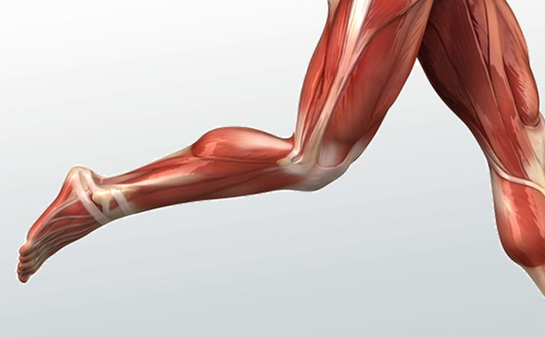
Compressor Efficiency KPI
Money In: Electricity
Useful Power Out: Pneumatics

Slide 12
Compressor Efficiency KPI
Compressor Eff’y KPI, Option 1 = “compressor specific performance”, the ratio of output to input:
Flow Out / Package Power
Scfm/kW (or 100 m3/kWh)
I Like flow/power Because Bigger Number = Good
Compressor Eff’y KPI, Option 2 = “compressor specific power”, the ratio power in to flow out:
Package Power/Flow Out
kW/100 scfm (kWh/100 m3)

Slide 13
Compressor Efficiency KPI
What is a “Good” and “Bad” Number?
Depends on Size and Type of Compressors. For instance,
For Smaller Oil Lube Compressors (<100hp), “Good”>5.0 scfm/kW or < 20 kW/100 scfm (<12 kWh/100m3)
For Larger Centrifugal Compressors (>500hp), “Good”>6.0 scfm/kW or < 17 kW/100 scfm (<10 kWh/100m3)
In Real Systems, Compressors Operate at Part Load, Which Can Reduce This KPI
I Recommend a “Red to Green” Bar, from 4.0 to 7.0

Slide 14
Compressor Controls Efficiency KPI
Total Compressor System Flow / Power (or the Inverse)
Comprehensive Power and Compressor Flow Metering is Needed
Other Metrics Are Helpful:
For Load-unload Systems: Total Compressor Loaded Percent (or Inversely, Total Unloaded Percent). Always loaded = 100 score
For VFD, Operating in Efficient Speed Range = 100 score
For Centrifugal Systems: Total Compressor Percent Not Blowing Off (or Inversely, Total Blow-off Percent). Never blowing off = 100 score

Slide 15
Compressor Controls Efficiency KPI
What is a “Good” and “Bad” Number?
Similar to Compressor KPI x .95, or 5% unloaded or blow-off
I Recommend a “Red to Green” Bar, from 4.0 to 7.0 scfm/kW
Or 95-100% Average Loaded (<5% Unloaded / Blow-off)
I recommend a red-green bar, from 90-100% of Ideal Efficiency
NOTE: A failed compressor system can look “good”, with low power because pressure is too low! Must measure effectiveness too!

Slide 16
Compressor Controls Effectiveness KPI
Ability to Control System at Minimum Pressure, Reliably
KPI = Difference From Target Pressure
What is a “Good” and “Bad” Number?
A Well-tuned System Can be +/- 5 psi from Target
Each Plant has its Own Min Pressure. After it is Determined, Display it as a Line, and the Current Pressure Above it.
I Recommend a “Red to Green” Bar, from +10 psi (bad) to +2 psi (good), or Change the Trend Line Color Accordingly
Red Flag All Pressure Below the Minimum Line

Slide 17
Dryer Efficiency KPI
Refrigerated Dryer Eff’y KPI = “dryer specific performance”, the ratio of output to input:
Flow Out / Package Power
Scfm/kW (or 100 m3/kWh)
I Like flow/power Because Bigger Number = Good
Purge Flow KPI = average compressed air purge flow percent

Slide 18
Dryer Efficiency KPI
What is a “Good” and “Bad” Number?
Depends on Type of Dryer. For instance,
For Refrigerated, “Good”>100 scfm/kW or < 1 kW/100 scfm (<0.6 kWh/100m3)
For Heated Regenerative, “Good”>75 scfm/kW or < 1.5 kW/100 scfm (<10 kWh/100m3) – purge is in addition
For Compressed Air Heated Purge, “Good” < 7.5% Average Purge
For Blower Purge, “Good” < 2.0% Average Purge

Slide 19
Dryer Effectiveness KPI
Ability to Dry Air at Min Power, Reliably
KPI = Difference from Target Dew point
What is a “Good” and “Bad” Number?
A Well-tuned System Can be 10-20 deg F
For Refrigerated, I Recommend a “Red to Green” Bar, from -5 deg F (bad) to +5 deg F (good), or 35-45 deg F, assuming a target of +40.
For Regenerative, First You Must “De-bounce” the Dew Point by 30 minutes, because dewpoint Spikes Are Normal.
For Regenerative, I Recommend a “Red to Green” Bar, from -20 deg F (bad) to +20 deg F (good), or -20 to -60 deg F, assuming a target of -40.

Slide 20
Conclusions
KPIs Tell You in One Number How Efficient and Effective Your Compressors, Dryers, and Controls Are
Start With Permanently-installed Power, Flow, Dewpoint and Pressure Measurement Instruments to Get Core Data
Add a Calculation Engine to Interpret the Readings Into Ratings, or “KPIs”
Trend and Display These KPIs so They Are Easy to Understand and Compare Before and After Failures and Improvements

Slide 21

About the Speaker
Product Manager, Kahn Instruments
Over 30 years of experience in the industry
Sponsored by
Rob Flynn
Kahn Instruments

Slide 22
Using Capacitive Dewpoint Sensors in Compressed Air Systems
Presented by: Rob Flynn, Product Manager
Kahn Instruments, Inc.
Wethersfield, CT
November 12, 2020

Slide 23
Simplified Compressed Air System
Out to plant

Slide 24
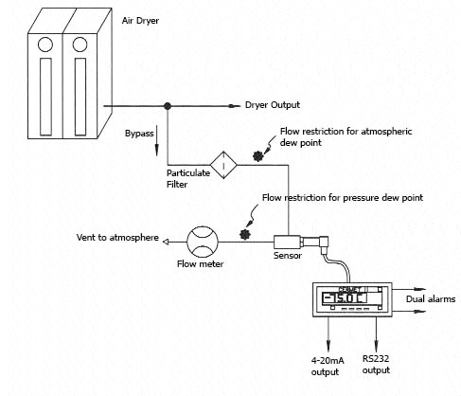
Compressed Air Dryer
Dewpoint Measurement Location
Dewpoint Hygrometer
(Sensor, cable, display)
Sample Block
(Optional)

Slide 25
Capacitive Sensor Technology
Ceramic or Aluminum Oxide Sensor
  Sensing element produces a capacitance value that’s related to the amount of water vapor it measures
  One instrument covers entire range
    Wide measurement range: -148 to +68°F dewpoint
    Excellent measurement accuracy: ±1.8 to ±3.6°Fdp
    Special units measure to: -184°Fdp

Slide 26
Capacitive Dewpoint Sensor
Ceramic or Aluminum Oxide
Dewpoint sensor responds to a small change in water vapor pressure
  + Advantages
    Economical
    Fast response
    Broad calibrated range (-148ºFdp to +68ºFdp)
    Suitable for industrial applications
  - Challenges
    Long term drift
    Temperature coefficient
Notes:
26

Slide 27
Capacitive Dewpoint Sensor
Ceramic or Aluminum Oxide
Dewpoint sensor responds to a small change in water vapor pressure
  + Advantages
    Economical
    Fast response
    Broad calibrated range (-148ºFdp to +68ºFdp)
    Suitable for industrial applications
  - Challenges
    Long term drift – addressed by periodic recalibration
    Temperature coefficient – addressed by incorporating a temperature sensor and compensation algorithm in the dewpoint sensor
Notes:
27

Slide 28
Ceramic Sensor versus Aluminum Oxide
Better accuracy
Faster response
More durable
  Withstands saturation and liquid water
  Withstands pressure shocks
Greater contamination resistance
Wider dewpoint measurement range
Better manufacturing techniques
Latest technology

Slide 29
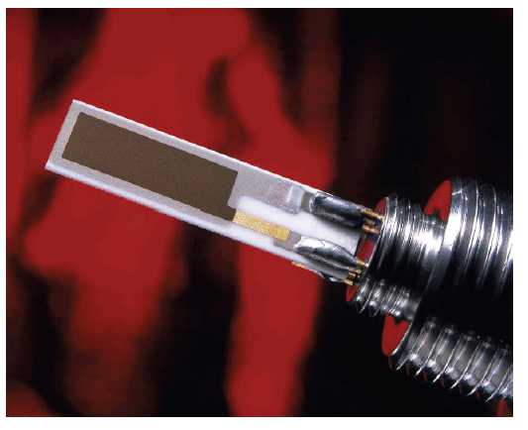
Capacitive
Ceramic Dewpoint Sensor
Porous Conductive Layer
Hygroscopic Active Layer
Conductive Layer
Ceramic Substrate

Slide 30
Capacitive Dewpoint Sensors
Product configurations
  A dewpoint transmitter
    Lowest cost, easiest to implement
  A dewpoint hygrometer with a display
    Gives you a local readout of measurements
  A portable hygrometer
    Allows monitoring of the air dryer, as well as the compressed air system throughout the plant

Slide 31
What instrument do you require?
For continuous measurements
Installed on air dryer or downstream
  Dewpoint transmitter
    4-20 mA output and no display
    Output signal wired to DCS or dryer control
    Ceramic Dewpoint Transmitter
  Hygrometer with local readout
    Dewpoint sensor, digital display, sensor cable, power cord
    On-Line Hygrometer

Slide 32
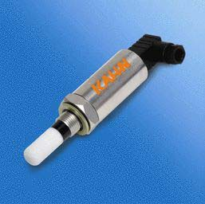
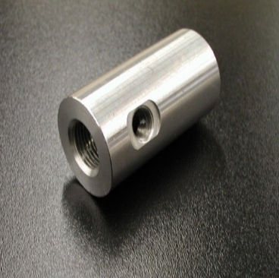
Installed on the Air Dryer or Downstream
Ceramic Dewpoint Transmitter
4-20 mA analog output
  -148 to +68°Fdp range
2-Wire loop powered
12 to 28 VDC operating voltage
NEMA 4 stainless steel housing
6500 PSIG operating pressure
Simple and economical
NIST traceable calibration
Easidew Transmitter
Sample Block

Slide 33
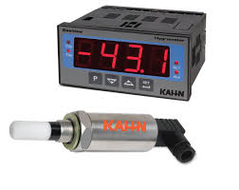
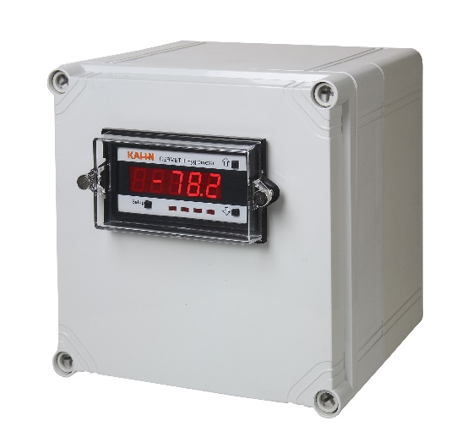

Installed on the Air Dryer or Downstream
If a local display is required
On-Line Hygrometer
  Dewpoint sensor
  Digital display
  6-ft long sensor cable
  Power cord for 120 VAC
  -148 to +68°Fdp range
  4-20 mA analog output
  Programmable alarm relays
  Optional NEMA 4 enclosure for display
Easidew Hygrometer
Cermet II Display in NEMA 4 enclosure
Sample Block

Slide 34
What instrument do you require?
For spot-check measurements:
  A hand-held, battery-operated, portable hygrometer:
    Portable Hygrometer
    Portable Hygrometer with data logging
  Verify air dryer performance
  Check the accuracy of the dewpoint sensor installed on the dryer or elsewhere
  Monitor the compressed air system throughout the plant

Slide 35
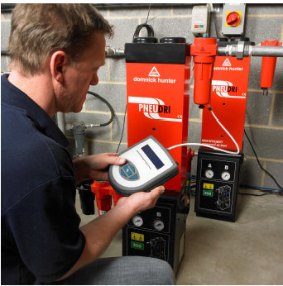
Hand-held, Portable Instruments
At or Downstream of the Air Dryer
Measure dryer dewpoint, check accuracy of on-board sensor, monitor dewpoint downstream
Internal or external dewpoint sensor
-148 to +68°Fdp
Extremely fast measurements
°Fdp, °Cdp, PPMv, PPMw
Data log up to 320,000 points
BlueTooth wireless data upload
Backlit display
NimH battery -- 48 hour usage
Pressures to 5000 PSIG
Durable NEMA 4 industrial design
Easy to handle and operate
NIST traceable calibration
HygroPort Portable Hygrometer
Use on -40 or -100°Fdp air dryers

Slide 36
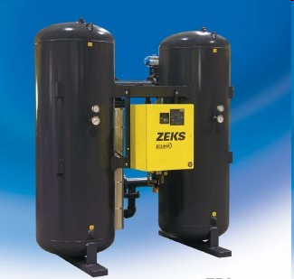
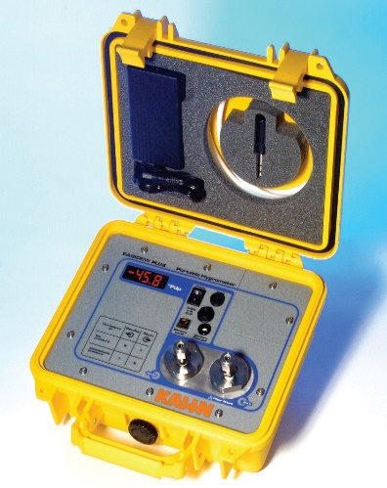
Hand-held, Portable Instruments
At or Downstream of the Air Dryer
Measure dryer dewpoint, check accuracy of on-board sensor, monitor dewpoint downstream
Economical, simple to operate
Dewpoint range -58°F to +68°F
Accuracy of ±3.6°F
Pressures to 4350 PSIG
Fast response
°F or °C display
NEMA 6 case
NIST calibration
Easidew Plus Portable Hygrometer
Ideal for -40°Fdp air dryers

Slide 37
Summary
Capacitive dewpoint sensor:
  The most common technology used to measure dewpoint in compressed air systems
  Economical to purchase, compact footprint, simple to install, easy to operate
  Available as a blind transmitter to provide a 4-20 mA analog signal, or display model, or portable
  Provides accurate measurements while responding rapidly to changes in dewpoint
  Can be installed on the air dryer or located downstream to measure dewpoint in the main air header, piping, or at points of use throughout the facility

Slide 38
Contact Information
Thank You!
Rob Flynn, Product Manager
Kahn Instruments, Inc.
885 Wells Road
Wethersfield, CT 06109
Phone: (860) 529-8643
Fax: (860) 529-1895
Email: hygros@kahn.com
Web site: www.kahn.com

Slide 39

About the Speaker
Sales Director, VPInstruments
Sponsored by
Menno Verbeek
VPInstruments

Slide 40
Measuring EnPI’s
Is my plant suffering from Obese or is it fit & healthy?
Notes:
Key Performance Indicator
Indicators that will tell you if if processes and machinery are okay

Slide 41
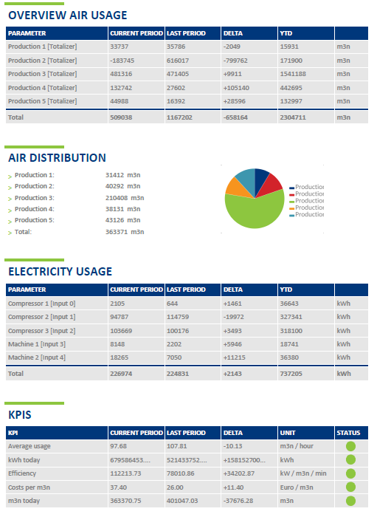
What is an EnPI?
Energy Performance Indicator (EnPI) is a measure of energy intensity used to gauge the effectiveness of your energy management efforts.

Slide 42
What are examples of an EnPI?
Monthly Energy Consumption, separated by
  Gas
  Electricity
  Water
  Steam
  Cooling water
  Water pumps
  Vacuum pumps
  Compressors
  blowers
  HVAC
Any variables that affect the energy consumption in a facility
(e.g., heating degree days (HDD), cooling degree days (CDD), dew point temperature, product output, the moisture content of the product, shift schedule adjustments, etc.)
Source: www.50001store.com/

Slide 43

Why EnPI’s are important
Raises awareness of goals to employees
Set specific goals that are achievable
Understand where your money is spent and help create budget for your goals
Tracking and Reporting which are key to understand trends and adjust your management strategy
Notes:
EnPI’s give direction
You don’t want to be stranded at one point

Slide 44
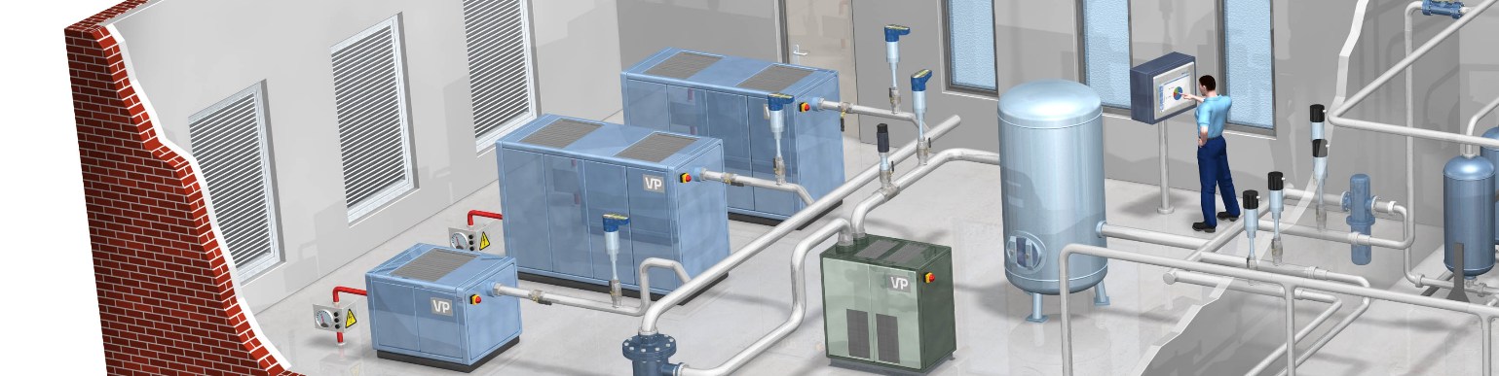
Compressed air EnPI’s
Energy used and costs consumed by running month/year
Energy used and costs per compressor room
Specific power / Efficiency in kW/100*SCF or kW/m3n/min
Air Quality (dew point)
Pressure loss over air treatment
Supply side
Notes:
Express leakage always in USD per dept.
Leakage is the messenger for more trouble to come, early warning for possible longer down time
Cost for repair vs return

Slide 45
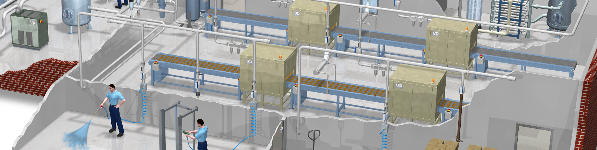
Compressed air EnPI’s
Air consumption running month/year
Return on Repairs
Pressure loss, point of generation to end factory
Costs per widget/tons produced
Production (repair/incident) up or downtime per machine
Leakage % and loss in $$$ per year
Demand side
Notes:
Express leakage always in USD per dept.
Leakage is the messenger for more trouble to come, early warning for possible longer down time
Cost for repair vs return

Slide 46
Think about your EnPI’s first
Many choices: What will help your company / sister companies best?
Start with two plans:
  Short-term (locate opportunities/find savings) &
  Long-term (maintain savings)
Create uniform right plan:
  Make uniform company wide decisions on which utilities and parameters are important
  What to measure?
  At what intervals?
  How will you use the data?
  Are we starting with Multiple utilities @ one single site or more sites in order to benchmark effectiveness of implemented measures and increase learning curves across sites?
Notes:
Many choices: What will help your company / sister companies best?
Start with two plans:
Short-term (locate opportunities/find savings) &
Long-term (maintain savings)
Make uniform company wide decisions on which utilities and parameters are important
Agree to what needs to be measured? At what intervals? How will you use the data? Otherwise you will end up with a bad plan and benchmarking different sites would become meaningless
Are we starting with Multiple utilities @ one single site or do we start with more sites in order to benchmark effectiveness of implemented measures and increase learning curves across sites?

Slide 47
Think about your EnPI’s first
Check for hurdles:
  People (authority)
  Technical (sensor locations)
  Financial (CAPEX/budget approval)
  IT (network usage for data communication)
Select the right partner(s)
Notes:
Check for hurdles, people (authority), technical (sensor locations), financial (CAPEX/budget approval), IT (network usage for data communication)
Select the right partner(s)

Slide 48

Keep it Simple: Start with 3 EnPI’s
Maintenance:
Finance:
Production:
        Leakage %
        Dew point & flow
        Running hours vs downtime hours
        Energy used per compressor/compressor room
        Delta Pressure supply and demand
        Costs per building/department for correct allocation
        MSCF of air/gas/liquid used
        Cost per x ton products
        Pressure band fluctuations
        Cost per x ton products
        Allocate costs / consumption per area
Notes:
When you’re new with KPI’s, then keep it simple. Too difficult KPI’s result in less buy in, lack of attention and have no priority over time.

Slide 49

Uniform way of working?
Differences can occur because:
You’re not using the same tools
You’re not using the same machine or instrument reference conditions
You’re using uncalibrated instruments
You’re combining different data sets or time periods
You’re using different metrics

Slide 50
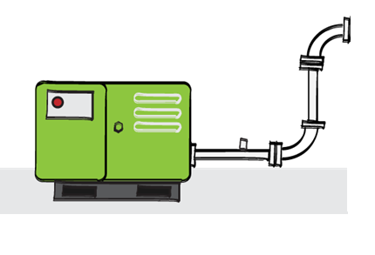
Example

Slide 51
Example

Slide 52
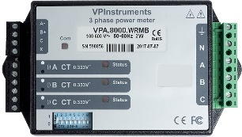
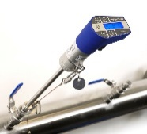

Example
Compressor performance
Specific power measurement
Flow contribution per compressor
Benchmark compressor performance
Electrical consumption by compressor
Collect start, stop, stand-by and running hours
=

Slide 53
Example
=
Compressor room Specific power measurement
Total contribution of all compressor
Electrical consumption by compressor
Collect start, stop, stand-by and running hours

Slide 54
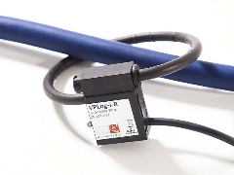
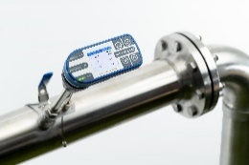
Example
=
Total Electrical power consumed of compressors and dryers versus Air into the tank
Specific power / Efficency of compressor room

Slide 55
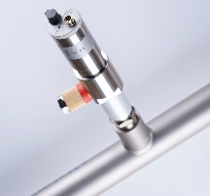
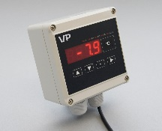
Example
Pressure sensor
Cdp/Fdp sensor
=
Factory base load measurment
Leak rate per main line
Predictive maintenance measurement when using
  Delta Pressure over filteration set up
  Cdp/Fdp together with Flow
Is dryer malfunctioning due to
  Drying bed capacity
  Broken drains

Slide 56
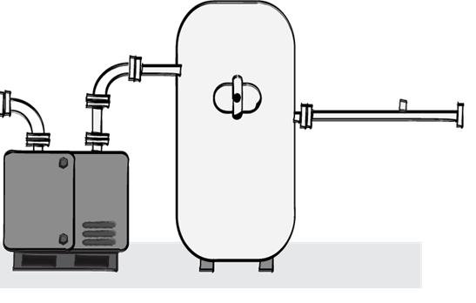
Example
=
Factory base load measurment
Leak rate per main line
Predictive maintenance measurement when using
    Delta Pressure over filteration set up
  Cdp/Fdp together with Flow
Is dryer malfunctioning due to
    Drying capacity
  Internal / external broken drains

Slide 57
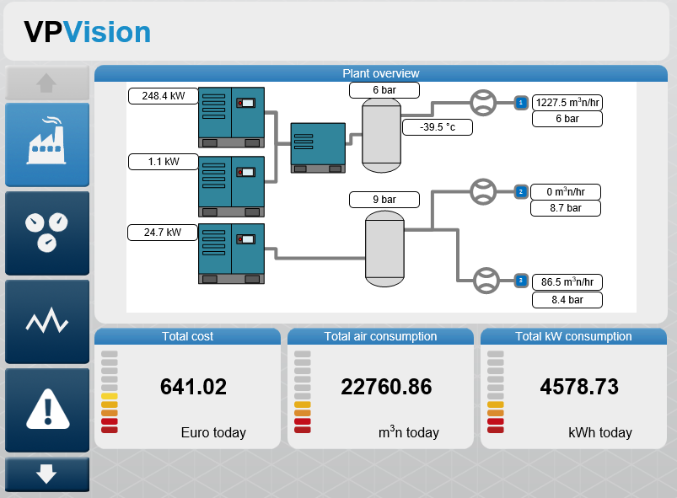
Example

Slide 58
Recap
EnPI’s give direction
Align people / departments
Start simple
Uniform way of working
Measurement tools & monitoring system monitor your EnPI

Slide 59
Menno Verbeek
menno.verbeek@vpinstruments.com

Slide 60
Measuring KPI’s: kW, Flow, Pressure, Dew Point
Q&A
Please submit any questions through the Question Window on your GoToWebinar interface, directing them to Compressed Air Best Practices Magazine. Our panelists will do their best to address your questions and will follow up with you on anything that goes unanswered during this session.
Thank you for attending!
Sponsored by

Slide 61
Thank you for attending!
The recording and slides of this webinar will be made available to attendees via email later today.
PDH Certificates will be e-mailed to Attendees within 2 days.

Slide 62
2021 Webinar Schedule Coming Soon
Want More?
Free On-Demand Webinars Available at
www.airbestpractices.com/magazine/webinars

