Slide 1
Proper Installation & Sizing of VSD Air Compressors
Ross Orr, Compressor Energy Services
Keynote Speaker
The recording and slides of this webinar will be made available to attendees via email later today.
PDH Certificates will be e-mailed to attendees within two days.

Slide 2
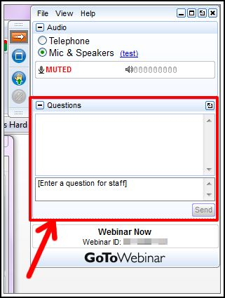
Q&A Format
Panelists will answer your questions during the Q&A session at the end of the Webinar.
Please post your questions in the Questions Window in your GoToWebinar interface.
Direct all questions to Compressed Air Best Practices® Magazine

Slide 3

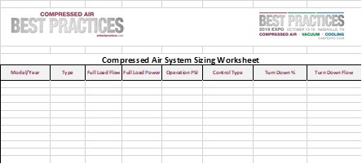
Handouts

Slide 4
Disclaimer
All rights are reserved. The contents of this publication may not be reproduced in whole or in part without consent of Smith Onandia Communications LLC. Smith Onandia Communications LLC does not assume and hereby disclaims any liability to any person for any loss or damage caused by errors or omissions in the material contained herein, regardless of whether such errors result from negligence, accident, or any other cause whatsoever.
All materials presented are educational. Each system is unique and must be evaluated on its own merits.

Slide 5

Proper Installation & Sizing of VSD Air Compressors
Introduction by Rod Smith, Publisher
Compressed Air Best Practices® Magazine

Slide 6

2019 Best Practices EXPO & Conference

Slide 7

About the Speaker
Systems Engineer, Compressor Energy Services
Ross Orr
Compressor Energy Services

Slide 8
Proper Installation & Sizing of VSD Air Compressors
January 24, 2019
Ross Orr
Systems Engineer
Compressor Energy Services
CAC Instructor
AIRMaster+ Specialist

Slide 9
Introduction
Compressed Air Best Practices Magazine - Resources
5 Tips on optimizing VFD air compressors
When to install a VFD compressor
How to size VFD air compressors
December 2018 article discussing Control Gap
Future Webinars are scheduled further discussing VFD compressor control strategies.
Proper Installation & Sizing of Lubricated VSD Air Compressors

Slide 10
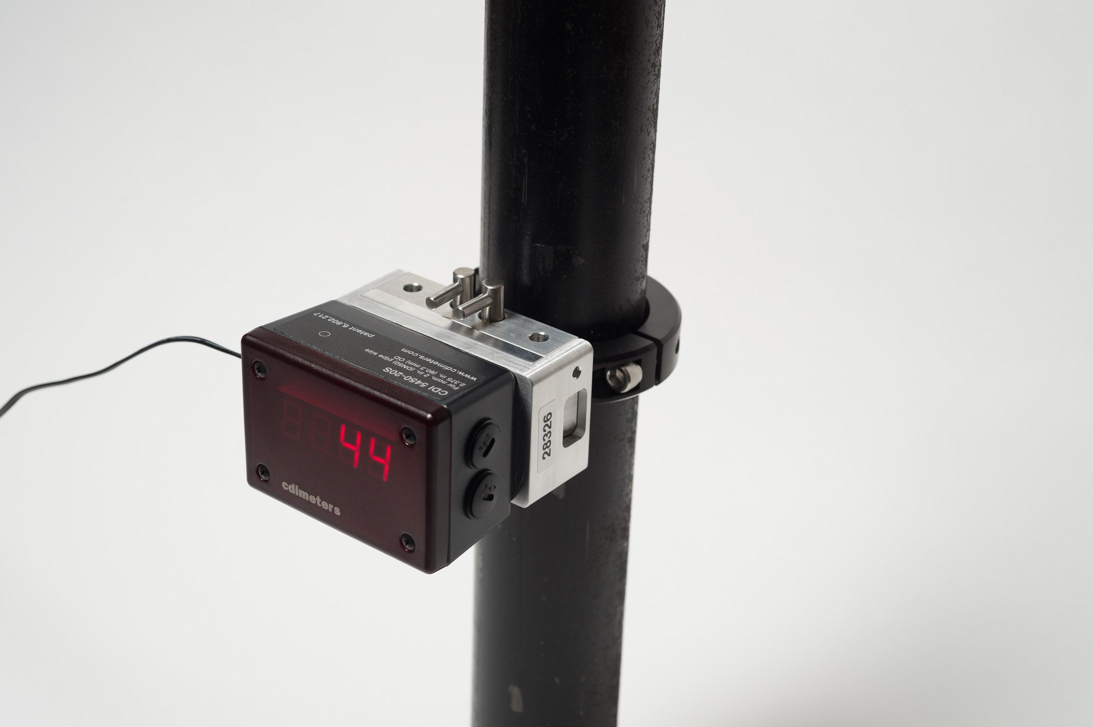
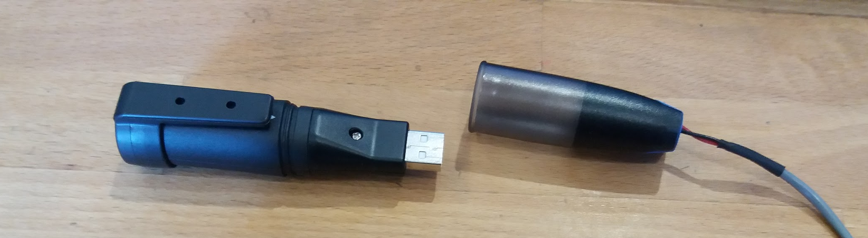
“Knowledge is Power” -- Collecting Data
System metering and monitoring.
Flow Meters -
kW meters - amp loggers -
Pressure transducers
Data logging - data collection
“You Can’t Manage What You Don’t Measure”

Slide 11
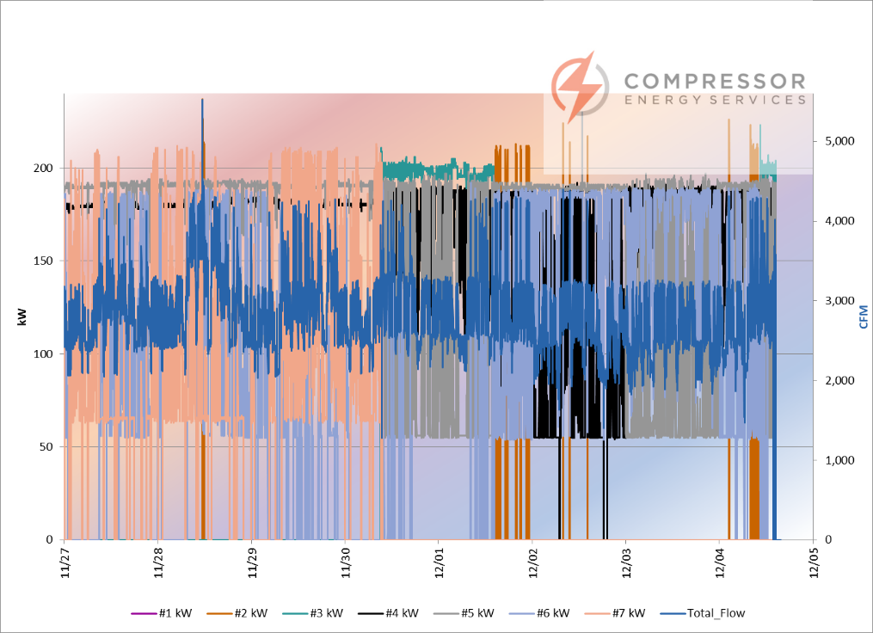
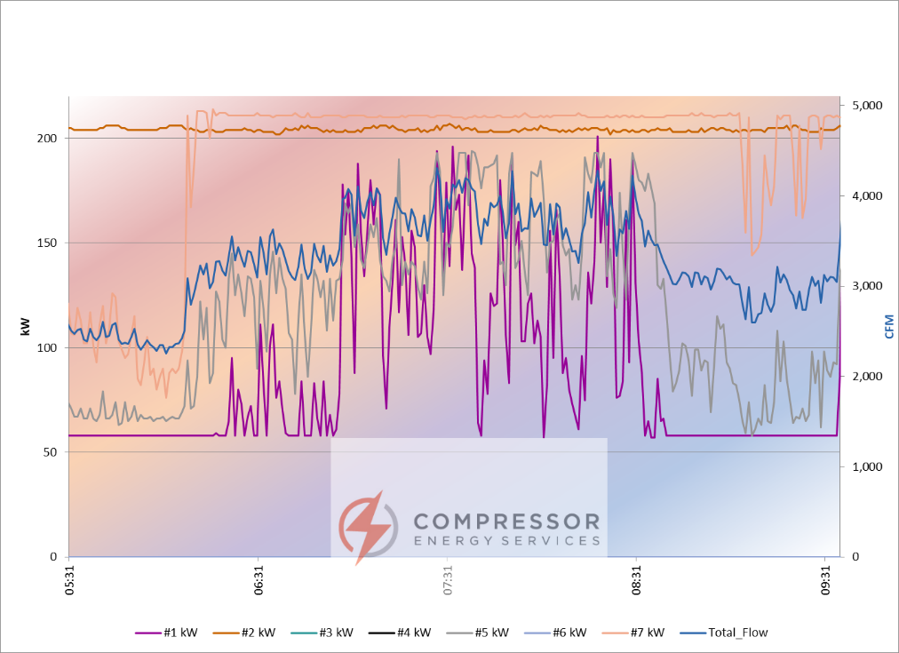
Interpreting Data -- Drilling Down

Slide 12
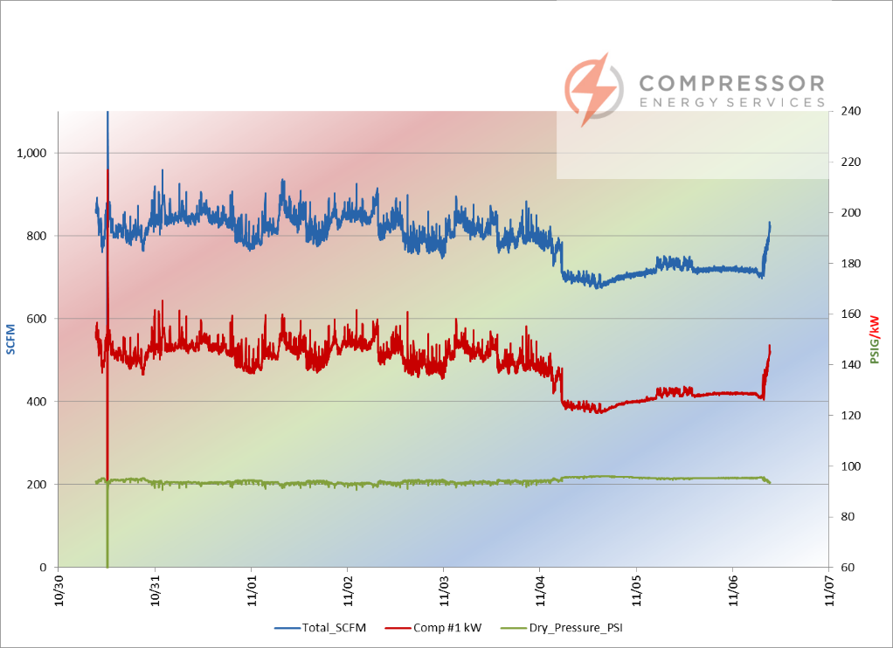
Interpreting Data -- KPI’s
Nice relationship between demand and kW input.
However……….the kW/100 or CFM/kW showed us this was still inefficient.

Slide 13
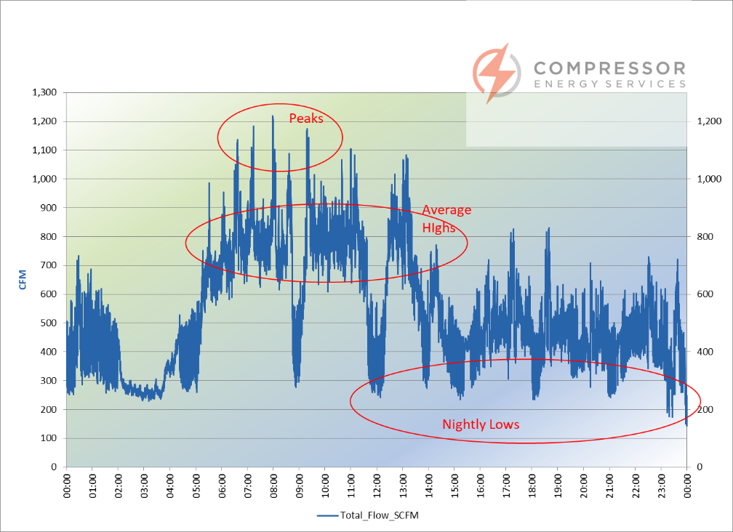
Interpreting Data -- What to Look For
Notice the peaks
Look for sustained highs.
Weekend and night lows
Is there an average demand where you spend most of the time?

Slide 14
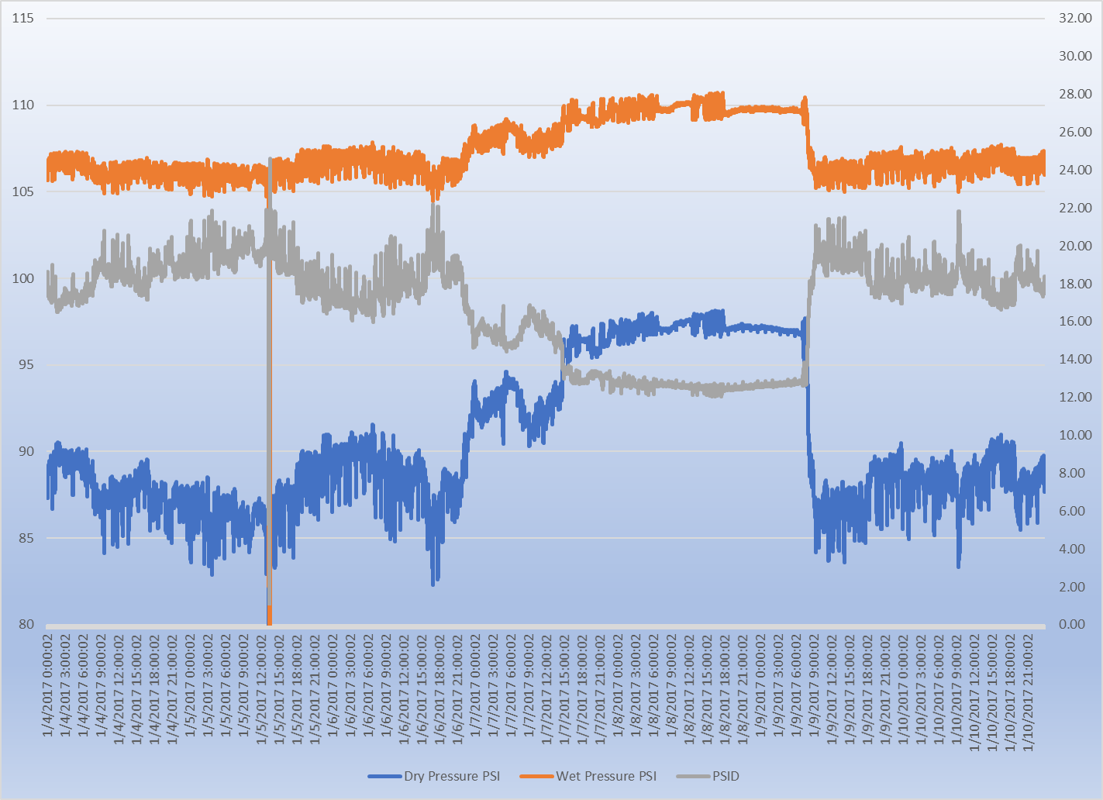
Interpreting Data -- Pressure

Slide 15
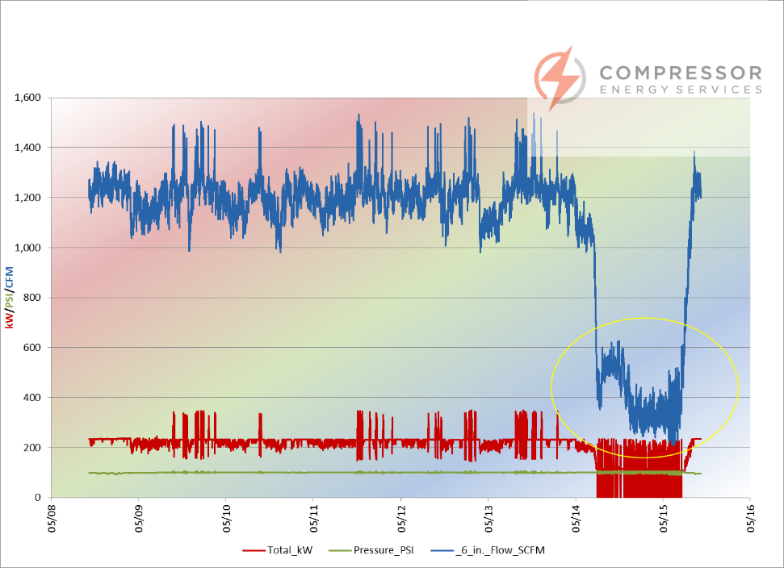
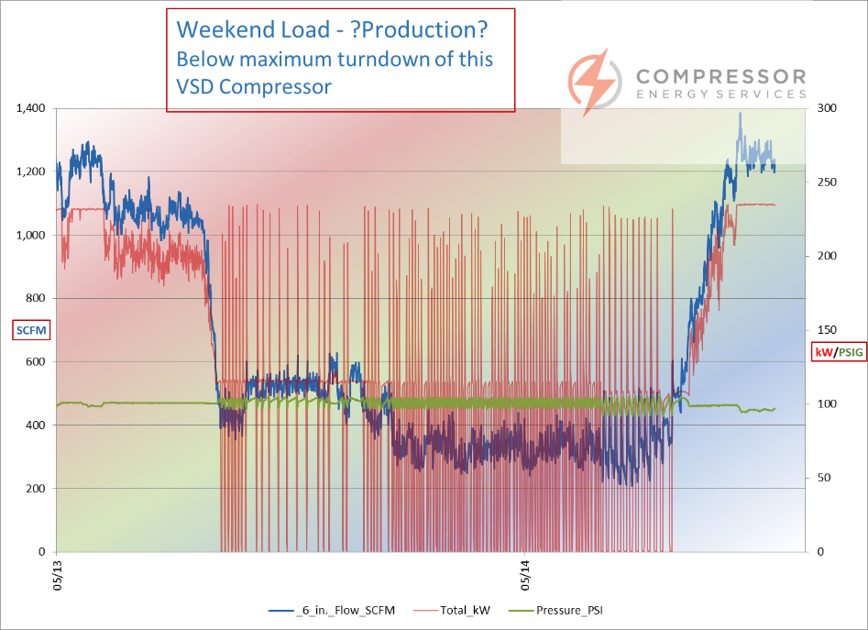
Interpreting Data -- Weekends

Slide 16

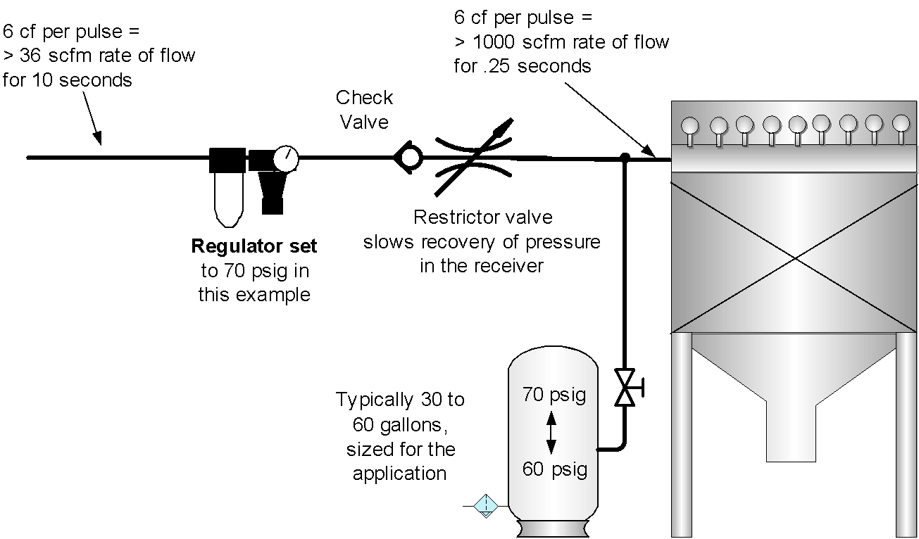

Hunting for Gold in the Data
Inappropriate uses
Draw a simple (but complete) Block Diagram of your compressor room. You may be surprised.
POU -- point of use receivers with designed storage?
Leaks
DO NOT FOOL YOURSELF -- Reality Check……….Will you really check for and repair leaks on a quarterly basis?

Slide 17


Why all this effort and fuss ??
Today, a VFD controlled air compressor is commonly considered the best thing since sliced bread.
Possibly it will end world hunger and maybe make you
coffee every morning !!!
Well……..it can make it easier to be more efficient and seems to make experts out of many of us, but there are limitations.

Slide 18
What does a VFD do?
Very simply…..A VFD is a trim machine that varies the compressor air end speed thereby reducing flow. By doing that we minimize the efficiency loss we see with other methods of control while at partial loads.
Fixed speed Modulation Control
Fixed speed Load/No load control
Fixed speed Variable Capacity
A VFD controlled compressor is typically less efficient at full load.
Despite that, a VFD controlled air compressor is still quite often the most efficient and versatile option available.

Slide 19
Sizing Considerations - Single Compressor
Meet the demand highs --
Include some measure of
growth, not too much however
Minimize run-time at less
efficient flows.
Minimize time operating below the maximum turndown of your compressor.
This is where your comparison of CAGI data sheets comes into play.

Slide 20
Sizing Considerations - Single Compressor
Unlimited Start/stop operation is advertised as possible but not desirable.
Why?
At these low loads, it is possible that moisture will build up in the oil instead of being carried downstream…..causing oil carryover and bearing damage.
Some newer designs are
re-introducing minimum
run times, some based
on oil temperature,
to reduce the negative
effect of operating at
low loads for long
periods of time.

Slide 21
Sizing Considerations - Single Compressor
Quite often, even in a small system an argument can be made to install a two compressor system……….A base load compressor with a VFD as trim.
However, in the Real World we know that space is limited capital budget is limited, and sometimes the appetite for a not-so-simple installation is just not there.
How will these two machines control? Complicates piping...adds other equipment.
At times like this your knowledge will help you to minimize the pitfalls of over-sizing a VFD system.
Minimize the potential for problems.

Slide 22
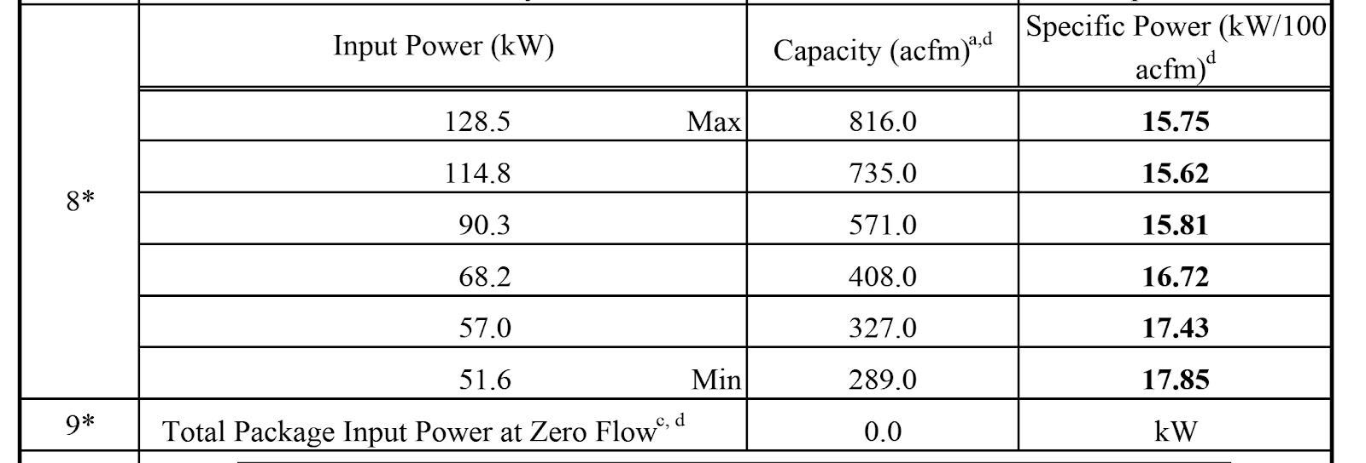
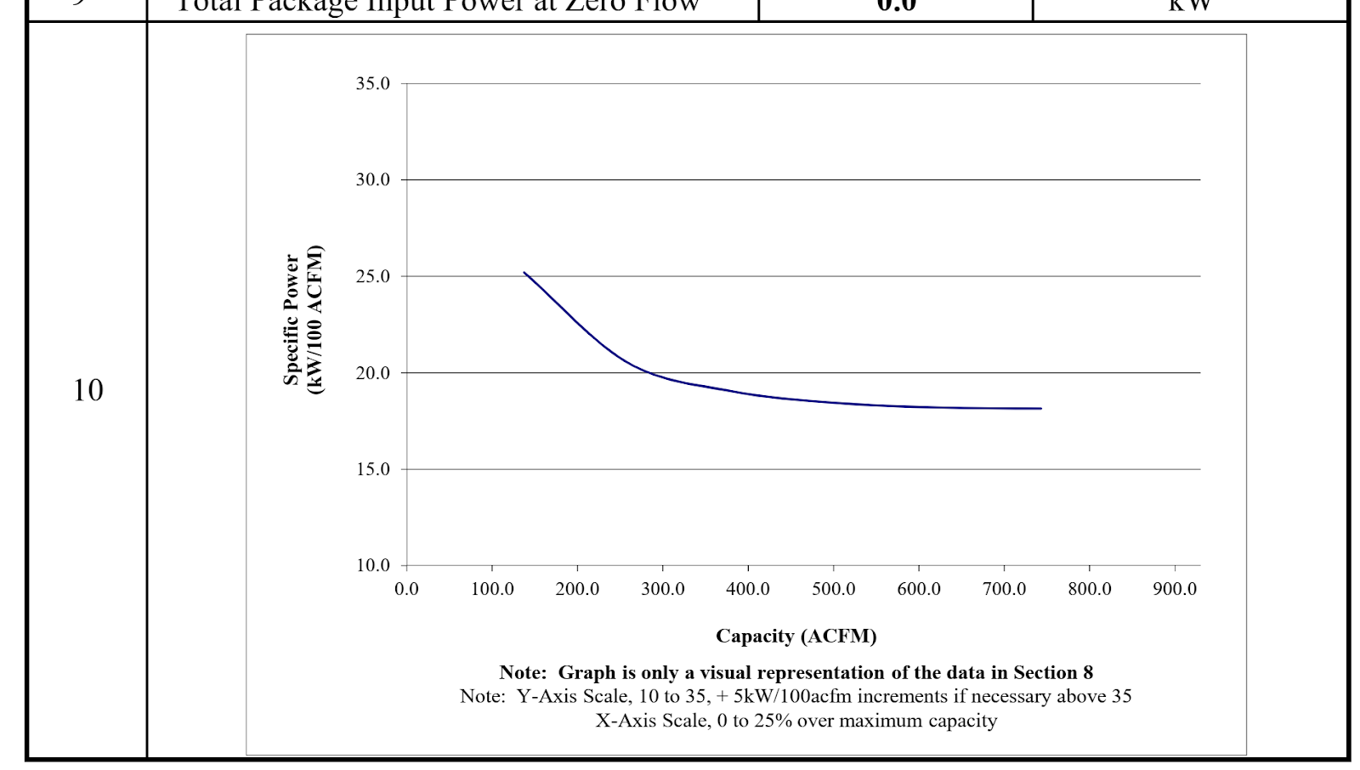
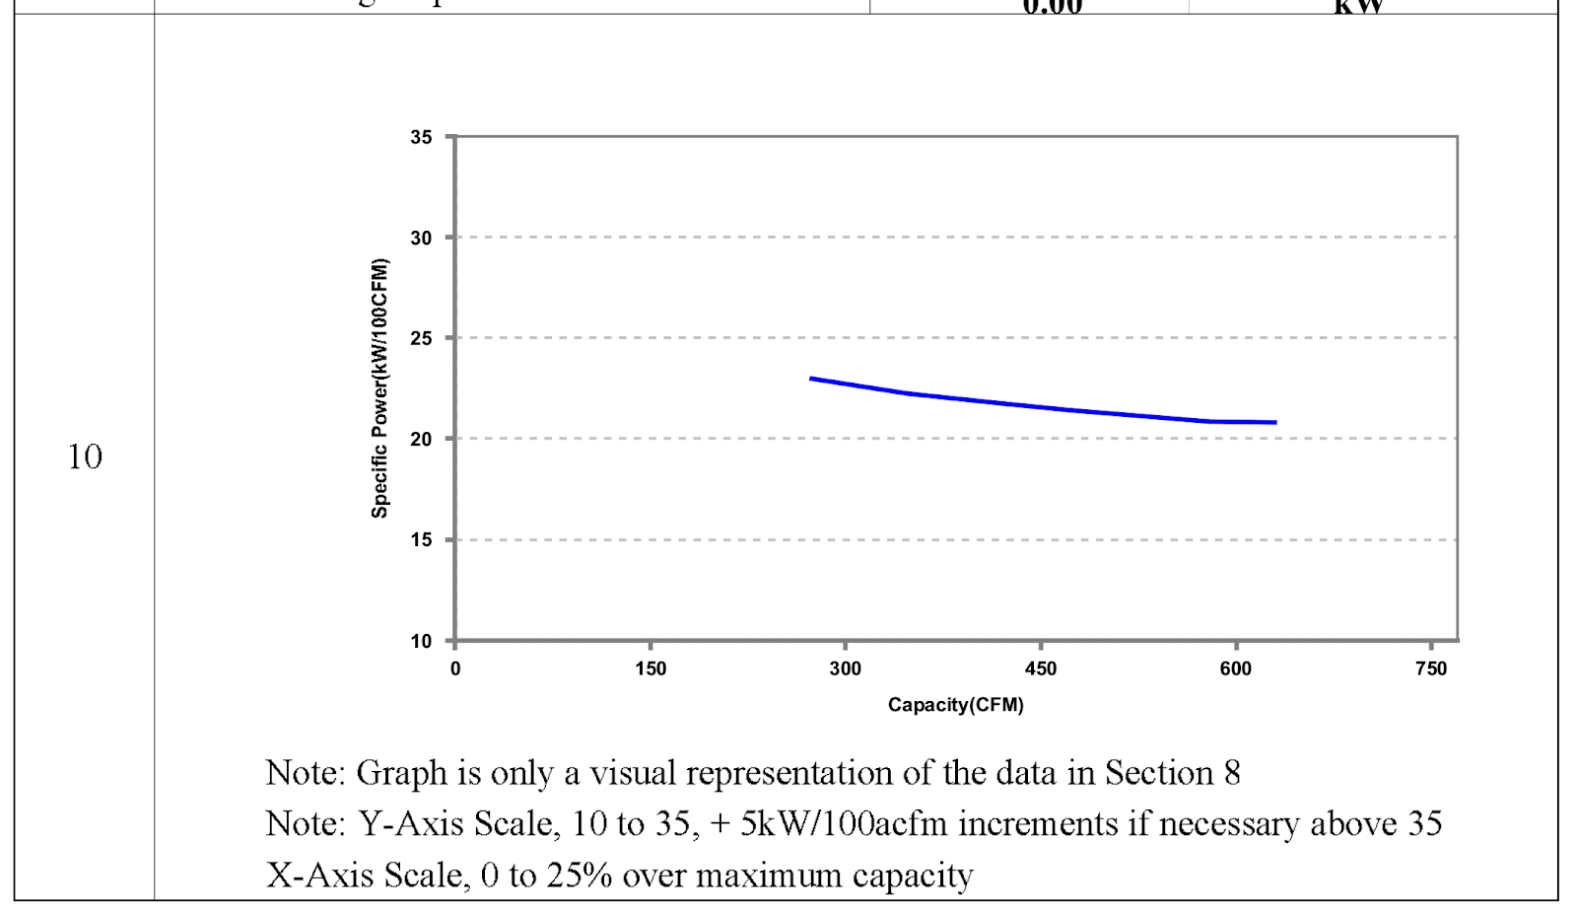
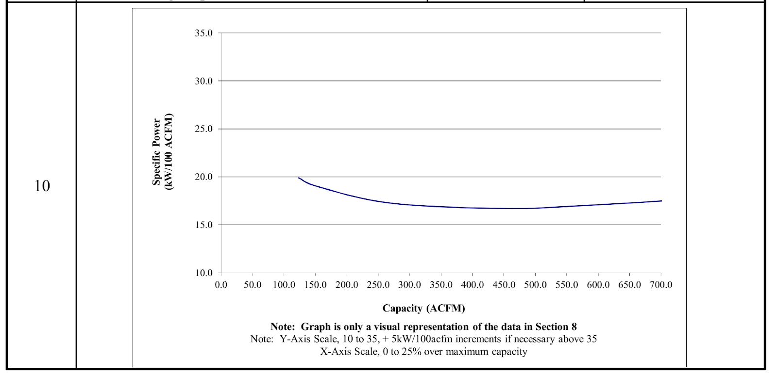
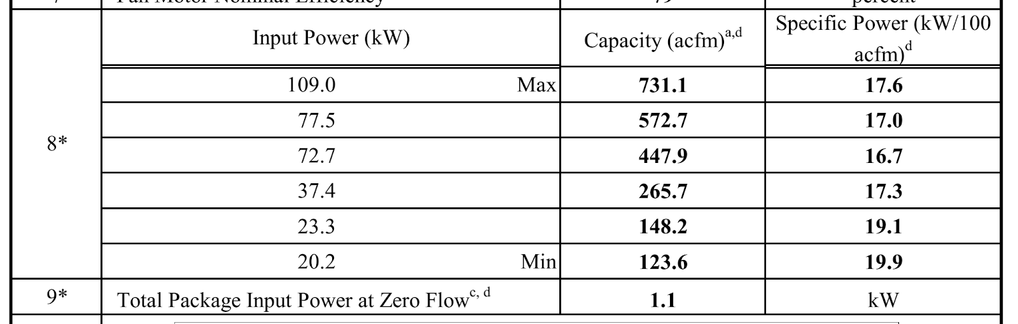

Compressor curves -- CAGI
CAGI…..Compressed Air and Gas Institute.
Not all VFD driven air compressors are the same. In fact, NONE of them are the same.
These curves can be hard to compare but the Specific Power chart gives us a great picture of the efficiency range of the models we may select.

Slide 23
Sizing Considerations - Multiple Compressor
With a multiple compressor system, you may find that you will want to keep an existing unit or two.
To do this, you should try to understand the performance characteristics of each existing air compressor to properly evaluate its value.
Formulate a list of your existing equipment to help you to understand it all and how it may fit in.
You will want to collect all available manufacturers information, any CAGI data sheets, and then check to see if your compressor is running off-design - usually because of pressure settings.

Slide 24
Sizing Considerations - Multiple Compressor
What is going to remain? (because of budget)
How will it be integrated into the future system?
What sequencing or Master Control package is needed?
As always with a compressed air system, decisions based on first cost can be costly !!

Slide 25
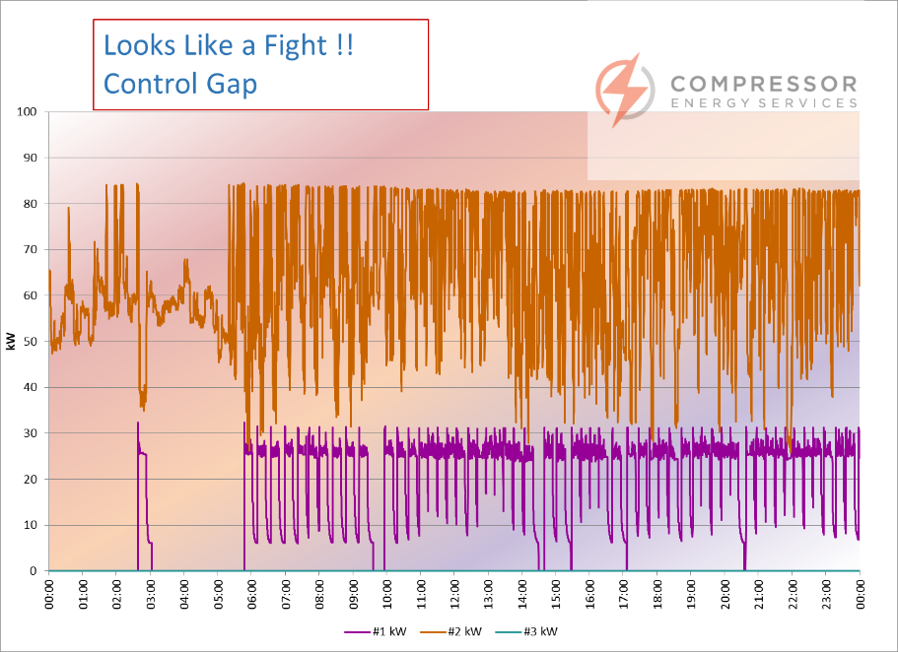
Sizing Considerations - Control Gap
This term is batted around quite a bit but is not always understood, nor is it easily explained.
Simply, in a two-compressor system the lead unit is maxed out, pressure drops so the trim unit (VFD) comes
on but the remaining load is below
the maximum turndown.
This causes the compressor to
start/stop rapidly, with potentially
adverse effects to the compressor
and a fluctuating system pressure.
This also causes two compressors to fight for control, as seen here.

Slide 26


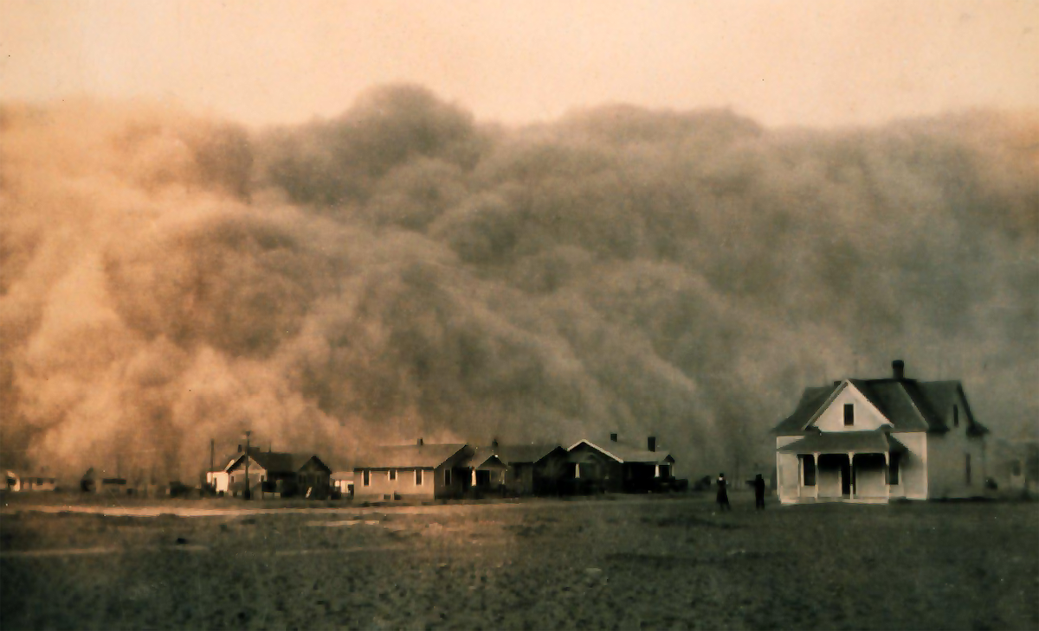
Installation considerations
Wiring to NEC and local codes.
VFD require special wiring considerations
Cooling -
PROPER Ventilation
Avoid putting a common duct on the VFD discharge and the compressor hot air discharge.
Ambient conditions-dust - Extra filtration may
be appropriate but can reduce cooling flow,
raising temperatures. Not a good situation.

Slide 27
Installation considerations
Discharge piping - Basically it is best to avoid piping a VFD to a common header to other control methods, L/NL especially. Here is where a receiver is useful.
?A Receiver is not required with a VFD…..??? Not so. storage adds capacitance and helps smooth the effect of sudden downstream demands. Smooths out the reaction of the VFD controls.
Flow controller should not be needed in a typical VFD system as they are better able to control to a very tight pressure band on their own.
Control panel - sequencer - totally dependent on the capabilities of the individual compressor model and brand.

Slide 28
The Basics
Try to make a choice that avoids too much time at or below minimum speed
Avoid a choice that operates too much of the time at or close to full load.
Understand your demand profile and how your compressor choice will operate at your facility.
Spend time on the installation - wiring - piping - ventilation - environment.
Lastly, review your system and the way it is operating on a regular basis. Make changes and adjustments as necessary to maintain the peak of efficiency.
Otherwise, you are only “Wasting Air More Efficiently”

Slide 29
Thank You
Ross Orr
Systems Engineer
Compressor Energy Services
CAC Instructor
AIRMaster+ Specialist

Slide 30
Proper Installation & Sizing of VSD Air Compressors
Q&A
Please submit any questions through the Question Window on your GoToWebinar interface, directing them to Compressed Air Best Practices Magazine. Our panelists will do their best to address your questions, and will follow up with you on anything that goes unanswered during this session.
Thank you for attending!

Slide 31
Thank you for attending!
The recording and slides of this webinar will be made available to attendees via email later today.
PDH Certificates will be e-mailed to Attendees within two days.

Slide 32
2019 Best Practices EXPO & Conference

Slide 33
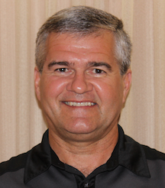

February 2019 Webinar
Visualizing KPI’s: Specific Power, Flow, Pressure, Dewpoint
Sponsored by
Ron Marshall
Marshall Compressed Air Consulting
Keynote Speaker
Thursday, February 28, 2019 – 2:00 PM EST
Register for free at
www.airbestpractices.com/magazine/webinars

