Slide 1
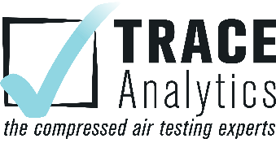

Safety and Quality in Compressed Air: Why You Should Care
Loran Circle, Circle Training & Consulting
Keynote Speaker
The recording and slides of this webinar will be made available to attendees via email later today.
PDH Certificates will be e-mailed to attendees within two days.
Sponsored by

Slide 2
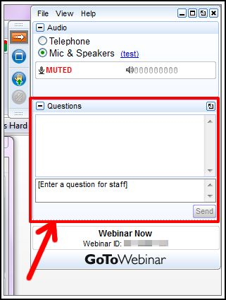
Q&A Format
Panelists will answer your questions during the Q&A session at the end of the Webinar.
Please post your questions in the Questions Window in your GoToWebinar interface.
Direct all questions to Compressed Air Best Practices® Magazine
Sponsored by

Slide 3
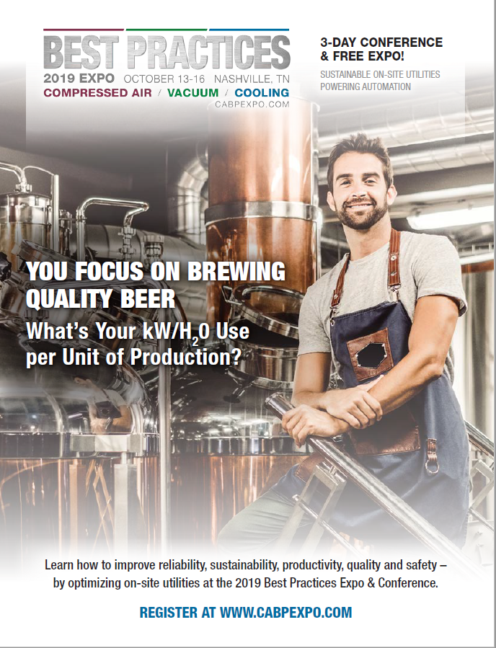
Handouts

Slide 4
Disclaimer
All rights are reserved. The contents of this publication may not be reproduced in whole or in part without consent of Smith Onandia Communications LLC. Smith Onandia Communications LLC does not assume and hereby disclaims any liability to any person for any loss or damage caused by errors or omissions in the material contained herein, regardless of whether such errors result from negligence, accident, or any other cause whatsoever.
All materials presented are educational. Each system is unique and must be evaluated on its own merits.

Slide 5
Safety and Quality in Compressed Air: Why You Should Care
Introduction
Compressed Air Best Practices® Magazine
Sponsored by

Slide 6
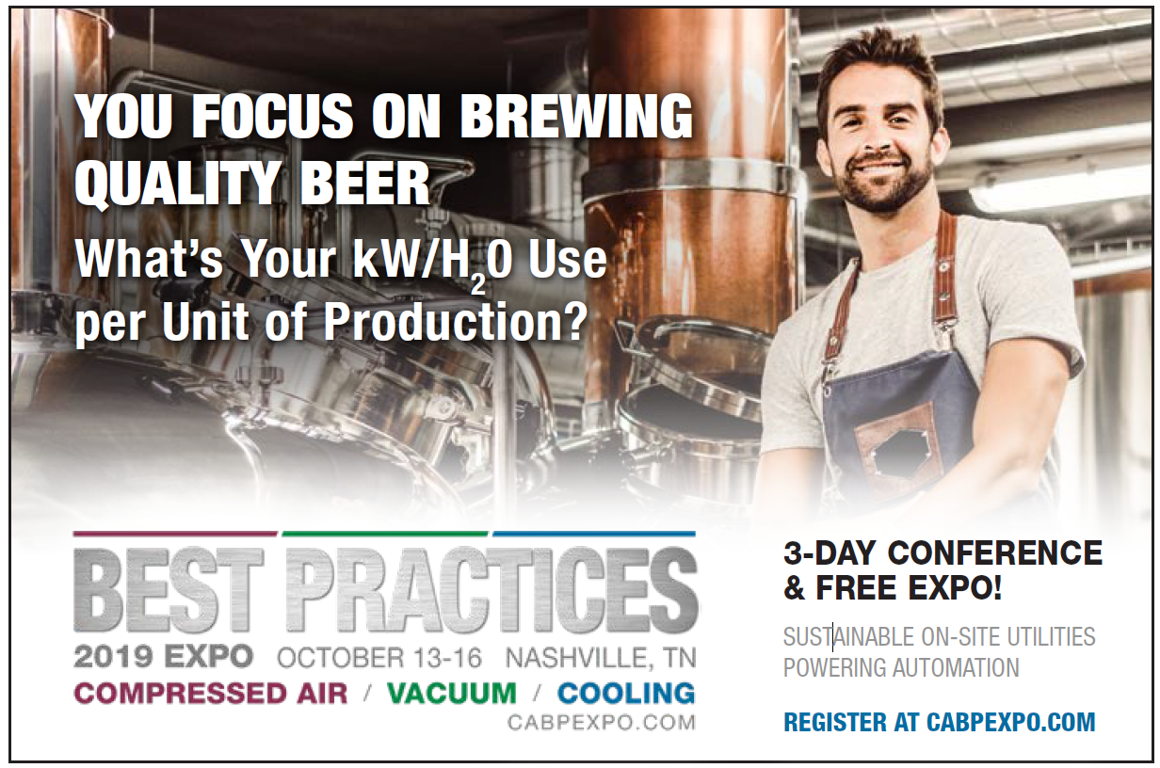
2019 Best Practices EXPO & Conference

Slide 7
2019 Best Practices EXPO & Conference
Call for Abstracts
The conference will focus on sustainable on-site utilities powering automation including compressed air, blower, vacuum and cooling systems. Presentations should encompass one or more of these themes.
Quality & Safety Management
Facility Maintenance & Reliability
Energy Savings / IoT Monitoring
Water Savings / Energy Management
  Abstract submissions are due Friday, April 12, 2019.
  Speakers receive a complimentary Conference Pass, a $675 value!
  To submit an abstract, please visit
  cabpexpo.com/conference/speakers

Slide 8

About the Speaker
Senior Consultant, Circle Training & Consulting
Over 45 years of experience in the compressed air industry
Certified AirMaster Plus by Department of Energy
Loran Circle
Circle Training & Consulting
Sponsored by

Slide 9
Safety and Quality In Compressed Air
Why Should You Care?
ISO 8573.1
Loran Circle
Compressed Air System Consultant

Slide 10

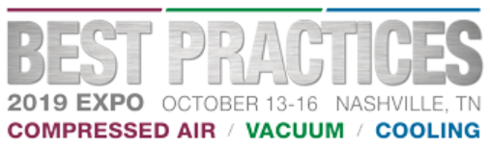
Webinar Agenda
Dangers of not having a process of checks and balances for air quality in your facility
What is the ISO 8573.1 standard for compressed air quality?
How to establish an ISO 8573.1 specification for your facility and processes
What could happen without a compressed air purity specification for your facility?
Importance of regular scheduled testing and maintenance of the air system

Slide 11


What Are The Dangers Of Contaminated Compressed Air?
Contaminants such as oil, water and particles will contaminate compressed air systems
Contaminants will cause poor product quality
Contaminants will cause higher maintenance expenses of manufacturing equipment, and contamination of product produced
Compressed air contamination is expensive
Could cause issues with direct and indirect food contact
Higher chance of legal liability

Slide 12
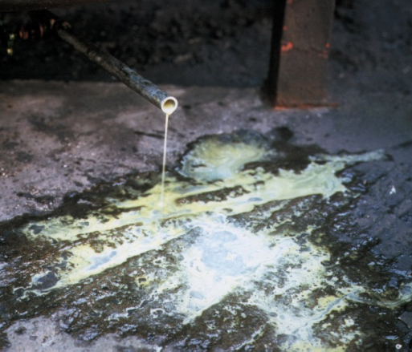
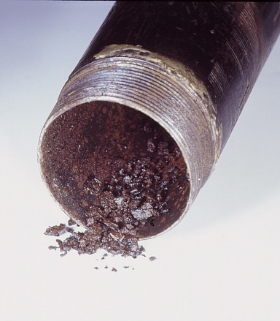
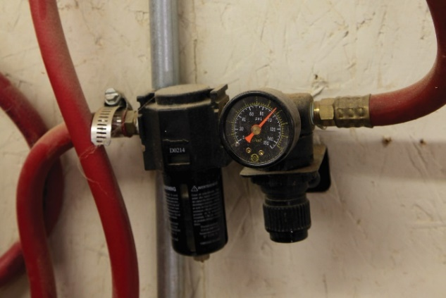
Dangers Of Not Setting ISO Standards
Would you want a product produced with the examples shown here?
Would you feel confident with using air for critical food or health processes?
Installation of point of use filter/regulators
Do I have your attention?

Slide 13
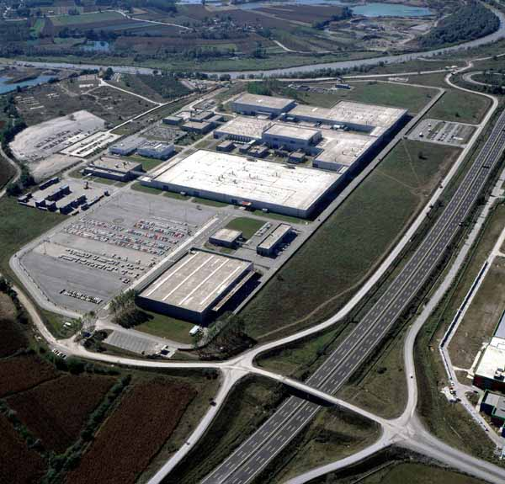

Actual Cases
Automobile manufacturing paint line was intermittently getting fish eyes in paint. Air testing gas chromatograph mass spectrometer showed Inlet gasses were causing the problem.
Potato chip plant used optical detection and compressed air for optical detection of defects in chips

Slide 14
ISO Standards
In years past clean air quality was referred to as “Instrument Air”.
It was presumed to be -40 and .01 micron of particulate and liquids. However, there were no set standards.
ISO (International Standards Organization) came up with standards for compressed air quality in 1991 and amended them in 2001 and lately 2010

Slide 15
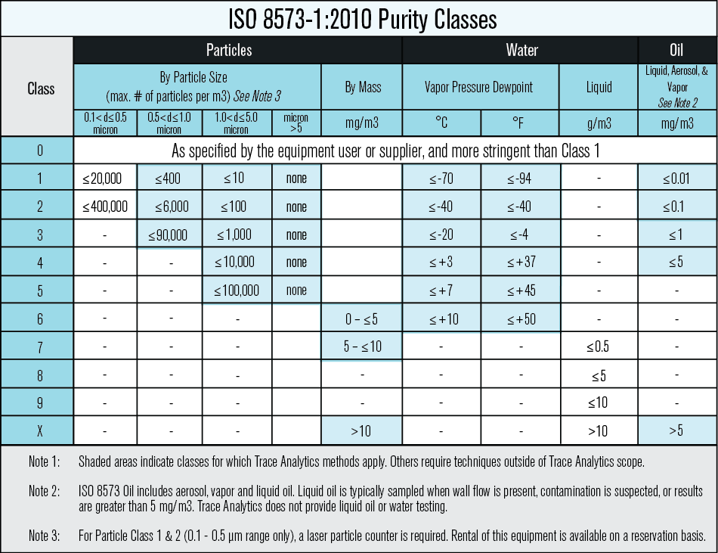
How ISO 8573.1 Is Used In Compressed Air Systems
Class Zero must be better than 1.1.1

Slide 16

Costs of Quality

Slide 17

Condensate Generation
Water IS a contaminant and an abrasive!!

Slide 18
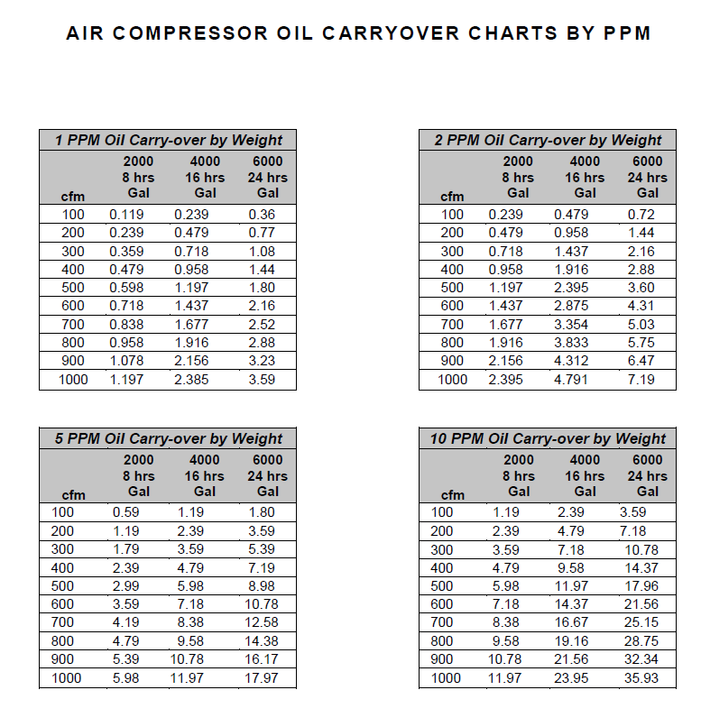
Oil Carryover
Oil carryover is based on the following:
Compressor rated flow (ACFM)
Intake Air Temperature - Annual Average (Deg F)
Operating hours per year (hrs)
Parts per million carry-over (ppm)
Fluid Type
Fluid Specific gravity
Maintenance of the air system
*This chart is an estimate only of oil carryover. Actual oil carryover is dependent upon the above criteria

Slide 19
How Do We Start?
Do a thorough assessment of the different processes within your facility
Start at the END of the line!!
Do an initial baseline test to determine current ISO 8573.1 level. This will identify what deficiencies exist and where corrections are needed. Then retest to verify.
What is the general ISO standard for the plant?
What “critical” processes are required?
Any Direct Contact with food or medicines?
Any Indirect Contact?
What are potential safety issues?
What potential health issues need to be considered?
What is the most critical air standard for the facility?
What cleanup equipment do you currently have?
What are the inlet conditions?
Understand compressed air quality is MORE than just installing dryers and filters

Slide 20
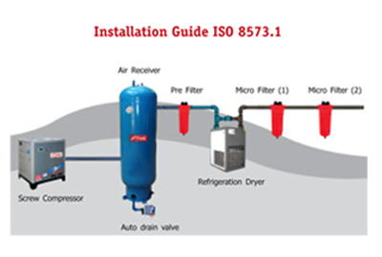
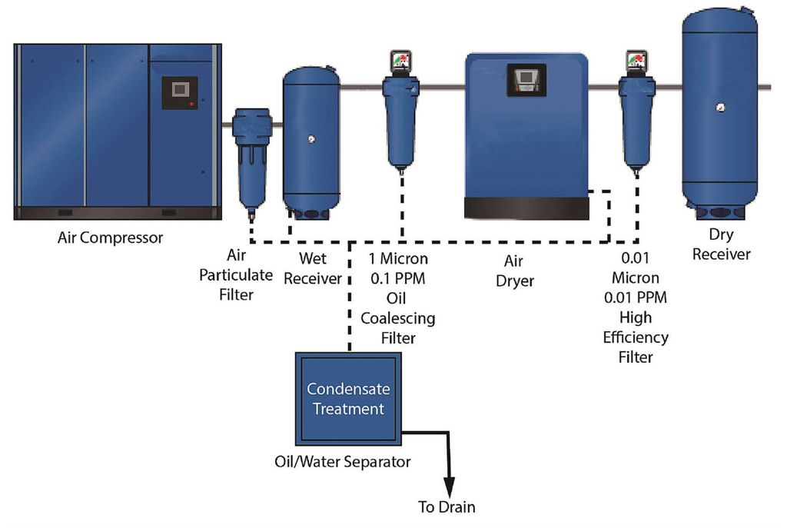
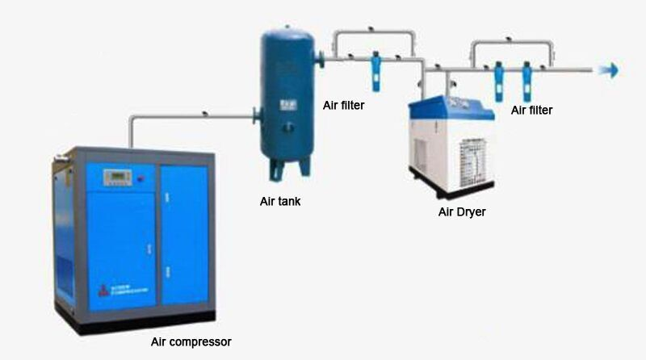
Installation Issues Affecting 8573.1
Installation and Maintenance have effects on air quality

Slide 21
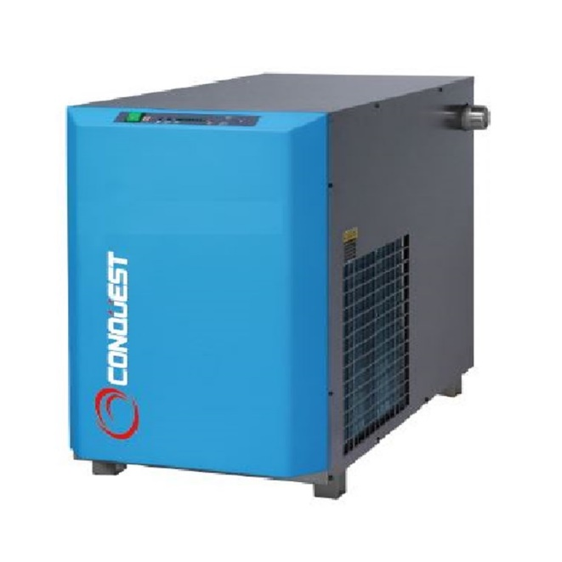
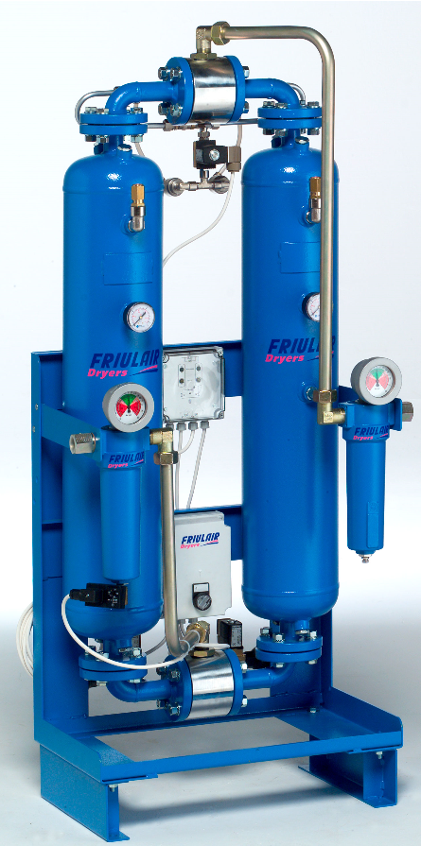
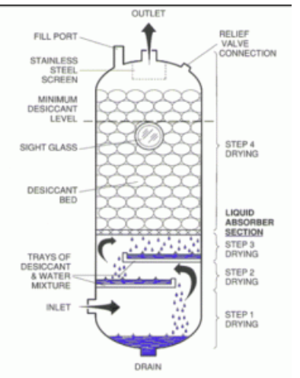
Dryers
Refrigerated Dryer 35-50F dewpoint
Desiccant Dryer -40F to -94F
Deliquescent Dryer Dewpoint Suppression

Slide 22
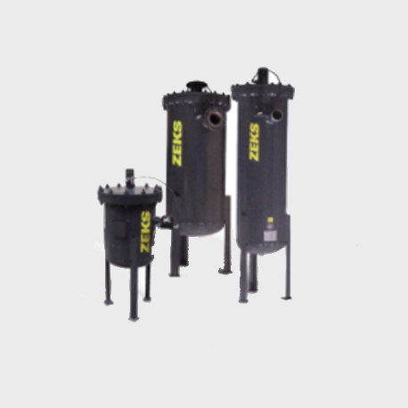
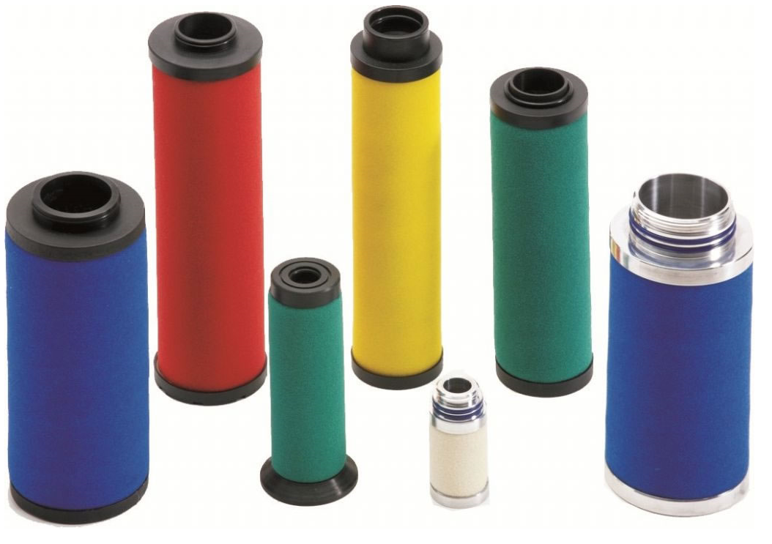
Filter Elements
Filters are broken down into 4 categories
Liquid Contaminants (Coalescing)
Dry particles (Particulate)
Odor (Carbon Filtration)
Mist Eliminators

Slide 23
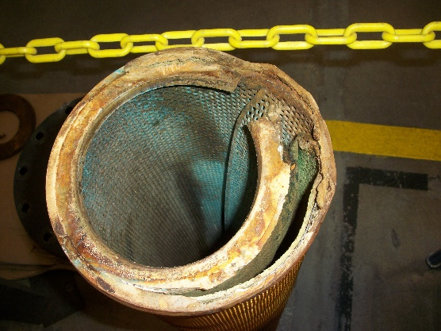
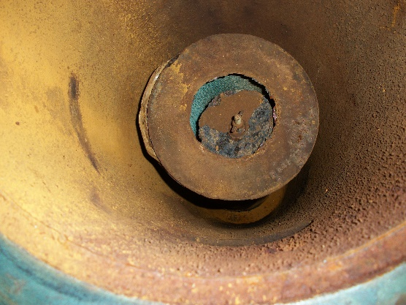
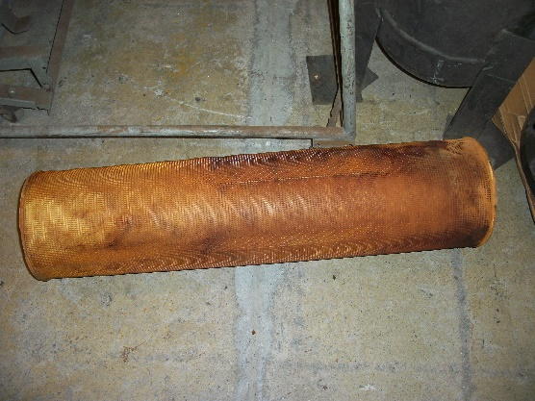
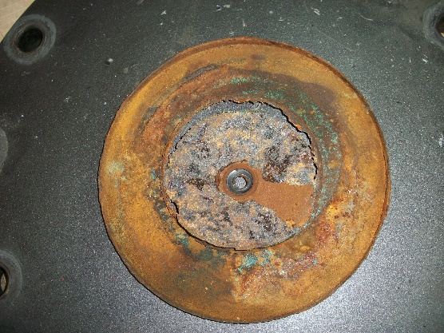
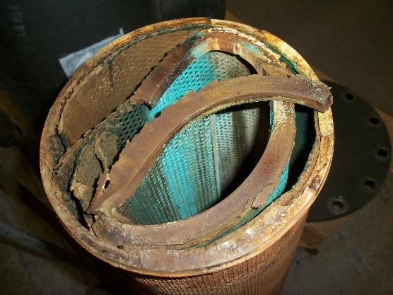
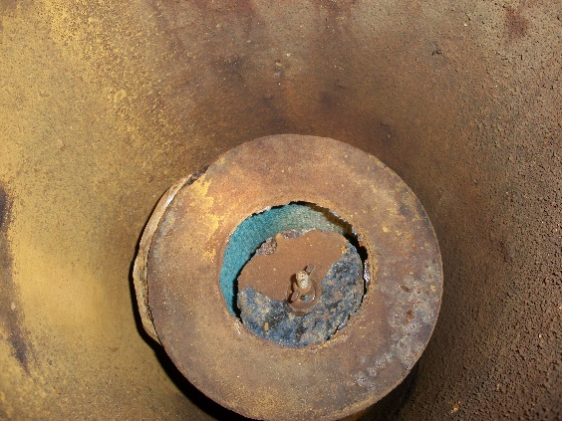
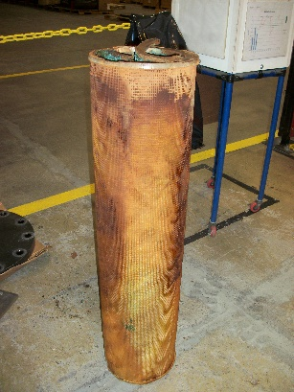
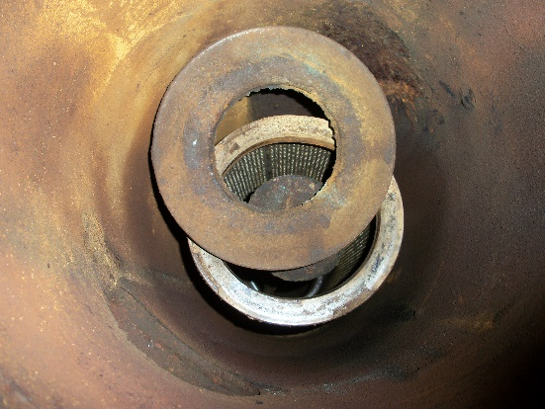
What Filters Look Like Inside Housing

Slide 24
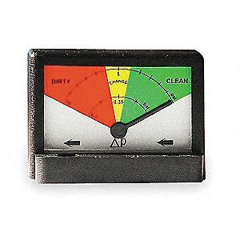
What Do All These Filters Have In Common?
They All Are CLEAN!

Slide 25
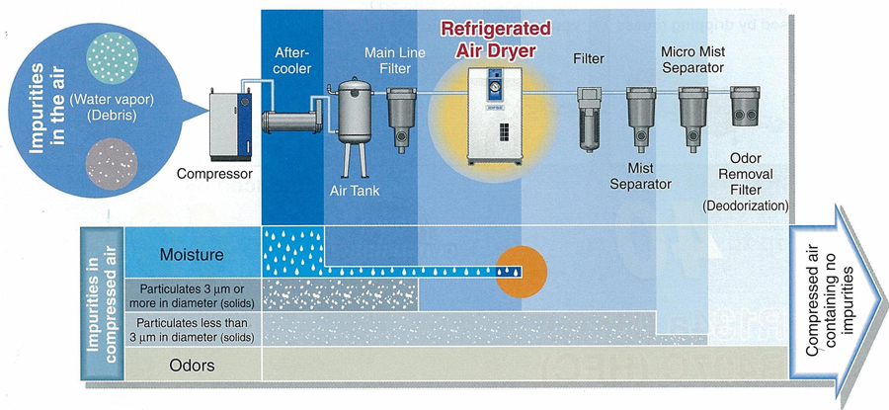
System Set Up

Slide 26
Ongoing Best Practices For ISO 8573.1
Have an ISO 8573.1 specification
Perform regular testing of air quality. Know your iso
Business card test for quick check (place clean white card over open blow off, contaminants will show on card)
Set up regular maintenance and inspection procedures
Don’t forget inlet conditions many chemicals and gasses come through the inlet
Visually inspect direct and indirect contact points and test those points
If you have a lower ISO standard for the majority of the plant, make sure to test air downstream of any dryers and filtration for point of use applications
Make sure your test lab is testing to 8573.1specifications
Test every 3 months to start. If the test results are consistent, go to every 6 months.

Slide 27

Summary
Identify what quality of air is required for your particular operation
Perform a plant risk assessment
Specify the standards required in your plant based on your specific process
Is there food contact? Direct or Indirect?
Are there critical processes?
Train employees on the costs of contaminated air and the importance of maintaining the air system
In the long term, contaminated compressed air will cost more than the expense of proper system maintenance

Slide 28
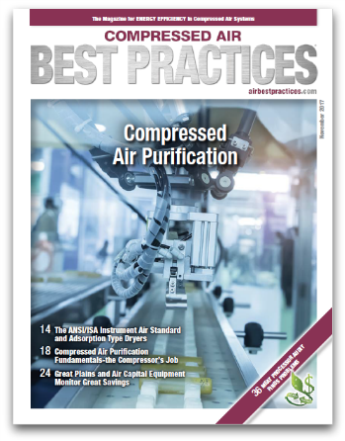
For More In Depth Seminars And Education
Don’t forget to register or get your booth reserved
for Best Practices EXPO & Conference
October 13-16, 2019
Nashville, TN
www.cabpexpo.com
Subscribe at www.airbestpractices.com

Slide 29
Thanks For Attending
Loran Circle
Certified AirMaster Plus
Plant Air System Design and Consulting
Customized Training On Air System Design, Compressor Operation and Maintenance
Sales Training for The Compressed Air Industry
Poland, OH
832-906-0469

Slide 30

About the Speaker
Owner and President of Trace Analytics with over 35 years of experience
Ochoa has written for and holds membership with the following committees:
  The International Society of Pharmaceutical Engineers (ISPE)
  The Medical Gas Professional Healthcare Organization (MGPHO)
  The National Fire Protection Agency (NFPA) Technical Committee for Respiratory Protection
Ruby Ochoa
Trace Analytics

Slide 31

The AirCheck Laboratory
Setting Up a Compressed Air Monitoring Plan
Ruby Ochoa | President & Co-Owner | 1-800-247-1024 ext. 211 | ruby@airchecklab.com

Slide 32
Monitoring Plans as per ISO 8573
1
Assessing your risks, system capabilities, and facility needs
2
Choosing an ISO 8573 purity class
3
Analyses and Packages for Your Specifications
4
Sampling Plans

Slide 33
CONDUCT A RISK ASSESSMENT

Slide 34

ASSESSING
YOUR SYSTEM FOR RISK
1
Identify Potential Hazards
2
4
Assess the Risk of Harm
Assess If Extra Controls are Necessary
3
5
Assess Existing Controls
Schedule Regular Review

Slide 35

DESIGNATING ISO 8573 PURITY CLASSES
ISO 8573-1:2010 [P:W:O]
direct contact: [2:2:1]
indirect contact: [2:4:2]
water unspecified: [2:–:1]

Slide 36
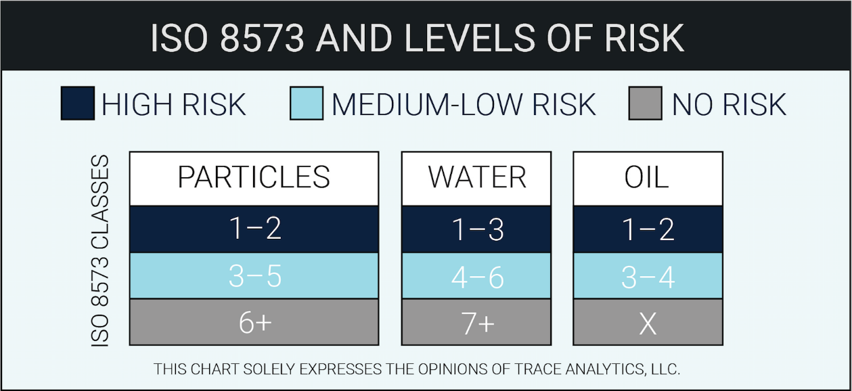
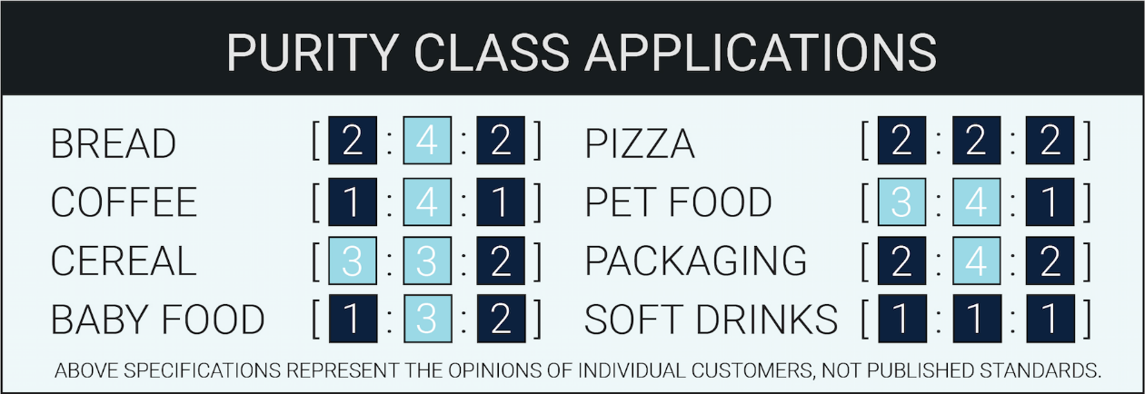
EXAMPLES OF PURITY CLASS APPLICATIONS

Slide 37
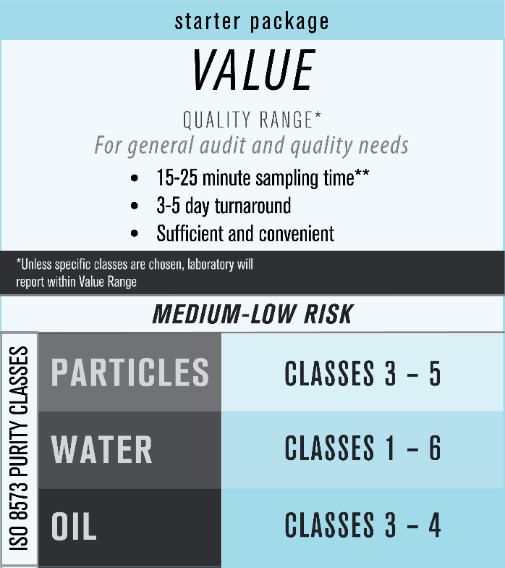
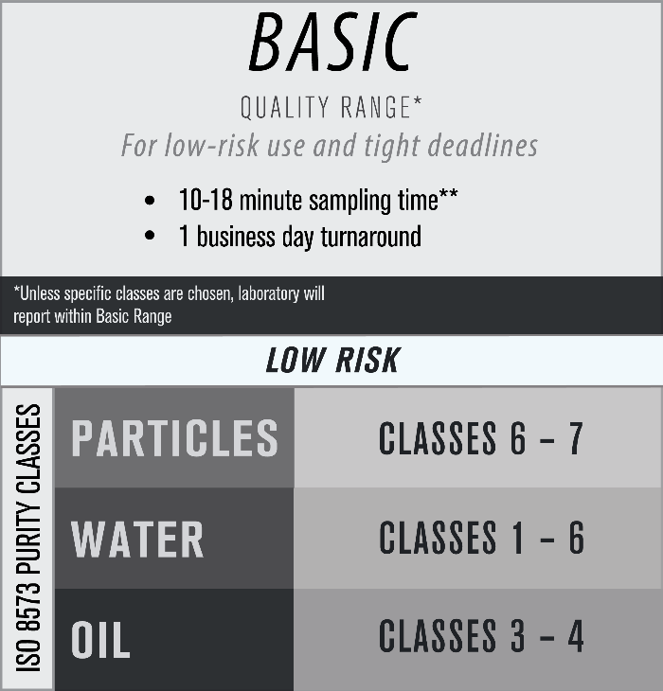
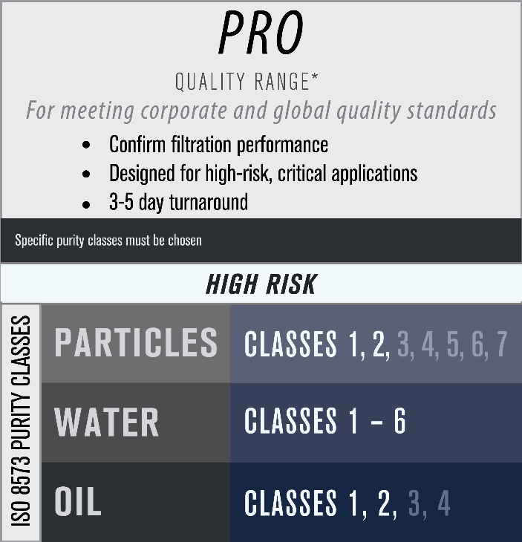
Trace Analytics Packages: [P:W:O]

Slide 38
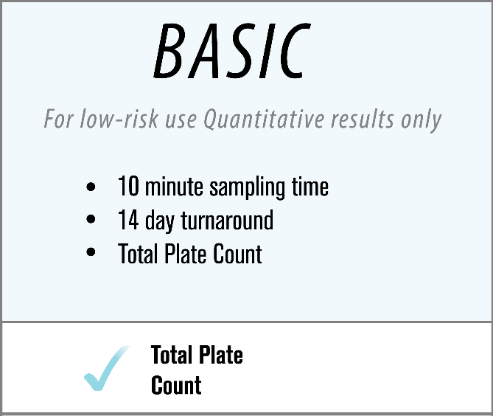
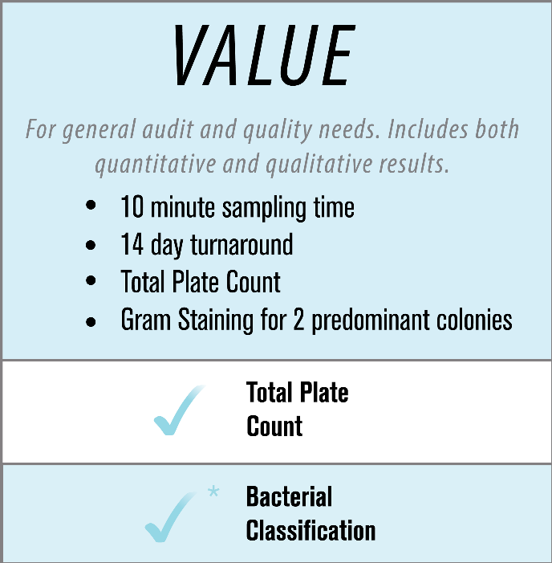
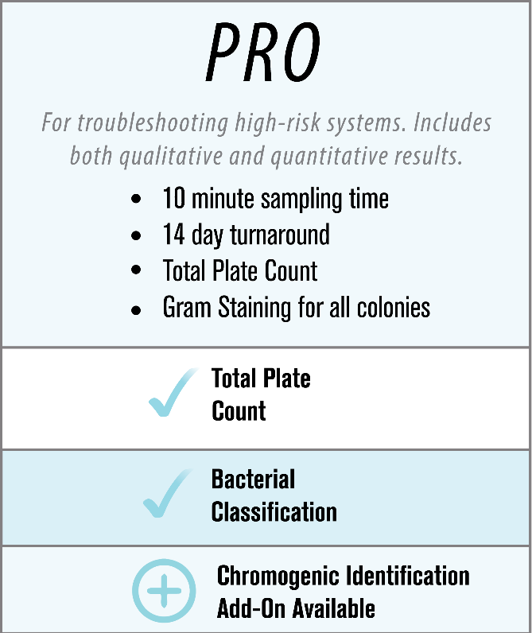
Trace Analytics Packages: MICRO

Slide 39




HOW MANY SAMPLES?
PERCENTAGE
MAINTENANCE
MINIMAL
SINGLE

Slide 40

HOW OFTEN TO TEST?
ANNUALLY
SEMI-ANNUALLY
QUARTERLY

Slide 41
CONTACT US FOR MORE
Ruby Ochoa | President & Co-Owner | 1-800-247-1024 ext. 211 | ruby@airchecklab.com

Slide 42

About the Speaker
Technical Service Specialist, BEKO Technologies
Josh Borrego
BEKO Technologies

Slide 43
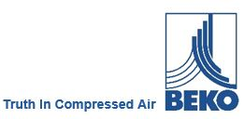
Safety and Quality in Compressed Air

Slide 44
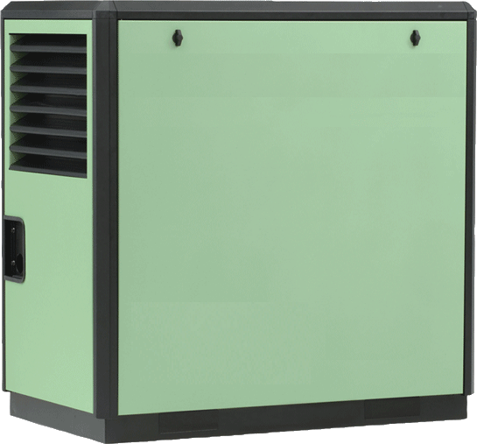

Safety and Quality in Compressed Air
Contaminants in your compressed air system.
How do contaminants get into the compressed air system?
Moisture
Bacteria
Viruses
Hydrocarbons
Particles
Other contaminants
Oil
Moisture
Bacteria
Viruses
Hydrocarbons
Particles
Other contaminants
Notes:
Everything a compressor takes in on the suction side will pass trough and goes into your system. Depending on the compressor type the compressor will also add oil what is used for lubrication. A very large impact on the contamination in the compressed air comes from the location the compressor is placed in because the compressor takes in the ambient air. What means if the compressor takes his air in from right next to a heavily used road or in a harbor the hydro carbon amount for example will go up significantly.

Slide 45
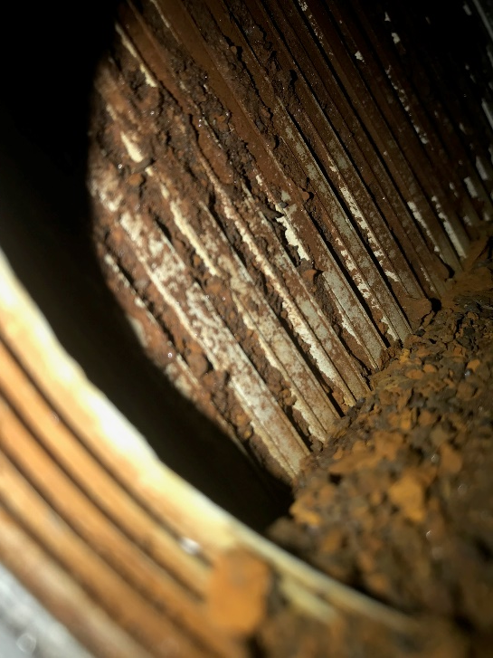
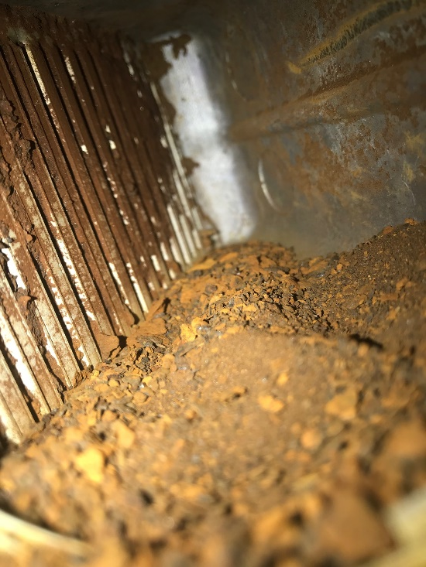
Safety and Quality in Compressed Air
Moisture in our compressed air
Notes:
Inlet side of an Evaporator with no prefiltration and black pipe installed in the system. Proper condensate management equipment like the BEKOMAT or CLEARPOINT water separator and filters will help you prevent rusty pipes and receiver tanks. Choosing the right material for the piping system before the dryer is vital to you system. Going with Aluminum, copper or galvanized in front of the dryer is always a good choice. It is also important to not mix materials like copper and steel because it will come to corrosion. This is called Galvanic corrosion and is an electrochemical process in which one metal corrodes preferentially when it is in electrical contact with another, in the presence of an electrolyte (Water).

Slide 46
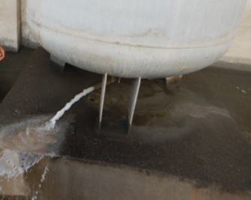
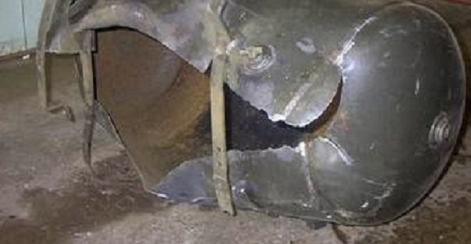
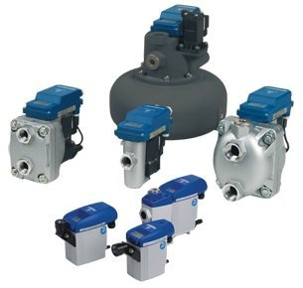
Safety and Quality in Compressed Air
Moisture in your compressed air
Notes:
Condensate management starts with properly sized drains. If we make the mistake to not take care of the drains in our system we will pay a large price in the long run. An exploding receiver tank can chausse large property damage and in the worst case human damage. By just installing and maintaining our drains we can save thousands in the long run.

Slide 47
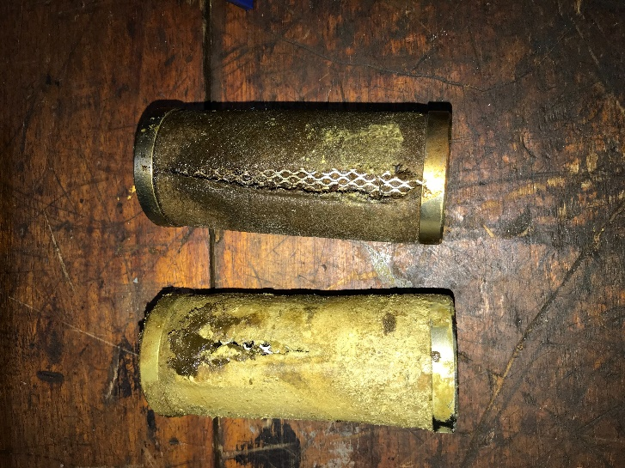
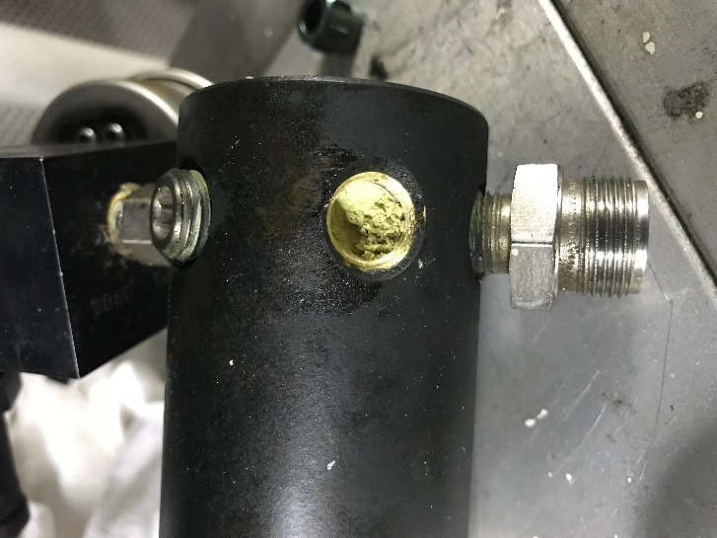
Safety and Quality in Compressed Air
Maintenance and how important it is.
Notes:
Here we see an pre and after filter of a desiccant dryer, after years without maintenance. This is a very good example of a lack of maintenance. The lack of maintenance destroyed also the pressure reduction valve who is in charge of the controll air on this dryer.

Slide 48
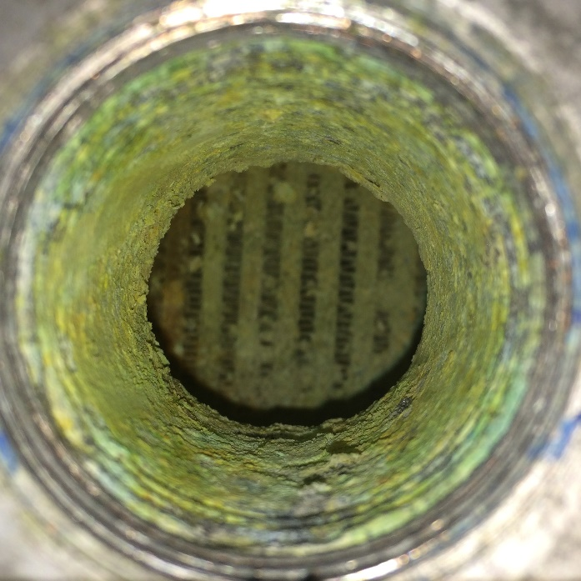
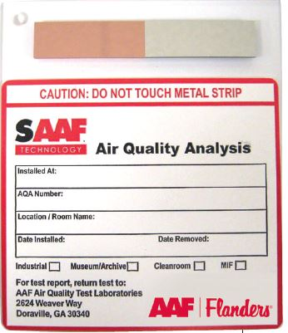
Safety and Quality in Compressed Air
Knowing your environment
Notes:
If we have acidity in the environment we will have this in a more aggressive form inside our compressed air system because we compress it mix it with water vapor and heat it up. We need to find out what the environment looks like and what is in the air the compressor sucks in before we install the equipment other wise we will see very expensive repairs in the future. Air coupons installed in the room can tell you what kind of air the compressor will suck in.

Slide 49
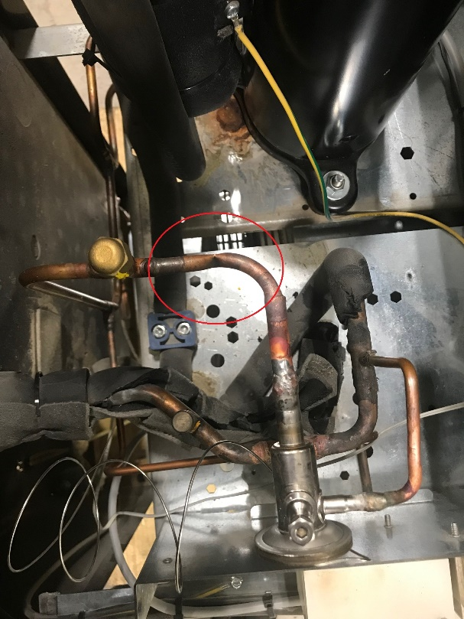

Safety and Quality in Compressed Air
Train your Service Technicians and Maintenance personal
Notes:
Untrained Service Technicians make costly mistakes but not on purpose. If we do not train service technician's we will see issues like the piped together filters what is like a bypass around the dryer for water, because of the pressure drop between this two filters. But not only the basics are important also the specialist training like refrigeration certification is important because her is where we at BEKO see the most training deficits. Technicians don’t know how equipment works and make wrong assumptions and damage the equipment even more.

Slide 50


Safety and Quality in Compressed Air
BEKO Technologies Service Training
BEKO Technologies
EPA 608 Certification Class
04/25-26/2019
BEKO Technologies
DRYPOINT X
Desiccant Dryer Training
05/14-15/2019
Notes:
BEKO Technologies offers a variety of trainings over the year to keep your technicians up to speed and always one step ahead when it comes to knowledge.

Slide 51
Safety and Quality in Compressed Air
Thank you for your attention.

Slide 52
Safety and Quality in Compressed Air: Why You Should Care
Q&A
Please submit any questions through the Question Window on your GoToWebinar interface, directing them to Compressed Air Best Practices Magazine. Our panelists will do their best to address your questions, and will follow up with you on anything that goes unanswered during this session.
Thank you for attending!
Sponsored by

Slide 53
Thank you for attending!
The recording and slides of this webinar will be made available to attendees via email later today.
PDH Certificates will be e-mailed to Attendees within two days.
Sponsored by

Slide 54
2019 Best Practices EXPO & Conference

Slide 55
2019 Best Practices EXPO & Conference
Call for Abstracts
The conference will focus on sustainable on-site utilities powering automation including compressed air, blower, vacuum and cooling systems. Presentations should encompass one or more of these themes.
Quality & Safety Management
Facility Maintenance & Reliability
Energy Savings / IoT Monitoring
Water Savings / Energy Management
  Abstract submissions are due Friday, April 12, 2019.
  Speakers receive a complimentary Conference Pass, a $675 value!
  To submit an abstract, please visit
  cabpexpo.com/conference/speakers

Slide 56


April 2019 Webinar
Techniques for Determining Savings from Aeration Blowers
Sponsored by
Tom Jenkins
JenTech Inc.
Keynote Speaker
Thursday, April 25, 2019 – 2:00 PM EST
Register for free at
www.blowervacuumbestpractices.com/magazine/webinars

