Slide 1


Selecting & Sizing Oil-Free Air Compressors
Tom Taranto, Data Power Services
Keynote Speaker
The recording and slides of this webinar will be made available to attendees via email later today.
PDH Certificates will be e-mailed to attendees within two days.
Sponsored by

Slide 2
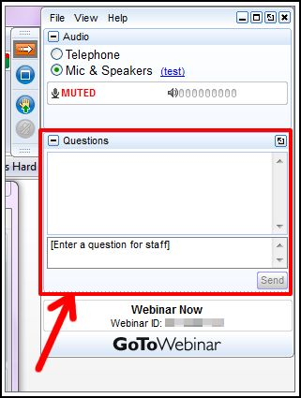
Q&A Format
Panelists will answer your questions during the Q&A session at the end of the Webinar.
Please post your questions in the Questions Window in your GoToWebinar interface.
Direct all questions to Compressed Air Best Practices® Magazine
Sponsored by

Slide 3
Handouts

Slide 4
Disclaimer
All rights are reserved. The contents of this publication may not be reproduced in whole or in part without consent of Smith Onandia Communications LLC. Smith Onandia Communications LLC does not assume and hereby disclaims any liability to any person for any loss or damage caused by errors or omissions in the material contained herein, regardless of whether such errors result from negligence, accident, or any other cause whatsoever.
All materials presented are educational. Each system is unique and must be evaluated on its own merits.

Slide 5
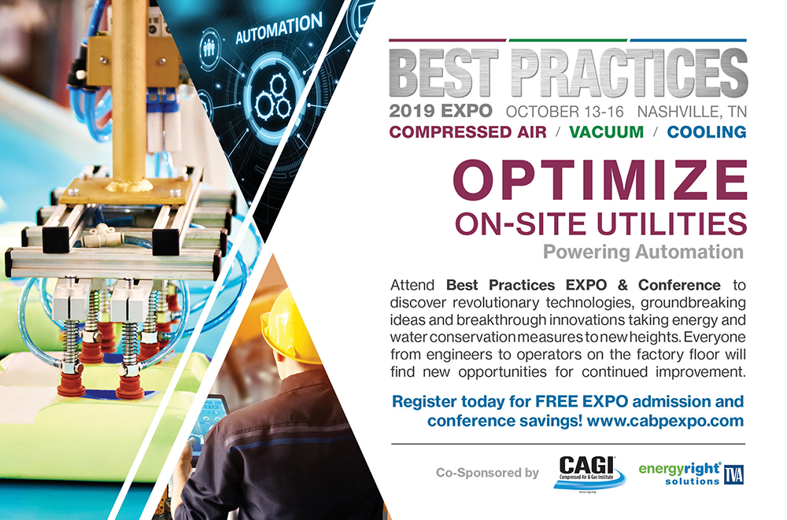

Slide 6
Selecting & Sizing Oil-Free Air Compressors
Introduction
Compressed Air Best Practices® Magazine
Sponsored by

Slide 7

About the Speaker
Owner, Data Power Services
Conducts compressed air system assessments, equipment testing and compressed air system training throughout the world with over 40 years of industry experience
U.S. DOE Energy Expert, Compressed Air Challenge technical committee member, Compressed Air Challenge qualified instructor and instructor for Qualified AIRMaster+ Specialist Training
Tom Taranto
Data Power Services
Sponsored by

Slide 8
Selecting & Sizing Oil-Free Air Compressors
June 6, 2019
Tom Taranto – Owner, Data Power Services
Notes:
Thank you to Compressed Air Best Practices and our Sponsors Nidec Motor Corporation, and Atlas Copco Compressors.
Thank you to everyone for attending this Webinar titled Selecting & Sizing Oil-Free Air Compressors.

Slide 9
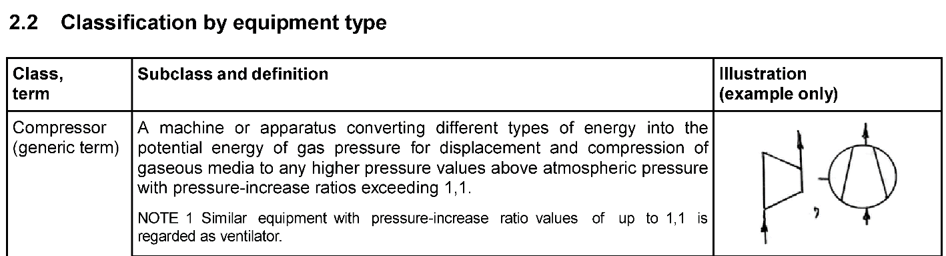
Compressors – Classification
ISO 5390 First edition – 1977-05-01
ISO/TR 12942 Technical Report 2012-09-01
  Pressure-increase ratios > 1,1
  14.5 psia x 1.1 = 15.95 psia → > 1.45 psig
Notes:
So, let’s start by defining an air compressor; which is classified by ISO as a machine that increases pressure of a gas having pressure ratios exceeding 1.1. So that’s about 16 psia or 1.5 psig. This range includes machines that are more commonly called blowers like regenerative or lobe style blowers as well as air compressors.
Compressor classifications are defined in ISO Standard 5390 combined together with ISO Technical Report 12942.
Compressors are defined as having pressure ratios greater than 1.1

Slide 10


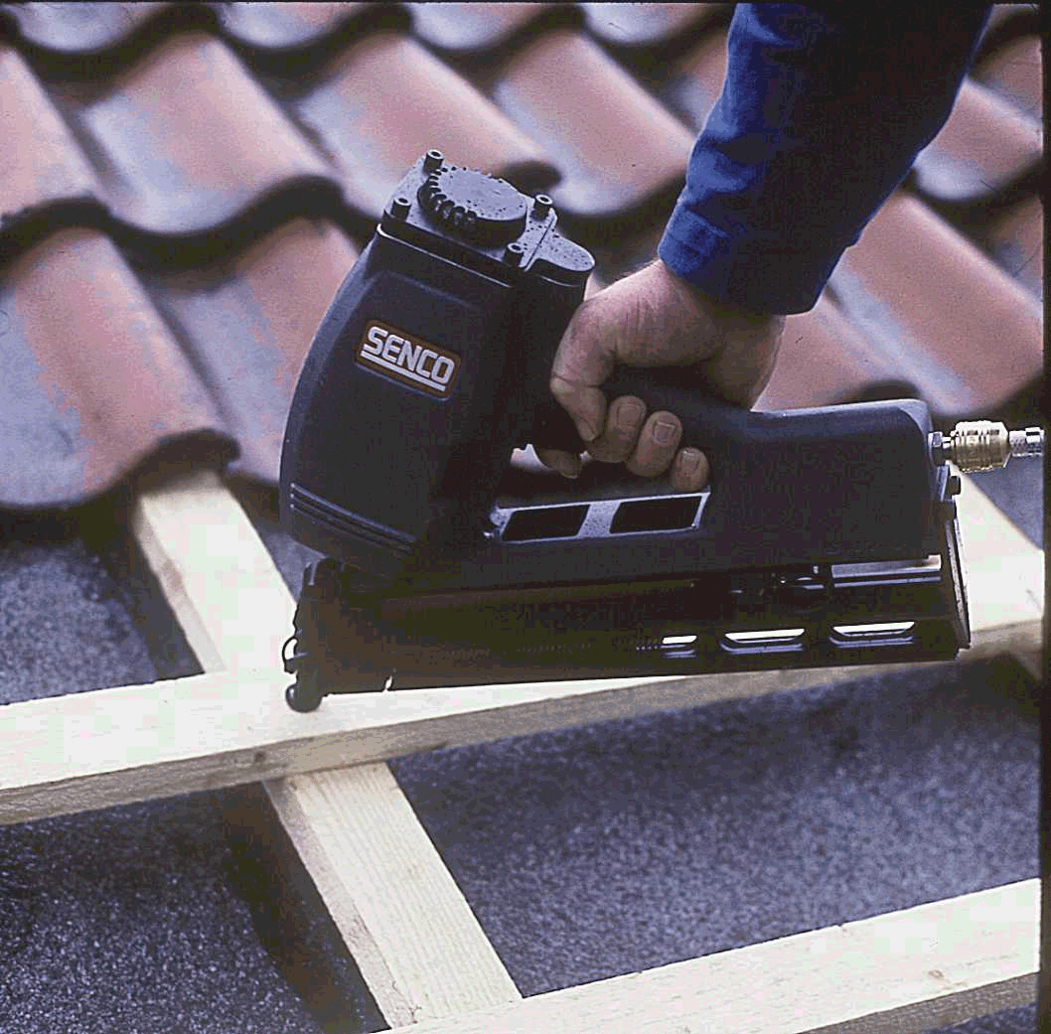
Compressed Air Primary Uses
Process
  Air is Consumed for Combustion,
  Oxidizing Agent, Biochemical
  Oxygen Demand BOD
Control
  Start / Stop and Control Equipment
Work
  Perform Work powering machinery,
  and tools
Notes:
What are the uses of compressed air? Process applications consume air for its oxygen content. Compressed air is also used to start / stop and control equipment. And perhaps most commonly in the industrial setting to perform work, powering tools and machinery.
Compressed air essential to the operation of modern industrial manufacturing plants. There are three basic ways that compressed air is used:
Process applications may use compressed air oxidation of organic compounds BOD Biochemical Oxygen Demand, or as an oxidizer in chemical process.
Powering equipment- as an energy source for example operating a drill or grinder, or powering a packaging machine.
For packaging machinery the end use conversion of pneumatic energy to work is often a pneumatic cylinder, or air motor.
However, it may be a rotary actuator, or venturi, a blowing nozzle, or many other devices that consume compressed air for the purpose of converting the pneumatic energy to do work.
Control applications can use compressed air to perform analog or digital operations as in Fluidics or Fluid Logic systems.
Compressed air is often considered to be a utility just like water and electricity.
It should be recognized that compressed air is often a critical process variable.
There are many Instances where compressed air use directly impacts production.
Compressed air performance may affect production rate, product quality, cost of scrap or rework and ultimately customer satisfaction.
To optimize system performance:
Understand how compressed air system supports productive air demands and eliminate waste.

Slide 11
Compressed Air Application Requirements
Air Pressure
  1.5 psig … 150 psig
Air Flow
  10’s … 100’s … 1000’s
    up to 5000 cfm
Air Quality
  Contaminates – Dirt… Water & Oil
    “Oil-Free”
Notes:
So for today the air compressors we’re discussing operate from 1.5 to 150 psig while delivering 10’s.. 100’s.. or even 1,000… of cubic feet per minute. As for air quality we talk about contamination from dirt, water, and oil. Today we’re focusing on “Oil-Free Air Compressors”
What is the require air pressure? Today we’re going to consider the range from 1.5 to 150 psig.
What is the air flow consumption? We’re going to look at the range up to 5,000 cfm.
What is the air quality requirement? Air quality according to the ISO Standard 8573 covers Dirt, Water, and Oil Contamination.
Since we’re discussing application of oil free compressors we’re going to only look at oil contamination.

Slide 12
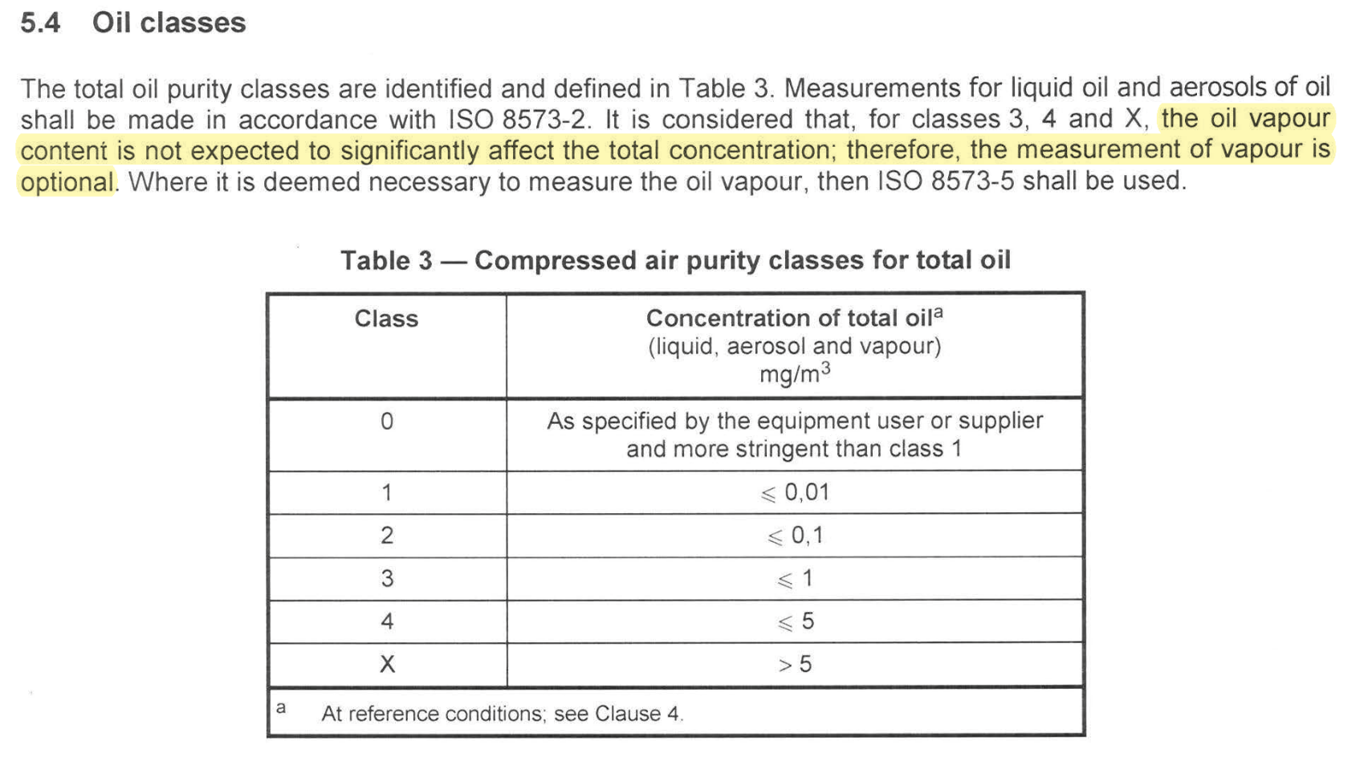
Air Quality – ISO 8573-1:2010(E)
Oil – Free Compressed Air: Purity Classes for total oil
Notes:
But what is “Oil-Free”? The ISO 8573 Air Quality Standard deals with Dirt, Water, and Oil and we are most interested in Purity Classes 1 - 4 and X for total oil content. Each class is described by a limit of total oil content in (mg/m3). You’ll also notice there is class Zero which is specified by the equipment user with a total oil content more stringent that You’ll notice that the measurement of oil vapor is “optional”.
There are varying degrees of oil or hydrocarbon contamination that can exist in compressed air.
The International Organization for Standardization ISO has a Standard to classify compressed air quality ISO 8573.
The standard has a total of 9 parts addressing various contaminants.
The basic contaminants discussed in ISO 8573-1 are as was mentioned before are
Dirt or particulates,
Water including liquid water and water vapor, and
Oil including liquid oil and oil aerosol content.
Today we are focused on “Oil – free air” so what does “oil – free mean in your application.
Purity classes are defined by concentration of liquid oil and oil aerosols from 5 mg/m3 Class 4 to 0.01 mg/m3 Class 1.
Notice that measurement of vapor and organic solvents is optional. Measuring Vapor is in Part 5 pf ISO 8573.
Part 6 is measurement methods for gaseous contaminates.
If requirements are more stringent than Class 1. That’s where Class Zero comes in.
For example oil vapor is considered optional, the allowable level must be specified to define Class 0, and testing is per ISO 8573-5.

Slide 13
Air Quality – ISO 8573-1:2010(E)
Class 0 – As specified by the equipment user or supplier and more stringent than Class 1
  Part 5: Test methods for oil vapour and organic solvent content
  Part 6: Test methods for gaseous contaminant content
  Part 7: Test method for viable microbiological contaminant content
Notes:
This is why there is a Class 0 comes in. When it comes to requirements more stringent for Class 1 there are test methods for oil vapor, gaseous, and microbiological contamination. Parts 5, 6, and 7 discuss test methods for these less common contaminates.

Slide 14
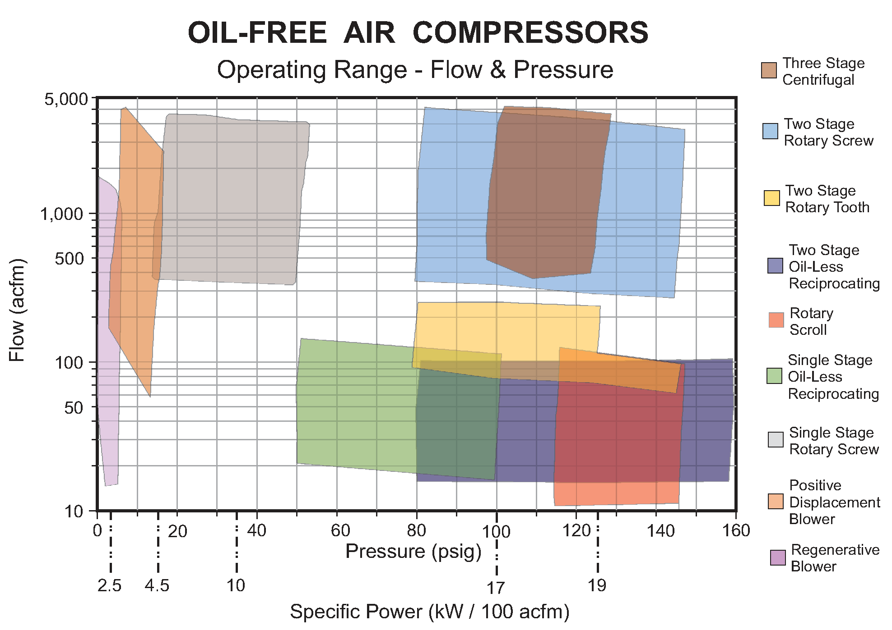
Selecting Compressed Air Flow & Pressure Range
Notes:
As we begin the oil-free compressor selection process, we need to know the required pressure. In this range chart air pressure along the X Axis ranging from 1.5 to 150 psig with air flow rate up to 5000 cfm as shown on the chart’s Y-Axis. Also, on the X-axis we show that the compressed air supply efficiency may range from 2.5 kW / 100 cfm at lower operating pressure up to 19 or 20 Kw/100 cfm in the “typical” 100 psig range. With that much variation in specific power we need to choose an air compressor That most closely matches our pressure requirement.

Slide 15
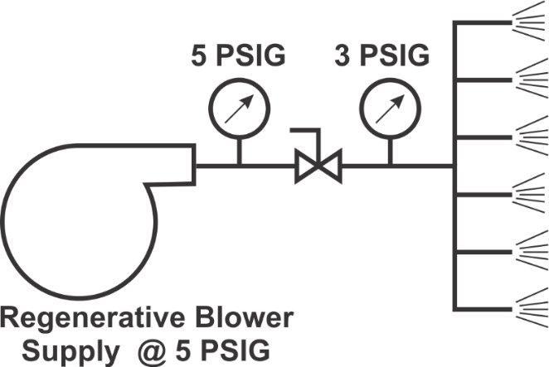
Optimize Flow & Pressure Source
Glass Chip Blowing - $ 50,300 / yr. Savings
Current Method
$76,000 / yr.
12 SCFM per nozzle ➔ 72 SCFM Total
8 Lines = 576 SCFM ➔ 128 Hp
Power Used 95 kW; 8,000 Hrs / yr.
760,000 kWH @ $ 0.10 / kWH
Regenerative Blower Method
$ 25,700 / Yr.
12 SCFM per nozzle ➔ 72 SCFM Total
8 Lines = 576 SCFM ➔ 43 Hp
Power Used 32 kW; 8,000 Hrs / Yr.
257,000 kWH @ $ 0.10 / kWH
65
Notes:
Here’s an example where compressed air is used to clean the product. Using 12 cfm per nozzle blowing from 6 nozzles and 8 production lines totals 576 cfm supplied from a 100 psig air compressor. Annual electrical energy cost is $76,000 (at $0.10 / kWh). Supplying the same amount of compressed air from regenerative blowers at 5 psig costs $25,700 / year, an annual savings for over $50,000.
100 psig air supply was controlled with a ball valve delivering 3 psig at the blowing nozzles.
95 kW at a cost of $76,000 / yr. assuming $ 0.10 / kWh
Regenerative blowers 32 kW at a cost of $27,500 / yr.
Savings $50,300 / yr.

Slide 16
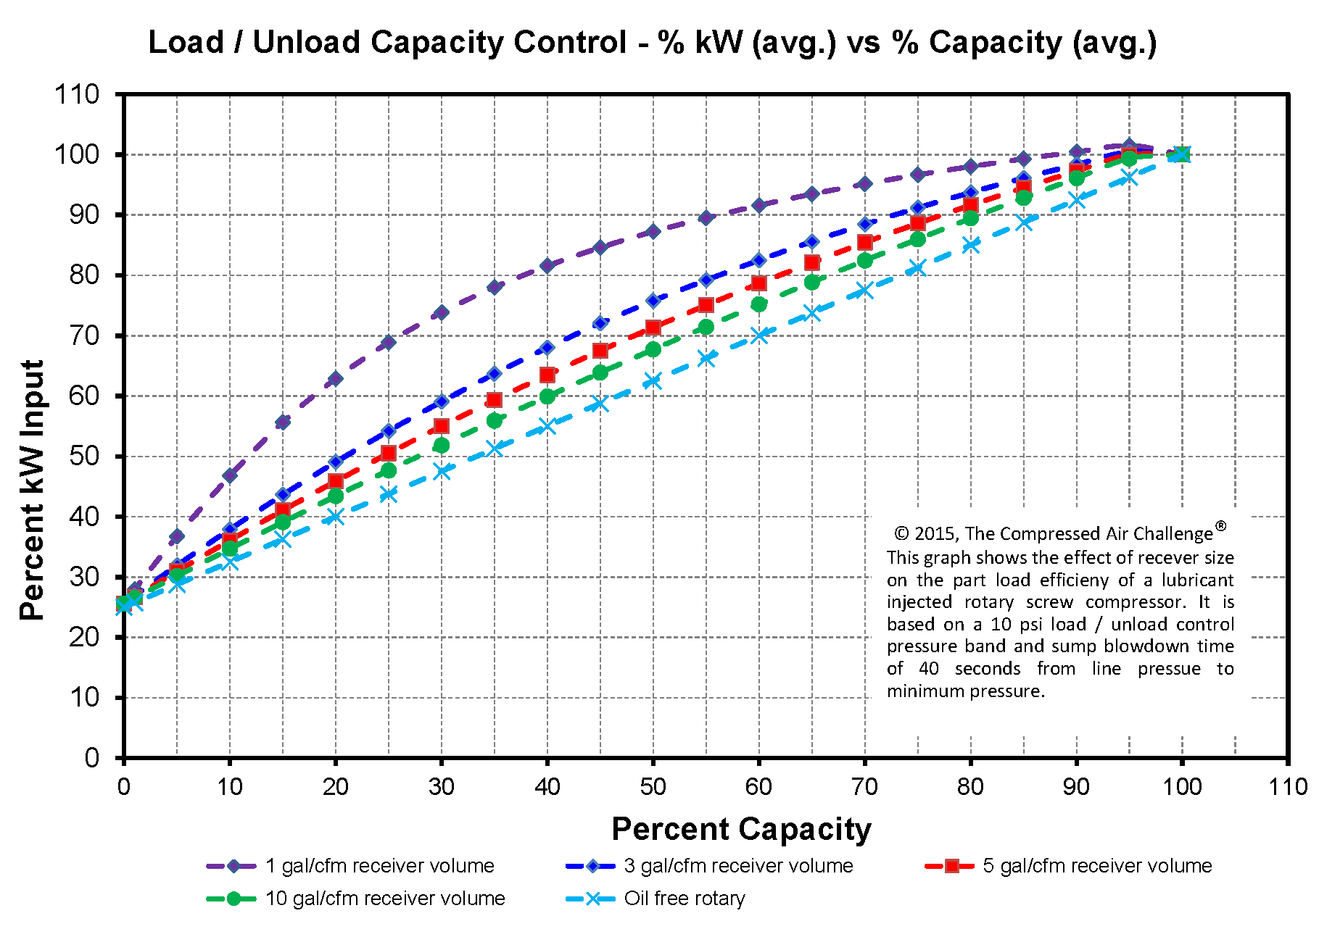
Control Strategy – Load / UnLoad Capacity Control
Notes:
The Control Strategy used is impacts energy use, particularly when multiple compressors are used. The curve shown here is for load / unload control and shows a family of curves based. The change in part load power is dependent on the sump blowdown time and how quickly the compressor loads and unloads. These curves apply only to lubricant injected compressors. For Oil-free compressors the power decreases to the unload power all most immediately when the compressor unloads.
We also need to develop an efficient control strategy.
Oil free rotary screw compressor have two control alternatives, Load / unload and VSD/
These part load capacity control curves for load / unload control apply only to lubricant injected rotary screw air compressors.
The change in part load power is dependent on the compressor’s sump blow-down time.

Slide 17
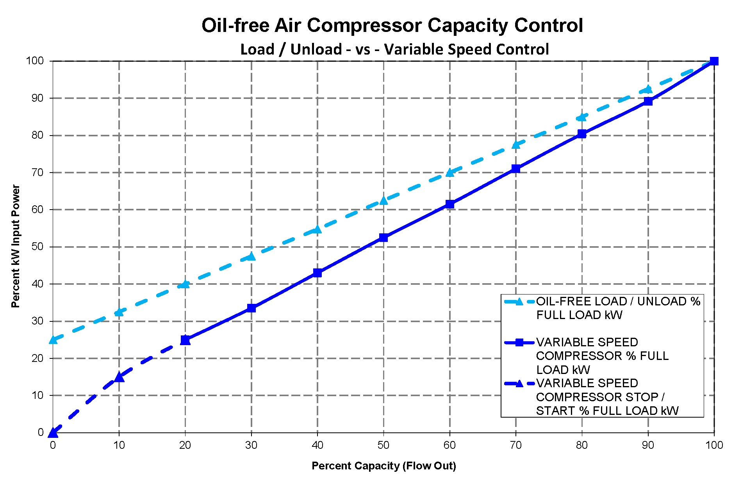
Oil-Free Compressor Control
Notes:
Two control methods are available for Oil-Free rotary screw compressors. They are Load / Unload and Variable Speed Drive. Comparing capacity control curves, we see that VSD has the best part load power characteristics. However, through much of the range the power difference is much less than can be associated with lubricant injected compressors. When combining VSD and Fixed Speed compressors it is important to consider the compressor size and possible control gap issues.
Oil-Free compressors do not have an oil separator / sump so when an Oil-Free rotary screw compressor unloads the power decreases to unloaded power almost immediately.

Slide 18
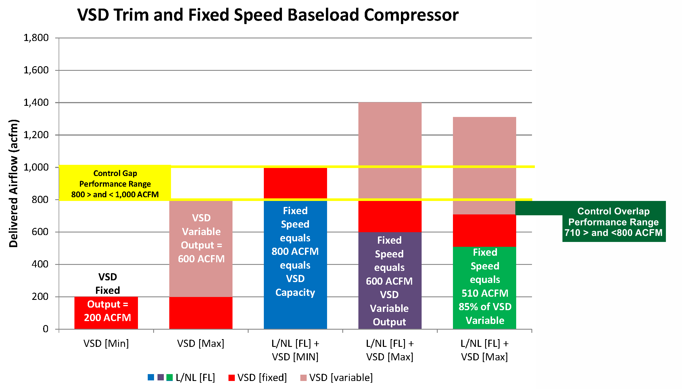
Control Gap in Variable Speed Control
Notes:
When combining VSD control with fixed speed load / unload compressors we need to be concerned and avoid creating a control gap.

Slide 19
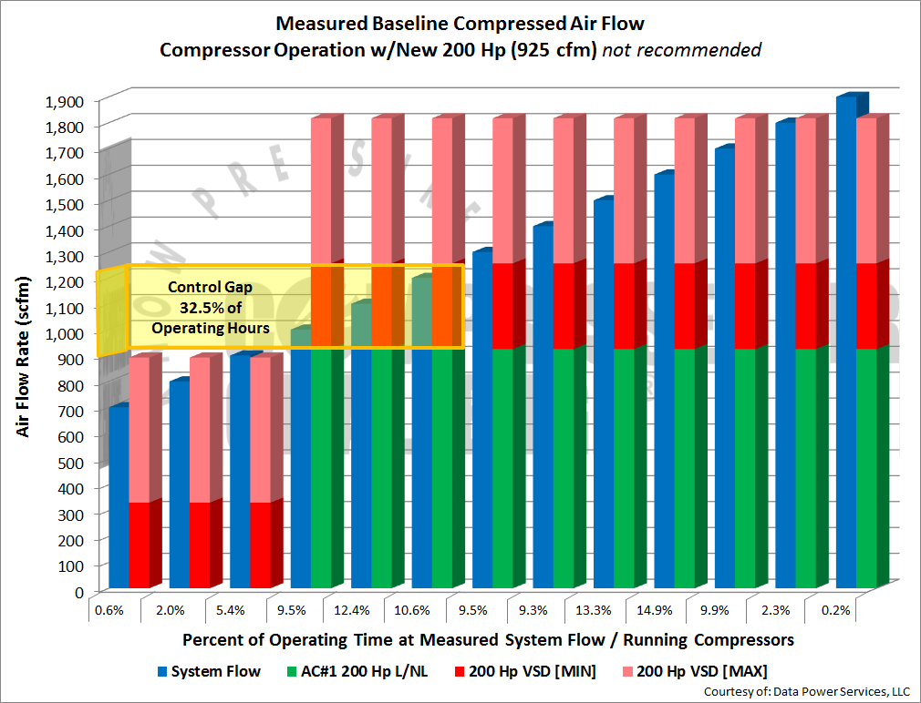
Control Gap in Variable Speed Control
Notes:
If there is going to be a control gap, or a range of less than optimal performance it should be in a range of capacity that is seldom found in the present airflow profile.

Slide 20
Demand Profile – Histogram of Baseline Flow
Notes:
Flow profile data can be evaluated using a histogram.

Slide 21
Selecting & Sizing Oil-Free Air Compressors
Four steps in selecting & sizing oil-free air compressors
  Match the compressor type to the required pressure.
  Determine air quality and define what “Oil-Free” means.
  Implement an efficient control strategy.
  Select compressor sizes that align with the demand profile.

Slide 22


About the Speaker
Product Marketing Manager – Medium Pressure Oil-free Screw Compressors, Atlas Copco Compressors
Leo Di Bello
Atlas Copco Compressors

Slide 23
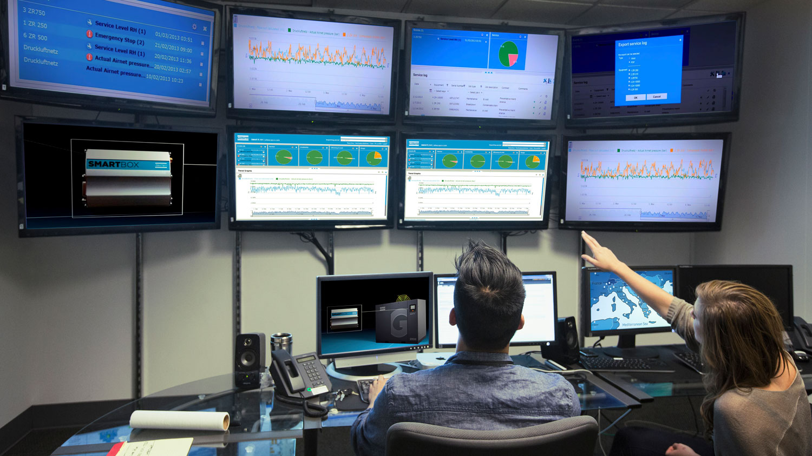
What to consider when purchasing a variable-speed oil-free screw compressor
Leo Di Bello, Product Marketing Manager

Slide 24
Variable Speed Drive Compressors
Oil-free screw compressors
Is a variable-speed or variable-frequency drive compressor the best solution?
Notes:
Variable speed drive is generally touted as the best “type” of compressor. In fact, to such an extent that historically and still today, power utilities in provinces and states have offered generous rebates for their purchase, and I can think of at least one state namely, California that has legislated – Title 24 - the use of a variable-speed compressor as the lead compressor for new construction whereby the application requires greater than 25 hp .

Slide 25
Variable Speed Drive Compressors
Oil-free screw compressors
The best solution - regarding the type of compressor regulation - depends on the demand profile. Usually there’s a good fit for variable-speed drive in many profiles.
Notes:
The best solution - regarding the type of compressor regulation - depends on the demand profile. Usually there’s a good fit for variable-speed drive in many profiles.

Slide 26
Variable Speed Drive Compressors
Oil-free screw compressors
Ideally, an audit of a current system is the best way to determine the existing demand profile. With this information one can then review the options available and make an informed decision to determine the best solution.
Notes:
Ideally, an audit of a current system is the best way to determine the existing demand profile. With this information one can then review the options available and make an informed decision to determine the best solution. Naturally, constant loads are best suited for the fixed-speed compressor while the variable-speed compressor can manage the varying loads.

Slide 27
Variable Speed Drive Compressors
Pitfalls
What are the pitfalls?
Notes:
So, what do we need to consider when purchasing a variable-speed compressor? Not all compressors are designed the same. What are the potential pitfalls? Let’s have a look. I have five that come to mind.

Slide 28
Variable Speed Drive Compressors
Pitfalls
What are the pitfalls?
Turndown
Notes:
Turndown.
As mentioned earlier, not all variable-speed drive compressors are created equal. Some have greater turndown capability while others have less.
Therefore, it’s important to understand the plant’s demand profile and choose a compressor with the best suitable operating range.

Slide 29
Variable Speed Drive Compressors
Pitfalls
What are the pitfalls?
Turndown
S.E.R.
Notes:
The second pitfall is…
The specific energy ratio or specific energy consumption – usually expressed in kW/100 cfm. While the ability of regulating the speed of the compressor to match demand is for the most part inherently more efficient for varying demands, it’s important to choose a compressor that has the best performance for the range in consideration. This can be accomplished by comparing the SER curves from different compressor brands. In order to compare apples-to-apples, it is recommended to request a CAGI datasheet from the manufacturer. Most compressor manufacturers participate in CAGI’s verification program. This is an asset for the wise purchaser whereby he or she can compare specifications on a more equal footing.

Slide 30
Variable-Speed Drive Compressors
SER Performance curves
Notes:
Per the first two pitfalls mentioned namely, “Turndown” and “SER”, Let’s have a look at an example of 5 performance curves from 5 different 200 hp oil-free screw compressors, A,B,C,D and E.
We clearly see -as exemplified in this graph - that the design performance is very different between these 5 machines. Compressor B clearly out runs the others with best turndown performance and lowest energy consumption. At the extreme, compressor B is 17% more efficient as compared to compressor C.
When we consider that over 75% of the lifecycle cost is due to power consumption, differences in energy consumption can amount to substantial cost savings. This is an important criteria to consider when comparing the compressors for purchase as any differences will pale in comparison with the savings in life-cycle cost.

Slide 31
Variable Speed Drive Compressors
Pitfalls
What are the pitfalls?
Turndown
S.E.R.
Speed windows
Notes:
Pitfall No. 3. Speed windows.
Speed windows. A speed window is basically a range of frequency whereby a compressor is allowed to run while avoiding operating ranges that cause resonance. To provide an analogy this is similar to a wheel balance problem while driving a car. Most of us have experienced this phenomena when excessive vibration is felt at specific driving speeds and we notice that the vibration goes away when either driving faster or slowing down. Hence, a window of operation.
Compressors cannot or should not operate at resonant frequency. This may sound obvious. However, some resonant frequency can occur at the micrometer lever where it’s inconspicuous. Although inconspicuous, if operating in this range, the resonant component is condemned to premature failure thereby compromising reliability. Moreover, if speed windows are used in between ranges, this only exasperates or compounds the effect on control gap mentioned earlier.
Therefore, look for a compressor that has been designed from the ground up for variable-speed drive within its claimed operating range. No speed windows!

Slide 32
Variable Speed Drive Compressors
Pitfalls
What are the pitfalls?
Turndown
S.E.R.
Speed windows
External frequency drives
Notes:
No. 4 – External frequency drives.
The use of external frequency drives for compressors that have not been designed for variable-speed drive are for the most part limited in operating range and will not provide the best turndown capability and in addition, as mentioned in the previous slide, either the manufacturer limits its operating range or programs speed windows.
In addition, one should also consider the extra installation cost as the required shielded cabling to minimize interference is quite costly.

Slide 33
Variable Speed Drive Compressors
Pitfalls
What are the pitfalls?
Turndown
S.E.R.
Speed windows
External frequency drives
Drive motor
Notes:
And lastly, No. 5 – The drive motor.
Variable drives not only can cause mechanical resonance to the compressor’s structure but also induce unwanted currents that can pit bearings and consequently induce bearing failure. Therefore, it is important that variable-speed compressors use drive motors designed for inverter duty with the necessary shielding to avoid premature bearing failures and also have the necessary cooling capability for operation at lower speeds. If required cooling at lower speed is not adequate, the drive motor will lose its magnetism and hence its torque ability which will result in compressor shutdown.

Slide 34
Thanks for your participation
Notes:
To conclude. Not all VSD compressors are created equal. Understand your air-demand profile and choose the best fit in performance and reliability.

Slide 35


About the Speaker
Director of Product Management, Nidec Motor Corporation
has held various positions in marketing for Nidec Motor Corporation and Emerson Motor Company over the last twenty-two years, including Product-line Manager for NEMA motors
Senior Member of IEEE
spent 12 years active and reserves as a U. S. Navy officer and was a qualified operating engineering officer
Tim Albers
Nidec Motor Corporation

Slide 36

Choosing the Right Compressor Motor
Tim Albers – Director of Product Management
6 June 2019

Slide 37
Choosing the Right Motor – Factors to Consider
Critical characteristics for design
Compressor enclosure versus open mounting
  Other environmental conditions
Electrical Design
  Motor starting
  Efficiency requirements
  Voltage variation allowance/tolerance
Fixed versus variable speed
2

Slide 38
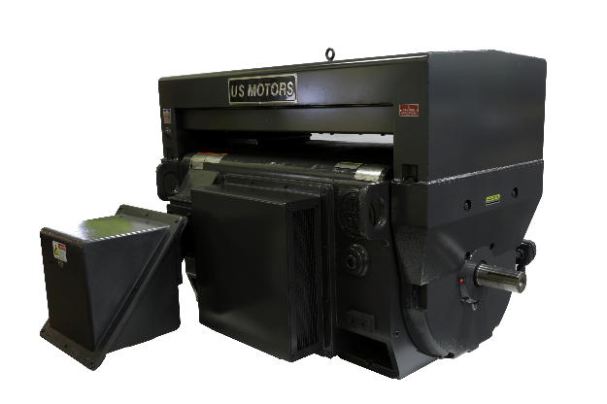
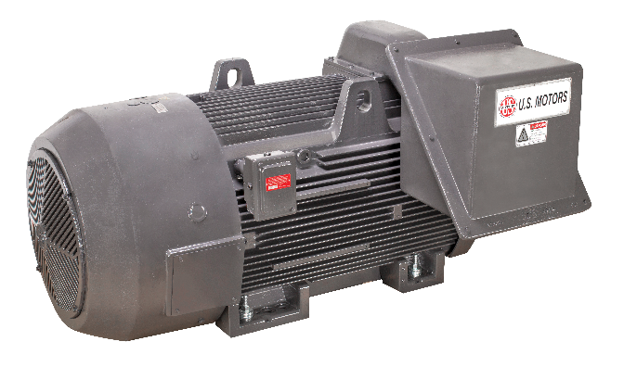
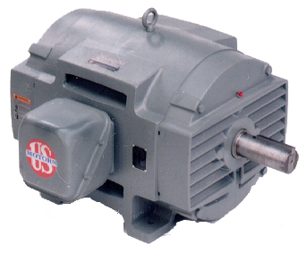
Choosing the Right Motor – Environmental Condition
Compressor enclosure versus open mounting
  Other environmental conditions
The enclosure drives many motor factors including:
  Ambient temperature of the motor – will affect motor size and bearing selection
  Motor enclosure choice from ODP (IP21) up to TEFC (IP55) with a great deal of variation in motor size, weight and cost
  ODP can size and weigh half as much versus the TEFC option
ODP (WP1)
WP2
TEFC
3

Slide 39
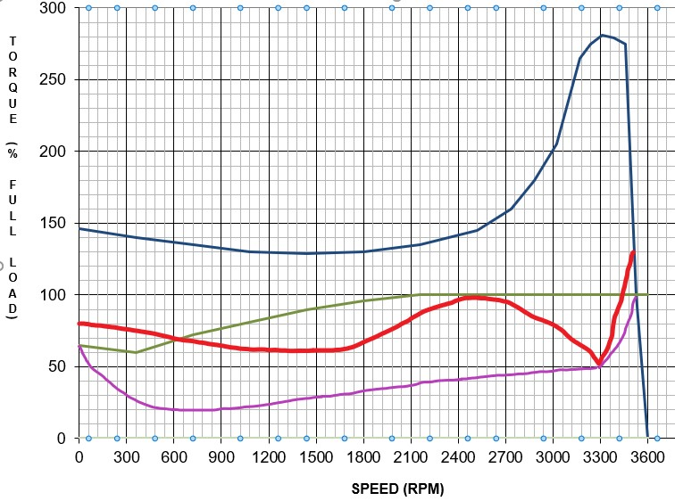
Choosing the Right Motor – Electrical Design
The motor design for the compressor varies based on:
  Motor starting
    Compressor start profile or loading
    Starting method
      Across the line
      Wye(star) start – delta run
      VFD
  Enclosure thermals
  Voltage variance allowance
  Required efficiency - legislation
  The motor design varies to accommodate or best fit
    Not as simple as just one choice, all of the above comes into play in choosing the design which determines the frame/size of the motor and critical performance
Change to VFD makes motor choice easier and harder
Standard Motor Start Profile
Loaded Compressor Start Profile
Wye/Delta Motor Start Profile
Unloaded Comp. Start Profile
4

Slide 40
Variable Speed
The EASIER: Variable speed makes starting a non-issue as the VFD can control the torque and speed through the starting cycle
The HARDER: Variable speed does add many other questions and items that must be taken into consideration
5

Slide 41

Inverter Duty Motor Features
Inverter Duty Motor Checklist
Feature | Benefit
Inverter Duty per NEMA® MG-1 Part 31 | Motor windings better able to withstand electrical stress induced by VFD pulses
Motor Shaft Grounding Ring and Insulated Motor Bearings | Protects motor and pump bearings by shunting VFD induced shaft currents to ground Minimizes bearing fluting caused by VDF induced motor shaft currents (larger HP)
Motor thermally capable of slow speed operation | Enhanced electrical design allows for low temperature rise even at lower speeds
Motor Winding Thermal Protection | Added protection against VFD induced motor heating
Space Heater | Reduces condensation that can lead to motor winding failures and lubricant contamination
Always be cautious to apply a VFD on a fixed speed compressor application as they will not have these features
6

Slide 42
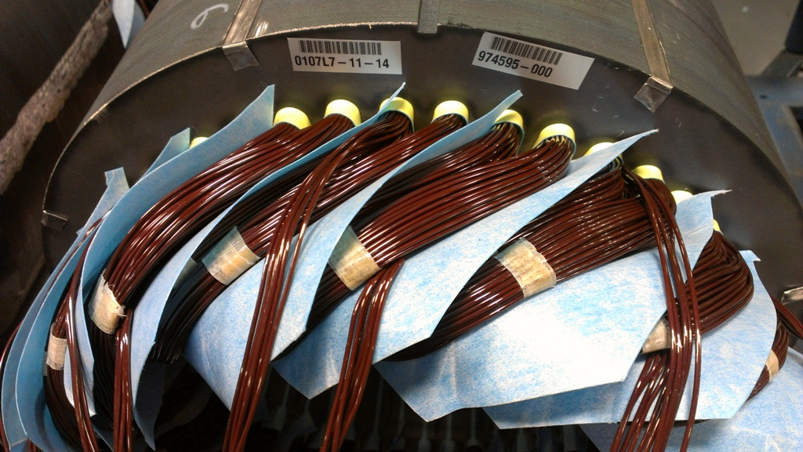
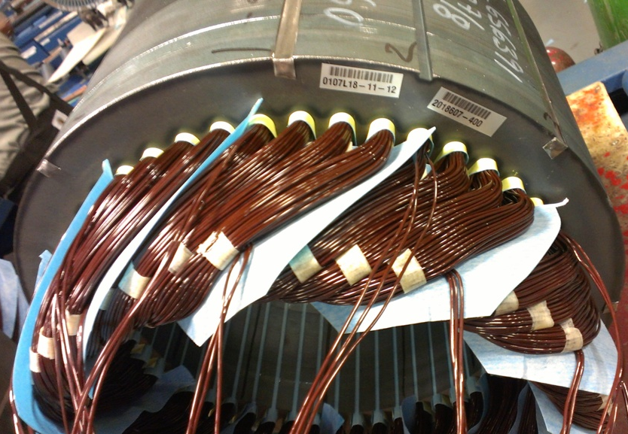
Inverter Duty per NEMA® MG-1 Part 31 for VFD
Phase paper is installed between every coil group instead of each phase
Use of Inverter Wire to minimize winding issues
Optimized winding for inverter operation
7

Slide 43
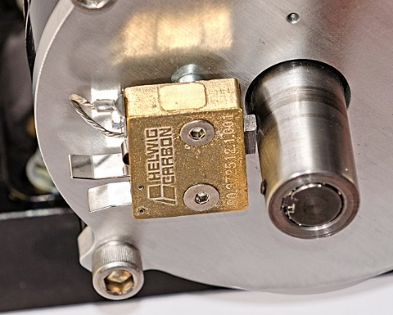
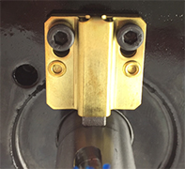
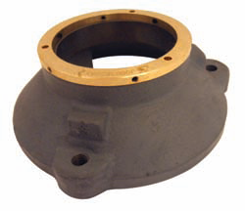
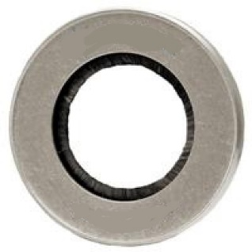
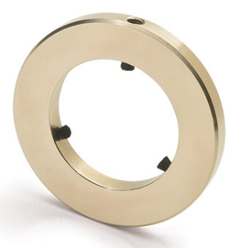
Bearing Protection for VFD
Shaft grounding device (ring or brush)
  Low resistance path to ground through motor frame
  Internal or externally mounted
Insulated bearing on opposite drive end on larger HP
Shaft Grounding brushes
Shaft Grounding rings mounted on a bearing cap
Shaft Grounding rings
8

Slide 44
Optimized Electrical Design for VFD
Low Loss Steel and Maximized Material Content
  Low thermal rise at rated RPM
  Wider speed range
  Maximized Torque
Enhanced Low Vibration Rotor Assemblies
  Minimize motor and equipment vibration
  Helps to minimize motor noise
  .08 ips or lower peak to peak maximum vibration
  Improved overspeed performance
Thermal Protection
9

Slide 45

10

Slide 46
Selecting & Sizing Oil-Free Air Compressors
Q&A
Please submit any questions through the Question Window on your GoToWebinar interface, directing them to Compressed Air Best Practices Magazine. Our panelists will do their best to address your questions, and will follow up with you on anything that goes unanswered during this session.
Thank you for attending!
Sponsored by

Slide 47
Best Practices EXPO Contest
Play for a chance to win a FREE Full Conference Pass to the 2019 Best Practices EXPO & Conference!! This is a $675 value! This contest is open to factory personnel, compressed air distributors, utility incentive programs and engineering firms. Exhibiting and sponsor companies are not qualified. A winner will be randomly selected from those who submit correct answers and notified tomorrow via email and phone.
The next slide will show a statement related to today’s topic that needs to be filled in. You will be provided the first letter of the words as a clue. Please submit your answers in your questions box.
Example
When I think of a beach vacation, I think of _______.
T____
T___ B___
S___ S_____

Slide 48
Best Practices EXPO Contest
Play for a chance to win a FREE Full Conference Pass to the 2019 Best Practices EXPO & Conference!! This is a $675 value! This contest is open to factory personnel, compressed air distributors, utility incentive programs and engineering firms. Exhibiting and sponsor companies are not qualified. A winner will be randomly selected from those who submit correct answers and notified tomorrow via email and phone.
The next slide will show a statement related to today’s topic that needs to be filled in. You will be provided the first letter of the words as a clue. Please submit your answers in your questions box.
Example
When I think of a beach vacation, I think of _______.
TOWEL
TIKI BAR
SEA SHELLS

Slide 49
Best Practices EXPO Contest
Play for a chance to win a FREE Full Conference Pass to the 2019 Best Practices EXPO & Conference!! This is a $675 value! This contest is open to factory personnel, compressed air distributors, utility incentive programs and engineering firms. Exhibiting and sponsor companies are not qualified. A winner will be randomly selected from those who submit correct answers and notified tomorrow via email and phone.
Based on the clues below, please submit your answers in your questions box.
When I think of oil-free air compressors, I think of _______.
A__ Q______
C____ Z___

Slide 50
Best Practices EXPO Contest
Play for a chance to win a FREE Full Conference Pass to the 2019 Best Practices EXPO & Conference!! This is a $675 value! This contest is open to factory personnel, compressed air distributors, utility incentive programs and engineering firms. Exhibiting and sponsor companies are not qualified. A winner will be randomly selected from those who submit correct answers and notified tomorrow via email and phone.
Based on the clues below, please submit your answers in your questions box.
When I think of oil-free air compressors, I think of _______.
AIR QUALITY
CLASS ZERO

Slide 51
Thank you for attending!
The recording and slides of this webinar will be made available to attendees via email later today.
PDH Certificates will be e-mailed to Attendees within two days.
Sponsored by

Slide 52


June 2019 Webinar
Understanding Flow for Proper Vacuum Pump Sizing
Sponsored by
Tim Dugan
Compression Engineering Corporation
Keynote Speaker
Thursday, June 27, 2019 – 2:00 PM EST
Register for free at
www.blowervacuumbestpractices.com/magazine/webinars

