Slide 1
The “Unofficial 3 Levels” of Compressed Air Best Practices® Systems
Rod Smith, Compressed Air Best Practices
Publisher
The recording and slides of this webinar will be made available to attendees via email later today.
PDH Certificates will be e-mailed to attendees within two days.

Slide 2
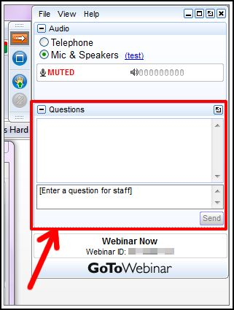
Q&A Format
Panelists will answer your questions during the Q&A session at the end of the Webinar.
Please post your questions in the Questions Window in your GoToWebinar interface.
Direct all questions to Compressed Air Best Practices® Magazine

Slide 3
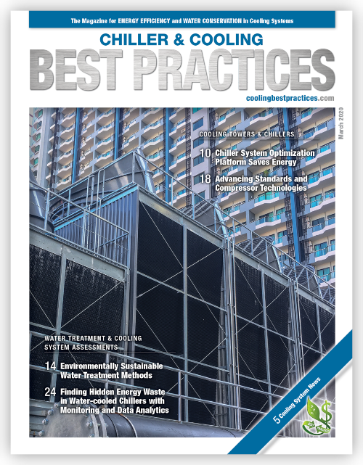
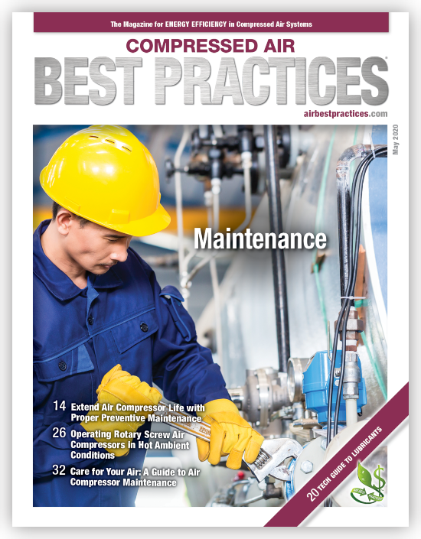
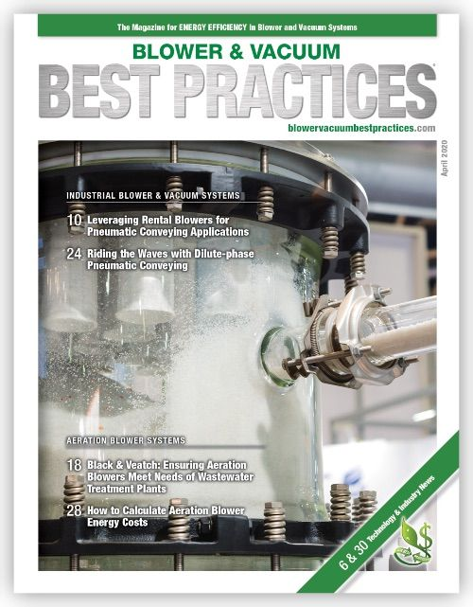
Handouts

Slide 4
Disclaimer
All rights are reserved. The contents of this publication may not be reproduced in whole or in part without consent of Smith Onandia Communications LLC. Smith Onandia Communications LLC does not assume and hereby disclaims any liability to any person for any loss or damage caused by errors or omissions in the material contained herein, regardless of whether such errors result from negligence, accident, or any other cause whatsoever.
All materials presented are educational. Each system is unique and must be evaluated on its own merits.

Slide 5
The “Unofficial 3 Levels” of Compressed Air Best Practices® Systems
Introduction
Compressed Air Best Practices® Magazine

Slide 6

About the Speaker
2006- Present: Publisher, Compressed Air Best Practices® Magazine
1992-2006: Former VP Sales & Marketing, Quincy Compressor and SPX Hankison
Rod Smith
Compressed Air Best Practices

Slide 7
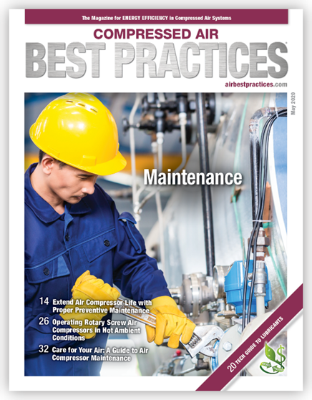
Compressed Air Best Practices® Magazine
Chiller & Cooling Best Practices Magazine
Blower & Vacuum Best Practices Magazine
Rod Smith, Publisher
Mission: to help Industry be more Sustainable
* Reduce utility bills for kW and H₂O per unit manufactured- “Energy/Water Intensity Improvements”
* Improve Process Quality, Reliability, Through-put

Slide 8
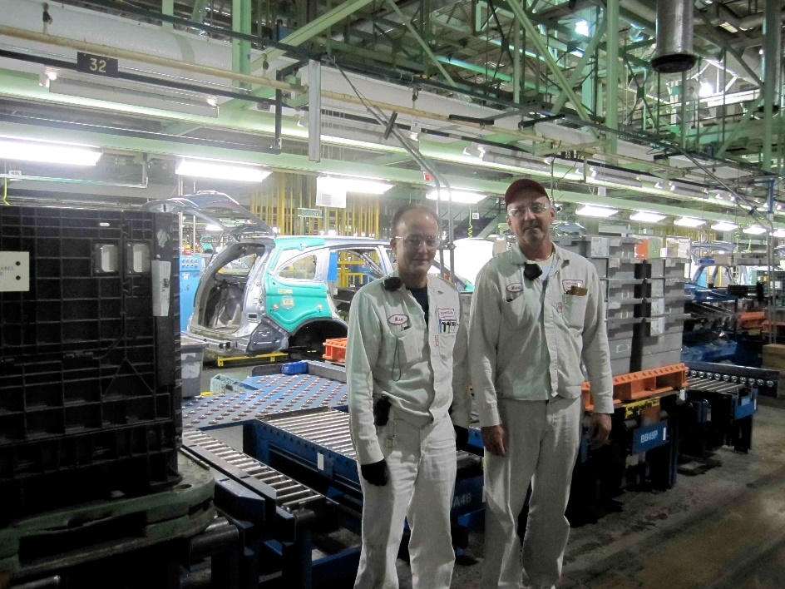

Compressed Air Systems Evolve in Plants
Idea of categorizing the journey into “Phases” or “Levels”
  Former Editorial Board Member Mike Seiter, Honda, RIP
Honda of America
East Liberty, Ohio
Compressed Air System Evolution
Phase 1 (late 1990’s)
5 x 1000 hp, 450 hp trim, pressure 135 psig
Phase 2 (2002-today)
2 x 1000 hp, 450 hp trim, pressure 105 psig

Slide 9
Compressed Air Systems Evolve in Plants
New Editorial Board Member John Bilsky, MWS, CCAS,Facilities Specialist, Gentex Corporation
Article published in Compressed Air Best Practices Magazine
“15 Years of Compressed Air Best Practices Support Gentex Business and Production Goals”
2004: Back-up air compressors mandatory
2005: Flow meters on production lines
Each year moving multiple plants to “new levels” of “Best Practice” concepts continues today!
2012: Gentex added larger compressed air storage tanks to its operations for increased compressed air storage.

Slide 10
Discussion Today: Is it Useful to Categorize Plants in “Levels” of “Best Practices”?
3 Levels of Compressed Air Systems – An Example
What % of Plants Fall into Each Level?- Please fill in Survey at end
Level 2: Supply-Side Optimization - Key Performance Indicator (KPI) Management/Measurement
Level 3: Demand-Reduction Projects with Supply-Side KPI Management/Measurement
Level 1: Reliable Pressure, Flow and Quality
How would you define "3 Levels"? - Please fill in Survey

Slide 11
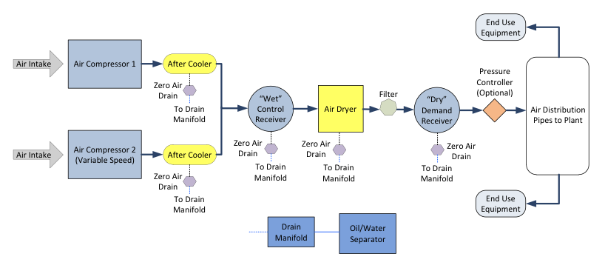
Level 1: Reliable Pressure, Flow and Quality
Inventory / Diagram of all System Components
Box Diagram of compressed air system- recommended by
Level 1 Compressed Air Challenge course
Know what your Own and Why – i.e. “are all those downstream filters necessary?”

Slide 12
Level 1: Reliable Pressure, Flow and Quality
Preventive Maintenance Plan for all System Components
Downtime is unacceptable-one won’t be around for long!
Air Compressors: one of the highest Maintenance ROI’s available – enable LONG LIFE, RELIABILITY and PEAK PERFORMANCE

Slide 13
Level 1: Reliable Pressure, Flow and Quality
Preventive Maintenance Plan for all System Components
Compressed Air Purification-MOISTURE AND OIL CAN STOP PRODUCTION: Aftercoolers, drains, dryers, filters, tanks, oil-water separators

Slide 14
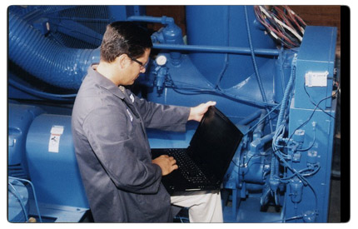
Level 1: Reliable Pressure, Flow and Quality
Contingency Plans
Gentex Example from article: First action in 2004: “air compressor systems that are production-critical must have a planned air compressor unit as a backup only. This air compressor is off except for maintenance to main system air compressors, or if a fault occurs with an on-line machine.”
Rental air compressor option?
What happens if a dryer fails? Which systems come into “direct or indirect” contact with food products (for example)

Slide 15
Discussion Today: Is it Useful to Categorize Plants in “Levels” of “Best Practices”?
3 Levels of Compressed Air Systems – An Example
Has your plant done a compressed air audit/assessment: How recently?- Please fill in Survey
Level 2: Supply-Side Optimization - Key Performance Indicator (KPI) Management/Measurement
Level 3: Demand-Reduction Projects
Level 1: Reliable Pressure, Flow and Quality
Which KPI's do you monitor? Please fill in Survey

Slide 16
Level 2: Supply Side Optimization & KPI Measurement
Measure Key Performance Indicators
Eliminate waste caused by poor design
Build a Compressed Air System able to turn further demand-reduction into savings
Honda of America
East Liberty, Ohio
Compressed Air System Evolution
Level 2 (late 1990’s)
5 x 1000 hp, 450 hp trim, pressure 135 psig
Car production: 240,000 autos
Level 3 (2002-today)
2 x 1000 hp, 450 hp trim, pressure 105 psig
Compressor Room kWh and pressure data logging
Had one $ and kWh metric for compressed air for whole plant
Car production: 240,000 autos
Monthly compressed air kWh budgets for each of 4 major production areas – flow meters measure each area like a utility
Demand-Reduction Projects
Master Compressed Air System Measurement and Management

Slide 17
Level 2: Supply Side Optimization & KPI Measurement
Conduct a Supply-Side Compressed Air System Assessment
Data-log air compressors for kWh and Pressure

Slide 18
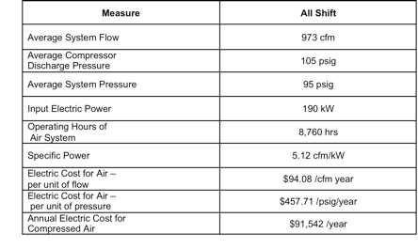
Level 2: Supply Side Optimization & KPI Measurement
Conduct a Supply-Side Compressed Air System Assessment
Establish Key Performance Indicators to Monitor and Manage
add “Dew Point” to the list below
If water-cooled, add cooling water treatment and cooling costs!
*Key Performance Indicators from a System Assesment article published by Hank van Ormer

Slide 19
Level 2: Cooling Water kW and Water Treatment costs – this is normally not Measured
Do you Know What Systems are Using Your Process Cooling Water?
Water-cooled Air Compressors can be a top consumer
Liquid Ring Vacuum Pumps can be a top consumer
Have Water Cooling and Water Treatment Costs Been Entered into ROI Calculations for “compressed air costs”?
Paper Mill Case Study
Level 2 Supply-Side Optimization
New air-cooled rotary screw compressors with heat recovery and master compressor controls
Reduce cooling-water consumption by 548 million gallons per year
Reduce kW and maintenance costs by $350,000 per year

Slide 20
Level 2: Supply Side Optimization & KPI Measurement
Conduct a Supply-Side Compressed Air System Assessment
Follow the exciting recommendations of a system assessment (equipment, controls, piping, storage, measurement)
Use KPI’s to make sure “things don’t go backwards”…i.e. controls are turned off…..
Would your system save energy if you used 25% less compressed air?
Flow changes but kW does not change proportionally
Comparing Demand with kW Consumption Leads to a full Supply-Side Analysis
Flow
kW / Energy

Slide 21
Discussion Today: Is it Useful to Categorize Plants in “Levels” of “Best Practices”?
3 Levels of Compressed Air Systems – An Example
What is the average leak load at the plants you visit or work in?: Please fill in Survey
Level 2: Supply-Side Optimization - Key Performance Indicator (KPI) Management/Measurement
Level 3: Demand-Reduction Projects
Level 1: Reliable Pressure, Flow and Quality

Slide 22
Level 3: Compressed Air Demand Reduction Projects
Compressed Air Energy Conservation Measures Improve
Energy/Water Intensity
Uptime
Return on capital
Steel Mill Case Study
Level 3 Supply and Demand-Side Assessment
New air-cooled VSD air compressors, dryers, and tanks
Piping Review leads to valving off sections of idled plant
Rental compressor costs reduced by $500,000 per year
Reduce cooling-water costs by $500,000 per year
Reduce kW costs by $135,000 per year
*Article published in Compressed Air Best Practices Magazine,
project done by Total Equipment Company, Pittsburgh, PA

Slide 23
Level 3: Compressed Air Demand Reduction Projects
Level 3 Demand-Side Projects
Measure air flow to reduce demand
Optimizing Pneumatics in OEM Production Equipment
Shutdown optimization
Heat recovery
Air Purification & Piping Specification
Air Pressure Sub-zones
Lowering Plant Pressure
Blow-off Air Optimization
Compressed Air Leak Management
Piping System Optimization
Fact
Demand-side system assessments will uncover significant ways to reduce compressed air use

Slide 24

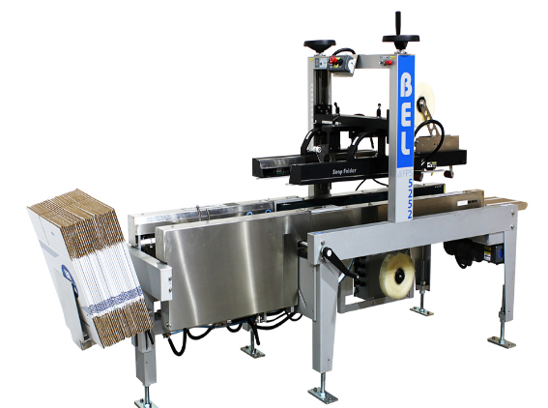
Level 3: Compressed Air Demand Reduction Projects
Keep Compressed Air Leaks from Coming Back!
Replace 2 position valve with a 3-position valve
Idle flow is reduced from 75 cfm to 25 cfm – on 20 MACHINES
Undersized Tubing Diameters, Valves and Cylinders Creating Pressure Restrictions
Air Leaks at FRL’s
Pneumatic Circuit Assessments
3-position valve does not use air when machine is idle
Stock Image: Unitizing & Palletizing Machine

Slide 25
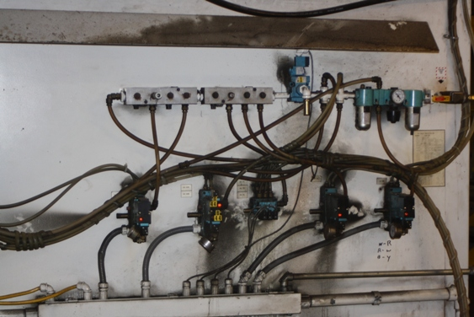
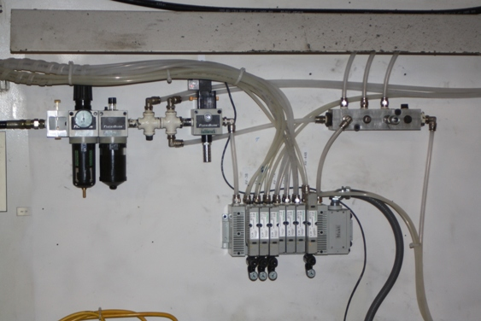
* Create a System and Process
* Tag and Fix 50% on the Spot
Level 3: Compressed Air Demand Reduction Projects
Pneumatic Circuit Assessment for Leaks
Actuators and Regulators creating significant pressure drops
Compressed air leaks in FRL fittings
Pressure drop due to undersized pneumatic circuits/tubes
Unitizing Machine Before
Unitizing Machine After

Slide 26
Level 3: Compressed Air Demand Reduction Projects
Compressed Air Leaks - Shut-down Optimization
Bottling Machines & Packaging Machines Continue to use compressed air when idle. Solution is to isolate them from compressed air system with valves that close when the machine is turned off.
Shut-Off Compressed Air Supply to Areas when Idle
Good way to prevent air compressors from feeding leaks at night
Source: Jennifer Meier, Global Energy & Engineering Manager, Visteon Corporation, July 2011 Compressed Air Best Practices Magazine

Slide 27
Level 3: Compressed Air Demand Reduction Projects
Engineering for Lower Plant Pressure-from 120 to 80 avg psi
Ball Corporation
“We believe in engineering solutions into our processes to keep lowering pressure. A can printer used 125 psi – now we use a 2-1 amplifier to support the two-inch cylinder (with a 6 inch stroke) needing that pressure.”
North American Operations
20 Aluminum Can Plants
15 Food Container Plants
Compressed air is #1 user of electricity accounting for 20-30% of total use
System assessments have reduced compressed air energy costs from $50 to $40 million per year (over the past 5 years)
- Doug Barndt, Manager, Demand Side-Energy-Sustainability, Ball Corporation (Editorial Board Member!)

Slide 28
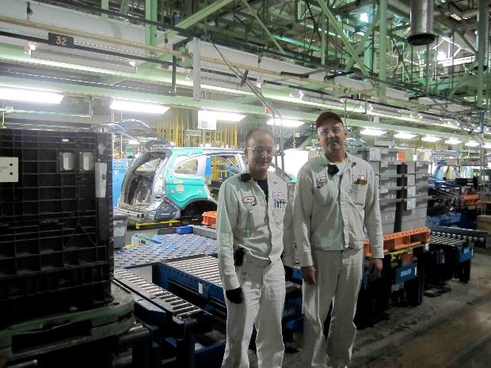

Level 3: Compressed Air Demand Reduction Projects
Flow Metering
Phase 2: Measure Air Flow (cfm) to Reduce Demand
Establish “Best Practice” Flow Requirements of Production Equipment
Charge Production Areas for cfm Consumption
Honda of America
East Liberty, Ohio
Compressed Air System Evolution
Phase 1 (late 1990’s)
5 x 1000 hp, 450 hp trim
Phase 2 (2002-today)
2 x 1000 hp, 450 hp trim
Compressor Room kW and pressure data logging
Plant Pressure 135 psig
Car production: 240,000 autos
Had one $ and kWh metric for compressed air for whole plant
Monthly compressed air kWh budgets for each of 4 major production areas – flow meters measure each area like a utility
Master Compressed Air System Measurement and Management
Plant Pressure 105 psig
Car production: 240,000 autos

Slide 29
Level 3: Compressed Air Demand Reduction Projects
Flow Metering
Measure Air Flow (cfm) to Reduce Demand
Establish “Best Practice” flow requirements of production equipment
Charge production areas for cfm consumption
Flow (cfm) measurements to 6 Unitizer Machines, Verallia Plant (Saint Gobain)
Establish “Best Practice Flow” for each machine
Data log and monitor the flow

Slide 30
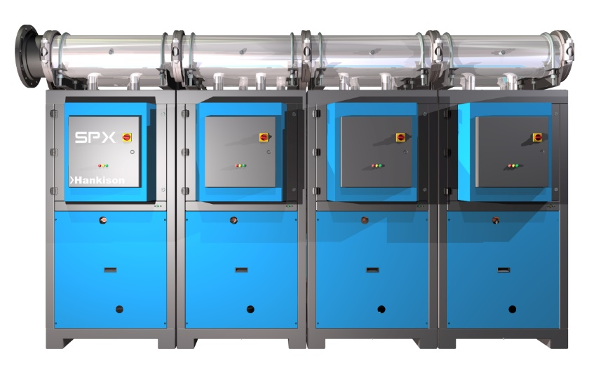
Level 3: Compressed Air Demand Reduction Projects
Compressed Air Purification & Piping Specifications for Reliability & Efficiency
Four Types of Contaminants in Compressed Air
1. Particles (from pipe scale, wear particles & atmospheric dirt)
2. Water (liquid, vapor and aerosol)
3. Oil (liquid, vapor and aerosol)
4. Microorganisms
Three Important Areas to Understand and Monitor
Does Compressed Air Come into DIRECT or INDIRECT CONTACT with food products?
2. Is our piping system new or old and could it be rusting and harboring moisture
3. What are the Pressure Losses through the Air Purification & Piping Systems?

Slide 31
Level 3: Compressed Air Demand Reduction Projects
Compressed Air Purification & Piping Specifications for Reliability & Efficiency

Slide 32
Level 3: Compressed Air Demand Reduction Projects
Compressed Air Purification & Piping Specifications for Reliability & Efficiency
Use ISO 8573.1 to Define Your Spec for Plant Air and for Specific Processes.
It can make sense to have two different specifications within a plant. Understand
the energy/maintenance costs of each option.
Example; Air Quality Levels 1.4.1 per ISO 8573.1 for General Plant Air
“Class 1 Particulates” (less than 10 per m3 of size 1-5 micron)
Class 4 Water (38 F pressure dew point)
Class 1 Oil (less than 0.01 mg/m3)
Example; Air Quality Levels 1.1.1 per ISO 8573.1 for Food Packaging
“Class 1 Particulates” (less than 10 per m3 of size 1-5 micron)
Class 2 Water (-40 F pressure dew point)
Class 1 Oil (less than 0.01 mg/m3)

Slide 33
Level 3: Compressed Air Demand Reduction Projects
Level 3 Demand-Side Projects
Measure air flow to reduce demand
Optimizing Pneumatics in OEM Production Equipment
Shutdown optimization
Heat recovery
Air Purification & Piping Specification
Air Pressure Sub-zones
Lowering Plant Pressure
Blow-off Air Optimization
Compressed Air Leak Management
Piping System Optimization
Fact
Auditors can find many projects AND teach how to “Maintain the Gain”

Slide 34
Discussion Today: Is it Useful to Categorize Plants in “Levels” of “Best Practices”?
3 Levels of Compressed Air Systems – An Example
Thank you for your time!
Level 2: Supply-Side Optimization - Key Performance Indicator (KPI) Management/Measurement
Level 3: Demand-Reduction Projects
Level 1: Reliable Pressure, Flow and Quality
Rod Smith, rod@airbestpractices.com

Slide 35
The “Unofficial 3 Levels” of Compressed Air Best Practices® Systems
Q&A
Please submit any questions through the Question Window on your GoToWebinar interface, directing them to Compressed Air Best Practices Magazine. Our panelists will do their best to address your questions and will follow up with you on anything that goes unanswered during this session.
Thank you for attending!

Slide 36
Thank you for attending!
The recording and slides of this webinar will be made available to attendees via email later today.
PDH Certificates will be e-mailed to Attendees within two days.

Slide 37



Thursday Webinar
Air Compressor Master Controls to Prevent Control Gap
Sponsored by
Tim Dugan
Keynote Speaker
Compression Engineering Corporation
Thursday, May 21, 2020 – 2:00 PM EST
Register for free at
www.airbestpractices.com/magazine/webinars

