Slide 1
Visualizing KPI’s: Specific Power, Flow, Pressure, Dewpoint
Ron Marshall, Marshall Compressed Air Consulting
Keynote Speaker
The recording and slides of this webinar will be made available to attendees via email later today.
PDH Certificates will be e-mailed to attendees within two days.
Sponsored by

Slide 2
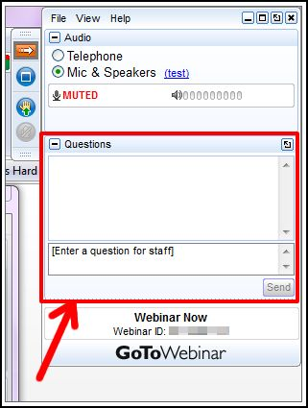
Q&A Format
Panelists will answer your questions during the Q&A session at the end of the Webinar.
Please post your questions in the Questions Window in your GoToWebinar interface.
Direct all questions to Compressed Air Best Practices® Magazine
Sponsored by

Slide 3
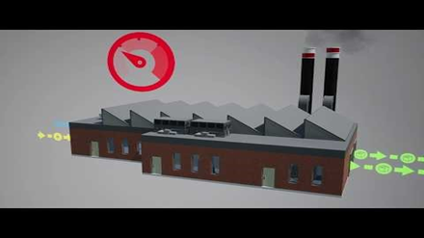
Handouts

Slide 4
Disclaimer
All rights are reserved. The contents of this publication may not be reproduced in whole or in part without consent of Smith Onandia Communications LLC. Smith Onandia Communications LLC does not assume and hereby disclaims any liability to any person for any loss or damage caused by errors or omissions in the material contained herein, regardless of whether such errors result from negligence, accident, or any other cause whatsoever.
All materials presented are educational. Each system is unique and must be evaluated on its own merits.

Slide 5
Visualizing KPI’s: Specific Power, Flow, Pressure, Dewpoint
Introduction by Rod Smith, Publisher
Compressed Air Best Practices® Magazine
Sponsored by

Slide 6
2019 Best Practices EXPO & Conference

Slide 7
2019 Best Practices EXPO & Conference
Call for Abstracts
The conference will focus on the industrial plant utilities of compressed air, blower, vacuum and cooling systems. Presentations should encompass one or more of these themes.
Quality & Safety Management
Maintaining compliance
Facility Maintenance & Reliability
Maintaining systems
Productivity / Energy Intensity
Increasing product output
Energy Management / Water Intensity
Reducing product rejects and liabilities
Increasing equipment longevity
Reducing kw per product produced
Reducing water usage across utilities
Energy monitoring and IoT
Creating an energy management culture
Abstract submissions are due Friday, March 29, 2019.
Speakers receive a complimentary Conference Pass, a $675 value!
To submit an abstract, please visit
cabpexpo.com/conference/speakers

Slide 8
About the Speaker
Chief Auditor, Marshall Compressed Air Consulting
38 year Employee of Power Utility
24 years Technical Compressed Air Support
Compressed Air Challenge Level 2 Instructor
International Trainer for United Nations Industrial Development Organization (UNIDO)
Ron Marshall
Marshall Compressed Air Consulting
Sponsored by

Slide 9
Visualizing KPI’s: Specific Power, Flow, Pressure, Dewpoint

Slide 10
Presenter

Slide 11
Coming Up
What are Key Performance Indicators?
Why KPI’s are important in compressed air?
Typical Compressed Air System
Suggested KPI’s or EnPI’s
Suggested Measurement Points
Analysis: What to look for in meeting objectives
Typical Problems in Measuring and Tracking
Examples of Best Practices

Slide 12
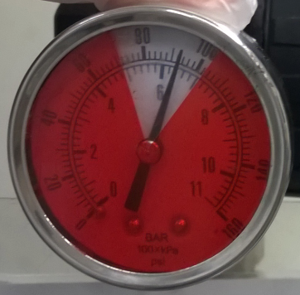
What are Key Performance Indicators?
A performance indicator or key performance indicator (KPI) is a type of performance measurement. KPI’s evaluate the success of a particular activity.
Source: Wikipedia

Slide 13
What are Key Performance Indicators?
Often success is simply the repeated, periodic achievement of some levels of operational goal
Sometimes success is defined in terms of making progress toward strategic goals.
Accordingly, choosing the right KPI’s relies upon a good understanding of what is important.
What is deemed important often depends on the department measuring the performance.
Source: Wikipedia

Slide 14
What are Key Performance Indicators?
KPI assessments often lead to the identification of potential improvements, so performance indicators are routinely associated with 'performance improvement' initiatives.
Source: Wikipedia

Slide 15
What Makes KPI’s effective?
A key performance indicator it is only as valuable as the action it inspires.
One of the most important, but often overlooked, aspects of KPIs is that they are a form of communication. As such, they abide by the same rules and best-practices as any other form of communication. Succinct, clear and relevant information is much more likely to be absorbed and acted upon.
Source: Klipfolio.com

Slide 16
Why KPI’s are important in compressed air?
Compressed air is a very expensive way to transmit energy, typically 10 times more costly than direct electricity
There are usually very few performance measurements done on compressed air
Unmanaged systems often produce compressed air very inefficiently, operators are usually unaware
Unmanaged system typically have high levels of waste, operators are often aware but don’t know the cost
Measuring the key performance of a system raise awareness of the cost of inefficiency and waste
A good system of measuring and evaluating KPI’s can lead to substantial improvements in cost of operation, reliability and quality of compressed air

Slide 17
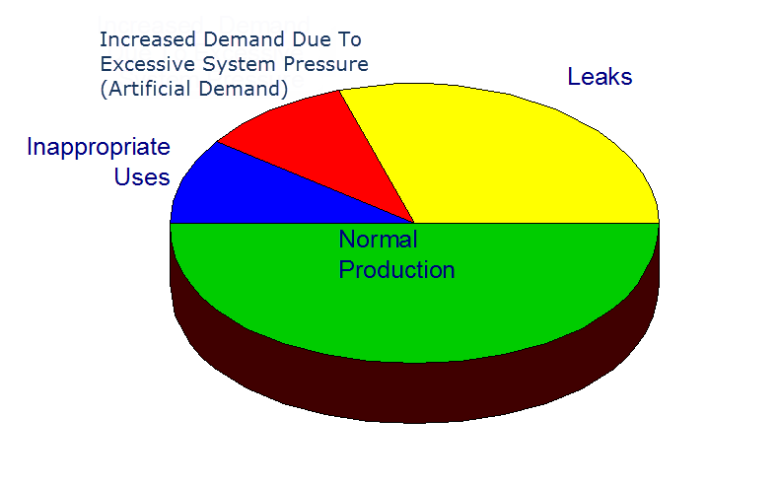
Compressed Air: What is most important?
Clean dry stable air being delivered at the appropriate pressure in a cost effective manner
Minimized waste
Leaks
Artificial Demand
Inappropriate Use
How do we know we are getting this?
Measuring performance is key
Measurements are compared to benchmark to determine success in meeting goals
Source: Compressed Air Challenge

Slide 18
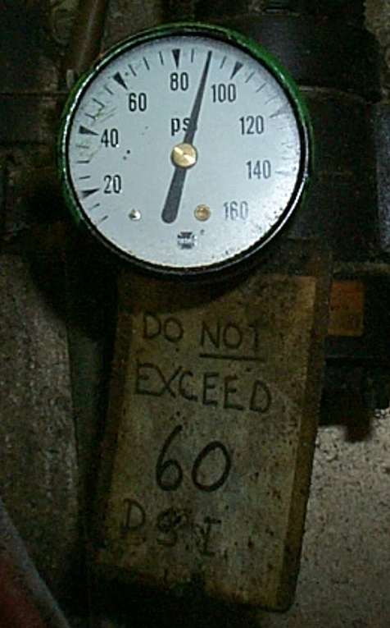
Example Spot Measurement
Pressure Key Performance
Key Performance Success
Key Performance Fail
Source: Compressed Air Challenge

Slide 19
Example Time Based Measurement
Site Goal: Pressure no lower than 90 at critical tools
Site appears to meet goals

Slide 20
Example Time Based Measurement
Site Goal: Pressure no lower than 90 at critical tools
Correctly placed metering shows key performance fail 87 psi
Spot reading
Low pressure event

Slide 21
Example Time Based Measurement
Site Goal: Minimize waste, run compressors efficiently
Flow metering shows KPI fail during non-production times
Compressor input 135 kW at 500 cfm = 27 kW/100 cfm
KPI fail since target is 20 kW/100 cfm, leaks < 200
Low flow
Waste

Slide 22
Example Time Based Measurement
Site Goal: Minimize waste, run compressors efficiently
Flow metering shows step change in non-production flow
Compressor input 108 kW at 325 cfm = 28.5 kW/100 cfm
500 cfm
325 cfm

Slide 23
Measuring KPI’s Important Points
Spot checks don’t show the whole picture
Meter placement must match site goals
Things can change as time passes, limits or method of comparison needed
KPI levels need to be set
Needs to be a communication system to alert of failure

Slide 24
Guidance on KPI’s: CSA C837-16 Standard
Measurement Boundary
Measure all inputs (kW)
Measure all outputs (cfm)
Track relevant variables (pressure, hours, units production)
Source: CSA C837-16

Slide 25
Guidance on KPI’s: CSA C837-16 Standard
Suggested KPI’s or Energy Performance Indicators (EnPI’s)
System Specific Power (SSP)
Total Energy Consumption (TEC)
Specific Energy Consumption (SEC)
Proportion of Non-productive Usage (PNPU)
Source: CSA C837-16

Slide 26
Guidance on KPI’s: CSA C837-16 Standard
SSP (kW/100 cfm or kWh/m3)
Average kW sent into the measurement boundary divided by average flow coming out x 100, during the measurement period.
An output of this might be average kW per 100 cfm.
This is an indicator of how efficiently the compressed air is being produced.
SSP changes with discharge pressure, so pressure should be tracked
Source: CSA C837-16

Slide 27
Guidance on KPI’s: CSA C837-16 Standard
TEC (kWh)
TEC is a measure of the total energy (kWh) consumed by a over the baseline period. The lower the energy consumed, the lower the electrical cost of operation.
Provided that the TEC can be normalized for time period and production levels, two different TEC measurements of the same system taken at different times may be used for comparative evaluation.
TEC is affected by both the SSP of the compressed air production equipment and the total volume of compressed air produced by the system during the baseline period.
Based on site electrical rates the operating costs can be determined
Source: CSA C837-16

Slide 28
Guidance on KPI’s: CSA C837-16 Standard
Optional: SEC (kWh per unit of product)
SEC is a measurement of the compressed air system energy required to produce a specified production output
Subject to an accurate characterization of the specified production output, the lower the SEC, the lower the energy intensity of the compressed air per specified production unit
The output of the product unit is subject to a great deal of variability depending on the characteristics of the facility and any production processes. This value may or may not be a useful output and the requirement for its calculation needs to be determined on a case by case basis.
Source: CSA C837-16

Slide 29
Guidance on KPI’s: CSA C837-16 Standard
PNPU (percentage of average flow)
PNPU is an estimate of the percentage non-productive air consumption compared to the average flow.
The value is the air flow measured or calculated, during special testing, divided by the average air flow during the same baseline period
In all systems there is some compressed air flow consumed by equipment and processes due to leakage, and air consuming equipment that is operating in non-production hours.
In systems where there is a period of time where there is no production during shutdown periods, such as evenings or weekends, this flow may be measured or estimated.
Source: CSA C837-16

Slide 30
Use of KPI’s
Determine when KPI’s are above or below expected target levels
Compare one measurement period to another (after improvements, failures)
Source: CSA C837-16

Slide 31
Additional KPI’s
Additional Parameters (user can decide)
Air pressure (high/low/average)
Temperatures (compressor, dryer, ambient)
Dew point
Contamination levels (particles, lubricant, dew point)
Other parameters as can be measured (downtime, availability)

Slide 32
Example Systems
Most common parameters pressure, amps/power and flow
More sophisticated systems show system efficiency
Some include other items like air dryers
Determination of non-productive flow is important but not always possible
Placement of the meters sometimes affects readings
Processing of the data is sometimes needed (moving averages)
Certain conditions can cause erroneous readings

Slide 33
Example Systems
Simple monitoring system – needs high level of interpretation
Confusing and unclear data, manual KPI calculation required
Measurement error due to flow meter position

Slide 34
Example Systems
Simple monitoring system – needs high level of interpretation
Moving average applied makes data clearer
Flow meter error when compressor is off must be subtracted out

Slide 35
Example Systems – Web Based
Source: CALMS.EU

Slide 36
Example Systems – Web Based
Source: CALMS.EU

Slide 37
Example Systems – Web Based
Source: CALMS.EU

Slide 38
Example Systems – Web Based
Source: Sparksdynamics.com

Slide 39
Example Systems – Web Based
Source: Sparksdynamics.com
See Jan/Feb 2019 CABP

Slide 40
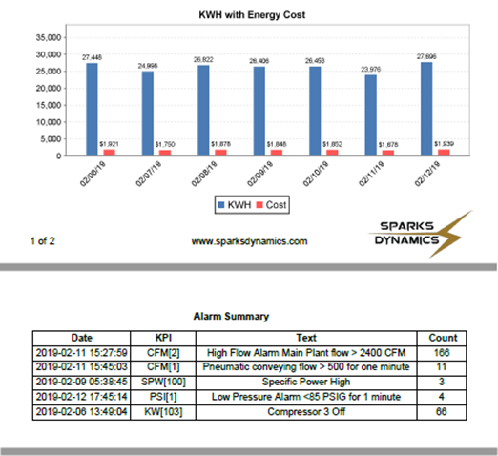
Example Systems – Web Based
Source: Sparksdynamics.com

Slide 41
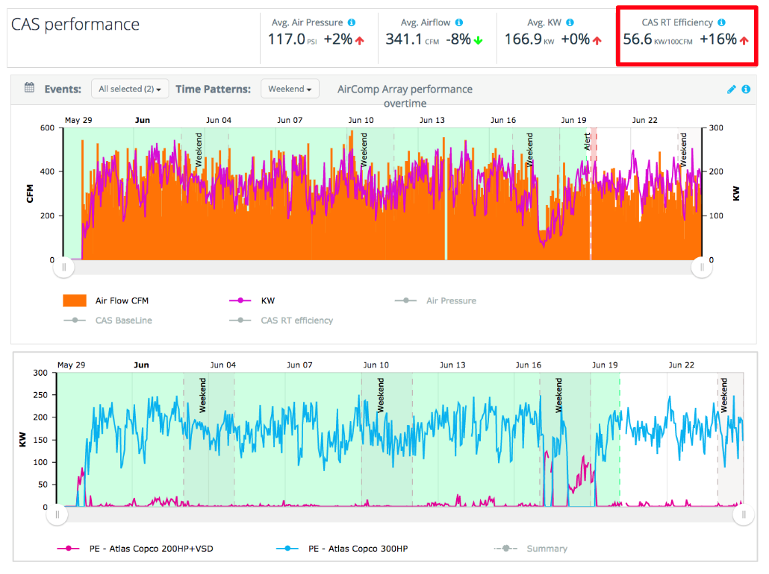
Example Systems – Web Based
Source: Lightapp.com as featured in Aug 2018 CABP

Slide 42
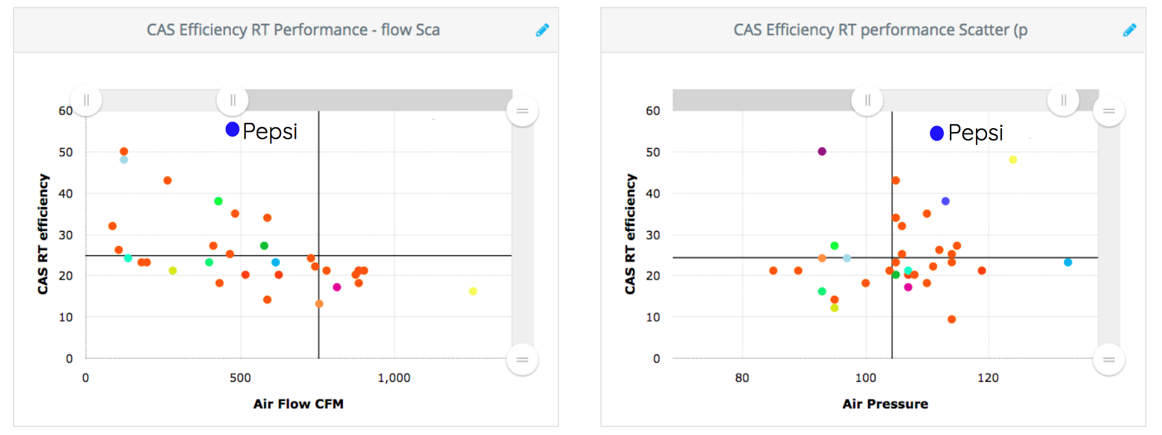
Example Systems – Web Based
Source: Lightapp.com as featured in Aug 2018 CABP

Slide 43
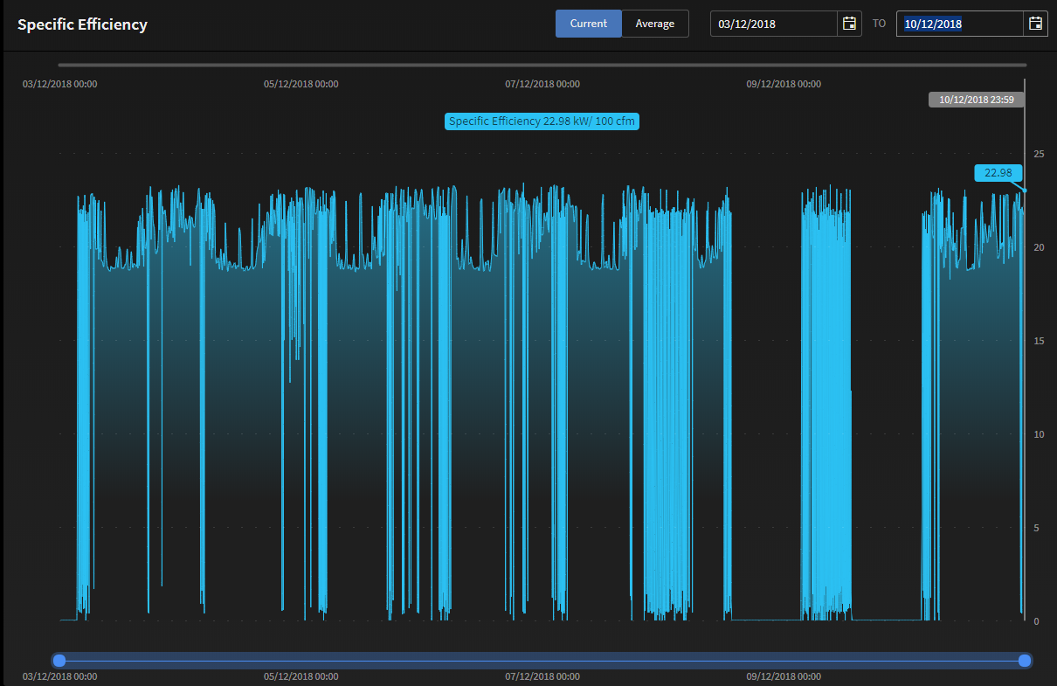
Example Systems – Web Based
Source: Kaeser
Source: EnergAir.com

Slide 44
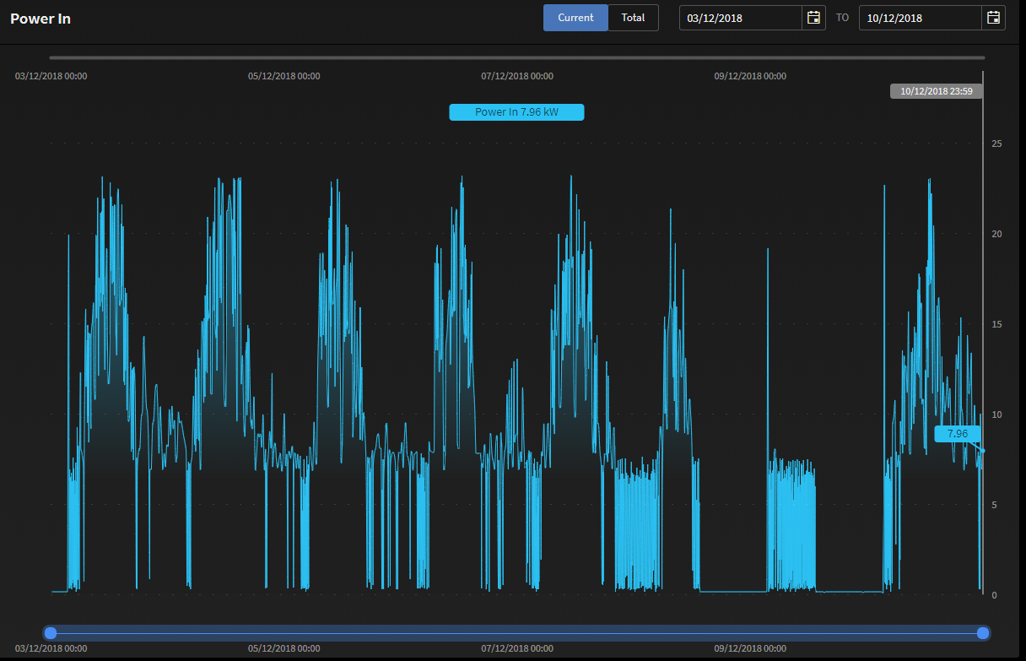
Example Systems – Web Based
Source: Kaeser
Source: EnergAir.com

Slide 45
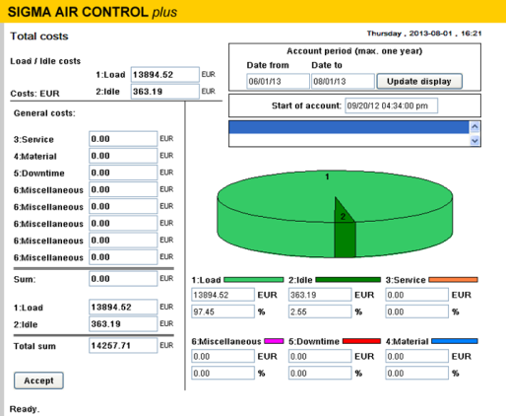
Example Systems – Controller Based
Source: Kaeser

Slide 46
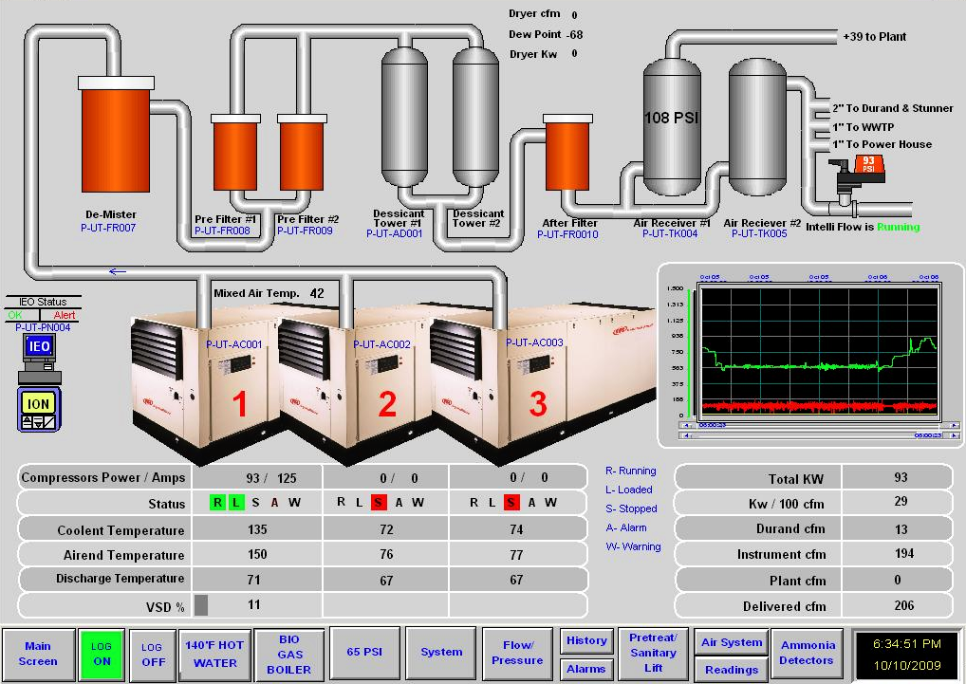
Example Systems – BMS based
User Designed System

Slide 47
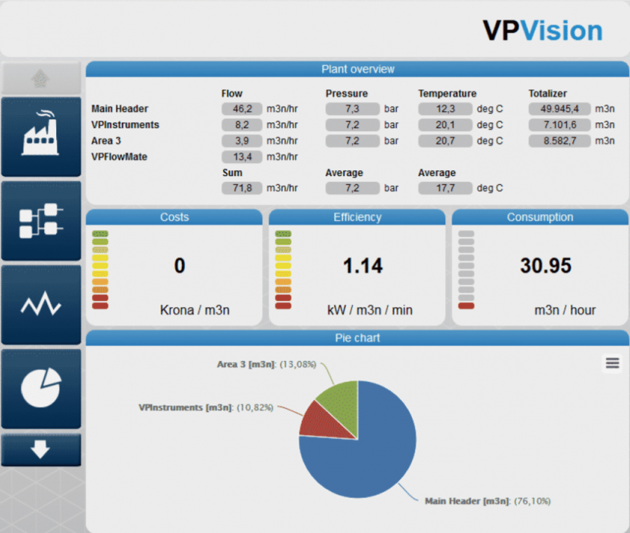
Example Systems – Controller Based
Source: VPInstruments

Slide 48
Important Points
Compressed air systems should be measured
Output of monitoring system needs to be clear and simple
Best practice is to monitor and track both production efficiency and waste
Communication and interpretation of problems must be easy to understand
Email notification of KPI’s daily, weekly or monthly is a good way of continuously monitoring systems

Slide 49
Recommended Measurements
Capture the full measurement boundary
Display on simple dashboard
Pressure
Discharge
Dryer
Critical Uses
Power
Compressor
Dryers
Flow
Main
Submetering
Important KPI’s
Dew Point
Temperatures
Warnings/Alarms

Slide 50
Summary
KPI’s are important to maintain system efficiency and effectiveness, reduce costs
It is important to capture all data and relevant variables
Monitoring systems can be used to identify problems and track changes
Sometimes there are challenges in correctly monitoring
Some processing of the data may be required
The best systems display data in an a way that is effective and easy to understand, and alert the operators if there are problems
There are various systems available to calculate and monitor KPI’s

Slide 51
About the Speaker
Sales Manager Americas, VPInstruments
Menno Verbeek
VPInstruments

Slide 52
30%
300$
Visualizing KPI’s
LEAKS
Costs
10
1.5h
Specific Power, Flow, Pressure, Dewpoint
Efficiency
Down time
1
Notes:
Key Performance Indicator
Indicators that tell you if processes and machinery are okay, if consumption and usage is within acceptable boundaries, if metrics start to deviate to help spot early problems, if the input ratio matches the output ratio.

Slide 53
2
Notes:
Not looking at the right data, your performance indicators and instrumentation might leave you stranded..

Slide 54
Why KPI’s are important
Know where you are
and where you’re going…
Company purpose
Savings goal
Production goal
Maintenance goal
Compliance goal
3

Slide 55
Why KPI’s are important
SMART KPI’s
Simple
Monitored permanently
Accounted for
Realistic
Trendable
4
Notes:
Nieuwe definitie van SMART ;-)

Slide 56
Compressed air KPI’s
Supply side
Energy costs per compressor room
Specific power/Efficiency per 100*SCF or kW/m3n/min
Quality (dew point)
Purity (N2)
Demand side
Leakage % and $$$ per annum
Return on Repairs
Pressure loss
Costs per widget/tons produced
Production (repair/incident) downtime per machine
5
Notes:
Express leakage always in USD per dept.
Leakage is the messenger for more trouble to come, early warning for possible longer down time
Cost for repair vs return

Slide 57
Keep it Simple: start with 3 KPI’s
Maintenance:
Leakage %
Dew point & flow
Running hours vs downtime hours
Number of CA related incidents
Finance:
costs per…
MSCF of air
Cost per x ton products
Production:
Pressure band
Cost per x ton products
Allocate costs/ consumption per area
6
Notes:
When you’re new with KPI’s, then keep it simple. Too difficult KPI’s result in less buy in, lack of attention and have no priority over time.

Slide 58
How permanent monitoring can help
Data is your starting point
Combine data!
Key data
Amps or Kw
Flow
Pressure
Temperature
Dew point
X products
10
2
Efficiency
DP/Demand
8
6
9
Cool reserve
kW/x Ton
Dryer capacity
7
Notes:
Amps/kw + Flow = efficiency
Flow + pressure = dif. pressure = pressure loss
Flow + temp = water cooling may become questionable during summer season
Flow + dewpoint = dryer capacity or dryer failure
Amount of kW per amount of product produced

Slide 59
Real time KPI example: efficiency
> 12?
Flow meter
A/B
> 10 < 12?
kW meter
< 10?
8
Notes:
Make scaling on good, bad performance with compressor curve or comp. performance data.
Thing become more complicated with multiple compressors, it then may require a specialist or specialized software

Slide 60
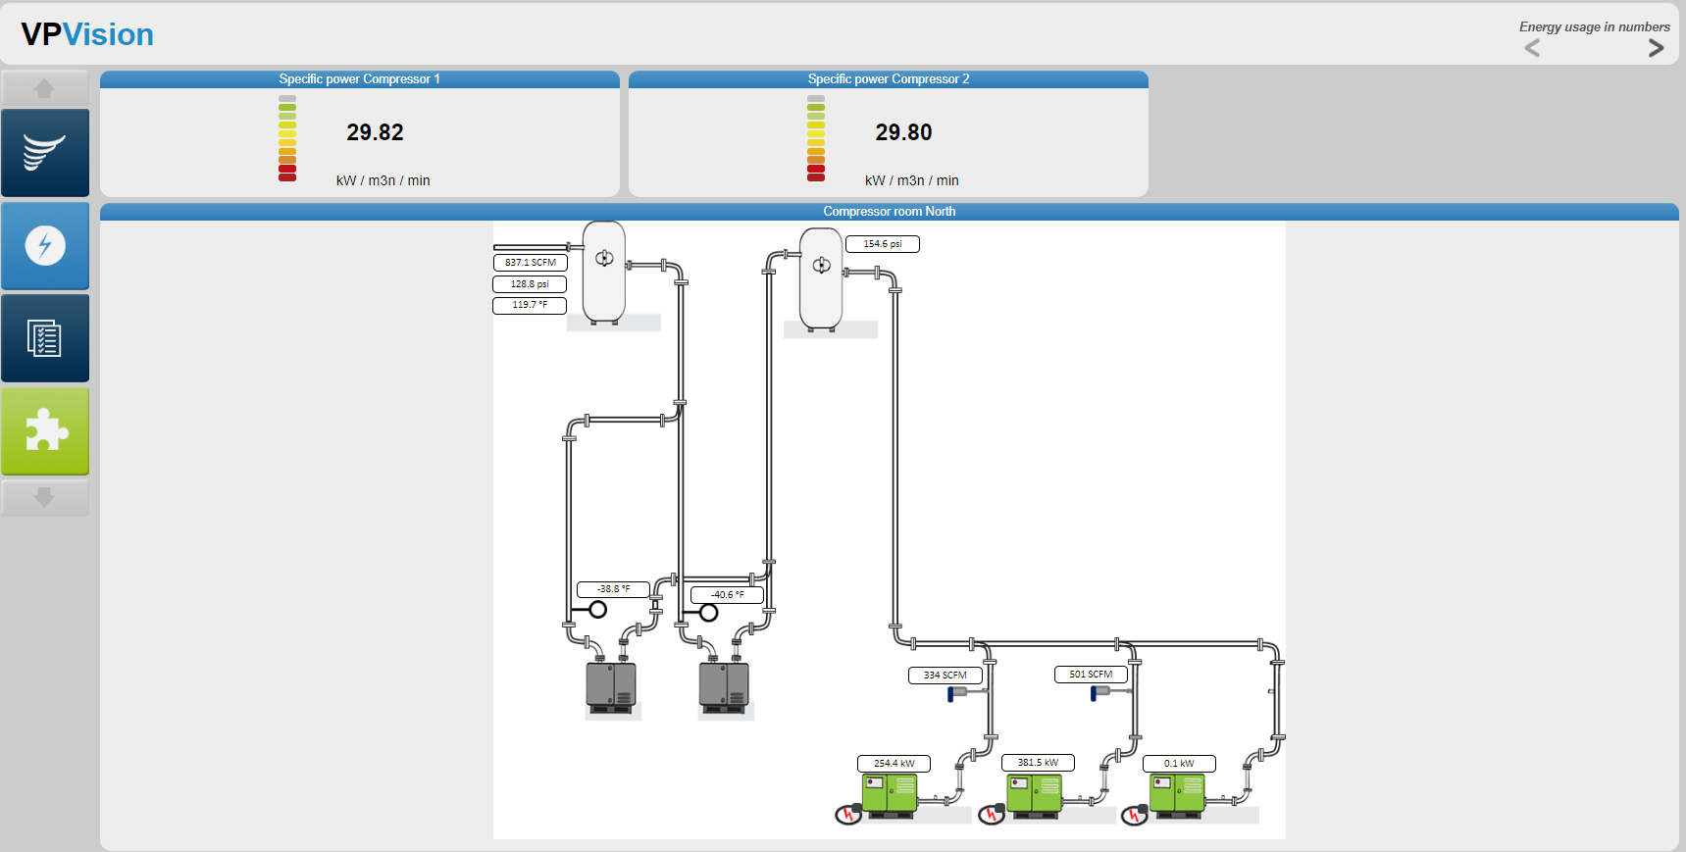
How you could make it visual
9

Slide 61
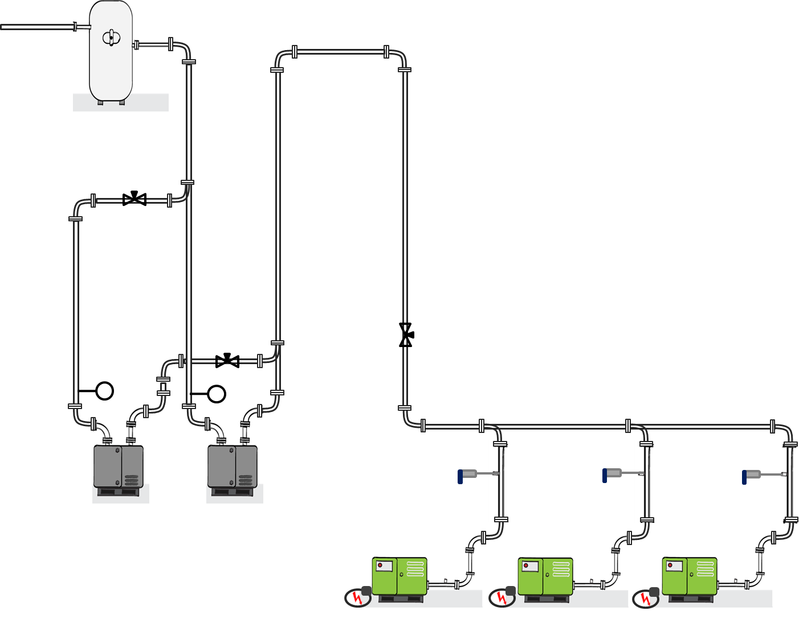
Efficiency for multiple compressors not so easy…
10
Notes:
Warning: efficiency monitoring is probably one of the most complex tasks. Many factors can influence the system efficiency…

Slide 62
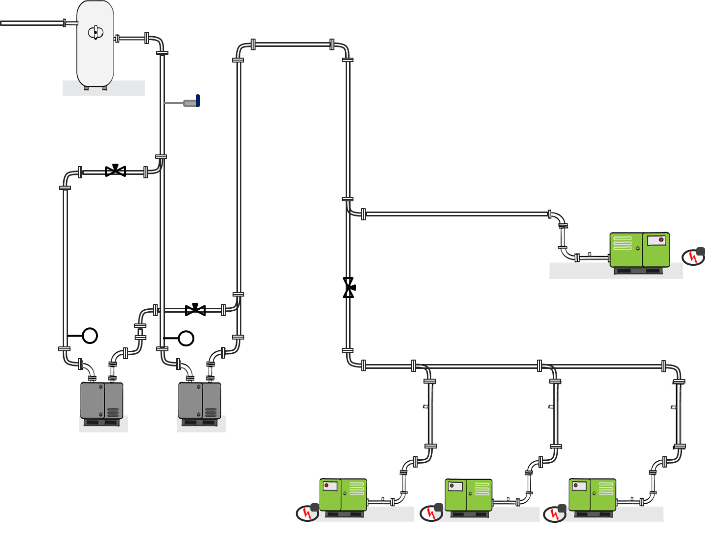
Efficiency for multiple compressors not so easy…
11

Slide 63
50
Common issues:
Leaking membrane valves
Don’t know which one leaks
Hard to access, no time to inspect all
Solution:
Permanent flow meter on main supply
Flow meter on each filter system
Central monitoring via VPVision
Added value
Real time leakage management
Optimized maintenance schedules
ROI: ½ year
Leakage %
12
Notes:
An example of how monitoring and metering helped lowering costs and improve operational uptime.
Flow meter became permanent part of KPI for flow. When flow increased membranes were likely to leak/be broken

Slide 64
Audit vs permanent
Long term data is key
13
Notes:
The case before would never have led to the saving without permanent monitoring. An audit might have revealed some, but after the fix, you would not know where it leaks next.
It is all about collecting data. Collecting just flow is useless, just as collecting just energy or just pressure. It is in the combination of data where you find the biggest saving opportunities.

Slide 65
Real time KPI: Air treatment pressure loss
DP monitoring without flow sensor? Makes no sense at all.
Flow [Q]
(P1-P2)/Q
> factor?
Pressure 1
-
Pressure 2
Q
P1
P2
Filter
Filter
Filter
14
Notes:
You can have low flow and almost no pressure drop over the filter.
When recording pressure drop over your filter you want to know at which flow.
Did we reach max capacity of the filter of is it clogged?

Slide 66
Real time KPI: Air treatment pressure loss
DP monitoring without flow sensor? Makes no sense at all.
210
180
150
FILTER POTENTIAL BURST LEVEL
120
NORMAL 100% FLOW DP LEVEL
90
60
30
15

Slide 67
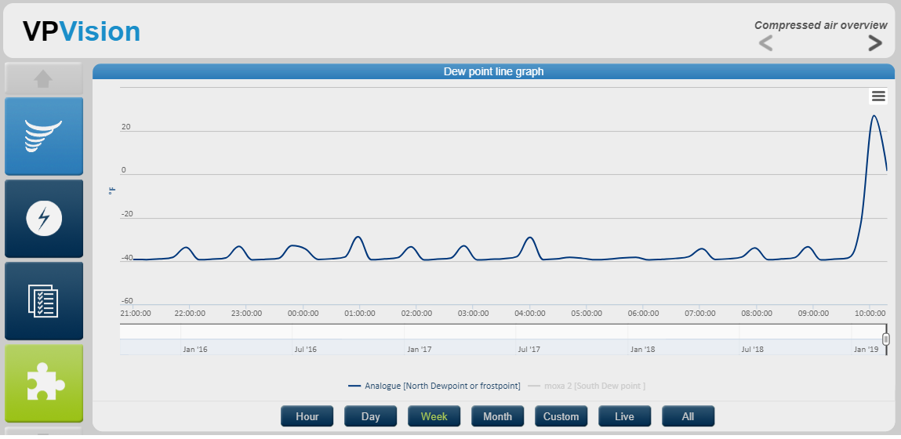
Dew point measurement
Just measuring dew point is not enough.
You want to be looking at dew point and flow.
16
Notes:
Hey! Dew point went up! You might run out to the dryer, inspect it and find it being okay. Without flow this graph is nice but not giving the complete picture.

Slide 68
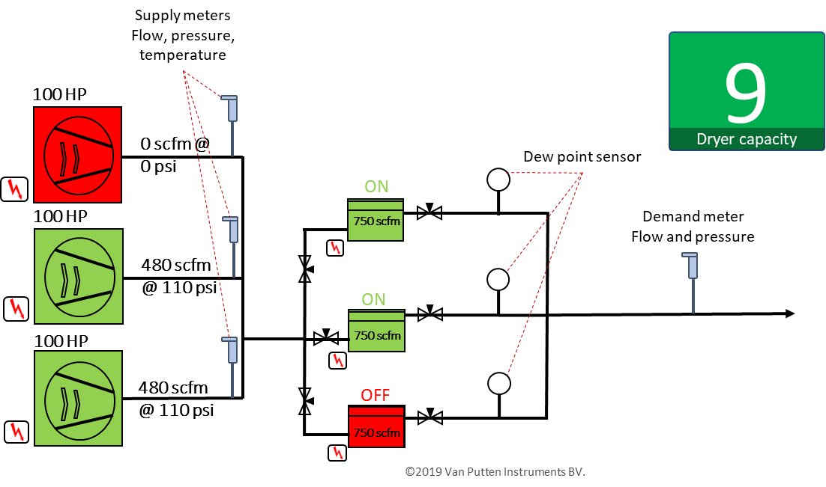
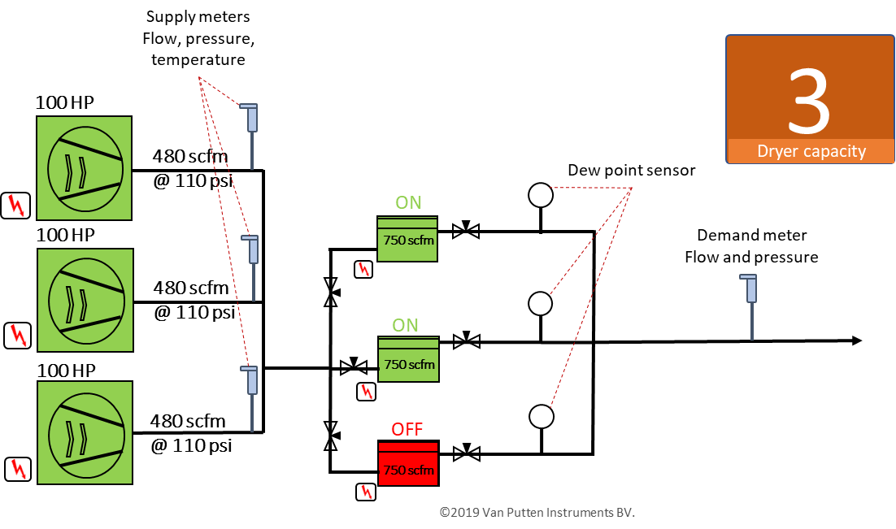
Real time KPI: Drying capacity
See when demand exceeds capacity
17
Notes:
When dew point is critical, always measure after dryer and storage tank and in the main line feeding the plant. Dryers can be bypassed during service, storage can have non working drains, and just taking dew point of the dryer is not a guarantee that this same dew point level is maintained in the plant.

Slide 69
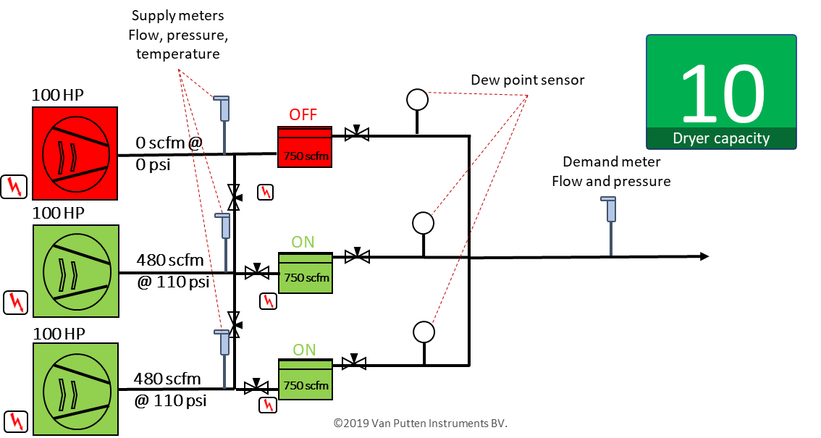
Real time KPI: Drying capacity
18
Notes:
And because we are here at Air best practices, when dew point is critical, dryers should always be in parallel with the compressor and each compressor should have its dedicated dryer.

Slide 70
Flow and dew point
19
Notes:
Picture 1: capacity related
Picture 2: dryer related. Cycle related, drain related, etc.

Slide 71
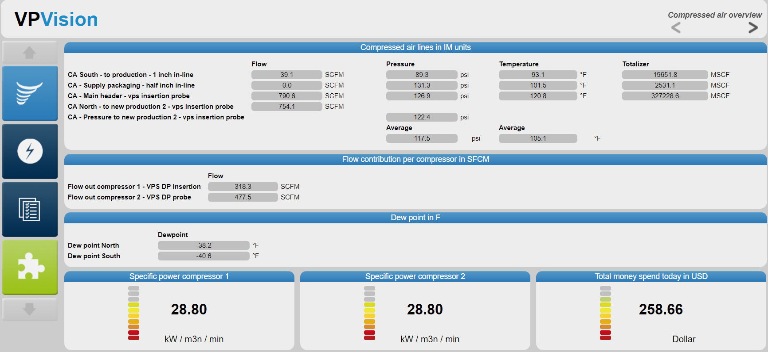
Monitoring example dashboard
20

Slide 72
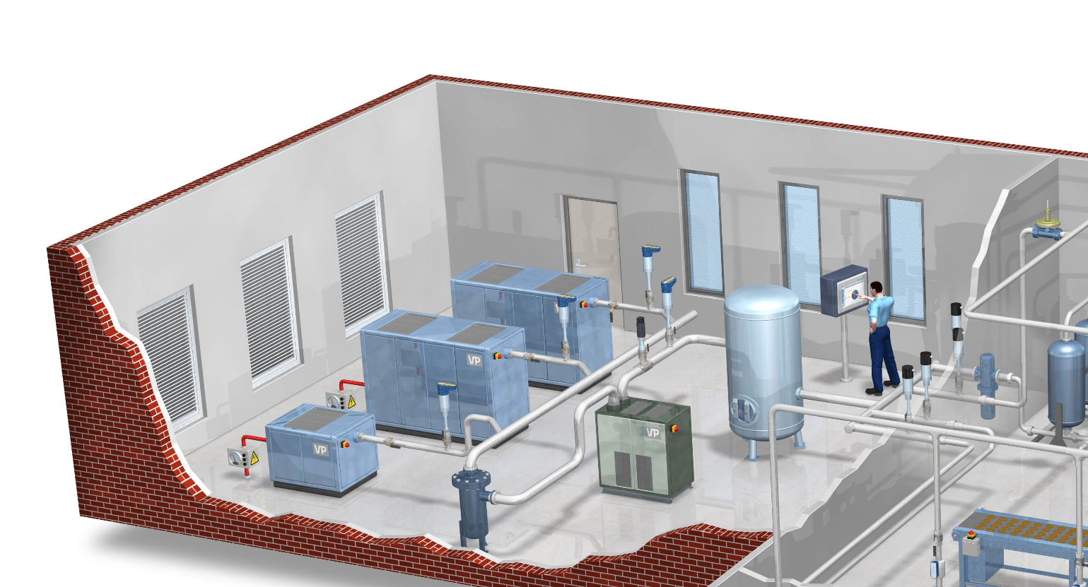
Where to start?
Efficiency monitoring
Air quality and flow
Cost allocation /
demand profile
21
Notes:
Efficiency: depending on how accurate you want it, an Amp meter of 3 phase power meter with a flowmeter suitable for saturated air measurement. Either per compressor or per compressor room.
Dewpoint and flow, they always should go together
Flow sensors with flow and pressure to continuously measure flow consumption and pressure. When calculation your dollar/scf allocating cost becomes a piece of cake

Slide 73
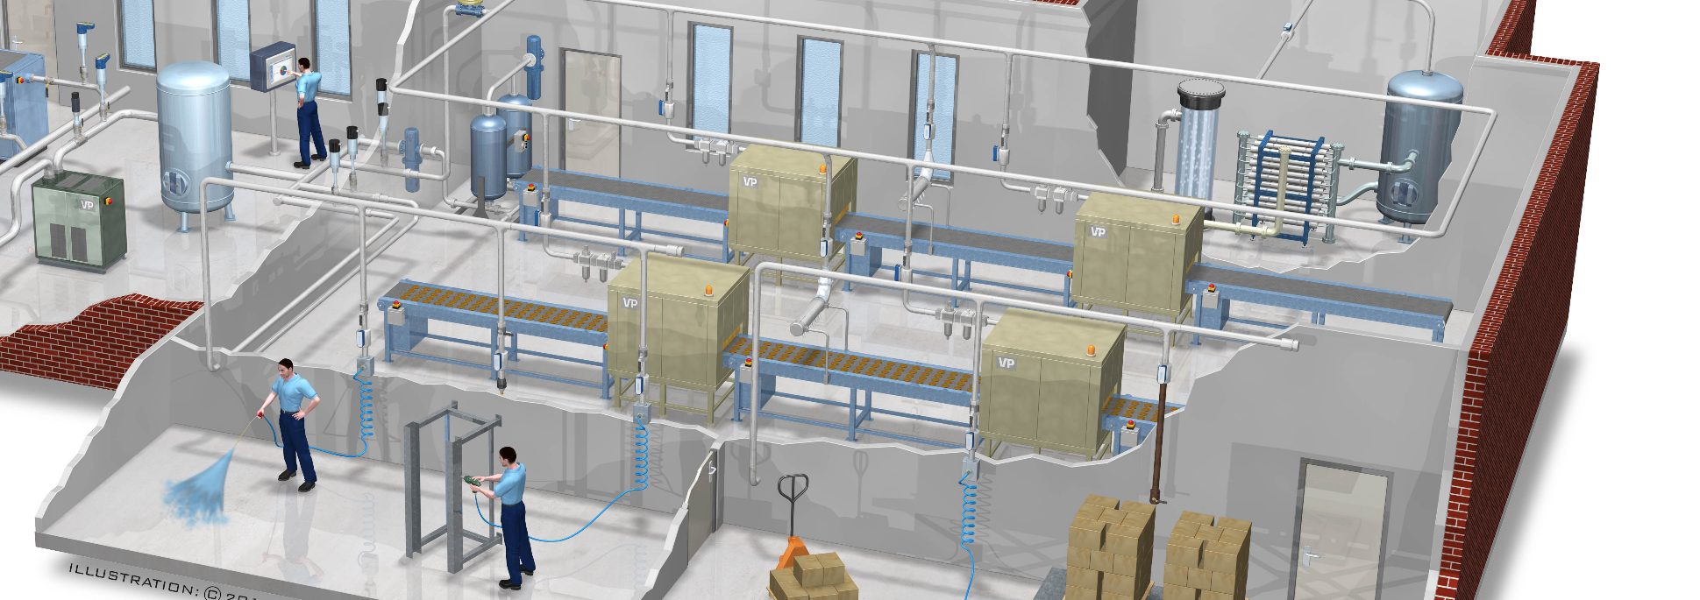
Where to start?
Allocate cost /usage per shift
Cost per X
Measure pressure
loss throughout
the plant
22
Notes:
Simple measure on subline to dedicated machines / operators tell mass flow used by shift/operator/machine
By adding pulse counter cost per X can be calculated
Pressure throughout the plant: pressure band monitoring

Slide 74
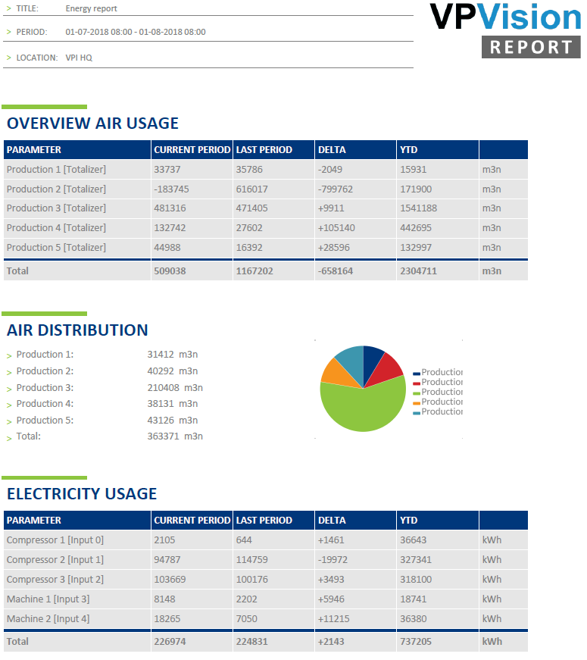
Example Report
23

Slide 75
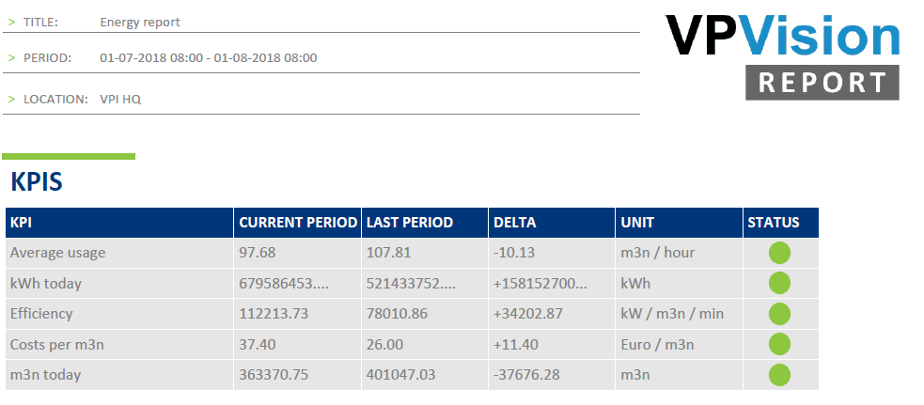
KPI example Report
24

Slide 76
Summary
Define your top 3
Collect your primary data (energy, flow, pressure, dew point, products produced)
Combine data to create better information
Report the data
Share data on an accessible dashboard for all
Make system changes based on facts!
25

Slide 77
26

Slide 78
27

Slide 79
Visualizing KPI’s: Specific Power, Flow, Pressure, Dewpoint
Q&A
Please submit any questions through the Question Window on your GoToWebinar interface, directing them to Compressed Air Best Practices Magazine. Our panelists will do their best to address your questions, and will follow up with you on anything that goes unanswered during this session.
Thank you for attending!
Sponsored by

Slide 80
Thank you for attending!
The recording and slides of this webinar will be made available to attendees via email later today.
PDH Certificates will be e-mailed to Attendees within two days.
Sponsored by

Slide 81
2019 Best Practices EXPO & Conference

Slide 82
2019 Best Practices EXPO & Conference
Call for Abstracts
The conference will focus on the industrial plant utilities of compressed air, blower, vacuum and cooling systems. Presentations should encompass one or more of these themes.
Quality & Safety Management
Maintaining compliance
Facility Maintenance & Reliability
Maintaining systems
Productivity / Energy Intensity
Increasing product output
Energy Management / Water Intensity
Reducing product rejects and liabilities
Increasing equipment longevity
Reducing kw per product produced
Reducing water usage across utilities
Energy monitoring and IoT
Creating an energy management culture
Abstract submissions are due Friday, March 29, 2019.
Speakers receive a complimentary Conference Pass, a $675 value!
To submit an abstract, please visit
cabpexpo.com/conference/speakers

Slide 83
March 2019 Webinar How to Design a Centralized Vacuum System
Sponsored by
Tim Dugan
Compression Engineering Corporation
Keynote Speaker
Thursday, March 14, 2019 – 2:00 PM EST
Register for free at
www.blowervacuumbestpractices.com/magazine/webinars

